Slide 1
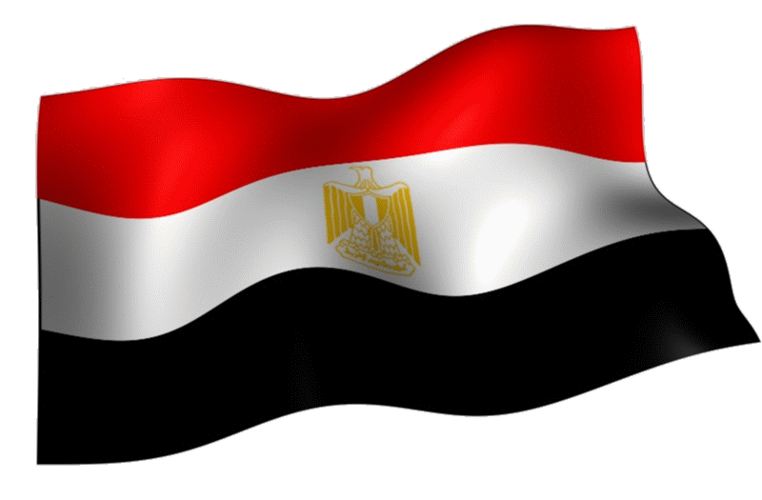
Achieving Measles, Rubella and CRS Elimination
Egyptian Story
Dr. Mohammad ABDELFATTAH
Undersecretary for Preventive Medicine, MOHP-Egypt

Slide 2
Outline
Country Background Information.
Measles and Rubella Elimination Strategies.
Measles and Rubella Routine Vaccination History
Activities to raise immunization coverage.
The National Verification Committee (NVC)
Way Forward.
Summary and Conclusion

Slide 3
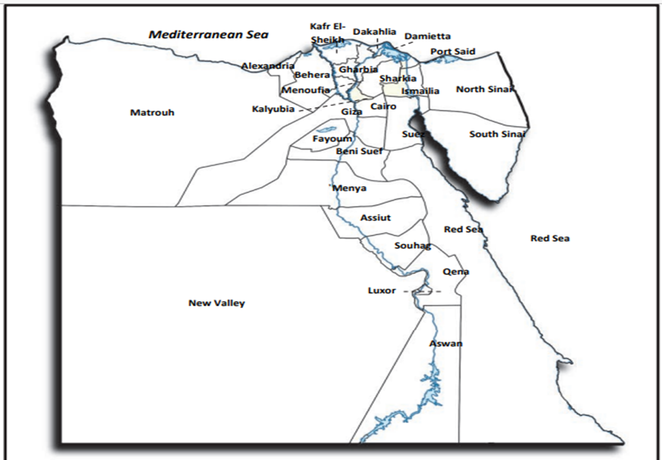
Country Background
Demography and Population Characteristics
Provinces 27 | Districts 286
Total Population | 106,936,038
Population density: | 103 (P/Km²)*
Population growth rate: | 15.6 (per 1000 total population)
Under-1 population: | 2,610,130
Under-5 population: | 14,449,234
Under-15 population: | 40,040,942
Urban population: | 42.4%
Rural population: | 57.6%
Notes:
Egypt is one of the member states of Eastern Mediterranean Region, World Health Organization. It has coastlines on the Mediterranean Sea (north), and the Red Sea (east). It is bounded on the west by Libya; on northeast Gaza Strip and Palestine, and on south by Sudan. Egypt is the second most populous country in the EMR with 106,936,038 population. The area of Egypt is 1,009,550 square kilometres.
It is administratively divided to 27 governorates and 286 health districts. Despite being in Africa, two governorates; South and North Sinai, are in Asia

Slide 4
Measles and Rubella Elimination Strategies, Egypt
1. Vaccination
2. Surveillance
Improve all surveillance indicators.
3. Laboratory
surveillance
4. Rapid response to confirmed cases and outbreaks
5. Community awareness
Improve vaccination coverage of routine MMR1 &2 to reach more than 95% at all levels.
Perform best practices and rapid response toward confirmed measles and rubella cases and managing suspected outbreaks
Enhance community participation and involvement
Raise the awareness on the demand of vaccinations.
Conduct SIAs at the national and sub-national levels for high-risk groups based on epidemiological situation.
Strengthen case-based surveillance.
Strengthen lab confirmation of each suspected cases
Strengthen the genotyping and sequences
Notes:
In Egypt, strategies to reach and sustain measles & rubella elimination included vaccination coverage above 95% whether in routine immunization or in Supplemental immunization activities SIAs (national and subnational). In addition to strengthen case based surveillance depending on laboratory confirmation and adequate genotyping and sequencing. Performing best practices and rapid response toward confirmed measles and rubella cases as well as enhancing community awarness and participation are other pillars of elimination strategies.

Slide 5
Measles and Rubella Routine Vaccination History
1977
Introduction of MCV at 9m
1999
Introduction of MMR at 18 m,
2nd MCV and 1st RVC
2008
Introduction of MMR dose at 12 m replacing MCV at 9 m
MCV 1 & RCV1 at 12 m and second dose at 18 m
Notes:
Regarding vaccination schedule, measles containing vaccine (MCV) was introduced in 1977 at age of 9 month. In 1999 a dose of MMR vaccine was added at age of 18 months representing the 2nd dose of measles containing vaccine and 1st dose of rubella vaccination. In 2008, the 9 month dose of MCV was replaced with MMR vaccine at age of 12 months to reach the final routine MMR vaccination at age of 12 and 18 months.

Slide 6
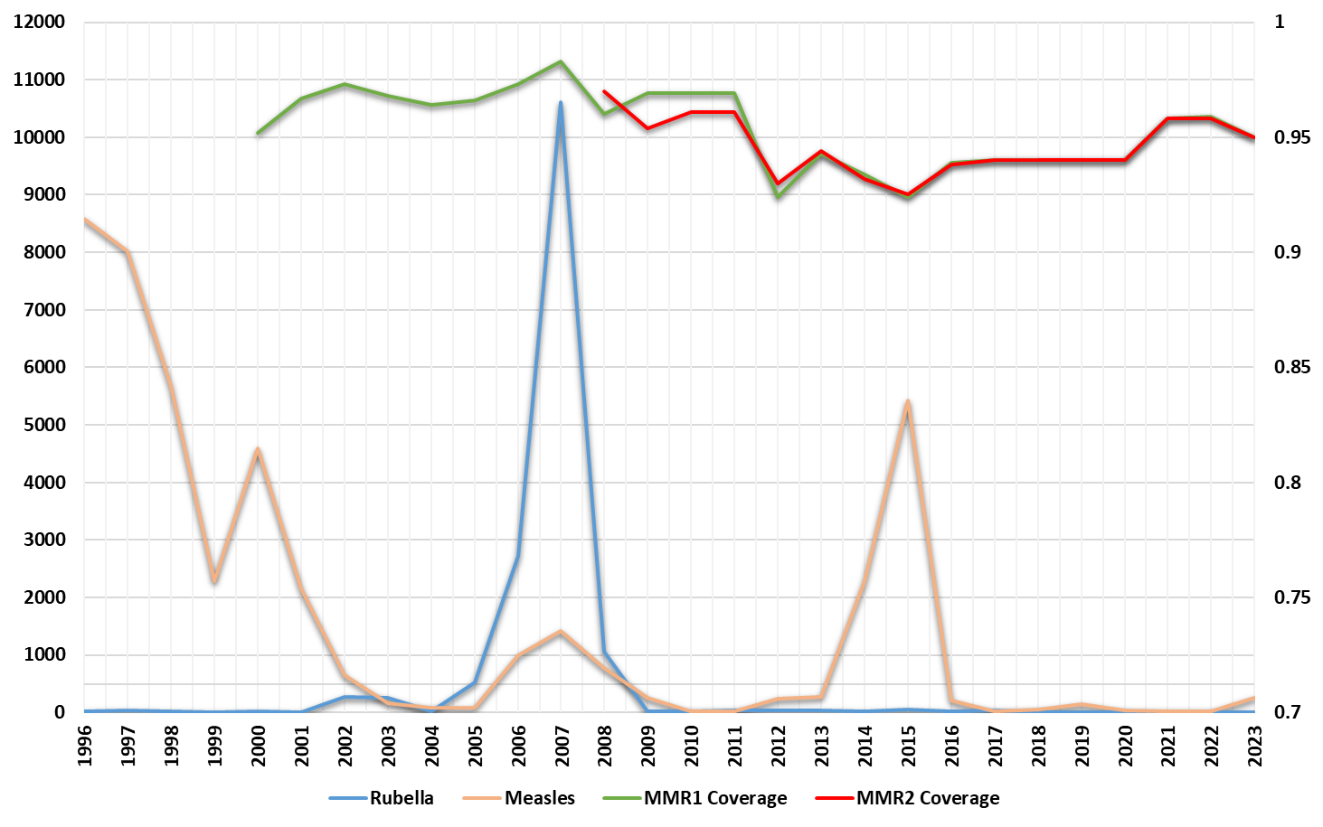
Measles and Rubella trend, MMR1&2 coverage and SIAs (1996-2023)
MR NIDs
10-20 ys
MR NIDs
9m – 10 ys
Lab confirmation
MR NIDs
9m – 6 ys
MR NIDs
2 ys – 10 ys
6
Notes:
This graph shows Measles and Rubella trend, MMR1&2 coverage and SIAs since late 90th . Before introduction of lab confirmation of cases, all outbreaks were classified as measles outbreaks. So the 1st outbreak afterword started in 2004-2005 was classified as biphasic with peak of more than 11,000 rubella confirmed cases and more than 2000 measles confirmed cases in late 2007. In response, the Egyptian MoHP implemented MR national campaign, in accordance with WHO recommendations targeting more than 35 million population in 2 stages, age of 10–20 years, (stage 1) and age of 2–10 years, (stage 2). in addition, NITAG, took the decision of adding a 2nd dose of MMR to establish the final routine MMR vaccination at age of 12 and 18 months.
After that and with the effect of relatively high vaccination coverage and the sensitive surveillance system, rubella confirmed cases were seldomly found with importation source of infection. However in 2012, importation of measles virus led to increasing cases and outbreak for more than 6000 confirmed cases with a peak in early 2015. in response MoHP implemented MR national campaign targeting 23 million population age 9 m -10 ys. As a follow up campaigns a catch up national campaign was implemented targeting more than 15 million aging 9 m – 6 ys in 2020.
Since 2008, MMR 1&2 vaccination coverage maintained as high as above 90% and reaching 95% in many years.

Slide 7
Effective response and planning
Establishing the ongoing routine vaccination schedule in 2008. It contains two doses of MMR vaccine in 12 and 18 months
In 2008, in response to a rubella epidemic curve 2007, the Egyptian Ministry of Health initiated (MR) catch-up campaign, in accordance with WHO recommendations for (SIA).
SIAs were conducted based on study of epidemiological situation. The Expert committee discuss the need of performing SIAs and refer their suggestion to NITAG.
Targeting individuals aged 10–20 years, (stage 1)
In 2009, Targeting individuals aged 2–10 years, (stage 2)

Slide 8
National MR campaigns
 | Target age group | No. Vaccinated | Coverage
2008 | 10-20 ys | 18.4 million | 99.8%
2009 | 2-11 ys | 17.2 million | 104%
2015 | 9m-10 ys 9m-15 ys in border govs. | 21.3 millions | 101.5%
2020 | 9m-6 ys 9m-10 ys in border govs. | 16 millions | 99.7%
Sub-National MR campaign 2021 (9m-15 ys)
 | Target age group | No. Vaccinated | Coverage
Aswan | 447,723 | 397,239 | 88.7%
Red Sea | 101,456 | 106,681 | 105.2%
Matrouh | 179,274 | 172,000 | 95.9%
Notes:
This table shows the national campaigns in 2008, 2009, 2015 and 2020 as I mentioned before.
It also shows the subnational vaccination campaigns targeting the border governorates (Aswan, red sea and Matrouh) in 2021, where most of importation of cases occurred from Sudan and lybia.

Slide 9
Activities to raise immunization coverage
1. Training
2. Media support
3. Health education
4. Supportive supervision
5. Monitoring of Coverage
Central staff
3 levels of supportive supervision
Administrative coverage data follow up monthly, quarterly an annually for analysis and feedback
TV spots
Radio spots
Health education messages for mothers and parents
Province: 27
Districts: 286
HCU: 5000
Doctors
Nurses
Sanitarians
Routine, vs Electronic
Newspapers and magazines articles
Social media
Posters of immunization schedule aligned in health units
Immunization schedule printed on birth certificate
Raedat Reefyiat (Rural Female Health Educators)
Non Governmental Organizations
Community Leaders
1- Central level
2- Governorate level
3- District level
Field survey to check coverage data.
Independent Coverage surveys done by WHO
6. Outreach activities
Special care for special population
Community leaders
Notes:
Regarding activities to raise immunization coverage, it include staff training and building capacity at all levels. Media support as well as health education to increase community engamnent and participation. Effective supervision at all administrative levels and monitoring of vaccination coverage for corrective intense measures. In addition to outreach activities to reach hard to reach areas.

Slide 10
Vaccination coverage (2020-2023)
Notes:
This figure shows the vaccination coverage of MMR1&2 in the last 4 years with increasing trend reaching above 95% level.

Slide 11
Sustainability of Immunization system
Immunization system
Strong political commitment to immunization
Strong community demand for vaccines
Evidence-based decision-making on immunization
Skilled, engaged and empowered health workforce
Financial sustainability in procuring vaccines
All Communicable disease are announced as of public health importance where surveillance, diagnosis and treatment is free of charge for all Egyptians or non-Egyptians by the low.
CME
EPI is probably the most accessible, available, and utilized of all public health programs in Egypt. According to health officials, many parents do not request health services for themselves or their children, but they do have their children vaccinated.
NVC, NITAG & expert committees
Notes:
Regarding immunization system sustainability, Egypt has Strong political commitment to immunization. Financial sustainability in procuring vaccines where All Communicable disease are announced as of public health importance where surveillance, diagnosis and treatment is free of charge for all Egyptians or non-Egyptians by the low.
We have Strong community demand for vaccines as EPI is probably the most accessible, available, and utilized of all public health programs in Egypt. According to health officials, many parents do not request health services for themselves or their children, but they do have their children vaccinated.
Also Evidence-based decision-making on immunization by national verification committee (NVC), NITAG & expert committees
And lastly Skilled, engaged and empowered health workforce by continuous medical education and staff building capacity.

Slide 12
Surveillance system
Fever and rash surveillance system
CRS surveillance system
2002
2017
Identify cases (lab based)
Report/Confirm
Cases
Compile data
Analyze data
Report Findings
Detect infants with clinically apparent symptoms
Prospective sentinel site surveillance
Infants <1 year of age
Tertiary facilities (11 university and educational hosp.)
Advocacy of CRS clinical manifestations
Laboratory testing of cases suggestive of CRS
Analysis of data and report findings.
Notes:
Regarding the surveillance system, we have strong fever and rash case based surveillance supported by laboratory confirmation since 2002. it includes case identification through reporting, investigation to compile the needed data, analysis, case classification and reporting to higher levels.
In 20017, congenital rubella syndrome (CRS) surveillance was initiated in 11 sentinel sites including university and educational hospitals covering the high density area and facilities with high rates. The system includes reporting of infants below age of one year with congenital detect and clinically apparent symptoms
Prospective sentinel site surveillance followed by Laboratory testing of cases suggestive of CRS and Analysis of data and report findings.

Slide 13
The National Verification Committee (NVC)
Date of Establishment: August, 2018
Date of First meeting: 1st October 2018
Date of Re-formulation: 1st October 2023
NVC composed of Chair person and 5 members: 1 virologist, 2 epidemiologists and 1 pediatricians and infectious disease specialist.
The first NVC report presented in the RVC meeting, October 2019 Tunisia
Egypt achieved Measles, Rubella and CRS elimination in November 2022.

Slide 14
The National Verification Committee (NVC)
Regular meetings held to:
- Review epidemiological situation
- Review actions to sustain elimination situation
- Discuss actions to be taken (NIDs, new vaccines, ….etc.)
Field visits to:
- Review cases and investigations
- Hospitals and reporting sites for advocacy

Slide 15
Challenges
Data collection and case reporting.
Continuously growing Immigrants & refugees population.
Cross border movements.
Population movement and high density.
Turn over of physicians in reporting sites and EPI staff at province, districts, and HCU.

Slide 16
Way Forward
Implementation of online data collection program using a suitable specially designed software, that will help EPI- staff at all levels in performing a high-quality on-site case reporting and investigation form completion.
Expand the experience of community leader's all over the country, this needs a well-defined selection criteria and implementation monitoring framework at provincial level.
Continuous capacity building through training of the EPI staff at province, districts, and HCU especially after complete introduction of electronic vaccine setting to all provinces.

Slide 17
Thank you

