Slide 1
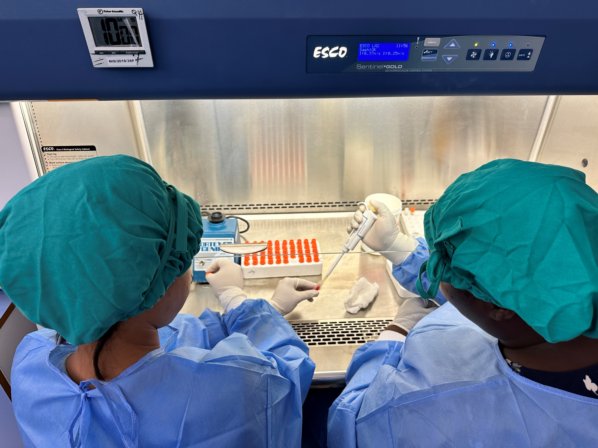
Update from the Global Measles Rubella Laboratory Network – Achievements and Challenges
Mick N. Mulders, WHO/IVB
Paul A. Rota, Chief Viral Vaccine Preventable Diseases Branch, US-CDC
Measles & Rubella Partnership Meeting: “From Awareness to Access: A Pathway to a Measles and Rubella-Free World”
04 – 07 March 2024 Washington D.C., US

Slide 2
What is a GMRLN?

Slide 3
Is this a GMRLN?

Slide 4
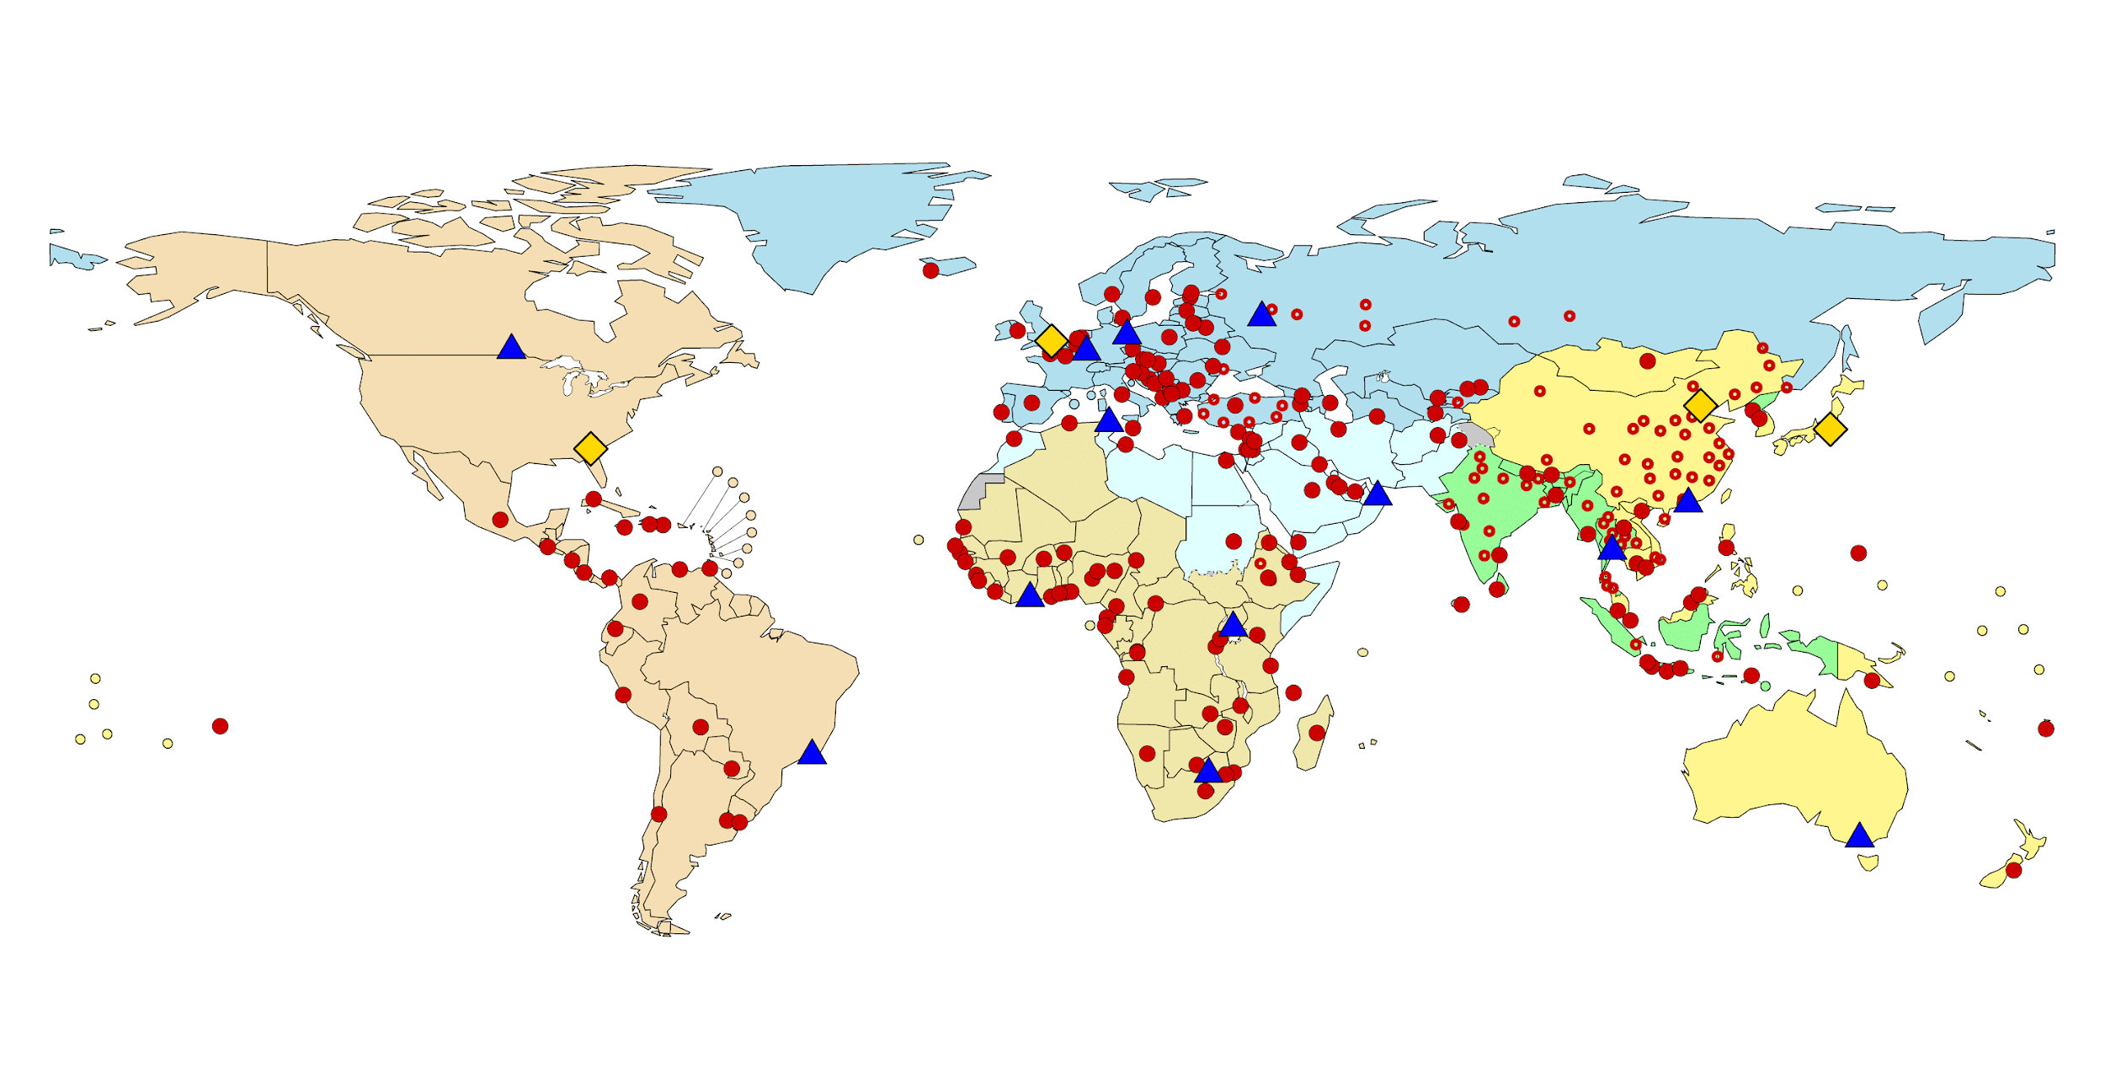
GMRLN: Global Measles Rubella Laboratory Network
Global coverage: Largest WHO coordinated laboratory network (737 laboratories)
Tiered structure like the Global Polio Laboratory Network: Regional Reference and Global Specialized Laboratories support National Laboratories
Regional Coordination
National Laboratories linked to national disease control programs
GMRLN testing by year | Specimens Received | Specimens Tested
2023 | 402,883 | Measles 333,835 Rubella 286,780 Total tests 620,615
2022 | 272,990 | Measles 217,179 Rubella 209,992 Total tests 427,171

Slide 5
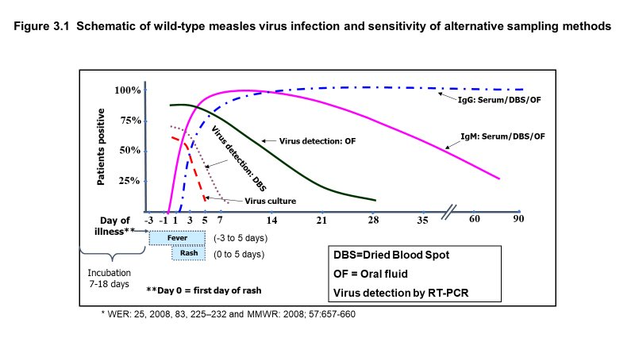
GMRLN – Functions
Support measles and rubella surveillance by performing laboratory testing for confirmation of infection
Detection of virus-specific IgM
Detection of viral RNA by RT-PCR
Specialty testing by regional and global reference laboratories
Genetic characterization of wild-type measles and rubella viruses
Conventional Sanger sequencing with standard protocols
Next generation sequencing in development
Assist with studies to measure population immunity
Guidelines for serosurveys
Development/deployment of measles-rubella multiplex bead assay

Slide 6
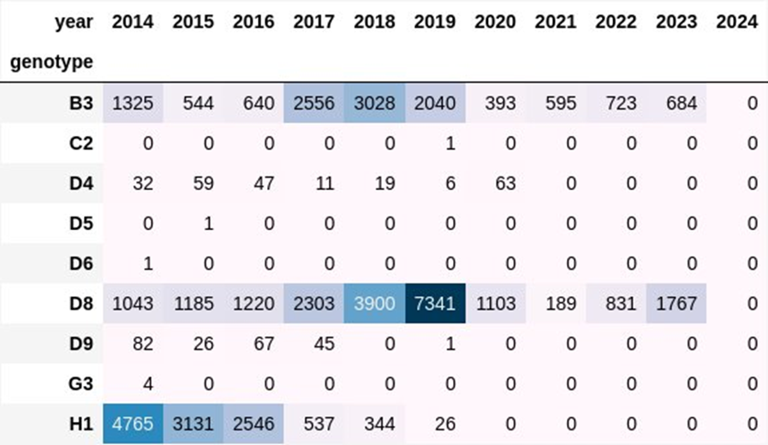
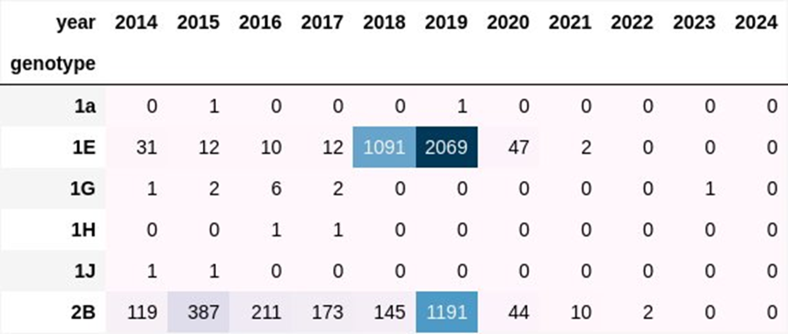
GMRLN – Sequence Databases
MeaNS
Sequence databases for measles and rubella are maintained by the UK Health Security Agency (UKHSA)
MeaNS- measles N-450
RubeNS- rubella- 731 E1
Governance by a MeaNS/RubeNS Steering Committee with representation from all WHO regions
Data are available only to GMRLN laboratories unless a special request is made to the SC
Routine training includes training on submission to the databases
Will be able to import WGS
Functions include analysis and search capacity
RubeNS

Slide 7
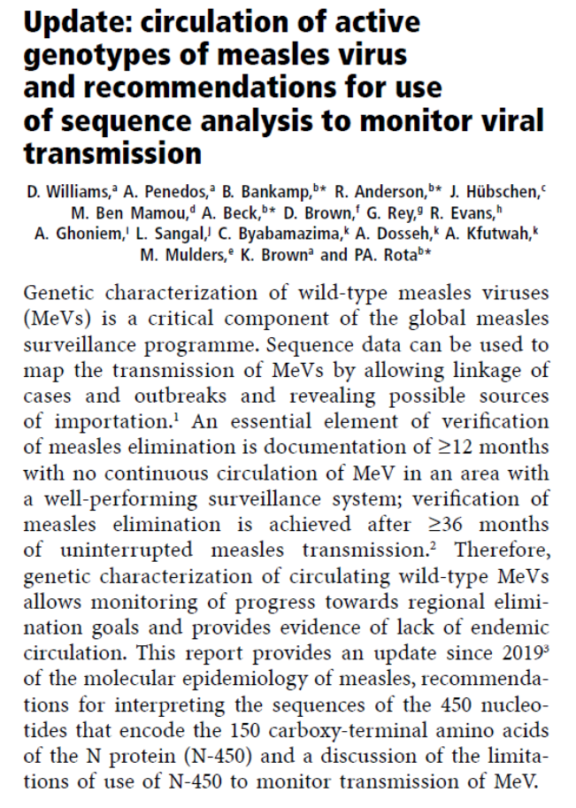
GMRLN – Responsibilities
To support Member States in obtaining timely, complete, and reliable laboratory-based surveillance data for measles and rubella
To ensure laboratories provide accurate data to National Verification Committees for case confirmation and classification as well as genotype information
Ensure laboratory quality by monitoring performance through external quality assurance programs, confirmatory and reference testing, and accreditation.
Provide technical assistance to national programs for laboratory testing
Provide training to expand testing capacity and maintain a stable, competent workforce.
Support laboratories in priority countries with laboratory reagents and diagnostic kits
Maintain global sequence databases for measles and rubella (UKHSA)

Slide 8
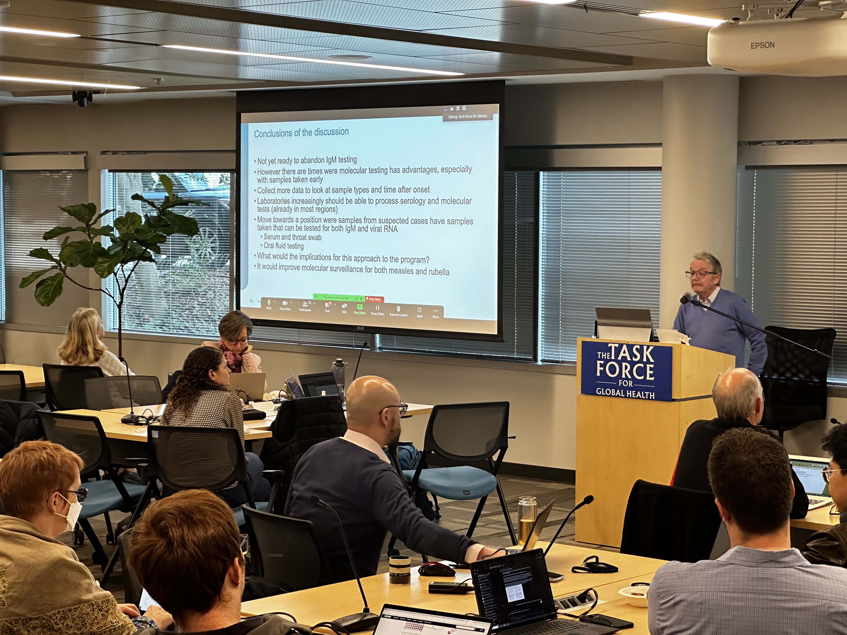
GMRLN – Working Groups/Projects
GMRLN has established working groups to monitor and plan activities and to develop new approaches
Strategy WG
Next Generation and Extended Window (NEW) WG
Includes sub-WG for quality control of next generation sequencing
Rapid diagnostic tests (RDT) WG
Roll out and use cases
Measles and rubella nomenclature WG
Other groups/projects
EIA test validation and implementation team
Plan for discrepant IgM test results
Validation of commercial IgM test kits
IRR implementation
Accreditation checklist
Revisions to Laboratory Manual
Multiplex bead assay implementation

Slide 9
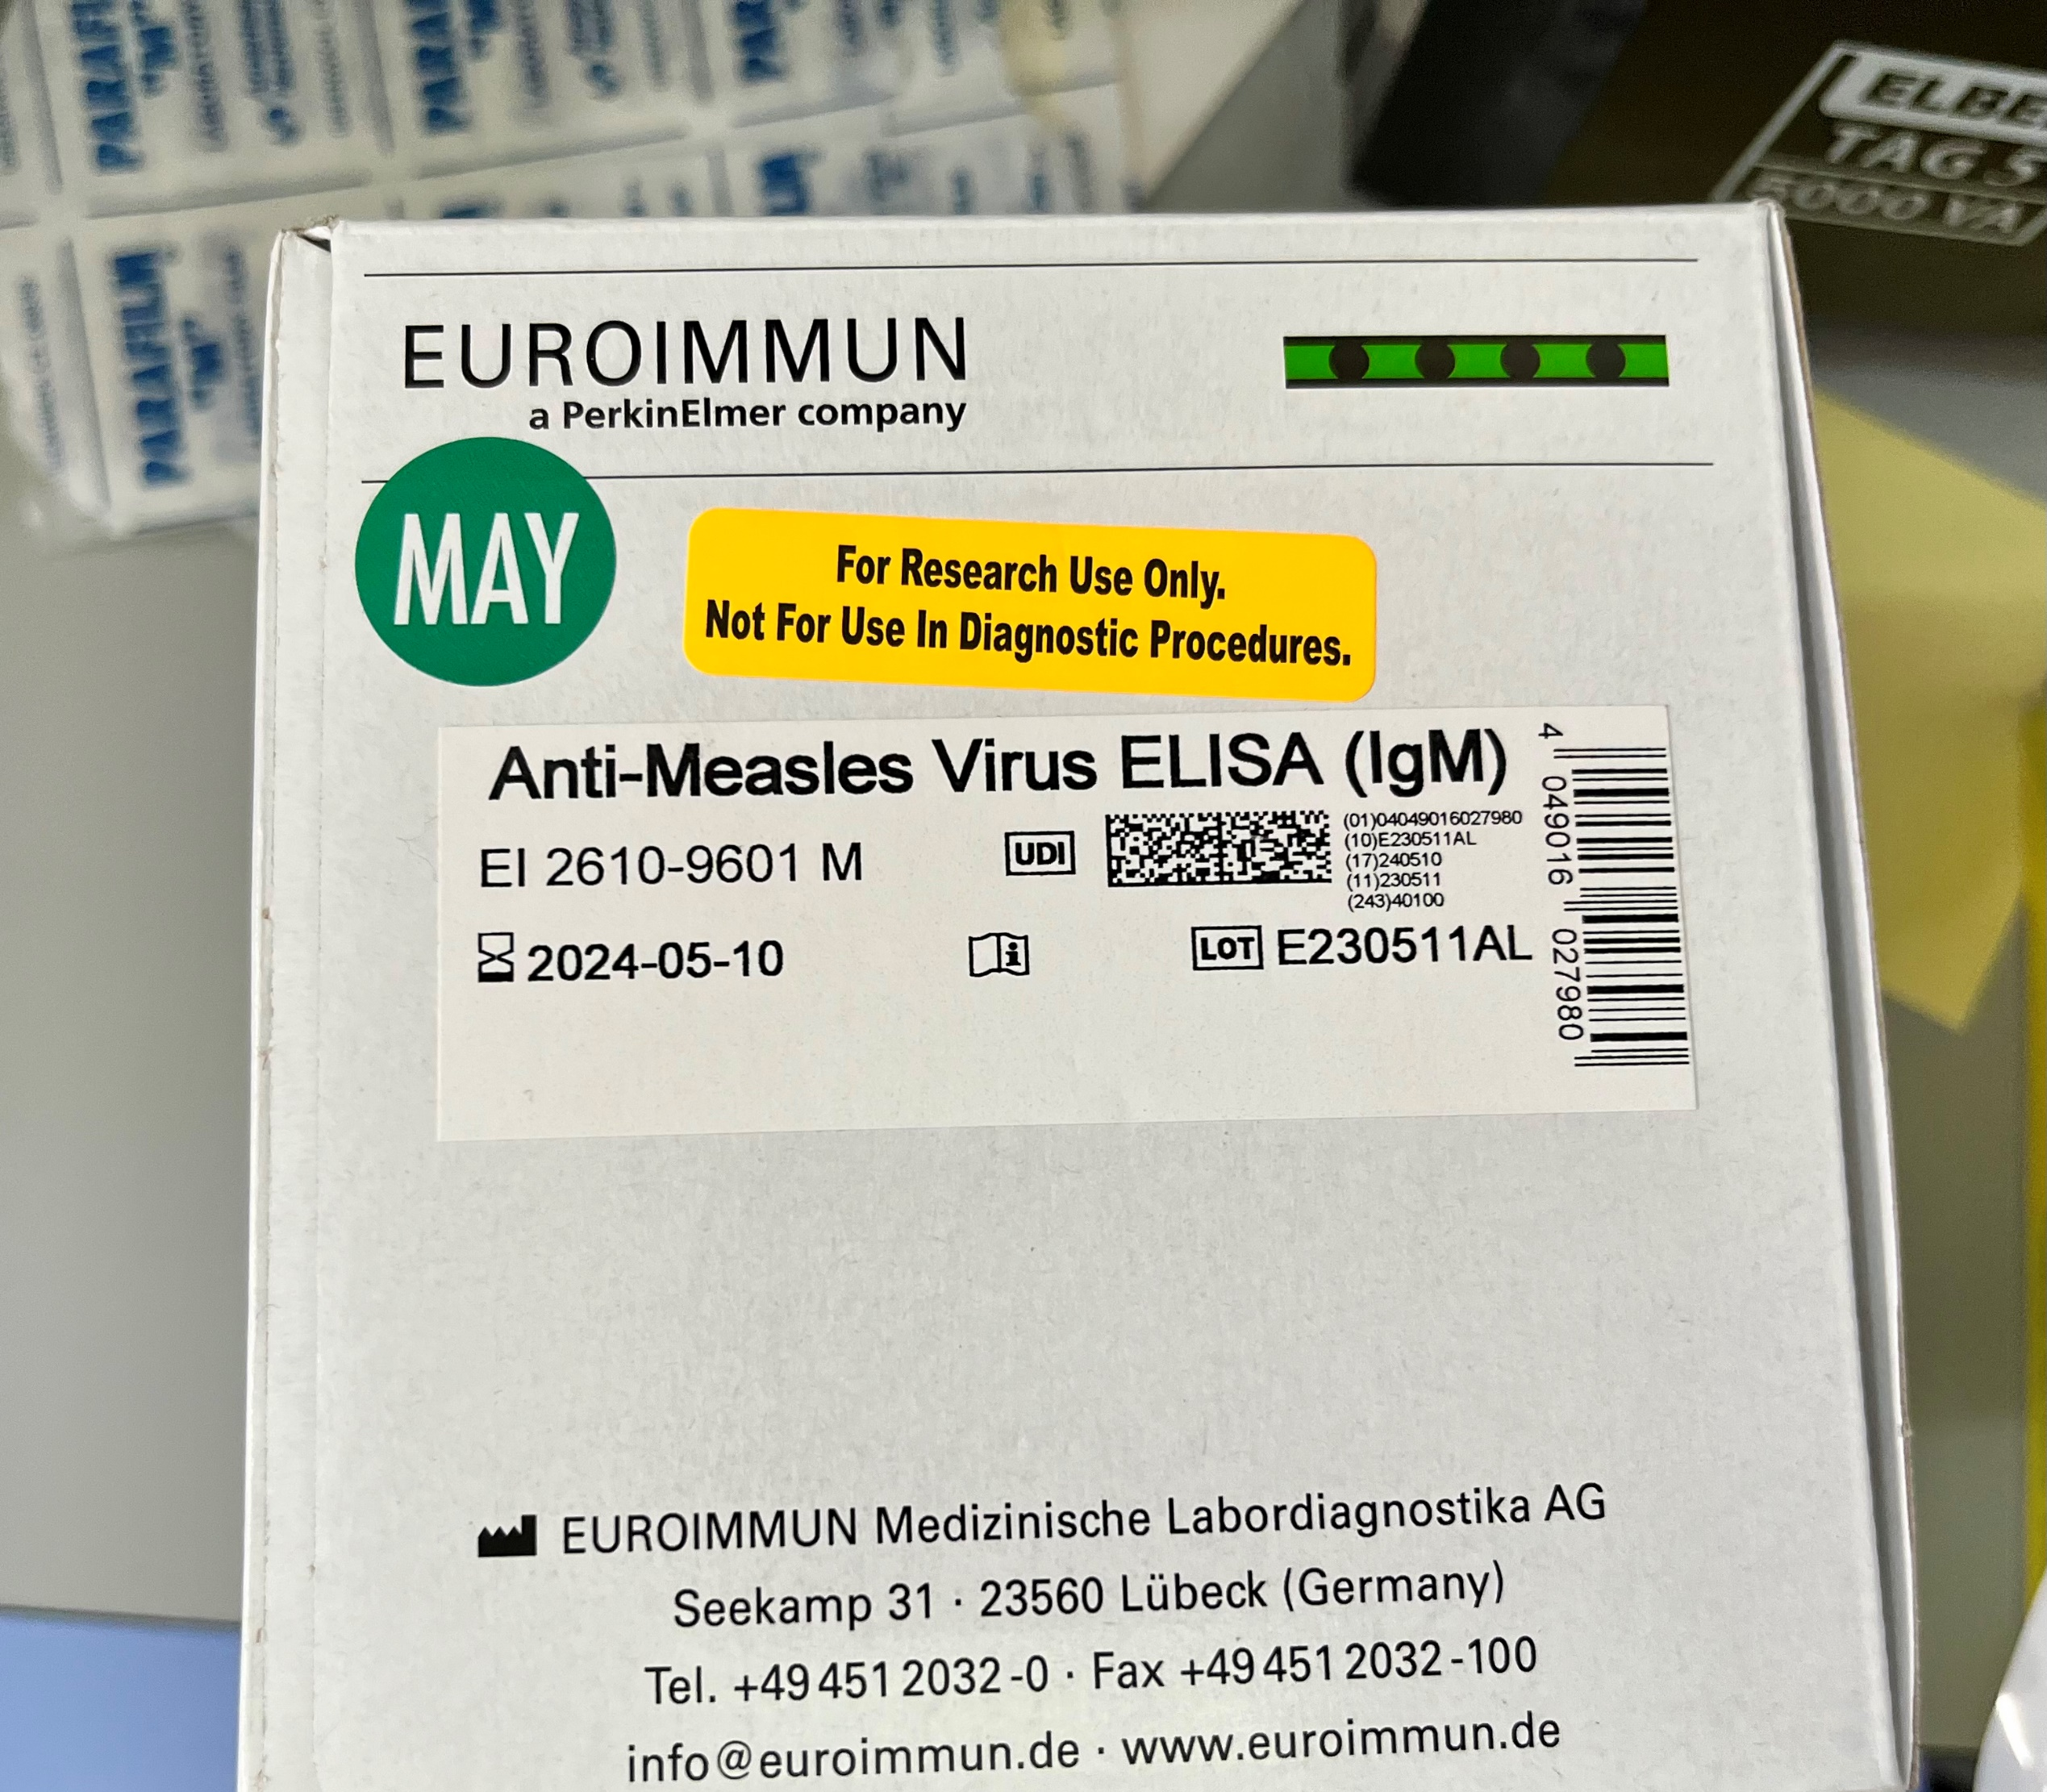
GMRLN – Outbreak Preparedness and Support
National outbreak response plans are essential
Laboratory testing to confirm and monitor outbreaks
Initial testing to confirm outbreak
Testing during the outbreak to monitor spread and termination of outbreak
Obtain representative samples for viral genotyping
If needed, reflex testing for rubella
Communication between laboratory staff and surveillance staff is critical to avoid over testing
Use of epidemiologic links to confirm cases
Laboratories should communicate with the Regional Laboratory Coordinator, WHO-HQ, CDC-IRR Team to ensure that reagents and kits need for testing are available
Laboratories should consider needs for surge capacity during outbreaks (laboratory space, equipment, supplies, staff)
Laboratory and surveillance teams should develop plans for reporting and analysis of testing data include linkage of laboratory and epidemiologic data

Slide 10
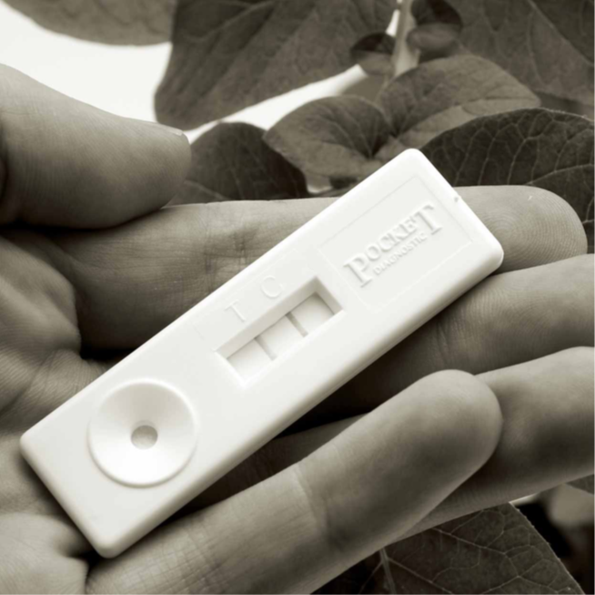
GMRLN – New Technologies
Use of RDTs to improve surveillance for measles and rubella
IgM detection for measles with specificity and sensitivity equivalent to commercial EIA
Results in 15 minutes, visual read, minimal equipment needed
Validation of commercial expected in 2024 enabling pilot studies
Potential to expand laboratory testing to remote areas
Reduce need for reverse cold chain
Rapid laboratory confirmation of outbreaks
Expand laboratory network and availability of testing capacity
Expand genotyping
Various use cases are being developed
Confirmatory testing by GMRLN

Slide 11
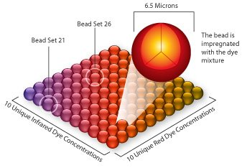
GMRLN – New Technologies
Use of microbead assays (MBA) to measure population immunity
MBA has beater sensitivity/specificity than commercial EIAs
Designed for seroprevalence studies
Measure antibody response to multiple antigens in a single test (measles and rubella)
Low volume of sample required
High throughput
Calibrated to international standards
Luminex platform widely available

Slide 12
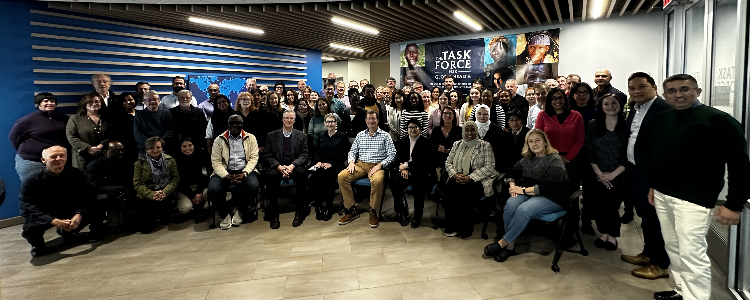
GMRLN - Achievements
Network laboratories remain focused and committed, despite many competing priorities
GMRLN strong and expanding
Overall performance of network laboratories remains at a high level
Strong coordination (meetings, WHO laboratory coordinators)
Serology and molecular EQA programs are robust
Capacity building through training has resumed
International Reagent Resource (IRR) providing extensive portfolio of reagents and panels to WHO laboratory networks

Slide 13
Current challenges for GMRLN-1
Need to expand capacity for molecular testing for case confirmation and genotyping (especially rubella)
Continual need for training to maintain a stable, competent workforce
Need to develop updated nomenclature to describe intragenotype variation of measles and rubella viruses
Due to limited resolution of standard Sanger sequencing, need to develop methods for whole genome sequencing
Maintaining robust, stable sequence database
Difficulty in expanding external quality assurance programs
Need countries with large subnational laboratory networks to develop national external quality control programs
Limited supply of well characterized serum for IgM testing

Slide 14
Current challenges for GMRLN-2
Need to develop testing algorithms for near and post elimination settings
Low positive predictive value of IgM testing in low incidence settings
Appropriate use of RT-PCR to confirm cases
Testing algorithms for breakthrough infections
Updates to the WHO Laboratory Manual
Coordination with other VPD networks
Improve regional training capacity, develop regional training focal points
Local costs (e.g. customs) for IRR shipments must be paid by the laboratory
Adequate and sustainable funding
Support for Regional Laboratory Coordinators
Continued support for IRR

Slide 15
Acknowledgements
VPData: to subscribe send email to LISTSERV@LISTSERV.WHO.INT with ‘SIGNUP GLOBAL_MR_UPDATE’ text in the body of the email
David Featherstone, Robyn Meurant, David Brown, Kevin Brown
WHO: Natasha Crowcroft, Patrick O’Connor, Anna Minta, Claudia Steulet, Sebastien Antoni, Anindya Bose, Laure Dumolard, Yoann Nedelec, Marta Gacic-Dobo, Carolina Danovaro, Lee Lee Ho, William Perea, Diana Chang-Blanc, Ann Lindstrand, Katherine O’Brien
CDC: Viral Vaccine Preventable Disease Branch, DVD, NCIRD, Accelerated Disease Control Branch. GID, GHC
UK-HSA: Keith Perry, Ana Penedos, David Williams
NIID: Team Akihide Ryo
CCDC: Wenbo Xu, Yan Zhang, Zhu Zhen, Mao Naoning
PHAC: Joanne Hiebert
VIDRL: Suellen Nicholson, Vicki Stambos and team
FIND: Jennifer Osborn
Gavi: Antara Sinha, Beth Evans, Lee Hampton
Laboratory coordinators
Myriam Ben Mamou (EURO), Lucky Sangal (SEARO), Amany Ghoniem (EMRO), Varja Grabovac, Roger Evans (WPRO), Gloria Rey (PAHO), Annick Dosseh (AFRO/w), Charles Byabamazima (AFRO/es), Maurice Demanou (AFRO/c), Deepa Sharma (CO/IND), Mick Mulders (Global)
Regional Reference Laboratories
National Laboratories
CDC for funding GMRLN

