Slide 1
Progress towards an MR MAP
Measles & Rubella Partnership meeting
Kristen Earle, PhD
Senior Program Officer, Vaccine Development

Slide 2








MR MAP development has been fostered by years of global partnership
An incomplete (perhaps inaccurate) overview of collaborative effort to advance MR microneedle array patches (MR MAPs)
~2011
2018
2019
2024
Need for alternate delivery method(s) prioritized by MRI, and recommended by SAGE in 2016
MAPs prioritized by VIPS via extensive partner engagement, and action plan developed
TPP developed by consensus of MR MAP Working Group and public consultation
TAG established to develop Evidence Considerations for Vaccine Policy (ECVP) document and Ph 3 framework

Slide 3



Key MR MAP features could increase campaign reach and coverage
An MR MAP introduced between 2028-2032 could avert ~300-350k deaths by 2050
Improved thermostability
No reconstitution
Needle-free administration
Candidates in pipeline suggest that controlled-temperature chain (up to 40°C) for 3 days and a VVM30 label are achievable, allowing last-mile delivery outside of cold chain
Increased ease of use will prevent reconstitution errors, and single dose presentation may reduce wastage and missed vaccination opportunities
Lack of needle-and-syringe could enable delivery by community health workers and generate no sharps waste for disposal

Slide 4
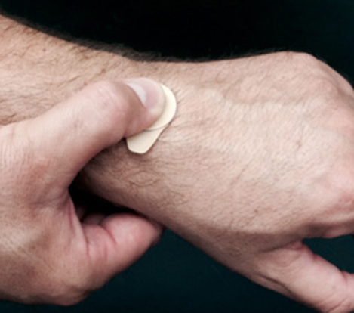
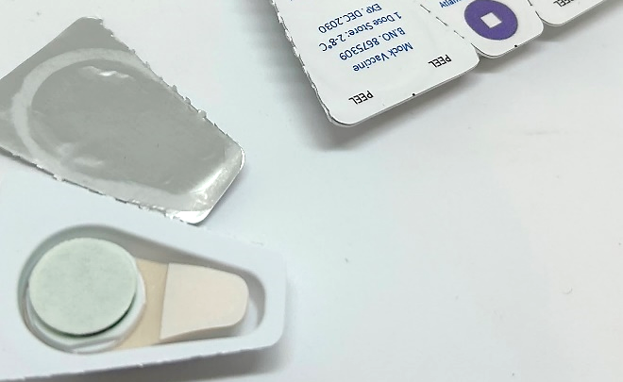
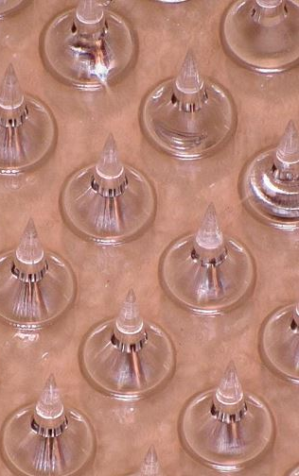
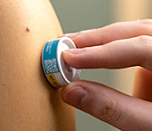
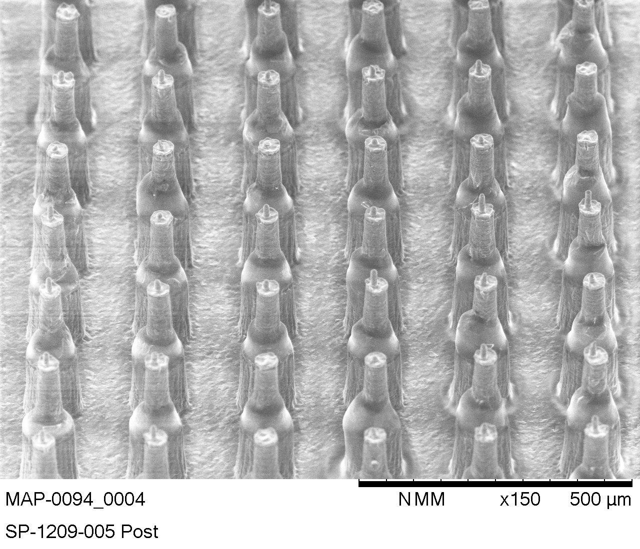


Our two lead MR MAP candidates entered the clinic in 2022
In addition to clinical development of 2 leads, our portfolio includes investments in back up technologies and industrialization POP/POC
Micron’s dissolvable “peel-n-stick” MAP technology
Vaxxas’s solid-coated “Nanopatch” MAP
Based in Atlanta, GA
Dissolvable MAP mounted on adhesive-lined backing with force feedback-indicator
Completed Phase I/II MR MAP trial at MRC The Gambia in Q1 2023
Based in Brisbane, Australia
Solid-coated MAP inside single-use applicator
Completed Australian Phase I MR MAP trial in 2022
Will enter Phase I/II at MRC The Gambia in Q1 2026

Slide 5
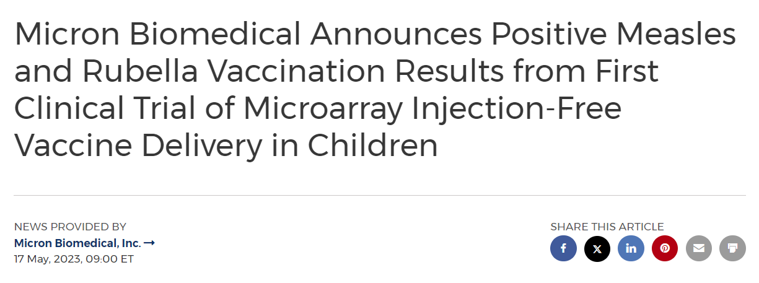
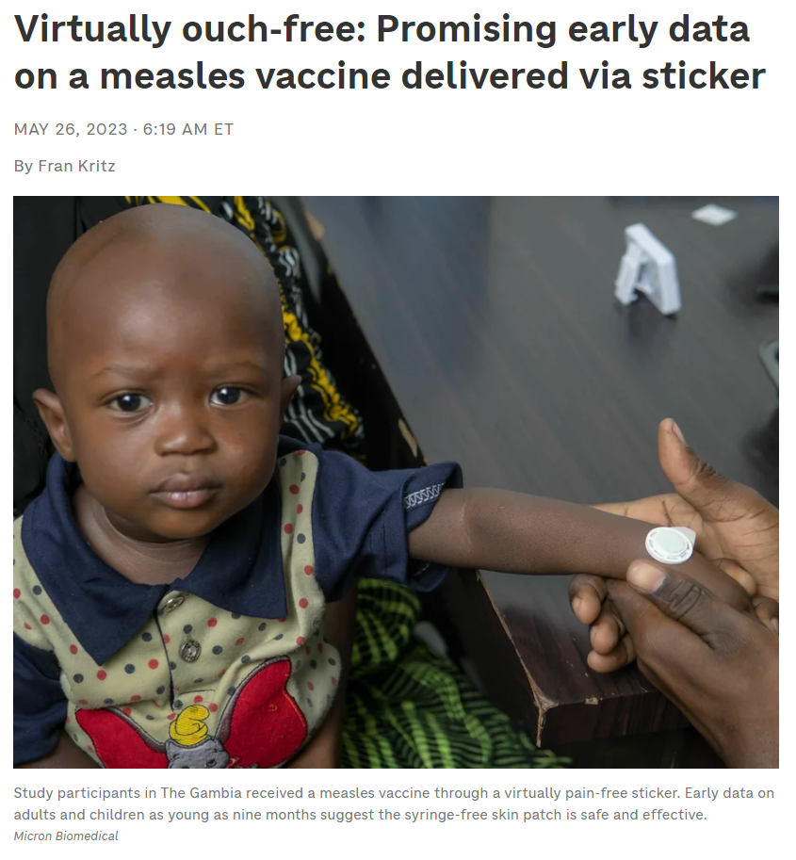
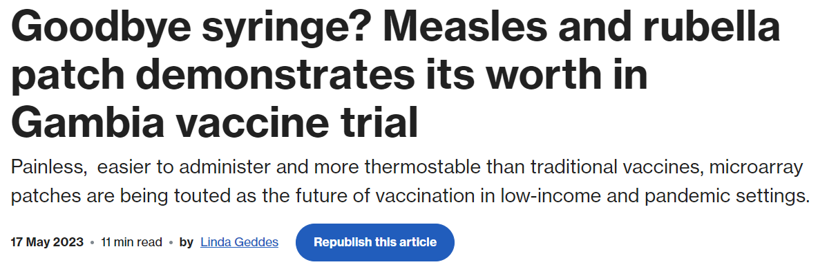
Successful Micron Phase I/II demonstrated clinical proof-of-concept
First time that a vaccine MAP was delivered to naïve infants – good safety and immunogenicity demonstrated
Sources: PR Newswire, Gavi, NPR

Slide 6
We have invested in a Micron pilot facility to accelerate launch to 2029
2023
2024
2025
2026
2027
2028
2029
2030
2031
2032
Development milestones
EMA M4All review
Pilot line construction
CTM
3-year acceleration possible with at-risk investment in pilot manufacturing facility
Previous estimate for PQ
Mfg and release of clinical trial material (CTM)
WHO PQ
Phase I/II
Clinical Study Report (CSR)
Phase IIb
Phase III
Key
Clinical
CMC
Regulatory
Stage gates
Go / no-go:
Safety / tolerability
Immunogenicity
Thermostability
Manufacturability assessment
COGS
Human factors assessment
Go / no-go:
Non-inferiority to subcutaneous MR
Assumptions to meet this timeline:
Pilot facility (10M MAPs/year) will be 1/10-1/5th commercial scale and can serve as the facility for Phase III CTM, licensure, PQ, and launch
Antigen supplier / market authorization holder can support EMA M4All regulatory review
Successful scale up of automated manufacturing process demonstrated in 2026
5 March 2024
6

