Slide 1
Not Business as Usual: Why Measles & Rubella are Important Now
Dr. Natasha Crowcroft and Dr. Patrick O’Connor, WHO

Slide 2
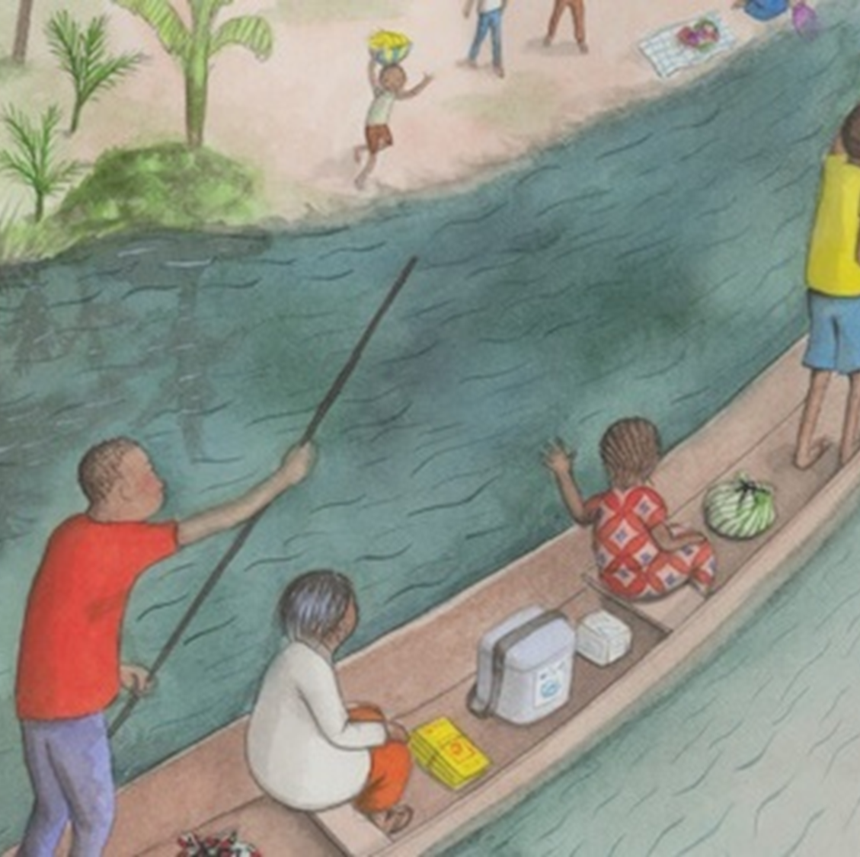
Outline
Why are measles and rubella important now?
What has been achieved so far?
What do we need to do now?

Slide 3
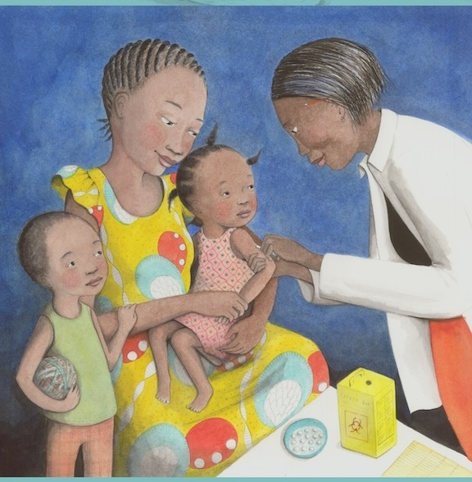
Why are measles and rubella important now?

Slide 4
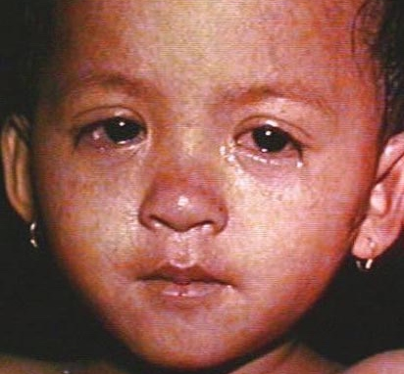
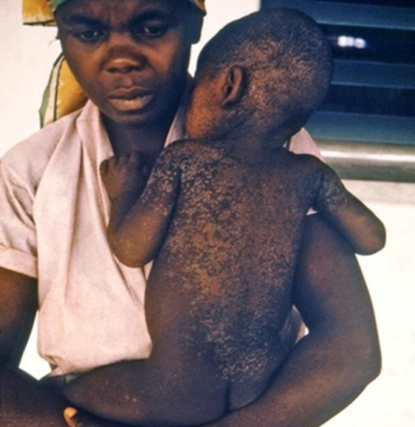
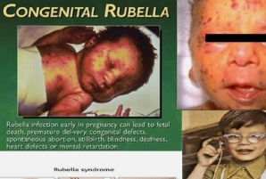

Measles and rubella – the diseases
Measles
Rubella
Measles complications include blindness, deafness, encephalitis, diarrhea and pneumonia.
Estimated >100,000 infants born with Congenital Rubella Syndrome (CRS) per year before vaccination
Heart
Patent/primary ductus arteriosus, other defects
Eyes
Cataracts, glacoma, blindness
CNS
Mental retardation, deafness
https://www.cdc.gov/measles/symptoms/photos.html?CDC_AA_refVal=https%3A%2F%2Fwww.cdc.gov%2Fmeasles%2Fabout%2Fphotos.html
Rubella (who.int)
Notes:
Measles is one of the most infectious viruses known
Measles prevention requires at least 95% of children to have two doses of vaccine.
Rubella now down to 32,000 cases and 19 countries left to complete introduction of the vaccine

Slide 5
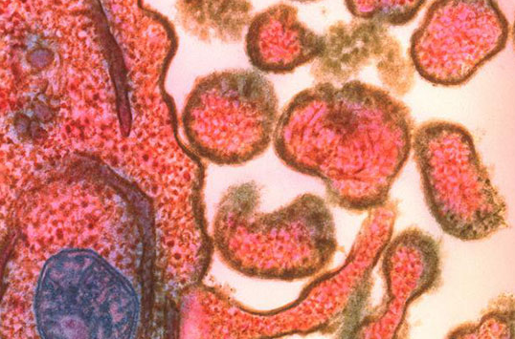
Measles vaccination has positive effects beyond preventing measles, protecting other health investments
“Immune amnesia” after measles puts people at risk of other infections for weeks to months, extending 2 to 3 years.
Measles causes malnutrition
Measles virus particles bud out from an infected cell (left) after replicating inside the cell in this colored electron micrograph. NIBSC/SCIENCE SOURCE
Source: Mina MJ. Measles, immune suppression and vaccination: direct and indirect nonspecific vaccine benefits. J Infect. 2017 Jun;74 Suppl 1:S10-S17. doi: 10.1016/S0163-4453(17)30185-8. PMID: 28646947.
Mina MJ, Metcalf CJ, de Swart RL, Osterhaus AD, Grenfell BT. Long-term measles-induced immunomodulation increases overall childhood infectious disease mortality. Science. 2015 May 8;348(6235):694-9. doi: 10.1126/science.aaa3662. Epub 2015 May 7. PMID: 25954009; PMCID: PMC4823017.
Sanders L. Measles erases the immune system’s memory – beyond the rash, the infection makes it harder for the body to remember and attack other invaders. ScienceNews – 21 May 2019; https://www.sciencenews.org/article/measles-immune-system-memory-infection
Laksono, B.M., de Vries, R.D., Verburgh, R.J. et al. Studies into the mechanism of measles-associated immune suppression during a measles outbreak in the Netherlands. Nat Commun 9, 4944 (2018). https://doi.org/10.1038/s41467-018-07515-0
Notes:
Immune amnesia: This is consistent with experimental work that attributes the immunosuppressive effects of measles to depletion of B and T lymphocytes.
These all-cause mortality gains mortality appear to derive in part from both:
by preventing measles infections, vaccination prevents measles-associated short- and long-term immunomodulating effects.
Secondly, a direct heterologous benefits of measles vaccines that enhance innate and adaptive immune responses non-specifically

Slide 6
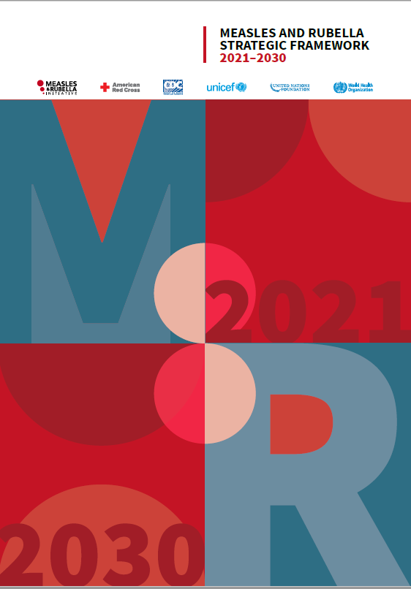
Global strategies recognize the importance of measles
Immunization Agenda 2030: “Use measles cases and outbreaks as a tracer to identify weaknesses in immunization programs, and to guide programmatic planning in identifying and addressing these weaknesses”
Sustainable Development Goals (SDGs): MCV2 coverage is an indicator of the fully vaccinated child
Measles and Rubella Strategic Framework 2021-2030
  Vision: A world free from measles and rubella
  Goal: Achieve and sustain regional measles and rubella elimination goals
  All regions have a measles elimination goal
Notes:
“Measles as a tracer” is not defined in Immunization Agenda 2030 (IA2030) but the strategy refers to it with regards to both coverage and disease, largely as indicators of system strengths and weaknesses
Several definitions of “tracer”
All refer to something that makes other things visible, lighting them up literally (as in a military flare) or figuratively (as in the substance used in a medical investigation to show the location of a problem).
“Measles could be called the equity virus: without vaccination, everyone gets measles, and without equitable health-care systems to deliver vaccination, measles will continue to present a threat to the most vulnerable.” ¹
Health inequities are differences in health outcomes that are avoidable, unfair and systematically related to social inequality and disadvantage²

Slide 7
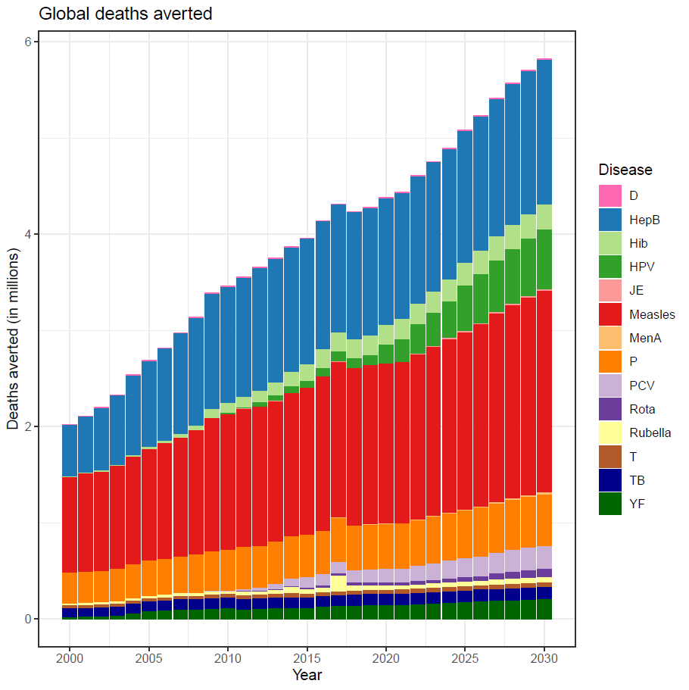
Global goal to prevent 50 million deaths by 2030 won’t be met without measles vaccine
Measles vaccine accounts for 37% lives saved by vaccines in 2021-2030
Measles vaccine brings 75% of the economic benefits of vaccines, for 25% of costs
Diphtheria
Pertussis
Measles
Tetanus
Carter A et al. Modeling the impact of vaccination for the immunization Agenda 2030: Deaths averted due to vaccination against 14 pathogens in 194 countries from 2021 to 2030. Vaccine. 2023 Aug 1:S0264-410X(23)00854-X.
Notes:
P = pertussis T= Tetanus D= Diphtheria
To estimate the potential impact of the aspirational coverage targets for IA2030, an analytical framework was developed to estimate the number of deaths averted due to an ambitious vaccination coverage scenario from 2021 to 2030 in 194 countries. A demographic model was used to determine annual age-specific mortality estimates associated with vaccine coverage rates.
It is important to note that one dose won’t get you to the coverage level to stop measles transmission – uniform coverage with two doses of MCV is needed/required.
The analysis is based on a 50% reduction in zero dose children by 2030
1-s2.0-S0264410X2300854X-mmc1.pdf (els-cdn.com)

Slide 8
Measles cases are increasing
Cases reported to WHO increased by 79% in 2023 versus 2022
2024 may be worse than 2023
2015
2016
2017
2018
2019
2020
2021
2022
2023
247,474 cases
180,015 cases
168,190 cases
276,157 cases
541,401 cases
93,840 cases
59,619 cases
171,156 cases
280,933 cases
100,000
50,000
0
Jan
Feb
Mar
Apr
May
Jun
Jul
Aug
Sep
Oct
Nov
Dec
Jan
Feb
Mar
Apr
May
Jun
Jul
Aug
Sep
Oct
Nov
Dec
Jan
Feb
Mar
Apr
May
Jun
Jul
Aug
Sep
Oct
Nov
Dec
Jan
Feb
Mar
Apr
May
Jun
Jul
Aug
Sep
Oct
Nov
Dec
Jan
Feb
Mar
Apr
May
Jun
Jul
Aug
Sep
Oct
Nov
Dec
Jan
Feb
Mar
Apr
May
Jun
Jul
Aug
Sep
Oct
Nov
Dec
Jan
Feb
Mar
Apr
May
Jun
Jul
Aug
Sep
Oct
Nov
Dec
Jan
Feb
Mar
Apr
May
Jun
Jul
Aug
Sep
Oct
Nov
Dec
Jan
Feb
Mar
Apr
May
Jun
Jul
Aug
Sep
Oct
Nov
Dec
Measles case distribution by month and WHO Region (2015-2023)
Data reported as at February 2024
Notes: Based on data received 2024-01 - Data Source: IVB Database - This is surveillance data, hence for the last month(s), the data may be incomplete.

Slide 9
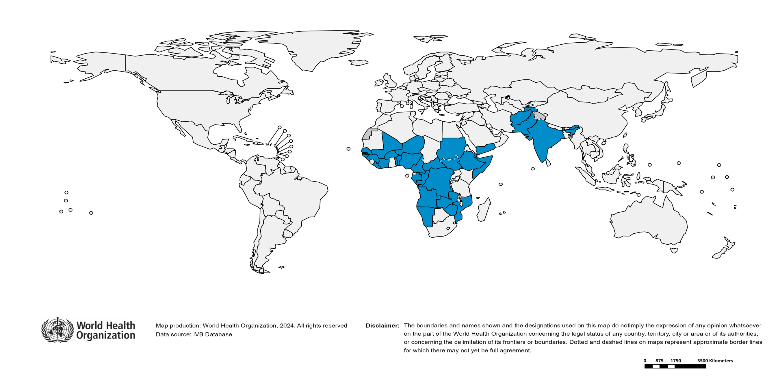
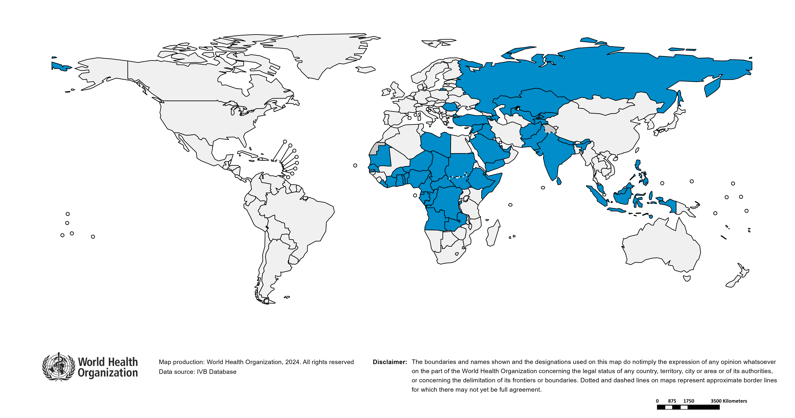
Large or disruptive measles outbreaks increased 2022-23
Number of countries reporting large outbreaks increased from 32 in 2022 to 51 in 2023
Increase observed in European (9) and Eastern Mediterranean (13) regions
2022
2023
Definition: >=20 cases per million per 12 months

Slide 10
Measles deaths don’t happen equally everywhere
Estimated 136,216 measles deaths in 2022, mostly in children - 43% increase on 2021
92% deaths occurred in 24% of the world’s population
Deaths in 2023 are likely to have increased further because cases have increased
Notes:
Who dies from measles?
Infants, immune compromised,
miscarriages

Slide 11
Pandemic hits: Measles vaccine coverage not recovered by 2022
Measles first dose (MCV1) coverage 3% below the pre-pandemic peak of 86%
86% too low to prevent the epidemics of 2019
Notes:
MCV1 83%
MCV2 74%

Slide 12
Pandemic hits:
Low-Income countries fare badly
Low-income countries are trailing behind with first dose measles coverage falling by 7%

Slide 13
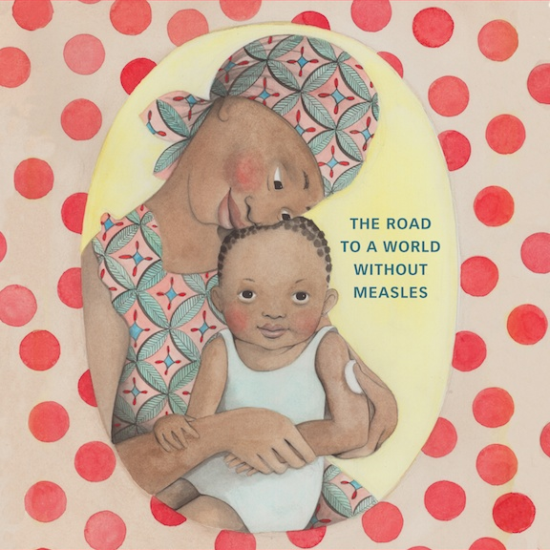
Pandemic hits: Supplementary Immunization Activities (SIAs) delayed and disrupted during Covid-19
Impact worst in low income, Gavi-eligible countries that rely on campaigns to prevent measles deaths and outbreaks
Middle income countries have now also started to face challenges funding campaigns

Slide 14
Over half of all countries in the world (54%) will be at high risk of a measles outbreak by end of 2024
48% of these countries at high risk are low- and middle-income countries
Total of 142 million children under 5 years of age are susceptible to measles, 73% living in low- and middle-income countries
Huge inequity
Risk assessed by US CDC using the ratio of <5 years old susceptible to the size of one birth cohort
Source: US CDC
Notes:
68 million children per year, half of the annual birth cohort, are born in non-Gavi-eligible MICs
73% susceptible children live in low- and low-middle income countries.
We need to make a correction to the 62% figure. By the end of 2024 there will be 105 countries at risk of measles outbreaks. Of these 105 countries, 50 are low- and low-middle income (as categorized by the world bank). So, nearly 48% of countries that are at risk of measles outbreaks are low- and low-middle income.
Global total number of children under 5 years of age = 666 million. 142 million of children under 5 years of age are naïve (susceptible) to measles. 15+74 = 89 million children under 5 years of age 89/142 = 62% are living in settings at high/highest risk of an outbreak by the end of 2024.
>2 birth cohort susceptible in under 5 years of age = highest risk = 15 million/34 million and represents 44% of children under 5 years of age are susceptible to measles
1-2 birth cohort susceptible in under 5 years of age = high risk = 74 million/258 million and represents 28% of children under 5 years of age are susceptible to measles
<1 birth cohort susceptible in under 5 years of age = lower risk = 53 million/374 million and represents 14% of children under 5 years of age are susceptible to measles
Number of susceptible children under 5 years of age, as of December 31, 2024 (assuming MCV2 and SIA doses first reach children who have been previously vaccinated)
Methodology:
Used to estimate the accumulated number of measles-susceptible people by year of age
WHO recommends SIAs before that number of susceptible under-5 children reaches the equivalent of one birth cohort
Outputs:
Immunity by vaccination opportunity
Accumulation of measles-susceptible children under 5
Outbreak risk ratio
Data:
WUENIC MCV1 & MCV2
National vaccination schedules
WHO SIA database
UNPD World Population Projections
Vaccine effectiveness estimates from systematic reviews
Programmatic Use:
Identifying age-groups with immunity gaps that may require additional vaccination strategies and / or policies
Second dose introduction
Changes in age of second dose
PIRIs
School entry checks
School vaccination activities
Guiding program managers and partners to plan when SIAs should be done
Supporting the need and timing of SIAs when country programs apply to Gavi
Providing key component of country prioritization for the Global Measles Outbreak Strategic Response Plan
Limitations:
Does not assess impact of subnational heterogeneity in vaccination coverage
Relies on administrative data when no post-campaign coverage survey done
No accounting for immunity from natural infection

Slide 15
“Measles as a tracer” makes inequity visible
“Measles could be called the equity virus: without vaccination, everyone gets measles, and without equitable health-care systems to deliver vaccination, measles will continue to present a threat to the most vulnerable.”¹
Achieving measles elimination requires high and equitable vaccination coverage. The greater the inequity, the higher the coverage required to prevent outbreaks. ²
Durrheim and Crowcroft, Lancet Global Health https://www.thelancet.com/pdfs/journals/lanpub/PIIS2468-2667(17)30026-9.pdf
Truelove et al 2019 Characterizing the impact of spatial clustering of susceptibility for measles elimination (nih.gov)

Slide 16
Stories told by measles as a tracer
2019 measles outbreaks told the story of a decade of stalled progress on improving routine immunization coverage
Increasing measles trends tell the story of lockdown, backsliding on coverage, delayed catch up
The need for Supplementary Immunization Activities (SIAs): a story of rescue from weak routine immunization
Outbreak response immunization: a story of rescue from failed routine and campaigns
16
Notes:
SDG Metadata-03-0b-01.pdf (un.org)

Slide 17
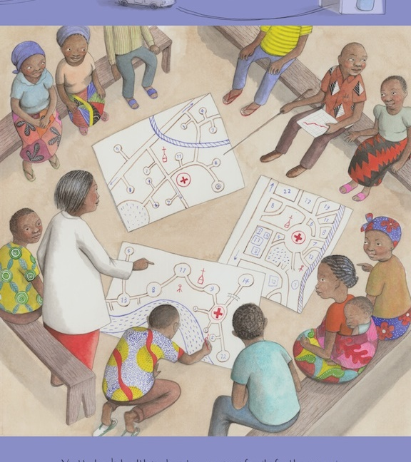
What has been achieved?

Slide 18
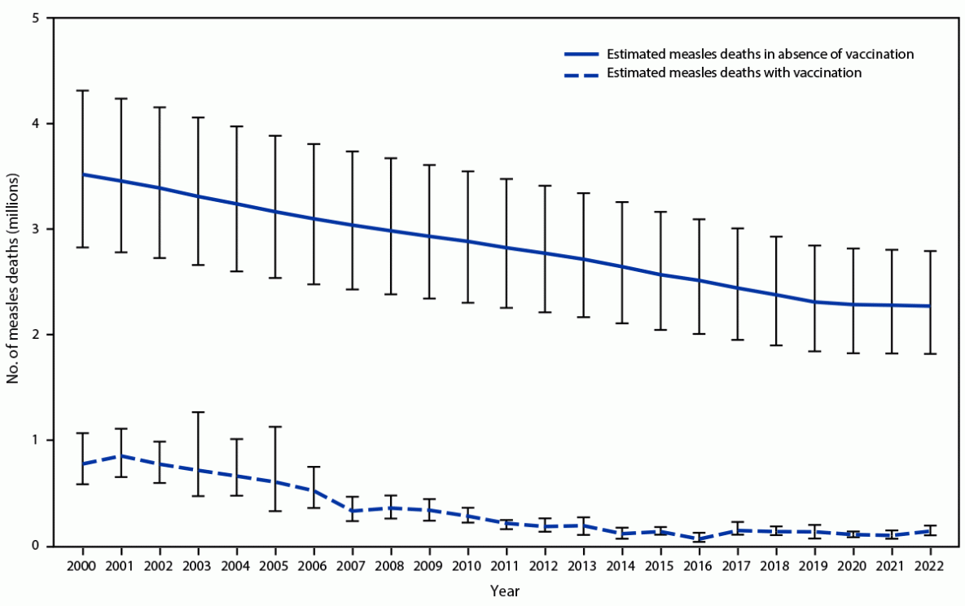
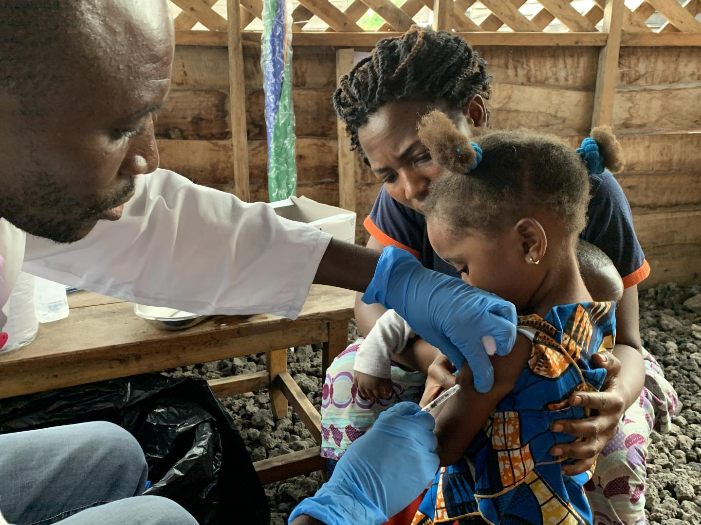
During 2000-2022, Measles vaccination prevented an estimated 57 million deaths worldwide
Source: WHO AFR
* With 95% CIs indicated by error bars.
† Deaths prevented by vaccination are estimated by the area between estimated deaths with vaccination and those without vaccination. A cumulative total of 57 million deaths were estimated to have been prevented by vaccination during 2000–2022.
Minta AA, et al. Progress Toward Measles Elimination - Worldwide, 2000-2022. MMWR Morb Mortal Wkly Rep. 2022 November 17, 2023 / 72(46);1262–1268

Slide 19
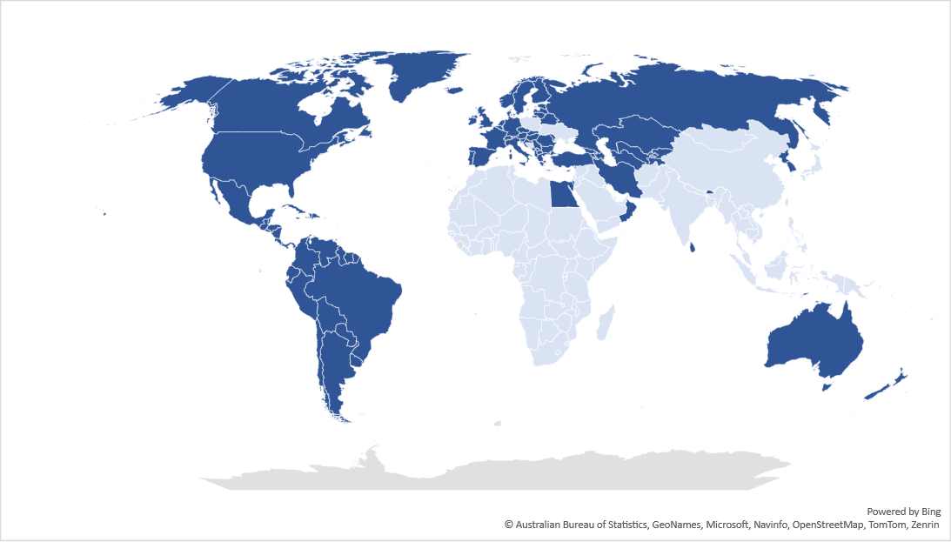
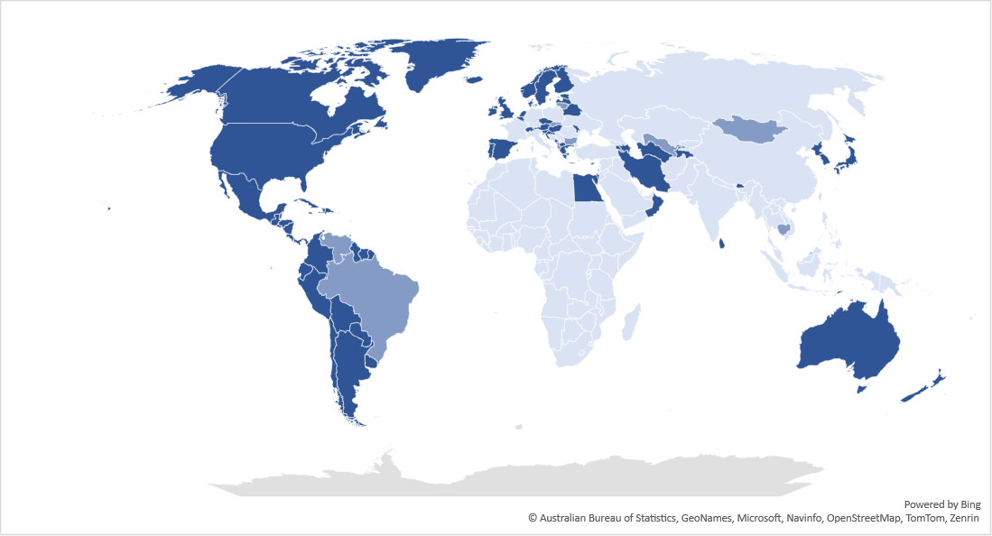
Countries and regions continue to make progress towards measles and rubella elimination
99 (51%) countries verified for rubella elimination
83 (43%) countries verified for measles elimination
Verified Eliminated
Not Verified Eliminated
Reestablished
Maps are not WHO endorsed borders. The evaluation of progress towards measles and/or rubella elimination is based on the most recent report submitted by the National Verification Committee (NVC) and evaluated by the Regional Verification Commission (RVC).
Notes:
Rubella elimination is a pathway to measles elimination
Gavi eligible countries verified eliminated / number of Gavi eligible countries in the WHO Region
Rubella verified eliminated
AFR = (0/37)
AMR = Haiti (1/1)
EMR = (0/6)
EUR = Kyrgyzstan, Tajikistan (2/2)
SEAR = DPR Korea (1/4)
WPR = (0/4)
Measles verified eliminated
AFR = (0/37)
AMR = Haiti (1/1)
EMR = (0/6)
EUR = Tajikistan (1/2)
SEAR = DPR Korea (1/4)
WPR = (0/4)
Note:
WPR = Cambodia – reestablished transmission of measles in 2020 after large measles outbreak lasting more than 12 months
WHO Member States by Regions
AFR = 47 Member States
AMR = 35 Member States
EMR = 21 Member States
EUR = 53 Member States
SEAR = 11 Member States
WPR = 27 Member States
Total = 194 Member States

Slide 20
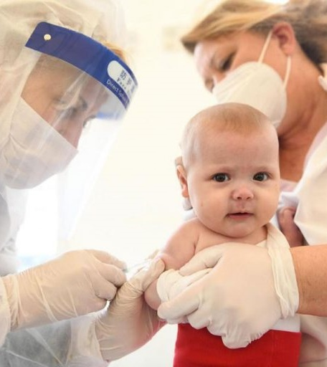
What do we need to do now?

Slide 21
Government policy - multiple levels
Community
Trust, inclusion, social norms resources, gender
Parents
Trust, inclusion, resources, knowledge gender
A child dies from measles
Health system
Accessible, culturally adapted, no financial barriers
Global strategic and funding landscape
Think broadly and deeply
Notes:
We know a lot from other programs about the ingredients for success.
We need to elevate the priority of measles and rubella at every level, from civil society up to the level of global partners
We need to reach out widely to partners and other initiatives including polio

Slide 22
Global strategic and funding landscape

Slide 23
Government policy - multiple levels
Global strategic and funding landscape

Slide 24
Government policy - multiple levels
Health system
Accessible, culturally adapted, no financial barriers
Global strategic and funding landscape

Slide 25
Government policy - multiple levels
Community
Trust, inclusion, social norms resources, gender
Health system
Accessible, culturally adapted, no financial barriers
Global strategic and funding landscape

Slide 26
Government policy - multiple levels
Community
Trust, inclusion, social norms resources, gender
Parents
Trust, inclusion, resources, knowledge gender
Health system
Accessible, culturally adapted, no financial barriers
Global strategic and funding landscape

Slide 27
Government policy - multiple levels
Community
Trust, inclusion, social norms resources, gender
Parents
Trust, inclusion, resources, knowledge gender
A child dies from measles
Health system
Accessible, culturally adapted, no financial barriers
Global strategic and funding landscape

Slide 28
M&RP is working with countries to achieve high quality Supplementary Immunization Activities (SIAs)
High coverage
Timely - right frequency and right timing within the year
Equitable - reaching those unprotected (unvaccinated and not fully vaccinated)
Targeted at the right age-range

Slide 29
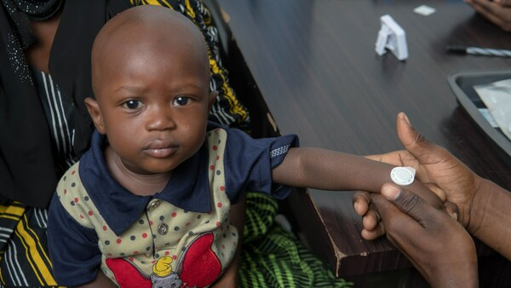
Innovation through Measles Rubella Microarray Patch vaccines (MR-MAPs)
Very promising results, high levels of protection
Potential gamechanger to increase coverage, enable increased integration of campaigns, improve emergency response, reduce medical waste
We need MR-MAPs NOW
https://www.prnewswire.com/news-releases/micron-biomedical-announces-positive-measles-and-rubella-vaccination-results-from-first-clinical-trial-of-microarray-injection-free-vaccine-delivery-in-children-301826746.html

Slide 30
Current state
SEVERE: Measles and rubella viruses cause devastating disease
INEQUITABLE: The impact of measles and rubella on children is deeply unfair, landing on those who face the most challenges
WORRYING: 2024 looks like it will be a very difficult year
WE’VE LEARNT A LOT: From smallpox, polio, health systems research, listening to communities… so much
HOPEFUL: We know what to do to prevent measles and rubella

Slide 31
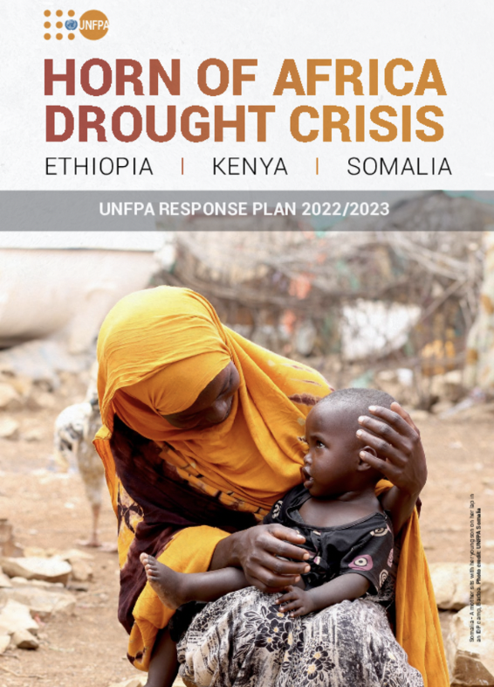
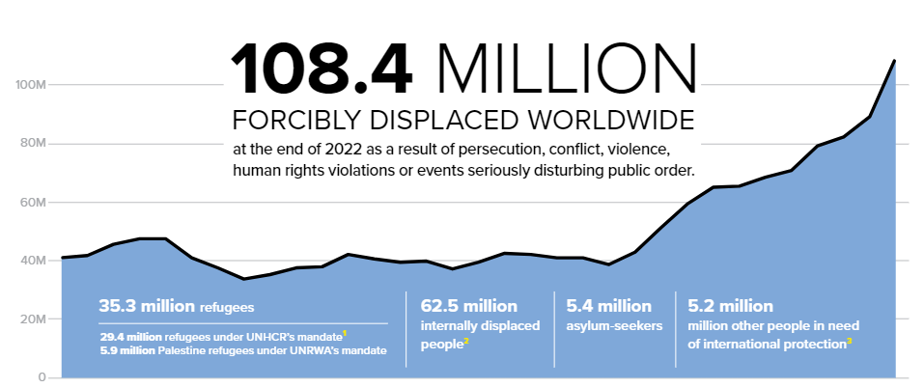
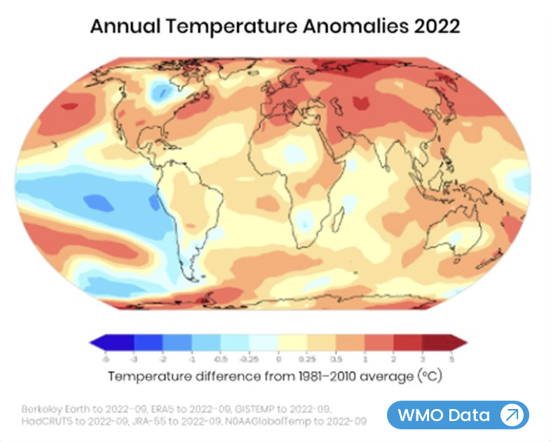
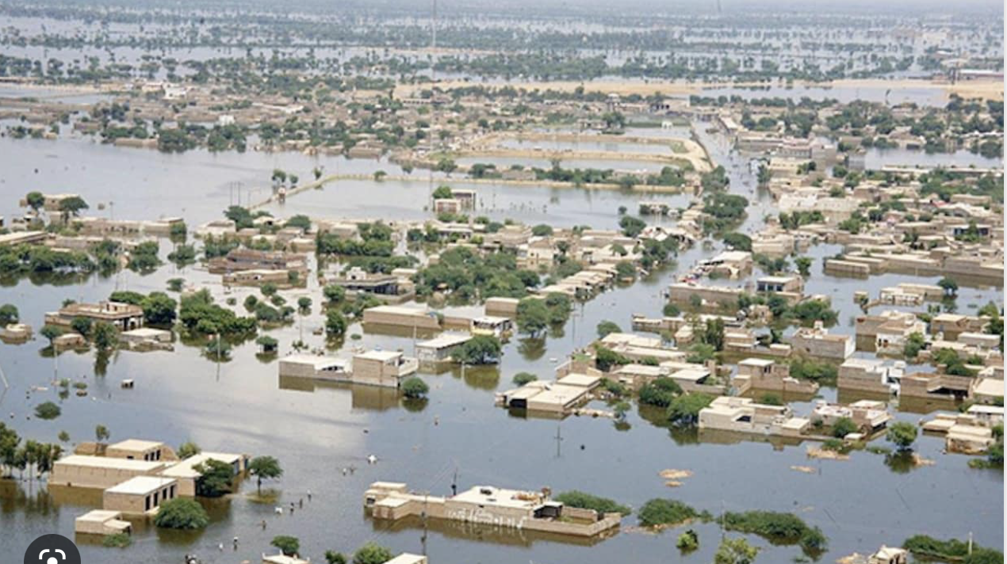
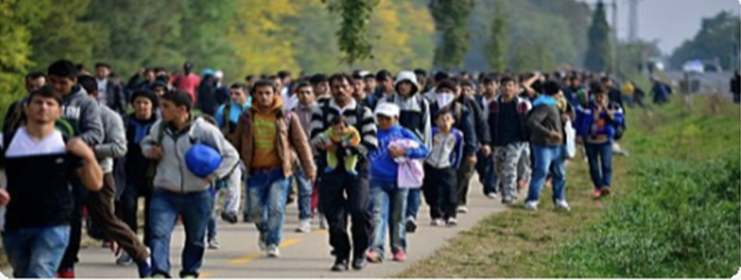
Measles is a crisis among many crises
Food, energy, war, economic, climate, natural, humanitarian
~45% of measles outbreaks are in conflict and fragile affected countries, making measles prevention and response more challenging
https://www.unhcr.org/global-trends-report-2022
Notes:
Making the anticipation more challenging

Slide 32
Conclusions: countries need both urgent and sustainable solutions
RESPOND NOW TO SAVE LIVES: Intense efforts needed to reach missed children
ADVOCATE: Prioritize Measles and rubella
FINISH THE JOB: Every child should have access to measles & rubella vaccines
INNOVATE: Better data, applied research
ALIGN AND ACT: Together we are stronger
Percentage of measles deaths per region

Slide 33
Thank you!

