Slide 1
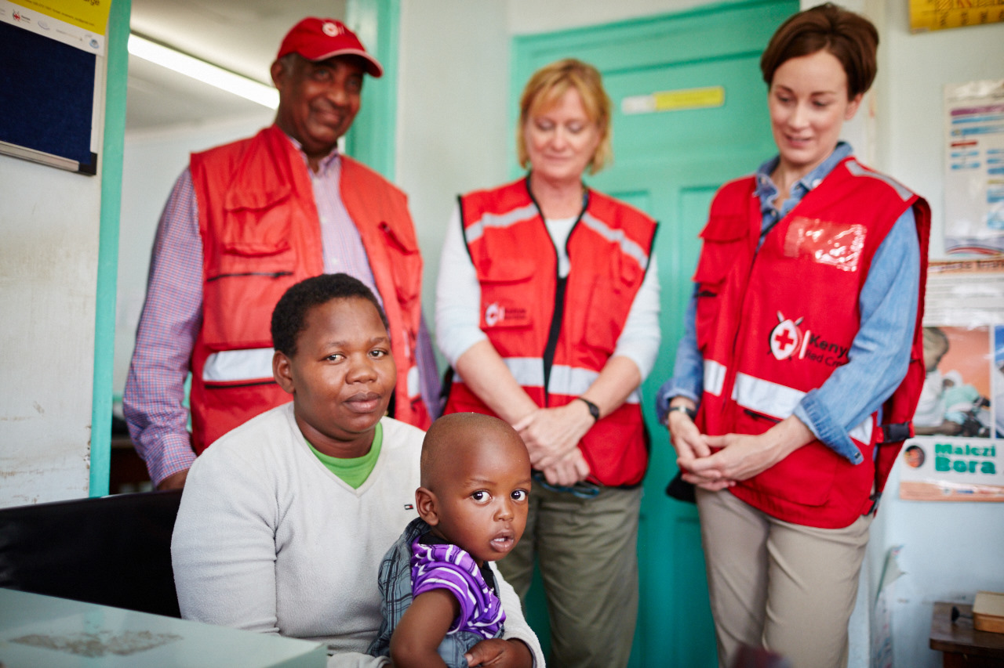
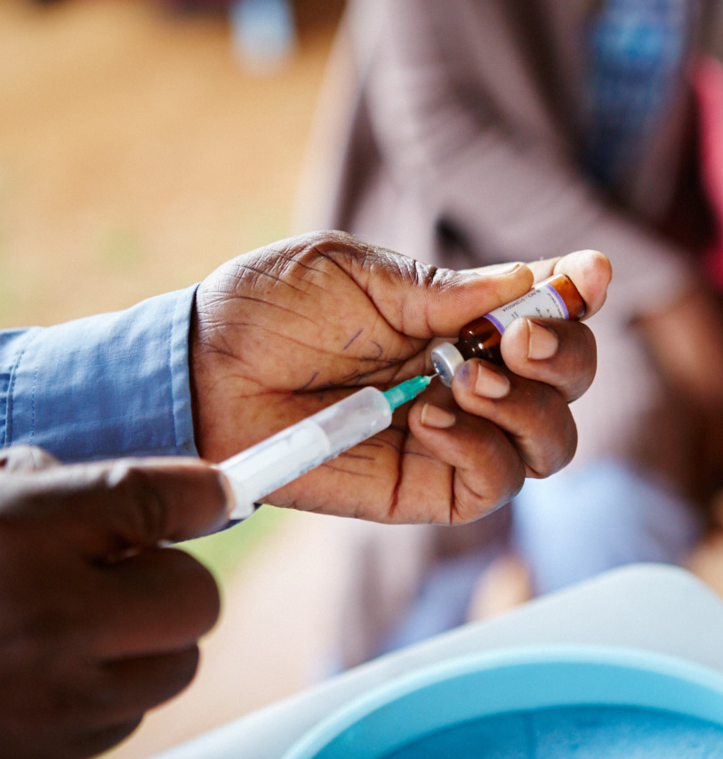
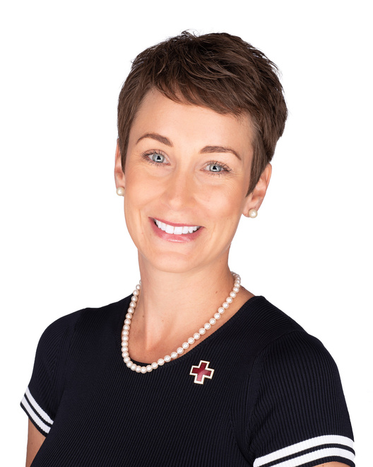
Social Mobilization
& How Communities Make
IMPACT
Measles & Rubella Partnership
American Red Cross 2024
Sara Horein
Notes:
Hi, everyone! Thanks so much for joining me this afternoon. I know that there are a lot of great sessions and speakers happening today, so I’m grateful that you chose to spend some time with me.
I hope to make this session on Social Mobilization & How Communities Make Impact as light-hearted and informative as possible, so that when you leave here today, you'll feel confident when answering these TWO questions through the lens of the Measles & Rubella Partnership:
How does the Red Cross use Social Mobilization?
How do local communities make Impact?
Before I help answer our questions, let me start by introducing myself!

Slide 2
Sara Horein
Independent Monitor
American Red Cross Volunteer
Notes:
First, let me start out with who I am not. I am not a President or CEO. I am not a PHD or Scientist. I am not a Professor or Scholar.
I am a Community Member. I am a Volunteer. I am a humanitarian. I am a Red Crosser.
My name is Sara Horein, and through the American Red Cross I serve as an independent monitor for the Measles and Rubella Partnership. I've been a volunteer leader with the Red Cross for more than 12 years now, and before coming here I was in marketing and communications. Between the two, I've had to do and teach a lot about storytelling and communications, which I love. So I'm really glad to be here today to share more.

Slide 3
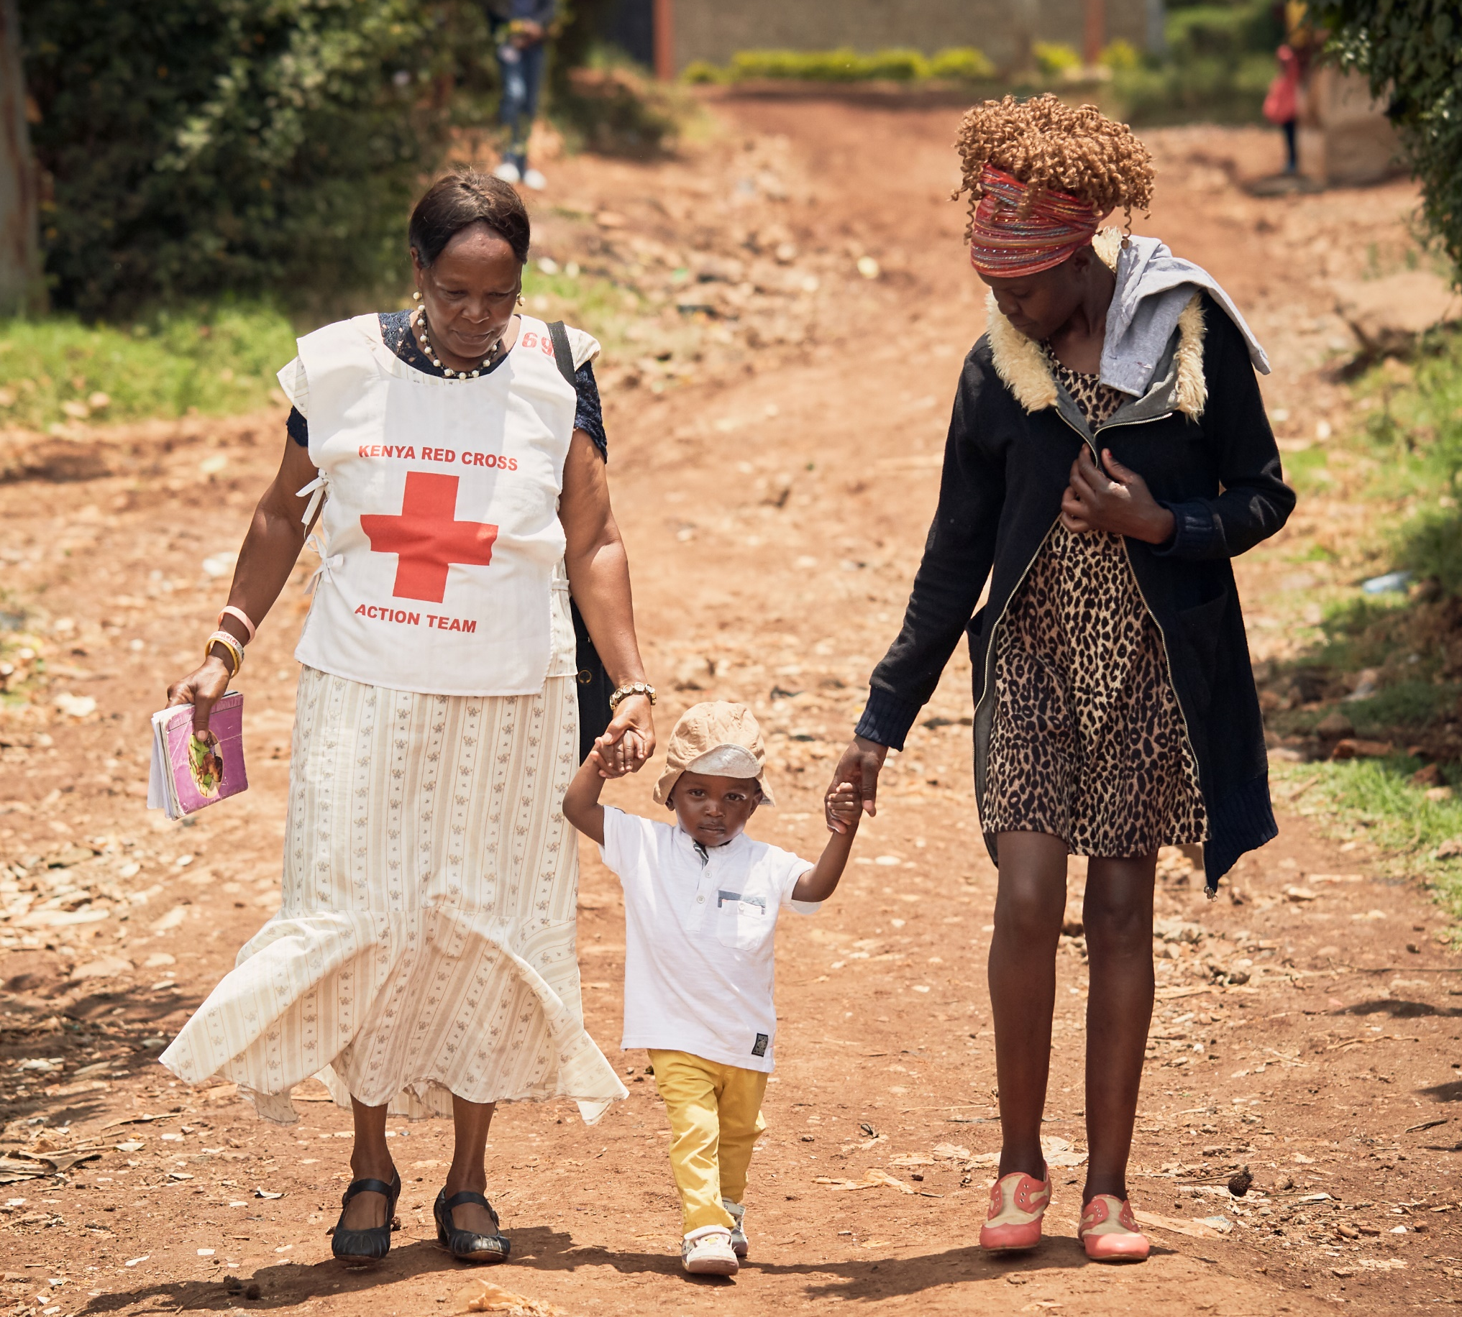
What is the GOAL of Social Mobilization?
To provide:
Key messages about vaccines
Access in the local community
Advocacy
Increase demand for vaccines
And much more
2
Notes:
In order for us to answer our TWO questions of the day:
1. How does the Red Cross use Social Mobilization?
2. How do local communities make Impact?
We must understand the GOAL of Social Mobilization.
The goal of social mobilization is to provide increase demand for vaccines at the community level. This tends to be a much easier task in communities that have seen firsthand how deadly measles and rubella can be.
When volunteers go house to house they are primarily presenting key messages developed by the Ministries of Health about the vaccination campaign.
Volunteers are able to advocate and overcome vaccine hesitancy because they are trusted members of the community who speak the local language and know the local customs. Caregivers recognize that the volunteers have the community's best interests at heart.
Let’s take a pause to look at this photo. What do you see?
I see a mother holding her child’s hand.
I see a Kenya Red Cross volunteer holding the other side of the child’s hand.
I see a purple vaccination booklet in the volunteer’s hand.
I see trust. I see advocacy. I see social mobilization.

Slide 4
Mobilization of Volunteers
Direct Campaign Support
Advocacy
Education
Access to Volunteer Networks
Encouragement to Caregivers
Training of Volunteers
Contribution of Funds
Trusted Community Members
Social Mobilization
Role of the American Red Cross.
Notes:
As a Red Cross Movement, we are focused on supporting the work of the Red Cross Red Crescent National Societies in the most fragile countries and settings.
As Marian reminded us yesterday the International Red Cross and Red Crescent Movement was born out of a desire to bring assistance without discrimination to the wounded on the battlefield.
Our principles include impartiality and humanity.
We are thus committed to ensuring that all children receive vaccinations – including vulnerable populations and those in conflicted areas.
Through the Red Cross Movement the American Red Cross is able to provide access to volunteer networks around the globe.
These volunteers are recruited directly from the communities they are serving and come with a built-in level of trust that makes the messages they are providing to their neighbors more readily accepted.
Red Cross volunteers educate communities by going house to house and by using other social mobilization techniques such as megaphones and sound trucks to share messages on when and where vaccinations can be received, why vaccines are important to a child’s health, and answer any questions that a caregiver may have.
As one of the founding partners of the Measles & Rubella Partnership the American Red Cross has provided support in a number of areas to help achieve the partnership’s goal of eliminating measles and rubella.
Since 2001 the American Red Cross has directly supported 145 vaccination campaigns in 47 countries.

Slide 5
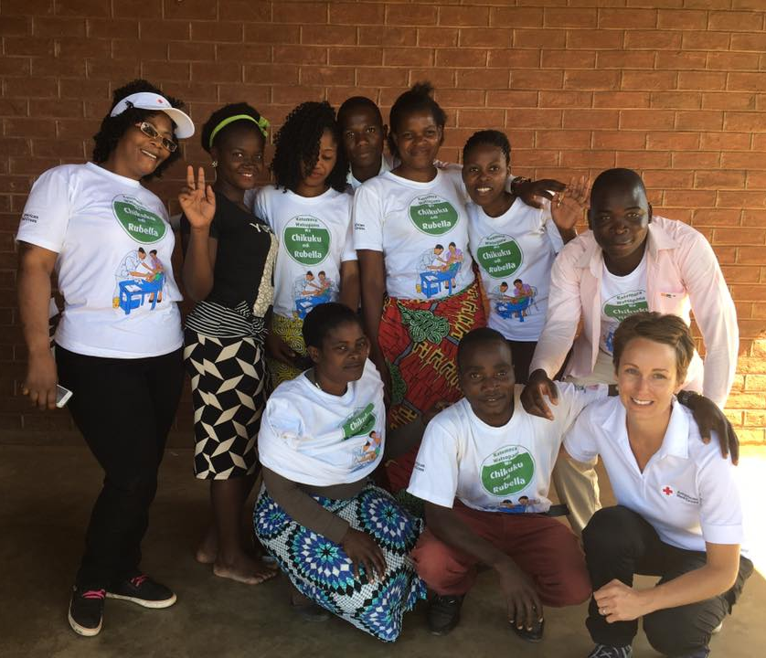
Notes:
So, who are Red Cross volunteers?
They are community members.
Using the t-shirt as a walking billboard versus posters.
2017 trip to Malawi where the government —supported by the American Red Cross and our partners in the fight to eliminate measles—completed a successful five-day vaccination campaign in the East African country. I volunteered in Malawi as Independent Monitors for the Measles and Rubella Partnership. My main role was to identify missed children and report problem areas in real time. Targeting 7.9 million children between 9 months to 15 years (46% of population) in five days was a huge undertaking given the economic struggles of this country.
The seemingly impossible feat of reaching 7.9 million children in just five days is only achievable through dedicated Red Cross volunteers. The success of any campaign relies on mobilizing parents and caregivers to bring their children to vaccination centers, and Red Cross volunteers are ideally located and well equipped to carry out this vital task. They speak the local language, know community members and understand local customs.

Slide 6
Ethiopia 2022
Notes:
I want us to take a quick look at a case study from a 2022 Campaign in Ethiopia.

Slide 7
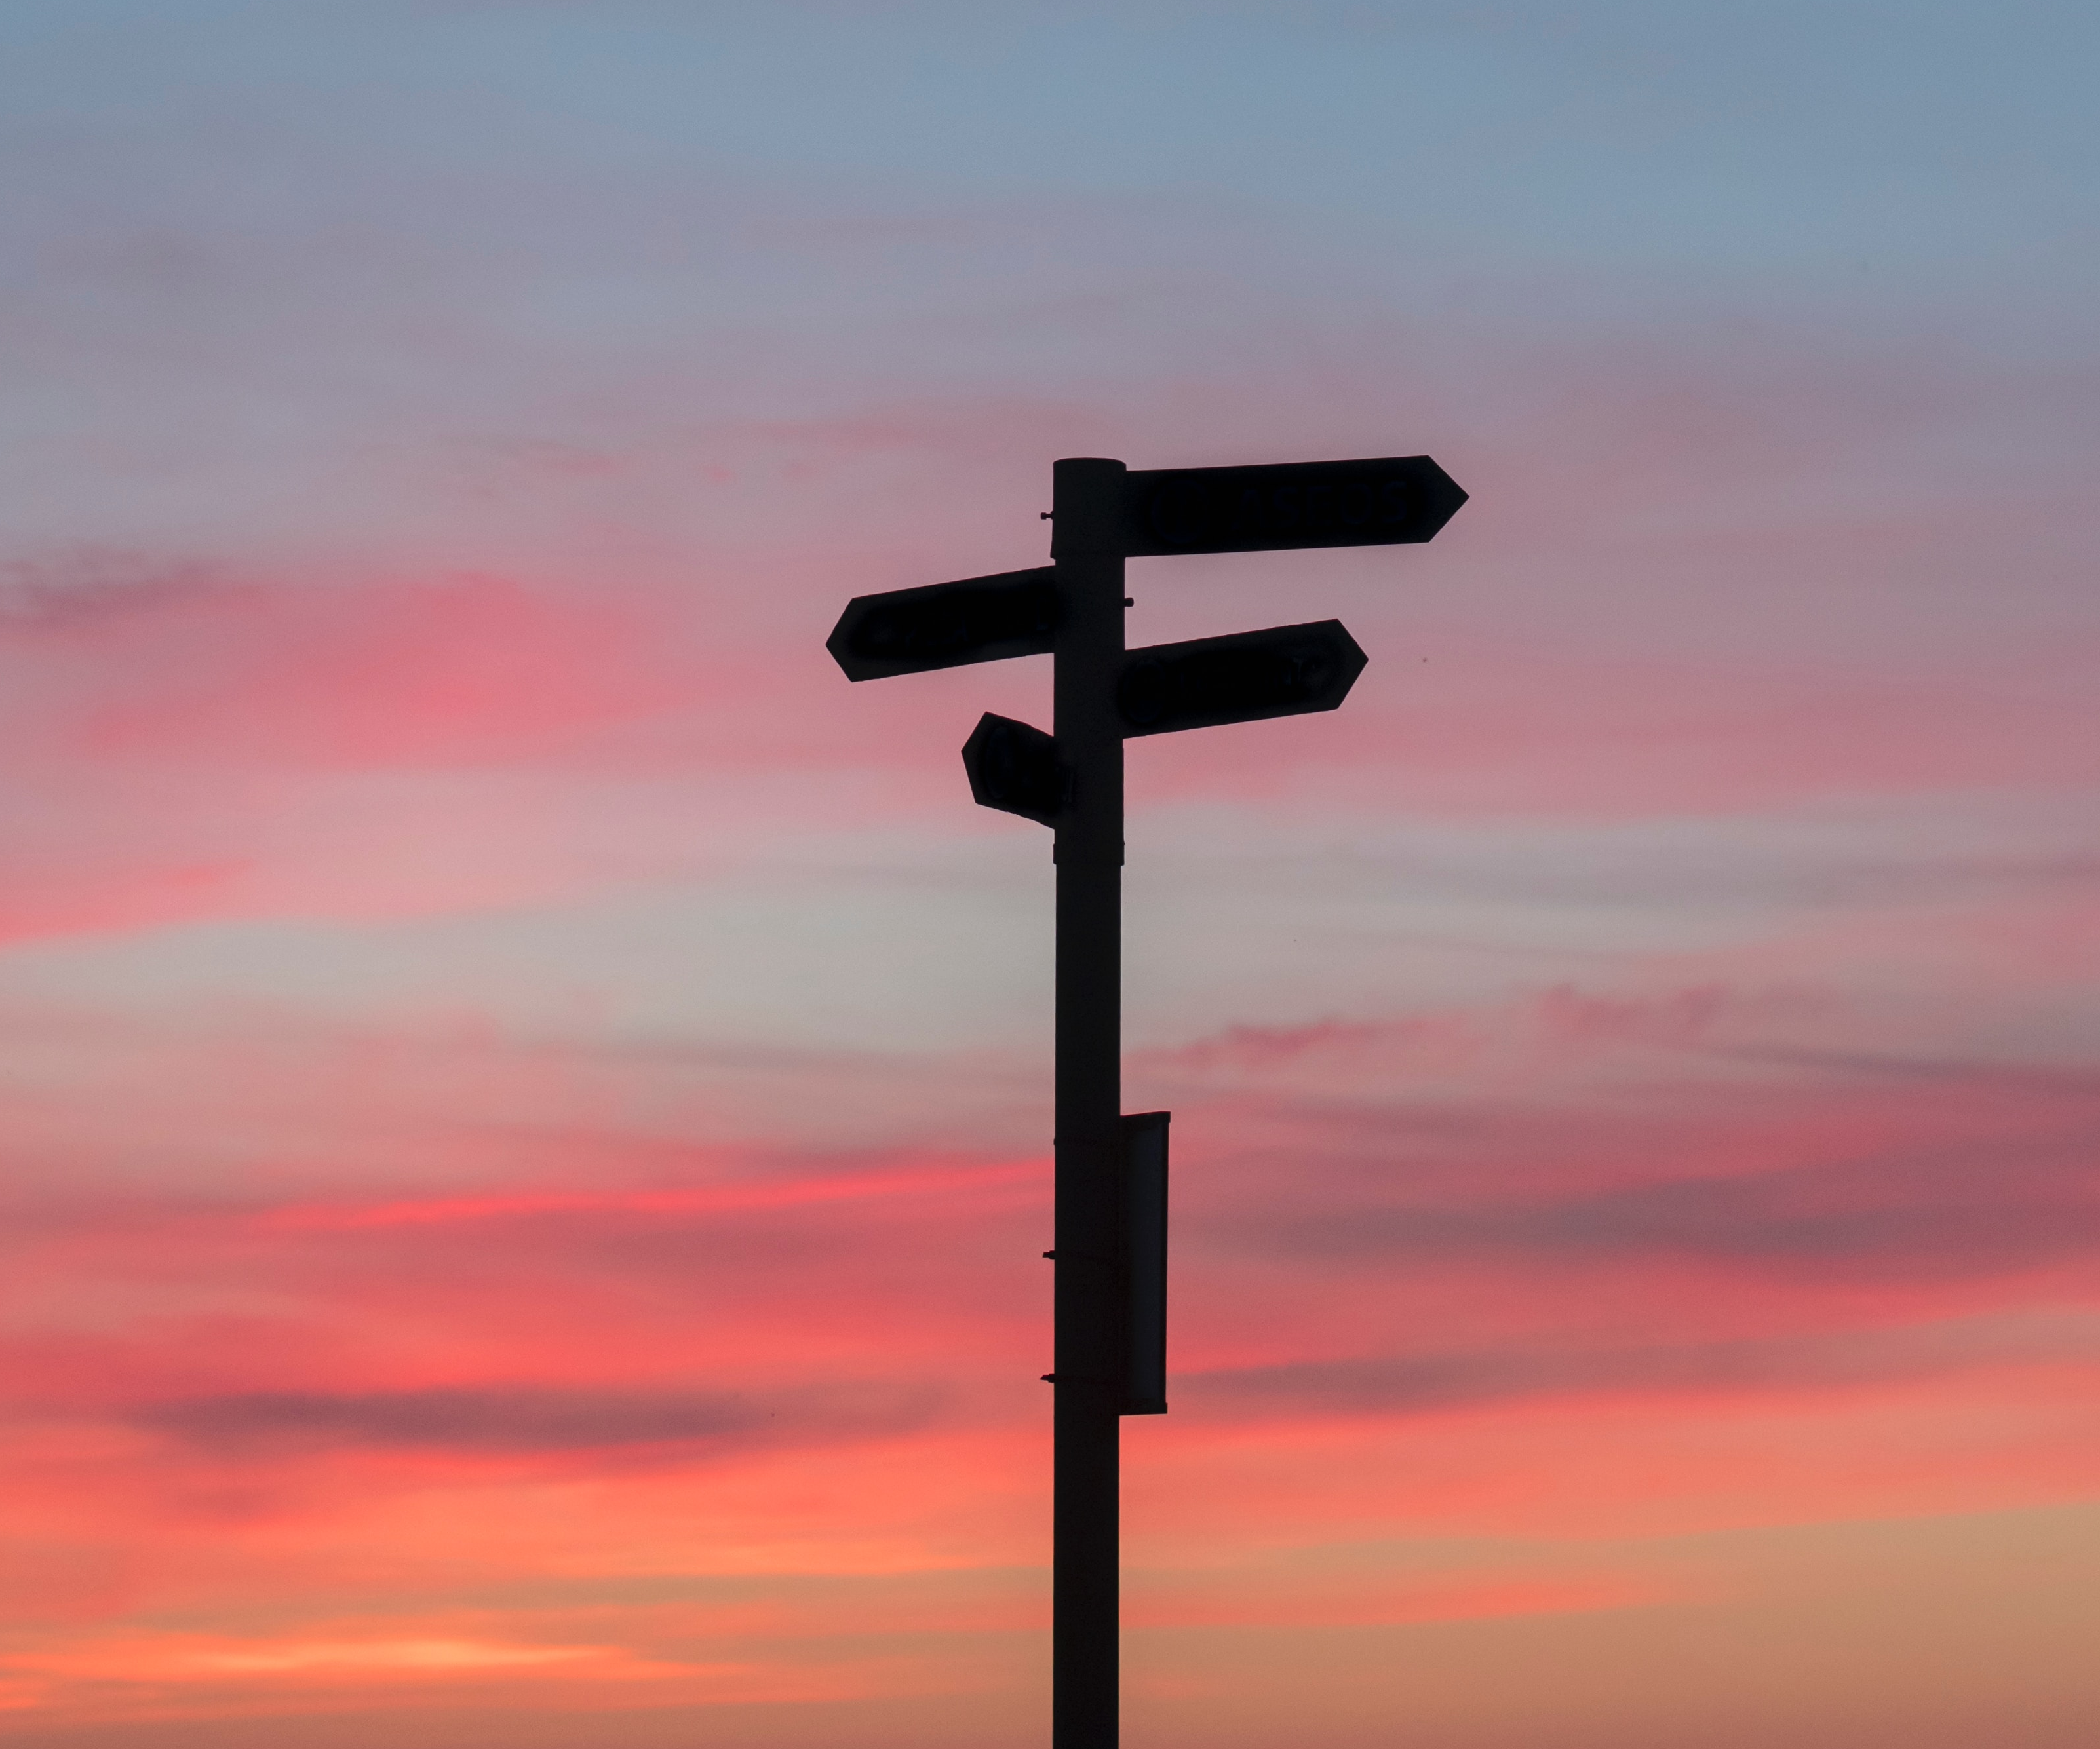
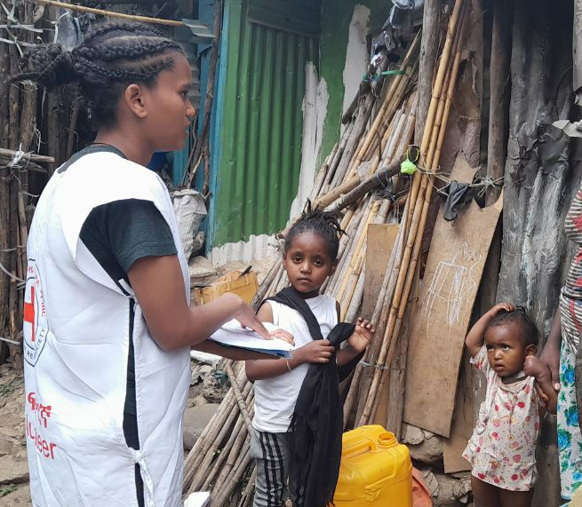
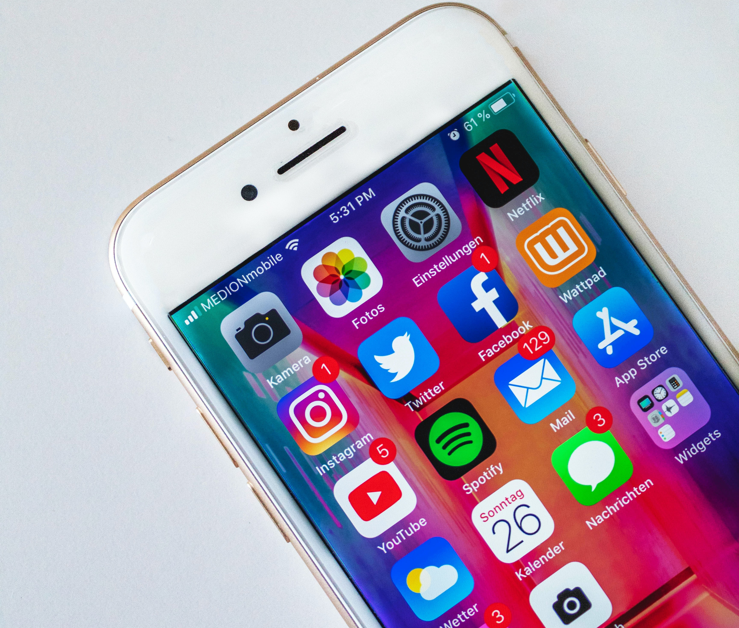
IMPACT
2,310
volunteers
mobilized
515,581 successfully vaccinated
Notes:
During the 2022 Ethiopia campaign, which was one of the first to be conducted during the pandemic, we mobilized 2,310 volunteers in Addis Ababa who reached 835,871 households and in the RC supported areas 515,581 were successfully vaccinated. The campaign was for 10 days and targeted children from 9 months to 5 years old
This was near the start of the pandemic where there was a lot of fear around COVID infections and skepticism of vaccines.
Having the RC volunteers so heavily engaged in reaching community members went a long way to addressing those fears. In fact following the campaign UNICEF specifically called out the Red Cross' work as a major contributor to its overall success.
6

Slide 8
Vaccination Campaign Support
2012-2023

Slide 9
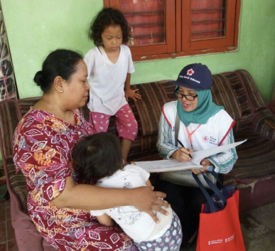
IMPACT
American Red Cross
Since 2012 we have partnered with
Red Cross / Red Crescent National Societies to:
Support 65 vaccination campaigns
Train 90,174 Red Cross volunteers in
social mobilization techniques
Visit 24,081,256 households
Support the vaccination of 40,290,541 children
Notes:
Since 2012 we have partnered with Red Cross/Red Crescent national societies to:
1. Support 65 vaccination campaigns (Supplemental Immunization Activities (SIA), routine immunization strengthening, outbreak response)
2. Trained 90,174 Red Cross volunteers in social mobilization techniques
3. Visited 24,081,256 households to provide information and encouragement to caregivers to have their children vaccinated.
3. Supported the vaccination of 40,290,541 children in Red Cross supported areas.
8

Slide 10
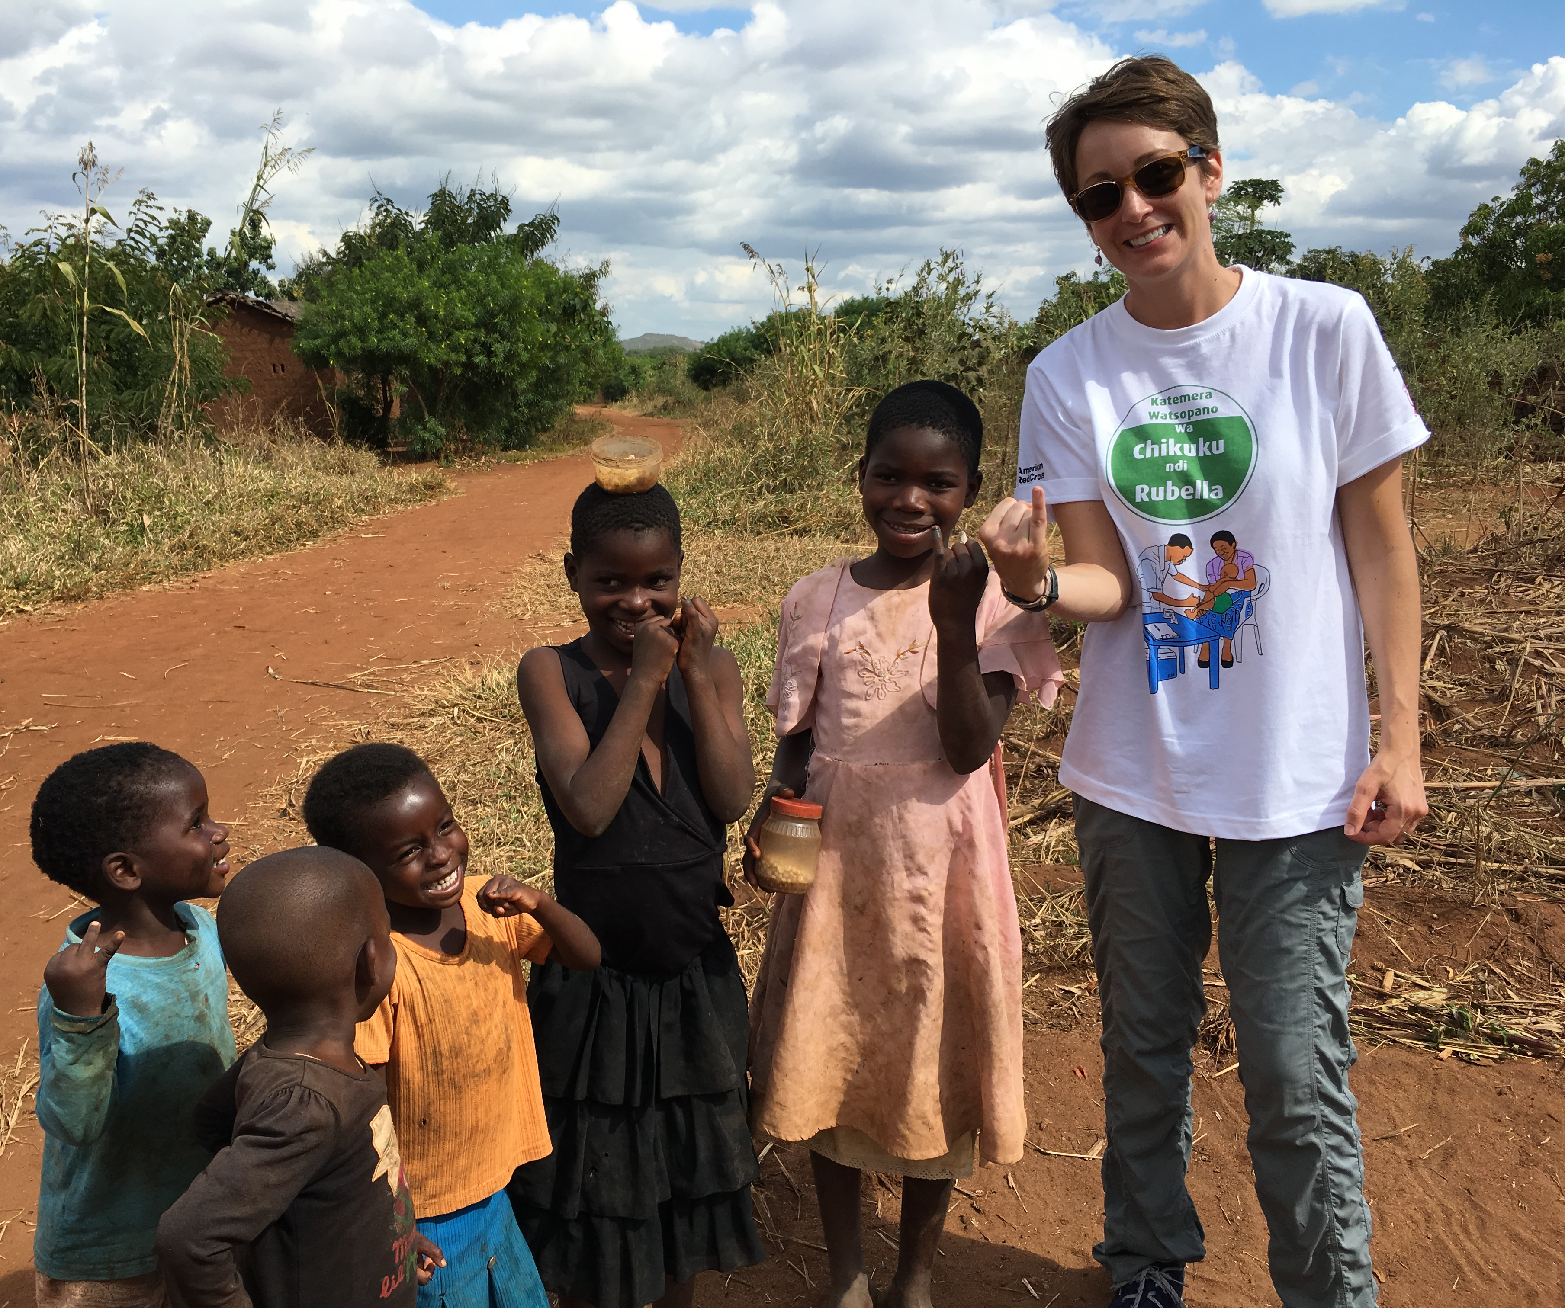
Notes:
MY TWO questions through the lens of the Measles & Rubella Partnership:
How does the Red Cross use Social Mobilization?
How do local communities make Impact?
The Red Cross uses Social Mobilization to educate communities by going house to house and by using techniques such as megaphones and sound trucks to share messages on when and where vaccinations can be received, why vaccines are important to a child’s health, and answer any questions that a caregiver may have.
Communities make an impact by providing local volunteers who know the local language and customs to advocate that all children receive vaccines – even the most marginalized and vulnerable.
These community level partnerships are of paramount importance in ensuring we reach all children with vaccinations.

Slide 11
Notes:
Thank you again for letting me join and talk about the social mobilization and how communities make impact. I look forward to answering questions or taking a deeper dive into any of these topics during the panel Q & A immediately follow this presentation.

