Slide 1
Gavi-UNICEF joint session: Using Immunisation to strengthen PHC
Washington, MR Partners’ meeting, 7th March 2024
Co-Chaired by Rie Takesue (UNICEF, Health Specialist, Health Systems Strengthening) and Jalaa’ Abdelwahab (Gavi, Director of Vaccine Programmes)
Panelists:
• Sanjay Bhardwaj (UNICEF, Health Specialist)
• Aidan O’Leary (WHO, Director of Polio Eradication)
• Emma Lebo (CDC, Medical Epidemiologist)
• Lucas Barrows-Townsend (Acasus, Project Manager)
• Lora Shimp (John Snow, Inc., Director, Immunization Center)
• Gladwin Muchena (Gavi, Senior Manager, HSIS)
• Chris Wolff (BMGF, Deputy Director, Vaccine Service Delivery Platforms)
Notes:
Primary Health Care is a strategic priority under the Immunisation Agenda 2030 and immunisation is a vital component of PHC. A robust immunisation programme offers opportunities to strengthen PHC by interacting with multiple health system levers - such as integrated campaigns can encourage multi-sectoral coordination of various health interventions (antigens like polio, YF and non-immunisation interventions such as vitamin A, deworming, bed nets). In turn, a strong PHC platform can support and improve the uptake of vaccines across the life course. This session will be discussing the link between immunisation (using MR programme as example) as a lever to strengthen PHC – challenges and opportunities.

Slide 2
Outline
09:00-09:30 Intro and presentations (Rie Takesue, UNICEF / Jalaa’ Abdelwahab, Gavi)
UNICEF broader support to PHC
Brief introduction to PHC and integration of services, UNICEF support to PHC
Opportunities and challenges for PHC to strengthen immunisation.
Outline of Gavi support to immunisation
Gavi overview and MR programme support
Gavi support and link to HSS+PHC
Health campaign effectiveness : Opportunity for strengthening PHC
Steps ahead
09:30-09:45 Q&A
09:45-11:00 Panel discussion (moderator: Jalaa’ Abdelwahab)
Notes:
Primary Health Care is a strategic priority under the Immunisation Agenda 2030 and immunisation is a vital component of PHC. A robust immunisation programme offers opportunities to strengthen PHC by interacting with multiple health system levers - such as integrated campaigns can encourage multi-sectoral coordination of various health interventions (antigens like polio, YF and non-immunisation interventions such as vitamin A, deworming, bed nets). In turn, a strong PHC platform can support and improve the uptake of vaccines across the life course. This session will be discussing the link between immunisation (using MR programme as example) as a lever to strengthen PHC – challenges and opportunities.

Slide 3
Achieving SDG3 with UHC through strengthening PHC

Slide 4
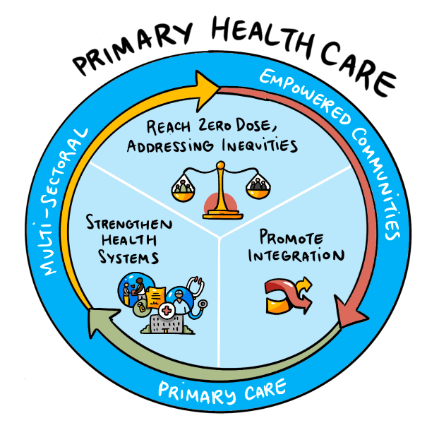
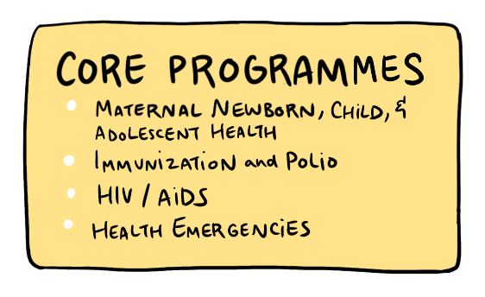
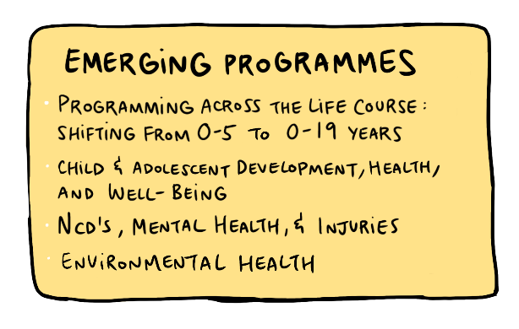
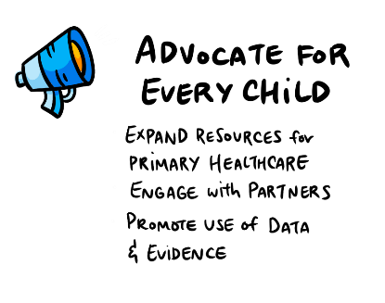
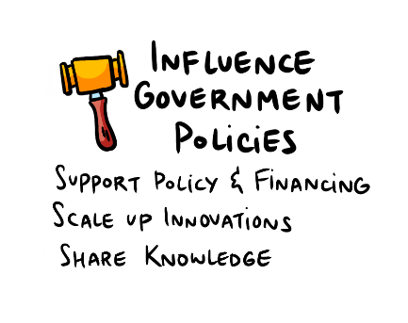
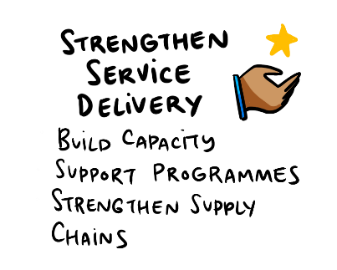
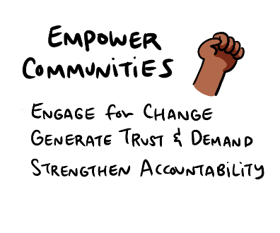

Slide 5
Operational framework for primary health care
Source: World Health Organization & United Nations Children's Fund (‎UNICEF)‎. (‎2020)‎. Operational framework for primary health care: transforming vision into action. World Health Organization. https://apps.who.int/iris/handle/10665/337641. License: CC BY-NC-SA 3.0 IGO

Slide 6
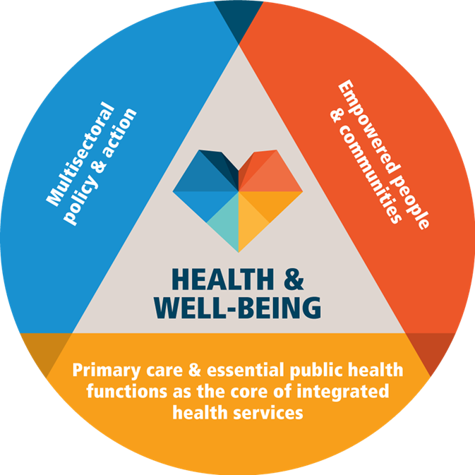
UHC by strengthening PHC, and health systems
Primary health care, as defined for Astana, 2018
UNICEF: multi – sectoral for change for children
UNICEF: sub national presence for technical PHC in district hospitals, health centers and community health workers to reduce child mortality
Food Systems
Child Protection
WASH
Community Engagement / Systems
Social Accountability
Education System
Social Protection
UNICEF/WHO Primary Health Care Operational Framework and PHC Results Indicators – global leadership
Supported by HSS at national, sub-national and community levels in the seven areas below
Supply Chain Management
Quality of Care
Data and Digital Health
Governance, Management and Partnerships
Private health services and systems support
National and sub-national financing
Health Workforce

Slide 7
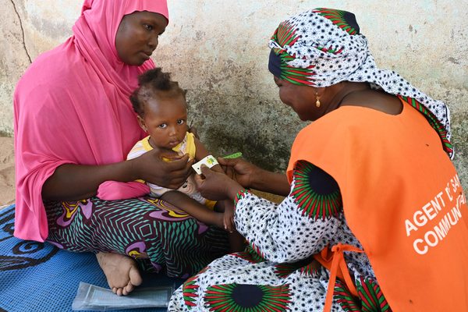
Community Health Delivery Partnership – for accelerated and coordinated action
Objective: To improve high-quality, equitable access to essential health and nutrition services at the community level and build health system resilience for greater global health security -and thereby reduce preventable morbidity and mortality
Approach
Coordination
One Budget
One Plan
One Implementation
Builds off an existing partnership mechanism, the Community Health Roadmap.
Expands the coalition for community health & nutrition to galvanize action and impact in countries.
Responds to the needs of countries that seek additional and more targeted support.
It is a flexible, agile, and responsive partnership mechanism that addresses technical assistance and financial needs of countries.
Notes:
CHDP, launched in Oct 2023 by UNICEF, WHO, World Bank, and USAID, aims to strengthen community health systems by formalizing and supporting community health workers.
The partnership focuses on enhancing the delivery of primary healthcare at the community level, emphasizing the importance of sustainable models for community health worker programs.
CHDP initiatives include developing a theory of change, aligning with global health priorities, and fostering regional collaborations to adapt strategies to local needs.

Slide 8
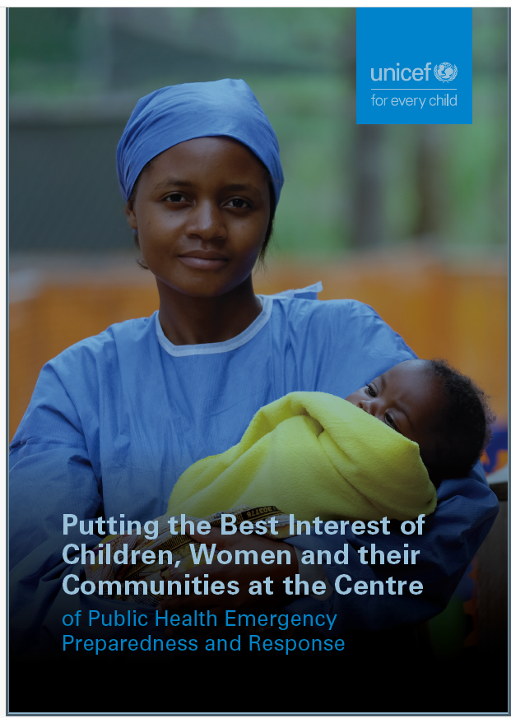
Health Emergencies Preparedness and Response
Policy, Partnerships and Financing
UNICEF emphases and contributes to a whole-of-society, whole of government approach to address health emergencies, including future pandemics.
Pandemic Agreement: working with member states to emphasize multi-sectoral perspective placing children, gender and communities at the center
WHO/WHE Partnership MOU on the HEPR 5 “Cs”: UNICEF offers co-leadership in community protection (community engagement) and counter-measures (supplies) while strengthening community PHC workforce for scalable care, collaborative surveillance and coordination.
Pandemic Fund: UNICEF is a co-implementing entity in 8 Pandemic Fund Proposals; UNICEF observer on the Board; Working closely across UN system and other entities to synergize action
Areas of specific expertise include:
Community engagement, social and behaviour change
Rapid support to Immunisation measles and rubella campaigns and integrated child health days
Access to live-saving commodities and materials
Electronic Medical Record for birth registration and immunization (1 tablet instead of 14)
“Live” Ongoing Responses to current Acute Health Emergencies
Measles and rubella outbreaks
Gaza and Sudan: support to continued health services and prevention of outbreaks
Schedule follow-up discussion with donors on Humanitarian Nexus
Notes:
Pandemic Fund: Yemen, Burkina Faso, Nepal, Ethiopia, Togo, Paraguay, Mongolia, West bank/Gaza

Slide 9
What do we mean by integrated PHC?
Sustainable integration cuts across multiple levels; Focusing on clinical integration alone is insufficient
Rainbow Model for Integrated Primary Care*
Normative integration
Systems Integration: structures and processes
Organisational Integration: production and delivery
Professional Integration: Partnerships between professionals, within and between orgs
Clinical Integration: person-centred perspective, coordinated care
Functional integration
Functional integration through common investments: Health Management Information Systems, HRH, supply, planning, financial management, Quality of Care
Population based care
Person-focused care
Macro level Miso Level Micro Level
How do we move along the continuum: Fragmentation Linkage Coordination Full Integration
Ref: Neill et al 2023
Valentijn et al 2013
Notes:
Many definitions of integration exist. Generally, it is important to look at it across different axes such as the levels presented here.

Slide 10
What are the Barriers to Integrated Primary Health Care?
Solution: Primary Health Care Networks
Notes:
Barriers: Inadequate number of health workers, financing streams, inadequate supply of essential medicines, nutrition commodities and vaccines, lack of policies and guidelines, poor supervision and monitoring and evaluation.
Joint HIV Evaluation of Integrated care UNAIDS 2023, also emphasized
the importance of integrated primary health care to improve conceptual clarity (recommendation 1), and integrated governance with national plans and teams (recommendation 2,3,4), to address some of the barriers.

Slide 11
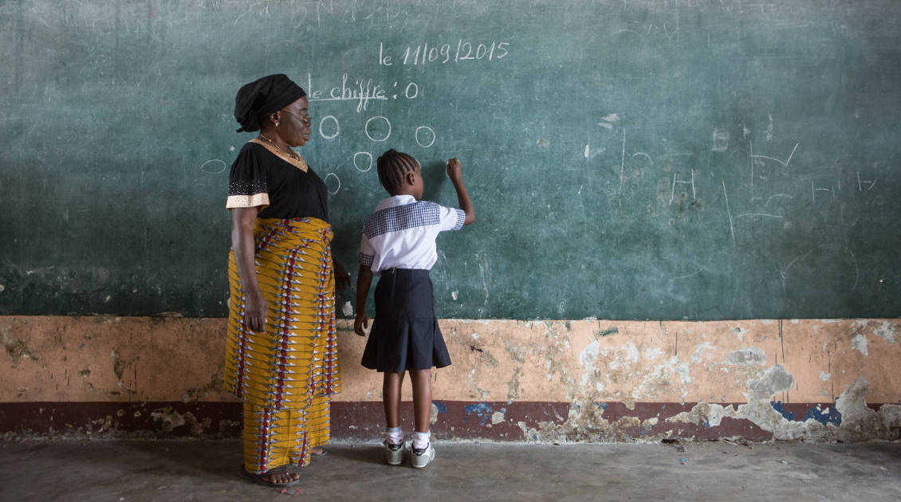
Steps Ahead
Select integration level – professional, organizational and systems, as well as clinical
Build strategic partnerships for complementarity
Invest on integrated data, technology and capacity building

Slide 12
Outline – Gavi presentation
Gavi overview and MR programme support
Gavi support and link to HSS+PHC
Health campaign effectiveness : Opportunity for strengthening PHC
Steps ahead

Slide 13
Gavi support to M&R

Slide 14
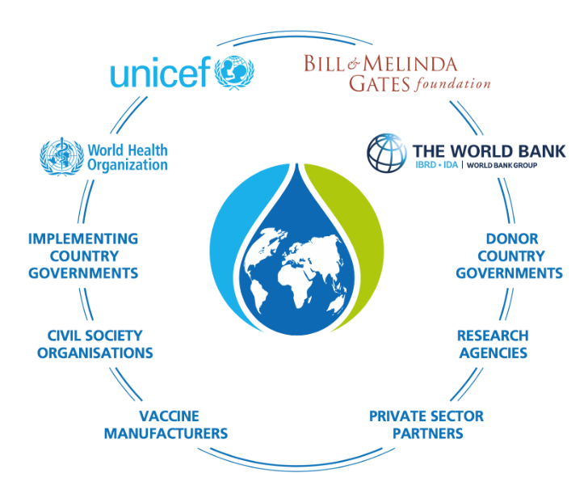
Gavi, the Vaccine Alliance and the Gavi Secretariat
The Alliance is a public-private partnership bringing the key stakeholders in global immunisation together around one mission; Gavi combines the technical expertise of the development community with the business know-how of the private sector.
The Secretariat is responsible for day-to-day operations of the Alliance; it has offices in Geneva and Washington DC. It is led by CEO a.i. David Marlow with Dr Sania Mishtar joining later in March 2024.
Notes:
Gavi, the Vaccine Alliance is a public-private partnership that helps vaccinate half the world’s children against some of the world’s deadliest diseases. The Vaccine Alliance brings together developing country and donor governments, the World Health Organization, UNICEF, the World Bank, the vaccine industry, technical agencies, civil society, the Bill & Melinda Gates Foundation and other private sector partners.

Slide 15
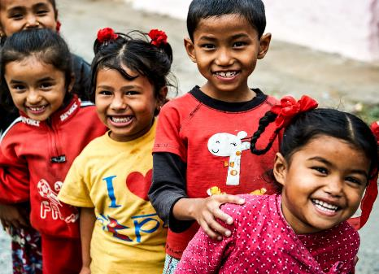
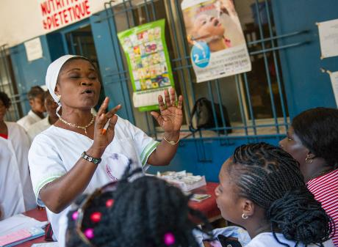
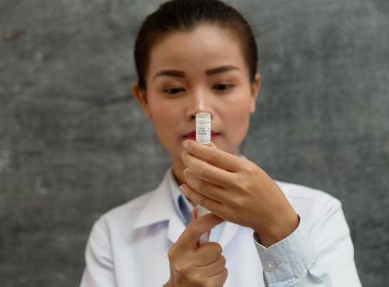
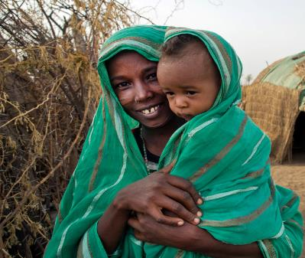
Gavi’s mission: equity is the answer
TO SAVE LIVES
AND PROTECT PEOPLE’S HEALTH
BY INCREASING EQUITABLE AND SUSTAINABLE USE OF VACCINES
Gavi support for routine immunisation in 2000 started with 78 lower-income countries By 2024 number of countries eligible for Gavi support: 54 lower-income countries
Notes:
Gavi support for routine immunisation in 2000: 78 lower-income countries Eligible for Gavi support in 2021–2025: 57 lower-income countries (54 countries in 2023)
COVAX support for COVID-19 immunisation since 2021: 146 countries (87 lower-income countries)

Slide 16
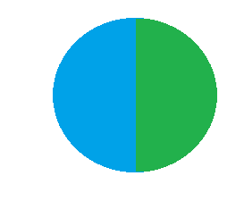
Gavi supported vaccine programmes, VIS 2024 considerations and vaccine delivery platforms
Pregnant people
Newborn
Infant
(<12 months)
2nd year of life (13-23 month)
Older children (2-8 years)
Adolescent (9-14 years)
Adults
Older people
Health workers
Existing portfolio
Routine vaccines
JE, Men A**,
PCV**, Penta, IPV** M*/MR*,**, MCV1, RV,
TCV**, YF**, Malaria
MCV2
Men A, MR, Malaria, OCV***
HPV**
Emergency
Stockpiles
[Multivalent Men, M/MR, OCV, YF, COVID-19, Ebola]†
VIS 2018
VIS 2024
RSV
Hep B BD
Hexavalent MMCV
(in progress)
Shigella
Td Booster
Shigella
TB
Dengue
TB
Dengue COVID-19
COVID-19
Others
RSV
GBS
COVID-19
Others
Hexavalent MMCV
(in progress)
DTwP Booster
Td Booster
TB
Dengue
Emergency
Stockpiles
Hepatitis E, M-pox & Chikungunya, Rabies PEP
*supported for periodic follow up. **supported with one-time catch ups beyond infancy ***mass preventive campaign.
†not all appropriate for new-borns & infants.
Notes:
Most existing GAVI Vaccine protfolios are focused on first and second year of life, aside from HPV and emergency stockpiles
However all the new programmes require new partnerships, new touchpoints and new stages in life as you can see in lower line
Mostly corresponds to school entry; In theory, Gavi is supporting MCV2 at school entry, but Gavi countries have so far chosen to introduce MCV2 in the second year of life
Assumed dose (15-18 months)
Influenza, diphtheria-tetanus-pertussis, COVID-19, Hepatitis E, GBS and RSV
Could include: COVID-19, seasonal influenza, Hep B, DTP booster, MMR, Varicella, Meningococcal
the VIS vaccines cover a broad spectrum of timepoints beyond just the infant schedule
The VIS would contribute to an ongoing trend of shifting toward a lifecourse approach, strengthening EPI by establishing additional touchpoints with individuals, and providing a foundation for delivery of blockbuster vaccines in the future, such as TB, malaria or HIV vaccines
As these time points are also critical for delivery of other health interventions, it provides an opportunity to leverage the immunisation platform to strengthen primary healthcare and achieve synergies across different components of health service delivery
In this way, the VIS candidates tie very well with the SDG objectives of leaving no one behind and using primary health care as a way to achieve UHC

Slide 17
Leveraging various Gavi funding streams for comprehensive support for M & R control
Strategy
Aim
Funding lever
Routine immunisation
Improve routine Measles containing vaccine 1st dose (MCV1) and MCV2 coverage to protect individuals and achieve high population immunity on an ongoing basis, and thus decrease reliance on SIAs
Introduce MCV2 in routine immunisation
Introduce rubella-containing vaccine (RCV) in routine immunisation, with an MR catch-up campaign, to quickly build up population immunity against rubella and avoid the paradoxical effect
Switch presentations from MCV 10-dose to MCV 5-dose
HSS / EAF
PEF TCA
NVS
SG
Preventive
Supplementary Immunization Activities (SIAs)
Periodic activity to supplement routine immunisation due to inadequate coverage and quickly address measles immunity gaps in unvaccinated (i.e. “measles zero-dose”) and undervaccinated children to prevent the risk of outbreak
NVS
Outbreak response
ORF through MRP
Rapid response to measles outbreak
HSS: Health System Strengthening, EAF: Equity Accelerator Funding, SG: Switch Grant, NVS: New Vaccine Support, PEF/TCA: Partner Engagement Framework/Targeted Country Assistance, ORF: Outbreak Response Fund, MRP: Measles and Rubella Partnership
Notes:
US$753m invested over 5.1, helping avert 1.4m deaths with 75% of those through campaigns

Slide 18
Gavi support and link to HSS and PHC
Notes:
PHC integration is 6.0 and development o

Slide 19
1
Notes:
This shows the distribution of funding by area or disease intervention compared to the overall picture over time
You can see changes as well as fragmentation

Slide 21
H
How can Gavi incentivize systems, organizational and professional shifts towards greater PHC integration in the context of national ownership?

Slide 22
Opportunities to strengthen PHC: links to immunization campaigns

Slide 23
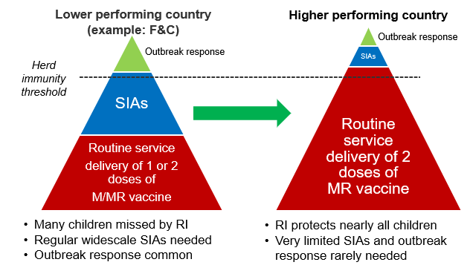
Vision of success
Strengthen RI to catch-up children with missed routine immunizations from COVID-19 pandemic era and reduce need for national wide SIAs (long term vision, SG2)
Maximise synergies between SIAs and zero dose agenda within the holistic health system strengthening approach, with focus on improving quality and integration
Collection of a learning agenda is important for guiding country initiatives and updating/ development of guidance to country teams. Majority of learnings from MR SIA given investment level

Slide 24
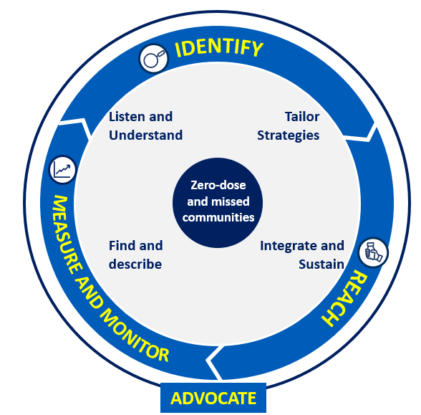
IRMMA: Leveraging synergies between SIAs and zero-dose / RI strengthening activities
Analysis of who, where, why, and how many missed children through microplanning, rapid convenience monitoring data and PCCS data
Outbreaks as flags of gaps in RI
Referral of missed children after SIA
Case studies: ZAMBIA & NIGERIA
SIA monitoring to help track RI vaccination status, measure outcomes and linkages to RI, and learn to improve
Monitor availability and use of PCCS
Strengthen other information systems relevant for ZD
Case study: NEPAL
Targeted and integrated SIAs / PIRIs toward communities with overlapping coverage gaps for multiple antigens
Links to catch-up and life course vaccination (requires going beyond 1st year of life)
Tailored and sustainable strategies addressing supply/demand-side barriers
Demand generation strategies targeting identified missed communities
Case study: NIGERIA
Advocacy for allocating resources through Government, Alliance Partners and donors, make a joint case for political attention and resources for RI/SIAs
Promotion of social accountability for immunisation, encouraging community monitoring of the equity, access and quality of immunisation services
Notes:
Move advocacy

Slide 25
Health Campaign Effectiveness (HCE) Coalition
Founded in 2020, the HCE Coalition’s Program Office is run by the Task Force for Global Health (TFGH)
The Coalition Leadership Team comprises global campaign funders, multi- and bi-lateral institutions, and country
Coalition members work around the world and across multiple disease domains (e.g., NTD, polio, VPDs, malaria, nutrition)
The Coalition seeks to identify best practices, reduce fragmentation, harmonize financing and strengthen collaboration amongst country leaders, funders, and implementers
Goal
Country-led health systems use a strategic balance of targeted health campaigns in concert with regular health services to achieve and sustain health-related development goals for all people
Notes:
Who is missing MRP?
IA2030?
Country Segments F&C
Africa CDC

Slide 26
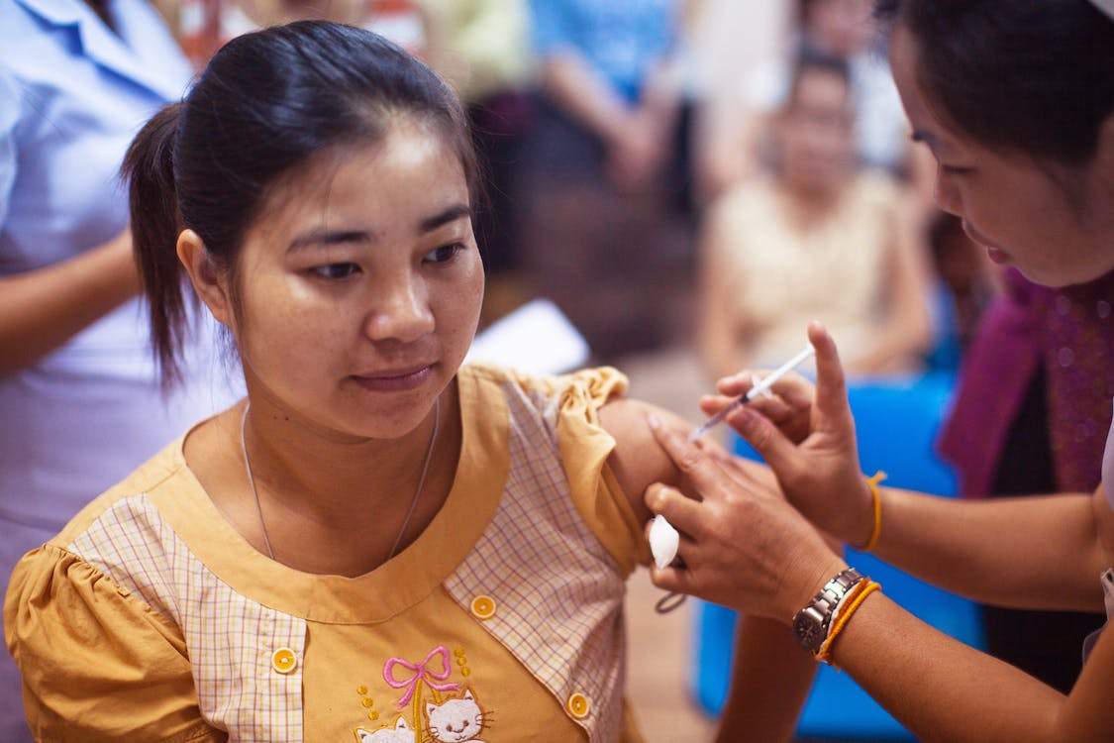
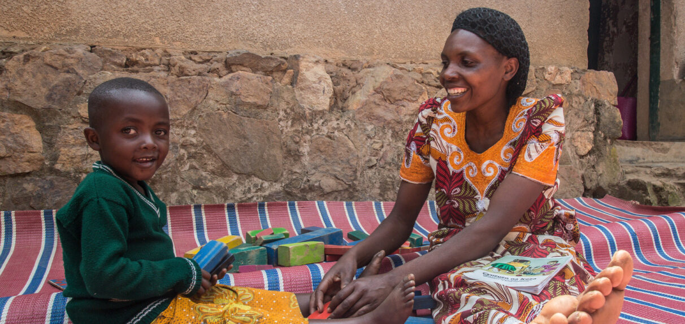
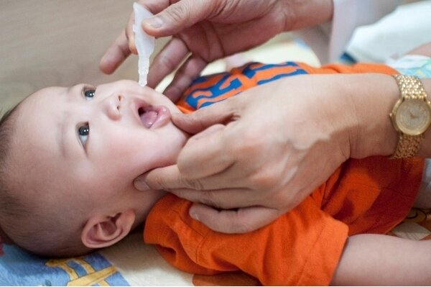
High-level Anticipated Outcomes For The HCE Collaborative Action Strategy (CAS)
1
2
3
Reduced fragmentation, and increased coordination and/or integration between campaign stakeholders & public health programs
More effective campaigns and efficient resource use
Streamlined approaches to measurement, monitoring, evaluation, and learning
4
5
6
Timely, harmonized funding processes and streams
Progress toward transitioning health campaign interventions to the primary health care (PHC) system in the long-term
High-quality, equitable, accessible and people-centered health services

Slide 27
Steps ahead

Slide 28
Only part of the problem statements addressed with work to date; MR Partnership must play role in improving routine and campaign quality through concerted efforts to integrate with PHC
Progress has been made in 2023
But more remains to be done with MRP
M&RP integration into IA2030 – pathfinder GHI
DTP3 70% requirement for MR intros removed in April 2023
Cross-Secretariat sensitisation to reduce timelines post-IRC approval started after June IRC
Revision of risk appetite on vaccine preventable disease outbreaks signed off by Gavi Board in December 2023
MR Partnership developed an end-to-end campaign tracker (application, planning, implementation and measuring)
MRP definition of campaign quality : timely, high coverage, equitable, targeting the right age range
Gavi funding secured towards MR Technical Assistance for applications, implementation and measuring
Pilot to outsource Post Campaign Coverage Surveys launched in Burkina Faso and Lao PDR in 2024
Revamp of Measles Switch Grant documentation and process to increase ease of requesting Switch Grant for MCV 5-dose
Roll out of HCE CAS in three pilot countries to inform needs and policy changes – campaign effectiveness
Explore health system strengthening through HSS strategy:
FPP and NIS
HSS strategy: 2YL
Raise the profile of measles and rubella in Health Campaign Effectiveness Coalition focus countries (Ethiopia, Nigeria, Pakistan)
Identify how IA2030 can establish and coordinate clearer engagement with efforts around Primary Health Care
Mobilise sufficient funding to fully meet MR TA needs for focus countries
Leverage OBR root cause analyses for Plans of Action for routine strengthening linked to PHC
Notes:
MCV2 introductions (South Sudan, CAR)
RCV introductions (as per country eligibility)

Slide 29
A Fragmented Campaign Ecosystem With An Opportunity For Change
London Declaration on NTDS
GPEI
M&RI
PEPFAR
COVAX
2000
2002
2005
2015
1988
2001
2003
2012
2020
GAVI & BMGF
Global Fund
PMI
GFF &TPoN
Over the last 25 years, there has been a growth of disease-specific financing, which has driven a proliferation of health campaigns targeting diseases, with little coordination between programs
This may result in strategic and operational inefficiencies and inequities that can strain health systems, burden health care workers, weaken health services and limit the potential health impact of campaigns
Global health campaigns play a strategic role within the context of a broader health system (e.g., PHC), and one does not always need to be at the cost of the other
The long-term aim is to reduce reliance on campaigns by strengthening health systems, but campaigns will continue in the near-term to respond to outbreaks, and support disease elimination and SDG health goals

Slide 30
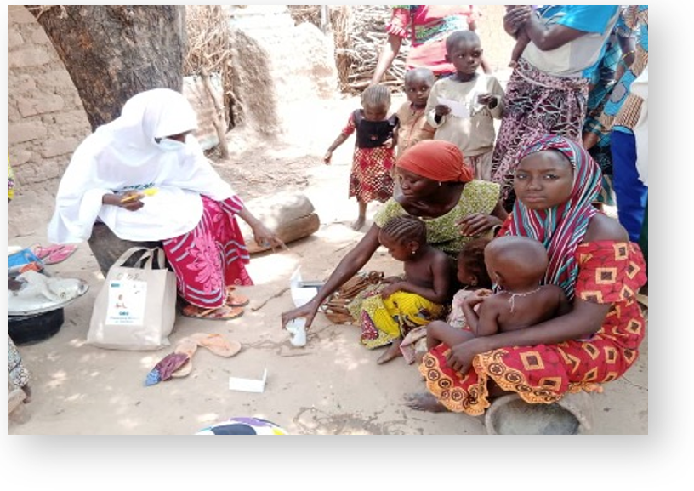
HCE Coalition Identified Best Practices & Opportunities For Impact
The HCE Coalition undertook 3 years of research in 15 countries, which demonstrated benefits and best practices associated with better coordinated and integrated campaigns
Examples of Benefits
Better coverage & acceptability
Cost savings
Improved program efficiences
Examples of Best Practices
Effective cross campaign coordinating bodies
Digitalize &
harmonize tools & logistics
Ensure participation at
all levels of decision-making

Slide 31
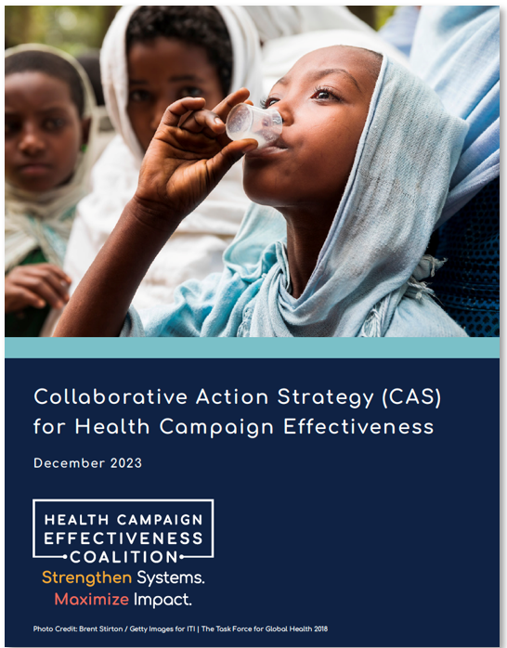
The Collaborative Action Strategy (CAS) As A Way Forward
Over the next 5 years, the HCE Coalition sees an opportunity to better coordinate campaigns by engaging all relevant stakeholders, and ensuring campaigns support broader PHC strengthening goals, via the Collaborative Action Strategy (CAS)
The CAS is an agreement among global, regional, and country level partners meant to shift ways of working:
to maximize the impact of campaigns on health outcome through better coordinated & integrated approaches at the country-level
The CAS will begin in 3 focus countries over the next 3 years, and at scale thereafter

Slide 32
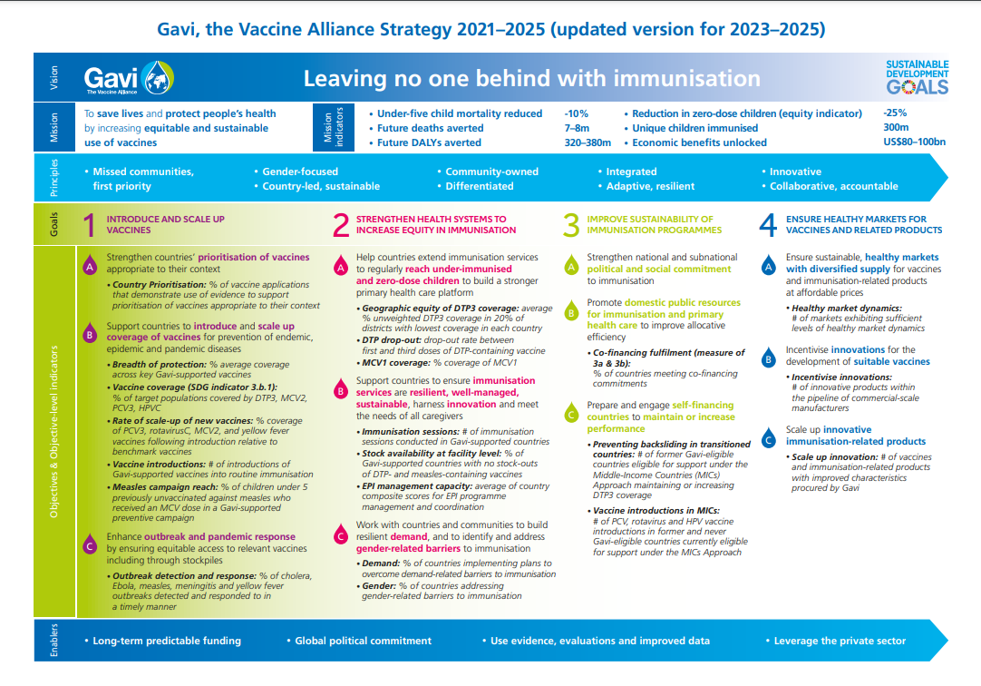
Gavi Strategy 2021–2025 (updated version for 2023–2025)

