Slide 1
A lifetime with measles and rubella;
Current issues
Alan R. Hinman, MD, MPH
September 11, 2019

Slide 2
Outline
Initiation into measles/rubella
  Measles – El Centro CA - 1966
  Going to NY State Health Department -1970
Publications I consider potentially significant
Current issues

Slide 3
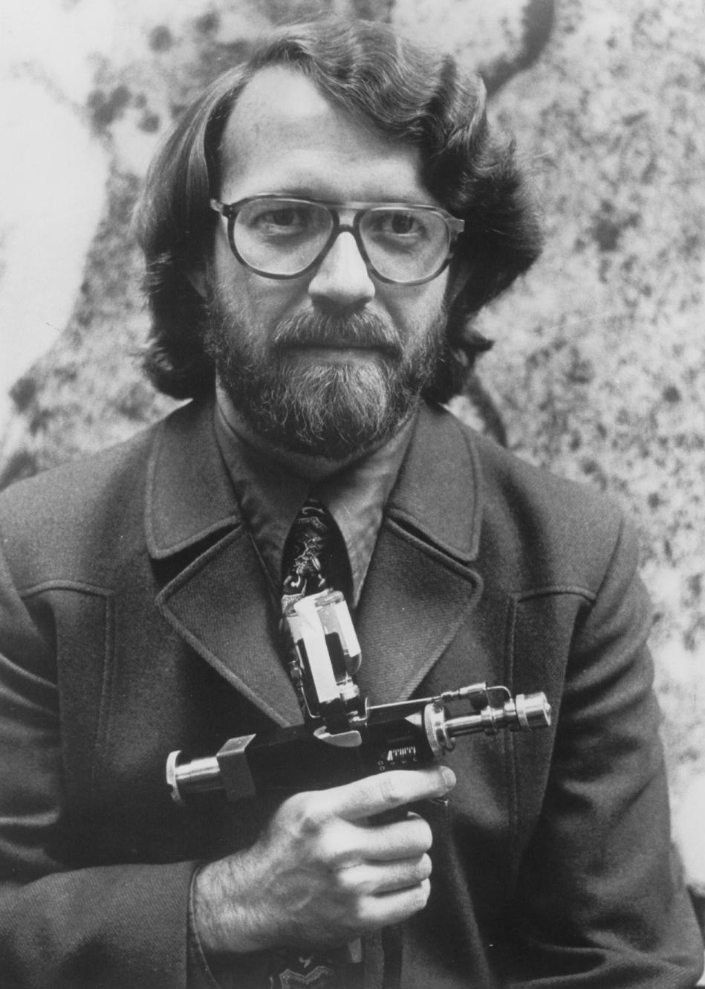

Slide 4
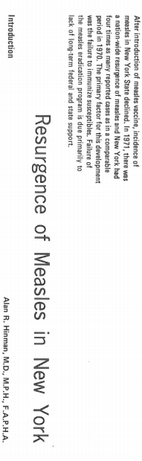
AJPH, April 1972

Slide 5
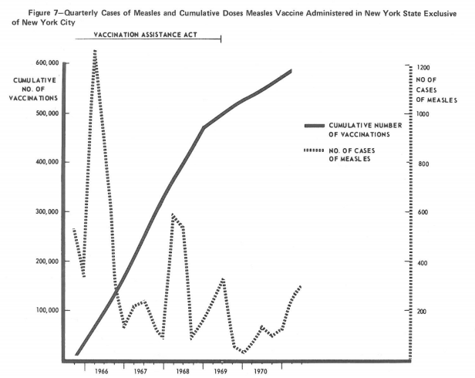

Slide 6
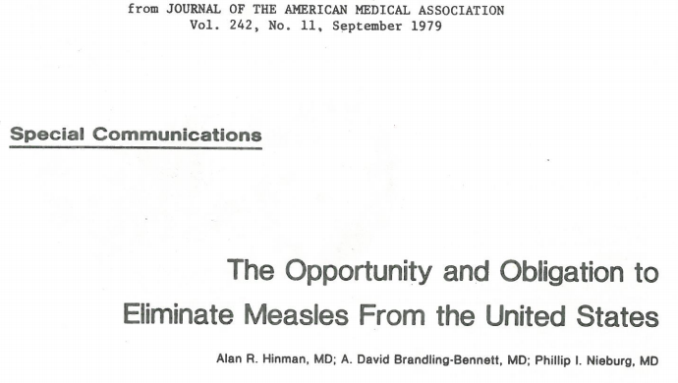

Slide 7
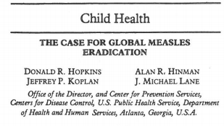

Slide 8
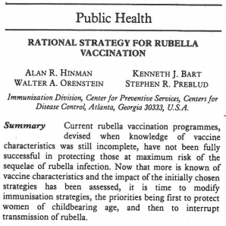

Slide 9
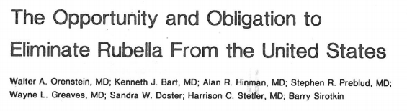

Slide 10
Current Issues
Increased incidence of measles globally and in US
4 states have abolished non-medical exemptions to school immunization requirements
The Americas de-listed as having achieved elimination – US at risk
82 countries verified as having achieved measles elimination
Rising vaccine hesitancy
Some social media platforms modifying searches on immunization
Immunization Agenda 2030 under development
Movement toward system strengthening and integration
Recent SAGE MR Work Group meeting

Slide 11
Conclusions
Measles eradication is inevitable!

Slide 12
Conclusions
Measles eradication is inevitable!
I would dearly love to see measles and rubella/CRS eradicated within my lifetime.
Since I’m now 80 (82) we’d better get on it!

