Slide 1
CRS surveillance in AFR: lessons learned
Measles-rubella Technical Advisory Group Meeting
2-3 June 2015,
Nairobi, Kenya

Slide 2
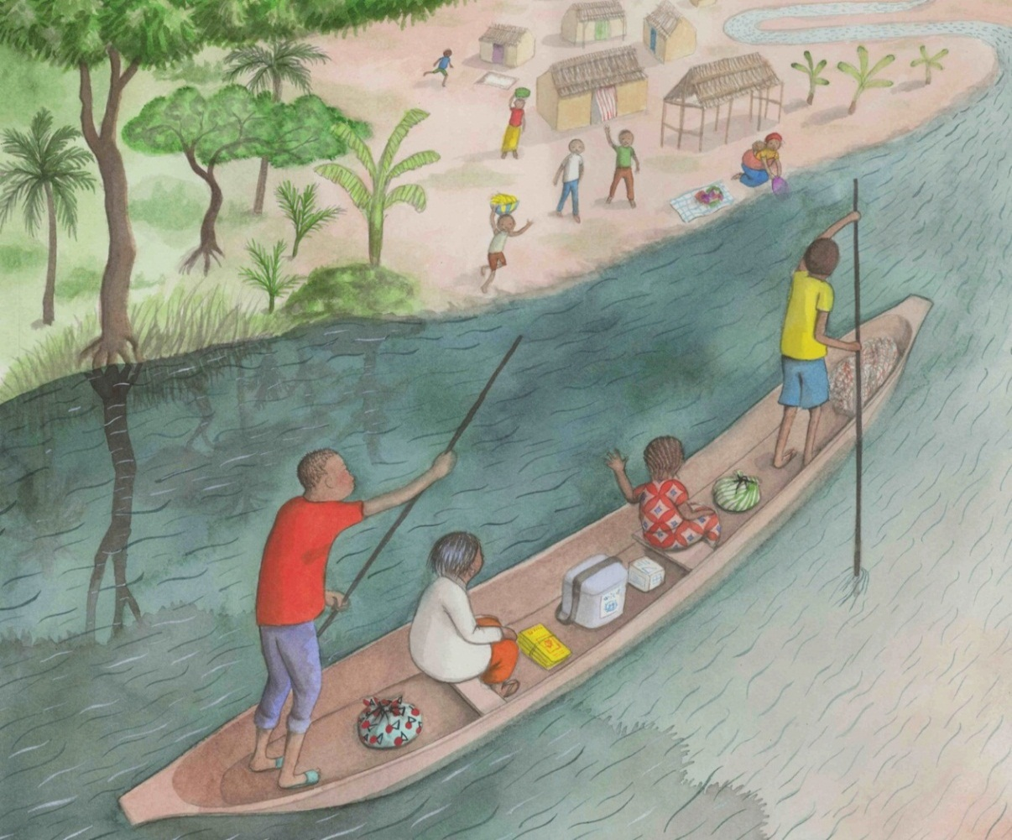
Outline
WHO CRS case definitions
Current CRS retrospective medical record reviews and CRS sentinel surveillance sites
Summary results CRS reviews and surveillance
Lessons learned
Way forward

Slide 3
WHO CRS case definitions
Clinically-confirmed CRS:
A child < 1 year with two manifestations in group (a) or one from (a) and one from (b)
Group A: cataract(s), congenital glaucoma, congenital heart disease, loss of hearing, pigmentary retinopathy
Group B: purpura, splenomegaly, microcephaly, mental retardation, meningoencephalitis, radiolucent bone disease, jaundice within 24 hours of birth
Source: African Regional Guidelines for Measles and Rubella Surveillance. Revised April 2015

Slide 4
WHO CRS case definitions (2)
Laboratory-confirmed CRS:
A laboratory-confirmed CRS case in an infant with a positive blood test for rubella IgM who has clinically-confirmed CRS
Congenital rubella infection (CRI):
An infant with a positive blood test for rubella IgM who does not have clinically-confirmed CRS
Source: African Regional Guidelines for Measles and Rubella Surveillance. Revised April 2015

Slide 5
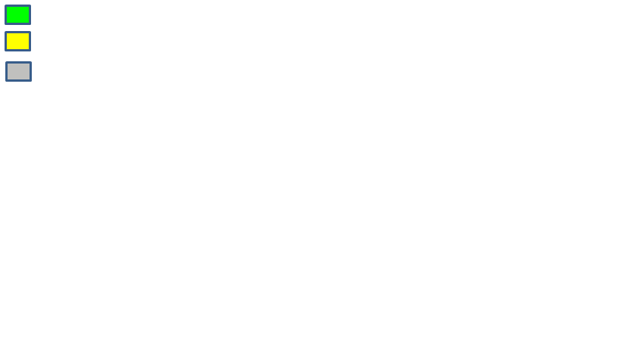
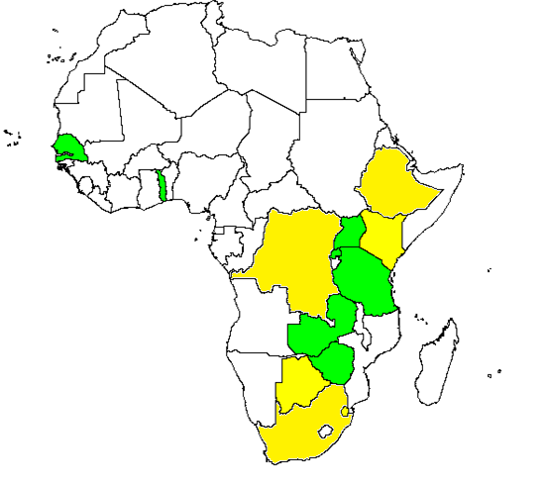
CRS sentinel surveillance in May 2015. AFR
CRS sentinel surveillance currently established
CRS sentinel surveillance planned
*
*
*7 countries with MR in routine EPI – BFA did MR SIA-intro in routine 2015
*
*
*
*
*
*
Not on map:
Retrospective burden reviews in Swaziland, Rwanda, Uganda
Retrospective CRS burden reviews conducted
& CRS sentinel surveillance planned

Slide 6
Retrospective CRS burden reviews
Identify clinical sites where infants with signs and symptoms consistent with CRS are likely to present
  Children’s hospitals
  Centers for hearing defects and blindness
  Centers for disabilities
  Specialty clinics: e.g. Cardiology, Ophthalmology, Audiology, Neonatology, developmental clinics
Consult general physicians, pediatricians, neonatologists, cardiologists, and professionals involved in TORCH* screening programmes
Review clinical records covering a period of at least two years, if possible following documented onset of a rubella outbreak
  To identify clinical entries meeting standard WHO clinical case definitions for CRS
  To identify a history of maternal rash illness that was provided during pregnancy and lab confirmation if available for suspected CRS case
  *Toxoplasmosis, Other (syphilis, varicella-zoster, parvovirus B19), Rubella, Cytomegalovirus (CMV), and Herpes infections

Slide 7
Retrospective CRS burden reviews - results
Rwanda, 3 sites 2010-12: 43 cataracts, 8 congenital glaucoma
Uganda, 4 sites 2011-12: 22 clinically confirmed CRS cases
Swaziland, 5 sites 2008-12: 14 cataracts

Slide 8
Results from CRS sentinel surveillance sites – case characteristics and completeness of database
Country | Total cases in data-base | Median age in months, range (% 1 year +) | Sex n | IgM result available n | Group A manifestations complete n | Group B manifestations complete n
Senegal | 11 | 0, 0-15 (10%) | M 4 (36%) F 7 (64%) | 11 (100%) | -- | --
Tanzania | 55 | 5, 0-10 (0%) | M 25 (46%) F 30 (54%) | 53 (98%) | 55 (100%) | 43 (78%)
Togo | 42 | 3.5, 0-20 (14%) | M 17 (40%) F 25 (60%) | 42 (100%) | 42 (100%) | 39 (93%)
Uganda | 6 | 8, 1-21 (33%) | M 3 (50%) F 3 (50%) | 6 (100%) | 6 (100%) | 6 (100%)
Zambia | 30 | 9, 0-80 (40%) | M 7 (23%) F 23 (77%) | 10 (33%), 7 pending | 30 (100%) | 30 (100%)
Zimbabwe | 109 | 0, 0-23 (4%) | M 65 (60%) F 43 (40%) | 107 (98%) | 106 (97%) | 107 (98%)
Total | 242 | 2, 0-80 (10%) | M 117 (49%) F 124 (51%) | 225 (93%) | 239 (99%) | 225 (93%)
Notes:
6 (100%)

Slide 9
Results from CRS sentinel surveillance sites – CRS case classification
Country | Number of children < 1 year in database | Total meeting case definition n | Clinically confirmed CRS n | Laboratory-confirmed CRS n | Congenital rubella infection n
Senegal | 9 | 0 | 0 | 0 | 0
Tanzania | 55 | 38 (69%) | 29 | 8 | 1
Togo | 36 | 5 (14%) | 2 | 0 | 3
Uganda | 4 | 4 (100%) | 3 | 1 | 0
Zambia | 18 | 15 (83%) | 13 | 2 | 0
Zimbabwe | 105 | 43 (41%) | 24 | 11 | 8
Total | 218 | 105 (48%) | 71 | 22 | 12

Slide 10
Results from CRS sentinel surveillance sites – Age in case categories
Age in months | Clinically confirmed CRS n | Laboratory-confirmed CRS n | Congenital rubella infection n
0-2 | 25 (35%) | 10 (45%) | 10 (83%)
3-5 | 20 (28%) | 5 (23%) | 2 (17%)
6-8 | 15 (21%) | 6 (27%) | 0
9-11 | 11 (15%) | 1 (5%) | 0
Total | 71 | 22 | 12

Slide 11
Results from CRS sentinel surveillance sites – Group A symptoms in case categories
Country | Clinically confirmed CRS n | Laboratory-confirmed CRS n | Congenital rubella infection n | Total
Cataract(s) | 42 (60%) | 18 (82%) | 1 (11%) | 61 (58%)
Glaucoma | 12 (17%) | 1 (5%) | 0 | 13 (12%)
Congenital heart disease | 50 (70%) | 19 (86%) | 4 (33%) | 73 (70%)
Hearing loss | 4 (6%) | 3 (14%) | 0 | 7 (7%)
Pigmentary retinopathy | 13 (18%) | 7 (32%) | 0 | 20 (19%)
Total | 71 | 22 | 12 | 105

Slide 12
  Lessons learned - strengths
  6 surveillance sites collecting data, longest since 2011 (Zimbabwe)
  3 more starting (Rwanda) or planned for 2015 (Botswana, Swaziland)
  Overall high level of data completeness
  Sites have documented CRS cases as baseline for monitoring after MR introduction
  Updated AFR measles-surveillance guidelines April 2015

Slide 13
  Lessons learned - challenges
  No regular reporting from sites – databases need to be shared, analysed, feed back provided (including WHO)
  Analysis showed
    Cases of age 1 year and above included (up to 40%)
    No uniform variable names and variable categories
    Variation in proportions of suspected cases that meet case definitions (14-69%)
  Variation may indicate natural differences or differences in applying guidelines and/or limitations in diagnostic capacities

Slide 14
Way forward
  Sub-regional CRS training planned June 17-19, 2015 in Harare (11 ESA countries) to
    Update on guidelines, provide current results and discuss lessons learned
    Strengthen CRS surveillance network
    Work on harmonization of standard operating procedures and reporting
    Plan and discuss publications of results from network collaboration
  Regular network workshops needed for exchange of experiences and results, discussion of modifications needed and reporting/publications, including IST West/Central

Slide 15
Back-up Slides

Slide 16
Current CRS sentinel surveillance sites in AFR
Country | Site(s) | Started CRS surveillance | MR intro
Senegal | Paediatrics Hospital Albert Royer Dakar | 2012 | 2013 | Data for 7/14-2/15, no manifestations info
Tanzania | Dar es Salaam (2), Dodoma (1), Kigoma (1), Kilimandjaro (1), Mbeya (3), Tanga (1), Zanzibar (1) | 6/2014 | 2014
Togo | 2 University Clinics in Lome, Be Hospital | 2012 | ?
Uganda | Mulago Hospital | 10/2014 | 2018
Zambia | Central Hospital, Kitwe; General Hospital, Livingstone; University Hospital, Lusaka; Arthur Davidson Children's Hospital, Ndola | 2014 | 2016
Zimbabwe | Harare Hospital | 11/2011 | 2015
Notes:
1. The University Teaching Hospital:
This is a public tertiary and teaching hospital with a bed capacity of 500 beds and cots in the department of paediatrics. Retrospective and Prospective surveillance has already started (October 2014%).
2. Arthur Davison Children’s Hospital:
The only children’s hospital in the country, located in Ndola and has a bed capacity of 250. Retrospective and Prospective Surveillance started in November 2014.
3. Kitwe Central Hospital:
It is located in Kitwe the Commercial hub of the Copperbelt Province and has a bed capacity of about 200. Retrospective and Prospective Surveillance started in November 2014.
4. Livingstone General Hospital:
It is located in Livingstone, Southern province. The hospital has about 80 beds in paediatrics. Retrospective and Prospective in January 2015.

