Slide 1
Global Measles and Rubella Update
5th African Regional Measles/Rubella TAG Meeting
2nd-3rd June 2015

Slide 2
Global MCV1 coverage has reached 84%
1st Dose measles vaccine coverage by WHO region, 1980-2013
Source: WHO/UNICEF coverage estimates 2012 revision. July 2013; Immunization Vaccines and Biologicals, (IVB), World Health Organization.
194 WHO Member States. Date of slide: 17 July 2013
Notes:
This chart shows the secular trend in coverage with the 1st dose of measles containing vaccine or MCV1. Globally, MCV1 coverage has leveled off at 83-84% for the past 5 years. Three regions still have MCV1 coverage <90%, AFR, SEA, and EMR. The AMR, EUR and WPR have sustained MCV1 above 90% for at least the past 9 years.

Slide 3
Measles and Rubella Targets
Global targets by 2015:
  Measles vaccination coverage ≥ 90% national and ≥ 80% in @ district
  Measles reported incidence <5 cases per million
  Measles mortality reduction of 95% vs. 2000 level
  Regional targets:
    Measles Elimination goals:
    2000 AMRO
    2012 WPRO
    2015 EURO, EMRO
    2020 AFRO, SEARO
  Rubella Elimination goals:
    2010 – AMRO, 2015 – EURO, no date – WPRO
Global Vaccine Action Plan (GVAP):
  2020 Measles and rubella elimination in 5 WHO regions
Notes:
A reminder of what current targets are. At global level, there are 3 control targets to be achieved by 2015. 1st measles vaccination coverage of ≥90% at national and ≥80% in every district, reported incidence of measles <5/million and measles mortality reduction of 95% compared with 2000 levels. All 6 WHO Regions have set target dates for measles elimination and 2 Regions have established rubella elimination targets. The 2020 GVAP goal is measles and rubella elimination in 5/6 Regions. I will report on progress towards the global 2015 targets and each of the Regions will report on progress towards their elimination goals.

Slide 4
Reported measles cases by WHO Region, 2000-2014
71% drop in incidence
2014: 42 per million
Data as of 27 May 2015. 148 / 194 Member States reporting data for 2014
Notes:
Looking more closely at the past 15 years, reported measles cases have decreased from more than 800,000 in 2000 to a little over 265,000 in 2014. Calculating this as an incidence rate per million population, measles incidence decreased by 71% over this time period. However, the incidence of 40 per million in 2014 is still substantially higher than the target of <5 per million. Also in 2014 we saw an increase in cases over 2013 particularly in W. Pacific Region.

Slide 5
21 million infants missed MCV1 in 2013 through routine
60% live in
  India
  Nigeria
  Ethiopia
  Indonesia
  Pakistan
  DRC
Outreach not done
Reluctance to open vaccine vials when <6 children present
Barriers to vaccinating children >12m of age
False contraindications
21 million infants unimmunized (MCV1), 2013
Notes:
In the assessment of the SAGE working group on measles and rubella, the biggest challenge facing achievement of the GVAP measles and rubella elimination targets is underlying weak immunization systems and low vaccination coverage both in routine services and SIAs. This pie chart makes the point that 60% of the 21 million infants who missed their MCV1 dose in 2013 lived in 6 large countries – India, Nigeria, Ethiopia, Indonesia, Pakistan and DRC.

Slide 6
Global and Regional MCV2 Coverage
New WHO-UNICEF Estimates
Global Coverage: 53%
Source: WHO/UNICEF coverage estimates 2013 revision. July 2014
Immunization Vaccines and Biologicals, (IVB), World Health Organization.
194 WHO Member States. Date of Slide: 17 July 2014
Notes:
MCV2 coverage is substantially lower than MCV1 with even wider differences between the Regions. WPR and EUR with coverage >80% and the African Region with coverage <10%. However, there is a steady increase in MCV2 coverage overall (black line) with the global estimate reaching 53% in 2013.

Slide 7
Immunization coverage with the second dose of measles containing vaccines by administered schedule in infants, 2013
< 50% (5 countries or 3%)
50-79% (28 countries or 14%)
The boundaries and names shown and the designations used on this map do not imply the expression of any opinion whatsoever on the part of the World Health Organization concerning the legal status of any country, territory, city or area or of its authorities, or concerning the delimitation of its frontiers or boundaries. Dotted lines on maps represent approximate border lines for which there may not yet be full agreement. © WHO 2014. All rights reserved
80-89% ( 31 countries or 16%)
>= 90% (74 countries or 38%)
2nd dose of measles containing vaccines in schedule but no coverage data available (10 countries or 5%)
Source: WHO/UNICEF coverage estimates 2013 revision, July 2014. 194 WHO Member States. Map production: Immunization Vaccines and Biologicals, (IVB). World Health Organization
Date of slide: 16 July 2014
Not available or 2nd dose of measles not introduced (46 country or 24%)
Not applicable

Slide 8
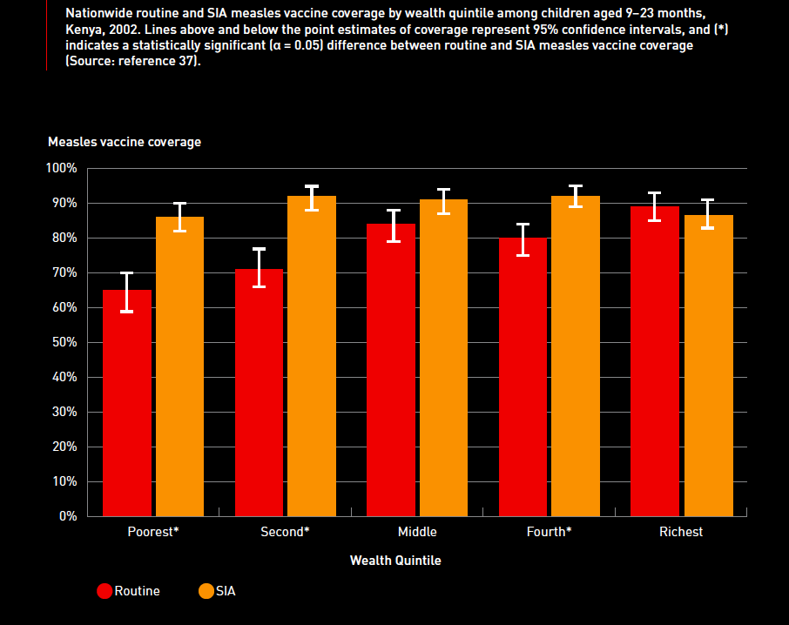

Slide 9

43 Measles Campaigns in 28 Countries in 2014
218 million children reached
24/43 (56%) attained 95% coverage
13/43 (30%) with coverage survey
35 of 43 SIAs integrated 1 or more other interventions
Measles (11)
Measles and Rubella (9)
OPV – 13
Vitamin A – 8
De-worming – 5
Other interventions – 2
Meas, Mumps, Rubella (8)
No SIA in 2014
Not Applicable
The boundaries and names shown and the designations used on this map do not imply the expression of any opinion whatsoever on the part of the World Health Organization concerning the legal status of any country, territory, city or area or of its authorities, or concerning the delimitation of its frontiers or boundaries. Dotted lines on maps represent approximate border lines for which there may not yet be full agreement. ©WHO 2014. All rights reserved.
Updated on 25 May 2015

Slide 10
Rubella containing vaccine coverage by WHO region, 1980-2013.
NB. MR is x2 M alone cost. Two doses mean signif increase
44%
Source: WHO/UNICEF coverage estimates 2013 revision. July 2014
Immunization Vaccines and Biologicals, (IVB), World Health Organization.
194 WHO Member States. Date of slide: 24 July 2014.
Notes:
This slide illustrates the lack of integration of rubella with measles and the large inequity between coverage with RCV vaccine in The Americas, EUR and WPR with coverage >90% and EMR, SEAR and AFR with coverage <50%. The global estimate of RCV coverage while increasing gradually was still only 43% in 2012.

Slide 11
Rubella Incidence per million population, 2014
<1 case per million (82 countries or 42%)
>1--<5 (21 countries or 11%)
>5--<10 (12 countries or 6%)
>10--<50 (12 countries or 6%)
>= 50 (7 countries or 4%)
Source: Joint Reporting Form as at 15 May 2015.
194 WHO Member States.
Map production: Immunization Vaccines and Biologicals, (IVB). World Health Organization
Date of slide: 15 May 2015
Not available / No data reported to WHO HQ (60 countries or 31%)
Not applicable
The boundaries and names shown and the designations used on this map do not imply the expression of any opinion whatsoever on the part of the World Health Organization concerning the legal status of any country, territory, city or area or of its authorities, or concerning the delimitation of its frontiers or boundaries. Dotted lines on maps represent approximate border lines for which there may not yet be full agreement. © WHO 2015. All rights reserved

Slide 12
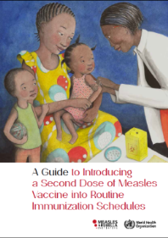
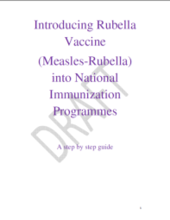
Introducing routine MCV2 & RCV
Global guidelines
Financial support: ~$750M from Gavi
Measles 2nd dose (41 countries)
  2014: Burkina Faso, Morocco, Rwanda, Senegal, Tanzania 2015: Malawi, Mozambique, Nepal, Papua New Guinea, Zimbabwe
Rubella vaccine introduction (53 countries)
  2014: Morocco, Rwanda, Tanzania, Yemen,
  2015: Burkina Faso, Cameroon, Myanmar, Papua New Guinea, Vietnam, Zimbabwe
Notes:
What is being done to increase MCV2 and RCV coverage? At global level, guidelines have been developed for use by countries for introduction of a 2nd routine dose of measles vaccine and introduction of rubella vaccine into national immunization programmes. Both these activities are being supported by Gavi with over $750M being made available to countries. The panel shows progress with MSD introductions with 5 of 41 remaining countries scheduled to introduce MCV2 in 2015. For rubella vaccine introduction, 6 countries of 53 countries are scheduled to introduce RCV in 2015.

Slide 13
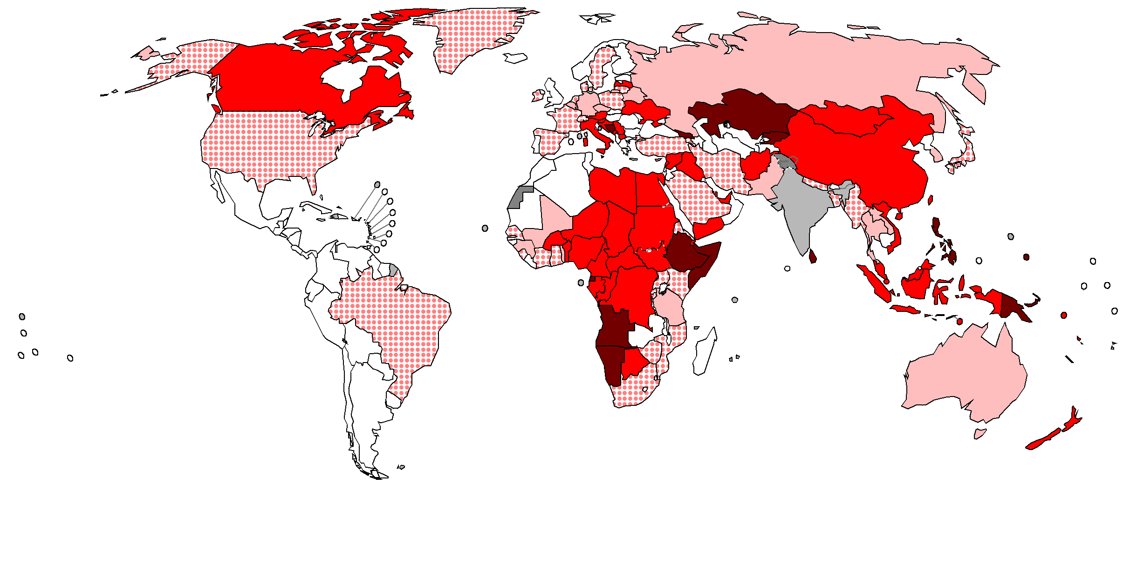
Reported Measles Incidence Rate* and
Countries with largest number of reported measles cases
Apr 2014 to Mar 2015 (12M period)
India^{c}: 24, 977 in 2014
Georgia: 2,387
China: 50,878
Egypt: 2,712
Nigeria: 3,736
Viet Nam: 3,946
Ethiopia: 14,923
Somalia^{b}: 10,297 in 2014
2,394 in 2015
DR Congoª: 35,835 in 2014
11,657 in 2015
Indonesia: 6,959
Angola: 8,527
*Rate per 1'000'000 population
<1
(72 countries or 37%)
≥1 - <5
(34 countries or 17%)
≥5 - <10
Philippines: 19,773
Data source:
Monthly reporting system, Data in HQ as of 4 May 2015
(14 countries or 7%)
≥10 - <50
(44 countries or 23%)
Papua New Guinea: 2,380
Reported cases in yellow boxes represent suspected cases reported by
national bulletins or other sources:
ª DR Congo Bulletin hebdomadaire de surveillance de la rougeole, 14.04.15
^{b} Somalia Weekly Polio Update. Week 3, and week 16
^{c} India WHO UNICEF Joint Reporting Form for 2014 data
≥50
(13 countries or 7%)
No data reported
to WHO HQ
(17 countries or 9%)
The boundaries and names shown and the designations used on this map do not imply the expression of any opinion whatsoever on the part of the World Health Organization concerning the legal status of any country, territory, city or area or of its authorities, or concerning the delimitation of its frontiers or boundaries. Dotted lines on maps represent approximate border lines for which there may not yet be full agreement. ©WHO 2015. All rights reserved.
Not applicable

Slide 14
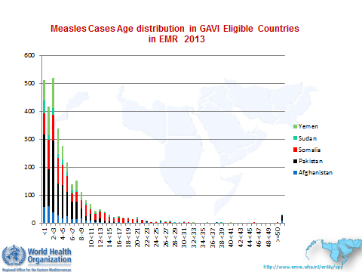
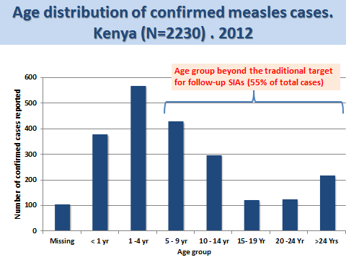
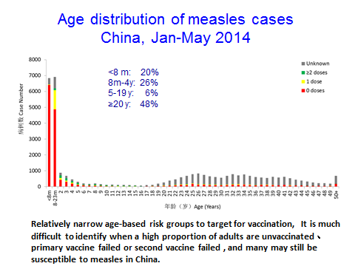
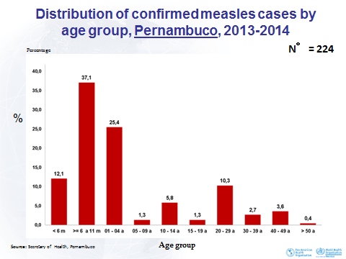
Types of Measles Outbreaks
Notes:
At the last meeting of the SAGE Measles and Rubella Working Group, there was a careful analysis of the types and causes of different measles and rubella outbreaks. I will show only measles outbreaks here for ease of illustration. Basically, there are 4 broad types of outbreaks depending on the coverage achieved and the resulting level of vaccine-induced immunity. The GAVI eligible EMRO countries illustrate a setting where coverage is low (most cases in young children); Kenya data from 2012 show the shift to older age groups when coverage increases; China is the 3rd type where very high coverage in vaccine-eligible children results is associated with cases at the extremes of the age distribution; and finally the last panel shows the age distribution from the current post-elimination outbreak in Pernambuco State, Brazil – again a bimodal age distribution

Slide 15
Progress towards 2015 global targets by WHO region
WHO Region | Measles Mortality reduction (2013) | 2013
 |  | MCV1 coverage | Measles/Rubella incidence (/million)
AFR | 84 | 74% | 185
AMR | 100 | 92% | 0.5
EUR | 65 | 95% | 32.0
EMR | 49 | 78% | 35
SEAR | 63 | 78% | 16
WPR | 88 | 97% | 17

Slide 16
Verification of elimination
2014 GVAP Report:
"After consulting with their respective Regional Technical Advisory Group, every region establish a regional verification commission, and after consulting with their respective National Immunization Technical Advisory Group, every country explore options for establishing a national verification commission, to scrutinize and monitor progress towards the measles and rubella elimination targets."
Progress:
Global Verification Framework published
4 Regions have developed their verification guidelines
AMR, EUR, WPR have fully functional Regional Commissions
Differences in definitions and surveillance indicators
Workshop planned 26 June
Notes:
In the 2014 GVAP Report, while all 18 recommendations will directly help countries and regions bet back on track towards elimination, one recommendation was specific to measles and rubella elimination. That is the recommendation that all Regions and countries establish RVC and NVC to "scrutinize and monitor progress towards elimination targets". There has been progress in implementing this recommendation:

Slide 17
Monitoring Progress through
Regional Verification of Measles Elimination
WHO Region | Regional Verification Commissions Established | Elimination Achieved
 |  | No. of countries | % of countries
Americas¹ | Yes | 34 | 97%
Europe² | Yes | 22 | 41%
W. Pacific³ | Yes | 6 | 22%
E. Mediterranean | No | - | -
SE Asia | No | - | -
Africa | No | - | -
1. Progress report on Plan of Action for Maintaining Measles, Rubella, and CRS Elimination in the Americas, September 12, 2014
2. Third meeting of the European Regional Verification Commission for Measles and Rubella Elimination (RVC)
10-12 November 2014, Copenhagen, Denmark
3. http://www.wpro.who.int/mediacentre/releases/2015/20150327/en/
Notes:
The 2014 Report on the Global Vaccine Action Plan made the recommendation that all Regions and countries establish verification commissions to "scrutinize and monitor progress towards elimination targets". This table shows the 2014 score card on progress towards regional measles elimination goals. The Americas is clearly out front with all but one (that is 97%) of the their countries having achieved elimination of measles. Europe is next with 41% and the W. Pacific with 22% of their countries having achieved elimination. The African, E. Mediterranean, and SE Asian Regions and their member countries have still to establish their verification mechanisms.

Slide 18
Key Challenges by WHO Region
Americas – risk of importations
W. Pacific – achieving measles elimination in China
Europe – competing priorities, vaccine hesitancy
E. Med – security limiting access
SE Asia – heterogeneous coverage in large countries (e.g. India, Indonesia)
Africa – persistent weak immunization & health systems; changing epidemiology of measles; quality of SIAs and low MCV2 implementation.

Slide 19
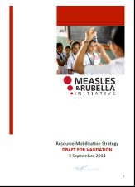
Estm. Resource Requirements &
Mobilization Efforts – 2015-2020
$1.4 billion needed for measles
& rubella control, 2015-2020
Actions:
Advocacy and resource mobilization working group led by UN Foundation
Resource mobilization strategy developed
GAVI review of future role
  Funding for follow-up MR campaigns
  HSS
  MR vaccine for 2nd dose
Notes:
The partner agencies in the M&RI are taking actions in response to each of these recommendations. One critical area is resource mobilization. The chart on the left is based on the most recent estimate of the external financial resource requirements to implement measles and rubella control activities from 2015-2020. Out of a total requirement of $1.4 billion dollars over the next 6 years, Gavi has set aside $718M and pledges from regular donors to the M&RI make up another $266 million, leaving a shortfall of $369M. To address the shortfall, the M&RI has established an advocacy and resource mobilization working group led by UNF, a resource mobilization strategy has been developed, and Gavi, at the request from its Board, is reviewing its future role in measles and rubella. Issues to be resolved are who will fund follow-up MR campaigns in Gavi eligible countries, and funding for the rubella component of MCV2. Breakdown of $1.4B is 80% vaccination campaigns; 10% core functions; 7% surveillance; 3% PSC … 1% for RI.

Slide 20
Summary
Measles and MR vaccines have had great impact and measles is at historically low levels
Despite this progress, many outbreaks continue to occur & 4 out of 6 WHO Regions are not on track.
Based on current trends and programme performance 2015 global targets will not be achieved on time
Outbreaks are due to programme failure to vaccinate and the barriers to vaccination are different across WHO Regions
RVC and NVCs provide encouragement and momentum towards regional elimination goals

Slide 21
Pareto-Juran principle
20% of the work (the first 10% and the last 10%) consume 80% of your time and resources

Slide 22
Most progress in measles mortality reduction occurred in Africa in last decade

Slide 23
Polio eradication – Innovations
New Tactics & Technologies
Universal
finger-marking
Migrant & transit strategies
Seroprevalence
surveys & modelling
Independent
monitoring
'SIADs'
rt-PCR
'Underserved Strategy'
LQAs
SIAs doubled
10 x tech assist
House-to-house
mOPV1
mOPV3
bOPV
Notes:
23
© 2009 Bill & Melinda Gates Foundation

Slide 24
“Business as usual" will not be enough
Seize every opportunity for vaccination:
  Ensure HW* immunized against measles and rubella
  Change practices and policies to reduce missed opportunities and permit opening of vials for 1 child
  Vaccinate with MCV1 even when child is >12m
  Enhanced implementation of MCV2
Ensure SIAs reach all children
  A change of attitude to preparations and implementation
Improve surveillance and use of data for action
  Increase rubella reporting
  Case-based data from all countries reported to RO, HQ
*health worker

Slide 25
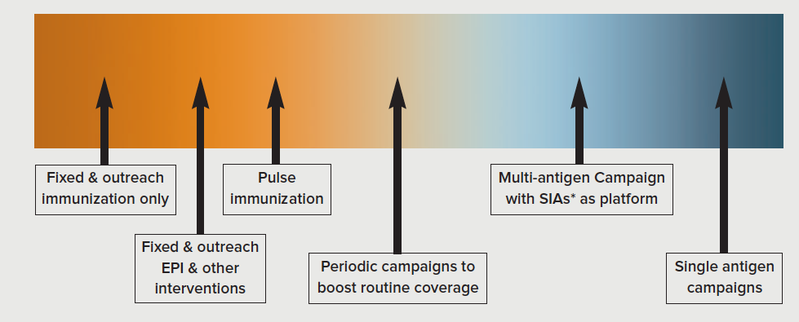
The continuum of immunisation strategies

Slide 26
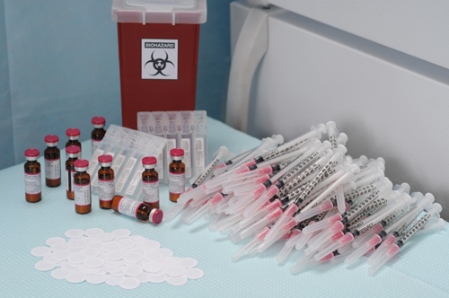
The horizon – e.g. Needle free patch technology

Slide 27
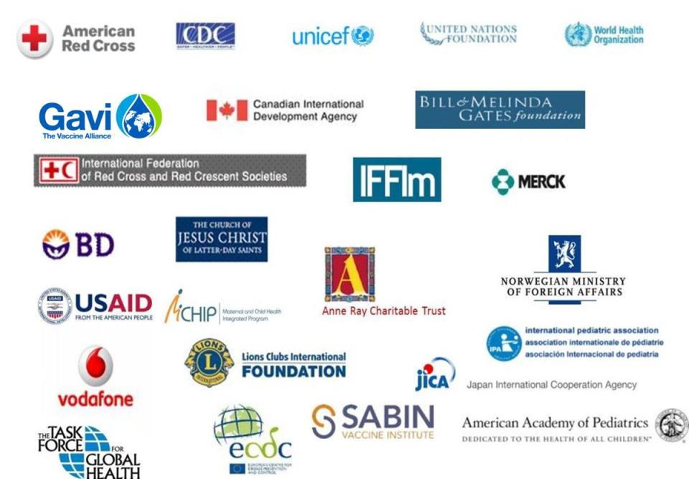
Notes:
Conclude by acknowledging all the partners who are contributing to efforts to achieve measles and rubella elimination

