Slide 1
GMRLN – Global Measles Rubella Laboratory Network
Mick Mulders
Expanded Program on Immunization; Department of Immunization, Vaccines and Biologicals; World Health Organization
Accelerating Progress towards Measles/Rubella Control and Elimination Goals
Hotel Royal, Geneva, 21-23 June 2016

Slide 2
The Role of the Laboratory is Critical
Case-based surveillance requires timely laboratory confirmation by a network of accredited laboratories
High quality surveillance, backed by strong laboratory support, is necessary for verifying elimination

Slide 3
GMRLN – The Network
Multi-tiered structure (703) supporting most Member States (191) started in 2000
  Global Specialized Laboratories (3)
    Develop standard protocols, new methods, reagents, supplies, training
  Regional Reference Laboratories (14)
    Confirmatory testing, proficiency testing, training, sequencing
  National Laboratories (180)
    Case confirmation (sequencing)
  Sub-national/provincial/prefecture Laboratories (506)
    Case confirmation

Slide 4
WHO Global Measles and Rubella Laboratory Network: 2016
2012
N= 690 labs
31 Prov. Labs
+ 331 Prefect. Labs
141 Sub-National Labs
National Laboratories
Regional Reference Labs
Global Specialised Labs
Provincial Labs China
Sub-National Labs

Slide 5
Main Tasks: GMRLN
Case confirmation
Monitoring genetic characteristics if circulating strains
Provide evidence for verification of elimination
Capacity building, training
Establishing and monitoring laboratory performance
Support studies of population immunity

Slide 6
Monitoring Laboratory Performance
Timely and complete reporting
Quality assurance
  Proficiency testing serologic and molecular
Quality control
  Confirmatory testing by supervisory laboratory
Accreditation
  Ensure WHO performance indicators are met

Slide 7
Workload: Specimens tested for measles IgM
Data source: surveillance DEF file
China is not reporting monthly data
Data in HQ as of 13 June 2016

Slide 8
Workload: Specimens tested for rubella IgM
Data source: surveillance DEF file
China is not reporting monthly data
Data in HQ as of 13 June 2016

Slide 9
Annual EQA for Serologic Tests

Slide 10
How did the laboratories perform in 2015?
(measles serologic panel 01502)

Slide 11
Sequences submitted to MeaNS and RubeNS
Submissions to MeaNS
Submissions to RubeNS
www.who-measles.org
www.who-rubella.org
*Database query 15 June 2016

Slide 12
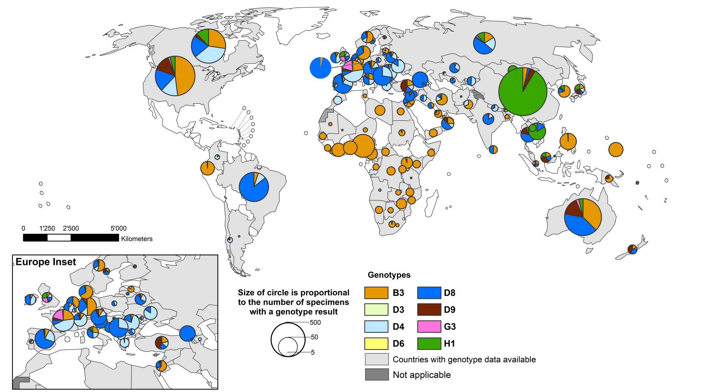
Global Distribution of Measles Genotypes: 2010-2015
MMWR 2016, 65/17
WER 2016, 91/18

Slide 13
Mapping Transmission Pathways Following the Outbreak in the Philippines in 2014: Tracking Genotype B3 “Harare”
Measles Genotypes Philippines
2000-2004: D3 endemic until 2003
2007-2009: D9 and G3 introduced and detected in outbreaks
2014-2015: B3 introduced, B3 and D9 continue to circulate and cause outbreaks

Slide 14
11 Wild-type Genotypes Detected Since 2005: 6 Still Circulating
Genotype | 2005 | 2006 | 2007 | 2008 | 2009 | 2010 | 2011 | 2012 | 2013 | 2014 | 2015
B2
B3
D11
D4
D5
D6
D7
D8
D9
G3
H1
Source: Paul Rota, CDC and GMRLN
Solid color: Genotypes with ongoing transmission;
Striped: genotypes with no detections for at least 3 years

Slide 15
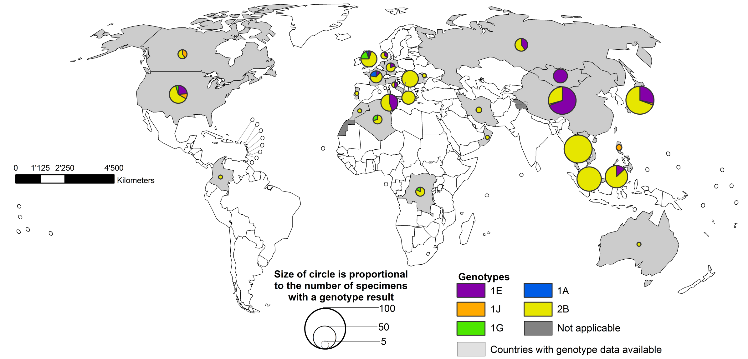
Global Distribution of Rubella Genotypes:
2010-2015
MMWR 2016, 65/17
WER 2016, 91/18

Slide 16
Achievements
Well-performing, quality assured laboratory network
Serologic testing performed by all network laboratories, with increasing use of molecular methods for case conformation
Molecular detection and characterization by RRL and some NL, expanding
QA/QC and accreditation in entire network ensuring high quality testing
Seven working groups supporting technical developments and guidance
Training, workshops and new laboratory manual to ensure proficiency of staff (61 trained in 2015-6)
Notes:
lab manual, measles vaccine-spec testing, rubella IgG standardization, molecular epidemiology: N.E.W. and MeaNS/RubeNS; serosurveys, molecular EQA
Last 12 months: Mol Hong Kong (16), Mol+sero Entebbe (12), MNG (1), QC/QA-Bangkok (11), CRS surveillance-BKK (22)

Slide 17
Challenges
Increasing workload
  Case-based surveillance
  Rubella control
  Elimination goals in all Regions
  Ongoing outbreaks: not to test all samples!
  Competing priorities (Zika, yellow fever, MERS-CoV, Ebola)
Maintaining expertise
  Staff attrition
  Introduction of new technologies
  Increasing demand from program
    Molecular epidemiology, verification of elimination

Slide 18
Challenges:
Securing Investment in Building GMRLN
Sustainability requires resources
Integration of testing for other VPDs
  YF, JE, epidemic prone diseases requiring surge capacity
Methods development and harmonization of methods
Sequence databases have increasing utility, but require expansion
Polio transition planning: Making the case for maintaining laboratory network capacity to meet future surveillance demand and respond to emergencies

Slide 19


What is a future without GRMLN?
The GMRLN is the largest globally coordinated laboratory network providing high quality laboratory support for the surveillance need to measure progress toward measles and rubella elimination
Support for continued expansion of GMRLN is needed to provide laboratory support for surveillance not only for measles and rubella but also for other VPDs and emerging pathogens

Slide 20
Acknowledgements
David Featherstone
WHO
  Peter Strebel, Alya Dabbagh, Robert Perry, Marta Gacic-Dobo, Claudia Steulet, Simarjit Singh, Olivier Beauvais
CDC
  Paul Rota & team
  Joe Icenogle & team
  GID team
PHE
  Kevin Brown, Richard Myers, David Brown
NIID
  Makoto Takeda, Katsuhiro Komasu, Yoshio Mori
Regional coordinators
  Hinda Ahmed
  Yan Zhang
  Varja Grabovac
  Sirima Pattamadilok
  Myriam Ben Mamou
  Gloria Rey
  Annick Dosseh
  Charles Byabamazima
Regional Reference Laboratories
National Laboratories
CDC for funding GMRLN
VPData: to subscribe send email to LISTSERV@LISTSERV.WHO.INT with ‘SIGNUP GLOBAL_MR_UPDATE’ text in the body of the email

Slide 21
Disclaimer
The boundaries and names shown and the designations used on this map do not imply the expression of any opinion whatsoever on the part of the World Health Organization concerning the legal status of any country, territory, city or area or of its authorities, or concerning the delimitation of its frontiers or boundaries. Dotted lines on maps represent approximate border lines for which there may not yet be full agreement. ©WHO 2016. All rights reserved.

Slide 22
Global distribution measles genotypes
2015 overlay measles incidence 2015

Slide 23
Global distribution rubella genotypes
2015 overlay rubella incidence 2015

Slide 24
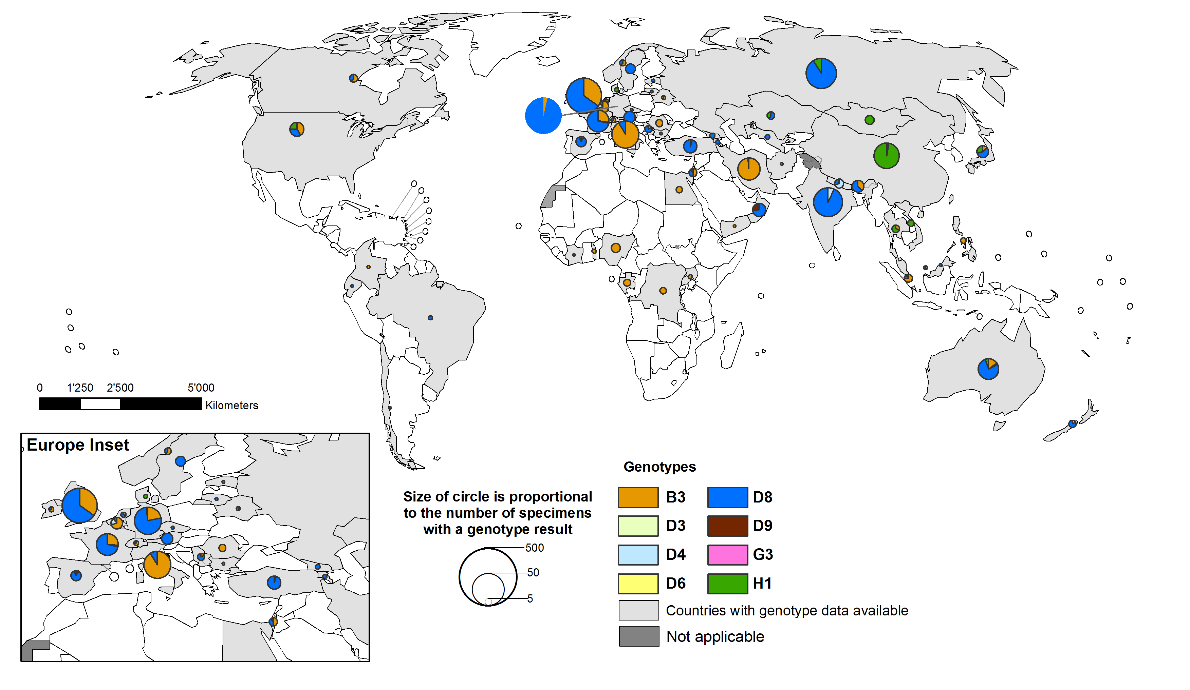
Global distribution of measles genotypes May 2015 – Apr 2016

Slide 25
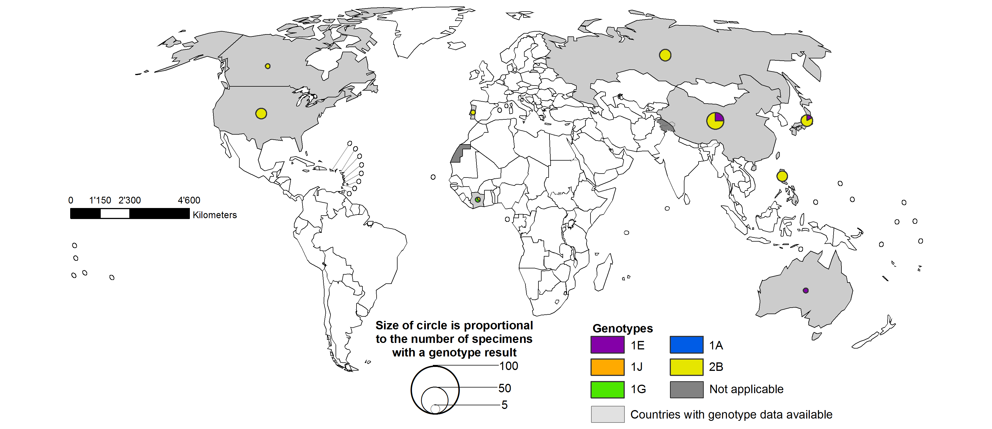
Global distribution of rubella genotypes
May 2015 – April 2016

