Slide 1
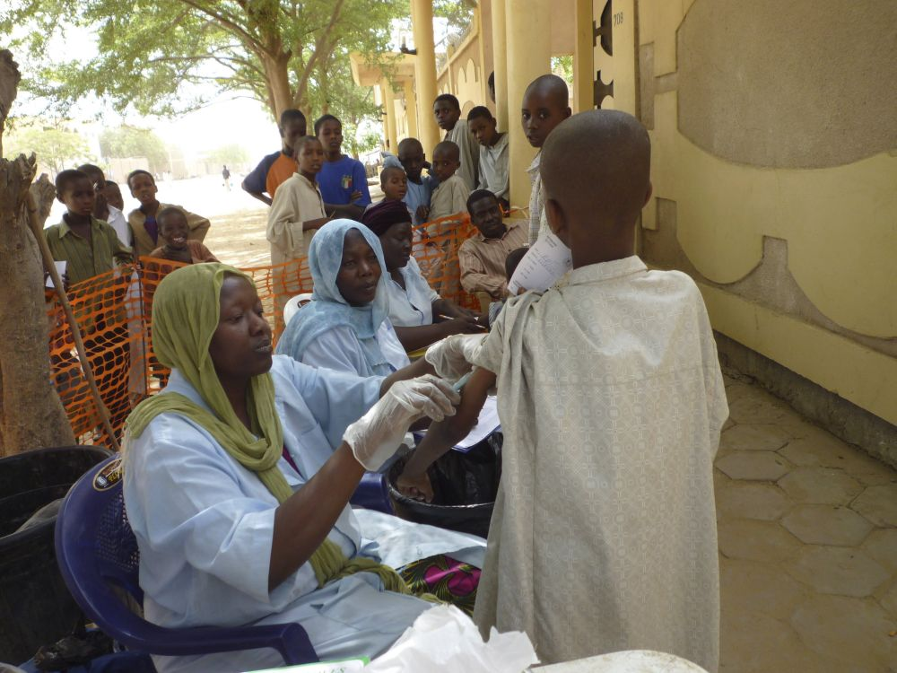
Measles/ MR Supplemental Immunisation Activities Quality
5th African Measles and Rubella TAG Meeting
Nairobi, Kenya, 2-3 June 2015

Slide 2
Outline
Targets for measles elimination in AFR
M & MR SIAs achievement
Gaps and Challenges
Future plans to improve Quality of SIAs
Questions for TAG

Slide 3
African Region Strategic plan for measles elimination: Targets for 2020
All countries in the African Region will achieve and maintain:
> 95% measles immunization coverage at national level and in all districts;
> 95% SIAs coverage in all scheduled measles SIAs, and in outbreak response immunization activities;
Measles incidence of <1: 1,000,000 population at national level;
≥ 80% of districts investigating ≥ 1 suspected measles cases within a year
Non measles febrile rash illness rate ≥ 2/100,000 pop. at national level.

Slide 4
TIMING - Building up to Quality and effective SIAs
Prepare budget and request funding from MoF (& donors)
Agreement by MoF ; Commitment Measles & Rubella Initiative, Gavi
POA finalized and National coordinating body established
Guidelines, Logistic & com. plans
Ordering vaccine & devices
Micro-planning & soc. mob
Training of personnel
Distribution of vaccine & mat’ls
SIAs
Evaluation
-18
-12
-8
-7
-6
-5
-4
-3
-2
-1
0
+1

Slide 5
Measles/MR SIAs AFR 2013- 2014:
Main Achievements
High political commitment and engagement of leadership, Rwanda, Ghana
Involvement of other sectors and partners agencies’ RWA MoH worked closely with MOE
Command centre and daily review meetings at all levels GHA, RWN
Involvement of local partners and NGOs in Health
Utilization of multiple channels of communication for mobilization
Timely implementation of SIAs readiness assessment, ERT, TAN
Conducting best practice workshop, DRC

Slide 6
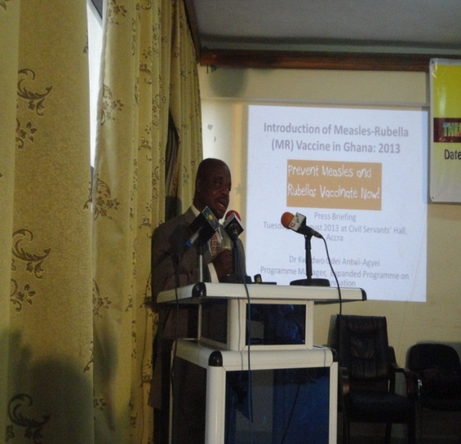
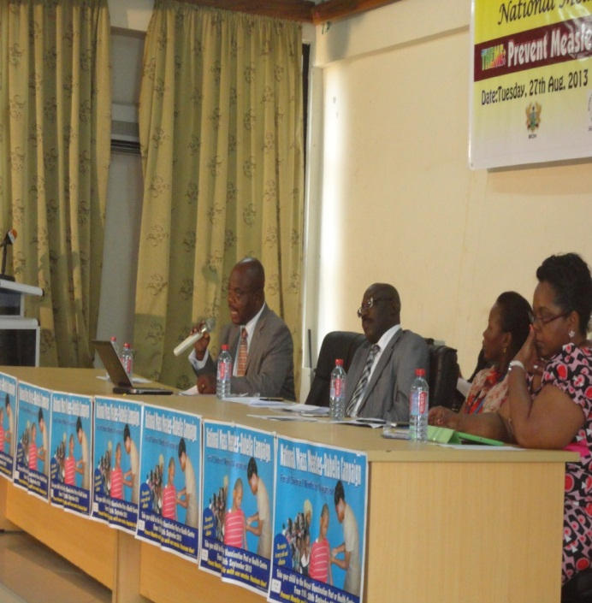
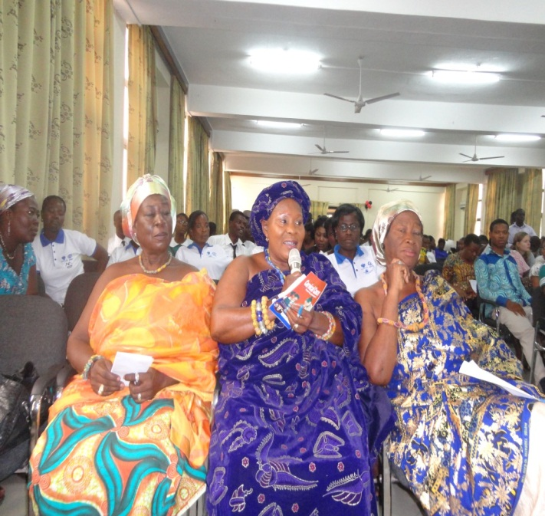
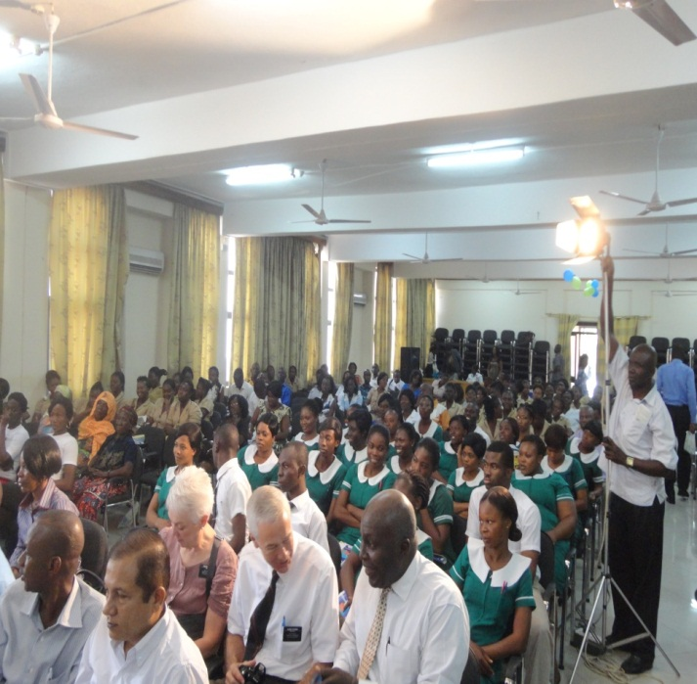
Ghana: Engaging the media to send messages Press briefing of MR Vaccination Campaign

Slide 7
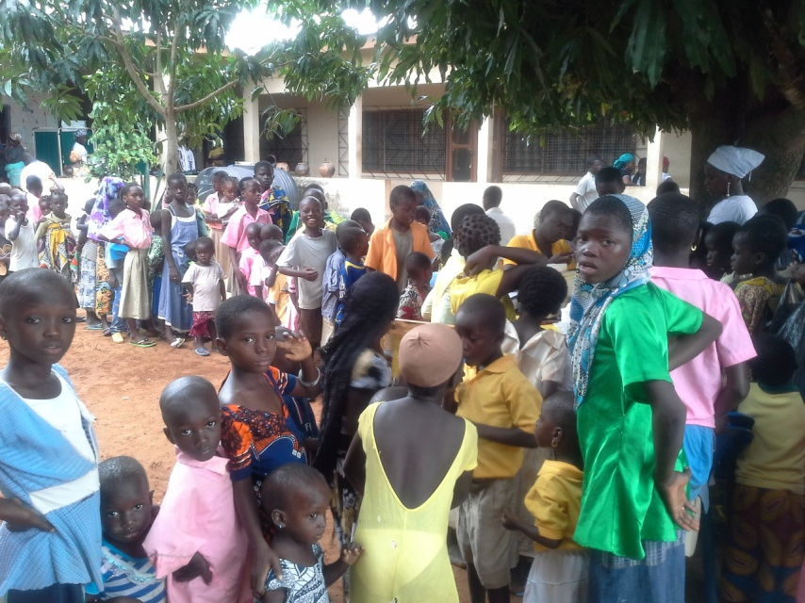
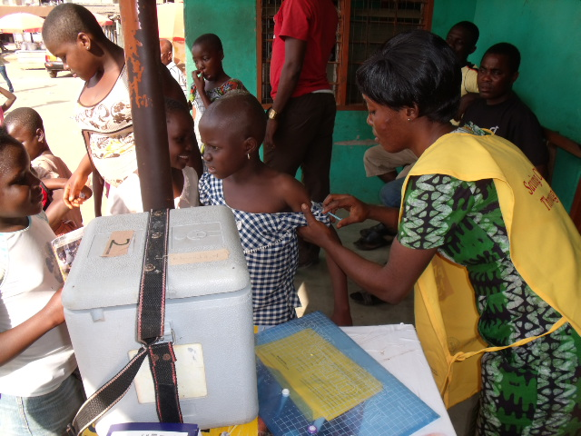
Implementation- High turn out
95.7% National coverage achieved ( Cov. Survey)
Supervisors at all levels - team, district, regional and national supervisors
Coordinators – national, regional, district and sub-district
Command centers at all levels
  Daily monitoring of performance through review meetings at all levels
  Daily Reporting to the regional and national level through emails, phone calls and SMS text messaging
AEFI Monitoring

Slide 8
Use of surveillance data to determine the target age group for SIAs, 2013/ 2014
M&RI support received for wider-age group SIAs – up to 10yrs based on local epidemiology
      DRC , Chad in 2013/ 2014 ( Gavi+ M&RI OBF)
      Togo, Benin, Mauritania, Cote d’Ivoire in 2014
      Mali in 2015
      M&RI and local funding for MR SIAs mobilized
            - Cape Verde: up to 24 years age
      Self financing
          - Angola in 2014
    Cape Verde: up to 24 years age

Slide 9
Major gaps documented with SIAs Quality
Delay in preparing plan & getting ICC endorsed plan for partners support eg. POAs not received- Niger, CAR..
Late and inadequate preparation & weak coordination
Late and/or poor quality micro-planning missing hard to reach population/areas repeatedly.
Lesson learnt from previous SIAs are not used systematically during planning and implementation
Failure to use evidence-based approach for communication and social mobilization

Slide 10
Major gaps documented with SIAs Quality (2)
Delayed in ordering vaccine and devices
Delay in clearance of injection materials and safety boxes - postponement of the campaign eg. TAN
Inadequate logistics management: poor distribution/ stock-outs
Failure in addressing Epidemiological shift of the susceptible pool to older age groups- for SIAs target age groups due to resource gap, Eth, NIG

Slide 11
Age Distribution of Measles Cases, Ethiopia 2006- 2015*

Slide 12
Confirmed Measles Cases , Ethiopia 2006–2014
1st Follow-up
2nd Follow-up
3rd Follow-up
4th Follow-up
Notes:
An example of limited impact of SIAs is shown on this chart from Ethiopia. Iy shows the weekly number of confirmed measles cases in Ethiopia for 2006-2014. Blue arrows show follow-up campaigns, all split in 2-5 different phases and targeting children <5y (except <4y in 2010-11). Despite these SIAs, large seasonal peaks continued in 2011/12 and 2013/14 (13,301 cases in 2014). The age distribution of cases is also shifting to >60% older than 5 y of age. Clearly the SIAs in 2010/11 and 2013 were not sufficient to prevent these outbreaks
1st follow-up targeted 6-59m
2005 97%
2006 87%
Overall coverage 88%
2nd follow-up 6-59m
2007 98%
2008 92%
Overall 92%
3rd follow-up 6-47m
Phase 1 107%
Phase 2 97%
Total 106% admin; survey estimate was 88%
4th follow-up 9 – 59m
Admin coverage was 98%, >95% for 66% of zones = 68 / 103 zones
Survey coverage was 90.7%, >92% for 55% of zones (technically, 55% of zones “passed” the LQAS, meaning that the confidence limits indicated the zones had a high probability of having coverage >85%).
.

Slide 13
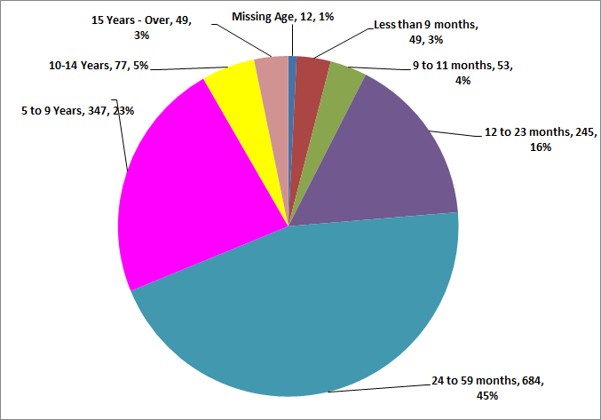
Distribution of Confirmed Measles Cases (Lab + Epi-link + Clinical) by Age,
Nigeria (Week01-20, 2015)

Slide 14
Major gaps documented with SIAs Quality (3)
Insufficient monitoring and supervision
Wrong numerator and/denominator (population data and reporting issue?)
Provisions not done systematically during planning for mop-up in districts with low coverage
Post SIAs Coverage validation not systematic and sometimes conducted very late
Sub-optimal quality of SIAs, Inadequate preparations and resource mobilisation

Slide 15
Delays in availability of funds: critical dates
Late fund disbursement by external (Gavi, M&RI) and local ( gov & local partners)
M&RI Late fund disbursement, UNF proposal submission process and fund transfer to WHO & UNICEF delays fund transfer to countries in the first quarter of each year
Inadequate or missing financial support from government and local partners eg. Uganda there is $3.2 million funding gap- campaign is scheduled in Sept, 2015.

Slide 16
Delays for making funds available: critical dates (2)
Gavi application/ approval/ Fund disbursement process takes at least 6-7 months
Countries | SIAs Plan approved by ICC | Decision letter received | External funds received in country | Funds at provincial/ district level | Champaign date
BFA | Sept 13 | Mar 14 | July 14 | Aug 14 | Oct 14
SEN | Aug 12 | May 13 | Jul 13 | Oct 13 | Nov 13

Slide 17
Comparison of Measles SIA Administrative vs. Survey Coverage, African Region, 2014-2015
-- 22/29 (76%) SIAs >95% national admin cov.
-- 6/14 (43%) SIAs >95% by Survey
-- 10% of all SIAs >95% in all districts
Notes:
This figure shows a comparison of measles SIA administrative coverage vs. survey coverage for 20 countries in the African Region in 2011-2012. The dotted line shows the target of 95% coverage and you can see that whereas three quarters of the countries report achieving the target (blue bars), by survey only ONE quarter did (red bars). This has led to a false sense of security and unexpectedly large measles outbreaks following SIAs

Slide 18
Comparison of Measles SIA Administrative vs. Survey Coverage, African Region, 2011-2013
Notes:
This figure shows a comparison of measles SIA administrative coverage vs. survey coverage for 20 countries in the African Region in 2011-2012. The dotted line shows the target of 95% coverage and you can see that whereas three quarters of the countries report achieving the target (blue bars), by survey only ONE quarter did (red bars). This has led to a false sense of security and unexpectedly large measles outbreaks following SIAs

Slide 19
Future plans to Improve Quality of SIAs
  Providing long term technical support 2-4 months- availability of global/regional pool of MR consultants
  Use of SIAs readiness assessment tool in order to identify gaps and take appropriate action on time
  Quality SIAs peer review workshop to improve preparation using monitoring for action
  Technical & financial support for Post SIAs coverage survey

Slide 20
Future plans to Improve Quality of SIAs (2)
  Document and disseminate “Best practices” in conducting measles SIAs, and using SIAs to strengthen routine EPI
  Ensure systematic calculation and use of adapted SIAs Quality indicators
  Continue promoting local resource mobilization

Slide 21
Improving Quality of SIAs
Technical & Financial Support
CAPACITY BUILDING
Consultants Training
E-Learning
FETP
Measles STOP
Regional workshops
Training Modules
Long term TA
Programme risk assessment
Global SIA Guidelines
  Pre-SIA readiness assessment
  Intra-SIA monitoring
  Post-SIA coverage survey
New seroprevalence survey methods
Funding:
  BMGF grant $18M
  GAVI Business Plan $2M/yr
Notes:
The approach being taken to improve the quality of SIAs is to strengthen country capacity to plan, implement and monitor their SIA performance. The chart on the rights shows the activities that are being implemented to build country capacity. These include …
New global tools and guidelines are being developed be used by Regions and countries. These include a Programme Risk Assessment tool (based on measles data). Global Guidelines for SIAs using injectable vaccines (MR vaccine) with sections on pre-campaign readiness assessment, intra-campaign supervision and monitoring, as well as new methods for conducting post-SIA coverage surveys. These activities are being supported by a grant from the Gates Foundation for $18 million dollars over 4 years as well as Gavi funds for TA through the Gavi Business Plan

Slide 22
Qs for TAG
What are the best approaches to ensure timely availability of resources and plans to guarantee implementation of high quality M/MR SIAs?
  Have a cut-off point for submission of final POAs?
  Advocate and assess country ownership?
What can be done to ensure early submission of Gavi application and timely approval for countries supported by Gavi for the introduction of MR & SIAs support ( Eth, Nigeria, DRC…)

Slide 23



















Anne Ray Charitable Trust

