Slide 1
Regional measles elimination program updates
B Masresha
WHO AFRO
AFR MR TAG Meeting
Nairobi, June 2015

Slide 2
Outline
Measles elimination targets
Routine immunisation coverage
  MCV2 introduction
  MR introduction
SIAs quality and financing
Surveillance performance
Overall progress towards Regional measles elimination
Next steps

Slide 3
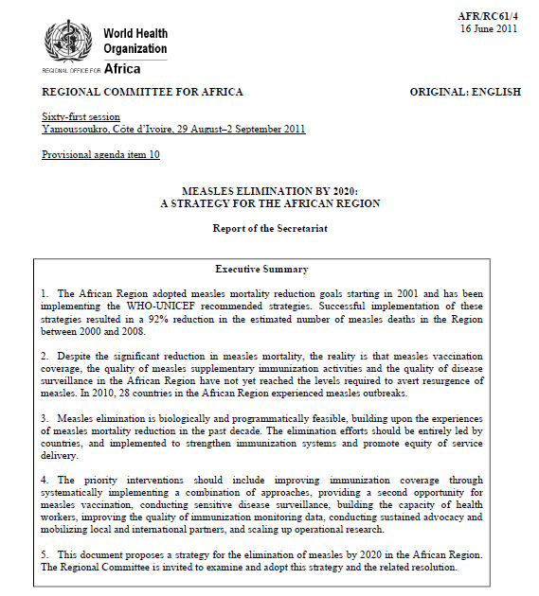
African Regional goal to achieve measles elimination by 2020
>95% MCV1 coverage at national and district level
> 95% SIAs coverage in all districts.
incidence of < 1 case / 10⁶ population /year (excluding imported cases).
Achieve the surveillance performance targets

Slide 4
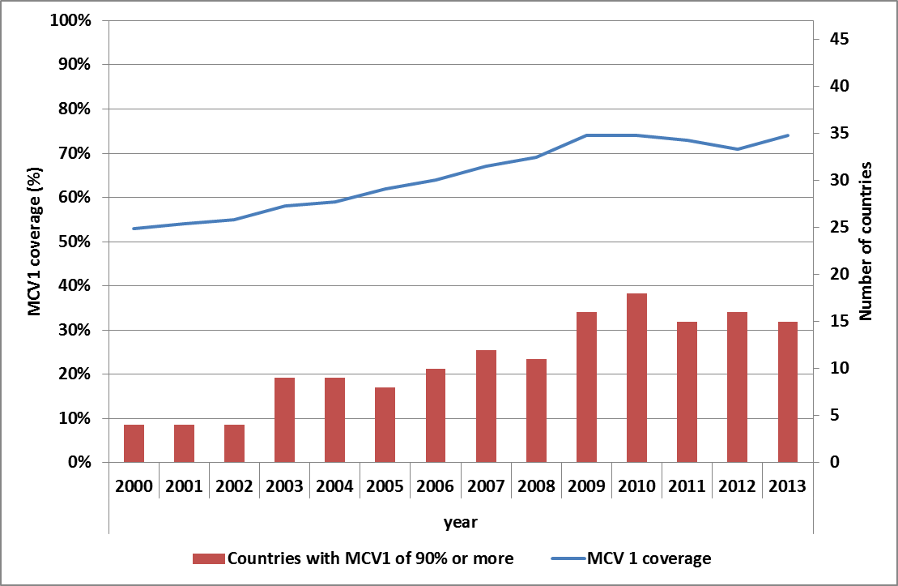
MCV1 coverage WHO UNICEF estimates, and number of countries reaching > 90% coverage. 2000 – 2013. (N=47)

Slide 5
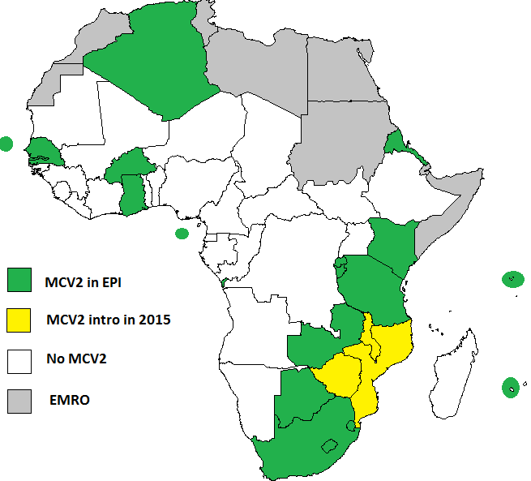
Status of MCV2 introduction in AFR. May 2015
19 countries with MCV2
3 countries approved / pending approval by GAVI and introducing in 2015

Slide 6
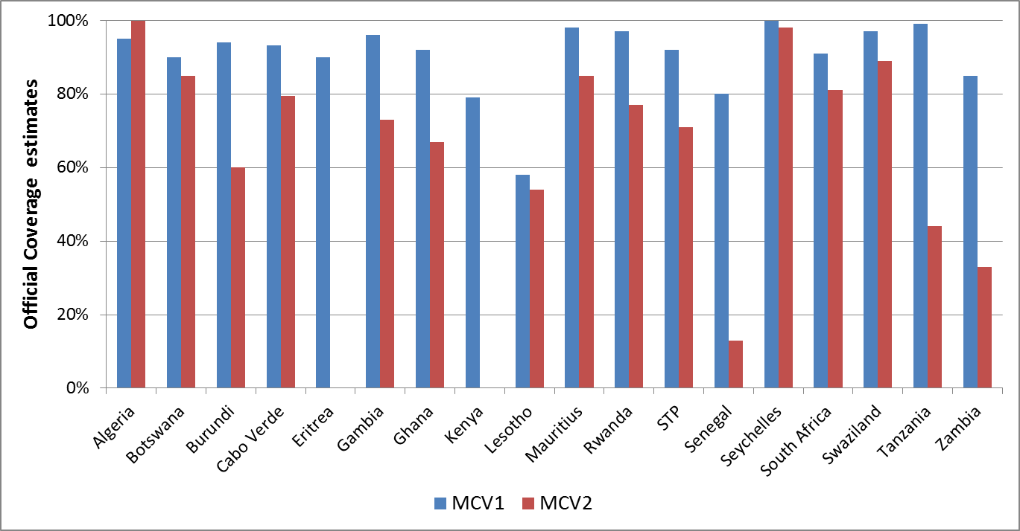
MCV1 and MCV2 reported admin coverage. 2014
Eritrea and Kenya did not report MCV2 coverage in JRF in 2014!

Slide 7
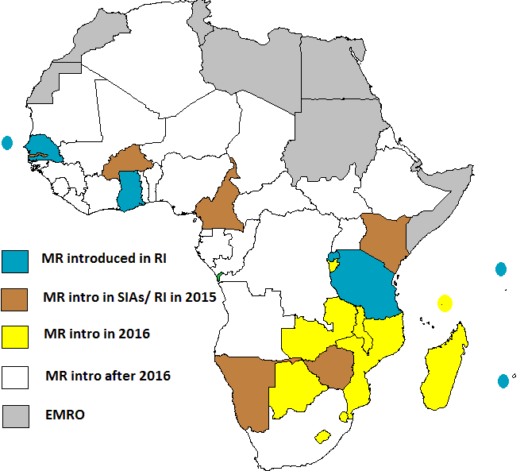
Status of MR introduction in AFR.
May 2015.
7 countries with MR in routine EPI
BFA did MR SIAs, and will introduce MR in EPI in 2015
MR SIAs in 2015 in CAE, GAM, KEN, NAM, ZIM

Slide 8
Measles SIAs in AFR. 2001 - 2014
A total of 774 million reached in SIAs since 2001.

Slide 9
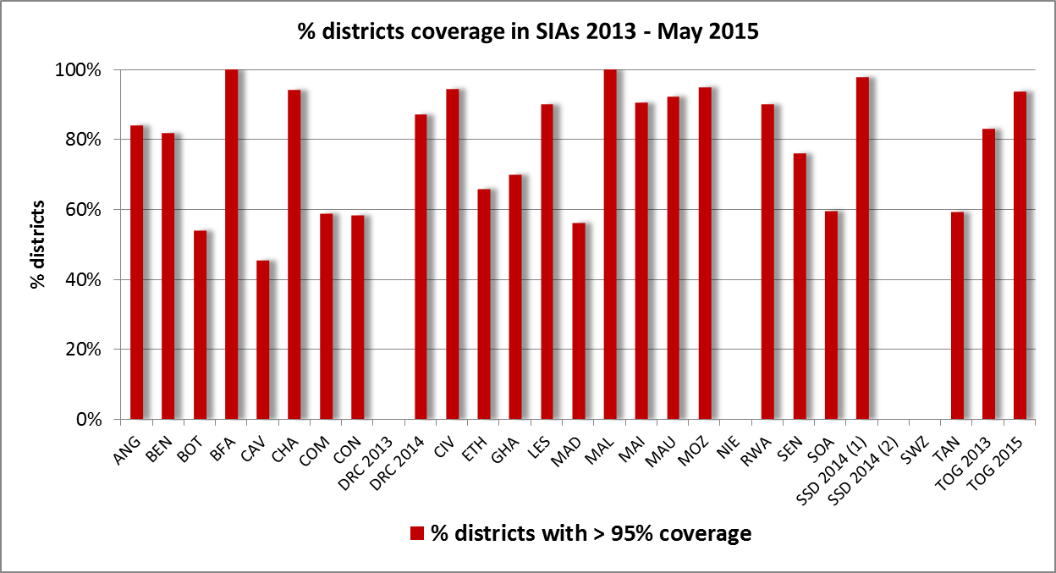
Quality of SIAs - district coverage

Slide 10
Funding for SIAs in 2014 - 2015
Country | Age target | Source of funding | GAVI funding | MRI funding for ops thru WHO (incl GPEI) | Local contributions
Angola | 9 M - 9 Y | Self |  | $245,687 | $14,856,335
Benin | 9 - 59 M | MRI |  | $409,834 | $183,472
BFA | 9 M - 14 Y | GAVI | $11,574,660 | $0 | $30,000
Chad | 9 - 59 M | GAVI / MRI | $2,134,652 | $2,470,183 | $697,247
CIV | 9 M - 14 Y | MRI |  | $2,869,333
DRC (Feb) | 9 M - 9 Y | GAVI / MRI |  | $1,408,052
DRC (April) | 9 M- 9 Y | GAVI / MRI |  | $850,066 | $288,506
DRC (July) | 9 M - 9 Y | GAVI / MRI |  | $1,529,676
Liberia | 9 M - 9 Y | MRI |  | $158,793
Mali | 9 M - 14 Y | MRI |  | $2,394,890 | $1,112,894
Mauritania | 9 - 59 M | MRI |  | $223,333 | $200,000
S Sudan | 9 - 59 M | MRI |  | $2,610,653
Tanzania | 9 M - 14 Y | GAVI | $28,826,693 | $120,000 | $346,867
Togo | 9 M - 9 Y | MRI |  | $184,000 | $50,916
 |  |  |  | $15,290,501 | $17,766,237

Slide 11
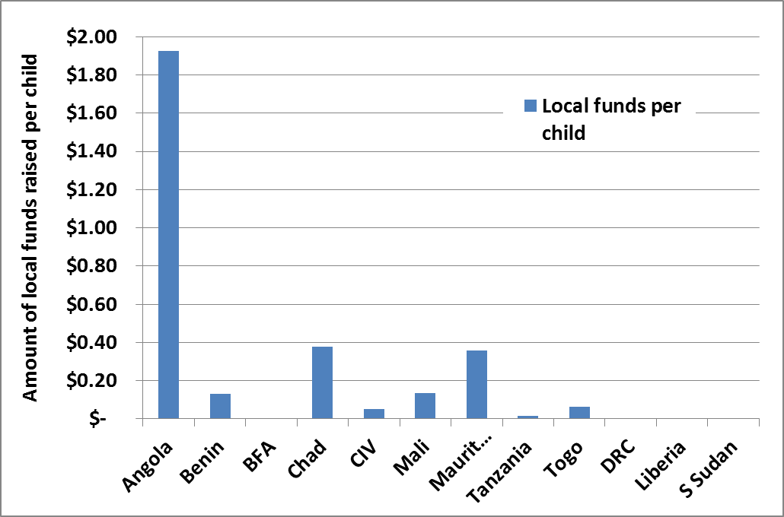
Local resources for measles SIAs per child targeted. 2014

Slide 12
Key Measles Surveillance Performance Indicators, African Region 2011 – end April 2015.
PERFORMANCE INDICATORS | 2011 | 2012 | 2013 | 2014 | 2015*
Number of reporting countries | 43 | 43 | 43 | 44 | 44
Number of suspected measles cases reported | 74,896 | 55,717 | 101,196 | 67,002 | 27,085
Number of confirmed measles cases | 32,323 | 20,935 | 69,910 | 37,394 | 11,355
Non-measles febrile rash illness (target >2/ 100,000 population ) | 4.4 | 3.7 | 2.9 | 2.6 | 2.6
% districts reporting at least 1 case with blood sample (target >80%) | 81% | 84% | 78% | 77% | 56%
Incidence of confirmed measles per million population | 42 | 27 | 76.9 | 39.5 | 11.8
* Info as of end April 2015

Slide 13
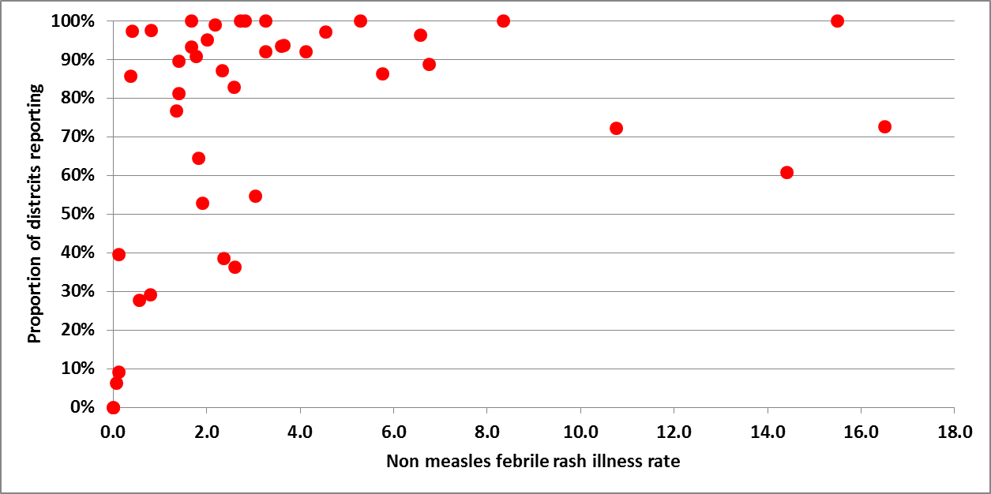
Scatter plot of surveillance performance according to the two principal indicators. 2014

Slide 14
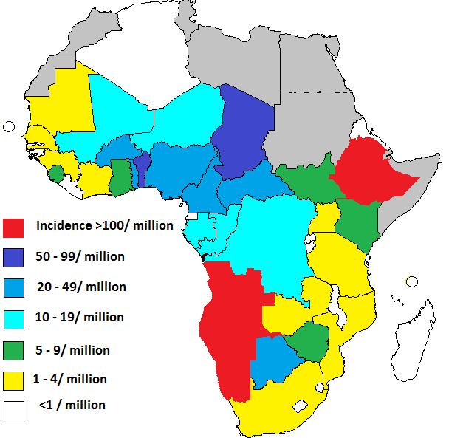
Incidence of confirmed measles in AFR. Case based surveillance data. 2014.
22 of 44 countries met the targets for both of the main surveillance performance indicators in 2014.

Slide 15
Measles incidence. AFR. 2014
Incidence per million population | # (%) of countries | Population | % of total regional population
<1 | 12 (27%) | 112.2 | 12%
1.0 – 4.9 | 9 (20%) | 196.9 | 21%
5 – 9.9 | 6 (14%) | 137.8 | 15%
10 – 19 | 5 (11%) | 128.5 | 14%
20 – 99 | 9 (20%) | 258.3 | 27%
100 and above | 3 (7%) | 113.2 | 12%

Slide 16
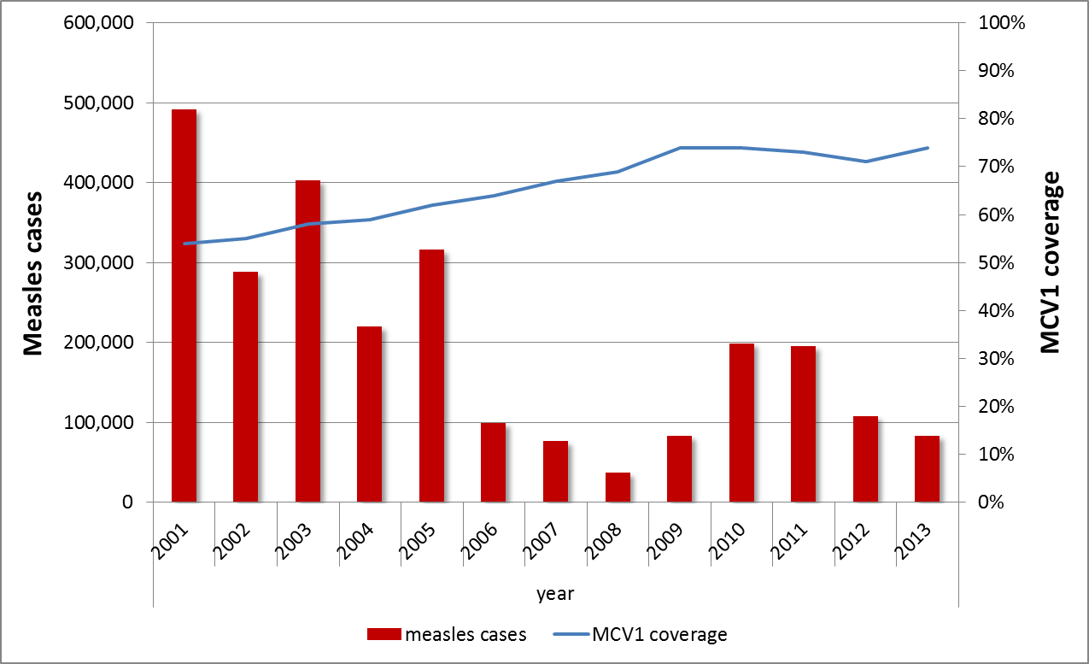
MCV1 coverage (WHO UNICEF estimates) and official case reports (JRF). AFR. 2001 - 2013
64% of case reports in 2010 = from Malawi
69% and 68% of case reports in 2011 and 2012= from DR Congo
63% cases in 2013 = Nigeria
89% cases in 2013 = 4 countries ( NIE, ANG, ETH, UGA)

Slide 17
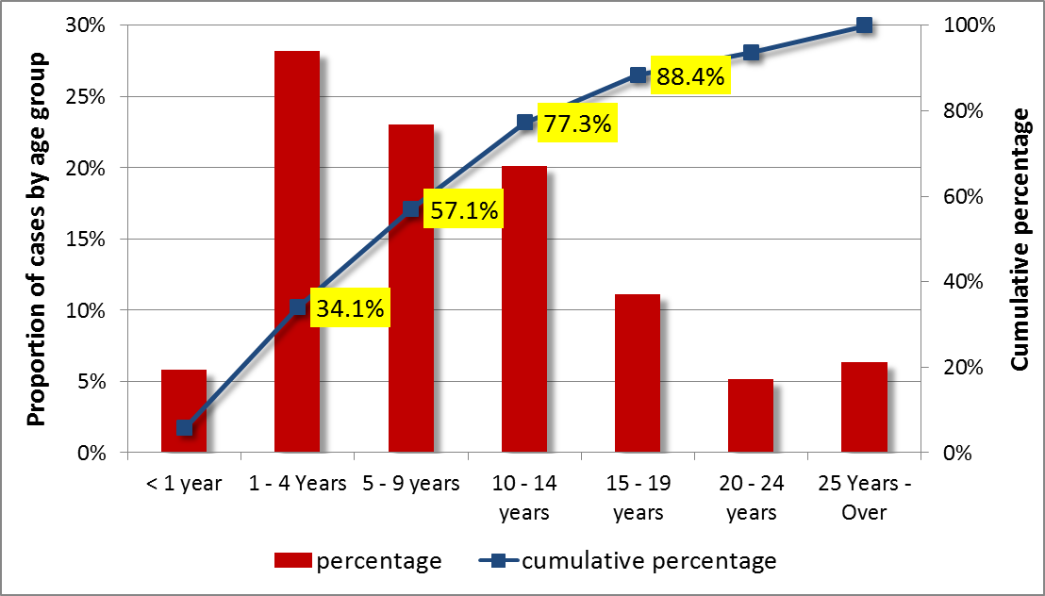
Age pattern of confirmed measles – the example from Ethiopia. 2015
N= 6955 confirmed cases as of epi week 18, 2015

Slide 18
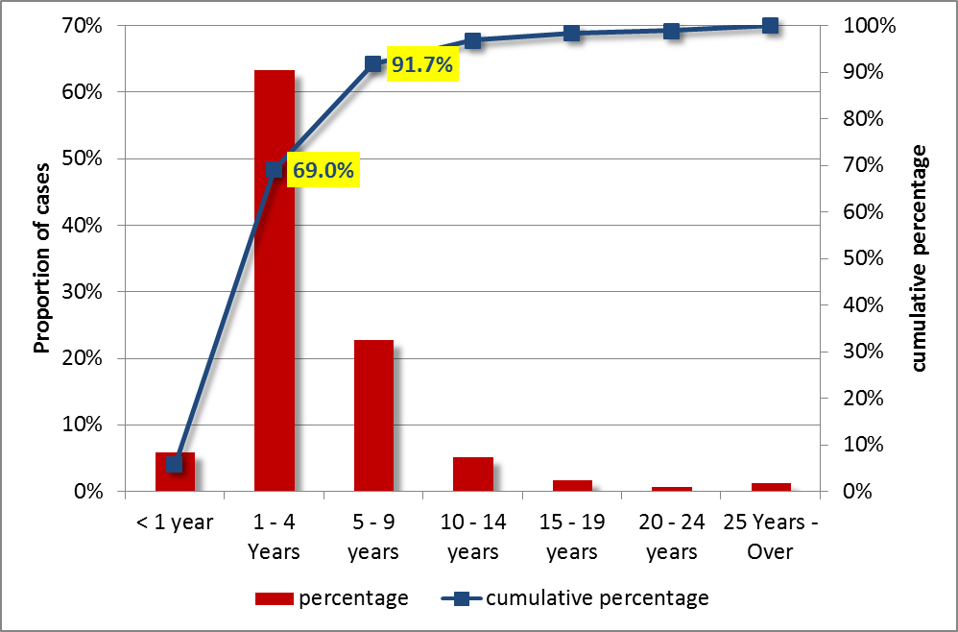
Age pattern of confirmed measles – the example from Nigeria. 2015
N= 1253 confirmed cases as of epi week 18, 2015

Slide 19
Introducing measles – rubella elimination standard surveillance
Guidelines finalised along with specific indicators
Training done in Rwanda, Botswana, Swaziland
Consensus built in Seychelles
Next in Eritrea, Ghana, Gambia, Mauritius, Cape verde, Algeria

Slide 20
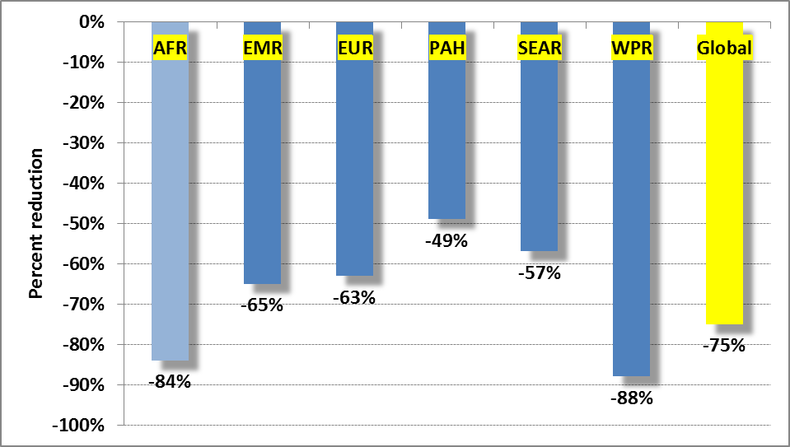
Reduction in estimated measles deaths by WHO Region. 2000 - 2013

Slide 21
Progress towards Regional measles elimination
>95% MCV1 coverage at national and district level: 8 of 47 countries in 2013 (WUENIC)
> 95% SIAs coverage in all districts: 7 of 26 countries in 2013 - 2014
incidence of < 1 case / 10⁶ population /year: 12 of 44 countries in 2014
Achieve the surveillance performance targets: 22 of 44 countries in 2014

Slide 22
Categorising countries according to levels of program implementation
Strong program, very low incidence sustained, nearing elimination (ALG, BFA, CAV, RWA, ERI, GAM, GHA, MAS, SEN, SEY, STP, ZIM) – 12 countries
  Increase MCV2 coverage, MR intro, elimination-standard MR surveillance, space SIAs wider, start work on national verification of elim’n, advocate for regional leadership of measles elimination
Coverage or surveillance gaps, on track for elimination, (BEN, BUR, BOT, CAE, CIV, COM, CON, LES, MAD, MAL, MAU, MOZ, SWZ, TAN, UGA, ZAM) – 16 countries
  Wide age-range SIAs, MCV2 intro, address surveillance gaps

Slide 23
Categorising countries according to levels of program implementation (2)
Larger countries, various forms of program gaps. (GUI, KEN, MAI, NAM, SOA,TOG, LIB, SIL) – 8 countries
  Improve quality of SIAs, Wide age-range SIAs, MCV2 intro
Very challenging countries, insecurity, high incidence and frequent large outbreaks, leadership gaps. (ANG, CAR, CHA, DRC, EQG, ETH, GAB, GUB, NIE, NIG, SSD) – 11 countries
  Advocate for better pgm ownership, RI strengthening, regular high quality SIAs targeting wider age gp, ..

Slide 24
Major challenges
Routine coverage not improving in countries with large populations
Measles elimination not yet a national priority in many countries
Lack of timely funding for [wide-age range] SIAs
Limited funding for measles-rubella surveillance and lab activities, esp as AFR scales-up to elimination mode surveillance
Weak quality investigation/ documentation of outbreaks

Slide 25
Next steps
Big advocacy drive needed using the opportunity of
  the momentum and excitement of interruption of WPV transmission
  the Ministerial level RVAP meeting in Nov 2015
  Next RC meeting
Scale up MR elimination-standard surveillance
Ensure policies are updated and align with implementation guidelines
Initiate developing the guidelines and structures for national verification of elimination

Slide 26
Thank you

