Slide 1
Update on measles & rubella surveillance in the WHO African Region – progress and challenges
Dr Richard Luce WHO/IST-Central
5th African Measles/Rubella Technical Advisory Group Meeting
June 2-3, 2015
Notes:
T

Slide 2
Outline
Measles surveillance
  Regional overview
  Country examples
  Implementation of elimination mode surveillance
  Surveillance system reviews
Rubella surveillance
  Regional overview
  Country example
Challenges

Slide 3
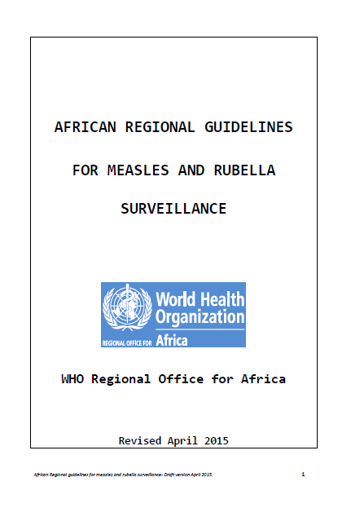
Measles/rubella surveillance guide
Previous version from 2011
Updated version April 2015
New guidance on:
  Investigation of rubella outbreaks
  Elimination mode surveillance for measles

Slide 4
Suspected measles cases (IDSR and case-based surveillance data bases) with MCV1 coverage, WHO-AFRO, 2003-2014

Slide 5
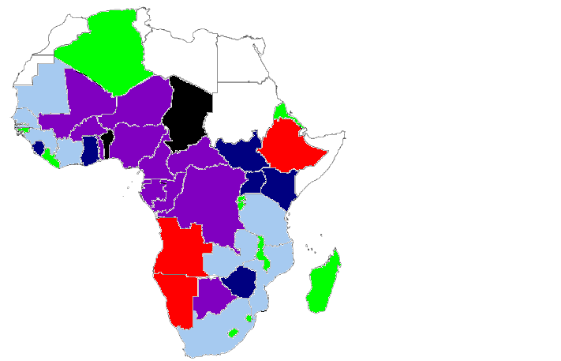
Confirmed measles incidence per million, 2014
< 1 case
≥ 1 and < 5 cases
≥ 5 and < 10 cases
≥ 10 and < 50 cases
≥ 50 and < 100 cases
≥ 100 cases
N = 37 847
EMRO countries

Slide 6
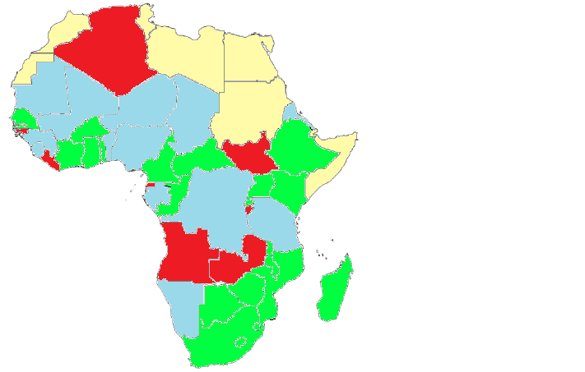
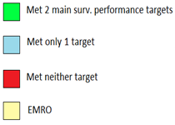
Measles surveillance performance by principle indicators, 2014

Slide 7
Age distribution of measles cases, Equatoriale Guinea, 2015
N= 598; W1-21

Slide 8
Age distribution of measles cases, Chad, 2015
N= 376; W1-21

Slide 9
Nigeria measles outbreaks in 2015
As of week 18, a total of 3,454 suspected measles cases reported from 37 states
1,350 confirmed cases by lab + epi link + clinical criteria (16 deaths)
  65% are < 5 yrs old
  77.5% are unvaccinated
  86.5% come from the three Northern zones (NW, NC, NE)

Slide 10
Liberia measles outbreaks in 2015
9 of 15 counties reported confirmed cases
563 suspected measles cases (518 confirmed)
  64.5% are children 9 - 59 months
  72% had not received MCV or had vaccination status unknown
  Limited specimen collection & testing over the last year (EVD)
Outbreak response activities done at various times locally in 6 counties since February 2015
Nationwide Measles SIAs May 2015, targeting 551,364 children aged 9-59 months; 99% coverage

Slide 11
Weekly reports of suspected measles cases by province, DRC, 2011-2014
Start of national SIAs Sept 2013
Source: DLM

Slide 12
Key Measles Surveillance Performance Indicators, African Region 2011 – end April 2015.
PERFORMANCE INDICATORS | 2011 | 2012 | 2013 | 2014 | 2015*
Number of reporting countries | 43 | 43 | 43 | 44 | 44
Number of suspected measles cases reported | 74,896 | 55,717 | 101,196 | 67,002 | 27,085
Number of confirmed measles cases | 32,323 | 20,935 | 69,910 | 37,847 | 11,355
Non-measles febrile rash illness (target >2/ 100,000 population ) | 4.4 | 3.7 | 2.9 | 2.6 | 2.6
% districts reporting at least 1 case with blood sample (target >80%) | 81% | 84% | 78% | 77% | 56%
Incidence of confirmed measles per million population | 42 | 27 | 76.9 | 39.5 | 11.8

Slide 13
Evolution of measles surveillance performance
Surveillance indicator | Number (%) of countries (2008, n=40) | Number (%) of countries (2012, n=43) | Number (%) of countries (2014, n=44)
NMFRI > 2/10⁵ | 24 (60%) | 29 (67%) | 26 (59%)
> 80% of districts with blood specimen | 21 (53%) | 26 (60%) | 29 (66%)
Both indicators | 16 (40%) | 22 (51%) | 22 (50%)
Countries with ≥1 district outbreaks |  | 29 (67%) | 26 (59%)
Incidence (< 5 cases / 10⁵) | 10 (25%) | 18 (42%) | 23‡ (48%)
‡14 < 1 case / 10⁶

Slide 14
Comparison of polio & measles surveillance performance, 2014
 | Polio |  | Measles
Country | AFP > 2/10⁵ per population < 15 years of age | % of cases with 2 samples collected in 14 days (80%) | NMFRI > 2/10⁵ | > 80% of districts with blood ≥ 1 specimen
Angola | 2,9 | 91 | 1,4 | 76
Congo | 5,3 | 88 | 3,6 | 97
Tchad | 5,8 | 95 | 0,4 | 87

Slide 15
Surveillance reviews 2014
Zambia
  Case definitions were correctly given by staff in < 50% of health facilities
  Polio surveillance performance indicators achieved
  Measles surveillance performance indicators not achieved
Uganda
  Active surveillance not systematically implmented
  Lack of documentation and refresher training
  Lack of connection between community surveillance and health facility for reporting
  No designated surveillance focal person in districts visited

Slide 16
Changes in elimination mode surveillance
“Suspected measles/ rubella”:
  Fever + generalised maculopapular rash
  OR Clinician diagnosed measles/ rubella
Measles epidemiological linkage: suspected case meets surv. case definition, is directly linked / contact established to a lab confirmed measles case with dates of rash onset occurring 7 – 21 days apart
An imported measles case is a confirmed case of measles which, as supported by epidemiological and/or virologic evidence, was exposed outside of the country during the 7–21 days prior to rash onset

Slide 17
Implementation of elimination mode surveillance (Seychelles)
Planning mission conducted May 2015
> 95% coverage with MMR1 and MMR2 for more than a decade
  Web based IDSR system in place (last outbreak of 10 cases in 2006)
  Will include key variables into the e IDSR system to generate the necessary indicators
Next steps:
  Establish lab confirmation of M/R
  Provide necessary training for lab and epi staff
  Establish regular data sharing

Slide 18
Implementation of elimination mode surveillance
Training conducted
  Botswana
  Swaziland
  Rwanda
Next countries:
  Gambia
  Mauritius
  Cape Verde
  Algeria
  Senegal
  Eritrea
  Ghana

Slide 19
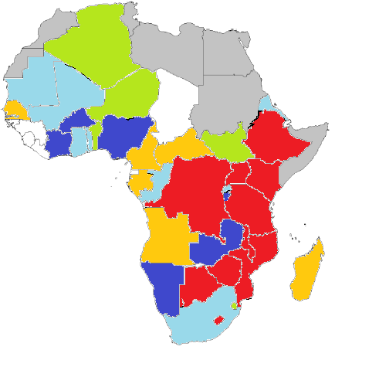
IgM+ rubella cases, 2014
0 confirmed cases
0-10 confirmed cases
11-50 confirmed cases
51-100 confirmed cases
101-200 confirmed cases
> 200 confirmed cases
EMRO countries

Slide 20
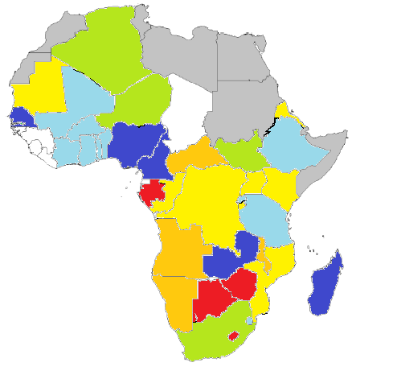
IgM+ rubella incidence per million, 2014
0 case
< 1 case
≥ 1 and < 5 cases
≥ 5 and < 10 cases
≥ 10 and < 30 cases
≥ 30 and < 50 cases
≥ 50 cases
EMRO countries

Slide 21
Lab confirmed rubella cases by age group, AFR, 2003 – 2015* (N= 46,908)
N =
3462 | 2699 | 1638 | 2354 | 2651 | 3809 | 2344 | 2480 | 7704 | 6595 | 3750 | 5853 | 1599

Slide 22
Confirmed rubella cases age group 2006-2014, Zambia
N = 872

Slide 23
Confirmed rubella cases age group 2003-2014, Kenya
N = 6173

Slide 24
Rubella outbreak in Gochas district of
Hardap Region , Namibia (N=165)
1st confirmed case presented on 3 Sept 2014
Last confirmed case was seen on 7 March 2015
April 15 end of outbreak
Out of those, 78 are males and 87 females (1 pregnant woman)
No serious complications were reported
No deaths were reported

Slide 25
Age distribution of lab confirmed rubella cases in Gochas (N=165), Sept 2014- March 17, 2015

Slide 26
Surveillance challenges
Discrepancy in IDSR and case based reporting
  DR Congo
Resources for scaling up elimination mode surveillance
Ensuring that measles surveillance is active and integrated with AFP
  Performance adequately monitored
  Data is utilized for program action

Slide 27
Surveillance challenges
Limited/variable availability and timing of financial resources
Performance gaps
  Documenting the investigation of outbreaks
  Use of line lists
  Capturing the information regarding any vaccination response activities
  Data use for action at country level

Slide 28
Questions to the TAG
How to secure resources required to scale up to elimination mode surveillance, to attain and verify elimination objectives
How to link with regional initiatives to benefit measles surveillance
  Field epidemiology training programs
  Africa CDC
  Emphasis on public health response in post-EVD context

Slide 29
Thank you

