Slide 1
Invalid MCV1 doses – how big a problem?
B Masresha
WHO AFRO
AFR MR TAG Meeting
Nairobi, June 2015

Slide 2
Outline
Age of MCV1 administration – analysis of DHS data
Country examples
Desk review of national immunisation policies
Conclusion
Way forward
Questions to the TAG

Slide 3
Policies for MCV1 administration
Recommended age
  At 9 months of age in all but 2 member States (MAS, SEY)
  Starting at 6 months in outbreaks, but not to be recorded as “MCV1”
“invalid dose” which may result in a suboptimal vaccine response, if
  premature vaccinations, i.e. vaccinations administered earlier than recommended and
  Vaccinations administered with inappropriately short intervals between vaccine doses.

Slide 4
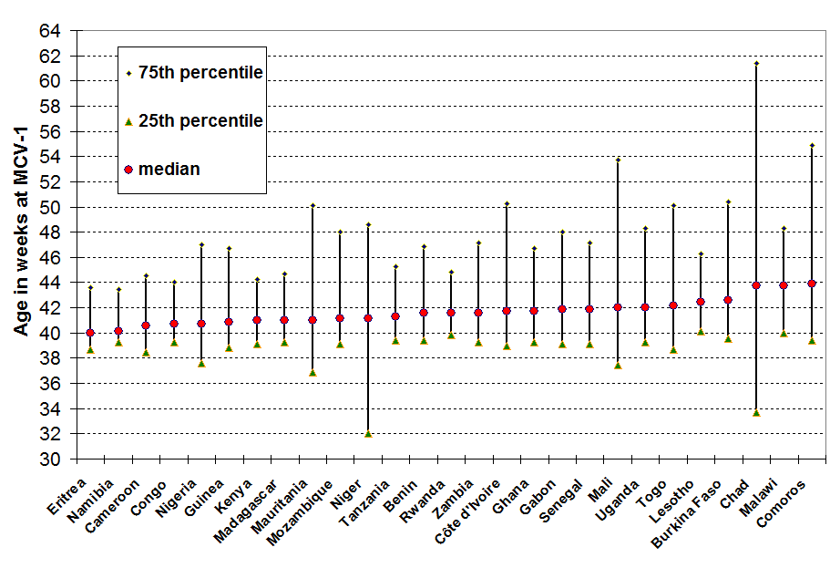
Median ages and percentile distribution of age at MCV1 in AFR. DHS data 1996 – 2004.

Slide 5
Findings from analysis of 1996 – 2004 DHS data
Average median age at MCV1 vaccination is 41.6 weeks (2.6 weeks delayed), [range: 1 - 5 weeks]
75th percentile delays; median at 8.4 weeks [range 4.4 - 22.4 weeks after the schedule]
75th percentile of distribution of age of MCV1 >/= 45 weeks of age in 19 of 26 countries
Large majority of children are not vaccinated on schedule.
A large proportion of children will be significantly delayed in being vaccinated (25% measles vaccines >2 months late).

Slide 6
Analysis using recent DHS data
Manas K. Akmatov et al. “Evaluation of invalid vaccine doses in 31 countries of the WHO African Region”. Vaccine 33 (2015) 892–901
  DHS data from 31 countries in AFR, (2003 – 2013)
    Review of records of 134,442 children with vaccination cards

Slide 7
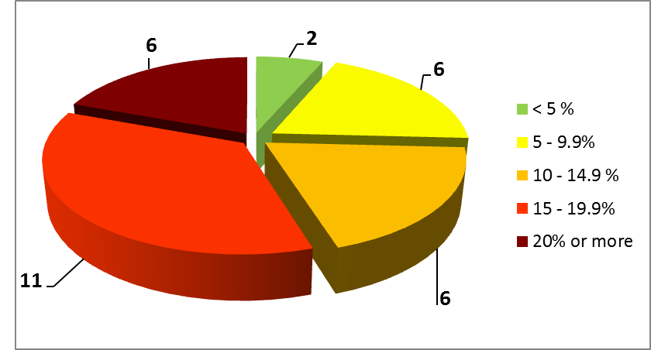
Number of countries and the proportion of invalid MCV1 doses

Slide 8
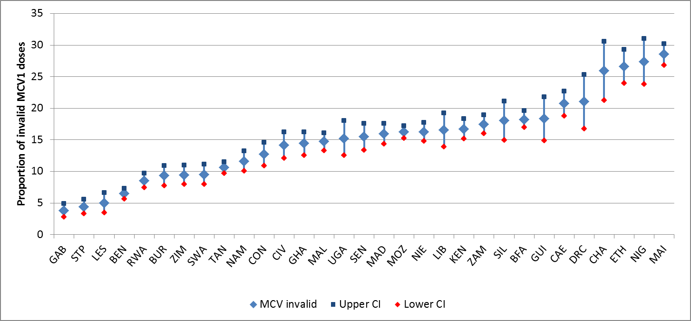
Proportion of invalid MCV1 doses and 95% confidence intervals by country. AFR.
DHS 2003 - 2013

Slide 9
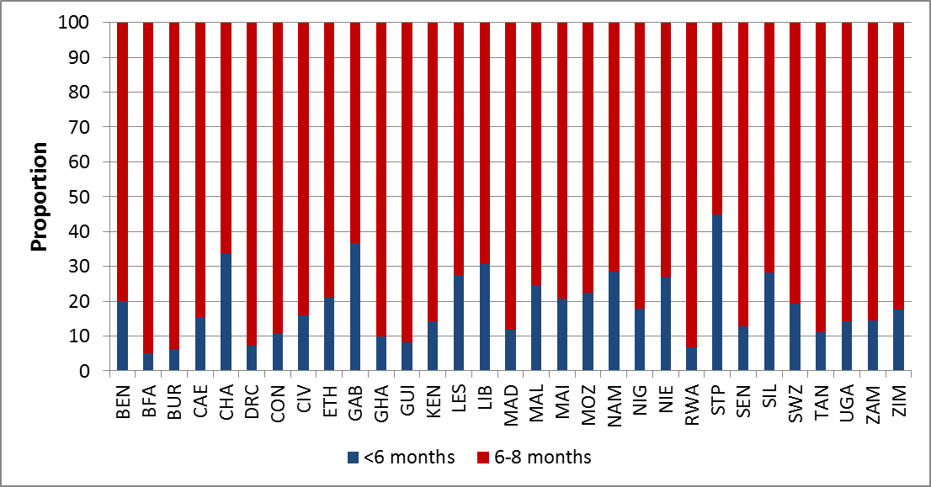
Proportion of age-invalid MCV1 doses
NB: Vast majority of invalid doses given between 6 – 8 months of age.

Slide 10
Additional DHS data analysis:
Ethiopia 2011
Ethiopia: 26.3 % (331 of 1260 with health cards with dates of MCV1 administration) doses received before the recommended age

Slide 11
Additional DHS data analysis:
Senegal 2014
Senegal: 16.6 % (345 of 2081 with health cards with dates of MCV1 administration) doses received before the recommended age

Slide 12
Additional DHS data analysis:
Uganda 2011
Uganda: 14.9 % (104 of 696 with health cards with dates of MCV1 administration) doses received before the recommended age

Slide 13
Additional DHS data analysis:
Tanzania 2010
Tanzania: 10.1 % (393 of 3909 with health cards with dates of MCV1 administration) doses received before the recommended age

Slide 14
Conclusion
5 – 25% of measles doses may be given too early!
More than half of the countries have at least 10% invalid MCV1 doses
Most invalid MCV1 doses are given between 6 – 8 doses.

Slide 15
National immunisation policy;
AFR desk reviews – May 2015
Compiled all available national immunisation policy documents from Member States
17 (36% of the Member States) national policy documents retrieved and reviewed
Some still in draft form, and dated 2003 - 2013, few undated!!
Lack of info from remaining countries!!!

Slide 16
Desk review of national immunisation policies
DATES OF NATIONAL IMMUNISATION POLICY DOCUMENTS
Undated | < 2005 | 2006 - 2010 | 2011 – to date
DR Congo | Ghana | Eritrea | Ethiopia
The Gambia | Togo | Namibia | Kenya
Madagascar |  | Nigeria | Malawi
Liberia |  |  | Saotome & Principe
 |  |  | Sierra Leone
 |  |  | Swaziland
 |  |  | Uganda
 |  |  | Zimbabwe

Slide 17
Desk review of national immunisation policies (2)
Minimum age of MCV1
  at 9 months in 15 of 17
  at 6 months in outbreaks in 4 of 17
  “younger than 9 months in outbreaks” in 1 country
Maximum age for MCV1 (or “target age for EPI”):
  11 months = 4 countries
  23 months = 2 countries
  5 years = 3 countries

Slide 18
Desk review of national immunisation policies (3)
Policy on the # needed to open a measles vial;
  The Gambia and Kenya: “1 child”
  Malawi: “Even small numbers”
Frequency of vaccination sessions at fixed sites: daily in 9 of 17 countries
Policy to check the immunisation status of infants and children coming for any health facility visits = policy exists in 8 of 17 countries

Slide 19
Desk review of national immunisation policies (4)
Invalid doses: none of the countries referred to “doses provided before recommended age”
Many references to doses provided at less than 4 weeks interval being “invalid”
Multi-dose vial policy in all countries
“Missed opportunities” referred in many policy documents
  None in the context of opening vials against the # of attendants at the vaccination session

Slide 20
Conclusions
Need to update national immunisation policies to reflect
  latest programmatic norms from the global and regional levels
  latest schedules, new vaccines
  Need to extend services to all
  Need for timely administration of vaccines

Slide 21
Way forward
Countries, with the help of WHO, to review their immunisation policies and national guidelines/ manuals with a view to clearly address the issue of invalid doses, and assure room for complete vaccination even beyond 1 or 2 years of age
Ensure that health workers understand the concept of invalid /late doses and strive to provide doses timely

Slide 22
Questions to the TAG
Are invalid doses a major problem, enough to warrant programmatic focus?
Is the information available on the invalid doses and policy gaps adequate to request a through revision of policies?

