Slide 1
Midterm Review Update
Global Measles and Rubella Strategic Plan 2012 – 2020
W. A. Orenstein, MD
Measles and Rubella Management Meeting,
Geneva, June 2016

Slide 2
Outline
Strategic Plan 2012-2020
  Rationale and objective for Midterm Review
  Overarching conclusions
Five core strategies
Building on the polio transition
Governance
  Resource mobilization

Slide 3
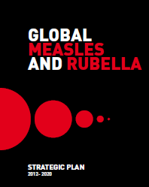
Global Measles and Rubella
Strategic Plan 2012 – 2020 (1)
Goals:
  - December 2015
    Reduce global measles mortality by at least 95% compared with 2000 estimates
    Achieve regional measles and rubella/CRS
    elimination goals
  - December 2020
    Achieve measles and rubella
    elimination in at least 5 WHO Regions

Slide 4
Global Measles and Rubella Strategic Plan 2012 – 2020 (2)
Five core strategies:
  Achieve and maintain high levels of population immunity by providing two doses of measles and rubella containing vaccines
  Monitor disease using effective surveillance, and evaluate programmatic efforts
  Develop and maintain outbreak preparedness, respond rapidly to outbreaks and manage cases
  Communicate and engage to build public confidence and demand for immunization
  Perform research and development to support cost-effective operations and improve vaccination and diagnostic tools

Slide 5
Milestones by end 2015
Reduce annual measles incidence to < 5/million, maintain level
Achieve > 95% reduction in estimated measles mortality compared with level in 2000
Achieve > 90% coverage with MCV1 nationally, and > 80% coverage in every district
Achieve > 95% coverage during SIAS in every district
Establish a rubella/CRS elimination goal in > 3 additional WHO regions
Establish a target date for measles eradication

Slide 6
Reaching the Global 2015 Milestones
Based on 2014 Data

Slide 7
Rationale for Midterm Review
Progress toward global and regional goals has plateaued
No 2015 milestones have been met
Feasibility of measles and rubella elimination questioned

Slide 8
Objectives of Review
To provide a candid review of progress toward, and key reasons for not attaining, 2015 goals
To assess the quality of implementation of strategies and principles, and recommend refinements
To formulate lessons learned and priorities for 2016 – 2020

Slide 9
Process, oversight and partner engagement
Process
  5 external consultants + secretariat
  Global, regional and country level assessment
    1-2 countries per Region
  Focus on strategy
  Desk review; interviews with key informants
Oversight
  SAGE (Measles and Rubella Working Group) – 2016
  World Health Assembly – 2017 (as part of GVAP Report)
Partner Engagement
  Partners participate in launch meeting, conference calls, and have the opportunity for input through this meeting and e-mail

Slide 10
Report: eight sections
  Monitor disease using effective surveillance, and evaluate programmatic efforts
  Achieve and maintain high levels of population immunity by providing two doses of measles and rubella containing vaccines
  Develop and maintain outbreak preparedness, respond rapidly to outbreaks and manage cases
  Communicate and engage to build public confidence and demand for immunization
  Perform research and development to support cost-effective operations and improve vaccination and diagnostic tools
  Building on the polio transition
  Governance
  Resource mobilization and advocacy

Slide 11
Overarching conclusions (1)
Current trends indicate that the Strategic Plan goal of achieving measles and rubella elimination in at least 5 WHO regions by 2020 is not on track.
Although all 6 regions have measles elimination goals and the ultimate vision is a world free of measles, it is premature to set a timeframe for eradication at this point. A review should be undertaken in 2020 to determine formal goals with timeframes for achievement.

Slide 12
Overarching conclusions (2)
Strengthening of immunization systems is critical to achieving regional elimination goals. There must be a focus on how working to achieve measles and rubella eradication can help strengthen health systems in general and immunization systems in particular.
Measuring coverage with measles and rubella containing vaccines, while important, is not the best indicator of progress toward measles and rubella control/elimination. Disease incidence is the most important indicator of progress.
There is an urgent need to strengthen the collection and use of surveillance data to better guide program strategy and implementation

Slide 13
Surveillance --findings
Successes
  188/194 member states with case-based surveillance for measles
  Global measles and rubella lab network
Challenges
  Although 188 countries have measles case-based reporting, only 157 countries report to global level; at global level there is no reporting of rubella
  Frequency of in-country case reporting is variable
  Indicator of surveillance sensitivity (>2/100,000 discards) requires further validation
  Within countries, quality of surveillance variable
  Case investigation data often incomplete
    No hospitalization, death, economic burden data requested, limiting the use of data for advocacy
  Global outbreak investigation protocol is basic
    Cannot determine who is giving disease to whom
  Translation of data to programmatic change often weak
  Surveillance infrastructure under-resourced

Slide 14
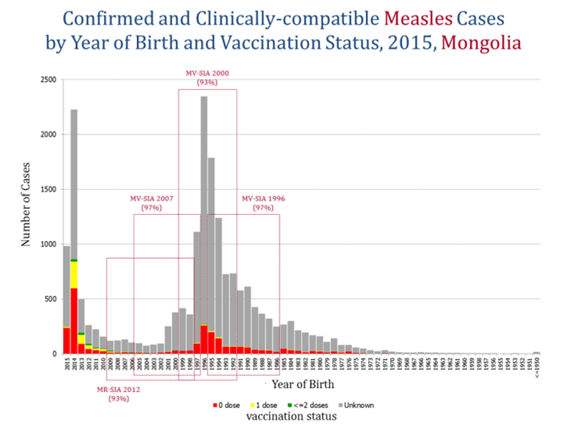
Power of surveillance

Slide 15
Surveillance recommendations (1)
A top priority for achieving the goals of the Measles Rubella Strategic Plan is to enhance case-based, laboratory-supported surveillance for measles and rubella
  All countries must implement case-based surveillance for measles and rubella
  Cases should be reported weekly from country to region
A working group on surveillance and outbreak investigation should be developed
Protocols need to be developed to guide how to conduct, interpret and disseminate data analysis results for policy
  E.g., who is transmitting to whom
  Exposure settings

Slide 16
Surveillance recommendations (2)
Sera collected to investigate cases of rash illness with fever to diagnose measles should be tested for rubella if found to be negative for measles, or tested for both at the same time
Training materials should be developed for use at global, regional and country levels to design and improve systems to collect both surveillance data and perform outbreak investigations and interpret data and disseminate results to all levels of the system
Countries need to dedicate resources for surveillance and partners need to supplement resources as needed, including resources for staffing, lab support, training, and other operational costs. Countries eligible for funding from Gavi should consider using HSIS funding to support the surveillance infrastructure
It is critical in developing surveillance systems to include the private sector

Slide 17
Surveillance recommendations (3)
CRS surveillance, either sentinel or national level, should be implemented, especially in countries using measles rubella vaccine
As the GPEI winds down, at a minimum the current level of measles and rubella surveillance should be maintained. Wherever possible the transition should be capitalized on to further strengthen surveillance for measles and rubella and other vaccine preventable diseases
The current measures to evaluate the quality of surveillance systems should be reviewed.
  Efforts should be made to determine if having 2 cases of rash illness with fever per 100,000 children per year shown not to be measles is adequate to say that measles would be detected if present

Slide 18
Immunization delivery -- findings
Successes
  Since 2012, 18 countries have introduced rubella containing vaccine.
  To date, 160 countries have introduced MCV2, up from 136 in 2010
Challenges
  MCV1 coverage remains inadequate
    2 regions have MCV1 coverage < 80%
  Quality of SIAs remains problematic
    Among 34 countries conducting SIAs between 2012 – 2014 followed by coverage evaluation, only 16 had coverage > 95%
    SIAs delayed due to funding gaps
  Assessment of coverage remains unreliable

Slide 19
Immunization coverage with 1st dose of measles containing vaccines in infants, 2014
<50% (4 countries or 2%)
50-79% (33 countries or 17%)
80-89% (35 countries or 18%)
90-94% (46 countries or 24%)
>=95% (76 countries or 39%)
The boundaries and names shown and the designations used on this map do not imply the expression of any opinion whatsoever on the part of the World Health Organization concerning the legal status of any country, territory, city or area or of its authorities, or concerning the delimitation of its frontiers or boundaries. Dotted lines on maps represent approximate border lines for which there may not yet be full agreement. © WHO 2015. All rights reserved
Source: WHO/UNICEF coverage estimates 2014 revision. July 2015. Map production: Immunization Vaccines and Biologicals, (IVB). World Health Organization
Date of slide: 16 July 2015
Not available
Not applicable

Slide 20
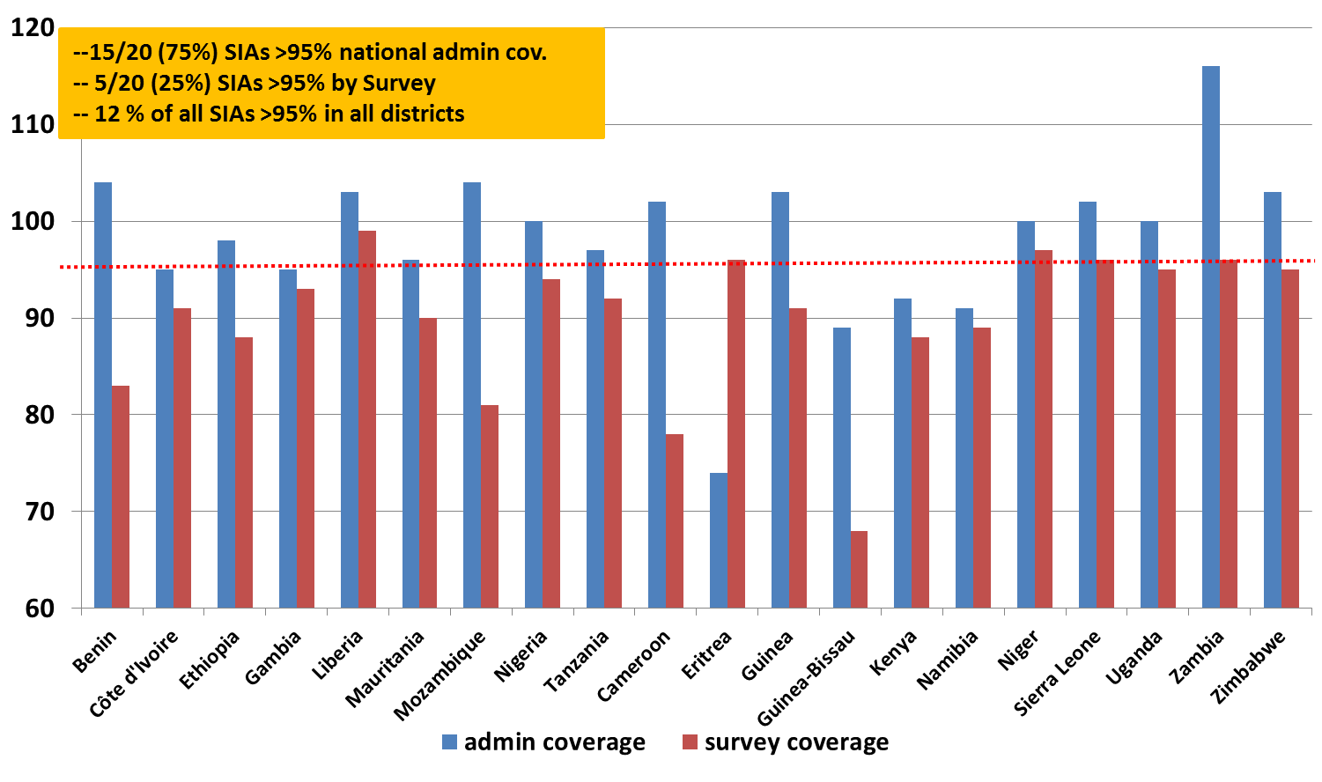
Challenge of SIA quality
Measles SIA Admin. vs. Survey Coverage, African Region, 2011-2012

Slide 21
Immunization delivery – recommendations (1)
Measles and rubella control and elimination activities at national level should be located within the overall immunization program.
Efforts to enhance measles and rubella prevention should take into account the importance of strengthening the overall immunization delivery system. For example,
  Delivery of MCV2 can be used as a platform to deliver other health interventions
  In planning SIAs, the enumeration of high-risk communities can be focused to also develop delivery of routine immunization services to these same populations, as was done in India.

Slide 22
Immunization delivery – recommendations (2)
A standardized method to categorize countries based on their likelihood of achieving and sustaining achievement of measles and rubella goals should be developed. Immunization (and surveillance) strategies should be tailored to the country category.
The current approach for determining the target age range for measles containing vaccine SIAs and measles and rubella containing vaccine SIAs should be re-evaluated, including the potential for developing new guidelines based on more detailed analysis of subnational data
Approval of financial support from international partners for preventive SIAs should be conditional on country commitment to meet minimum standards of readiness as articulated in the SIA readiness checklist

Slide 23
Immunization delivery -- recommendations (3)
Efforts should be made to determine key reservoirs for measles and rubella that have proven to be exporting disease, and take remedial action to terminate transmission.
The accuracy, completeness and timeliness of administrative coverage data must be improved to increase their usefulness
Use of the district level program risk assessment tool should be considered.

Slide 24
Outbreak preparedness and response – findings
Successes
  Existence of USD 10 million annual fund for ORI in Gavi-eligible countries
Challenges
  Outbreak investigations need to be expanded to understand why they occurred and serve as advocacy tools
  Use of data from investigations needs to be improved to guide strategy and program
  Funding for non-Gavi and Gavi-graduating countries is desperately needed

Slide 25
Outbreak preparedness and response -- recommendations (1)
All measles outbreaks should be promptly investigated and used to develop a susceptibility profile of the population
A clear definition of what constitutes an outbreak is required
Training materials should be developed for use at global, regional and country levels to perform outbreak investigations, as well as to understand the underlying reasons that outbreaks are occurring and disseminate investigation results.

Slide 26
Outbreak preparedness and response -- recommendations (2)
Guidance should be developed to allow countries to assess the economic burden of outbreaks. Information on cost and disruptiveness of outbreaks should be used as an advocacy tool
There must be adequate financial, human and laboratory resources to conduct outbreak investigations
  Gavi-eligible countries should consider HSIS funds
  Resources are urgently needed for non-Gavi eligible countries
Countries should develop outbreak preparedness plans. These should be assessed by RVCs.

Slide 27
Building public confidence and demand – findings
Successes
  Increased recognition of importance of communications with dedicated staff at UNICEF
Challenges
  Inadequate long term investment in communications
  Crafting, testing, delivering audience-specific messages
    Inadequate rubella-specific messaging
  Capitalizing on outbreaks to raise awareness of disease and need for prevention

Slide 28
Building public confidence and demand – recommendations (1)
Increased resources are needed for communication to raise the visibility of vaccine preventable diseases with a focus on measles and rubella
Creating and promoting demand for immunization requires a long term investment
Communication plans may target many different audiences (e.g., politicians, public health leaders and workers, healthcare providers, parents, etc.). Plans targeting each of these audiences should be developed and audience-specific messages developed and tested

Slide 29
Building public confidence and demand -- recommendations (2)
Communication research science should be used to identify the most effective means of communication in order to inform communication strategies used.
Outbreaks of measles and rubella should be recognized as opportunities to promote the importance of vaccination, with emphasis on measles rubella containing vaccine

Slide 30
Building public confidence and demand -- recommendations (3)
Messages specific to rubella need to be developed, tested and used
Data on measles incidence, complications and deaths as well as stories of actual cases should be the focus of educating various audiences about the importance of preventing the illness. Information on CRS can also be an advocacy tool.
In advocating for improved prevention of measles and rubella, it will be important to collect stories of how a focus on measles and rubella helped to enhance overall immunization and health systems

Slide 31
Research and development --findings
Successes
  In past decade, series of conferences focused on measles and rubella research, next scheduled for 2016
  Existing research agenda
  Some ‘game-changing’ technologies, e.g., microneedles in development
Challenges
  Need to emphasize operations research as well as technologically-oriented research
  Recurrent lack of adequate long term funding

Slide 32
Research and development -- recommendations (1)
Operations research, in addition to technologically-oriented research, should be used to determine how best to terminate measles transmission including achieving optimal uptake of vaccination in populations, which populations should be targeted for special immunization efforts, how to optimize surveillance systems, and the economic impact of disease
Sustained commitment to adequately funding measles and rubella research is required. An advocacy plan to secure funding should be developed

Slide 33
Research and development -- recommendations (2)
A working group focusing in a sustained fashion on advocating for, promoting and prioritizing measles and rubella research is critical. The natural home for this group is WHO.
Research should be conducted to determine the impact at country level of measles and rubella control and elimination efforts on the immunization system

Slide 34
Polio legacy transition planning -- three key components
Maintaining and mainstreaming essential polio functions (e.g., immunization, surveillance)
Sharing knowledge and lessons learned from GPEI to improve child health globally
Transitioning polio capacities, infrastructure, and assets to support other public health priorities, where appropriate

Slide 35
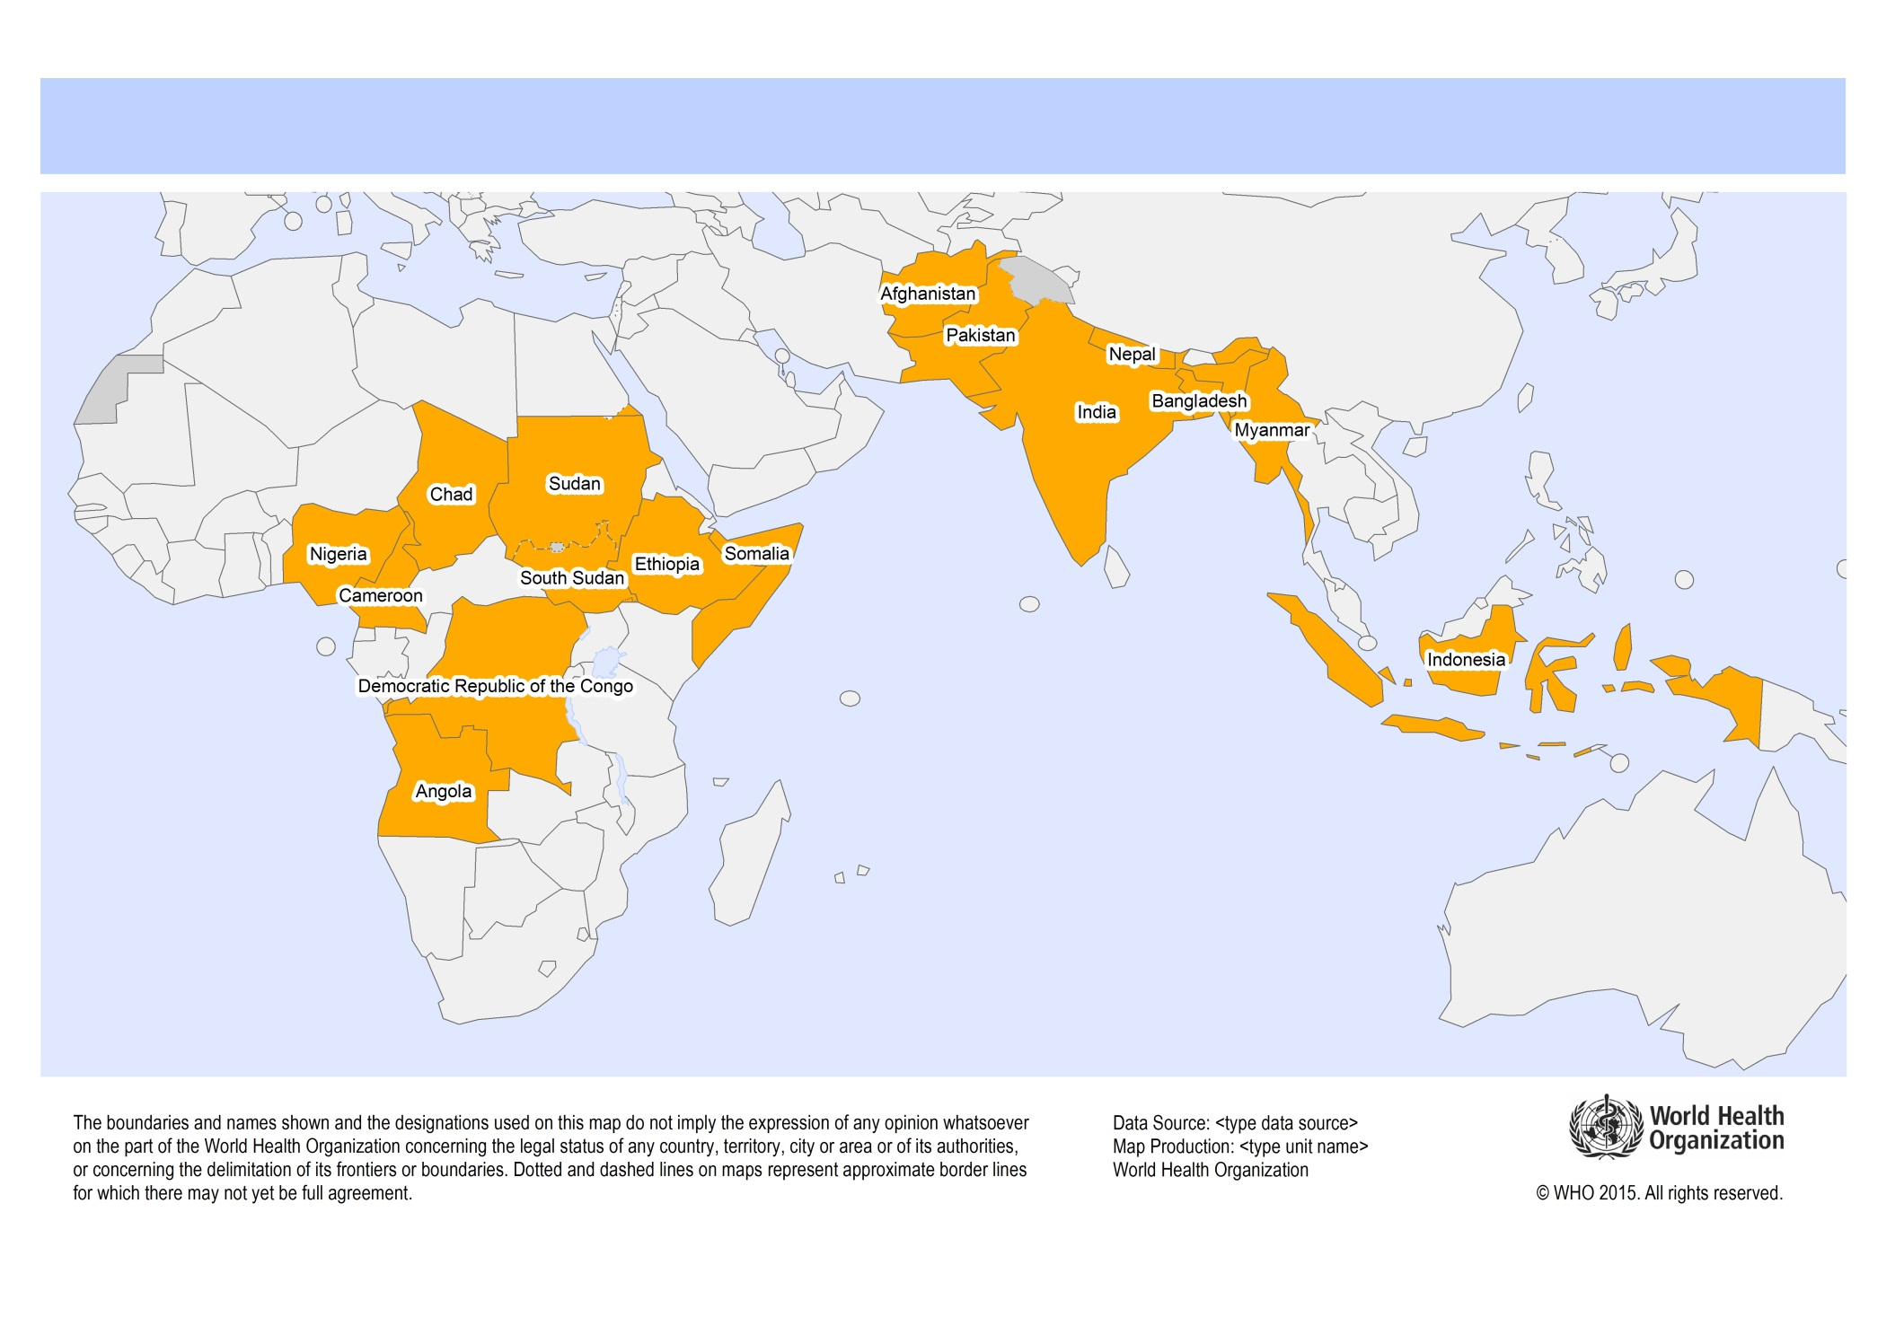
  16 priority countries for polio transition planning

Slide 36
Characteristics of the 16 priority
“polio transition” countries
Most of the world’s unvaccinated and under-vaccinated children
Most of the world’s measles cases and deaths
Most of the world’s rubella and CRS
If polio assets are lost, EPI progress in these countries and globally may be reversed

Slide 37
Polio transition recommendations (1)
All stakeholders involved in control and elimination of measles and rubella should engage in polio transition planning (at all levels) to make the most of the opportunity and avoid the risks of the end of GPEI
The strengthening of immunization systems and the control and elimination of measles and rubella should be designated as high priorities for polio transition planning and implementation
Polio assets should be re-purposed in such a way as to sustain essential polio functions, as well as the measles and rubella vaccination and other immunization functions that they have been supporting.

Slide 38
Polio transition -- recommendations (2)
As part of the country planning framework for immunization and in support of the Global Vaccine Action Plan goals, a concrete plan with an earmarked budget should be developed and implemented for transitioning essential polio assets to immunization system strengthening. Under the leadership of the ministries of health, this plan should aim to include the participation of all partners with an interest in health system strengthening.

Slide 39
Governance recommendations (1)
Efforts to control and eliminate measles and rubella should be integrated with the general immunization system and should be used to build and enhance the overall immunization system.
RVCs should be established in all regions where they do not exist, and their efforts strengthened in regions in which RVCs do exist. RVCs should serve as independent reviewers of progress toward measles and rubella elimination, and make region and country-specific recommendations

Slide 40
Governance recommendations (2)
M&RI and Gavi have complementary roles and should coordinate their support to countries based on the principles of
  Governments have primary responsibility
  Coordination of financial, technical, communication and advocacy support
  Collaboration on program evaluation
  Accountability for achieving results
  Leveraging existing initiatives, networks, working groups and agency capacity based on comparative advantage
Gavi and M&RI should work together to optimize use of available resources and to bring to bear the different strengths of each organization.

Slide 41
Resource mobilization -- findings
Successes
  Major increase in funding commitment for Gavi has resulted in more funding for Gavi-eligible countries
Challenges
  Funding for non-Gavi countries is increasingly limited
  Lack of comprehensive, multi-year, Financial Resource Requirements (FRR) information
  Lack of adequate data on how measles and rubella elimination can strengthen immunization and health systems

Slide 42
Annual M&RI and Gavi expenditures for measles and rubella control and elimination activities, 2001-2016

Slide 43
Resource mobilization recommendations (1)
A multi-year FRR document for measles and rubella vaccination in the context of overall immunization systems should be developed. It should include demand-driven, country-driven projections of need, and reflect funding from Gavi, M&RI, and other donors, and domestic financing.
The recent support from Gavi for measles and rubella vaccination activities provides a major step forward for achieving measles and rubella goals. However, it is not itself sufficient to provide adequate assistance globally as many countries are not Gavi-eligible. There is a need for additional funding.

Slide 44
Resource mobilization recommendations (2)
The 5 M&RI founding partners should have adequate staff capacity to identify and align the resources needed and mobilize additional donors and resources to fill the funding gap for immunizations overall and measles and rubella vaccination in particular
Country co-financing for measles and rubella vaccination activities should increase as countries move along the development continuum
Efforts should be made to identify examples of when a focus on measles and rubella elimination has led to building the overall immunization system

Slide 45
Midterm review -- summary
Review at the strategic level of 2012 – 2020 Measles and Rubella Strategic Plan
Evaluates strategies, polio transition, governance, resource mobilization
Goal is document with data-based, practical and realistic recommendations to guide activities 2016 – 2020 and align partner efforts

