Slide 1
Experience with the measles outbreak response fund
Accelerating Progress towards Measles and Rubella Control/Elimination Goals
21 June 2016
Kaushik Banerjee

Slide 2
In this presentation
Background
How it has worked so far
Lessons learned
2 country examples
Suggested actions

Slide 3
Background
June 2012 – GAVI Board approved USD 55m to be managed by MRI
Feb 2013 – UN Foundation concluded the MOU with GAVI on behalf of the MRI
Current funding goes up to 2017
Purpose
To enable countries experiencing measles or/and rubella outbreaks to rapidly respond to these while they are still relatively small and localized, to prevent them from developing into large and widespread outbreaks.

Slide 4
Management
The MR Initiative founding partners* are responsible for decision on allocation of the outbreak response funds
The WHO headquarters, Expanded Programme of Immunization functions as the secretariat for management and reporting of the use of outbreak response funds
* MRI founding partners are ARC, CDC, UNF, UNICEF and WHO

Slide 5
How has it worked so far
Funded
  4 countries in 2013, >$ 7 million provided
  5 countries in 2014, >$ 7 million provided
  8 countries in 2015, >$15 million provided
  3 countries so far in 2016, $2.05 million provided
Funded
  outbreak responses
  wide age group SIAs

Slide 6
Funds disbursed

Slide 7
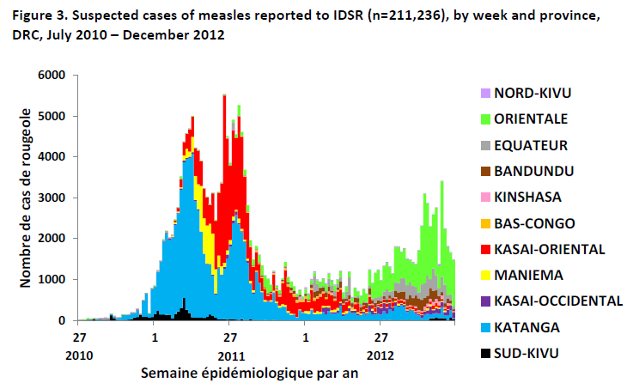
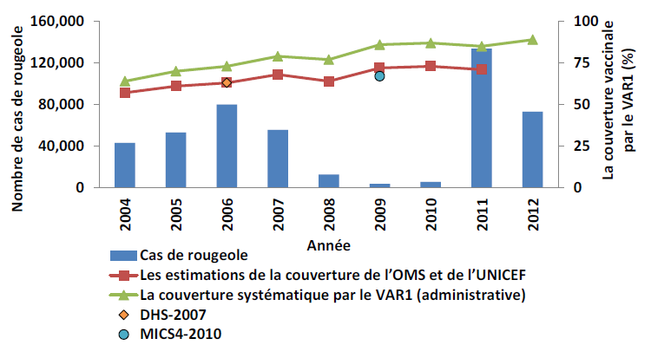
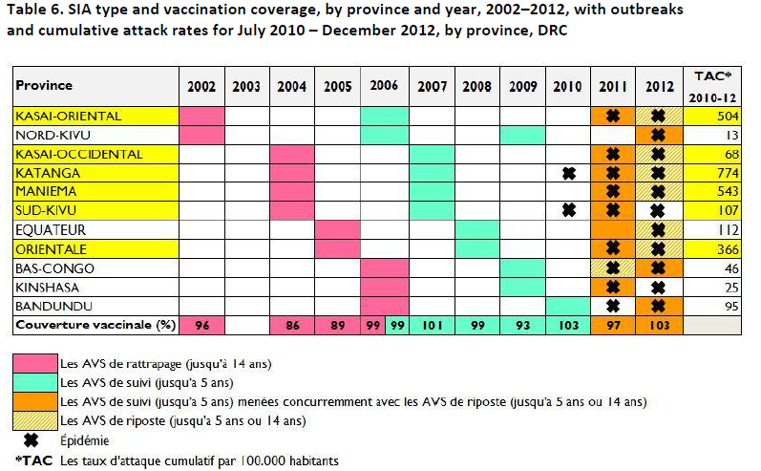
Response in DRC
Age targeted 6m – 9y
Cost USD 6.1 million

Slide 8
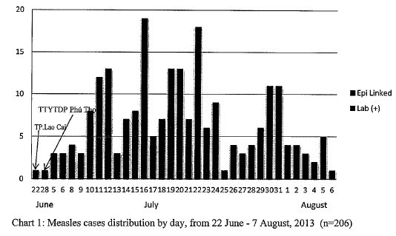
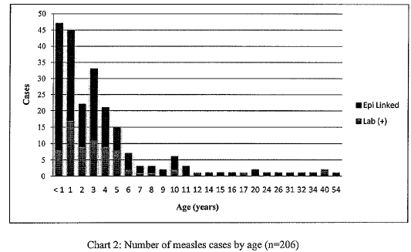
Response in Vietnam
436 villages in 4 districts and Lao Cai city
Cost USD 39,000

Slide 9
Lessons learned
Outbreaks reported late (surveillance issues)
Political considerations
  Delays in labelling it as an outbreak
  Inappropriate small scale responses
Proposal often lacking in details, coherence
Report
  Often delayed
  Short on details

Slide 10
Lessons learned
Immunization response
  Too much, too late
  Quality suffers
    Cases continue after response
Investigation of outbreaks sub-optimal
Data not used to identify gaps in immunity
Basic issues need fixing
  Surveillance, outbreak investigation
  Immunization systems strengthening

Slide 11
Constraints
Fund cannot be used in non-GAVI countries
  We could not fund
    Republic of Georgia
    Syria
    The Philippines
    Mongolia
Countries graduating out of GAVI support

Slide 12
2 country examples
Strong routine with one SIA to fill immunity gap:
  Republic of Korea
Strong routine offering MCV1 and SIAs:
  Malawi

Slide 13
Reported measles cases and measles vaccination
coverage, 1990-2013*, Republic of Korea
Approach: MCV1+2+SIAx1
Birth rate: <11/1000
Pop: 48,391,343
MCV1: 99%
*2013 data through 20.08.2013

Slide 14
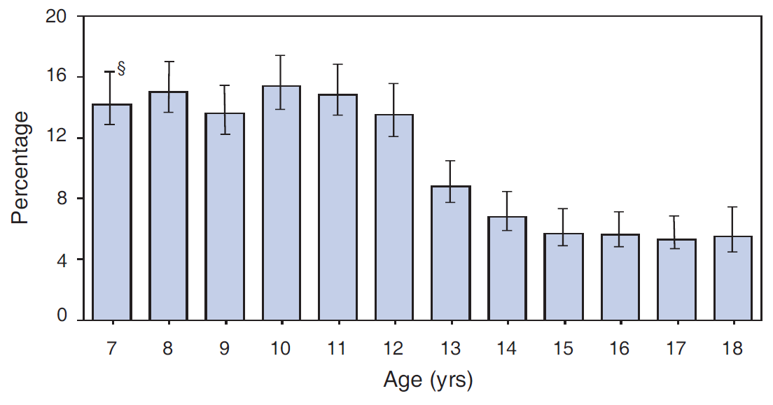
Proportion of persons aged 7–18 yr* with measles susceptibility,† by age — Republic of Korea, 2000
*N = 18,139.
† Defined as not having anti-measles immunoglobulin G antibody.
§ 95% confidence interval.
Source: MMWR 2007; 56:304-307
Notes:
2000 serosurvey
N = 18,139
Sample by age group (7-18y), region
Residual sera from 36 hospital laboratories
Enzygnost IgG ELISA measles

Slide 15
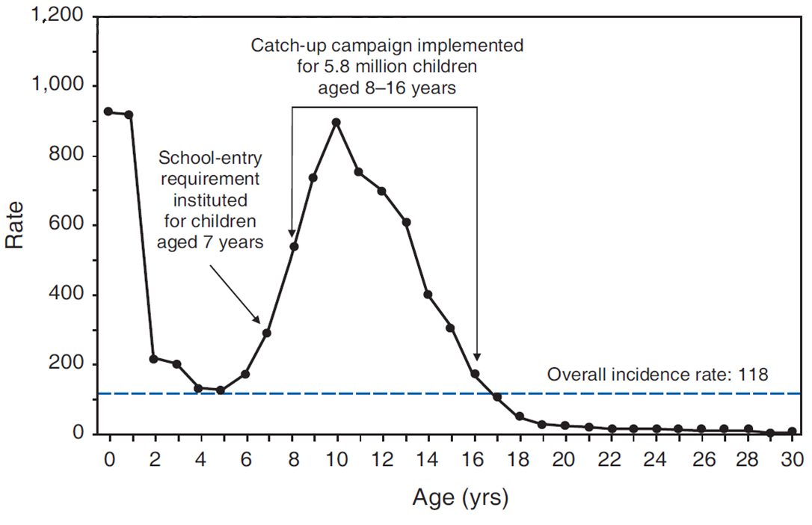
Incidence rate* of reported measles cases, by patient age — Republic of Korea, 2000–2001
* Per 100,000 population
Source: MMWR 2007; 56:304-307

Slide 16
Reported measles cases and measles vaccination
coverage, 1990-2013*, Republic of Korea
*2013 data through 20.08.2013

Slide 17
Reported measles cases and measles vaccination
coverage, 1996-2013*, Malawi
107% admin
*2013 data through 10.09.2013

Slide 18
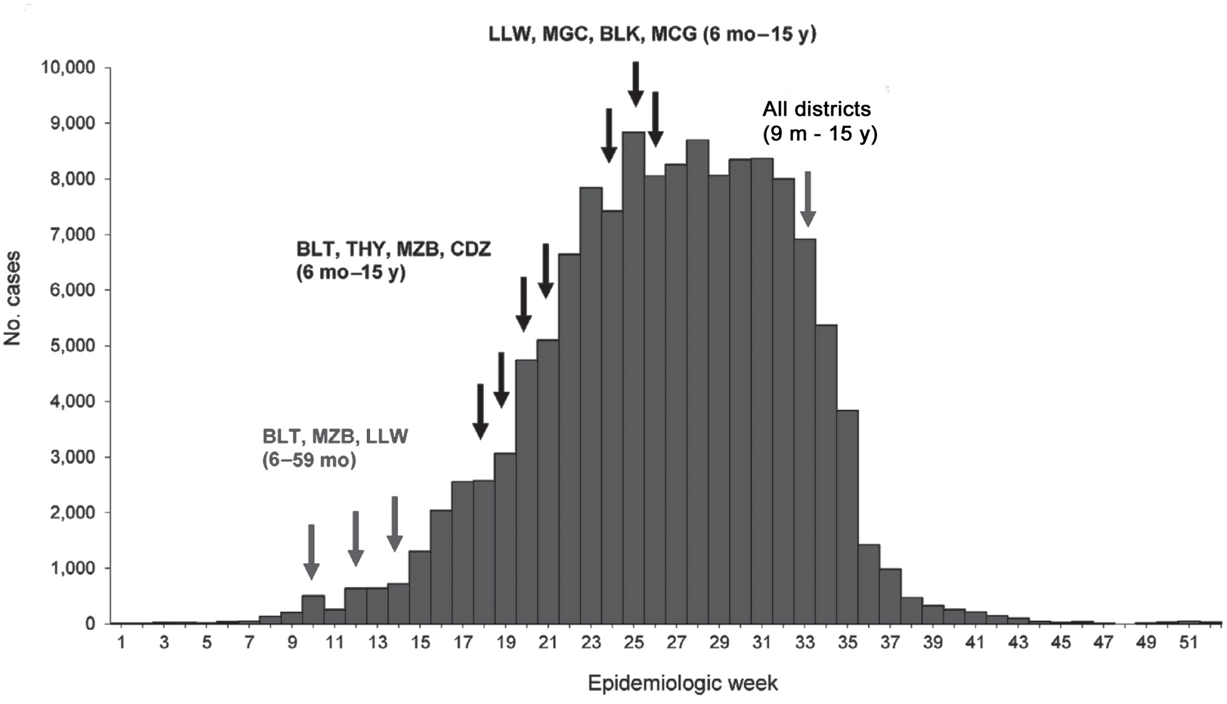
Measles cases by epidemiological week, Malawi, 2009 – 2010

Slide 19
Confirmed measles cases by age, Malawi, 2010
Adapted from Minetti, Emerg Infect Dis 2013; 19(2):202-9

Slide 20
Reported measles cases and measles vaccination
coverage, 1996-2013*, Malawi
107% admin
*2013 data through 10.09.2013

Slide 21
Country experience shows that…
Rep of Korea: SIAs targeted age groups involved in the outbreak; very low incidence after SIA
Malawi: gaps in routine not recognized; age range cases in 2010 matched the age groups covered in 1998 SIA (<90% coverage)
  Initial outbreak responses with narrow age range, narrow geographic focus, worked locally

Slide 22
Suggested actions
Outbreaks should be investigated to better define the susceptibility profile of the population
Outbreak investigations should aim to uncover the underlying reasons why outbreaks are occurring (e.g. who is transmitting to whom; what are the exposure settings)
Resources to be mobilized for a similar fund in non-Gavi eligible countries

Slide 23
Thank you!
Merci !

