Slide 1
MR introduction and rubella epidemiology in AFRO
Regional MR TAG
Nairobi, Kenya
June 2-3 , 2015

Slide 2
Outline
Background
Epidemiology of Rubella
Strategic options for rubella control AFR
MR introduction progress noted issues related to MR introduction in AFR
Guidance requested from TAG

Slide 3
Background (1)
No Regional target yet for Rubella elimination
The Regional TAG guidance (2008) encouraging member states for uptake of RCV , that are able to achieve and sustain optimum coverage performance
The regional strategic plan encouraging member states to uptake Rubella containing vaccine

Slide 4
Background on Rubella Surveillance
Background on Rubella Surveillance (2)
The rubella disease burden documentation depends on measles case based surveillance - only negative measles cases tested for Rubella
  Often reagents stock out may compromise testing for Rubella
  Limitation of country outbreak documentation hence under estimation
  E.g.
    Ethiopia outbreak of 2013, over 7000 cases confirmed Rubella in one region not in data base
    South Africa stopped testing for Rubella 2013 and 2014 and resuming mid year in 2015 ; 6000+ cases of suspected cases for measles only 28 tested for Rubella

Slide 5
WHO recommended steps leading to the introduction of a new vaccine
*Most use the existing Rubella data from Measles surveillance to justify introduction RCV
Few countries, had special studies or sentinel surveillance data
Implementation
Political decision*
Cold chain/logistics capacity?
Financing available/sustainable?
Public health priority?
Vaccine cost-effective?
Disease burden*?

Slide 7
Regional Strategic Plan 2014 - 2020
Aim of strategic plan is to ensure achievement of universal immunization coverage within the WHO African Region.
To accomplish that aim, the following objectives have been defined:
  to improve immunization coverage beyond the current levels
  to complete interruption of poliovirus transmission and ensure virus containment
  to attain elimination of measles and make progress in elimination of rubella and congenital rubella syndrome
    Target: At least 25 countries to introduce rubella-containing vaccine by 2020 (10 countries by 2015, 15 countries by 2017)
  to attain and maintain elimination/control of other vaccine-preventable diseases

Slide 8
Options of Rubella control
Approach 1: CRS Reduction | Approach 2: Rubella /CRS Elimination
Vaccination of adolescent and adult females only Through routine services or SIAs direct protection to WCBA | “The preferred approach” MR or MMR vaccine in a wide-age range SIAs followed immediately with introduction of MR or MMR vaccine in the routine program at 9 or 12 months of age
However, in the absence of vaccination of infants and young children, rubella continues to circulate = ongoing exposure of pregnant women. | All subsequent follow-up SIAs should use MR or MMR vaccine.
The main goal of Rubella vaccination is prevention of CR Infection including CRS

Slide 9
Source - AFRO strategic options document
Cohorts to vaccinate | GOAL
 | Reduce CRS | Eliminate CRS in 20 – 30 yrs | Eliminate CRS in 10 – 20 yrs | Eliminate CRS in < 10 yrs
WCBA | RI or SIAs | RI or SIAs | RI or SIAs for females not targeted by previous SIAs | Speed-up SIAs (targets older children, adolescents, adults)
1 – 4 yrs |  | 1 dose RI and regular follow up SIAs or 2 doses in RI | 1 dose RI & regular fup SIAs or 2 doses in RI after catch up SIAs ( 9 m – 14 yrs) | 1 dose RI and regular follow-up SIAs OR 2 doses in RI after speed-up SIAs
5 – 14 yrs |  |  | Catch up SIAs ( 9 m – 14 yrs) | Speed up SIAs
15 – 39 yrs |  |  |  | Speed up SIAs

Slide 10
Lab confirmed Measles Igm+ vs Rubella IgM+, e.g. ESA Countries
SOA, not testing 2011 – 2015 April; Ethiopia outbreak of 2013 not included

Slide 11
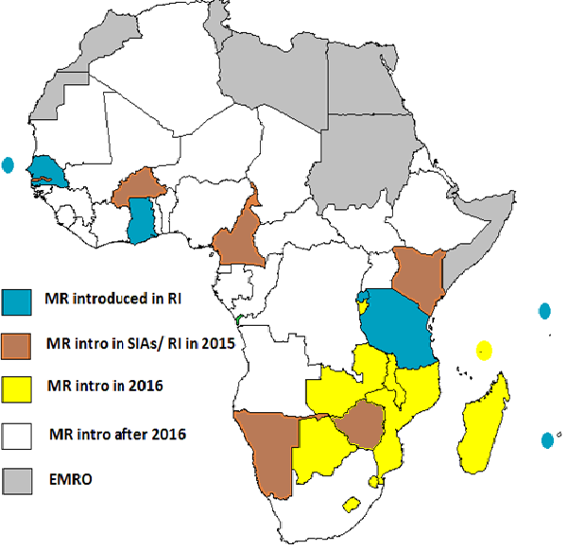
Status of MR introduction in AFR. May 2015.
7 countries with MR in routine EPI
BFA did MR SIAs, and will introduce MR in EPI in 2015
MR SIAs in 2015 in Cam, GAM, KEN, NAM, ZIM
For 2016, expression of interest pending from some

Slide 12
Experiences from countries that introduced MR
Country | Date of introduction of MR | Introduction into RI (Interval) | Type of MCV2 vaccine
Cap Verde | Last quarter 2012? | Since 2009 In RI | MMR used
Ghana | September 11-20 , 2013 | Immediate with no delay | Monovalent for MCV2
Rwanda | April 2013 | Interval 6 months | Monovalent for MCV2 July 2014 ; planning to switch to MR2 August 2015
Senegal | Last quarter 2013 | Immediate with no delay | MR for MCV2 since early 2014
Tanzania | 18-24, Oct 2014 | October 2014 to March 2015 (5 mths) | MR for MCV2
B.Faso | Nov 2014 | May 2015 | MCV2 since Oct 2014 ;switched to MR2 by May 2015

Slide 13
Noted Issues among planning countries to introduce MR in 2015
Country | Planned introduction of RCV | Intended timeline for RI introduction | ISSUES /Comments
Zimbabwe | 2015 August shifted to September due to delay in supply | Within 1 month of MR SIAs to introduce in RI | Dates of SIAs repeatedly postponed due to supply assurance
Kenya | 2015 November for MR SIAs ( <15 years) | MR in RI planned for 2017 | Cost of MR not supported by Gavi, Country considers cost implication
Cameroun | Date of SIAs planned for April 2015 | Date plan for RI pending | Gavi approval only in May 2015, no date yet but Q4 2015
Gambia | Oct 2015? | January 2016 | Latte Gavi approval and release of funds

Slide 14
Summary of issues / Comments
Enough stock of Measles so delay in the MR switch
GAVI does not support MR for MCV2
Long interval of MR into RI -> needed catch up to be done
Issues of Co-payment so not thinking of WCBA
GAVI graduating country so cautious

Slide 15
Follow up SIAs to use MR -2017
Ghana , Rwanda , Senegal , Tanzania
Countries in pipeline to introduce MR in 2016
Burundi, Zambia, Malawi, Lesotho, Comoros, Lesotho, Madagascar

Slide 16
Countries that are in the pipeline for RCV introduction /comments
Burundi | 2016 | Intending to apply for Gavi support
Zambia | 2016 | Submitted intent
Malawi | 2016 | Intending to submit EOI to Gavi in September
Lesotho | 2016 | Intending to submit EOI to Gavi in September | trying to approach GAVI
Madagascar | 2016 | Pending confirmation
Comoros | 2016 | Pending confirmation
Ethiopia | 2017 | Pending confirmation

Slide 17
Issues noted related to MR introduction
Payment related
  Due to cost component of MR in routine introduction countries are not taking up MR for the RI on time
  cohort missing on the Rubella component if not high coverage in the countries
Stock related
  Continued use of existing measles vials until phased out with interval prior to switching to MR in RI
  Supply time line frequently changing for Gavi supported countries
    implications on delayed preparation for SIAs

Slide 18
Issues noted related to MR introduction (1)
Challenge of MR and MCV in same fridge
  Storage volume
  Wastage
  Documentation of doses administered ( MR or MCV),
  Health workers inconvenience (dose 1 and dose 2 , different formulations)
Vaccine formulation - Self financing vs GAVI supported countries
  Limited suppliers of MR for self financing countries limits their choice towards MMR
  Countries are forced to introduce MMR instead of Needs advocacy with manufacturers

Slide 19
Issues noted related to MR introduction (2)
Postponement of MR introduction with lack of epidemiological evidence, not perceived as public health problem
  Eritrea, Zambia, Ethiopia
The vaccination of Health care workers against Rubella in time of outbreaks
  Namibia to vaccinate female health workers against Rubella
MMR vs MR discussions to guide countries
  Dialogue with countries - with no disease burden disease burden documentation for mumps , and or limited supplier for self financing requests with MR (BOT, NAM , SOA , LES)

Slide 20
Summary
The existing rubella surveillance data being used to make decision of introduction in most countries
  Few countries have sentinel CRS and special studies
  Despite the limitations, the descriptive epidemiology in the region is indicative of Rubella being mainly childhood disease
With the current plan , the target of introduction with partners support and Government commitment is likely to be met
The delay of switch to MR into RI is creating a gap following the catch up SIAs in some countries - Cost implication is limiting the uptake
For self financing countries & Gavi graduating countries with background of the limited supplier is a rate limiting step to the uptake of RCV

Slide 21
Requested guidance from MR TAG
What will be the guidance for countries that have introduced MR …..considering the WCBA ?
GAVI funding model for MR introduction to ensure that countries introduce in RI as early as possible after SIAs.

