Slide 1
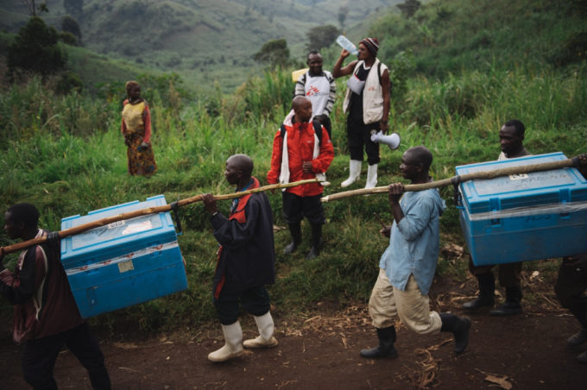
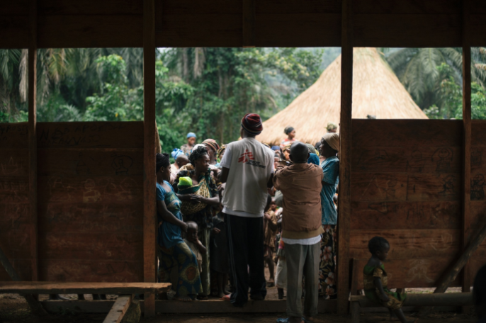
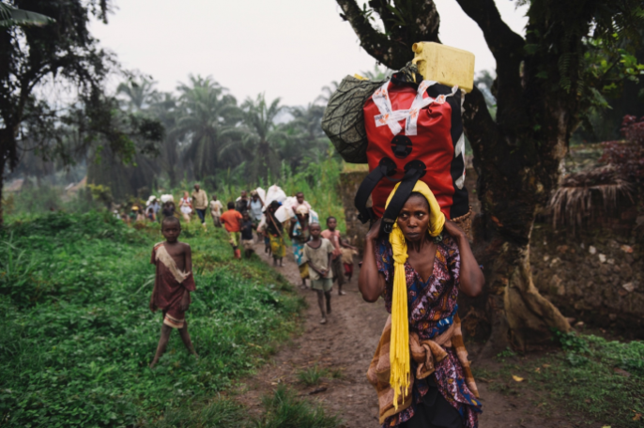


Measles vaccination in MSF context: priorities, results and challenges/concerns
Photographs by Phil Moore, DRC, 2014
AFRICAN REGIONAL MEASLES-RUBELLA TAG MEETING Nairobi, June 2nd-3rd 2015
Florence Fermon & Aitana Juan

Slide 2
Overview of the presentation
Outline MSF vaccination activities
Measles outbreak response activities
Vaccination in humanitarian emergencies
Vaccination in Ebola affected countries

Slide 3
MSF and vaccination
MSF projects in 2013:
66 countries, 387 projects,
215 (55%) in unstable contexts
Expenses: €612 M
(± 90% funding private, non-governmental sources)
Vaccination policy clearly established in 2007
Priority countries to strengthen routine immunization
Outbreak response
Preventive vaccination campaigns:
  Reduce risk of outbreaks in high risk areas
  Preventive vaccination in emergencies¹
¹ SAGE Working Group on Vaccination in Humanitarian Emergencies. Vaccination in acute humanitarian emergencies: a framework for decision making. IVB WHO, October 2013

Slide 4
Overview of MSF vaccination activities
Evolution of MSF vaccination activities, 2008-2014
 | 2008 | 2009 | 2010 | 2011 | 2012 | 2013 | 2014
Doses routine vaccination | 1 229 897 | 1 200 894 | 1 206 712 | 1 595 883 | 1 707 794 | 2 264 553 | 1 801 550*
Doses in response to epidemics | 1 817 957 | 9 530 871 | 5 630 285 | 4 970 623 | 2 368 839 | 3 928 079 | 1 165 064
Doses preventive campaigns |  |  |  | 76 064 | 79 838 | 455 037 | 863 733
Doses post-exposure prophylaxis | 18 240 | 31 688 | 50 248 | 66 466 | 61 413 | 77 285 | 69 169
Total doses administered | 3 066 094 | 10 763 453 | 6 887 245 | 6 709 036 | 4 217 884 | 6 724 954 | 3 899 516
* Incomplete reporting routine vaccination for 2014

Slide 5
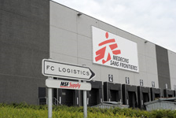
MSF supply of vaccines

Slide 6

MSF measles outbreak responses
Despite routine and SIAs activities, we are facing an excessive number of outbreaks

Slide 7
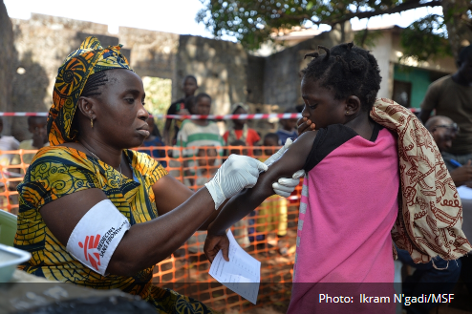
Outbreak responses
2015: 20 measles outbreak response interventions + other going on
Sudan, DRC, CAR, Chad

Slide 8
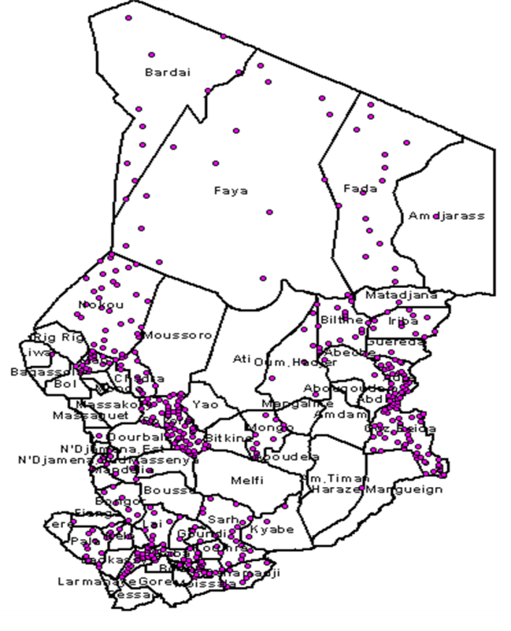
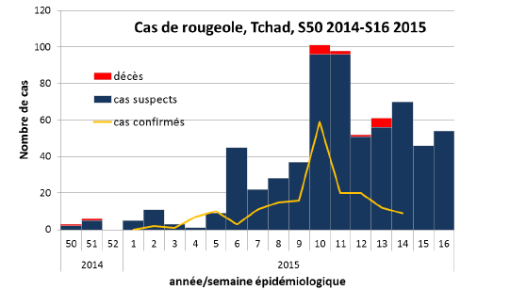
Measles outbreak in Chad: an unexpected situation?
SIAs conducted in 2012 and October 2014
April 2015
  637 suspected measles cases reported
  15 deaths reported
  52% of confirmed cases >15 years of age
Outbreak in 11 districts
Response campaigns:
  conducted in 6 of 11 districts in outbreak
  targeting different age groups
WHO AFR Measles weekly partner updates. May, 2015

Slide 9
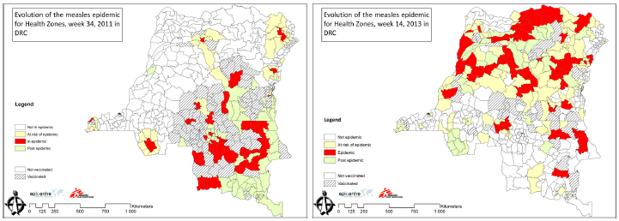
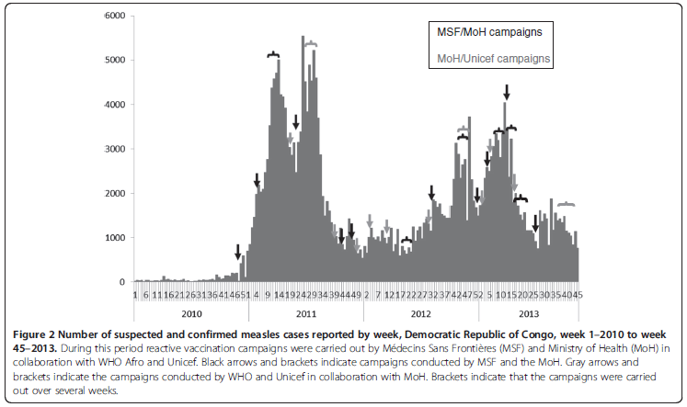
Measles outbreak in DRC
2010-2013:
  increase in the number of cases from south to north
  Several ORI conducted by MSF and MoH
SIAs conducted in 2014
Mancini et al. Description of a large measles epidemic in Democratic Republic of Congo, 2010-2013. Conflict and Health 2014, 8:9

Slide 10
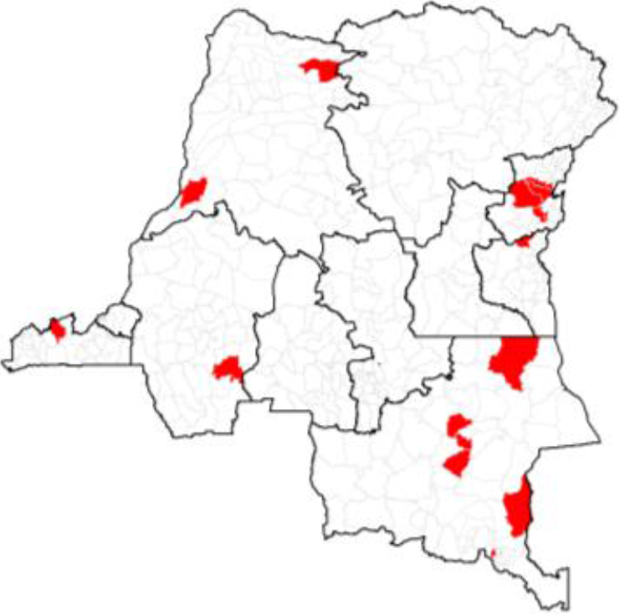
Measles outbreak in DRC: a repetitive situation?
May 2015:
  11,657 measles cases reported
  134 measles deaths reported
  19 zones de santé affected with 261 districts
Mid June
  Extension to other areas
WHO AFR Measles weekly partner updates. May, 2015

Slide 11
Why measles outbreaks remain so frequent in some countries?
How could the quality of vaccination activities be improved?
Are age group tailored to the specific context?
Is EPI able to ensure a basic protection?
  Limited window to vaccinate: 9-11 months
  Catch-up not clearly mentioned in EPI policy
Are intervals between campaigns adapted following a systematic risk analysis?
Is there enough flexibility to implement context-specific strategies?
Are decisions possible at district level?
Is MRI fund for ORI known and used as required?

Slide 12
Preventive vaccination in humanitarian emergencies
Measles vaccination is one of first 10 priorities in emergency situations
New WHO recommendations for extended vaccination package according to risk evaluation

Slide 13
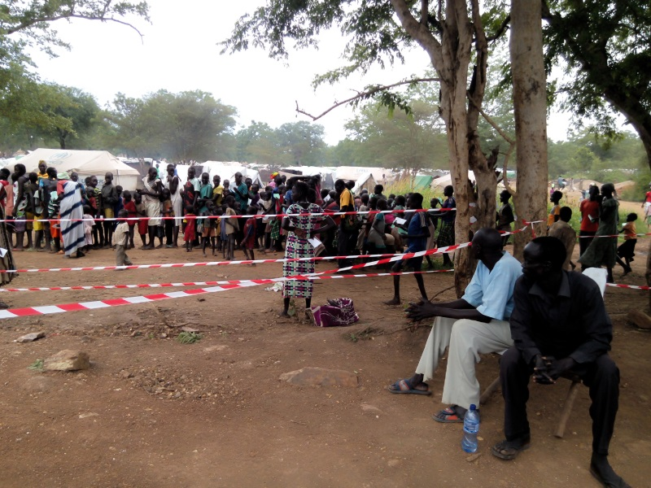
Preventive vaccination in emergencies
Measles quickly implemented, but insufficient follow-up over time
Lack of awareness of new WHO recommendations leading to long negotiations and delay in implementation
Cost and availability of some vaccines
There is need of appropriation and support from HQ and regional offices of UN agencies and partners

Slide 14
Measles vaccination in Ebola affected countries
A new challenge

Slide 15
MSF operational proposals in Ebola affected countries
2 countries: Liberia and Sierra Leone
Pilot innovative and context adapted vaccination campaign for measles
Test strategies: door to door and fixed sites, in rural and urban setting
Analyse the outcomes and share/discuss results on the feasibility of mass vaccination in an EVD context with possibly different approaches
Collaborate with MoHS and partners

Slide 16
Main strategic points
Training of staff
Strong supervision
Specific Ebola triage
Adapted IPC measures
Use of retractable needles + safety container
Complete micro-planning with specific attention to “at risk and hard to reach populations”
Vaccination teams performance expected 150-200 children per day per fixed-site team
Follow up of post-vaccination fever
Health Promotion and advocacy activities, important component of the project (pre and post-vaccination)

Slide 17
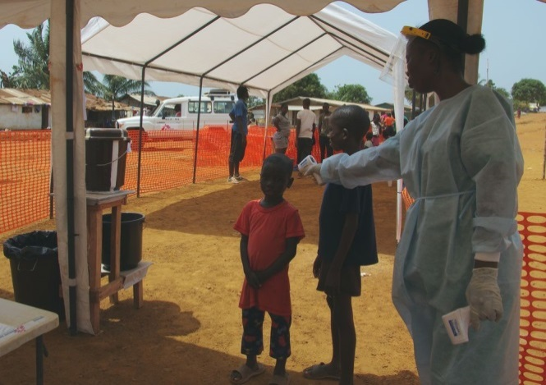
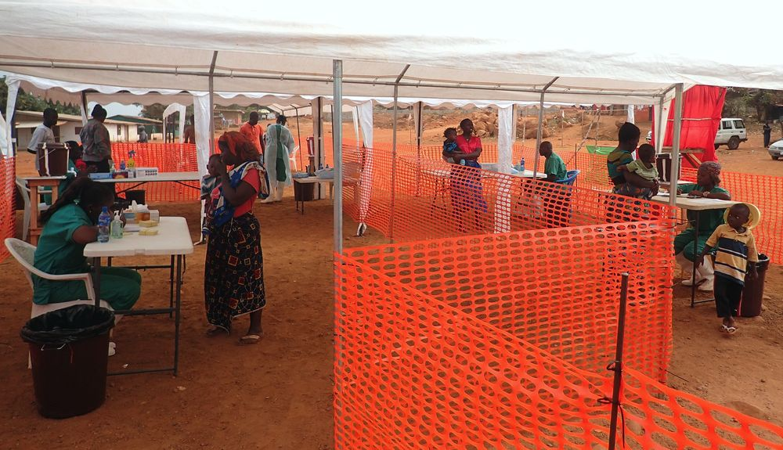
IPC measures
Triage
Case investigation area, holding area and referral system
Efficient crowd control measures and strict flow circuit:
  ≤ 10 children in the waiting area
  ≤ 3 people inside the vacci area
Don’t touch policy
Hand washing points 0.05% chorine (staff, parents and children)
Accidental exposure protocol in place and known by staff
Waste management: secure collection and burning

Slide 18
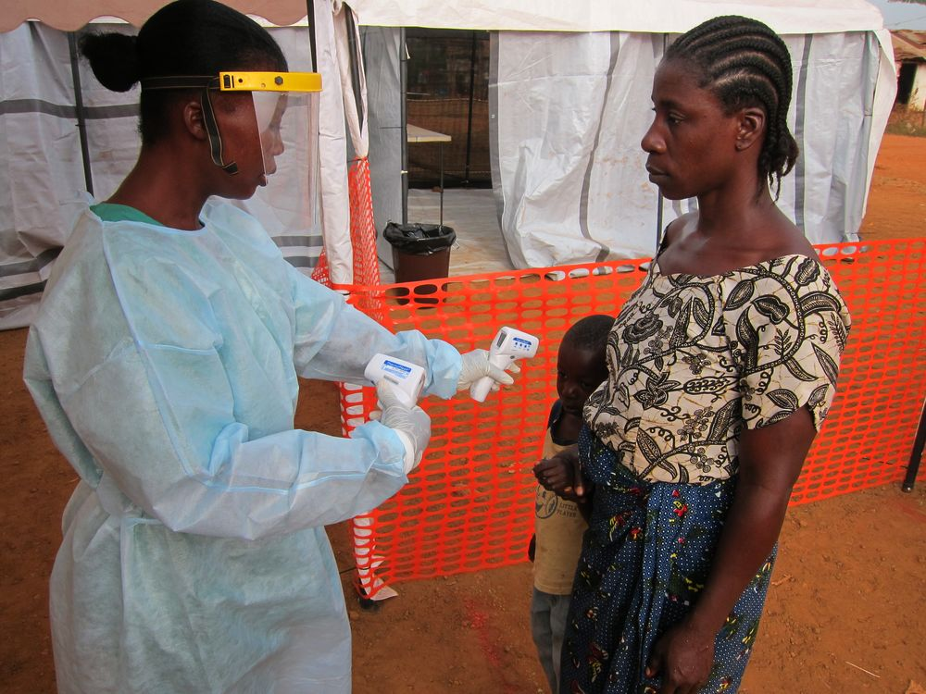
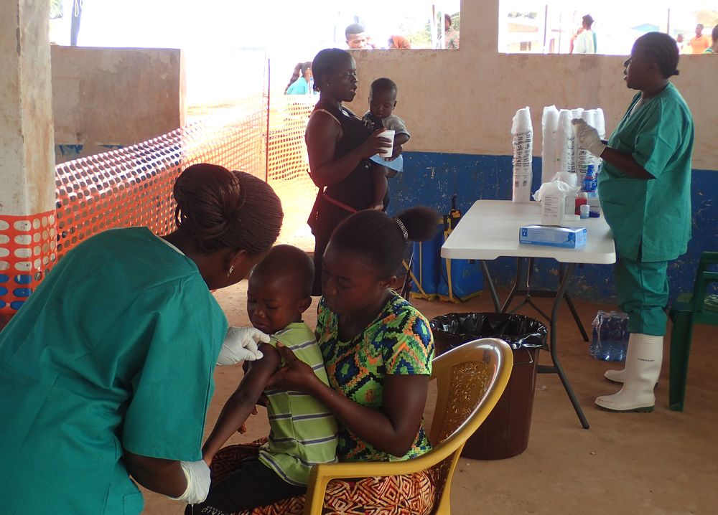
IPC measures (2)
Personal protective equipment (PPE):
  Triage/case investigation: scrubs/boots + face protection + gown + gloves
  Vaccinators: scrubs/boots + gloves

Slide 19
Challenges vaccination in Ebola context
Ebola uncertain evolution
EPI should be re-established as soon as possible after the start of an epidemic, when training and specific procedures can be implemented
Lack of expertise
Lack of specific recommendations on best approaches
Importance of implementing pilot projects (innovative, context adapted vaccination activities)
Need of involvement of a multidisciplinary team, with advice from infection-control specialists

Slide 20
MSF main concerns on measles
EPI is the base to guaranty and maintain efficient measles coverage but:
  It requires clear written MCV1 policy to catch-up children >12 months if required
  Strong ownership of UN agencies to support/implement flexibility out of the traditional target age group
There is a need of better tailored, quality and evaluated SIAs
Ebola situation highlight the need to:
  Avoid long break in EPI
  Ensure safety protection measures for patients and staff
  Communication and social mobilization

Slide 21
Thank you

