Slide 1
Strengthening the investigation, documentation and response to measles outbreaks. The case of DRC
Balcha Masresha
WHO AFRO
June 2016

Slide 2
Outline
Routine immunisation performance
Measles SIAs
Measles weekly reporting trends 2011-2016
Patterns of age and vaccination status 2015 - 2016
Measles outbreak investigation in DRC
Challenges
Proposed measures to address gaps

Slide 3
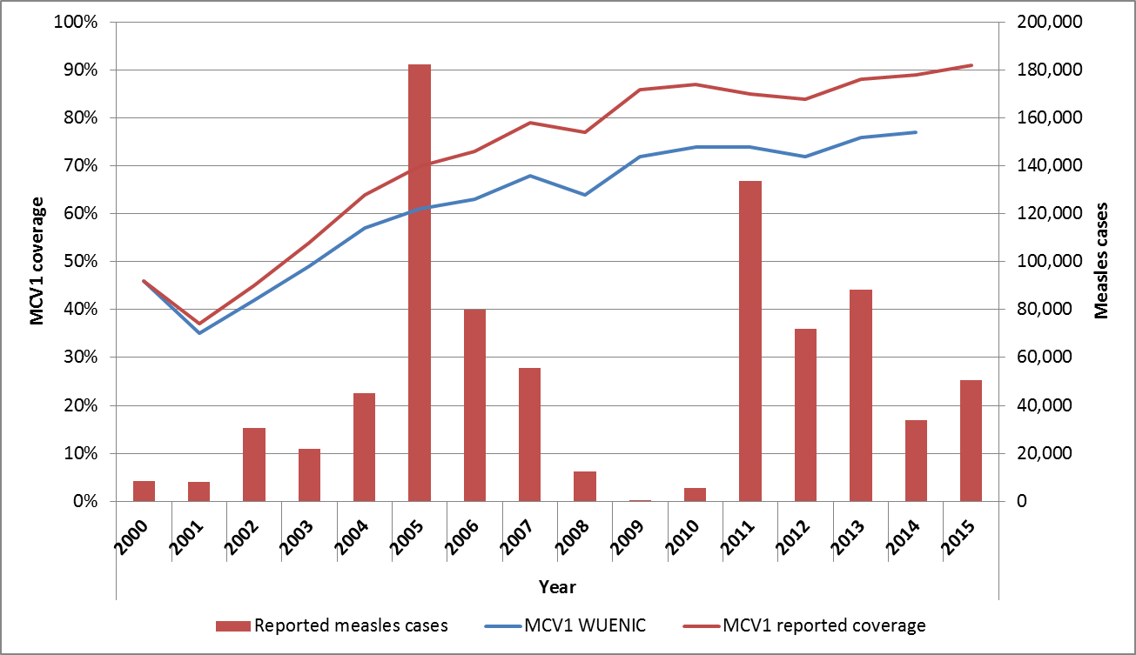
MCV1 coverage and reported measles cases. 2000 – 2015. DR Congo
Catch up SIAs
Phased Follow-up SIAs

Slide 4
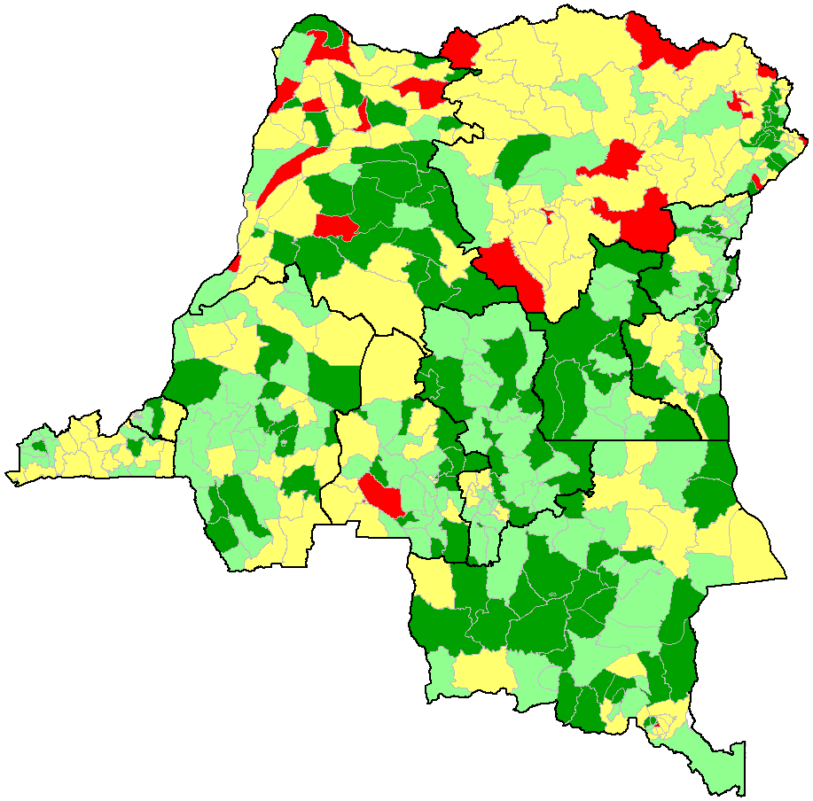
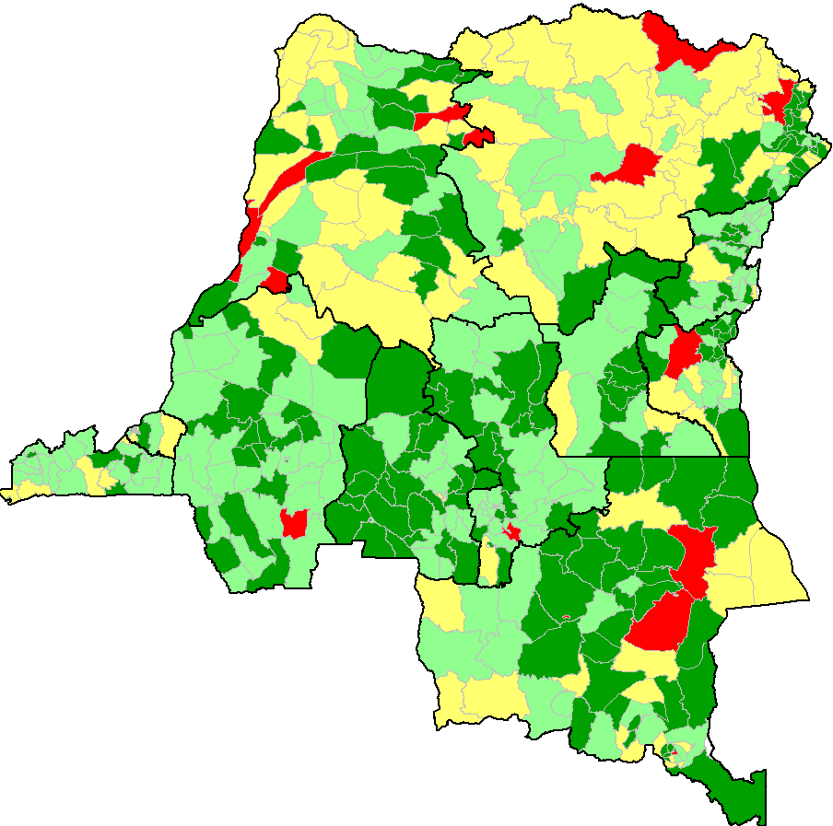
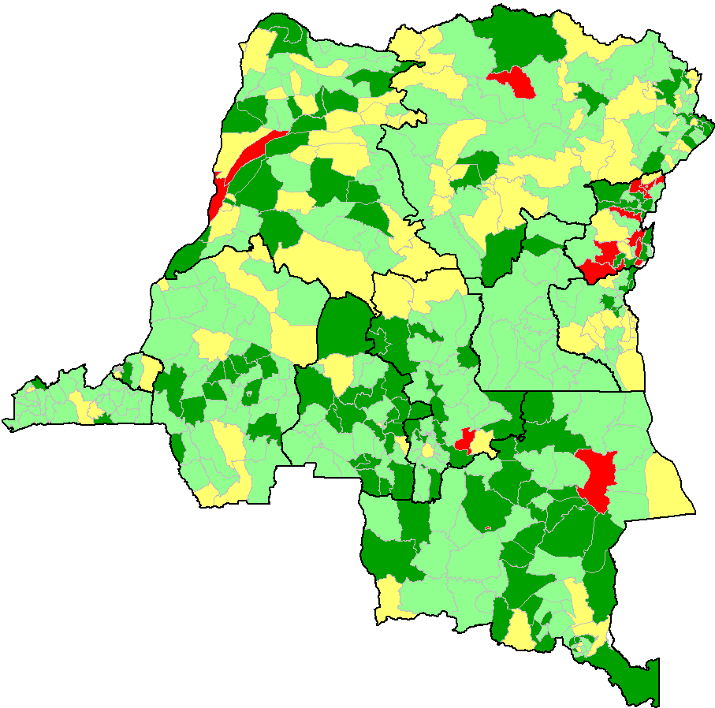
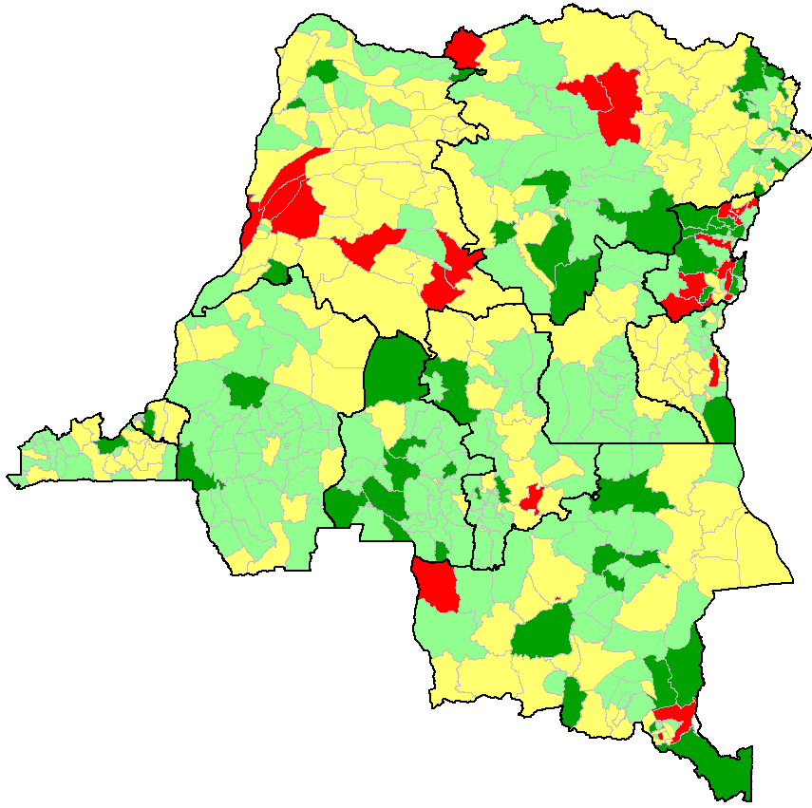
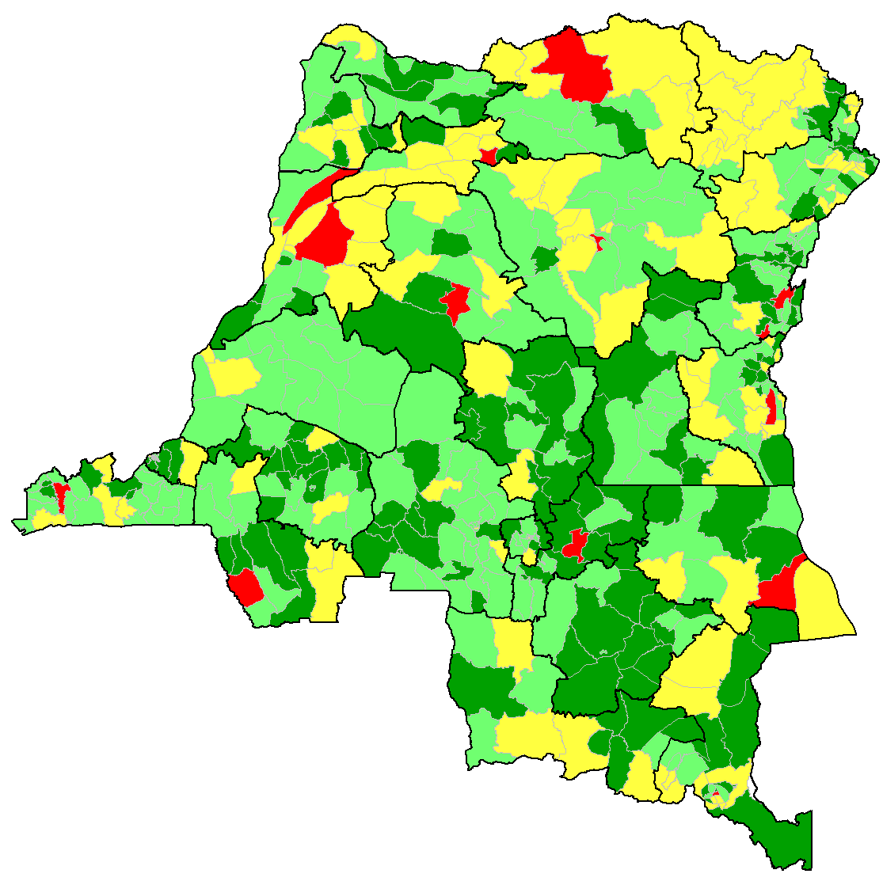
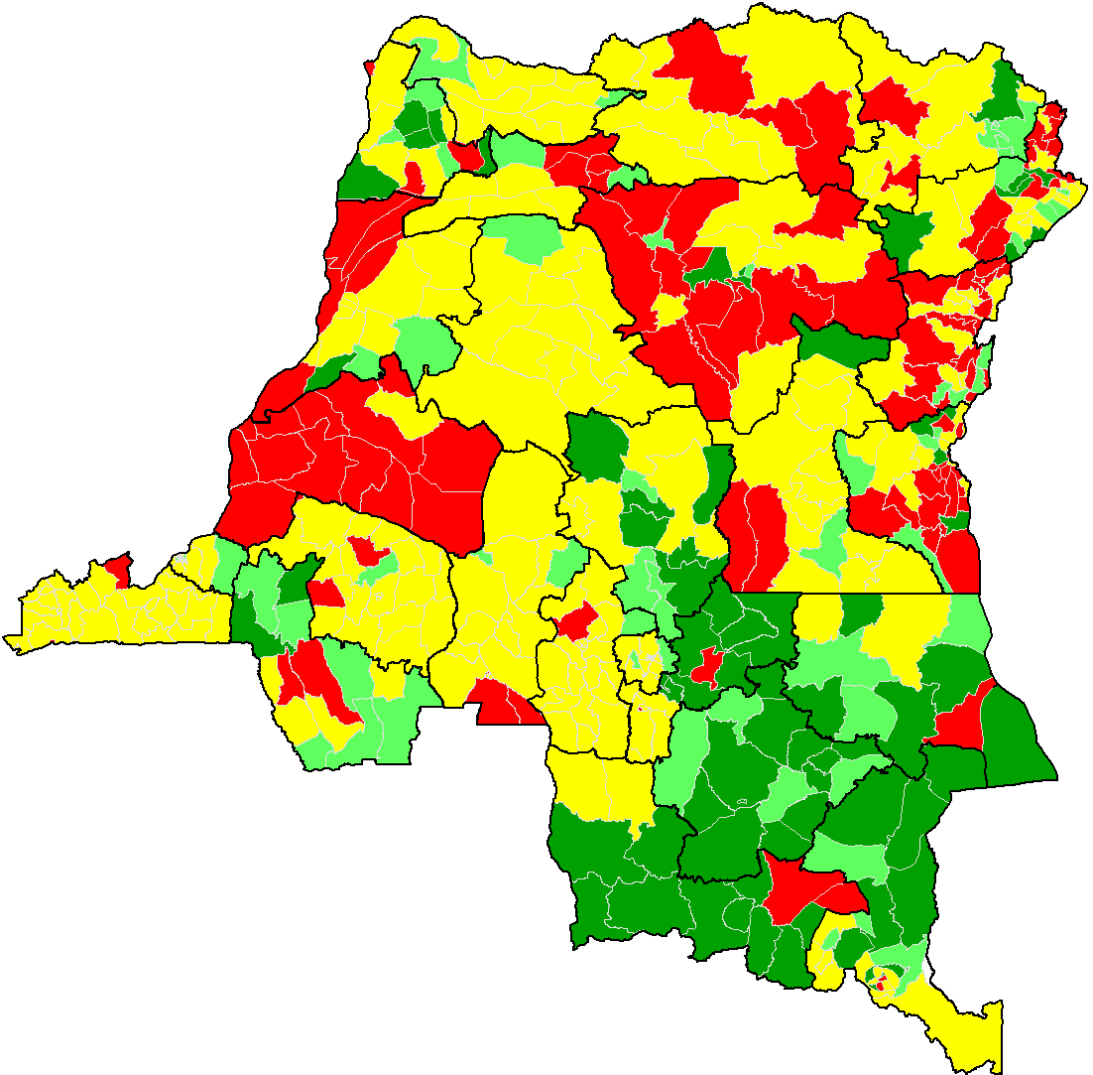
MCV administrative coverage shade map. DRC. 2011- 2016
CV VAR 2011
CV VAR 2012
CV VAR 2013
CV < 50%
50% >=CV<80%
80% >= CV <95%
CV >=95%
CV VAR Jan-Avril 2016
Complétude = 77,5%
CV VAR 2014
CV VAR 2015

Slide 5
District level admin MCV1 coverage,
DR Congo. 2012 - 2015
MCV1 coverage by district | % districts by coverage category by year
 | 2012 | 2013 | 2014 | 2015
MCV ≥95% | 28% | 26% | 36% | 38%
MCV 80% - 94% | 33% | 49% | 42% | 40%
MCV 50% - 79% | 33% | 24% | 21% | 21%
MCV < 50% | 6% | 1% | 2% | 1%
Total | 100% | 100% | 100% | 100%

Slide 6
Measles SIAs in DRC. 2002 - 2014
Type of SIAs | Year | Target age group | # reached | Admin coverage | % districts > 95%
Catch-up | 2002 | 6 mo – 15 yrs | 5,554,824 | 96%
 | 2004 |  | 8,604,754 | 86%
 | 2005 |  | 6,957,653 | 89%
Follow-up | 2006 | 6 mo – 5 yrs
 | 2007 |  | 3,768,794 | 101%
 | 2008 |  | 2,811,092 | 99%
 | 2009 |  | 2,412,168 | 93%
Follow-up and response | 2011 | 6 mo – 5 yrs | 20,460,098 | 98%
Follow-up | 2013 | 6 mo - 10 years | 11,019,958 | 100.40%
 | 2014 | 6 mo - 10 years | 20,699,401 | 101.00% | 87.10%

Slide 7
Weekly trends of measles, by province, 2011 – epi week 20, 2016. DR Congo
Source: DLM

Slide 8
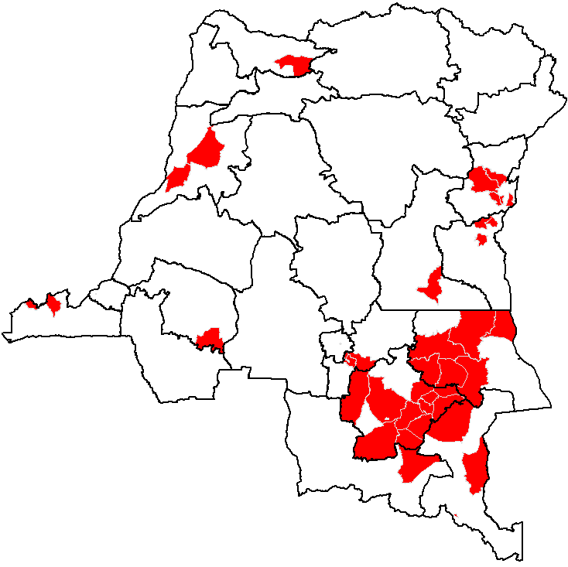
Confirmed measles outbreaks in DRC
Epi weeks 1 - 52, 2015
Suspected measles: | 50,669
# investigated: | 2,697
Lab confirmed measles | 538
Measles confirmed by epi link | 4,214
Lab confirmed rubella | 457
# ZS with measles outbreaks in 2015 | 45
50% des ZS du pays actuellement en épidémie sont au Katanga
ZS en épidémie

Slide 9
Lab. confirmed measles cases by age group and vaccination status. Weeks 1 - 52, 2015. DR Congo
538 lab confirmed measles cases, of which 74% were < 5 years of age.
Vaxn status : 38% vaccinated, 26% not vaccinated, and 36% unknown.

Slide 10
Lab. confirmed measles cases by age group and vaccination status. Weeks 1-20, 2016. DR Congo
106 lab confirmed measles cases, of which 72% were < 5 years of age.
Vaxn status : 25% vaccinated, 31% not vaccinated, and 43% unknown.

Slide 11
Measles outbreak investigations in DR Congo
Outbreak investigations:
  often done by local teams, NGOs.
Outbreak response:
  Often limited to case management, mass vaccination
  Not enough attention on improving routine, strengthening surveillance or selective vaccination!!!

Slide 12
Review of 5 outbreak investigation reports from DRC. Feb – March 2016
Investigation triggered by:
  3 IgM positive cases
  Increasing number cases in aggregate reports
  Letter from a village chief – (in Kiambi ZS)
Focus of investigation:
  Records review, community case search, specimen collxn
  Tabulation of cases by age, Vaxn status, epi curve
  Triangulation with coverage data in 2 ZS
  Response measures recommended to ZS
    Response vaxn done on spot in 2 ZS

Slide 13
Challenges with outbreak investigation and documentation in DRC
Line lists rarely filter up to the national level
  problems with communication/ internet access/ costs
  difficulty in access to some areas, insecurity,
  delay b/n specimen collection and lab confirmation,
  lack of transport /funding/ trained personnel for investigation.
  operational and administrative challenges with the recent re-organization into 26 provinces.
Epi-linkage often not used to classify / analyse cases.

Slide 14
Challenges with outbreak investigation and documentation in DRC (2)
Case based surveillance vs aggregate weekly reporting
  13.6% of cases ( incl. epi linked cases) in CBS database vs IDSR for 2015
  Only 5.3 % investigated with specimens in 2015
  Only 62% districts with at least 1 suspected measles case report in 2015
IDSR data too aggregated= incomplete age info/ No vaxn status, etc
Lots of NGOs in the field!
No data harmonisation b/n EPI and DLM.
Multiple competing activities in country!!

Slide 15
Feb 2015: finalising Gavi application for MenA intro + EPI manager’s meeting
Mar 2015 : polio SNIDs+ MLM course for 40 participants + prep JRF + training for IPV intro + joint field supervision for IPV intro in 4 antennes
Apr 2015 : Introduction of IPV in Bas Congo, Bandundu, Kinshasa, Equateur + AVW
May 2015 : training on IPV intro at C level for 2 Kasai, Maniema, Katanga
June 2015: Intro of IPV in Kasai Occidental, Kasai Oriental, Katanga, Maniema
July 2015: Gavi JA + mid-year review of EPI plan of action
Aug 2015: Intro of IPV in NK, SK, Ori. + prep Gavi M SIA application + switch plan
Sept 2015: 2 polio SNIDs
Oct 2015: ☺ ☺ ☺ ☺ ☺ ☺ ☺ ☺ ☺ ☺ ☺ ☺ ☺ ☺ ☺ ☺ ☺ ☺ ☺ ☺ ☺
Nov 2015: polio SNIDs + measles response campaign 40 ZS in Katanga
Dec 2015: polio SNIDs
Jan 2016: Measles SIAs strategic planning workshop
Feb 2016: YF OB response + prep ICG applic’n + prep JRF + MenA SIAs Kivu + MCIA
Mar 2016: polio NIDs + draft polio preparedness and response plan+ investigation and response to VDPV outbreak in Yaleko + EVIAN + MNTE SAGE WG mtg
Apr 2016: polio NIDs + switch tOPV-bOPV + AVW+ MRI and GAVI jt measles mission
May 2016: evaluation of VDPV response + start YF response + inv. VDPV in Yambuku
June 2016: YF response campaign + MenA SIAs in 4 districts

Slide 16
Proposed measures to improve quality of investigation and response
Raise the profile / priority status of measles elimination within the EPI and DLM programs!!!
Advocate with DLM to support case-based surveillance.
Provide adequate human and financial resources to scale-up case-based surveillance
  Strengthen the measles team in WHO DRC
    Epidemiologists & data managers – at national / prov’l levels
  Revise ToRs and funding sources for the WHO provincial surveillance staff
Encourage and fund regular active surveillance

Slide 17
Proposed measures to improve quality of investigation and response (2)
Close monitoring of performance at the subnational level to provide targeted support to improve case reporting and investigation
Follow performance using all surveillance performance indicators . Eg., T/C, % outbreaks investigated, completeness of investigation, etc
Use FELTP graduates for outbreak investigation and documentation, and for further capacity building in country

Slide 18
Thank you

