Slide 1


Egypt
Accelerating Progress Towards Measles and Rubella Elimination
Geneva, Switzerland
21 – 23 June, 2016
Presented by
Dr. Munir Abdullah – EPI Manager

Slide 2
Introduction
Egypt is a highly populated country, about 90 millions
Distributed in 27 governorates, including 281 districts
Our health system includes more than 5,000 health centers and units
Birth cohort 2.7 millions

Slide 3
History of Routine Measles Vaccination in Egypt
Vaccine | Age at vaccination | Type of Vaccine | Year introduced in RI
MCV1 | 9 months | M | 1977
 | 12 months | MMR | (August)2008
MCV2 | 18 months | MMR | 1999

Slide 4
Measles Outbreak in Egypt
Egypt faced an importation of measles virus in 2012 from Sudan to the governorates of Red Sea and Aswan that spread to the rest of the provinces in the following years. Number of cases in 2012 was 245 confirmed measles cases (Incidence Rate = 2.8 / 1,000,000)
In 2013 the number reported was 270 cases (3.17)
There were 2,284 confirmed measles cases reported during 2014 (26)
8 governorates suffered from measles outbreak during 2014.
Matrouh suffered the most with 6 deaths. Outbreak started on July 2014 and there was a gradual increase in the reported cases of measles until it reached its peak in November, 2014.

Slide 5
Onset of the disease in –Shalateen- Red Sea in April 2012
Laboratory diagnosis has been confirmed by the central laboratory of the Ministry of Health
Genotype “B3” from Sudan ( It was “D4” in 2007-2008)
The disease spread from the Red Sea to Aswan and then from there to Sharkia - Giza - Cairo - Alexandria (El-Amriyah) - Matrouh - Beni Suef – Suhag – Menia
Cases appeared in low-lying areas of health education - tribes and nomads and itinerant - places difficult to reach it (such as Siwa and Shalateen)

Slide 6
Number of confirmed measles cases and MCV1/MCV2 coverage in Egypt 2000-2015
99.8%
10 y-20y
101.5%
9m-10y
104%
Number of cases
2y-11y
Coverage
NIDs
NIDs coverage

Slide 7
The root cause of the outbreak is accumulation of susceptible and immunity gaps in some risky areas.
73% of reported cases at 2014 were at age less than 10 years
62% of confirmed measles cases at 2015 were at age group from 9 M to 10 Y old.

Slide 8
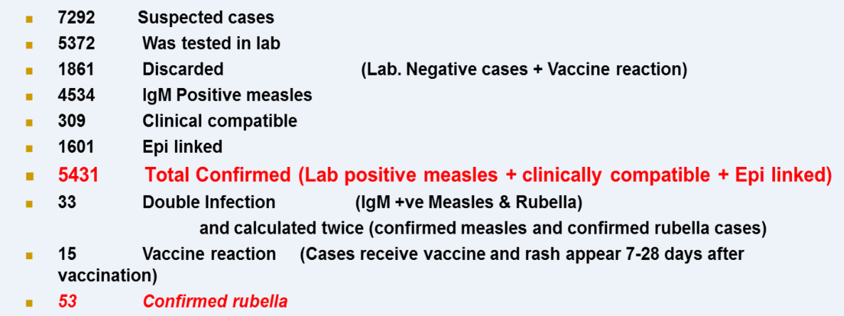
In 2015

Slide 9
Most Affected Governorates in 2015
Governorates | Cases | IR / 1,000,000
Bani Sweif | 742 | 266
Giza | 1488 | 197
Aswan | 224 | 161
Cairo | 1012 | 103
Alexandria | 307 | 65
Suhag | 169 | 37
Menia | 186 | 35
Matrouh | 381 | 879

Slide 10
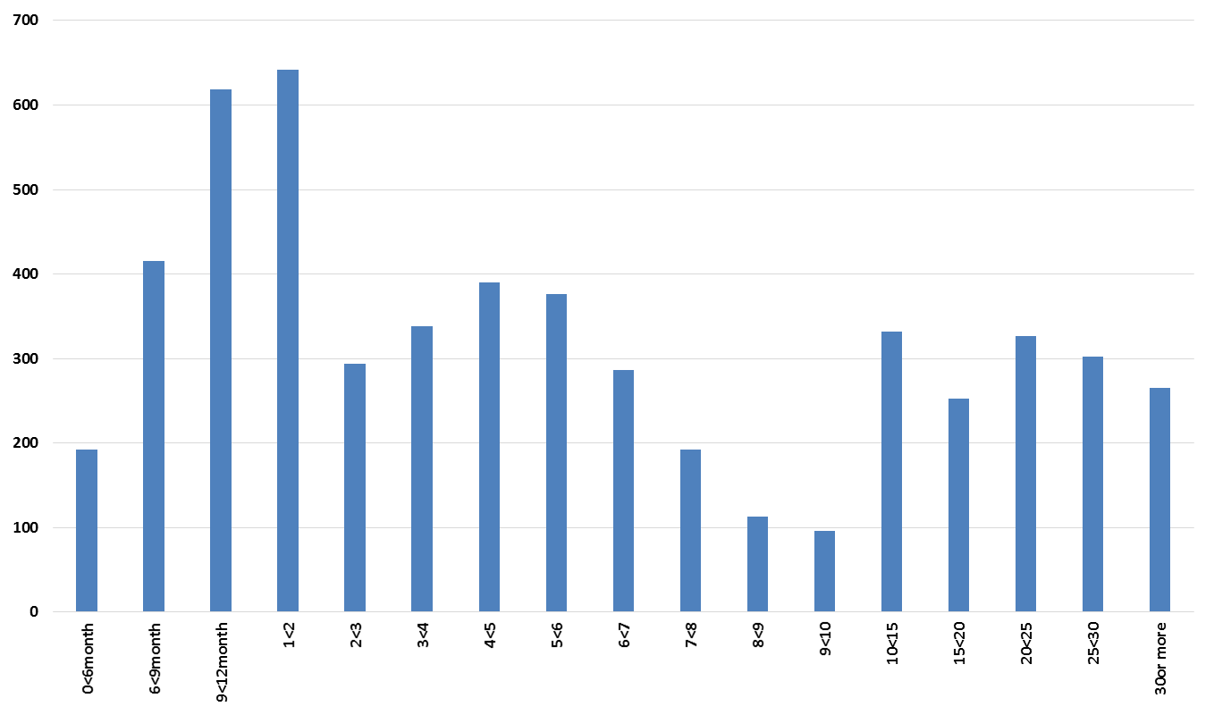
Age distribution of confirmed measles cases Egypt 2015
Number of cases
Age

Slide 11
Distribution of confirmed measles cases by month in Egypt 2006-2015
Number of confirmed measles cases

Slide 12
Number of confirmed measles cases by age group in Egypt 2010-2015
 | 2010 | 2011 | 2012 | 2013 | 2014 | 2015
< 1 year | 2 | 7 | 14 | 36 | 428 | 1226
1-5 yr | 5 | 7 | 97 | 223 | 971 | 2039
6-10 yr | 3 | 5 | 39 | 58 | 359 | 795
11-15 yr | 0 | 1 | 30 | 32 | 129 | 225
> 15 yr | 4 | 6 | 61 | 63 | 387 | 1146
Total confirmed cases | 14 | 26 | 241 | 412 | 2274 | 5431

Slide 13
Distribution of confirmed measles cases by sex
Egypt 2012-2015
Number of confirmed measles cases
49%
51%
59%

Slide 14
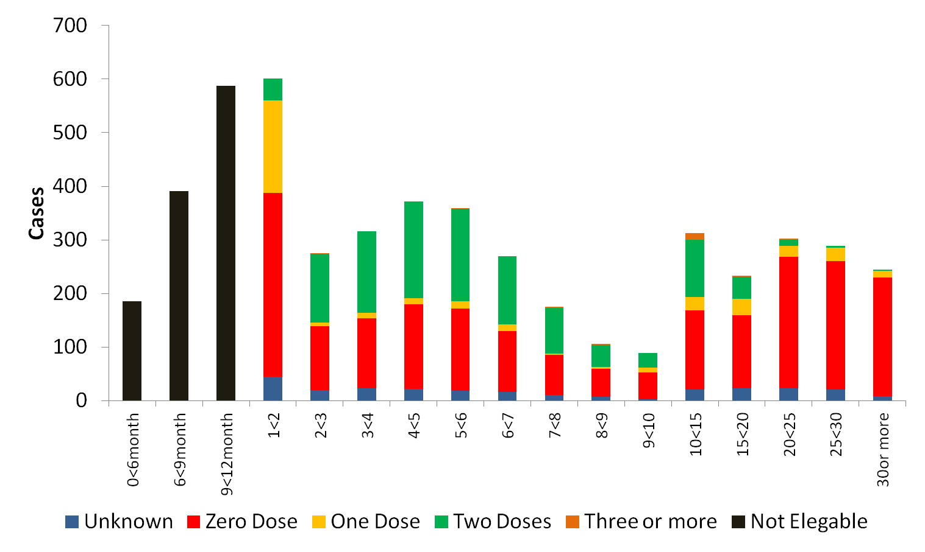
Vaccination status of confirmed measles cases by age group Egypt 2015

Slide 15
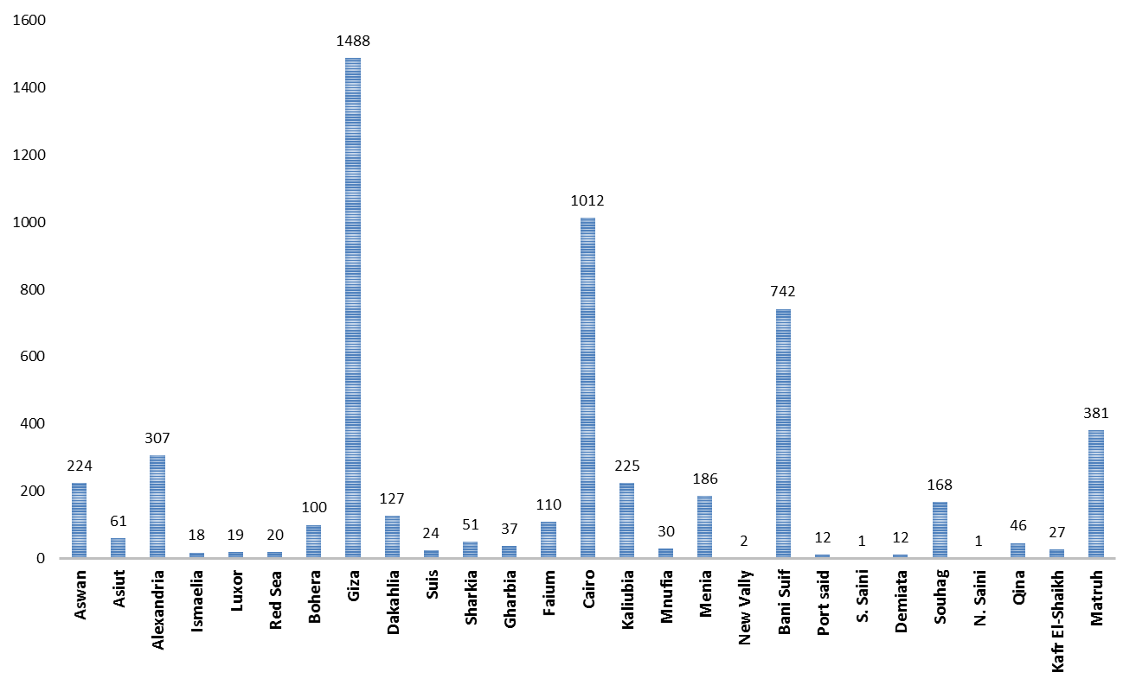
Distribution of confirmed measles cases by Governorate of residence Egypt 2015

Slide 16
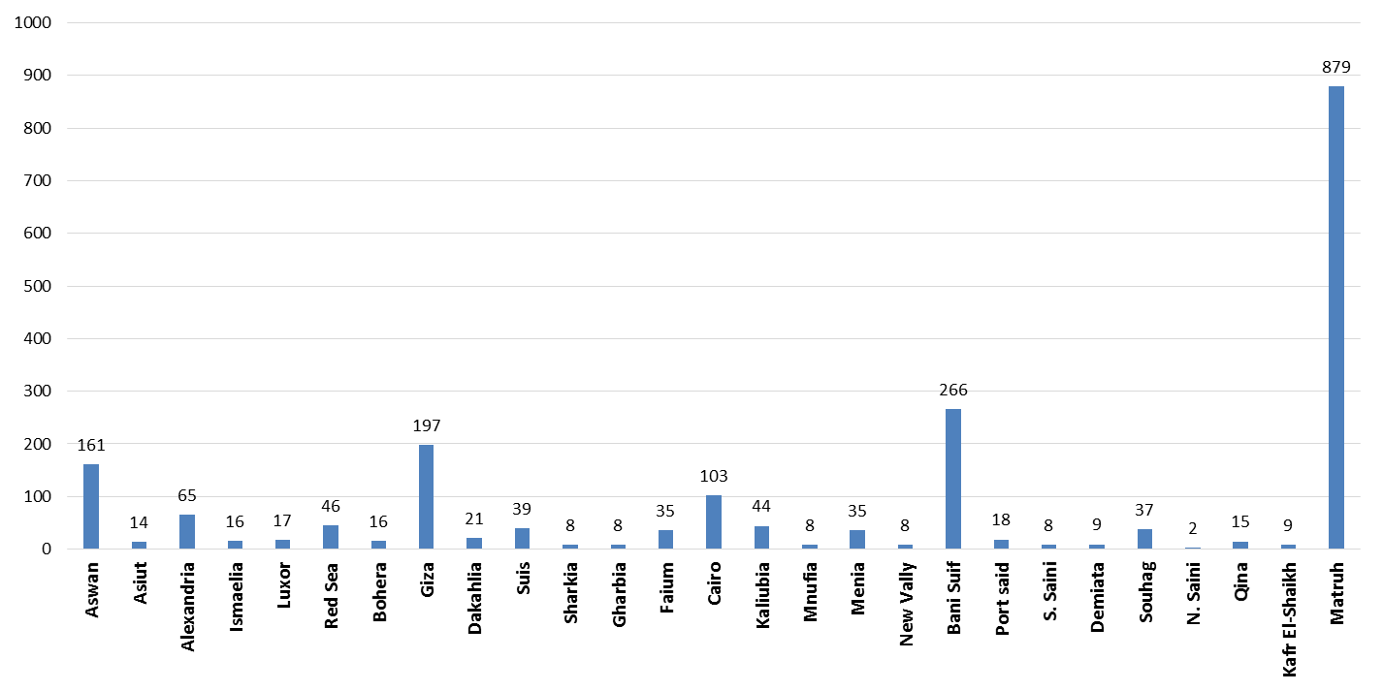
Distribution of confirmed measles ( Incidence Rate / 1,000,000 ) by Governorate of residence Egypt 2015

Slide 17
History of Measles SIAs implemented in Egypt
Year SIA conducted | Target age | Target population | Administrative coverage
Measles antigen
2000-2001 | 6 y - 11 years | 7,386,000 | 96%
2002-2003 | 11 – 16 years | 6,670,000 | 96%
MMR
2001-2002 | 6 years cohort | 1,683,000 | 96%
2002-2003 | 6 years cohort | 1,526,000 | 95%
2003-2004 | 6 years cohort | 1,569,000 | 97%
Dec 2014 | 9 m – 7 years | 106,395 | 101%
MR
2008 | 10 – 20 years | 18,397,660 | 99.8%
2009 | 2 – 11 years | 17,200,000 | 104%
Nov 2015 | 9 m0 – 10 years | 23,000,205 | 102%

Slide 18
Outbreak Response
NITAG meeting at 22 Dec 2014 recommended implementation of NIDs using MR vaccine to children from 9 months to 10 years during 2015 .

Slide 19
Chains of Command
EPI manager: Dr. Munir Abd-Allah
CDC General Manager: Dr. Mohamed Genedy
Head of Central Department for Preventive Medicine: Dr. Alaa Eid
Head of Preventive Medicine Sector: Dr Amr Kandil

Slide 20
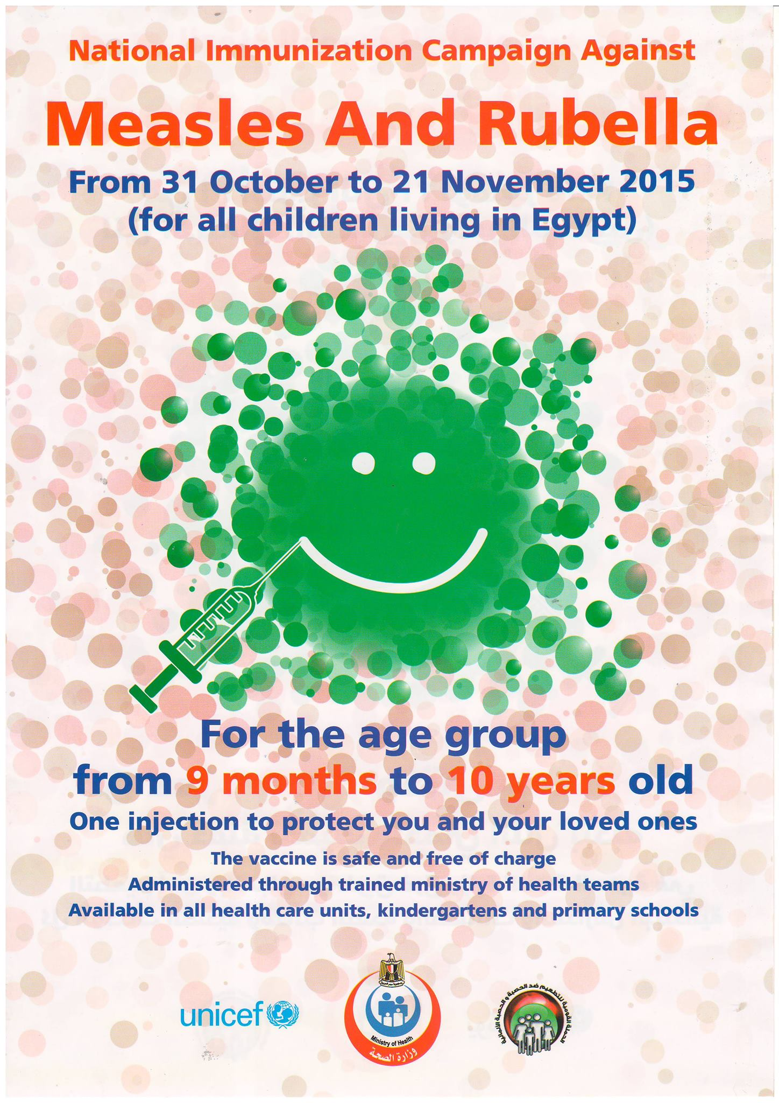

Slide 21
Strategy
Three weeks campaign
Vaccination of all children from 9 M to 10 Y old (Egyptian and Non Egyptian).
Use of safe and effective MR vaccine.
Application of safe injection and safe disposable of waste.

Slide 22
Strategy (cont.)
Vaccination in the presence of physician trained to deal with adverse events specially anaphylactic shock.
Vaccination through fixed teams at health care facilities, schools, Nurseries, fixed posts in hard to reach areas and satellite villages.
MOHP supervision with external intra and post campaign monitoring by WHO, UNICEF and CDC staff.
Strong system of AEFI reporting.
Waste disposal according to National policy.

Slide 23
MR Campaign: Supplies and Manpower
23 million | Target
12,085,005 | School age target
10,914,995 | Non-School age target
15,224 | Number of teams
763 | Governorate supervisor
2,780 | District supervisor
9,843 | Physicians
29,194 | Nurses
6,493 | Sanitarians
33,196 | Site coordinator
53,294 | Vaccination sites

Slide 24
Final report
% | Total Number Vaccinated |  | Vaccination Non Egyptian |  | Vaccinated Egyptian |  | Target
 | 5-10 Years Old | 9 Months to <5 Years | 5-10 Years Old | 9 Months to <5 years | 5-10 years | 9 Months to <5 years
23318455 (101.5%) | 12093387 | 11225058 | 16772 | 8305 | 12076615 | 11216753 | 23 million

Slide 25
Preliminary results of the Coverage Evaluation Survey (PCM) of Egypt 2015 MR SIA
Goveronate | Coverage (%) | Goveronate | Coverage (%)
Cairo | 99.2 | Damietta | 99.2
Alexandria | 99.2 | Dakahlia | 99.6
Port-Saed | 93.3 | Sharkia | 97.5
Suez | 98.3 | Kalubia | 98.3
Giza | 99.6 | Kafr El-Sheikh | 99.6
Beni Suef | 100 | Gharbeya | 97.5
Fayoum | 100 | Menoufia | 97.9
Minya | 98.8 | Behira | 98.8
Assuit | 96.7 | Ismailia | 95.8
Souhag | 100 | Red Sea | 98.8
Qena | 93.8 | New Valley | 98.3
Aswan | 96.7 | Matrouh | 97.9
Luxor | 98.8 | South Sinai | 99.6
Overall National Coverage |  | 98.2% (95% CI: 97.87% - 98.53%)
93.3
93.8

Slide 26
Lessons Learnt
Adequate planning ahead of time leads to ease of implementation,
Training and supportive supervision are essential for a successful campaign,
Advocacy of pediatricians, private sector is essential,
Dealing with Vaccine Hesitancy: The best tool to overcome rumors is the same tool used to spread rumors (the use of Facebook to overcome social media rumors),
Daily announcement in media and available free hot line to answer all question related to NID and MR vaccine.

Slide 27
Way Forward
Strengthen outbreak investigation, coordination of teams, surveillance and reporting,
Regular meetings of lab and surveillance officers,
Ensuring adequate supply of lab reagents,
Strengthen RI activities and outreach activities to bridge the immunization gap and vaccinate defaulters,
Updating special plan for high risk population (Groups)
  Continuous communication and social mobilization to improve population demand to vaccination, specially in hard to reach and slum areas.

Slide 28


