Slide 1
A Public Health Career Built on a Framework of Vaccines and Vaccinations
Jeffrey P. Koplan, MD, MPH
Emory Global Health Institute
American Red Cross- Measles & Rubella Initiative
11 September 2019

Slide 2


Slide 3

“It was impossible to believe that Alan was lying in that pale, plain pine box merely from having caught a summertime disease. That box from which you cannot force your way out. That box in which a twelve-year-old was twelve years old forever. The rest of us live and grow older by the day, but he remains twelve. Millions of years go by, and he is still twelve.”
― Philip Roth, Nemesis

Slide 4
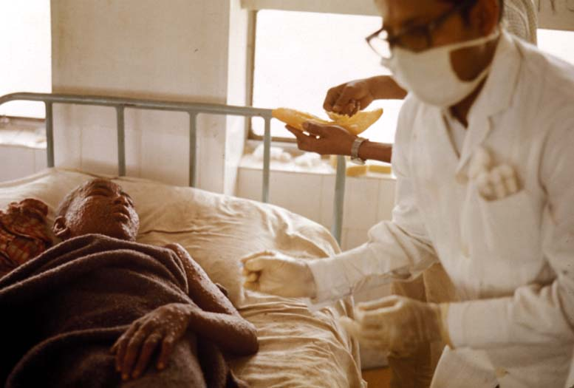
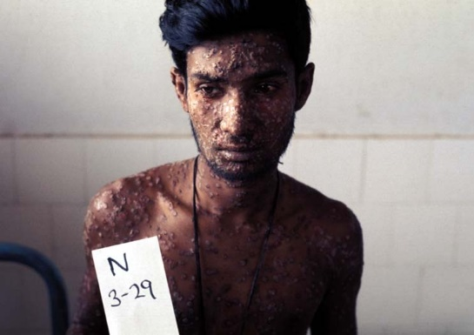

Slide 5

The Smallpox Virus

Slide 6
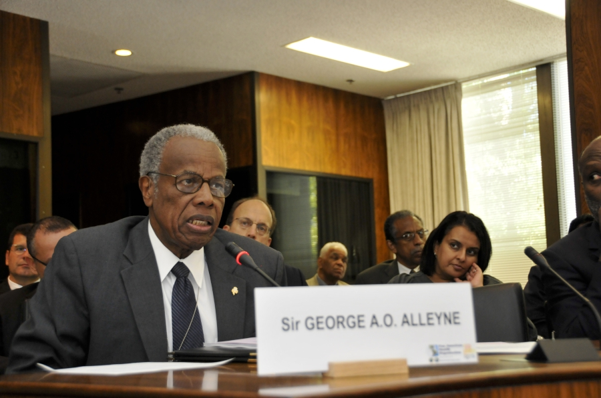

Slide 7
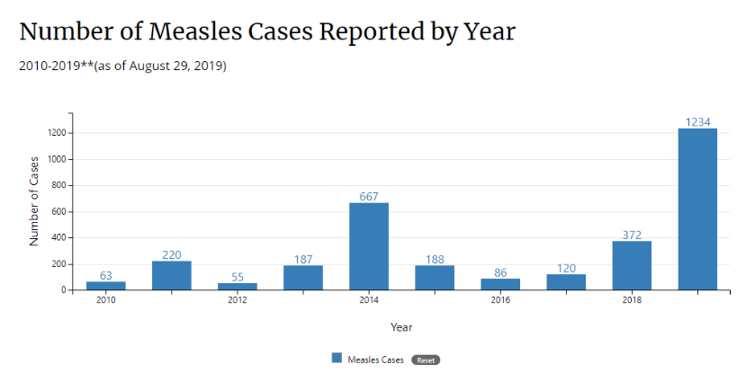

Slide 8
Parental Concerns About Vaccines
Vaccine Safety
Necessity of vaccines
Freedom of choice
Countering Vaccine Hesitancy. Kathryn M. Edwards, Jesse M. Hackell, THE COMMITTEE ON INFECTIOUS DISEASES, THE COMMITTEE ON PRACTICE AND AMBULATORY MEDICINE. Pediatrics Sep 2016, 138 (3) e20162146; DOI: 10.1542/peds.2016-2146

Slide 9

Absence of Disease

Slide 10
Historical Amnesia

Slide 11
Parental Liberty
“Parental liberty is not absolute but constrained by the duty to protect children.”
- Davis and Shah, JAMA, July 2, 2019

Slide 12
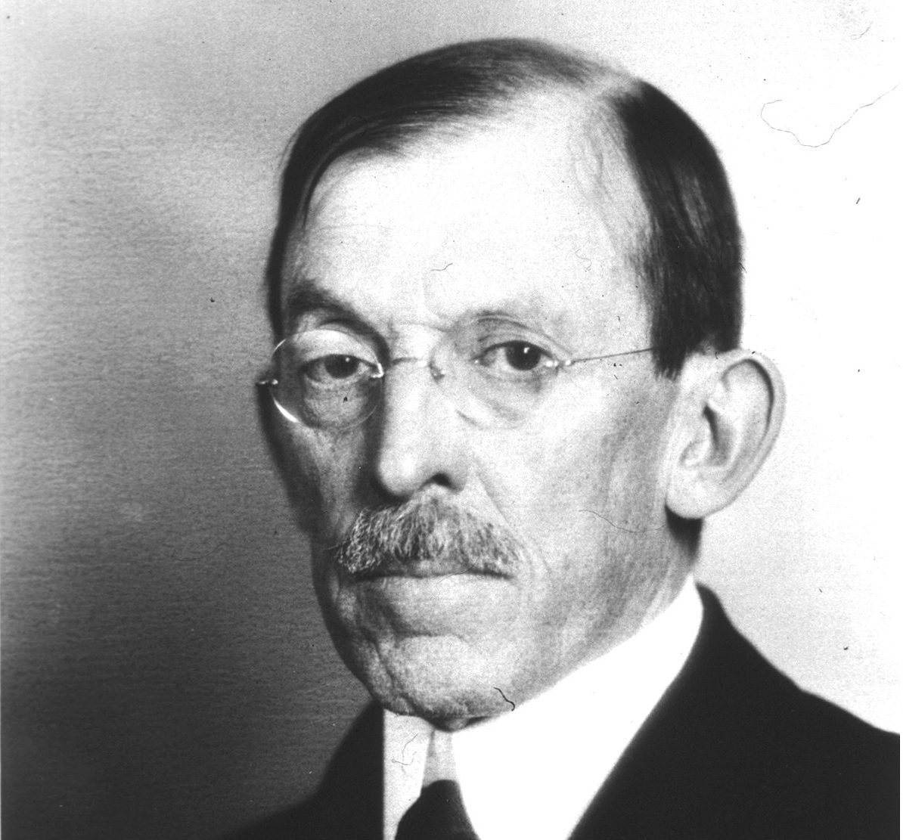
“Public health is purchasable. Within a few natural and important limitations any community can determine its own health.”
― Hermann M. Biggs, MD
Commissioner of Health, New York City and State (1911)

Slide 13
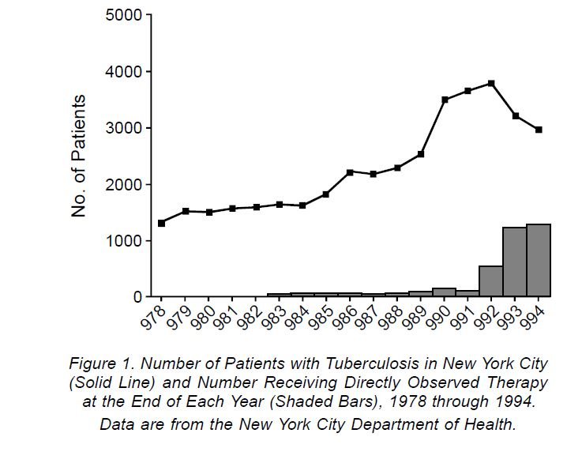

Slide 14

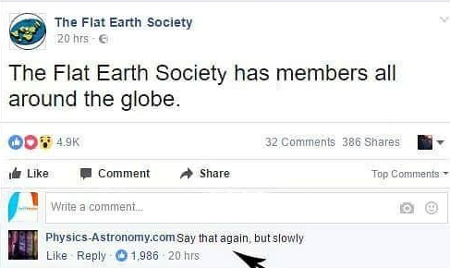
Distrust of Science
z

Slide 15
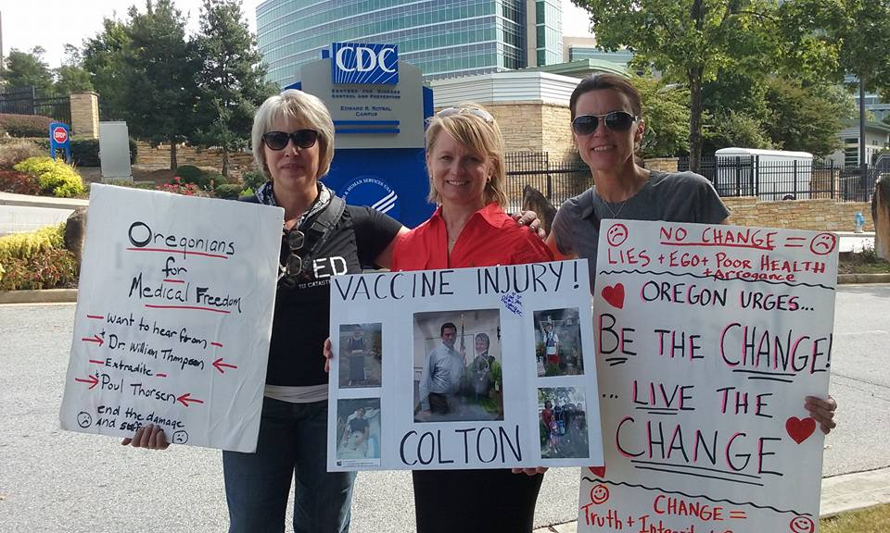
Distrust of Institutions

Slide 16
Growth of Internet
Facilitates fake science!

Slide 17
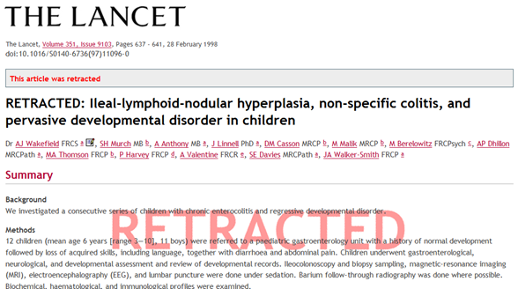
Charlatans

Slide 18

Religious Concerns
Four factors Christians should consider regarding vaccinations:
1. “as we who have the mind of Christ…we should strive to honor him with how we use that mind. “We should use the best available empirical evidence and not anti-science propaganda, anecdotes, celebrity non-endorsements, or unwarranted skepticism of government institutions such as the National Institutes of Health (NIH) and the Center for Disease Control and Prevention (CDC). “
2. “We should strive to seek the common good.”
- Joe Carter, editor for The Gospel Coalition & author of The Life and Faith Field Guide for Parents
www.thegospelcoalition.org/article/what-christians-should-know-vaccines/

Slide 19
Religious Concerns
3. “Remember that rather than using our liberty to avoid vaccinations, evangelicals have historically been at the vanguard of promoting vaccinations.”
4. “ A parent who refuses to have their child vaccinated is morally responsible for the outcome of that choice.
- Joe Carter, editor for The Gospel Coalition & author of The Life and Faith Field Guide for Parents

Slide 20
“Guarding your own health doesn’t only make sense, it’s actually a mitzvah. That means that even if you don’t want to do it, for whatever reason, you are still obligated to do so. The Torah is teaching us that our body is a gift from G-d and we are therefore not the owners of it and we can’t cause it any damage.. It is not enough to deal with health issues as they arise; we must take precautions to avoid danger.”
“Obviously, as in all cases, especially in regard to the health of children, one should consult one’s personal physician, a licensed medical doctor.”
- Rabbi Yehuda Shurpin, Content Editor of Chabad.org

Slide 21
“In reply to your letter in which you ask my opinion about the injections that are commonly given to young children: It is with regard to matters such as these that the axiom “Do not set yourself apart from the community” applies. You should act according to that which is done by [the parents of] the majority of children who are in your children’s classes…”
- The Lubavitcher Rebbe, Rabbi Menachem M. Schneerson, of Righteous Memory
https://www.chabad.org/library/article_cdo/aid/2870103/jewish/What-Does-Jewish-Law-Say-About-Vaccination

Slide 22
Alternative Medicine
Effective vs. Ineffective?

Slide 23
Legal Concerns
“The right to practice religion freely does not include liberty to expose the community or the child to ill health or death.”
- Prince v Massachusetts, 321 US 158, 166-167 (1944)

Slide 24
Solutions
Coercive and persuasive approaches are most effective when used together.

Slide 25
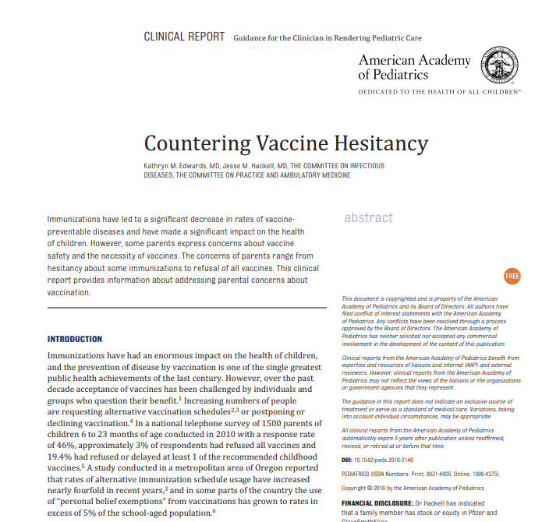
Countering Vaccine Hesitancy. Kathryn M. Edwards, Jesse M. Hackell, THE COMMITTEE ON INFECTIOUS DISEASES, THE COMMITTEE ON PRACTICE AND AMBULATORY MEDICINE. Pediatrics Sep 2016, 138 (3) e20162146; DOI: 10.1542/peds.2016-2146

Slide 26
Conclusion
Vaccinations are arguably the greatest contribution to human health.

Slide 27
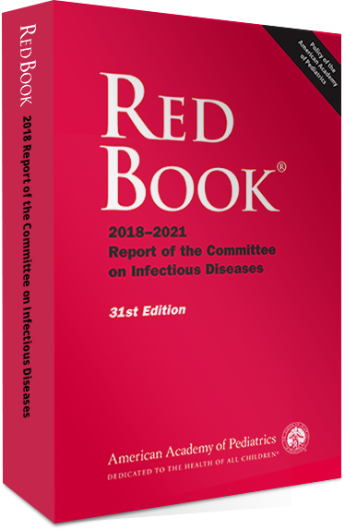
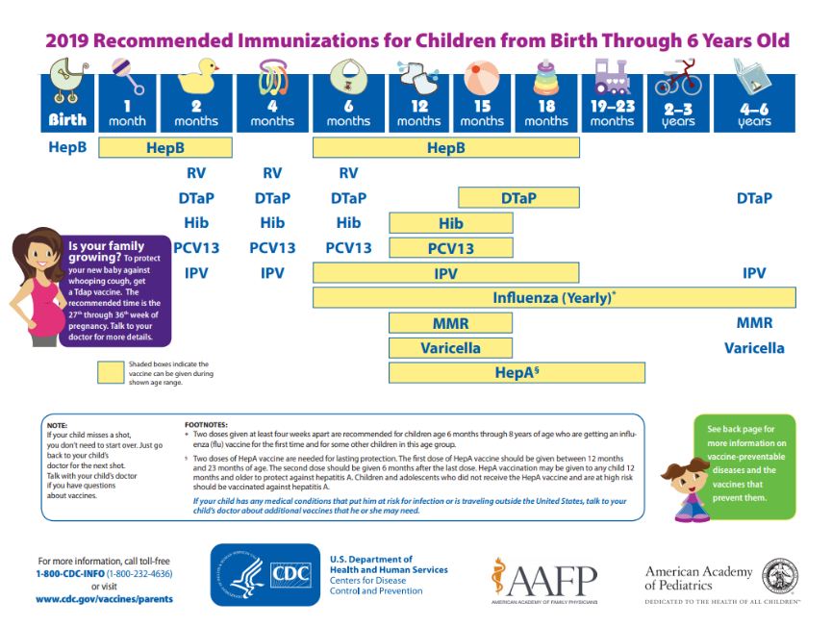

Slide 28
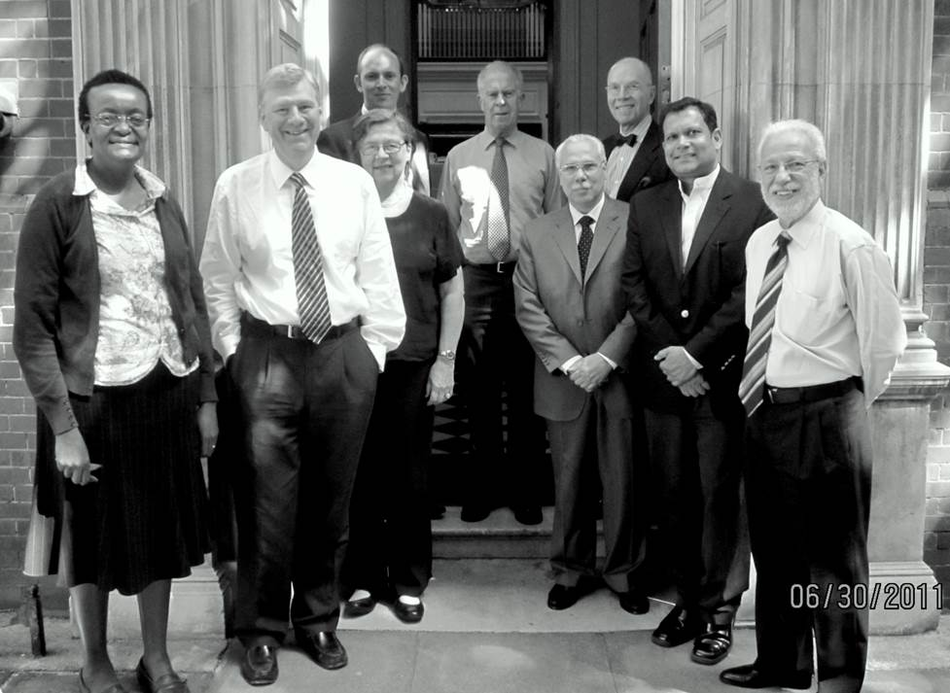

Slide 29


