Slide 1
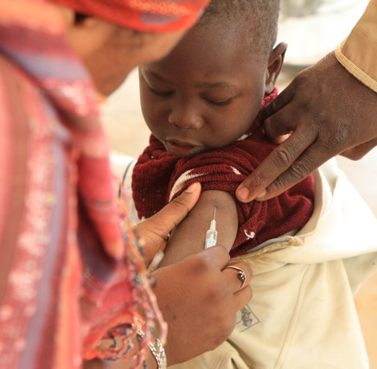
African Region- priorities to reach the 2020 measles elimination goal.
Dr Balcha Masresha
WHO Regional office for Africa
Sept 2012

Slide 2
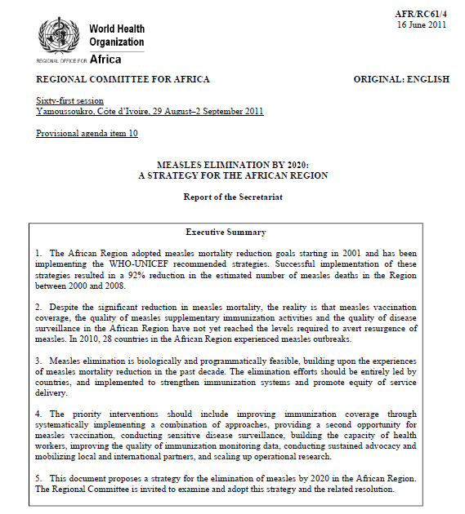
Regional Committee resolution on Measles Elimination. Sept 2011

Slide 3
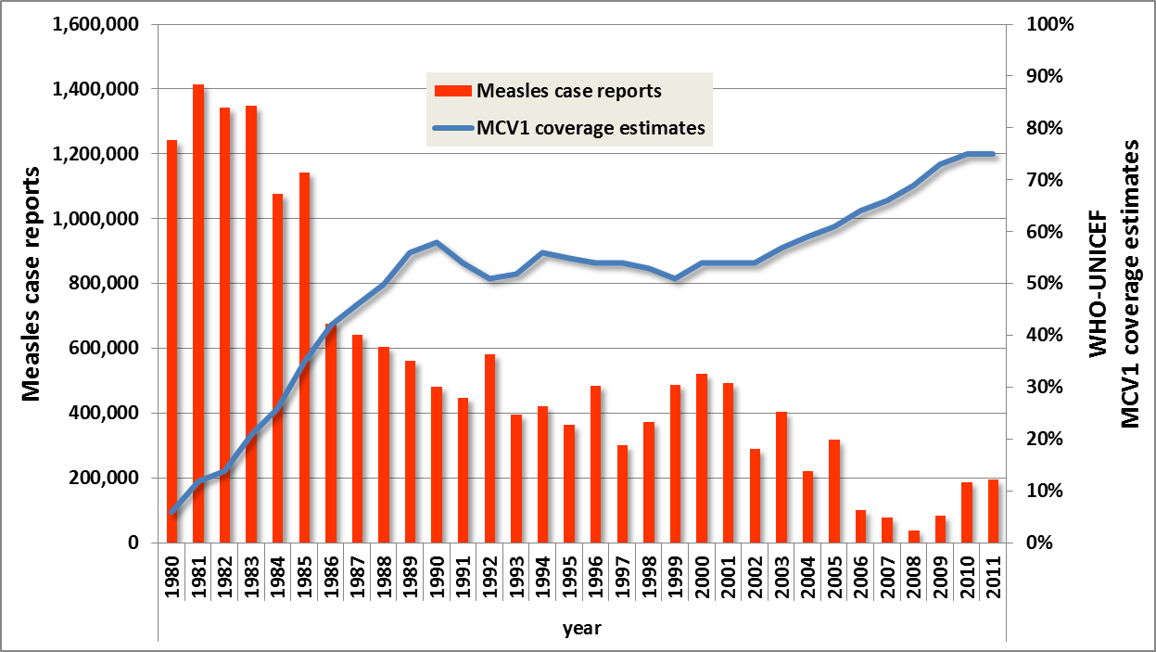
Measles case reports & MCV1 coverage (WHO-UNICEF estimates). AFR. 1980 - 2011
Follow up SIAs
Catch up SIAs
64% of case reports in 2010 = from Malawi
69% of case reports in 2011= from DR Congo

Slide 4
Number of countries according to MCV1 coverage category. 2009 - 2011. (WHO UNICEF coverage estimates)
MCV1 coverage category | Number of countries
 | 2009 | 2010 | 2011
>90% | 16 | 16 | 16
80 – 89 % | 4 | 7 | 7
70 – 79% | 11 | 8 | 10
60 – 69% | 9 | 10 | 5
<60% | 6 | 5 | 8

Slide 5
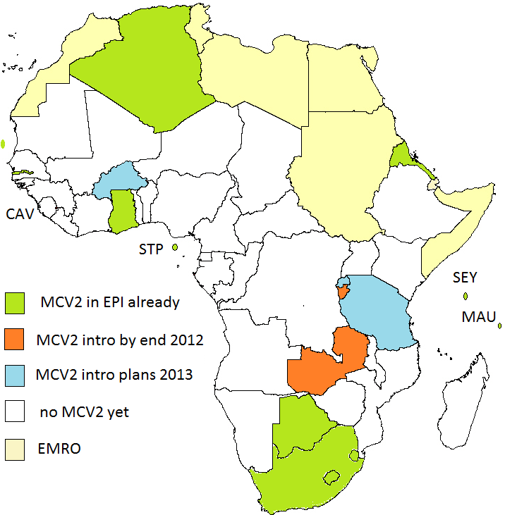
MCV2 introduction in AFR. August 2012
A total 30 countries are expected to introduce MCV2 by end 2015.

Slide 6
Measles SIAs. AFR. 2012
SIAs reached 17 million children (Jan - Aug 2012) in 10 countries
  Additional 22.3 million to be reached by the end of 2012 in 5 more countries
  Including wide age group SIAs in 3 countries

Slide 7
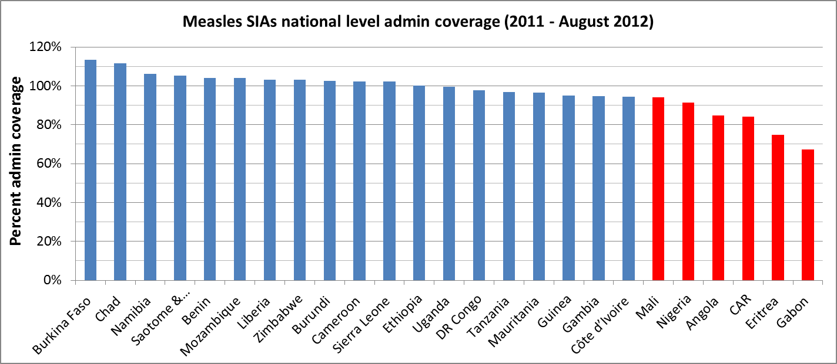
SIAs admin coverage against 95% coverage target (in 2011 - 2012)

Slide 8
Local funding for measles SIAs,
2011 - 2012
NB: A total of USD 18 million PLUS raised locally by these countries in 2011 - 2012

Slide 9
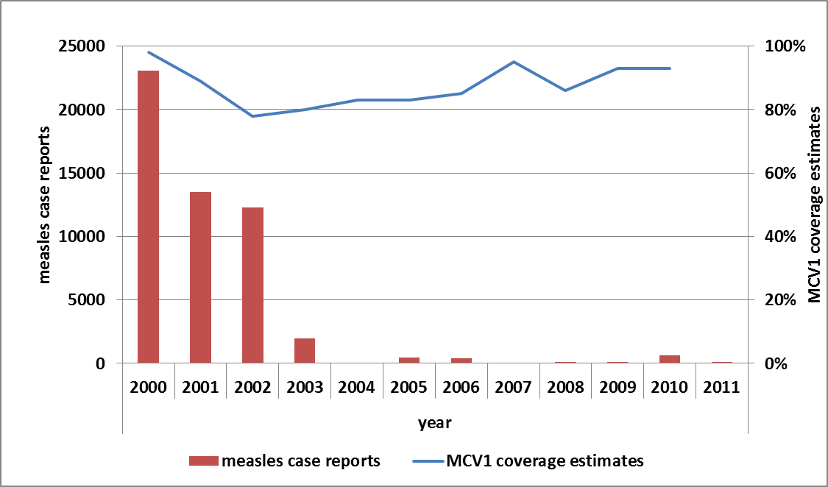
Measles case reports and MCV1 coverage (WHO UNICEF estimates). Ghana. 2000 - 2011

Slide 10
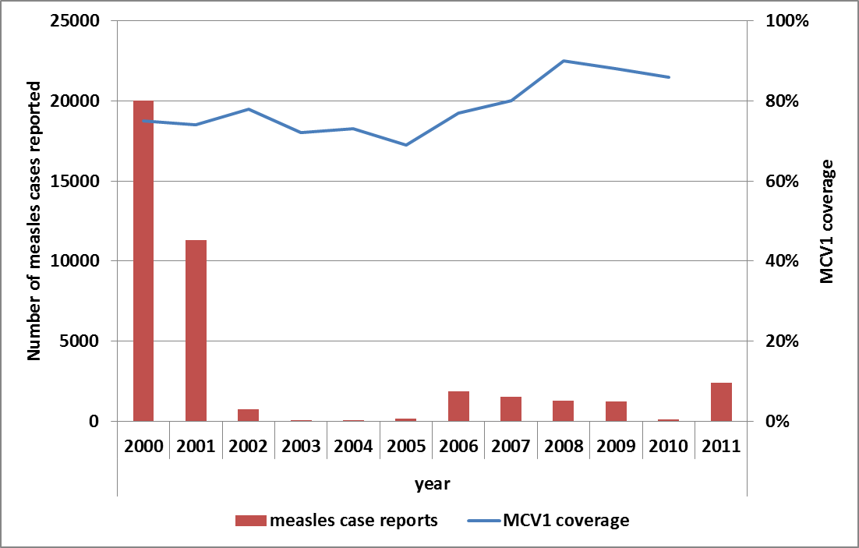
Measles case reports and MCV1 coverage (WHO UNICEF estimates). Kenya. 2000 - 2011

Slide 11
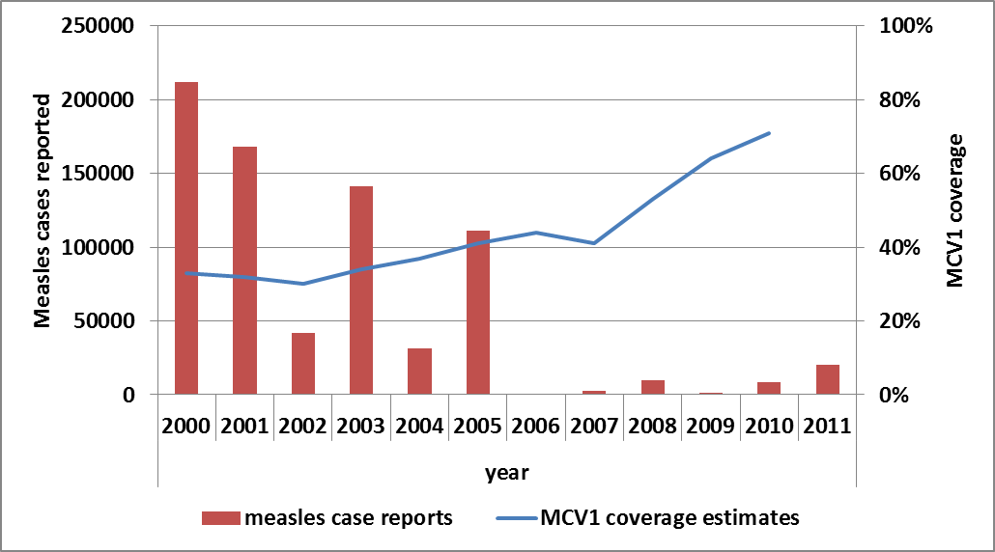
Measles case reports and MCV1 coverage (WHO UNICEF estimates). Nigeria. 2000 - 2011

Slide 12
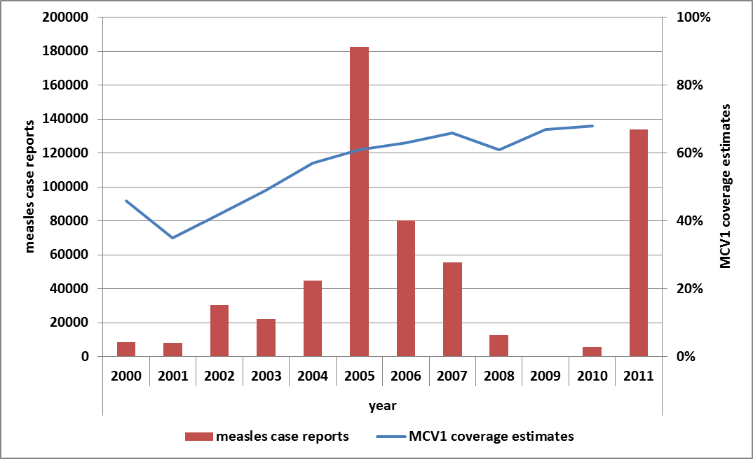
Measles case reports and MCV1 coverage (WHO UNICEF estimates). DR Congo. 2000 - 2011

Slide 13
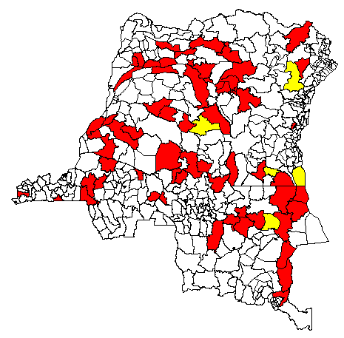
Trends in weekly measles case reporting. DR Congo,
2010 – week 33, 2012
ZS en alerte (5)
ZS en épidémie (80)
lundi 17 septembre 2012
Source: DLM

Slide 14
Measles surveillance performance.
2010 – 2012. AFR
Performance indicators/ parameters | 2010 | 2011 | 2012 (Jan 1 - Aug 10)
Number of reporting countries | 42 | 43 | 43
Number of suspected measles cases reported | 163,575 | 74,896 | 32,449
Number of confirmed measles cases | 127,422 | 32,323 | 12,964
Non-measles febrile rash illness (target >2/ 100,000 population ) | 3.7 | 4.4 | 2.9
% countries meeting target for NMFRI rate | 25/42 (60%) | 22/42 (51%) | 25/43 (58%)
% districts reporting > 1 case with blood sample (target >80%) | 84% | 81% | 76%
% countries meeting target for district reporting | 29/42 (69%) | 23/43 (53%) | 19/43 (44%)
Incidence of confirmed measles per 100,000 population | 16.5 | 4.2 | 1.5

Slide 15
Status vis-a-vis 2012 pre-elimination targets (as of end 2011)
Indicator | Proportion
Countries with MCV1 coverage in 2010 (WHO UNICEF estimates) of 90% or more | 35%
Countries with at least 80% districts reporting MCV1 coverage of 80% or more in 2010 | 7%
Countries with at least 90% districts reporting 95% or more SIAs coverage in 2009 -2011 | 23%
Countries with at least 80% districts reporting suspected measles cases in 2011 | 53%
Countries with a NMFRI rate of at least 2 per 100,000 population in 2011 | 51%
Countries with incidence of confirmed measles of less than 5 cases per million population in 2011 | 56%

Slide 16
Main Challenges
Measles outbreaks in the face of:
  gaps in immunisation systems
  Shifting epidemiological susceptibility towards older age groups
Gaps in local and partner resource mobilisation
Multiple social and health sector priorities at country level
  Polio eradication, HIV-AIDS, epidemics, health worker attrition, NUVI

Slide 17
Priorities for the Region
Strengthening routine immunisation systems
SIAs targeting susceptible population groups
  Resource implications
Strong advocacy at regional and global level
Introducing rubella vaccines

Slide 18
Opportunities ahead for measles elimination in AFR
Efforts to reprogram/ realign HSS support to immunisation program outcomes
  Focus on CAR, CHA, DRC, ETH, GUB, GUI, NIE, NIG, UGA, ZAM
GAVI support:
  for SIAs in selected countries
    ETH, NIE, DRC in 2013
  for wide age group MR SIAs
  for outbreak response

Slide 19


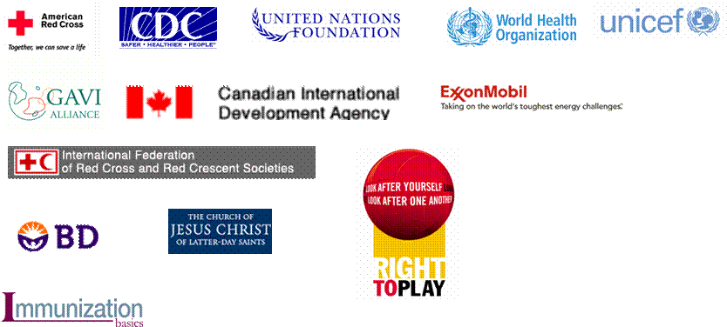














Anne Ray Charitable Trust

