Slide 1
Measles immune amnesia
Rik de Swart
Department of Viroscience, Erasmus MC, Rotterdam, the Netherlands
1

Slide 2

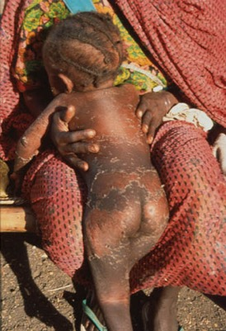
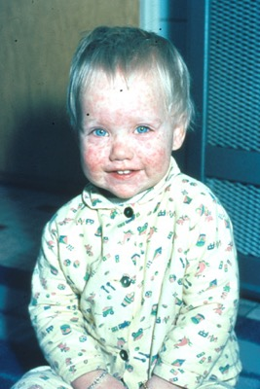

Measles: the disease
Highly infectious
Long incubation time (9-19 days)
Rash, fever, cough, conjunctivitis
Immunosuppression: opportunistic infections
  e.g. pneumonia, gastrointestinal disease, otitis media
Rare but severe neurological complications
Estimated global mortality: 109,638 (2017)
https://measlesrubellainitiative.org/

Slide 3
Measles: the disease
Highly infectious
Long incubation time (9-19 days)
Rash, fever, cough, conjunctivitis
Immunosuppression: opportunistic infections!
  e.g. pneumonia, gastrointestinal disease, otitis media
Rare but severe neurological complications
Estimated global mortality: 109,638 (2017)
https://measlesrubellainitiative.org/

Slide 4
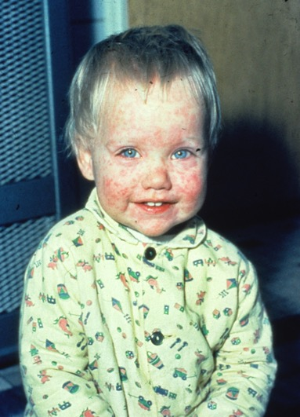
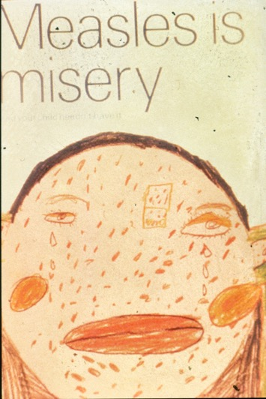
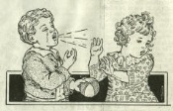
Measles incubation period
2 weeks

Slide 5
Measles incubation period
Black Box

Slide 6
Measles incubation period
Playground for virologists!

Slide 7
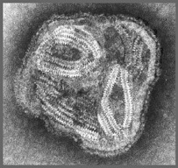
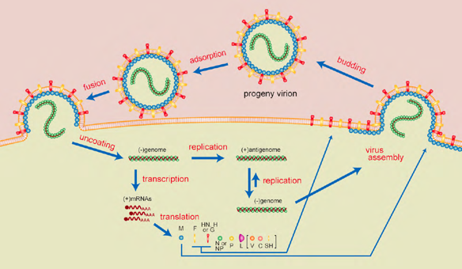
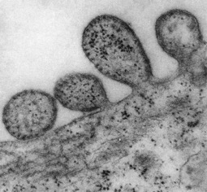
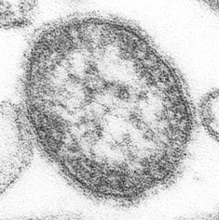
Measles virus
Enveloped virus
Obligate intracellular parasite
Cellular receptors determine which cells can get infected
Cellular receptors measles virus:
  CD150 (immune cells)
  Nectin-4 (respiratory epithelial cells)

Slide 8
Measles virus
Enveloped virus
Obligate intracellular parasite
Cellular receptors determine which cells can get infected
Cellular receptors measles virus:
  CD150 (immune cells)
  Nectin-4 (respiratory epithelial cells)

Slide 9
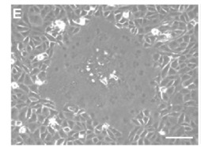
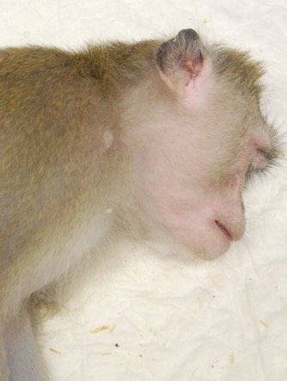
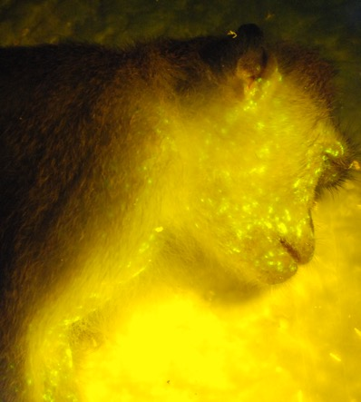
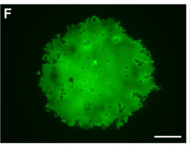
Recombinant measles virus
Non-human primate model for measles

Slide 10
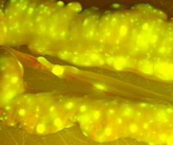
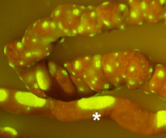
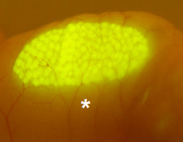
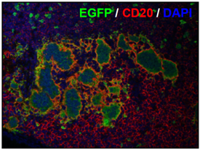
MV infects CD150⁺ memory lymphocytes
Cell-associated viremia
High infection levels in lymphoid tissues
T-lymphocytes: preferential infection of memory cells
B-lymphocytes: infection of both naive and memory cells
PLoS Pathog 2007, 2011, 2012, 2014

Slide 11
MV infects CD150⁺ memory lymphocytes
Cell-associated viremia
High infection levels in lymphoid tissues
T-lymphocytes: preferential infection of memory cells
B-lymphocytes: infection of both naive and memory cells
PLoS Pathog 2007, 2011, 2012, 2014

Slide 12

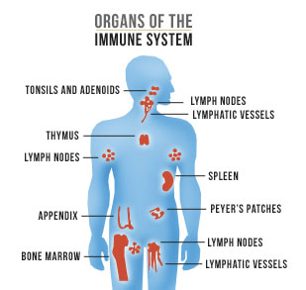
Memory
Your 2018 summer vacation:
‘regular’ memory
The infections you have had:
‘immune memory’

Slide 13
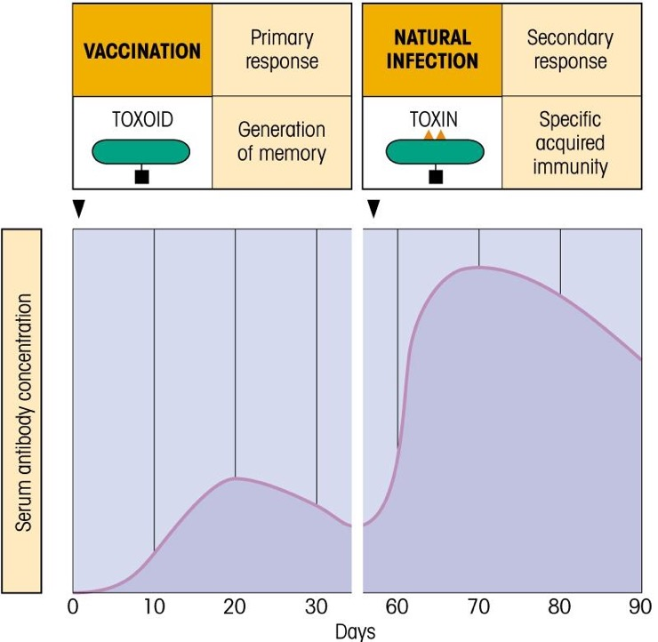
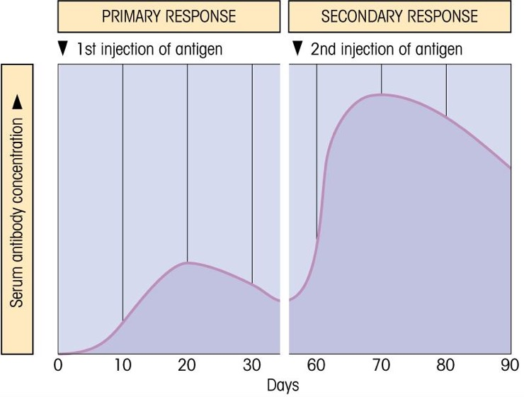
Immune memory: basis for vaccination
Faster
+
Stronger

Slide 14
Immune memory: basis for vaccination
Jenner 1796: cowpoxvirus
(vacca = cow)

Slide 15
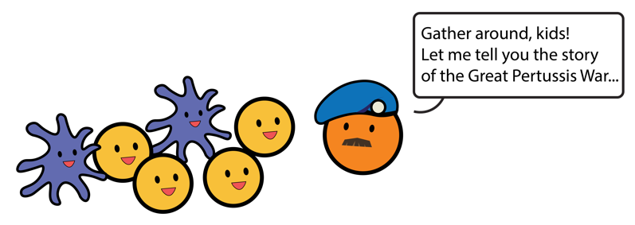
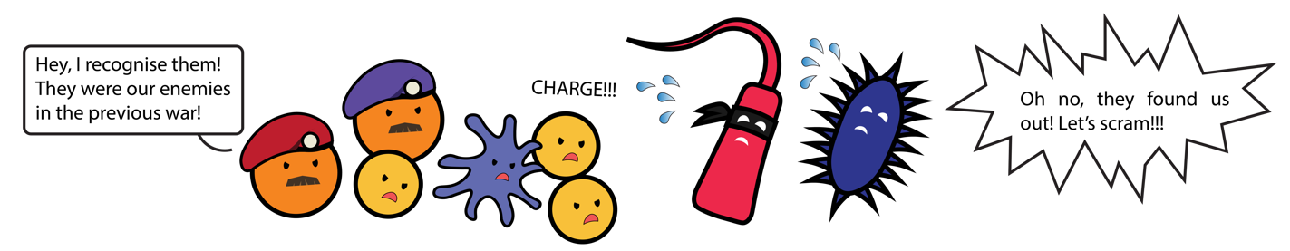
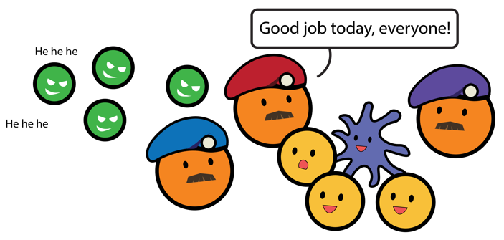
But: immune memory cells express CD150
Cartoons by Brigitta Laksono

Slide 16
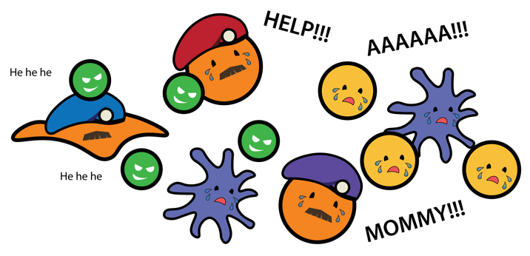
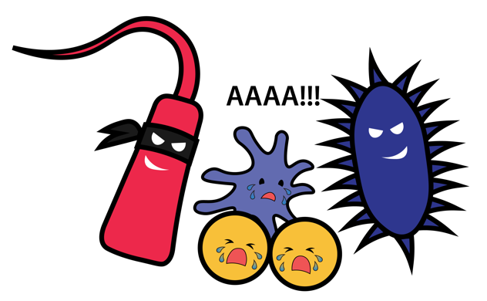
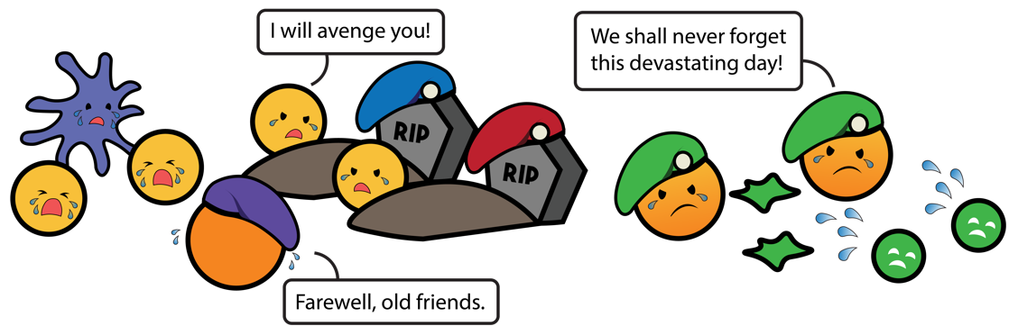
Measles causes immune amnesia
Cartoons by Brigitta Laksono

Slide 17
Measles incubation period
Black Box

Slide 18
Measles incubation phase: infection of immune cells

Slide 19
Remaining questions
Observations from experimental MV infections in the monkey model
How about natural measles in unvaccinated children?
  Evidence for long duration of measles immune suppression in humans?
  Evidence for infection of memory lymphocytes in humans?
  Evidence for depletion of lymphocyte subsets in humans?

Slide 20
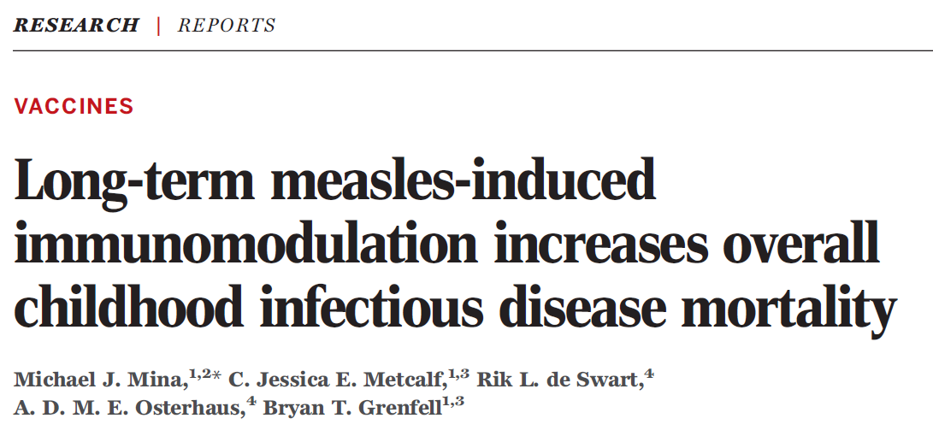
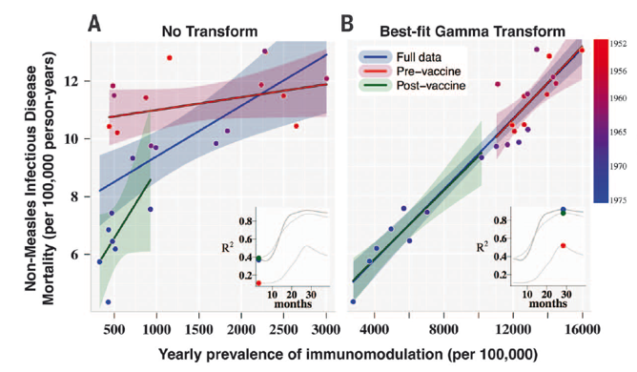
Duration of measles immune suppression in humans
Ecological study (2015)
Mina et al., Science 348:694-9, 2015

Slide 21

Duration of measles immune suppression in humans
Case-based study (2018)

Slide 22
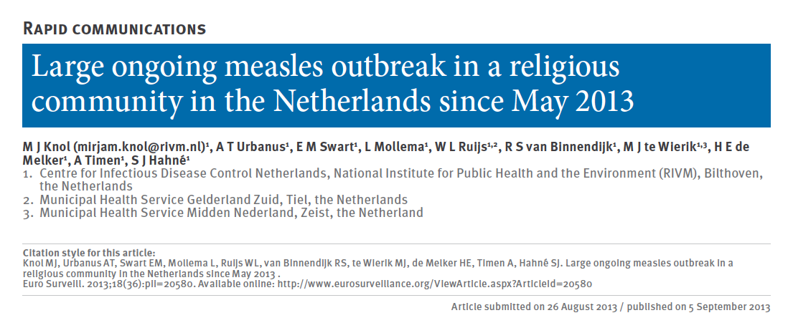
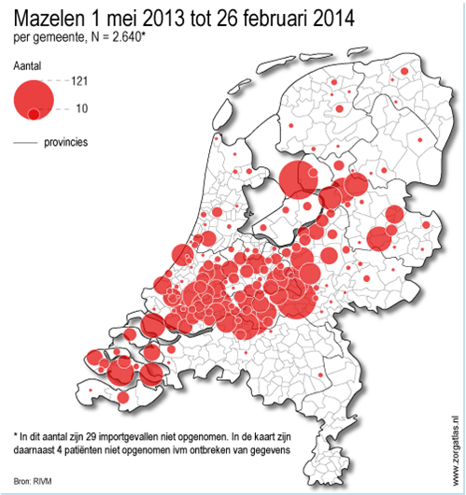
Measles outbreak 2013 / 2014
March 2014: >2600 reported cases

Slide 23
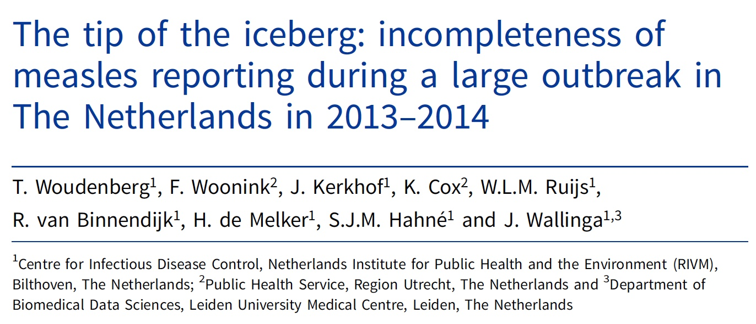
Measles outbreak 2013 / 2014
March 2014: >2600 reported cases
Estimated real number: >30,000 cases

Slide 24
Clinical study in unvaccinated children
Title: Studies into the mechanism of measles-associated immune suppression during an outbreak of measles in The Netherlands (NL45323.078.13)
Objective: validate immune suppression model in measles patients
Study design: Observational cohort study
Study population: Unvaccinated children in orthodox protestant families, 4-17 years of age.
Laksono et al., Nat Commun (2018)

Slide 25
Clinical study in unvaccinated children
Title: Studies into the mechanism of measles-associated immune suppression during an outbreak of measles in The Netherlands (NL45323.078.13)
Ethical approval: July 2013 (MEC-2013-302)
Cohort A: acute measles cases
Cohort B: paired samples pre- and post measles
Eben-Haëzerschool (Opheusden)
Rehobothschool (Opheusden)
Sebaschool (Ochten)
Laksono et al., Nat Commun (2018)

Slide 26
Cohort A: early acute measles
Laksono et al., Nat Commun (2018)
Days relative to onset of rash

Slide 27
Cohort A: early acute measles
Naive CD4⁺ T-cells
Naive CD8⁺ T-cells
Naive B-cells
Percentage MV-infected cells (out of subset)
Memory CD4⁺ T-cells
Memory CD8⁺ T-cells
Memory B-cells
Laksono et al., Nat Commun (2018)
Days relative to onset of rash

Slide 28
Cohort B: paired PBMC before and after measles
Laksono et al., Nat Commun (2018)

Slide 29
Cohort B: paired PBMC before and after measles

Slide 30
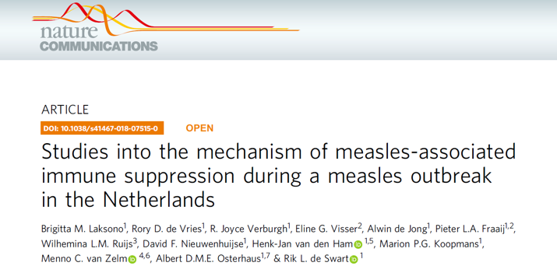

Conclusions
Measles viremia is associated with infection of memory T- and B-lymphocytes
Measles has a lasting impact on circulating lymphocyte subsets
These results support the immune amnesia model

Slide 31






Acknowledgements
Erasmus MC department Viroscience
Brigitta Laksono
Rory de Vries
Joyce Verburgh
Albert Osterhaus
David van de Vijver
Marion Koopmans
Erasmus MC department Pediatrics
Eline Visser
Pieter Fraaij
Annemarie van Rossum
Erasmus MC department Immunology
Diana van den Heuvel
Menno van Zelm
Erasmus MC department of General Practice
Arthur Bohnen
Erasmus MC department of Medical Informatics
Kartini Gadroen
Caitlin Dodd
Mirjam Sturkenboom
RIVM Bilthoven / GGD Gelderland Zuid
Helma Ruijs
Princeton University
Michael Mina
Bryan Grenfell
University of Pittsburgh
Paul Duprex

