Slide 1
Measles Outbreaks in Southern Africa in 2010
Presentation to the MI 10th annual meeting
Sept 2011
B Masresha
WHO AFRO

Slide 2
Outline
Routine immunisation and SIAs in Southern Africa
Measles case reporting and epidemiological characteristics. 2010
Role of vaccination refusals in propagating the outbreak
Experience with outbreak response
Lessons learnt and way forward

Slide 3
Routine immunization and SIAs coverage in Southern Africa

Slide 4
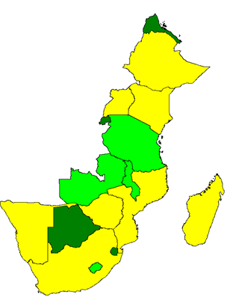
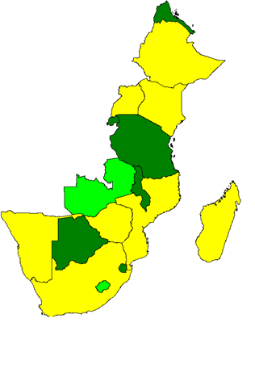
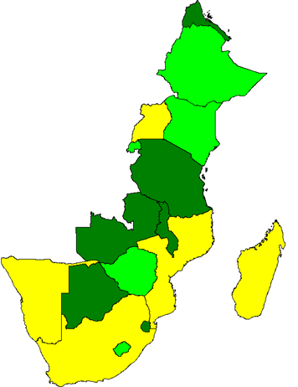
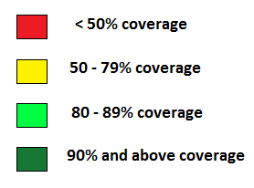
MCV-1 Coverage. WHO/UNICEF estimates. 2008 - 2010
2008
2009
2010

Slide 5
Measles SIAs in Southern Africa.
2001 - 2009
 | 2001 | 2002 | 2003 | 2004 | 2005 | 2006 | 2007 | 2008 | 2009 | 2010
BOT |  |  |  |  | Follow up |  |  |  | Follow up
LES |  |  | Follow up |  |  |  | Follow up
MAL |  | Follow up |  |  | Follow up |  |  | Follow up
NAM |  |  | Follow up |  |  | Follow up |  |  | Follow up
SOA |  |  |  | Follow up |  |  | Follow up
SWZ |  | Follow up |  |  |  | Follow up |  |  | Follow up
ZAM |  |  | Catch up |  |  |  | Follow up
ZIM |  | Follow up |  |  |  | Follow up |  |  | Follow up
27.7 million vaccinated across the 8 countries from 2001 – 2009.

Slide 6
Measles SIAs results. Southern Africa. 2007 - 2009
% districts with >95% coverage | Administrative coverage | Country
100% | 114% | Botswana (2009)
70% | 92% | Lesotho (2007)
75% | 100% | Malawi (2009)
82% | 104% | Namibia (2009)
38% | 87% | South Africa (2007)
 | 96% | Swaziland (2009)
91% | 110% | Zambia (2007)
50% | 92% | Zimbabwe (2009)

Slide 7
Measles surveillance and case reporting

Slide 8
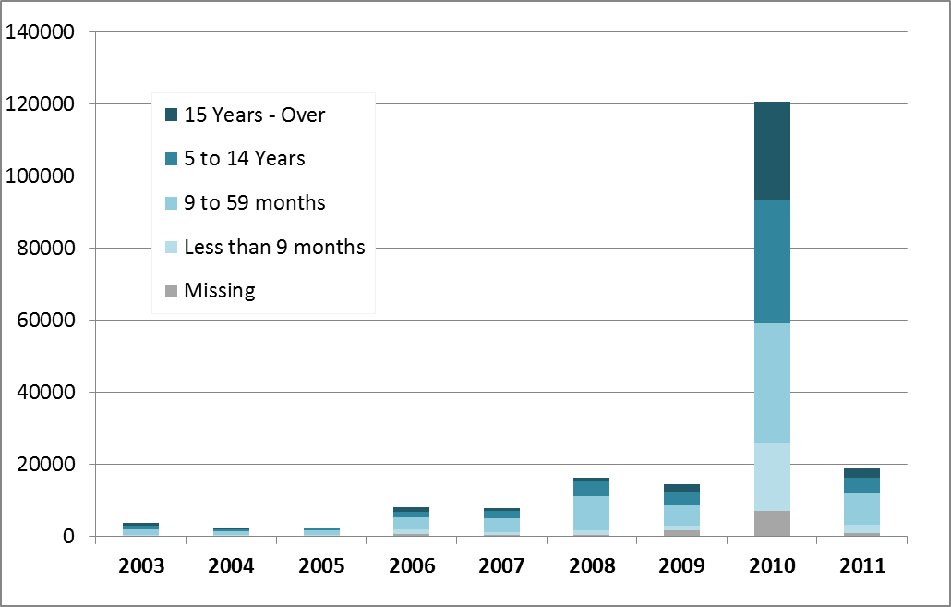
Confirmed measles. Case based surveillance data. AFR. 2003 – July 2011

Slide 9
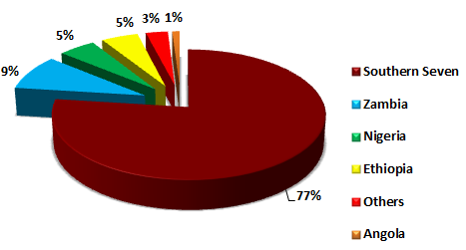
Proportion of confirmed measles cases by country. 2010. AFR
[N= 133,412]
Malawi, Swaziland, Lesotho, Botswana, Namibia, Zimbabwe, South Africa

Slide 10
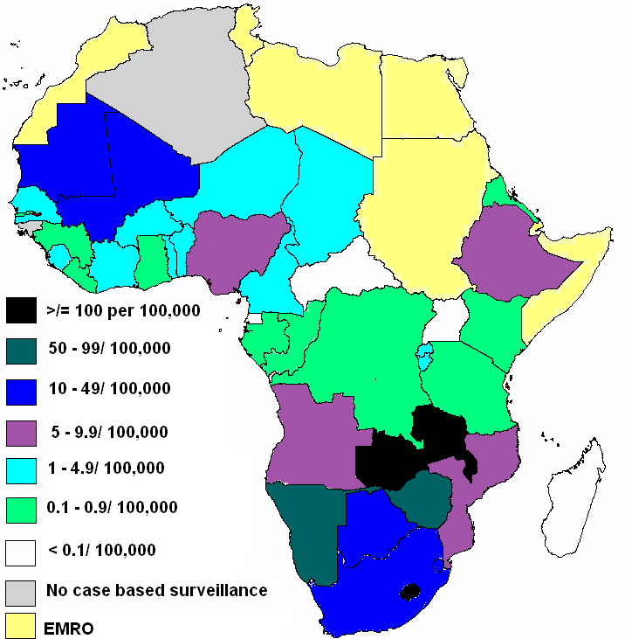
Incidence of confirmed measles per 100,000 population. AFR. 2010
Regional incidence: 17.4 per 100,000 population
10 countries (112.6 million total population) have measles incidence of >10 cases per 100,000

Slide 11
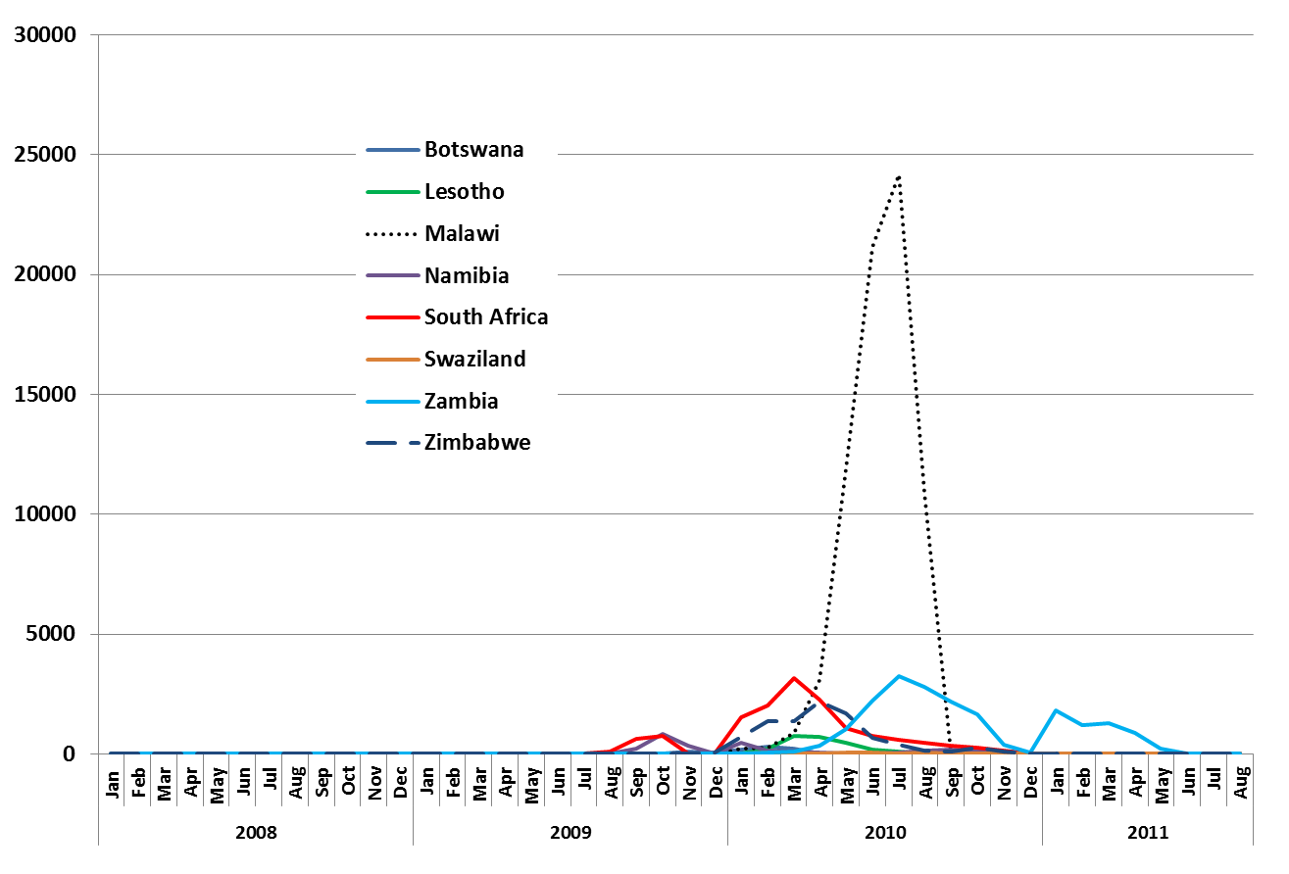
Monthly trends in confirmed measles cases. Southern 7 and Zambia. 2008 - 2011

Slide 12
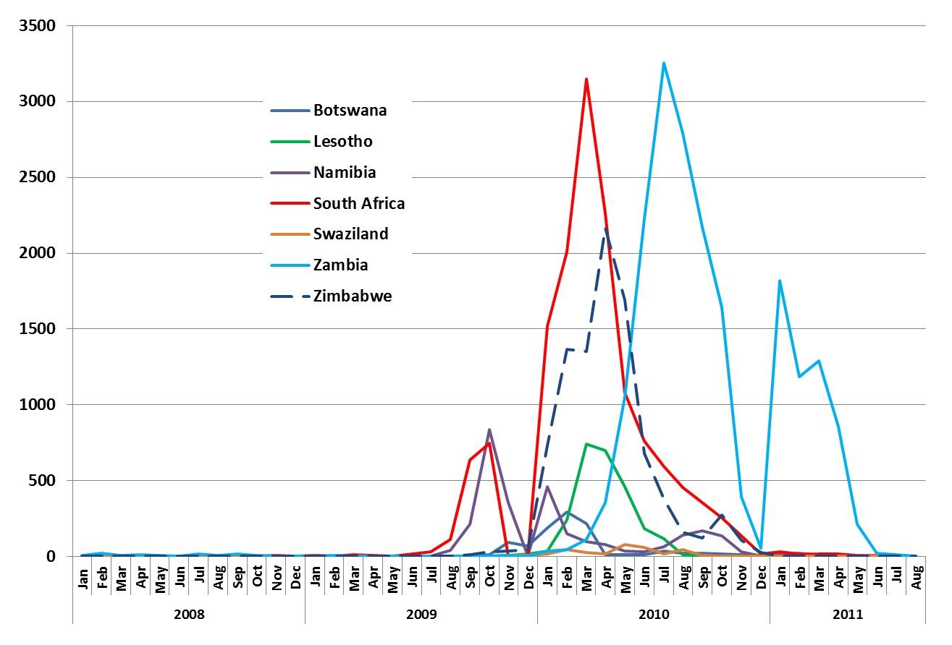
Monthly trends in confirmed measles cases. 2008 – 2011.

Slide 13
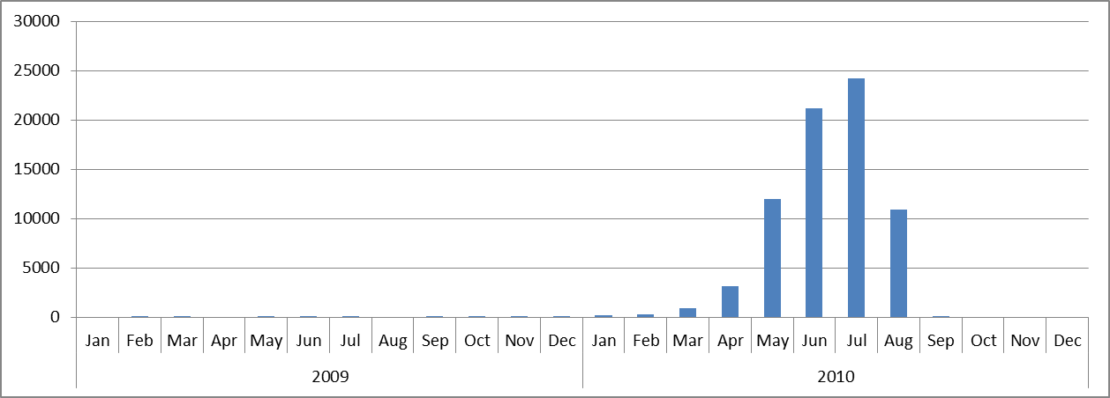
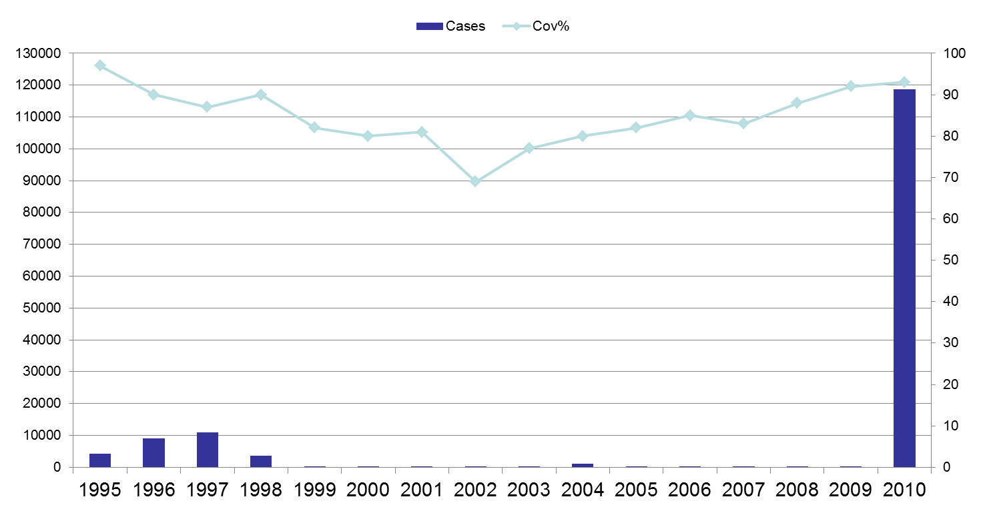
Malawi measles cases and coverage (1995-2010) & monthly case reports (2008 – 2011)

Slide 14
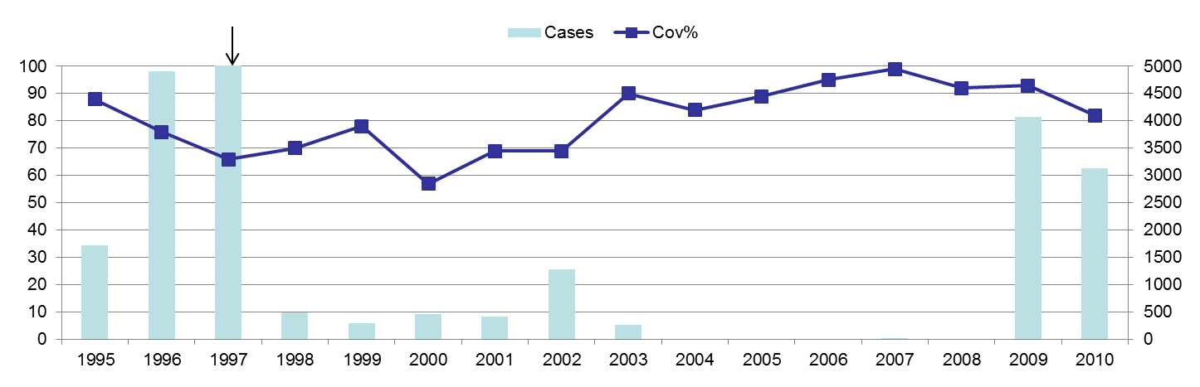
Namibia measles cases and coverage (1995-2010) & monthly case reports (2008 – 2011)

Slide 15
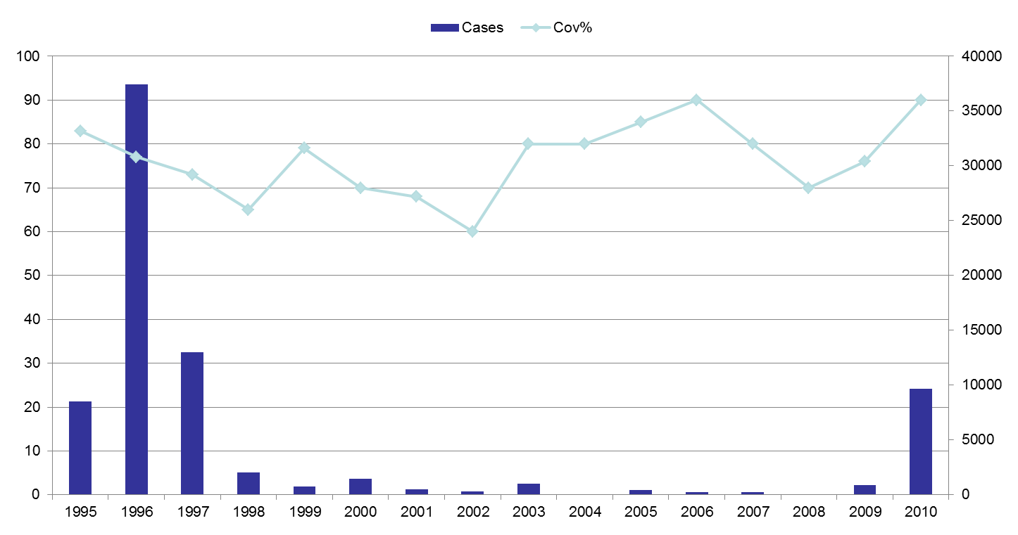
Zimbabwe measles cases and coverage (1995-2010) & monthly case reports (2008 – 2011)

Slide 16
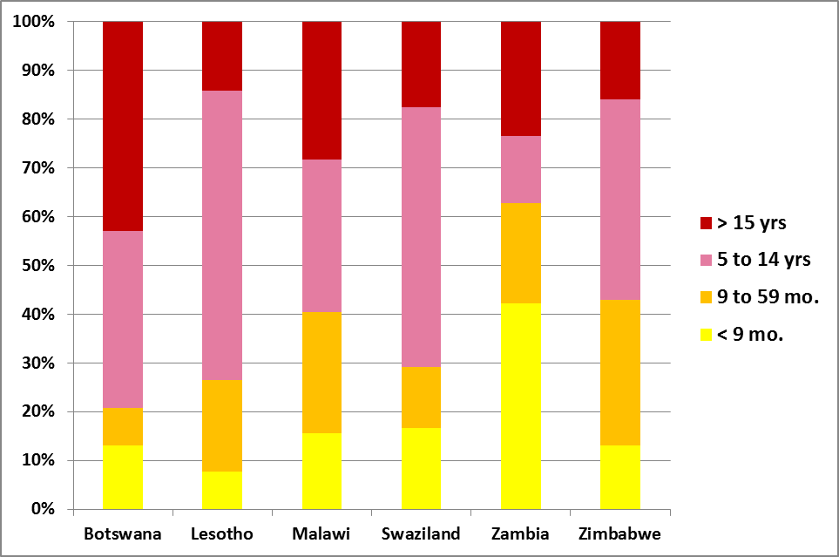
Age group of confirmed measles cases by country. Southern Africa. 2010

Slide 17
Confirmed measles cases by age category and vaccination status. Zimbabwe. 2010 (N=7,870)
47%
Not targeted by follow up SIAs or child health days

Slide 18
Confirmed measles cases by age category and vaccination status. Malawi. 2010 (N=72,566)
73% cases aged
6 – 11 months
59%
Not originally scheduled to be targeted by follow up SIAs

Slide 19
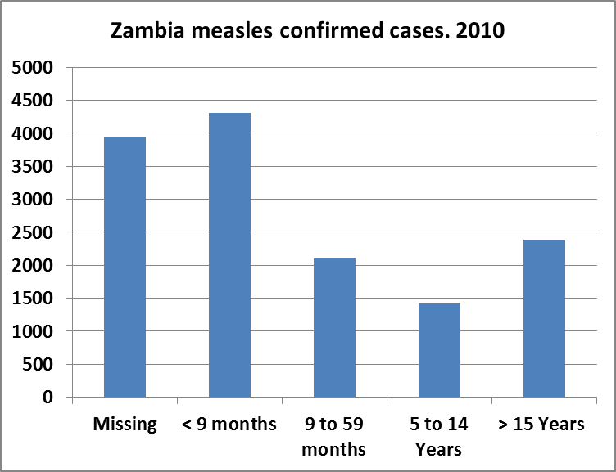
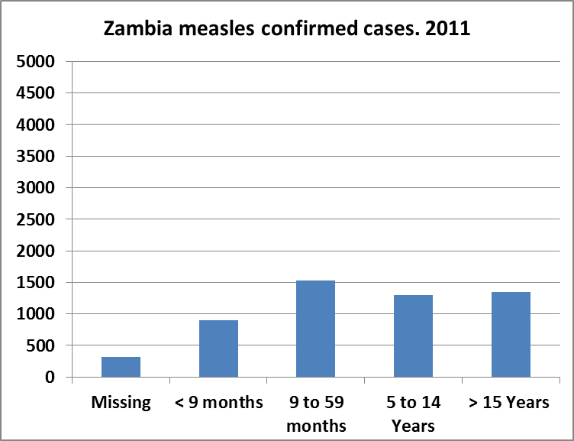
Measles outbreaks in Zambia. 2010 – July 2011
Follow up/ outbreak response SIAs
N= 14,145
N= 5,393

Slide 20
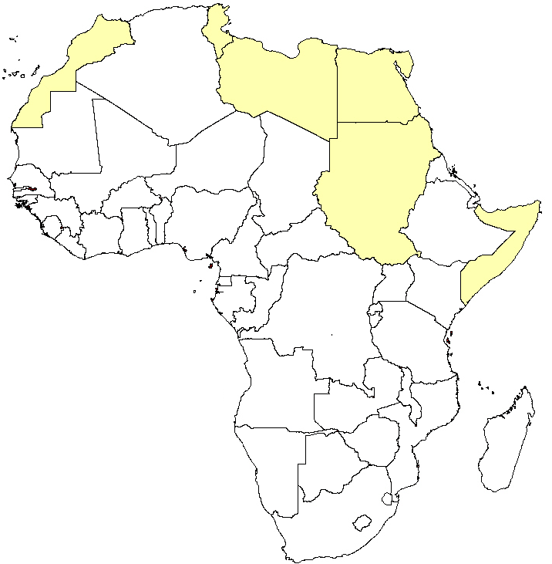
Circulating measles virus genotypes
2008
2009
2010
D8
B2
Still predominantly B3 ( ) with few exceptions.
D4

Slide 21
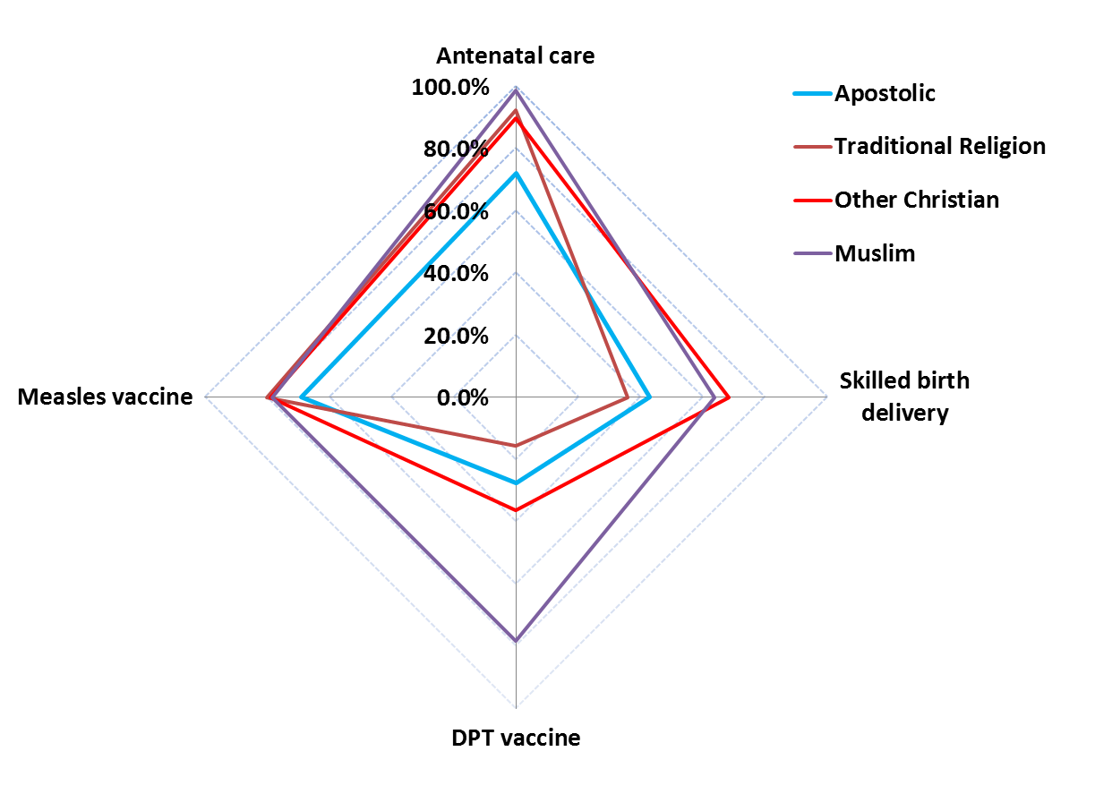
Apostolic religious groups in Zimbabwe
~ one third of the population in Zimbabwe
the lowest usage rate of health services in terms of immunisation and maternal health services.
Coverage Of Health Services By Religious Affiliation, Zimbabwe 2009. Courtesy of UNICEF Zimbabwe.

Slide 22
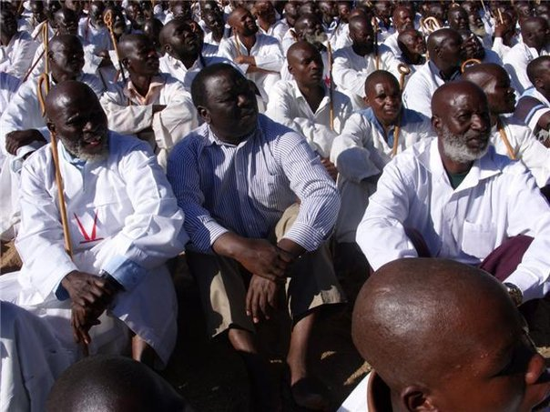
Handling religious resistance to vaccination among followers of Apostolic faith in Zimbabwe
FGD conducted in two provinces.
In Manicaland, some districts set up outreach points esp for the Apostolics, with early morning and late evening service delivery.
IEC – radio and TV spots, sms messages
PM met with of the Apostolic sect leaders, traditional chiefs etc.
Parliamentary committee on Health mobilised communities.
The MoH and partners considering a review of the Child protection act to include immunization as a child right.

Slide 23
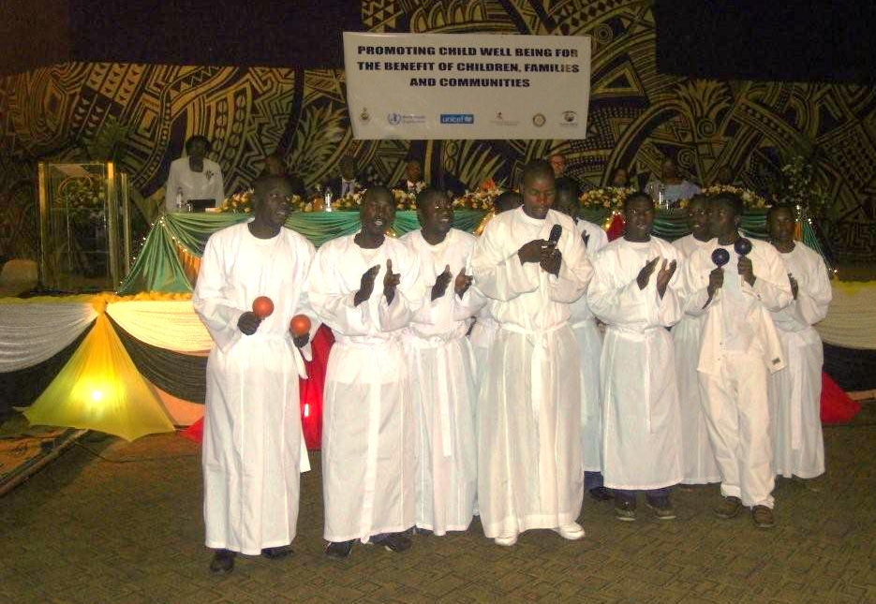
“Promoting child well being for the benefit of children, families and communities”

Slide 24
Factors that contributed to the measles outbreaks in Southern Africa in 2010.
Epidemiological shift to older age groups (all)
Gaps in routine immunisation (all)
Gaps in SIAs coverage (NAM, BOT, ZIM)
Resistance to vaccination from apostolic religious groups (ZIM, MAL, ZAM)
Postponement of scheduled SIAs (BOT)
Long inter-campaign interval (LES, ZAM)

Slide 25
Extent of ultimate mass vaccination outbreak response in 2010
6- 14 years in all countries except Zambia
Zambia :
  6 – 14 years in Lusaka
  6 – 59 months in all other provinces

Slide 26
Experiences with measles outbreak management in Southern Africa
Weak capacity to conduct timely and quality outbreak investigations
Risk assessment for outbreaks focused on children < 5 yrs
Resistance to vaccination not addressed timely
Lack of resources that could be mobilised readily
Patchy response approach: age group, geographic extent, strategies applied
  Too much focus on doing non-selective mass vaccination
Funding
  from within countries: Malawi, SOA, Zambia, Namibia
  CERF: Lesotho, Zimbabwe

Slide 27
Lessons learnt and way forward
Immunity gaps:
  Timely conduct of follow up SIAs
  Ensure adequate vaccination coverage in all districts
  Engage religious refusals
Surveillance
  Capacity building for outbreak investigation
SIAs:
  Local financing and timely implementation
  Acknowledge the epidemiological shift to older age groups and amend target age group for SIAs accordingly

