Slide 1

12th Annual Meeting
The Measles & Rubella Initiative
Western Pacific Regional Update:
The Final Push
10-11 September 2013
American Red Cross
National Headquarters
Washington, DC

Slide 2
Regional Measles and Rubella Goals
2003: Measles elimination to be used to strengthen routine immunization
Sept 2005: By 2012, the Region should aim to eliminate measles;
Oct 2010: Reaffirms the 2012 measles elimination goal and calls to accelerate control of rubella and the prevention of congenital rubella syndrome;
Sept 2012: Reaffirms the commitment to eliminate measles and accelerate rubella control;

Slide 3
Technical Advisory Group on Immunization Recommendations, June 2013
Measles
  The TAG urges countries to make intensified efforts to accelerate progress towards achieving and sustaining measles elimination.
Rubella
  The TAG recommends establishing a regional goal of eliminating rubella, with a target date to be determined

Slide 4
Measles and rubella reported cases and coverage of MCV1 and MCV2, 1980-2012
Source: WHO-UNICEF Joint Reporting Form (data for 2012)

Slide 5
Measles Cases by Month and Year, Region, 2008-Jul 2013
Source: National measles and rubella monthly report
Data as of 20 August 2013

Slide 6
Measles incidence per million population by country/area, WPR, 2013*
*Annualized as of July 2013
Source: National measles and rubella month reports as of 20 August 2013

Slide 7
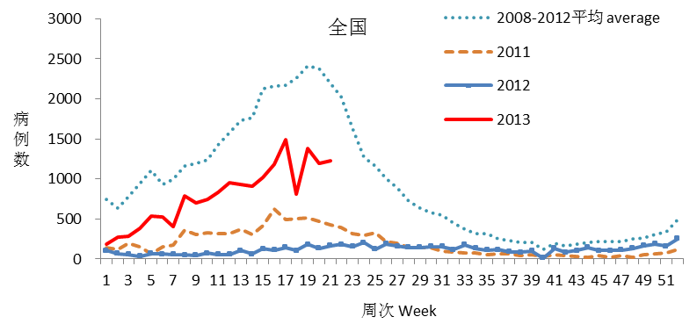
2013年麻疹疫情回升
The resurgence of measles in 2013

Slide 8
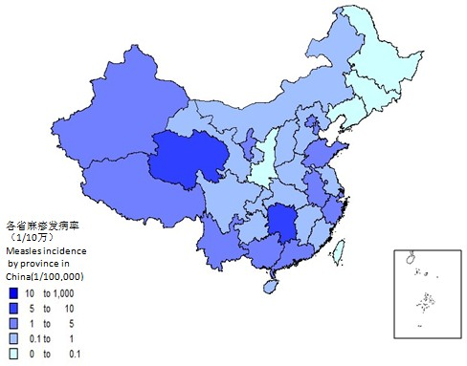
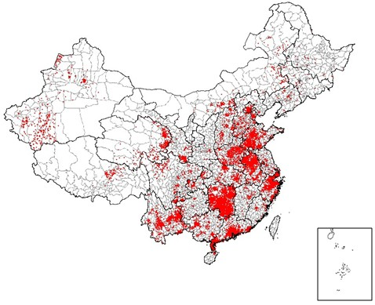
Reported incidence and confirmed Measles Cases, by Province, China, 2013*
2013年1～5月全国麻疹病例按区县分布（1点=1病例）
measles distribution by county in 2013 from JAN to MAY (1dot equals 1case)
2013年1～5月全国各省麻疹发病率
measles incidence by province in 2013 from JAN to MAY
* Source: National Notifiable Disease Reporting System , data through May
数据截至2013年5月

Slide 9
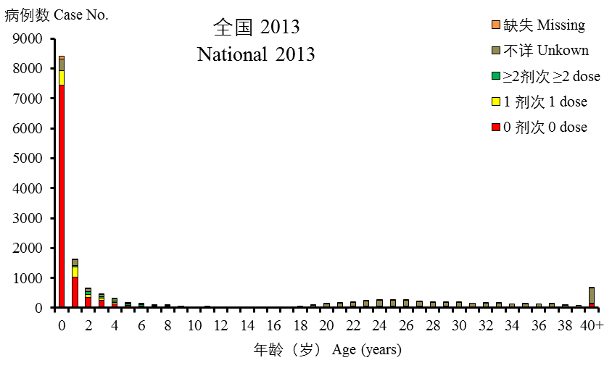
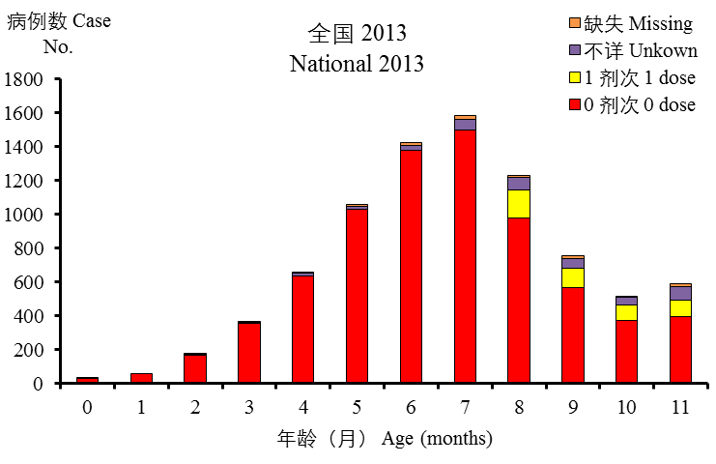
Measles cases by age group and vaccination status, China, January - May 2013
Source: National surveillance report as of May 2013
数据截至2013年5月

Slide 10
Select Recommendations from National / International Consultation on Measles, China, June 2013
Provincial (or smaller) SIAs needed to fill immunity gap
Survey population coverage among young children at national and subnational levels
Develop stronger immunization practice standards to reduce missed opportunities
Reduce nosocomial transmission of measles by reducing admissions, isolating cases, and vaccinating health workers

Slide 11
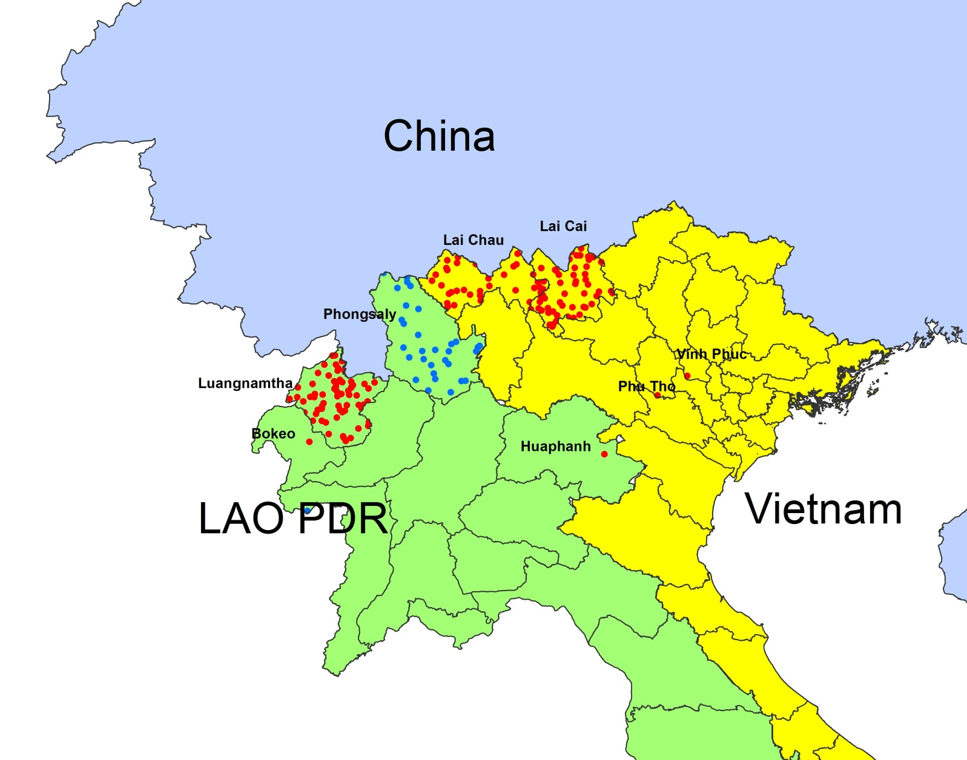
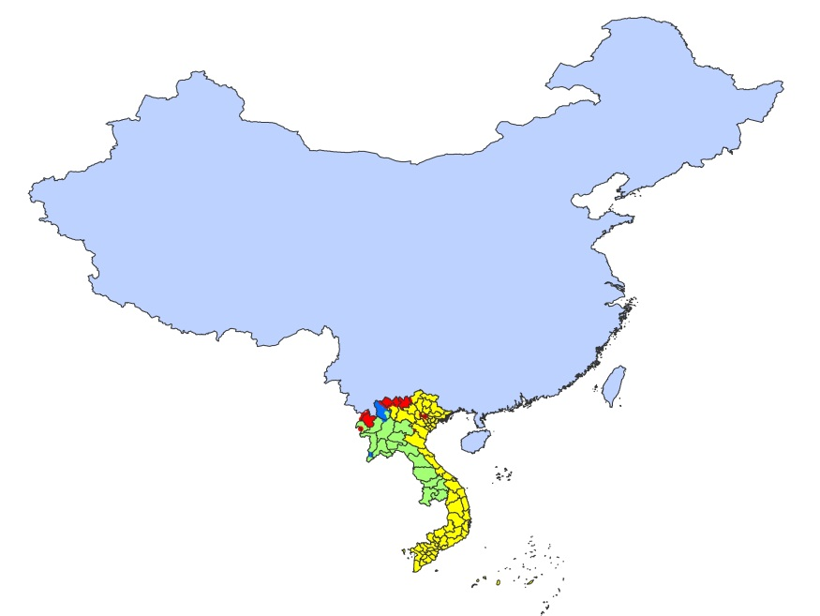
Confirmed Measles Cases, Lao PDR and Viet Nam, 2013
Legend:
Cases with onset in 2013
Cases with onset in 2012
1 dot = 1 case
Source: National measles and rubella report as of 20 August 2013

Slide 12
Confirmed measles cases by month of rash onset, Philippines, 2013
*National measles and rubella monthly reports as of 20 August 2013

Slide 13
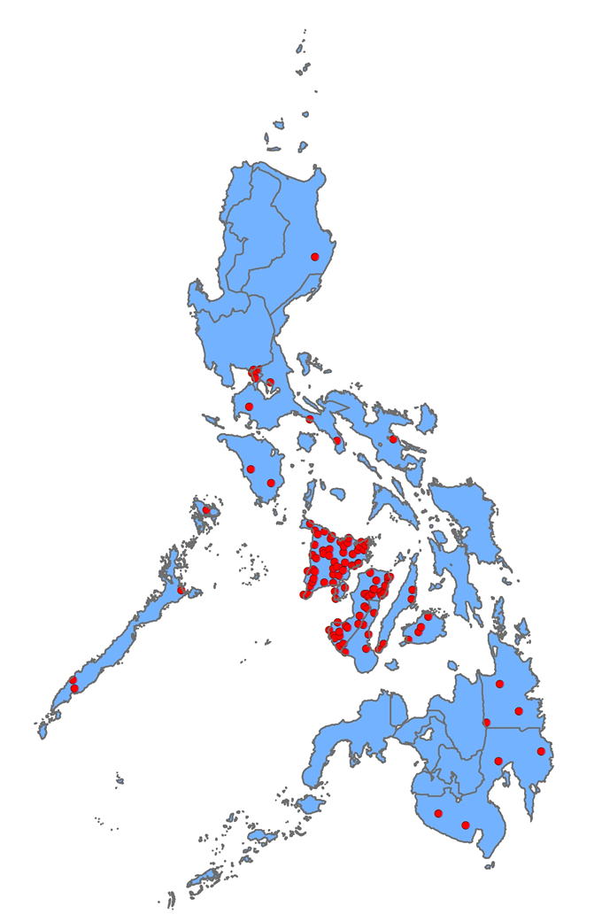
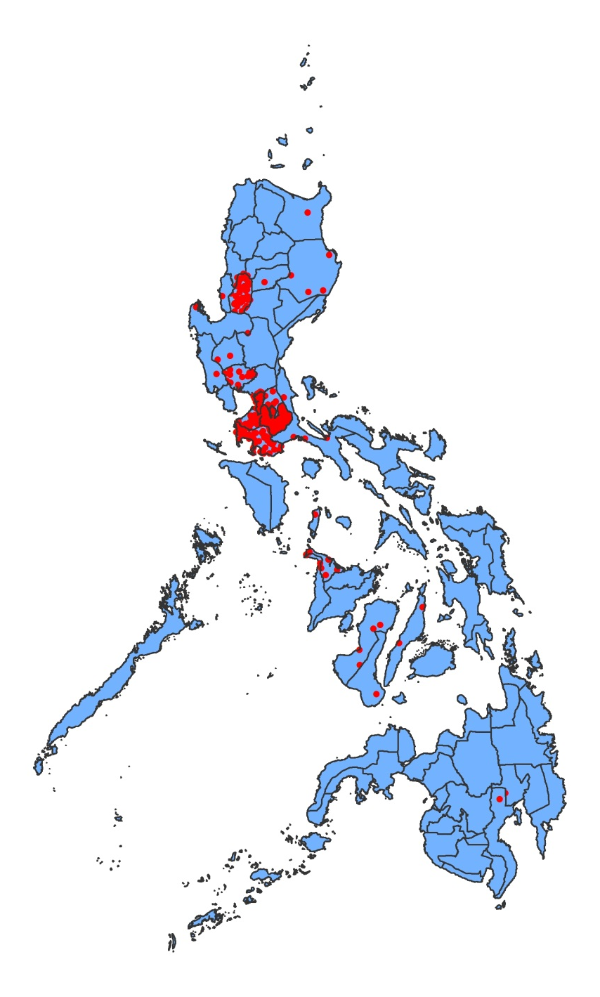
Laboratory and epi-linked confirmed measles cases by province,
Philippines, 2012 and 2013¹
2012
2013
1 dot = 1 case
Dots are placed at random within the corresponding
province, and might not reflect the exact location of the case.
¹National measles and rubella monthly reports from January to July 2013

Slide 14
Laboratory and epi-linked confirmed measles cases by age group and vaccination status, Philippines, 2013 (N=410)
*National measles and rubella monthly reports as of 20 August 2013

Slide 15
Confirmed measles cases by month of onset,
Malaysia, 2008–2013
*National measles and rubella monthly reports as of 20 August 2013

Slide 16
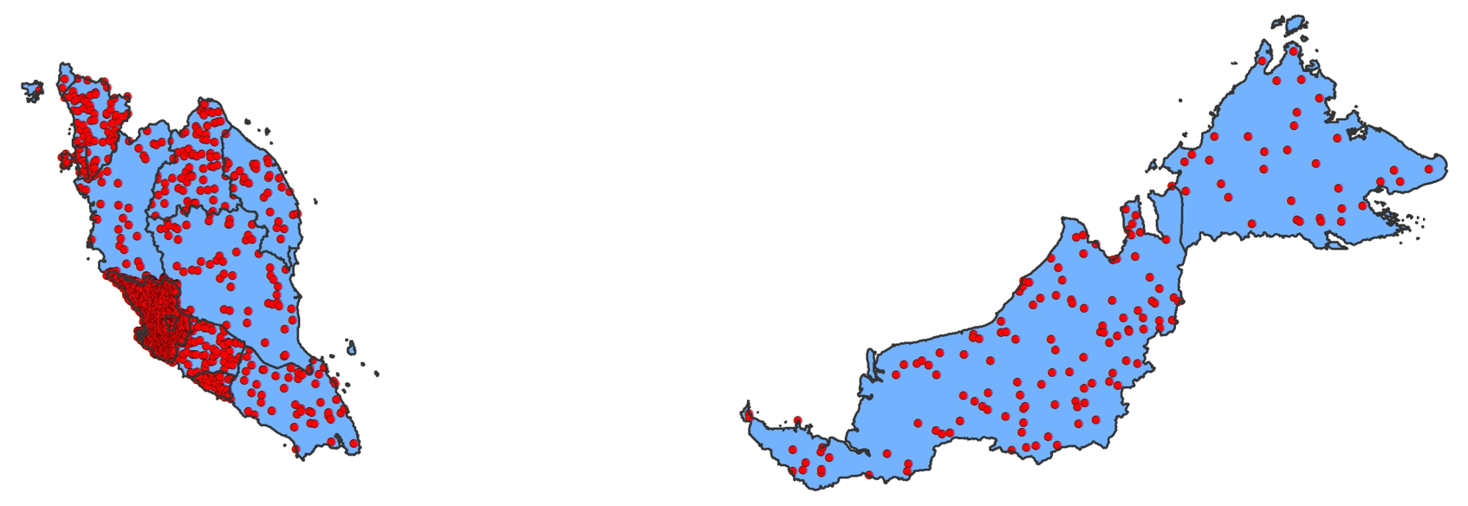
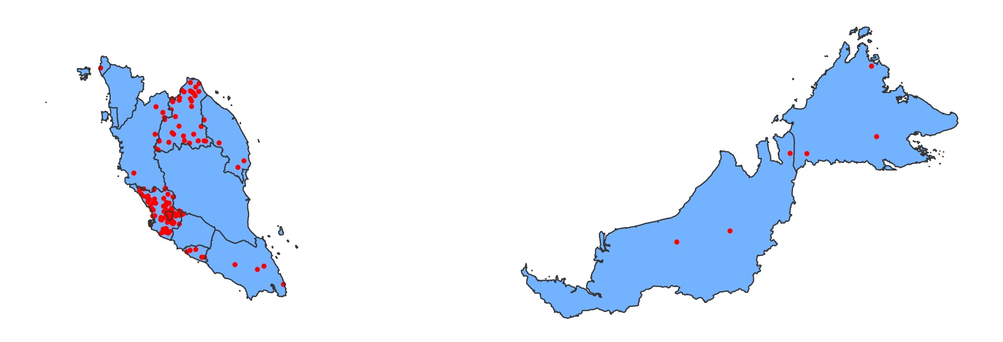
Laboratory and epi-linked confirmed measles cases,
Malaysia, 2012–2013¹
2012
1 dot = 1 case
2013
Source: National measles and rubella monthly country reports
¹ Reports received for January to July 2013
*Dots are placed at random within the country,
and might not reflect the exact location of the case.

Slide 17
Laboratory and epi-linked confirmed measles cases by age group and vaccination status, Malaysia, 2013 (N=140)
*National measles and rubella monthly reports as of 20 August 2013

Slide 18
Verification of Measles Elimination
Guidelines for verification finalized in March 2013
First annual progress reports due 1 October 2013
  5/16 National Verification Committees may request verification of elimination: Australia, Japan, Korea, Macao, Mongolia
Training for the Subregional Verification Committee for the Pacific islands in September 2013

Slide 19
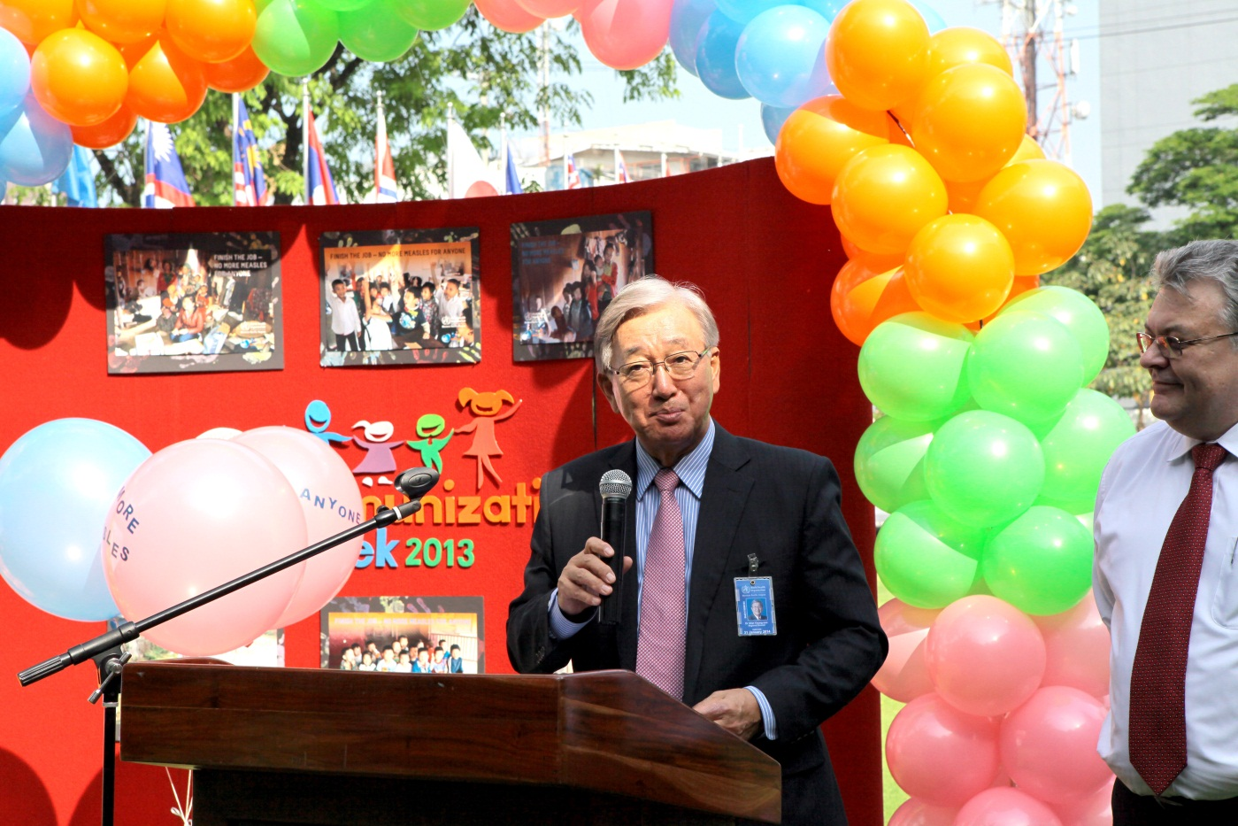
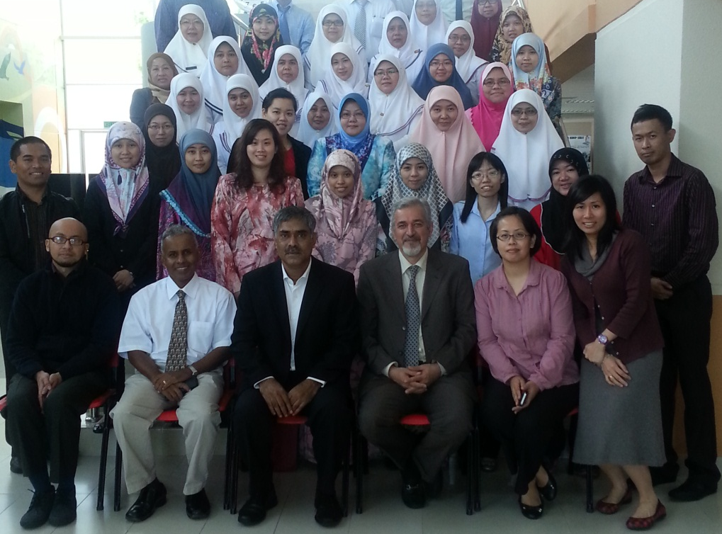
World Immunization Week: No more measles, for anyone
WIW launching in Brunei Darussalam
WIW launching at Western Pacific Regional Office by the Regional Director, Dr Shin Young-soo

Slide 20
National MCV1 coverage and percentage of district with >=80% MCV1 coverage in non-pacific countries, WPR 2012
Source: WHO-UNICEF Joint reporting Forms

Slide 21
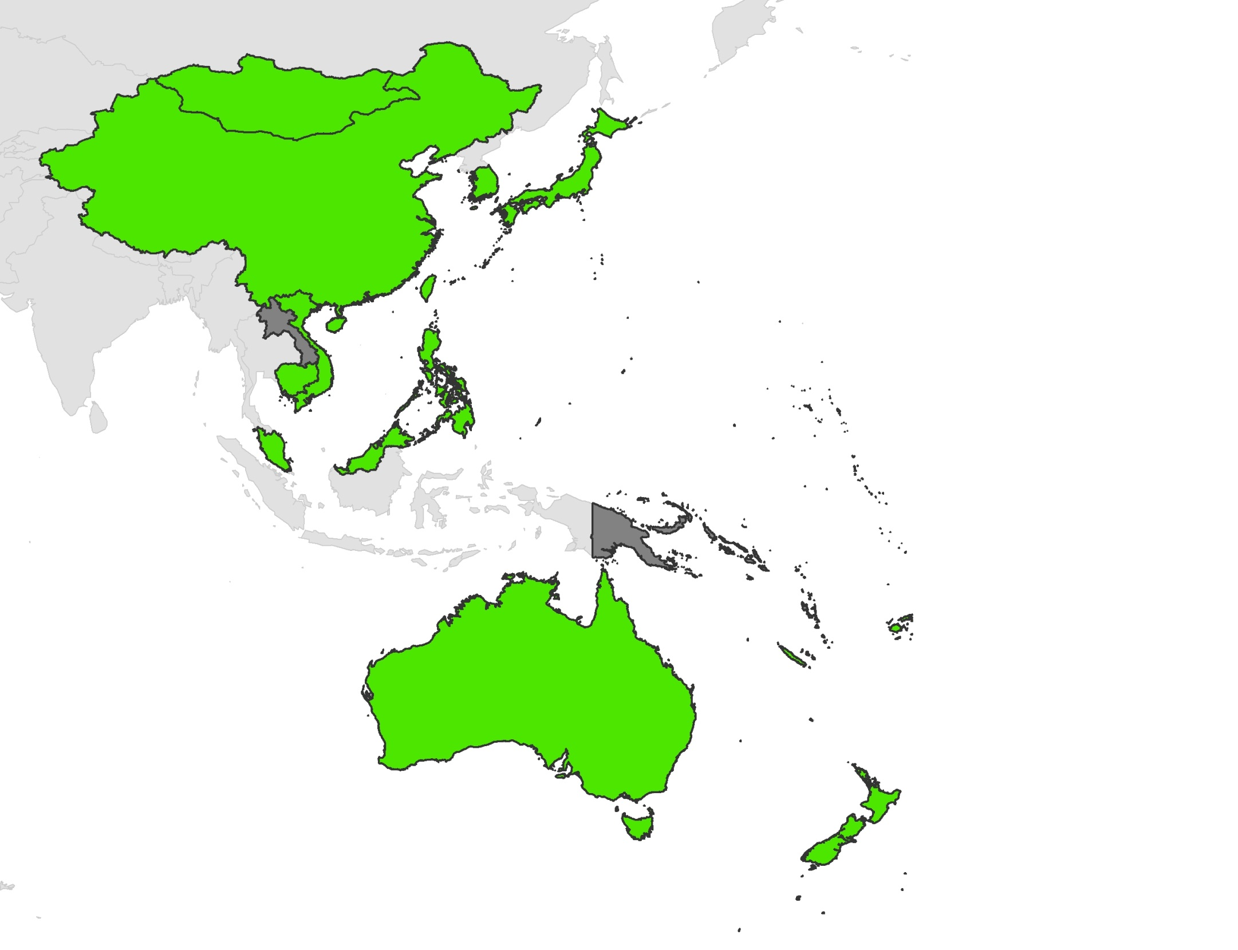
MCV2 introduction into routine EPI in (region) 2013
Only 5 countries or areas have not yet introduced MCV2:
  Kiribati
  Lao People’s Democratic Republic
  Papua New Guinea: 2013 GAVI application
  Solomon Islands
  Vanuatu
With MCV2
With no MCV2

Slide 22
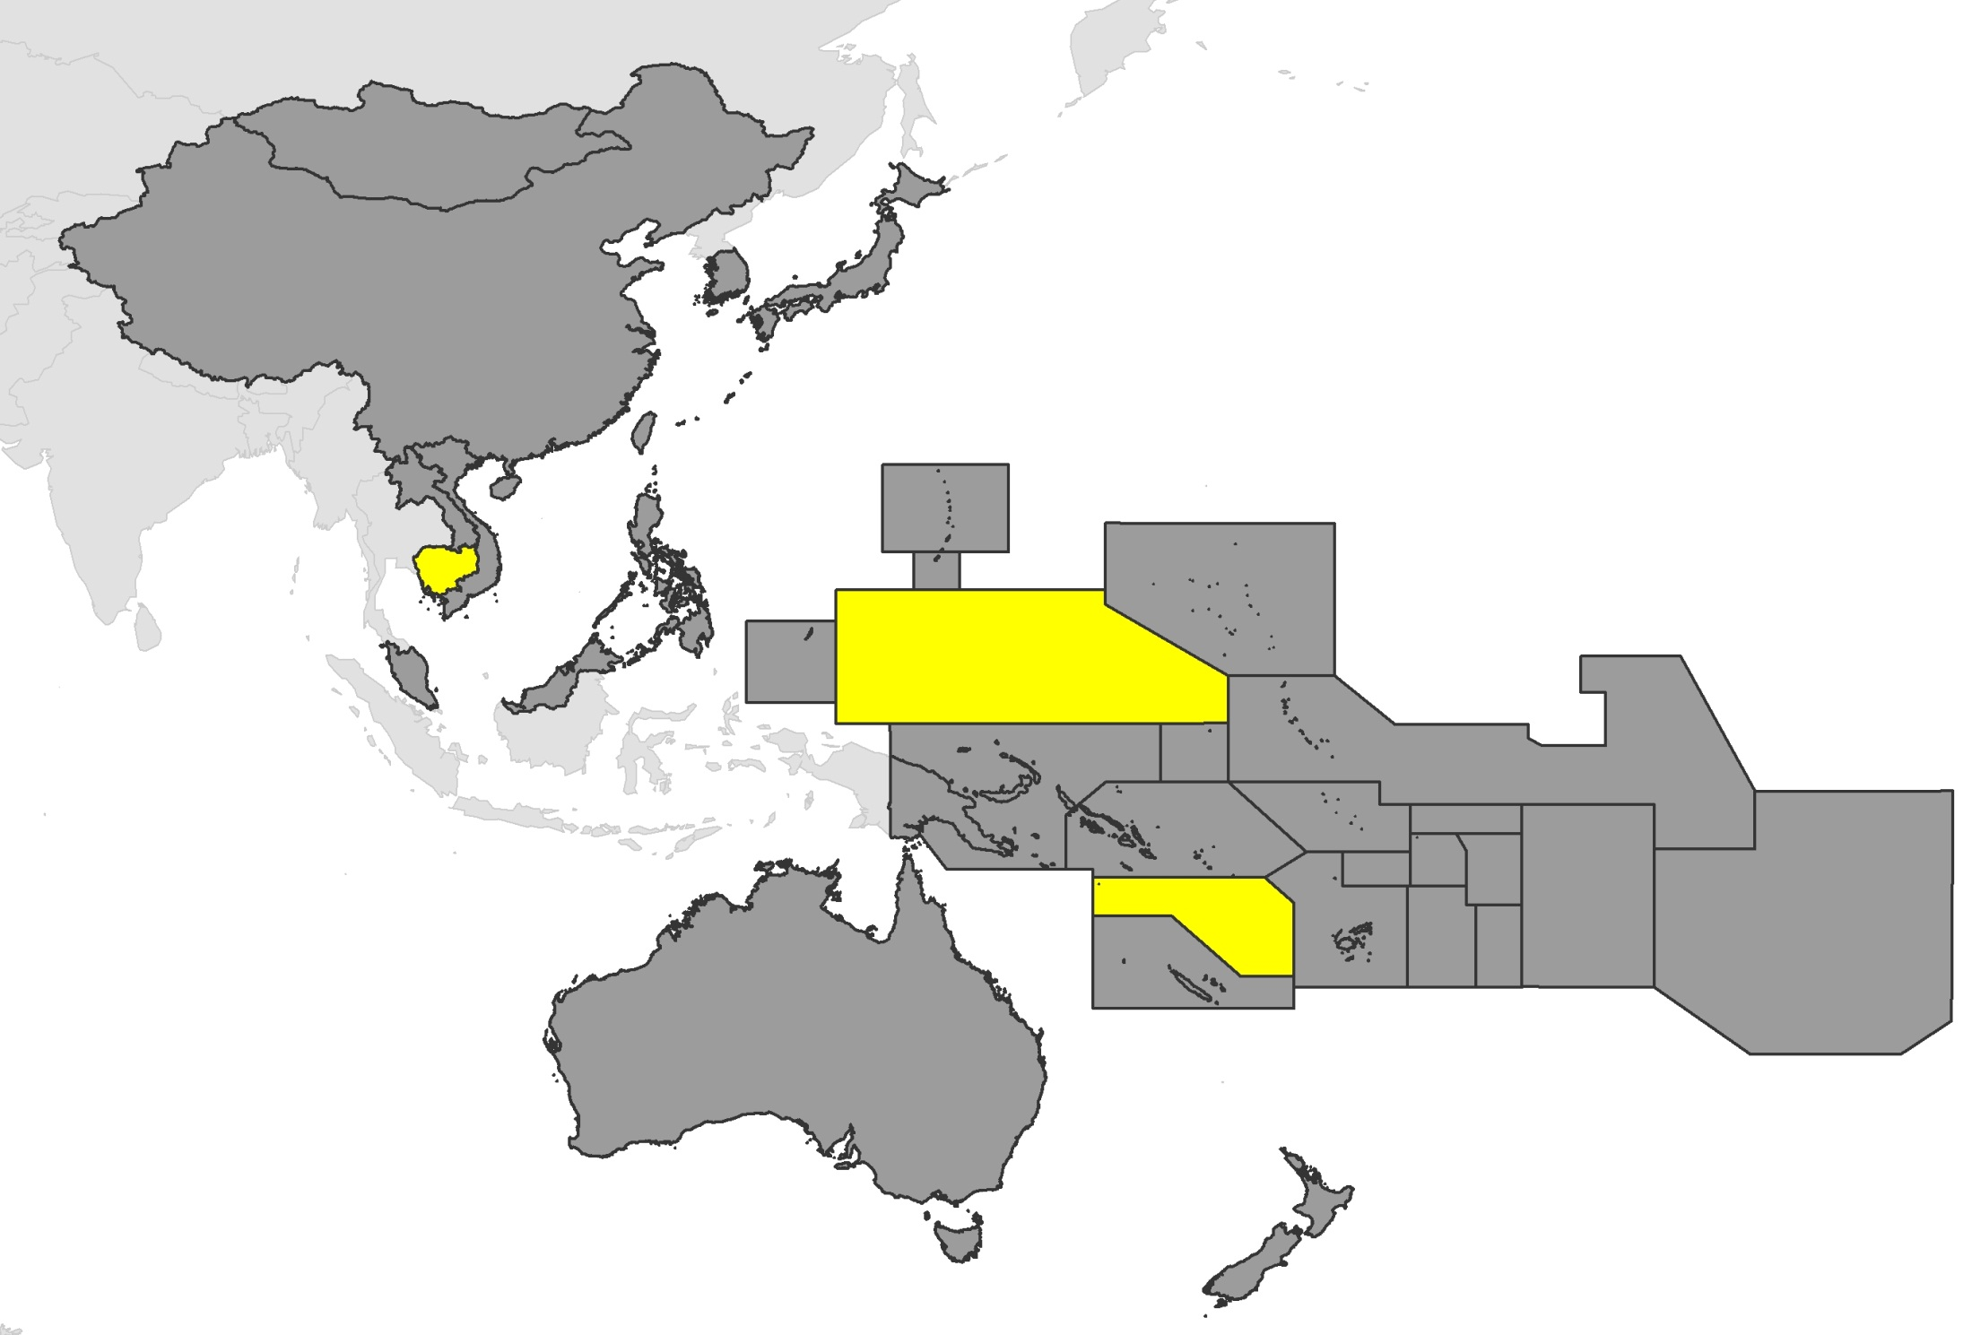
Measles SIAs in 2013,
Western Pacific Region
LEGEND
2013 (KHM, FSM (Chuuk State) & VUT)

Slide 23
2013-2015 SIA plans and budget
Country | Vaccine | Target Age | Dates | Geographic Extent | Other intervention | Funding source
Micronesia | MR | 9-59 m | Jul 2013 | Chuuk State |  | CDC/MoH
Vanuatu | MR | 9-59m | Aug 2013 | Nationwide |  | MRI/MoH
Cambodia | MR | 9m-15y | Q4 2013 | Nationwide | OPV, Vit A | GAVI
Viet Nam | MR | 9m-15y | Q2 2014- Q4 2014 | Nationwide |  | GAVI
Philippines | MR | 9-59 m | Aug 2014 | Nationwide | OPV | MoH
Lao PDR | MR | 9-59 m | Q4 2014 | Nationwide |  | MRI
2014: FSM (Pohnpei State); Vanuatu (5-15 years);
2015: Papua New Guinea; Solomon Islands

Slide 24
Indicators of Progress Towards Measles Elimination and Rubella Control, Western Pacific Region 2008-2013¹
Category | Target | 2013 | 2012 | 2011 | 2010 | 2009 | 2008
Low measles incidence
Incidence (% countries < 5 per million population) |  | 71% | 59% | 41% | 59% | 47% | 53%
Incidence of confirmed measles per million population² |  | 21.7 | 5.9 | 11.7 | 27.0 | 34.0 | 81.6
High quality surveillance
National reporting of discarded measles cases | > 2 per 100,000 | 4.3 | 2.4 | 2.8 | 1.7 | 2.8 | 1.6
% of 2nd level admin units reporting ≥ 2/100 000 discarded measles cases | > 80% | 38% | 35% | 40% | 28% | 23% | 22%
% of suspected cases with adequate blood specimens | > 80% | 96% | 91% | 73% | 70% | 71% | 80%
High population immunity
% countries with MCV1 ≥90% |  |  | 76% | 70% | 66% | 57% | 71%
% countries with MCV1 ≥80% in all dist |  |  | 63% | 41% | 46% | 46% | 58%
¹ Data as of August 2013
² Only lab and epi linked cases for 2013
Source: WPRO surveillance database and WHO-UNICEF JRF

Slide 25
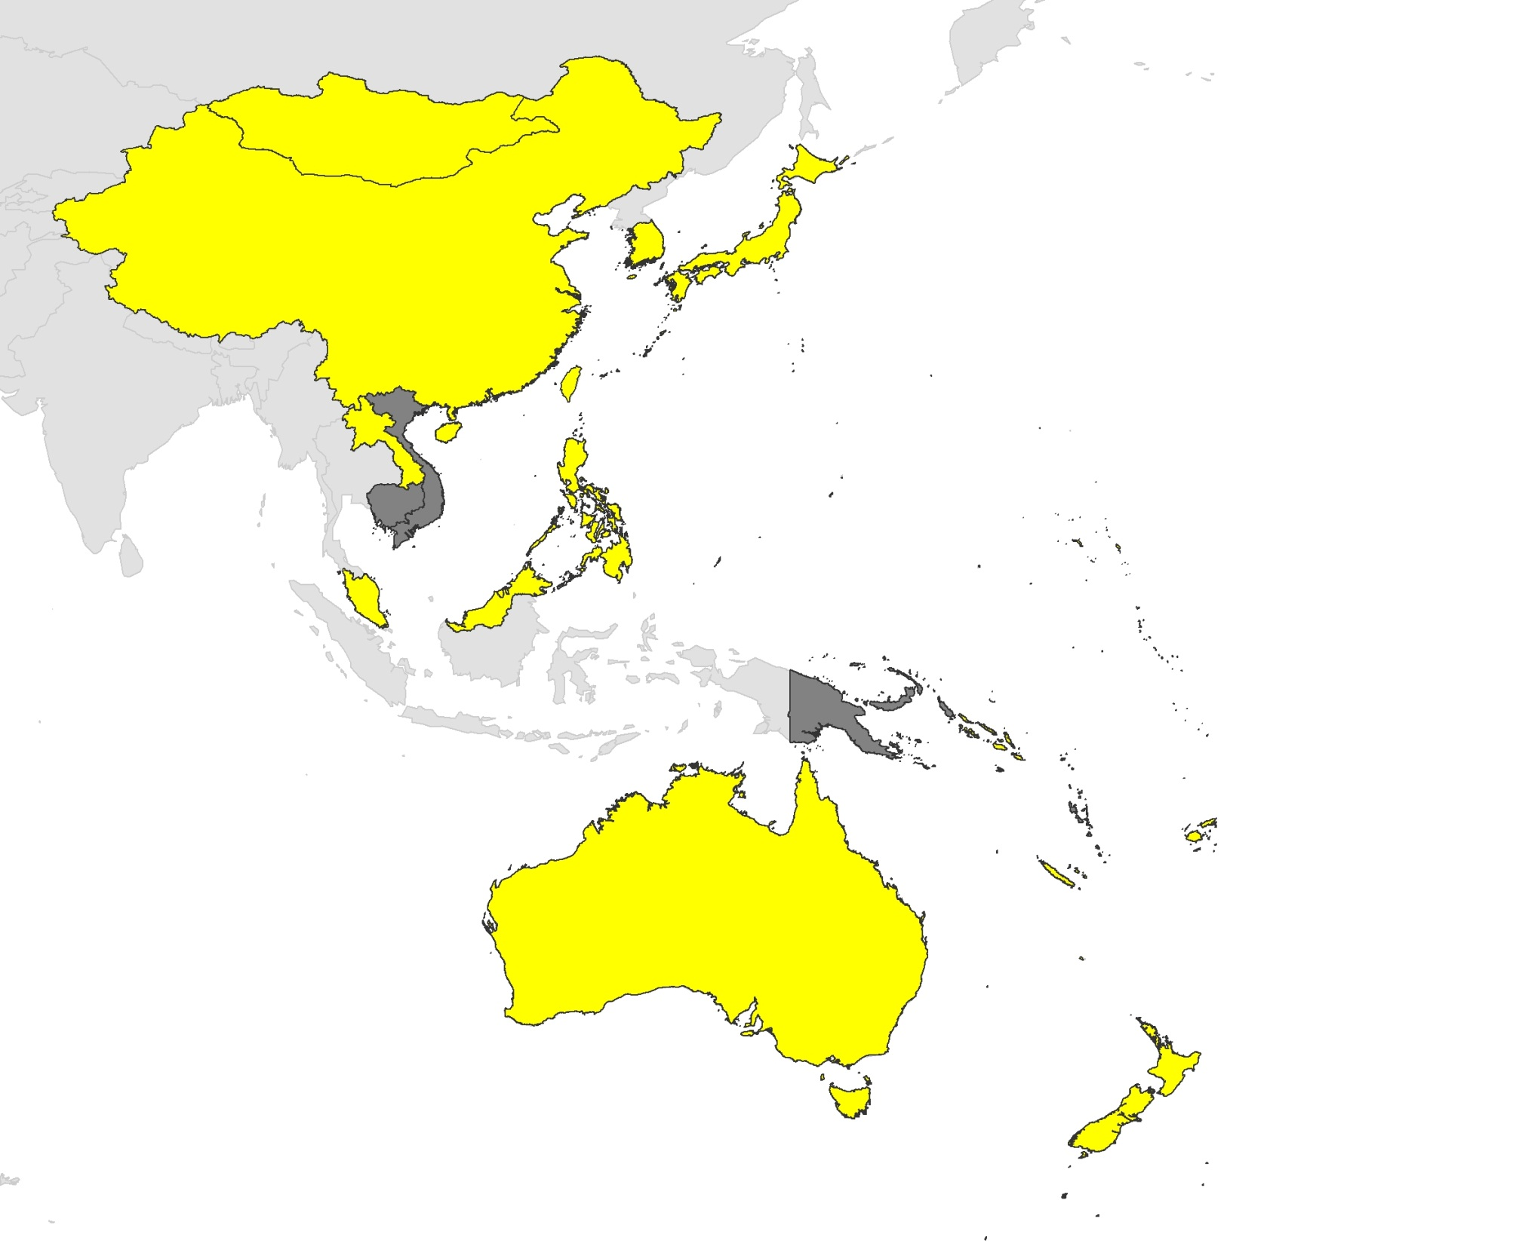
Rubella-containing vaccine introduction in (region) 2013
Only 4 countries and areas have not introduced RCV in RI in 2013:
Cambodia: 2013 MR SIA (9 mos to <15 years)
Papua New Guinea: 2013 GAVI application
Vanuatu: 2013 MR SIA (9 to 59 months)
Viet Nam: 2014 MR SIA
With RCV
With no RCV

Slide 26
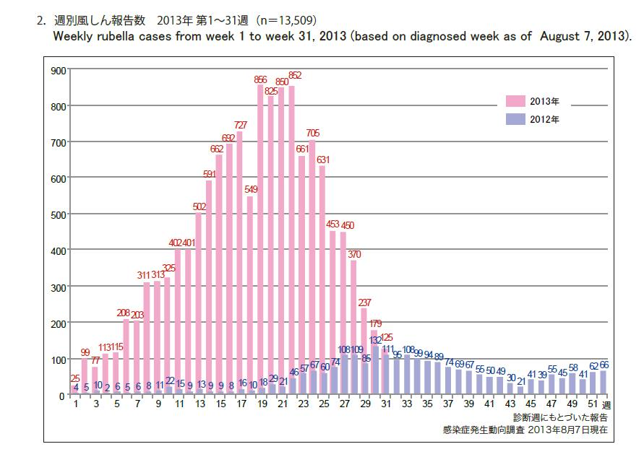

Slide 27
MRI Support Needed
Achieving measles elimination goal
  China, Malaysia, Philippines
Regional rubella elimination goal
SIAs
  Lao follow up campaign
  Vanuatu (6-15 years)
  Kiribati, Samoa, Tuvalu
Surveillance sensitivity
  Pacific islands countries, Papua New Guinea, Viet Nam

Slide 28
Acknowledgements
China CDC (slides 7-9)
NIID, Japan (slide 26)

Slide 29
Thank you

Slide 30
Number of countries with MCV1 coverage of at least 90%, WPR, 2008-2012
Source: WHO-UNICEF Joint reporting Forms

