Slide 1
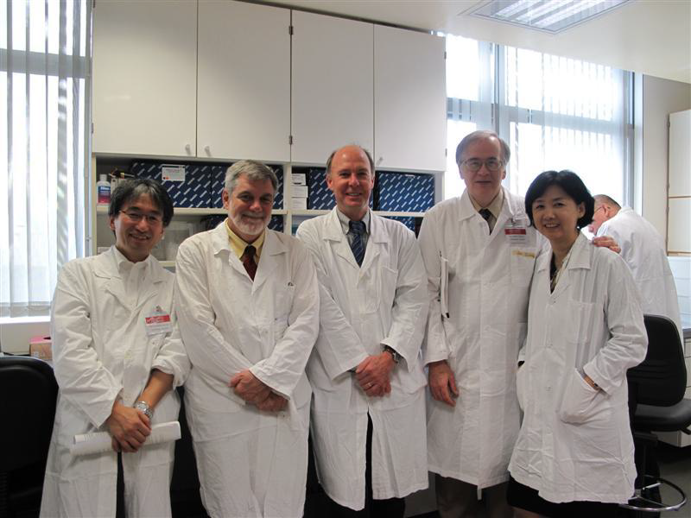
Hong Kong Training Workshop, 2010

Slide 2
WHO Global Measles and Rubella Laboratory Network: 2001-2010
2001
2010
N= 679 labs
10 Sub-National Labs
National Laboratories
80
Regional Reference Labs
31 "NLs"
Global Specialised Labs
+ 331 "SNLs"
124 Sub-National Labs
As of July 2010
National Laboratories
159 countries =
172
Regional Reference Labs
Global Specialised Labs
2
183/193 countries served by proficient labs
Provincial Labs China
2
Sub-National Labs Russia
Notes:
The Global Measles and Rubella Laboratory Network was fully established in 2000 and has grown from 80 national and reference labs in 2001 to 172 labs serving 159 countries in 2010. Some large countries have a large number of subnational laboratories including China (331), the Americas (124) and Russia (10) making a total number of 679 labs. All labs follow the same standardized procedures and a strong quality assurance programme with annual proficiency testing and regular accreditation assessments in place.

Slide 3
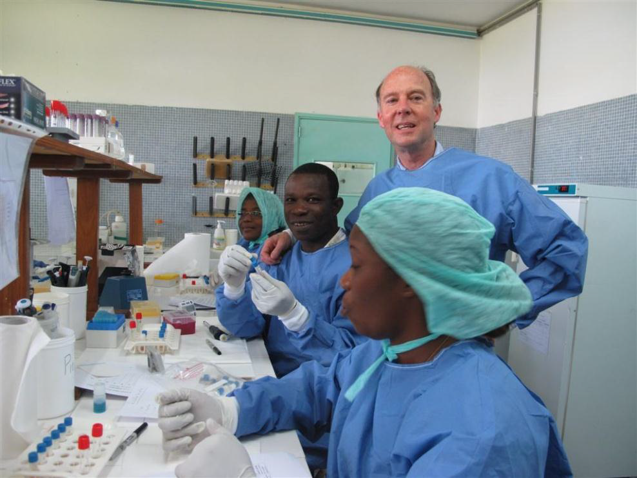

Slide 4
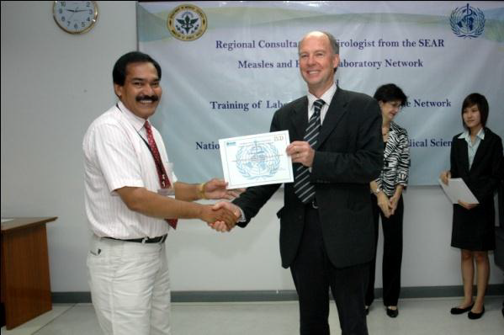
Awarding a WHO Accreditation Certificate, SE Asian Region

Slide 5
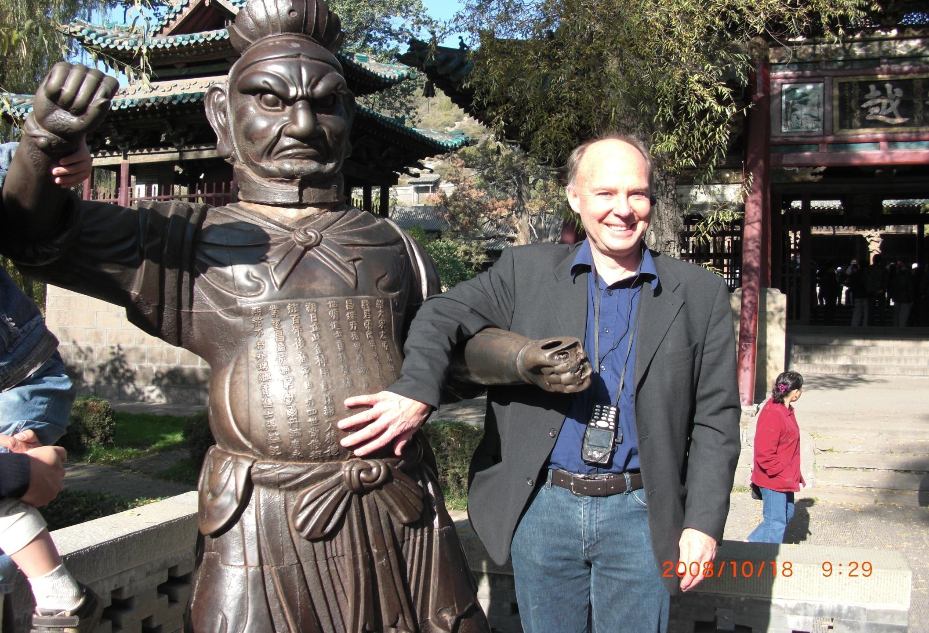
David Featherstone - Global Measles and Rubella Laboratory Coordinator, 2001-2012

Slide 6
