Slide 1
Session 4
Cross Cutting MR and RI Priorities
Introduction
Steve Cochi
Senior Advisor
Global Immunization Division, US CDC

Slide 2

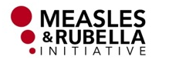
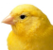
RI & MR Elimination key synergies
Systems
Strategies
(vax across life cycle)
Monitoring/Surv
Outbreak response
Mobilization/Advocacy
Research & Innovation
SIAs
Monitoring/Surv
Outbreak response
Mobilization/Advocacy
Research & Innovation
Achieve High
MCV1 & MCV2
Respond to signals to
improve coverage
Support ways to improve coverage:
2YL
Missed Opps

Slide 3
Rationale for working together
Measles Deaths Averted by SIAs and RI
2000-2008: 8.4 million deaths averted (66%)
2000-2008: 4.3 million deaths averted (34%)
- Source: WHO. WER, 4th December 2009. Date of Slide 03 February 2010.
Notes:
3
The foundation for measles rubella elimination rests on routine immunization. This graph shows the estimated proportion of measles deaths averted by SIAs and Routine Immunization from 2000 to 2008. Cumulatively, 2/3s of measles deaths averted were from Routine Immunization while 1/3 were from SIAs.

Slide 4
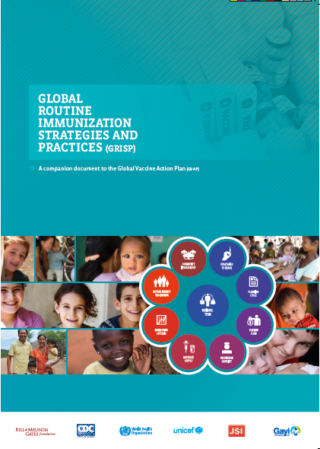
New RI Guidance: GRISP
Global Routine Immunization Strategies and Practices
A companion document (not another plan), a way of thinking
  Guidance on Transformative investments
  Framework of RI strategies
In line with MR Elimination, reasserts routine immunization as the foundation for sustained decreases in morbidity and mortality from vaccine preventable diseases.

Slide 5
MRI RI Workgroup
Focus on synergies between RI & MR Elimination
Objective: maximize opportunities to both strengthen RI as part of MR elimination & reinforce critical role RI plays in MR elimination.
Role: Facilitate, link & advocate for priority activities related to RI strengthening & MRE
Priority projects on the radar:
2YL
Landscape analysis, WHO, UNICEF
Generate Evidence, WHO, CDC, BMGF
Global Guidance, WHO
Country projects
Missed Opportunities
5-dose vial project– Ethiopia, WHO, CDC, BMGF
5-dose vial project - Tanzania, JSI
Guidance on forecasting & wastage, WHO
Improving Monitoring
Global guidance recording & reporting vaccines with attention to MCV & 2YL considerations
MSD Introduction
Reviewing evidence/country experiences

Slide 6
  Critical to RI and MR Elimination: Polio Transition
  GPEI workforce (N=80,000+)
Millions of vaccinators
Tens of thousands of
local social mobilizers
Thousands of skilled technical staff
Includes social mobilizers. Does not include vaccinators or regional/headquarters personnel.
Hundreds of highly skilled technical managers/leaders
>1000 personnel
>100 personnel
>40 personnel
>10 personnel
1+ personnel

Slide 7
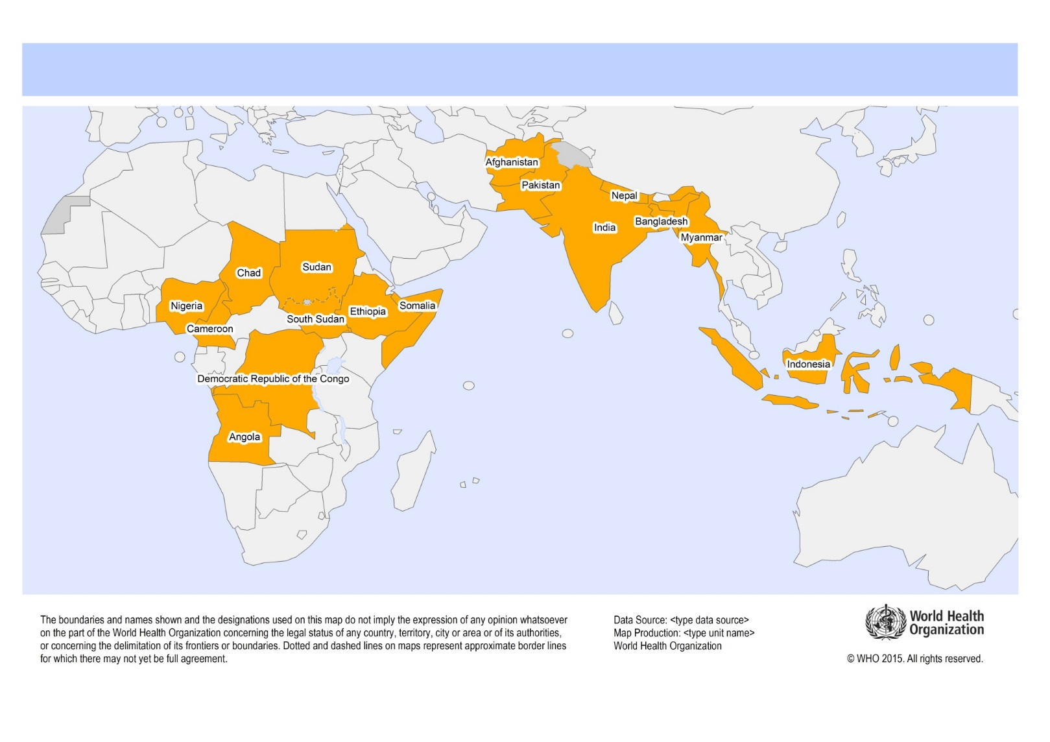
  16 Priority countries for polio transition planning

Slide 8
Characteristics of the 16 Priority
“Polio Legacy” Countries
Most of the world’s unvaccinated and under-vaccinated children
Most of the world’s measles cases and deaths
Most of the world’s rubella and CRS
Consequences of losing polio assets – risk that EPI progress in these countries and globally will be reversed

Slide 9
Most Obvious Frontline Candidates for Transitioning of Polio Assets
RI / Immunization system strengthening
Measles and rubella elimination
These can and should be linked closely together

Slide 10
Recommendations to MTR
  The strengthening of immunization systems and the control and eventual elimination of measles and rubella should be designated as high priorities for polio legacy planning and transitioning of polio assets. Such repurposing will help sustain essential polio functions in the longer term.
  A concrete plan should be developed and implemented for transitioning polio assets to both measles and rubella elimination and RI in keeping with and in support of GVAP goals.
  This plan should directly link MR elimination with immunization system strengthening and incorporate use of measles outbreaks to identify low performing districts needing specific actions.

