Slide 1
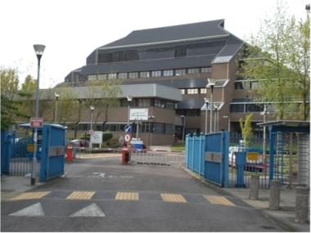

A Rapid Diagnostic Test for Measles – Can it Transform surveillance?
Measles & Rubella Initiative Partner Meeting, September 11,12 2019 Washington, DC.Dr David Brown, Consultant WHO IVB.
Laboratorios de Flaviviruses, + Respiratorios e Samparo,
FIOCRUZ, Rio de Janeiro
Virus Reference Department, Public Health England

Slide 2
AIMS:
  Briefly describe key role of surveillance for measles programme, how we do laboratory based surveillance and why we need new approaches.
  Describe the development of new tools for measles diagnosis produced as part of a B&M Gates Foundation funded project.
  Review studies demonstrating RTD performance in Brazil and India and discuss some the challenges of introducing a new diagnostic.

Slide 3
Surveillance of Measles
Progress in measles control 2000-2017
Surveillance is Key to measure the impact of guide direction of the vaccination programme.
Measles vaccination is one of the most cost effective PH interventions.
Great progress-95% Reduction in Measles Deaths 2000-17.
But much still to do-Estimates indicate still >100,000 Deaths due to measles annually.
Measles Elimination achieved in 84 (43%)of countries.
To measure Population vaccine Coverage.
Incidence of Measles cases

Slide 4
Measles case definition is non-specific:
Rubella
Measles
Dengue
Measles case definition
‘Case with fever of 38C, maculopapular rash,either cough, coryza or conjunctivitis, or any case which a physician thinks is measles’
HHV-6
Echoviruses
Parvovirus B19
Others
4
A RDT for measles; implication for global surveillance
Notes:
6

Slide 5
Laboratory diagnosis of measles is needed for surveillance
Virus detectable by PCR in oral fluid
Virus detectable in nasopharynx
Virus detectable in blood
Rash
Relative levels
CD8
T cells
IgG
CD4
T cels
IgM
Immune suppression
-14
-7
0
7
14
21
28
3
Days after onset of rash
Infection
Rash onset
Diagnosis- serology – IgM detection-Serum/EIA or Oral Fluid
Molecular epidemiology: RT-PCR: (early samples) – Oral fluid, T/S, urine, lymphocytes
Virus isolation – need Vero-SLAM cells for wild strains
5
A RDT for measles; implication for global surveillance

Slide 6

Current Laboratory diagnostic testing for measles .
Collect blood sample
National Measles laboratory
Transport serum to Laboratory
1-?days
Testing Target < 4days
Public health response

Slide 7
Tracking measles strains
The Measles Virus is serologically monotypic.( vaccine effective for over 50 years)
Can detect differences in the genetic code of strains. (sequencing)
To use in surveillance Measles community agreed a Common language to describe these differences to enable us to track transmission pathways.
Genotypes are based on a standard window of 450bps, which varies by 12% between strains. In all 24 Genotypes have been described and accepted.

Slide 8
Measles Virus Genotypes: Compare sequences to create a ‘phylogenetic tree’ showing relationships between strains. Analogous to a Family tree.
Montreal.CAN/89 D4
Victoria.AUS/12.99 D9
Palau.BLA/93 D5
Bangkok.THA/93/1 D5
Illinois.USA/89/1 D3
Manchester.UNK/30/94 D8
Genotyping:
- Sequence 450bp of N gene
12% variation
8 clades: A – H
24 genotypes:
A, B1-B3, C1-C2,
D1-D11, E, F, G1-G3, H1-H2
Illinois.USA/50.99 D7
Victoria.AUS/16.85 D7
Bristol.UNK/74 D1
NewJersey.USA/94/1 D6
Johannesburg.SOA/88/1 D2
MVi/Mpigi.UGA/18.00 D10
MVs/Madrid.SPA/94 F
Erlangen.DEU/90 C2
Tokyo.JPN/84/K C1
Maryland.USA/77 C2
Goettingen.DEU/71 E
Edmonston-wt.USA/54 A
Libreville.GAB/84 B2
Yaounde.CAE/12.83 B1
NewYork.USA/94 B3.2
Ibadan.Nie/97/1 B3.1
Hunan.CHN/93/7 H1
Beijing.CHN/94/1 H2
Berkely.USA/83 G1
Amsterdam.NET/49.97 G2
Gresik.INO/18.02 G3
0.01
8
A RDT for measles; implication for global surveillance

Slide 9
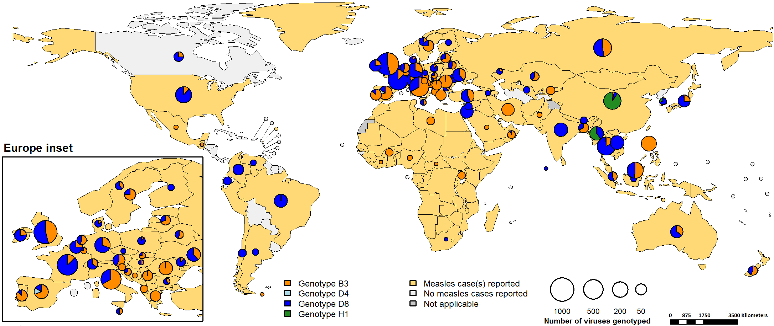
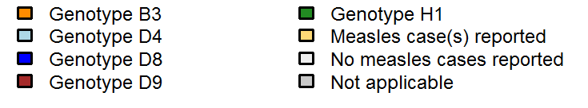
Distribution of measles genotypes from January 2018 to December 2018 inclusive (12 month period)
Source: http://www.who-measles.org/Public/Data_Mnt/who_map.php
Data source: MeaNS database for genotypes, IVB database for incidence
9
A RDT for measles; implication for global surveillance

Slide 10
Monitoring Measles Genotype disappearance-
Global genotype detection 2008-2019 (Aug)
Genotype | 2008 | 2009 | 2010 | 2011 | 2012 | 2013 | 2014 | 2015 | 2016 | 2017 | 2018 | 2019
B2 | 1 | 12 | 52 | 7
B3 | 17 | 94 | 387 (2) | 336 | 1082 | 596 | 1494 | 566 | 721 | 2673 | 2995 | 970
D4 | 425 | 338 | 666 | 2026 | 927 | 134 | 41 | 66 | 53 | 15 | 19 | 2
D5 | 114 | 18 |  |  |  |  |  |  | 1
D8 | 76 | 37 | 96 | 246 | 832 | 1700 | 1223 | 1301 | 1552 | 2552 | 3748 | 3628
D9 | 26 | 28 | 41 | 225 | 91 | 79 | 91 | 33 | 96 | 46
D11 | 0 | 6 | 1
G3 | 0 | 0 | 25 | 51 | 1 | 15 | 5
H1 | 157 | 144 | 158 | 29 | 66 | 181 | 4850 | 3167 | 2599 | 544 | 348 | 24

Slide 11
Use of Measles Genotyping and Sequence Data, Molecular epidemiology
Genotypes and Sequence Data Inform:
  Sustained transmission( endemic transmission) 1 strain in circulation for >1 year
  In elimination phase- Distinct pattern of small outbreaks caused by different strains, linked to imported cases.
Limitations of Genotyping
  Tracking pathways becoming more difficult.
  Little diversity in outbreak setting
  Complex patterns of importation (multiple imports from one O/B)
  Future-Extended and Whole Genome Sequencing- increases resolution.
11
A RDT for measles; implication for global surveillance

Slide 12

Can rapid tests and alternative samples help overcome barriers to rapid comprehensive measles reporting?
WHO -Only 3% of cases are reported to program!
Oral fluid and Capillary blood samples –easier to collect , less invasive , will increase compliance.
Timeliness of results. Surveillance is defined as information for action! Many programmes miss the 4 day reporting target for laboratory results.
Shipping samples can be a challenge - geography, maintaining cold chain
Significant delays in outbreak confirmation — delays initiating appropriate control measures
12
A RDT for measles; implication for global surveillance

Slide 13
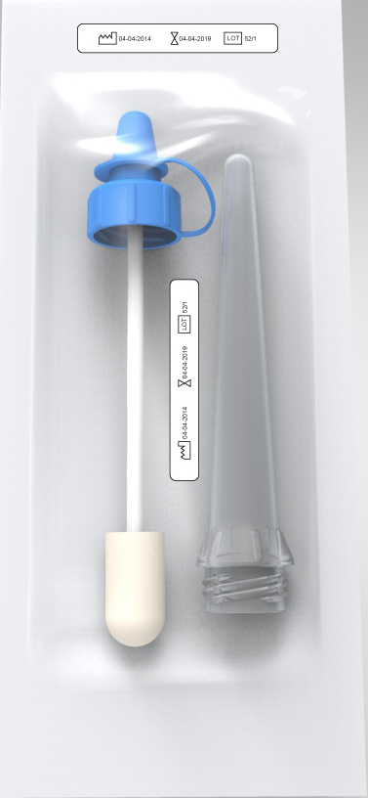
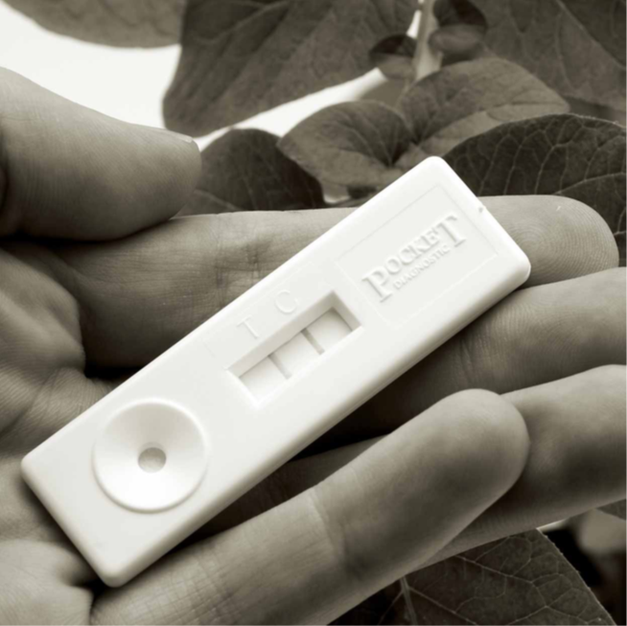
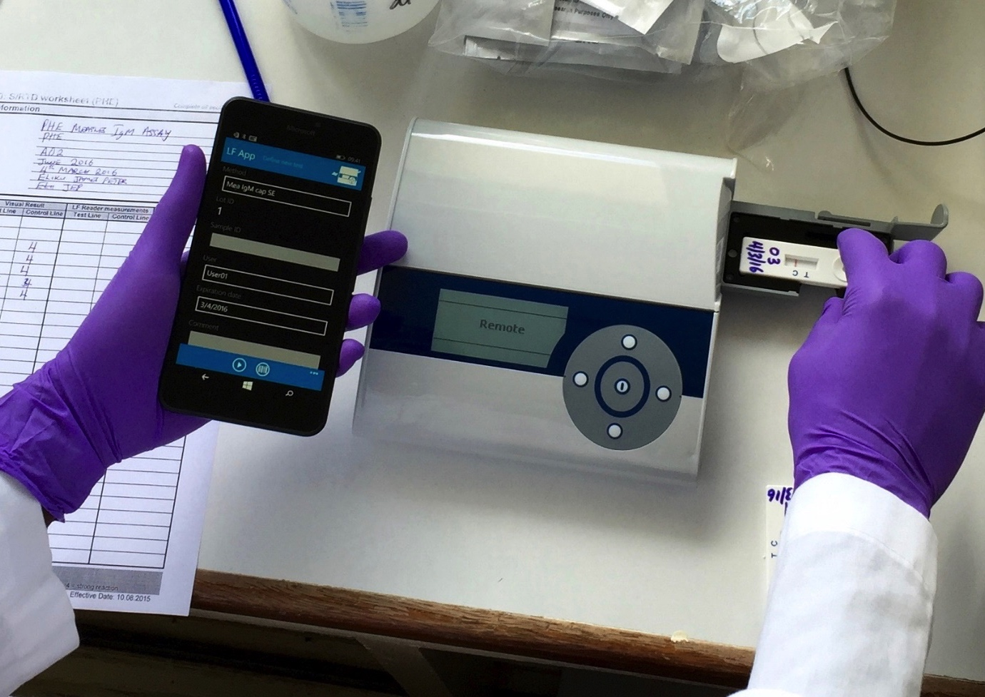
New tools developed for B&M Gates
M/R IgM RDT project
Oralight OF collector
Oralight™ - new oral fluid collection device
Lateral Flow tests for use on serum, capillary blood and oral fluid.
    Tetanus toxoid specific IgG antibody.
    Measles specific IgG antibody.
    Measles and Rubella specific IgM antibody.
ESEQuant lateral flow reader/ mobile phone
13
A RDT for measles; implication for global surveillance

Slide 14
Using Oral fluid samples for measles diagnosis
Advantage of oral fluid collection over serum
      Less invasive and reduced stress for patient and parent
      Easy to collect. Mother may collect and self collection possible for older children, under supervision
      Similar patterns of antibody to serum (gingival fluid is a transudate)
      Lower antibody level requires optimized assay for accurate results.
 | IgG (mg/100ml) | IgM (mg/100ml)
Serum | 1250 | 80
Whole Saliva | 1.4 | 0.2
Parotid Saliva | 0.04 | 0.04
Gingival Crevicular Fluid | 350 | 25
Serum:Gingival Crevicular Fluid ratios | 3.6:1 | 3.2:1
14
An RDT for measles; implication for global surveillance
BMGF PHE RDT project final report: December 2018
Notes:
IgM concentrations1;400, IgG 1:900 compared to serum.

Slide 15
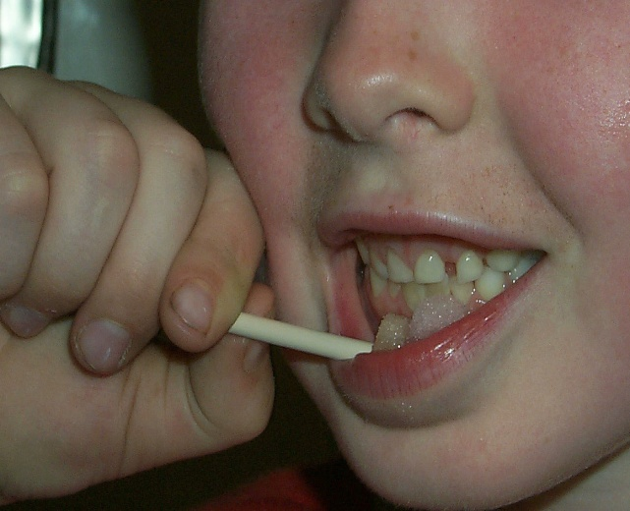
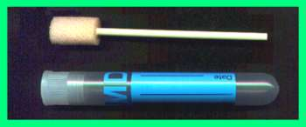
Oral fluid collection: Oracol
Oracol™ device (Malvern Medical Developments) successfully used since 1994 in UK(>200,000 cases investigated)
Limitation: Requirement for sending to laboratory for extraction and testing
15
A RDT for measles; implication for global surveillance

Slide 16
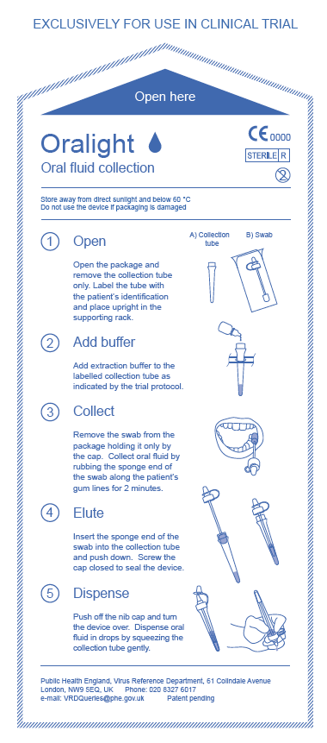
Oralight: Packaged for use
16
A RDT for measles; implication for global surveillance

Slide 17
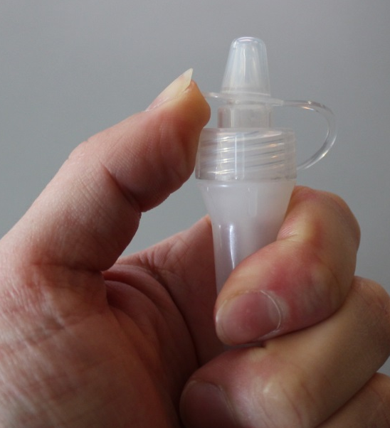
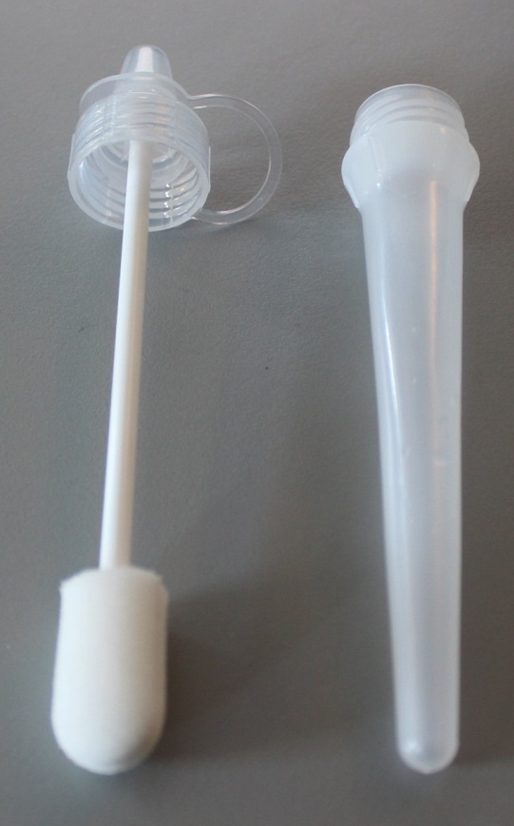
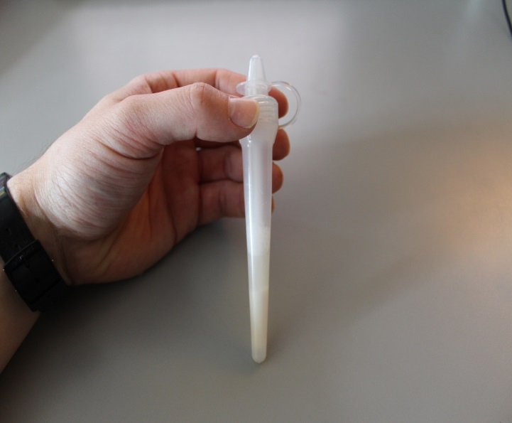
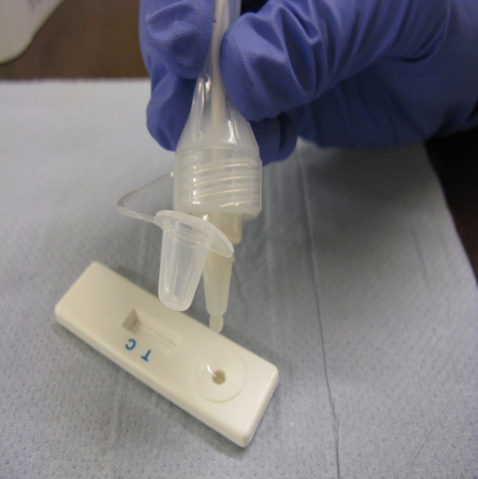
Extracting oral fluid from the Oralight™
1. Device
3. Flip open primary lid
2. Add extraction buffer (1ml). Push down swab and tighten screw cap to squeeze OF into tube
4. Invert and dispense OF into test device or for storage
3.
1.
2.
17
An RDT for measles; implication for global surveillance
4.

Slide 18
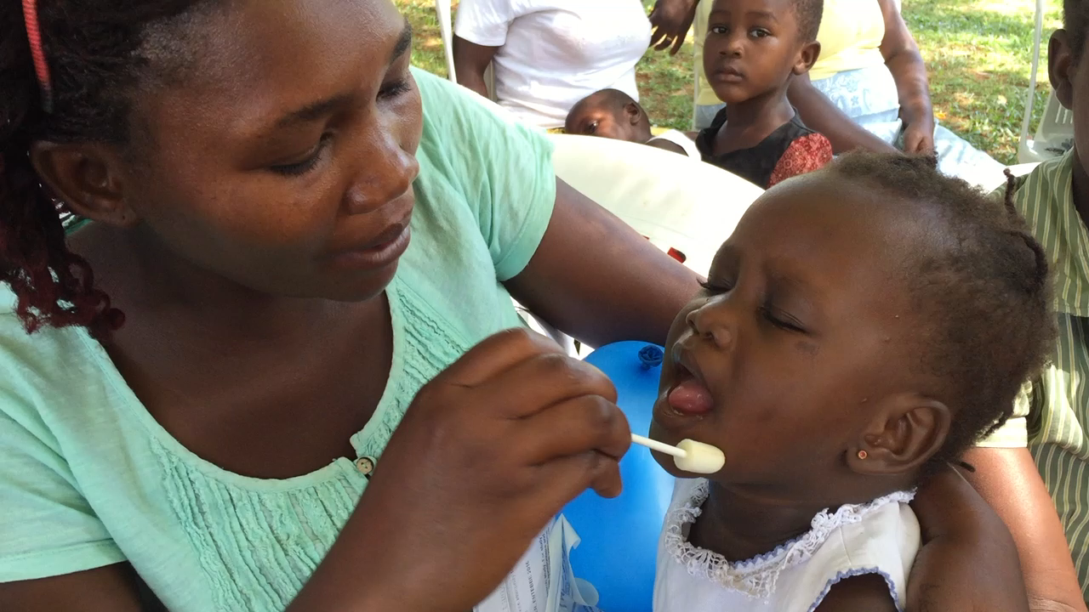
Oralight: Usability and Safety Study: Entebbe, Uganda. OF collected using both devices from 154 children 6-59 months.
Usability:
    Comparable performance –sample volume, IgG level.
    No problem in using either Oralight or Oracol devices but some preference for Oracol due to need to hold cap of Oralight
    Oralight initially felt drier in the mouth than Oracol
    Extracted Oralight fluid contained more particulate material than Lab processed Oracol sample
Safety:
    Blood contamination in 4.5% of Oracol and 7% in Oralight
    Contributing factors: Status of teeth/oral hygiene, over vigorous rubbing of gums with devices
    No evidence of discomfort or bleeding on review 5 mins and 30 mins after collections.
Oracol is CE marked, used for >20 years
18
A RDT for measles; implications for global surveillance

Slide 19
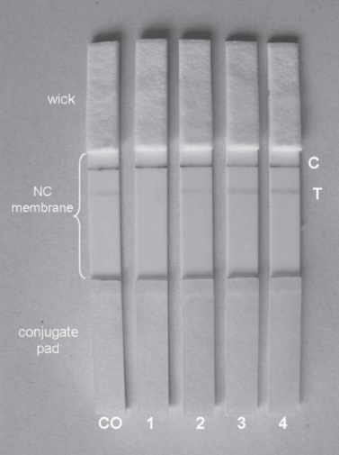
A point-of-care test (RDT) for measles diagnosis: detection of measles-specific IgM antibodies and viral nucleic acid - Warrener et al: Bull World Health Organ 2011
Components of the point-of care test (RDT) and examples of signal intensities obtained
during RDT testing of sera from four patients and of the cut-off control serum
Main findings:
With serum, RDT showed a sensitivity and specificity of 90.8% (69/76) and 93.6% (88/94), respectively.
With oral fluids, sensitivity and specificity were 90.0% (63/70) and 96.2% (200/208), respectively.
Both H and N genes were reliably detected in RDT
strips and the N genes could be sequenced for genotyping.
Measles virus genes could be recovered from RDT strips after storage for 5 weeks at 20–25 °C.
19
A RDT for measles; implication for global surveillance

Slide 20
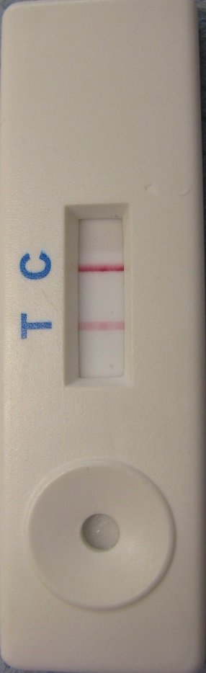
Capture format lateral flow assay
gold-labelled antigen and anti-human IgM test line
Direction of reagent flow
Add sample
OF/ blood
Gold labelled measles N
antigen
Test line :
anti-human IgM
Control line:
Antibody: anti- microbial antigen
Blood separation pad
Nitrocellulose
membrane
Plastic backing card
Cotton linter paper wick
Conjugate release pad
Notes:
Control lines:
Specific antibodies to microbial antigens/toxins
Test Line: single anti-human IgG, Fc fragment specific
Gold: 40nm gold colloid
Conjugates: directly conjugated microbial antigens/toxins
Complexed SA-gold-bTT

Slide 21
Measles IgM RDT evaluation in Rio:
Results: RDT vs Lab EIA
125 sera from Brazilian surveillance system, Positive and negative for measles IgM, 28 dengue IgM positives.
Used WHO 4 point Visual scoring scale : ≥2 being interpreted as positive for measles IgM in the RDT,Control line consensus visual scoring ≥2 being considered as valid.
Concordance: 96.0% (120/125)
Sensitivity: 96.1% (74/77)
Specificity: 100% (46/46)
Good correlation (97%, Kappa 0.95) with the ESEQuant suggest the measles RDTs are usable without the reader if necessary.
21
A RDT for measles; implication for global surveillance
Notes:
Comparison of Siemens IgM ELISA results with RDT visual test line score consensus, using a visual scoring of ≥2 being interpreted as positive for measles IgM in the RDT and a control line consensus visual scoring ≥2 being considered as valid.
Sensitivity: 96.1% (74/77)
Specificity: 100% (46/46)
Concordance: 96.0% (120/125)

Slide 22
Reading RDT in the Field- study designs used, based on results of Brazilian study.
Visual reading: independently by two trained staff at 20 minutes. Record result.
Invalid tests and tests giving discordant results repeated.
Record result using a mobile phone camera. Image can be sent to National laboratory for review if doubts/ disagreement about result.
Scan used devices with ESEQuant on receipt of RDT at reference laboratory.
22
A RDT for measles; implication for global surveillance

Slide 23
NPSP, Uttar Pradesh, India 2017-2018:
Measles IgM RDT evaluation.
      Evaluation of RDT device under field conditions for measles diagnosis and genotype determination.
      Ethics and ICMR approval
      2 day training for 15 district surveillance team.
      All collections by surveillance team
757 subjects recruited using normal surveillance criteria-with suspected measles cases having rash onset previous 4-28 days.
8 subjects from each of at least 75 outbreaks. OF, capillary blood and venous blood samples collected from all cases.
Usability and feasibility data collected.
Similar study in Uganda -380 cases recruited 2018.
23
A RDT for measles; implication for global surveillance

Slide 24
Comparing True Positives Vs RDT
True positive cases were then defined as:
  Positive results in Siemens IgM EIA assay, or, N gene positivity in Oral Fluid sample
True positives Vs CBRDT:
True Positives Vs OFRDT:
CBRDT Obs 1
OFRDT Obs 1
 | Pos | Equiv | Neg
True case | 507 | 35 | 20
Undefined* | 1 | 3 | 10
Negative | 6 | 9 | 142
 | Pos | Equiv | Neg
True case | 412 | 81 | 63
Undefined* | 2 | 2 | 9
Negative | 8 | 11 | 139
True cases
True cases
Sensitivity – 96%
Specificity – 96%
733
727
Sensitivity – 87%
Specificity – 95%
Equivocal results excluded from these calculations.
PCR result led to the re-classification of 26 Siemens EIA equivocal or neg cases as true positives
24
A RDT for measles; implication for global surveillance

Slide 25
Measles H gene PCR positive RDT vs Measles IgM positive RDT: N=197, UP, India
Data from NPSP, India, 2017
25
A RDT for measles; implication for global surveillance
25

Slide 26
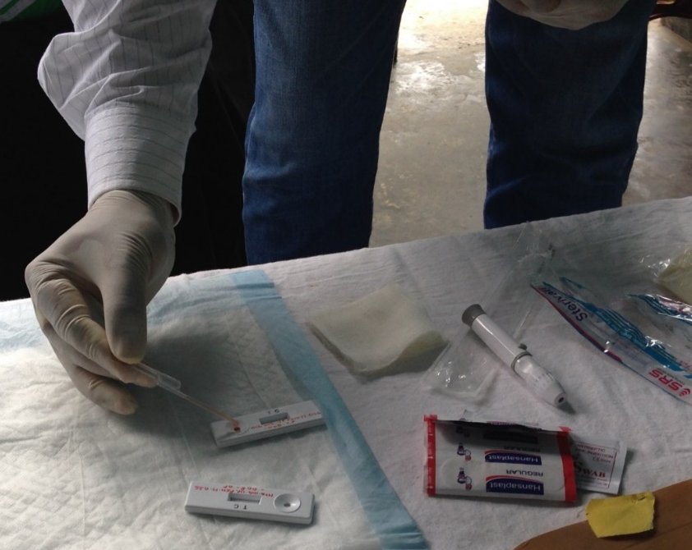
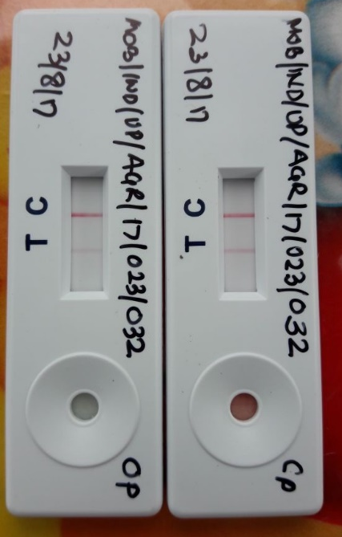
Performing the measles IgM RDT in the field Indis 2017
RDT Test lines scored as:
Negative = 0
Equivocal =1
Positive = 2+ weak, 3+ moderate, 4+ strong
OF sample
Capillary sample
26
A RDT for measles; implication for global surveillance
Notes:
Parallel testing of both sample types in the field study

Slide 27
Conclusions:
Measles IgM RDT using serum and CAP has similar performance to Siemens EIA / serum for case confirmation. Using OF samples it is 10% less sensitive.
PCR on used RDT is positive in >90% of used IgM positive OF/RDT and 50% CAP/RDTs in early samples . Introduction would enhance the sampling frame for Molecular epidemiology studies .
RDTs for Malaria, HIV widely used in clinics. In our studies both approaches were successfully introduced following short training and were preferred by surveillance staff and parents to blood collection.
The successful introduction of the technologies developed in this project has the potential to transform measles surveillance: A point of care test for real time case confirmation 20 Mins! using Measles IgM, which can be used to trigger early public health response .
27
A RDT for measles; implication for global surveillance
An RDT for measles; implications for global surveillance

Slide 28
FOUR Pilot studies now established to address feasibility of introducing RDT use into MR surveillance program, 2019.
 | Status | Notes
Malaysia | In process (pre-RDT period-300+ cases recruited). Use of RDT underway following training in August | n=450, includes impact on reporting times and PH response.
Uganda | Study underway following training in July, RDT testing established in level 3,4 clinics in 6 districts in Uganda. | n=200, Clinic based CB includes impact study, economic evaluation, internet based reporting. Control phase setting.
Brazil | Planned | Improved flexibility for Lab-based (in state labs), testing serum from surveillance cases. O/B investigations following reintroduction of measles
Cameroon | Training complete- April 2019. | Lab-based, testing serum from surveillance; some feasibility assessment. Control phase
Ghana | Training may 29,30, 2019 | Lab-based, testing serum from surveillance; some feasibility. Control phase.
28
A RDT for measles; implication for global surveillance

Slide 29
Future plans and issues
NOT yet available. Project to Commercialise and gain regulatory approval is under review.
Project also aims to produce a Rubella IgM RDT
Device received with enthusiasm at all study sites. Only risk identified so far– will introduction reduce case reporting to national surveillance
How should the RDT be used in Measles surveillance ?(WHO WG)
-Replace Lab tests at national laboratory?
-Move testing to the clinic?
-Endemic measles tranamission and/or Elimination phase?

Slide 30
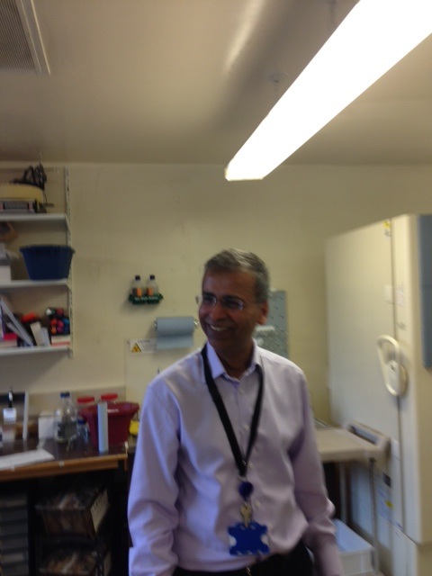
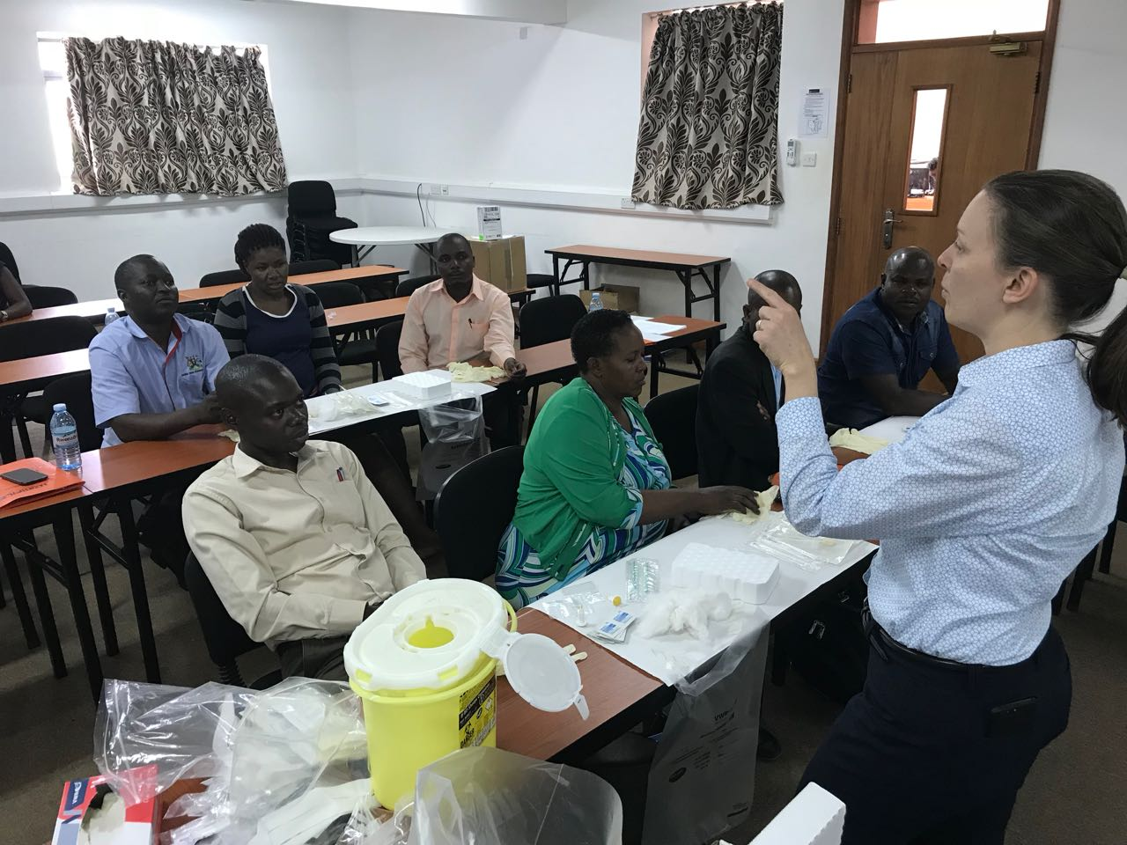
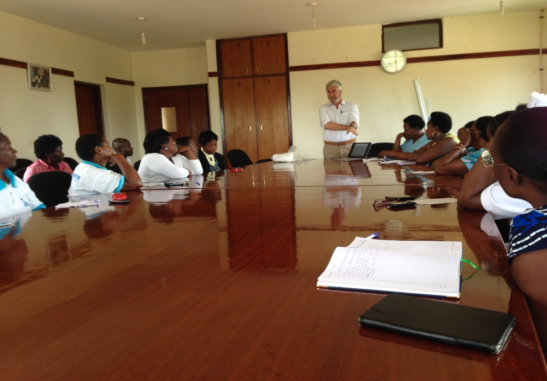
Acknowledgements:
B&M Gates Foundation
David Brown
Dhan Samuel
Lenesha Warrener
David Featherstone
Ben Childs –Maddison designs,
CARCLO –swab manufacture
Keith Perry
Kevin Brown
Field Studies:
Uganda
Josephine Bwogi,
Anatoli Kamali
Theopista Kabaliisa
Henry Bukenya
Peter Eliku.
Brazil
Marilda Siqueira
India
Lucky Sangal
Sunil Bahl
Ashutosh
Abhishek
Ashok
Diamond
30

