Slide 1
Towards Measles Elimination in China
Global Immunization Meeting, Geneva
March, 2011

Slide 2
Outline
Progress on Measles Elimination
Elimination Activities
Challenges

Slide 3
Measles Epidemiology

Slide 4




Reported measles incidence
China, 1955-2010
Incidence in 2010 achieved the lowest.
28.6/million
38159 cases: Lab-confirmed: 69%;
Source: National Notifiable Reporting System (NNDRS)

Slide 5
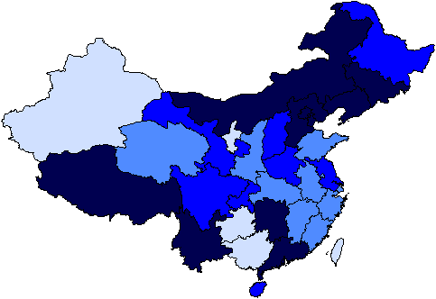
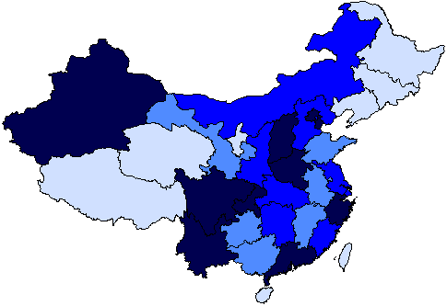
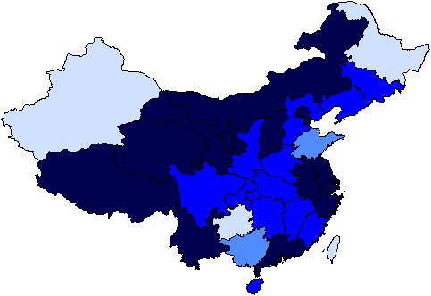
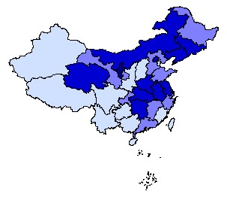
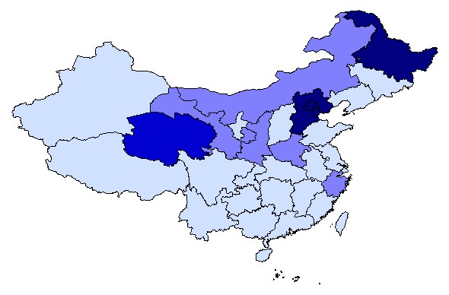
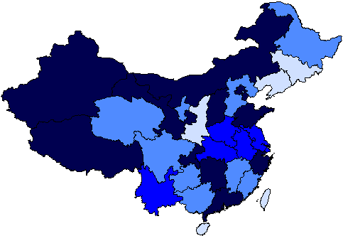

Reported measles incidence◊* by province, China, 2005 ～ 2010
2006
2007
2005
2010
2008
2009
Regional accumulated in different years
◊ Source: NNDRS
* Incidence per 100,000 population

Slide 6
Reported measles incidence by age group, China, 2005-2010
<1y old age group show the highest incidence
20-30 group relatively high
Source: NNDRS

Slide 7
Elimination activities

Slide 8
Strengthen routine immunization
Achieve and maintain routine 2 doses MCV coverage > 95%
Strengthen surveillance
Strengthen school entry immunization
Conducting SIAs
Improve outbreak response
Enhance social mobilization
-----Action Programs for Measles Elimination
in China, 2010-2012

Slide 9
Surveillance in 2009/2010
Index | 2009 | 2010
Reported incidence of excluded cases | 1.2/100 000 | 1.4/100 000
Rate of suspected cases investigated in 48 hours | 86.9% | 89%
Rate of blood specimen collected in sporadic suspected cases | 70.3% | 77%
Rate of blood test outcome reported in 7 days | 75.3% | 85%

Slide 10
Conducting SIAs
Guidelines issued
  Nonselective vaccination
2004-2009
  Catch up: 25/31 provinces, 8M -14Y
  Follow up: 6 provinces, 8M -6Y
  Approximately 140 million vaccinated
2010
  Nationwide SIAs, September 11-20
  102.3 million children vaccinated
Notes:
During 2004-2009, 27 provinces have conducted province-wide catch-up measles supplementary immunization activities (SIAs) and 5 provinces conducted follow up SIAs in 2008-2009.
The deep green shows the provinces which completed SIAs before 2009, and the light green are some province did an immunization campaign responded to the epidemic and outbreak all through the province.
The activities were implemented regardless of immunization and disease history, approximately 140 000 000 children and adolescents were vaccinated in total. The reported SIAs coverage was 92-99%.
These red characters stand for provinces developed follow-up SIAs.

Slide 11
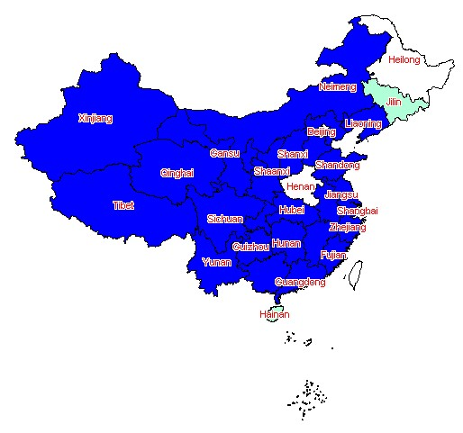

Completed SIAs, China, 2004-2009
Catch up: 25 provinces,8M -14Y
Follow up: 6 provinces, 8M -14Y

Slide 12
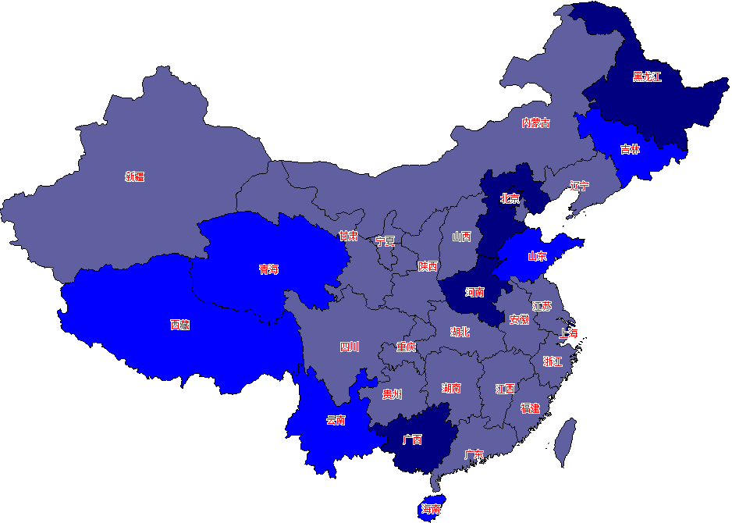

SIAs conducted, China, 2010
  5 provinces:8M-14Y
  6 provinces, 8M-6Y
  20 provinces, 8M-4Y

Slide 13
Number of reported cases by week, 2006-2011
Source: NNDRS

Slide 14
Proportion of measles by age group , China, 2005-2011
Age group
≤1 year: 28%( in 2005) 51%(in 2010) 82%
2-14 year: 41%( in 2005) 18%(in 2010) 56%
≥15 year: 29%( from 2005 to 2010) stable

Slide 15
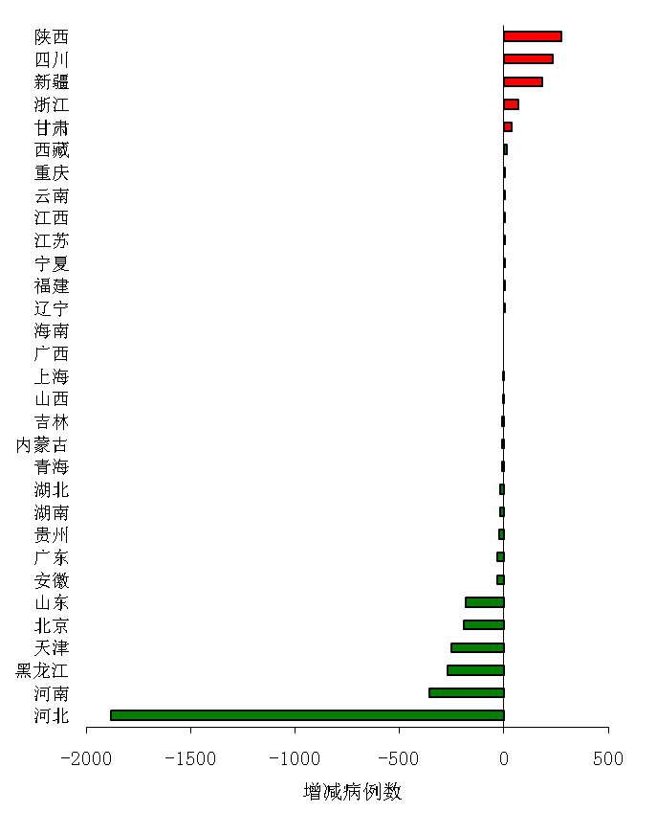
Measles reported status in Jan-Feb,2011
reported cases 1418；Lab-confirmed: 91%;
Declined 63% compared to 2010.1-2

Slide 16
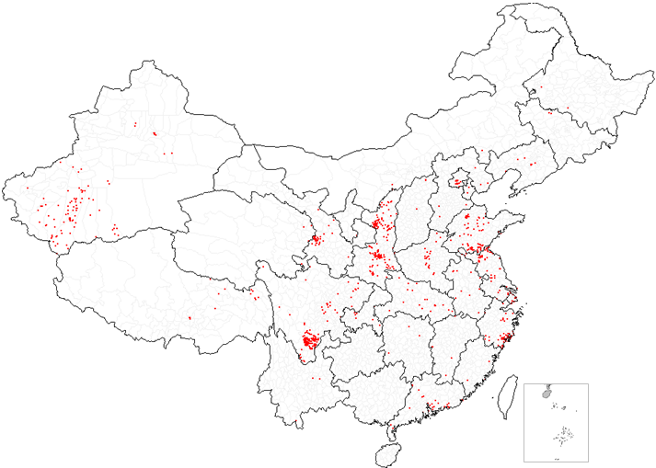
Reported measles cases by county, China, Feb,2011

Slide 17
MCV immunization history of cases by age, China, Jan - Feb,2011
Age group | 0 dose(%) | 1 dose(%) | ≥2 doses(%) | unknown(%)
＜8 month | 92 | 0 | 0 | 8
8 month | 89 | 6 | 1 | 4
9-11 month | 69 | 23 | 0 | 8
1 year | 61 | 24 | 6 | 9
2-6 year | 50 | 18 | 16 | 16
7-14 year | 30 | 19 | 30 | 21
15-34 year | 25 | 10 | 5 | 61
≥35 year | 37 | 4 | 0 | 60
total | 61 | 13 | 5 | 21
Source: Measles Surveillance System

Slide 18
Challenges Remain

Slide 19
Huge population
huge gaps between difference regions
Floating population
Nationwide SIAs conduct difficultly
social mobilization
population attitude
anti-vaccine movement

Slide 20
Adults are potential problem
Surveillance system
Hospital-infection control and case management
  ——Need differentiate strategies and measures

Slide 21
Actions in 2011

Slide 22
Maintain the high immunization coverage
8M:MR ; 18-24M:MMR
Conducting SIAs
focus on target population
Strengthen school entry immunization
Strengthen surveillance
syndromic surveillance ; rubella surveillance: CRS
Improve outbreak response
Health education
4.25

Slide 23
Thank you

