Slide 1
Overview of
Second-Year-of-Life (2YL) healthy child visit work
Dr Rudi Eggers, WHO HQ
Presentation to the
Measles Rubella Management Meeting
21 – 23 June 2016

Slide 2
Outline of the presentation
Problem statement
Benefits of a 2YL
  For additional scheduled doses (boosters, 2nd doses, primary doses)
  To catch up missed doses
  To provide integrated child health interventions
2YL project
  Demonstration countries / other projects
  Literature review and landscape analysis
  Development of generic guidance & implementation of guidance

Slide 3
Problem statement
With launched of EPI 1974
  Target six specific vaccine-preventable diseases: diphtheria, pertussis, tetanus, measles, poliomyelitis, and tuberculosis, all in the first year of life
WHO has substantially increased number of recommended vaccines to be given by all immunization programs
  hepatitis B, Haemophilus influenzae b, pneumococcal disease, rotavirus, rubella
  however, many still perceive immunization as a health intervention only for children <1 year old and do not offer vaccinations to children over 1 year of age even if the child was never vaccinated
  Even when policies are in place to allow vaccination of children over 1 year of age, this often does not translate to a change in practices.

Slide 4
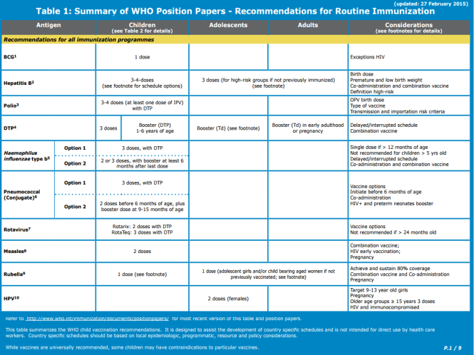
2YL Scheduled doses: WHO Recommendations
DTP: Booster dose recommended 1-6 years (DTP-containing vaccine 4 or DTPCV4). For Pertussis-containing booster, it is recommended preferably during the second year of life.
Measles-containing vaccine 2 (MCV2): to be given either through mass campaign or to be added into routine schedule when countries have >80%
  Where high-risk of measles mortality: recommended 15-18 months
Men A routine dose: a 1-dose schedule, at 9–18 months of age based on local programmatic and epidemiologic considerations.
Pneumococcal conjugate vaccine:
  Different common schedules (3p+0, 2p+1, or 3p+1) schedules.
  Emerging evidence: supports the use of 2p+1 as alternative schedule,
  with the third dose (the +1 dose) given between 9 and 15 months.

Slide 5
Country schedules
Countries with MCV2, 2014
Countries with MCV2 and DTP4, 2014
Recommended in 2014 (154 countries or 79%)
Both recommended in 2014 (128 countries or 66%)
Not Available, Not Recommended (40 countries or 21%)
DTP4 not recommended (26 countries or 13%)
Not applicable
MCV2 not recommended (9 countries or 5%)
Not Available, None recommended (31 countries or 16%)
Not applicable
Recommended in 2014 (19 countries or 10%)
Countries with both
MCV2 and DTP4
at the same time
in 2YL, 2014
Not Available, Not recommended (175 countries or 90%)
Not applicable
The boundaries and names shown and the designations used on this map do not imply the expression of any opinion whatsoever on the part of the World Health Organization concerning the legal status of any country, territory, city or area or of its authorities, or concerning the delimitation of its frontiers or boundaries. Dotted lines on maps represent approximate border lines for which there may not yet be full agreement. ©WHO 2016. All rights reserved.
Data source: WHO/IVB Database, as of 13 January 2016, Map production Immunization Vaccines and Biologicals (IVB), WHO

Slide 6
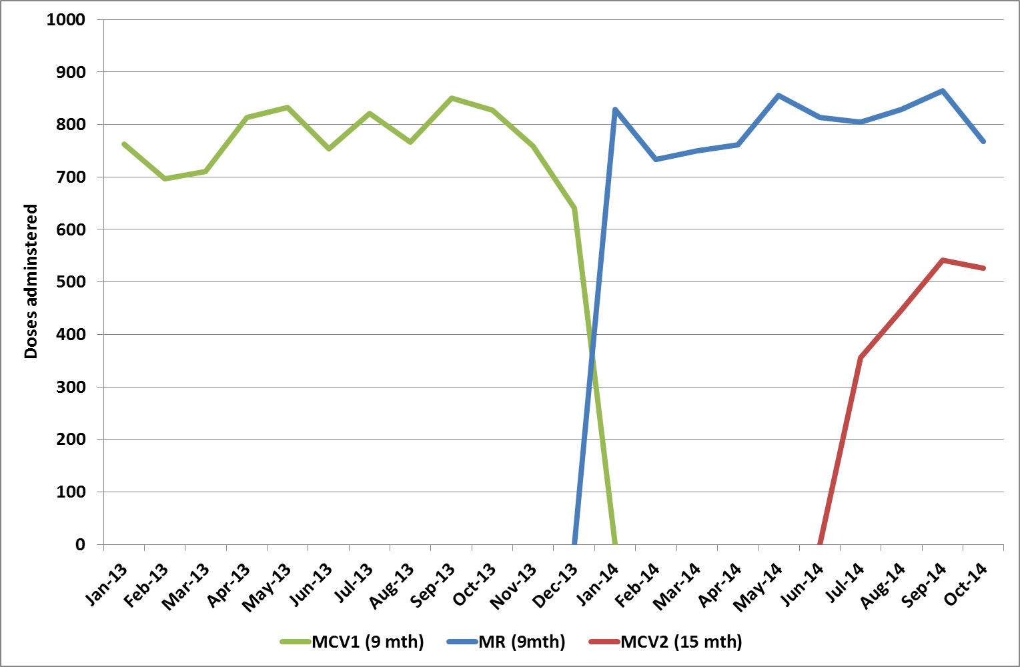
Rwanda: Difficulties with measles second dose
Easy change from measles to MR at 9 months
Slow uptake of measles at 15 months

Slide 7
Lessons learned from recent MSD introductions
PIEs conducted in Tanzania, Zambia, Ghana, Cambodia, India, Burundi, Senegal, Eritrea
Planning, training and demand creation
Planning not started early enough
Health staff training
    Not conducted adequately or universally (“measles is an old vaccine”)
    Health workers not aware of MDVP, criteria for MSD, target population
    Written guidelines not available
Demand creation among caregivers
    Need to improve communication with caregivers about need for 18 month visit
Implementation and integration
Need active defaulter tracing for MCV1-MCV2 drop-outs
Need proactive screening for eligible children at HF & strategies to reach kids > 9 mth
Need to use of microplanning to focus on hard-to-reach children
Opportunities to use MSD as platform to enhance community demand for vaccinations & health services beyond 12 months (2YL platform)
Infrequent vaccination sessions (concern about wastage)
Importance of opening vial for a single child needs to be emphasized
Data and recording
Need reliable target populations
Parallel systems of imm. coverage reporting (HMIS and DVDMT)
Need to update recording tools (e.g., vacc. register, tally sheet, and monthly reporting form and vacc. cards)
Inadequate training on use,
    Confusion about how to record first dose of MCV if administered >12 months
    MCV1-MCV2 dropout not reported or monitored
No systematic monitoring and evaluation or use of data for action

Slide 8
Defining a package of interventions
For all children:
  Measles second dose
  Catch-up on other vaccinations (except BCG) that the child may have missed in the first year of life
  Growth monitoring and promotion (GMP)
  Vitamin A
  Deworming (Mebendazole)
For children as indicated:
  Follow up/referral on early infant diagnosis (EID) for HIV/AIDS
  Referral for IMCI or iCCM for children with fever or other illness

Slide 9
Benefits to establishing a strong 2YL platform
1) For additional scheduled doses
Booster doses of routine immunizations
  Eg. DTP4 are increasingly recognized of public health importance
Second dose
  A second Measles Containing Vaccine dose (MCV2) is recommended in most settings. Although some countries offer MCV2 at school entry ages, most offer MCV2 during the second year of life.
Part of primary schedule
  For some newer vaccines such as pneumococcus vaccine, one schedule option includes a routine dose in the second year of life
  Meningitis A routine dose may be given at 12 – 15 months
Primary schedule
  Multiple vaccines in development such as vaccines for malaria and dengue fever that will likely be recommended for children over 1 year of age.

Slide 10
Benefits to establishing a strong 2YL platform
2) To catch up missed doses
Achieve higher coverage of vaccines offered in the first year of life through catch-up vaccination.
An important opportunity to provide missed vaccines to children and to improve overall coverage.
By expanding vaccination services to the 2nd year of life, a child will no longer be limited to a 3-month window for receipt of MCV1; this change will positively impact the achievement of the measles elimination goals. Other missed doses in infancy should also be given at this time.

Slide 11
Benefits to establishing a strong 2YL platform
3) To provide integrated child health interventions
“Healthy child visit”
Create opportunities to integrate with other health interventions.
Immunization systems are increasingly integrated with other health interventions with the intent of maximizing public health impact with limited resources.
2nd year of life platform is an opportunity to further integrate immunizations with other health interventions such as Vitamin A supplementation, nutrition, growth monitoring, and deworming.

Slide 12

2015 - Year 1
2016 - Year 2
2017 - Year 3
2YL Working Group (collaboration with Measles RI Subgroup)
Demo country: Zambia
Implement generic guidance, training and advocacy material in Implementation 4 countries
Demo country: Senegal
Final guidance to countries
Generic guidance to countries wishing to introduce a 2YL visit
Training material
Advocacy and communication material
Global landscape analysis
Lit. review
JRF data review
CDC 2YL assessment: Ghana
Other 2YL assessments

Slide 13
WHO Country pilots
Two countries selected that already have a 2YL visit
  Initially: one country with MSD, one country with non-MSD visit
  Zambia (assessment completed) and Senegal (assessment started)
Review experience and preparation of MSD introduction through country visit, desk review and stakeholder interviews of existing experiences in implementing 2YL
Assess impact of 2YL on MCV1 and other coverage and evaluate cost
Propose actions and guidance to this specific country to improve coverage in 2YL:
  Advocacy and communication
  Programme roll-out
  Recording and reporting

Slide 14
WHO Country pilots - Process
Review experience. Retrospective review of preparation & implementation of 2YL (MSD) introduction -- country visit, desk review and stakeholder interviews
Explore. Meetings and discussions on how to improve within the country context
Plan. Propose actions & guidance to improve 2YL platform:
    Strengthen policy, guidance (catch-up or late vaccination)
    Programme operations (integrating interventions, recording, reporting)
    Advocacy, communication, social mobilization (changing the mindset)
Implement. Implement plan including way to measure change
Learn. Compile lessons & impact for input to guidance

Slide 15
Guidelines on establishing an integrated 2YL healthy child visit
Combined inputs from
  2 country pilots and adaptations
  Landscape analysis, incl. lit. review and JRF analysis
  CDC projects in 2 countries
  Other assessments
Target audience
  National programmes wishing to establish a 2YL visit (including but not limited to MSD)
Implementation
  Use the guidelines in 4 countries
  Revise and finalize document

Slide 16
Thank you

