Slide 1
Creating the post-2020 MR Framework
The Measles & Rubella Initiative Leadership Team

Slide 2
Outline
  The global immunization environment
    Immunization Agenda 2030
    Gavi 5.0
  The MR post-2020 framework process
  Findings
  The draft framework
  Conclusions

Slide 3
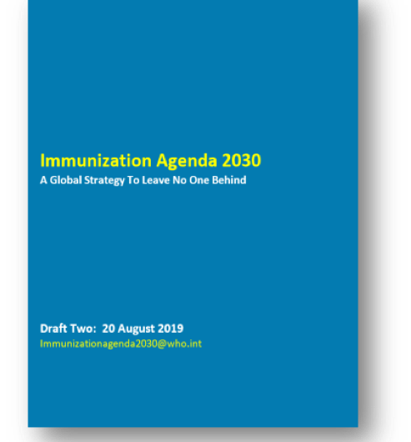

Immunisation Agenda 2030
With GVAP coming to an end in 2020
New vision and strategy for vaccines and immunization is needed
Set a new direction for the next decade that engages and aligns stakeholders – immunization and beyond – at all levels
Address emerging issues, and harness new solutions for impact
Re-iterate the importance of vaccinations in contributing to the broader health & development agendas
Based on >2000 comments received on Draft 0 and ~2000 on Draft 1
Comments from stakeholders were included in Draft Two, circulated back on August 20th 2019

Slide 4
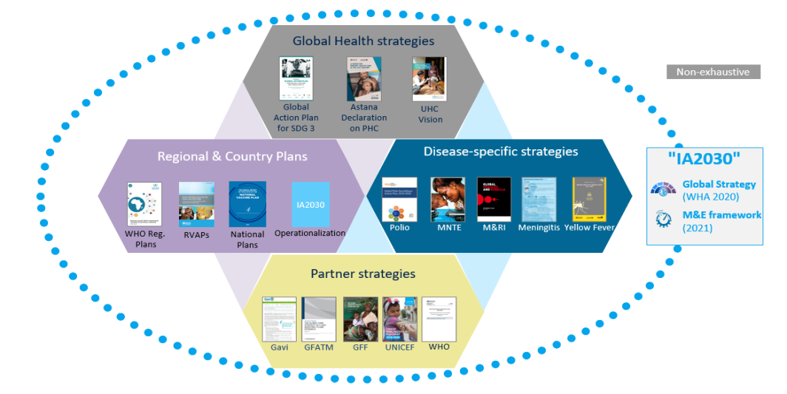
New vision & strategy will build on/live within ecosystem of recent strategies, responding to changing context

Slide 5

The value of immunisation in the next decade
Immunization linked to …
14 of 17 SDGs
… broad set of compelling arguments for value of vaccines
2021-2030
Innovation
1
Healthy children & families = INCREASED PROSPERITY
6
Clean water, sanitation & hygiene (WASH) + vaccines = LESS DISEASE
11
Protected urban public health = HEALTHIER CITIES
2
Immunization + nutrition
= HEALTHIER FAMILIES
7
Efficient supply chain equipment = CLEANER ENVIRONMENT
13
Vaccines = MITIGATION OF CLIMATE CHANGE IMPACT
3
Immunization = HEALTHY LIVES & WELL-BEING
8
Healthy population = MORE PRODUCTIVE WORKFORCE
16
Strong health systems = LONG-TERM STABILITY
4
Vaccines support cognitive development through better health = IMPROVED LEARNING
9
Healthy vaccine market = INNOVATION
17
Innovative partnership = UNPRECEDENTED PROGRESS
5
Immunization = EMPOWERED WOMEN & GIRLS
10
Better health = INCREASED EQUALITY
Source: UN; Gavi analysis

Slide 6
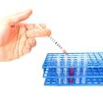
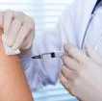


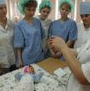




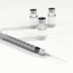


"IA 2030" will be responsive to changes in global context
Delivering
vaccines along
the life-course
Including gender-specific interventions to vaccination services
Addressing
wide subnational variation
in coverage
Responding
to changing demographics
Implementing services during
and following fragility & emergencies
Responding
to outbreaks
and antimicrobial resistance
Ensuring access
to vaccines,
and optimal use
of vaccines
Harnessing innovations
to improve programme function and coverage
Responding
to the decreasing awareness
of the value
of immunization
Addressing
vaccine hesitancy
and anti-vaccination
activism
Ensuring
global vaccine supplies meet national needs
Uncertain programmatic
and financial
self-sustainability
Source: Gavi (health systems photo)

Slide 7

Ultimate goal is for the new vision and strategy to be endorsed at the World Health Assembly
March
June
August
October
January
May
Launch
Co-creation & co-development
Endorsement
Review by anyone…anywhere…at any time using offline/online methods
Dedicated events with countries, regions, partners (CSOs, ROs, COs)
Co-Creation Forum
Draft
Zero
Draft
One
Draft
Two
SAGE
WHO
Executive Board
World
Health
Assembly

Slide 8
IA2030 vision and impact goals
DRAFT
Vision
Impact goals
A world where everyone, everywhere, at every age,
Reduce mortality and morbidity from vaccine preventable diseases for all across the life course
…fully benefits
from vaccines…
Leave no one behind by increasing equitable access and use of new and existing vaccines
…for good health
and well-being
Ensure good health and well-being for everyone by strengthening immunization within primary health care and contributing to universal health coverage and sustainable development

Slide 9

Seven strategic priorities
DRAFT
Immunization Programs for primary health care /
universal health coverage
      Outbreaks
      & Emergencies
      Life course
      & Integration
      Commitment
      & Demand
      Research
      & Innovation
      Coverage & Equity
      Supply &
      Financing

Slide 10
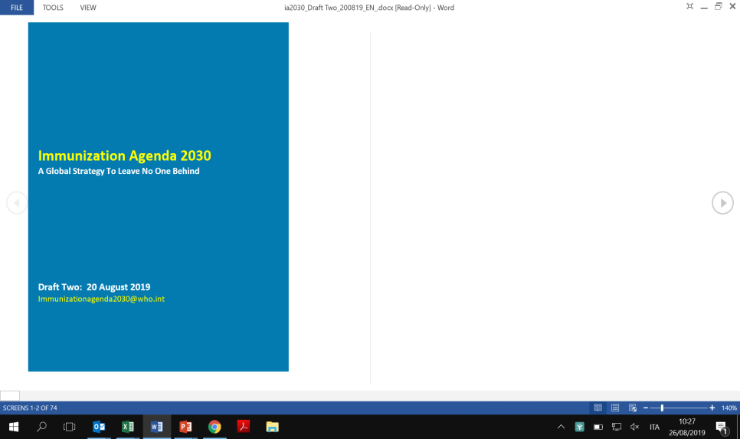
"Immunization Agenda 2030" will include two components
DRAFT
Immunization Agenda 2030
  Documents to be endorsed at WHA 2020
Immunization Agenda 2030 Vision & Strategic framework (draft 2)
Vision (5-10 page document, for everybody)
  Vision 2030 and beyond – to inspire and rally
  Values & high-level strategic priorities
  The case for immunization
Strategic framework (10-15 page document, for immunization community & wider stakeholders)
  Strategic priorities & goals, core principles, ways and means to guide development of global, regional, national strategies and plans
  "Living" throughout the decade
IA2030 Online Resources
IA2030 Online Resources
  Technical guidance documents "living" throughout 2021-30
  Existing or new global, regional, country plans & goals (e.g., regional strategies)
  Existing or new disease- and topic-specific technical guidance and best-practice documents (e.g., Measles strategy)
Living throughout 2021-2030
Technical guidance
Operational
plans
Disease specific documents

Slide 11
IA 2030 will emphasize measles key roles in immunization
DRAFT
In 'Intro' and 'What's new in IA2030'
  Mentioning data point on 21 million deaths averted from measles over 2010-2017 in first sentence (for intro)
  Positioning measles as indicator of robust immunization system and pathfinder for strengthening PHC
Measles at the heart of IA2030
In 'Lessons learned from disease-specific initiatives'
  Beef up paragraph on measles and position it as flagship for RI and promoter of equity
  Adding focus area on measles as a pathfinder for national immun. programs
In SP#2 Coverage & equity'

Slide 12

Outline
  The global immunization environment
    Immunization Agenda 2030
    Gavi 5.0
  The MR post-2020 framework process
  Findings
  The draft framework
  Conclusions

Slide 13

The next strategic period will be critical for the Alliance’s new 2030 aspiration
Vision
Leaving no-one behind with immunisation
To save lives and protect people’s health by increasing coverage
and equitable use of vaccines
Mission
Set of principles
1
2
3
4
Ensure healthy markets for vaccines and related products
Goals
Strengthen health systems to increase equity in immunisation
Introduce and
scale up vaccines
Improve sustainability
of immunisation programs
Enablers

Slide 14
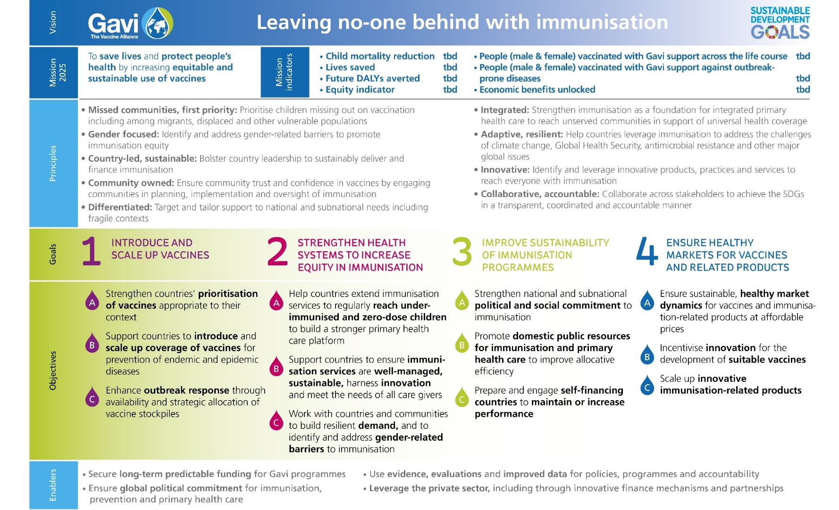
Gavi, the Vaccine Alliance strategy - Measles relevant areas

Slide 15
Outline
  The global immunization environment
    Immunization Agenda 2030
    Gavi 5.0
  The MR post-2020 framework process
  Findings
  The draft framework
  Conclusions

Slide 16
MRSP2030 Strategic Framework
Goal: development of a vision for measles and rubella strategic priorities in the context of the post immunisation agenda 2030 ensuring alignment among all M&RI partner agencies

Slide 17
Project Overview
Conducted desk reviews, interviews and launched survey
M&RI Chapter meeting and M&RI broader stakeholder consultation
MT / LT discussion and approval of first draft of Framework
JUL
AUG
SEPT
OCT
NOV
DEC
SAGE; F2F meeting to further flush out v0 of Framework, and mission briefing / donor outreach - TBC
Finalization of post-2020 MR Framework
Provided initial observations on linkages of IA2030 to MRI LT / MT
Opened virtual group brainstorm – transparent sharing of ideas
Phase 1: Initial data collection
Phase 2: Stakeholder consultation
Finalize framework
Notes:
M&RI chapter meeting- provide an overview of project and feedback received; begin discussions on framework structure, vision and goals.

Slide 18







Emerging themes from desk reviews
Measles-Rubella related
Agency strategy documents
Disease control strategies
Alignment on principles and goals to IA2030 but strategic shifts will be required for MR components
More priority should be given to system strengthening
Increase the use of data
Ensure all recommendations from MTR and other evaluations are fully implemented and tracked
Targets and timelines for elimination and control goals (at global and regional levels) need to be re-evaluated in line with ia2030’s M&E framework
Low appetite for vertical-life programme and MRI needs to evolve
Key principles were common across documents and relevant for MRSP2030
Equitable service delivery across life course to achieve UHC
Resilient, sustainable and integrated health systems
Innovation and market shaping
Working in partnerships
Outbreak preparedness and response
Differentiated approach to supporting countries in achieving their goals
Building leadership, management, and coordination capacity at national levels
A number of other disease control initiatives exists, resulting in more areas for collaboration and partnerships. Potential areas include:
Integrated service delivery
Integrated surveillance and data sharing
Coordinated emergency response and preparedness
Coordinated community engagement
Building national political will

Slide 19
Emerging themes from Interviews
KEY ACHIEVEMENTS
Reduction in M&R burden, particularly in U5
Intro of 2nd dose Measles and intro of Rubella
Improvements in MR surveillance with more case-based surveillance
Use of 2012-20 MRSP as advocacy platform, increasing attention to MR
Clear narrative highlighting measles control as a marker of the immunization program strength
Increasing emphasis on routine vax
More engagement from Gavi
MAIN SHORTFALLS
Stagnation of routine immunization coverage
Sub-optimal quality of SIAs with failure to reach zero dose children
Surveillance of insufficient quality to achieve elimination standard and data was not used to fill immunity gaps and inform timely actions
Insufficient community engagement to create demand and address vax hesitancy

Slide 20
Emerging themes from Survey
Rate the importance of the current components of the strategy
Do the current components require a shift in strategic direction?
General concurrence on the importance of the current strategic components for the post 2020 period
Although the current components are relevant for post 2020, almost all require significant shifts

Slide 21
Emerging strategic priorities
Vaccination
Surveillance & data
Outbreak preparedness & response
Community engagement
Embed MR in all immunisation and health systems
Reduce reliance on nationwide SIAs and increase efforts to optimize coverage, actively targeting 0d children
Promote tailored approaches
Increase focus on fragile/insecure countries
Leverage life-course vaccination
Ensure robust regional, national/sub-national plans and monitoring
Promote sustainable and integrated surveillance systems in collaboration with other disease initiatives
Improve diagnostic capabilities at national and sub-national levels
Develop more guidance on use of data: (i) risk mapping and (ii) classification of countries and areas for differentiated interventions
Provide more clarity on the need, timing, and extent of outbreak response
Develop more formal processes and structures to obtain outbreak response funding
Strengthen country capacity to conduct risk assessments and high-quality outbreak response
Better and tailored engagement in all relevant country-level stakeholders, particularly on vax hesitancy
Develop broader partnerships with greater engagement of global and local level CSO

Slide 22
Outline
  The global immunization environment
    Immunization Agenda 2030
    Gavi 5.0
  The MR post-2020 framework process
  Findings
  The draft framework
  Conclusions

Slide 23






The emerging MRSP2030 framework aligns with ia2030
VISION
GOALS
PHC / UHC
Integration
Partnerships
EQUITABLE POPULATION IMMUNITY ALONG THE LIFE COURSE
DATA DRIVEN APPROACHES TO MONITOR DISEASE
OUTBREAK PREPAREDNESS & RESPONSE
PEOPLE CENTRED COMMUNICATION & ENGAGEMENT
Ownership/ Accountability
Sustainable Financing & Supply
Research & Innovation
Objectives & Activities
Strategic Enablers

Slide 24
Outline
  The global immunization environment
    Immunization Agenda 2030
    Gavi 5.0
  The MR post-2020 framework process
  Findings
  The draft framework
  Conclusions

Slide 25
Conclusions
MR post-2020 Framework remains a work in progress
Key principals in its development include:
  Consideration of SAGE guidance
  Alignment with SDG agenda, IA 2030 & Gavi 5.0
Shift in the ‘how’ rather than the ‘what’
Areas for further discussion
  Level of endorsement, e.g., ?WHA
  Governance structure and link to IA 2030

Slide 26
Please direct comments to:
Please join us tomorrow at 7:30 AM in Hall of Service, ARC building 1730 E Street for small group discussions
Participate in the virtual bulletin board at this link: https://app.klaxoon.com/join/QKQDAR
  Please reach out to kom@mmglobalhealth.org to state your interest and separate sessions will be organized to provide an overview of the board plus ”how to”

