Slide 1
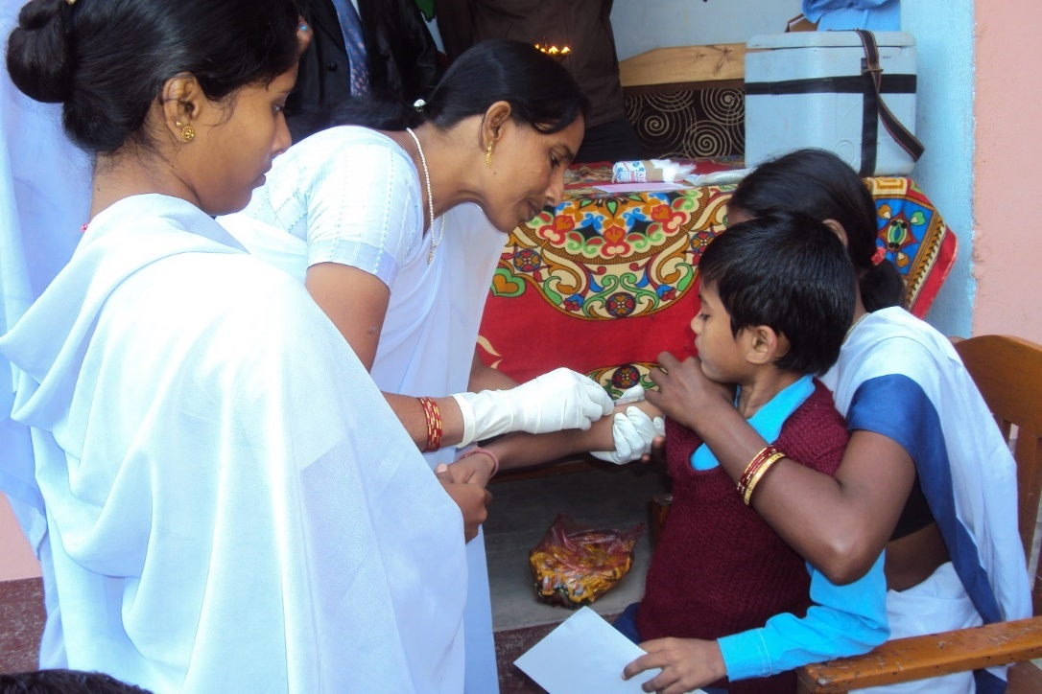
India’s Experience with Measles 2nd dose and DPT Booster in 2nd Year of Life
Dr Pradeep Haldar
Ministry of Health & Family Welfare
Government of India
June, 2016

Slide 2




Universal Immunization Programme
(Scope and scale)
One of the largest public health programs in India
30 million pregnant women; 27 million newborns targeted annually; >9 million sessions planned per year;
>27,000 cold chain points for storing and distributing vaccines
BCG, DPT, OPV, Measles, Hepatitis B, Tetanus Toxiod, Hib containing Pentavalent vaccine (DPT+HepB+Hib) provided nationwide and Rota & JE vaccine in select states/ districts
India is the largest manufacturer of vaccines with a functional National Regulatory Authority
Notes:
Before I start, here are a few facts to put in context the sheer size and scale of India’s Universal Immunization Program (UIP). India not only has the largest birth cohort of children for vaccination, it is also the largest developing country manufacturer of vaccines all over the world. In Dec 2012, the Assessment of India’s National Regulatory Authority was conducted and found functional by WHO and member countries.

Slide 3
Major Programme Milestones
Measles 2nd dose intro
Hepatitis B vaccine scale up
Penta intro
Open vial policy; JE 2nd dose intro
India certified polio-free
-IPV intro
- Mission Indradhanush
JE vaccine intro
1978: Immunization Programme of India launched
1985: UIP launched
1995: Pulse Polio Programme launched
MNTE validated
2016
Last wild polio virus reported from India
2015
-Rota Intro
2014
2013
2011
2010
2006

Slide 4
Revised National Immunization Schedule
Age | Vaccines given
Birth | BCG, OPV, Hepatitis B
6 Weeks | OPV, Pentavalent, Rota , PCV
10 weeks | OPV, Pentavalent, Rota
14 weeks | OPV, Pentavalent +IPV Rota , PCV
9-12 months | Measles (MCV1), JE*, PCV, MR***
16-24 months | Measles (MCV2), JE*, DPT-B, OPV-B, MR***
5-6 years | DPT-B2
10 years | TT
16 years | TT
Pregnant Mother | TT1, 2 or TT Booster**
Being scaled up
* Endemic districts 199 out of 674
** one dose if previously vaccinated within 3 years
*** MR after introduction will replace Measles
Planned to be introduced

Slide 5
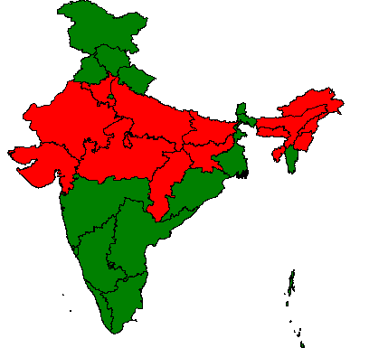
Introduction of Measles 2nd dose
2Yr Vaccination
2nd Dose of Measles introduced starting from 2010 in a phase manner
  21 better performing states directly introduced 2nd dose measles in RI
  14 states conducted a measles catch-up campaign to cover all children between 9 months to <10 years of age.
  2nd dose introduced in these 14 states under RI after 6 months of campaign completion
All States/UTs introduced Measles 2nd dose under Routine Immunization by December 2013
Measles 2nd Dose
Campaign followed by RI
Directly under RI
~ 119 million children vaccinated through campaigns in 14 states

Slide 6
Challenges for 2nd dose introduction -India

Slide 7


Already existing vaccine(MCV) in the system
Not a new vaccine at all, it was there all along
No new work/ additional activity/preparations
No new skills required to administer MCV-2
The vaccine availability was never an issue
Introduction of 2nd dose led to decrease in wastage of the vaccine
No significant additional burden on cold chain space as 2nd dose leads to better utilization of vaccine

Slide 8
The crux of the challenge in 2nd dose measles
Skill and capacity was there but utilization of opportunity to be made
New schedule
Record keeping (Registers and Home records), reporting formats all needs to update to capture the event.
Knowledge present but aptitude and practice skill to be build up
Community awareness for 2nd dose of measles
Second dose introduction of measles under Routine to be treated as new vaccine introduction

Slide 9
Challenges faced in 2nd dose, were addressed
Low initial pick up following MCV-2 introduction in RI
Utilization of opportunity (DPT 1st booster or DPT-4)
Gap between DPT-4 and MCV-2, coverage gradually needs to close
    Regular reviews of States/UTs on administrative coverage (HMIS) and concurrent RI-monitoring in DTFIs/STFIs
    GoI feedback regularly to states on missed opportunity on 2nd dose of measles.
    Low coverage of 2nd dose MCV were taken up in UIP reviews at national level during EPI program managers meeting
    Aptitude/practice behaviour of front line workers targeted to increase MCV2 coverage

Slide 10
Monitoring 2nd dose measles introduction complete
in the routine EPI program based on RI monitoring
18 non catch-up campaign states/UTs have incorporated
MCV2 in their RI schedule after 2010
367 campaign districts covered in Phase 1, 2 & 3
of 14 states have already incorporated MCV2 in their RI
schedule as of February 2014
4 states/UT were providing MCV2 as MMR before 2010

Slide 11
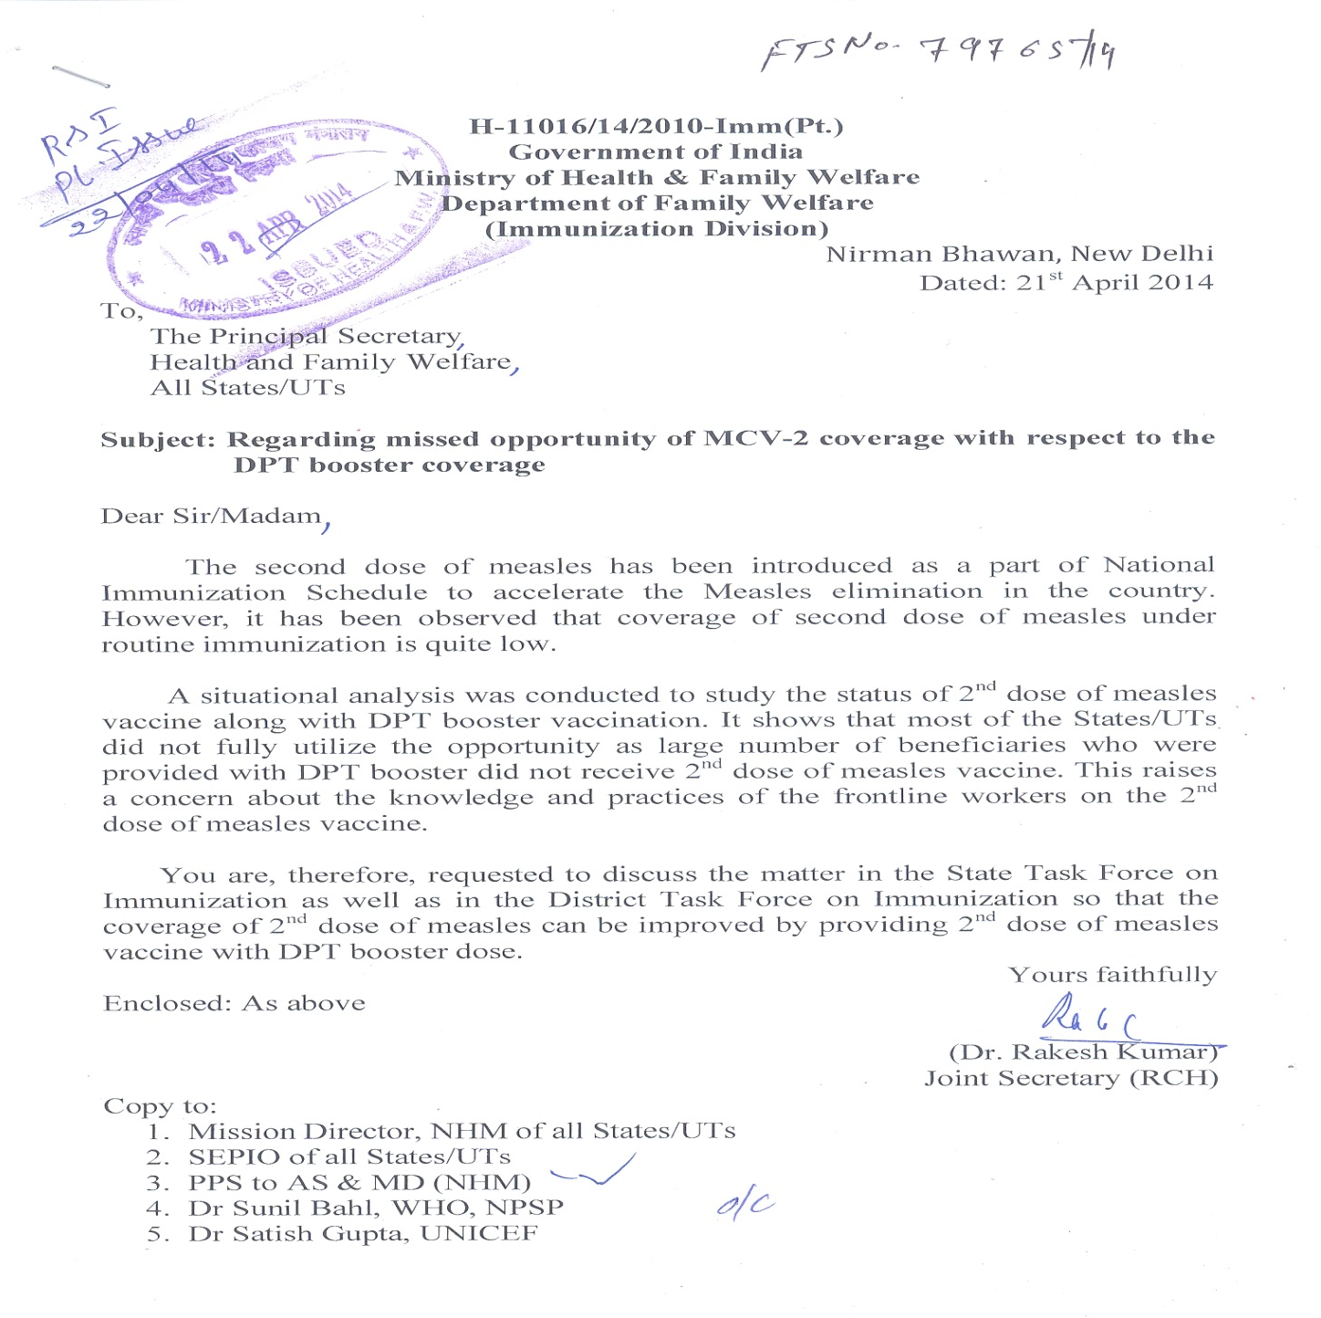
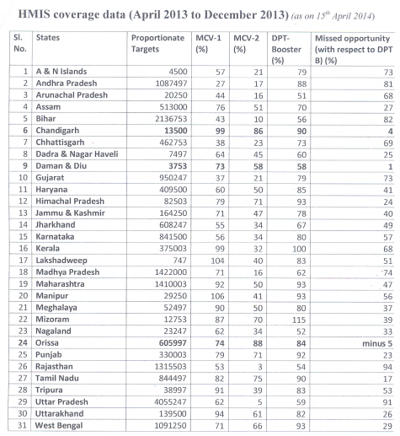
National Government letters to states as feedback

Slide 12
Drop-out on reported coverage DPT4 Vs. MCV2
2014
2015*
12%
7%
<10%
10% to 20%
20% to 30%
>=30%
DPT4 | MCV2
76% | 64%
DPT4 | MCV2
79% | 72%
*Source: HMIS data (Jan2015-Dec2015) as on 16 May 2016

Slide 13
Missed opportunity DPT-4 Vs. MCV-2
Based on HMIS data,2011-2016*
DPT4-MCV2 gap narrowed over the years because of close monitoring
Source: HMIS data as on 6 May 2016

Slide 14
2nd Year Vaccination
Utilization of opportunity increased
Gap between MCV2 and DPT 4 coverage narrowed
But coverage of DPT 2nd year vaccines, still a challenge
Why, challenge????

Slide 15
The system is not used to prioritize immunization in the 2nd year of life
All monitoring tools are for infant immunization
  Full immunization measured/reviewed are function of vaccination of one year old children
  DPT-3 used as the core benchmark EPI indicator
  Standard dropout rate assessed (DPT-1 to DPT-3)
  Standard coverage monitoring chart is not customized for vaccination coverage beyond 1 year of age
  Tickler bag for tracking drop out are for 1st year children
  Nationalized coverage evaluation surveys does not gives estimates beyond 1 year of age

Slide 16
To go beyond utilization of opportunity……

Slide 17
Tangible Steps to increase coverage of 2Yr Vaccination
During the past 8 years, Govt. of India has taken numerous steps to increase immunization coverage for both 1st and 2nd year of vaccination. This includes
  Frequent and systematic capacity building of Health care workers
  Monitoring full immunization coverage along with individual antigens thus ensuring vaccination for all doses
  Incentivizing ASHA for following up every child to get all scheduled vaccine for 1st and 2nd year of life.
  Developing a communication and demand generation strategy for all doses
  Efficiently using new vaccine introduction opportunity to bridge knowledge and awareness gap
  Immunization weeks and Mission Indradhanush
The impact of these initiatives can been seen in the change in coverage during the past years.

Slide 18
Challenges with 2Yr Vaccination
Learning from Measles 2nd Dose Introduction
Introduction of Measles 2nd dose had few critical challenges:
  Recording and reporting: in electronic data reporting system need to be revised
  Behaviour change: Health care workers have been giving one dose of Measles vaccine for 25 years and that behaviour need to be changed
  Monitoring progress: No survey captured 2nd Year vaccination status and it was challenging to monitor coverage
  Opportunity for DPT-4 not utilized

Slide 19
  Learning from Measles 2nd Dose Introduction
  Recording and reporting
Challenges
  All manual recording and reporting formats and tools need to be revised. This included immunization cards, tally sheets, micro planning tools, monthly reporting format, electronic health management portal (HMIS) etc.
Measures
  Standardized Immunization card was developed and states were provided funds to print and distribute
  Use of updated tools was monitored through field visits
  HMIS was updated to include Measles 2nd dose

Slide 20
Learning from Measles 2nd Dose Introduction
Monitoring Progress
Challenges
  Almost all surveys cover children between 12-24 months age and therefore measure coverage of only first year vaccines
  Non existent survey data for 2nd Yr vaccines
  The only estimates available are though administrative coverage
Measures
  Improving the quality of administrative data through data review, validation and completing the feedback loop
  Introducing the concept of Complete Immunization and incentivizing the ASHA (local mobilizer) to increase coverage for 1st and 2nd year vaccination

Slide 21
Full Immunization Coverage (FIC)
Using a higher precision scale
As against the global trend of using DTP3 as the benchmark of Immunization coverage, India extended the measure scale to FIC
FIC is defined as a child receiving all vaccines scheduled within one year of life by the end of 1st year
India also introduced the concept of Complete Immunization (CI) i.e. all vaccines upto 2 year of age
FIC= 1 dose of BCG+3 dose of Penta+3 dose of OPV+1 dose of Measles
CI= FIC+ 2nd dose Measles+1st DPT booster+1st OPV booster

Slide 22
Incentivizing FIC & CI
ASHA, a local village level mobilizer, is a key resource to mobilize children for immunization
She is a community based volunteer and is provided limited incentive for various activities
In 2012, a new incentive was introduced for ASHA to ensure that each child receives all due vaccines in 1st and 2nd Year of life i.e. to ensure FIC and CI
This also acted as an Inter-Personal Communication (IPC) tool to educate parents about various dose schedule and to mobilize them for getting all scheduled doses of 1st and 2nd Year

Slide 23
Summary
2nd dose introduction in schedule to be treated as new vaccine
Knowledge to be transformed into aptitude and practice as the same is underutilised vaccine
Close monitoring required of:-
  2nd dose introduction
  Missed opportunity
  Going beyond DPT -4 coverage
  Tools to be developed for 2nd year monitoring
  Going beyond 1st year of vaccination schedule
Vaccine utilization improves with low wastage rates and cold chain requirement increases marginally.

Slide 24
Thank You

