Slide 1
LAYING THE FOUNDATION FOR A SUCCESSFUL FUTURE
MEASLES AND RUBELLA

Slide 2
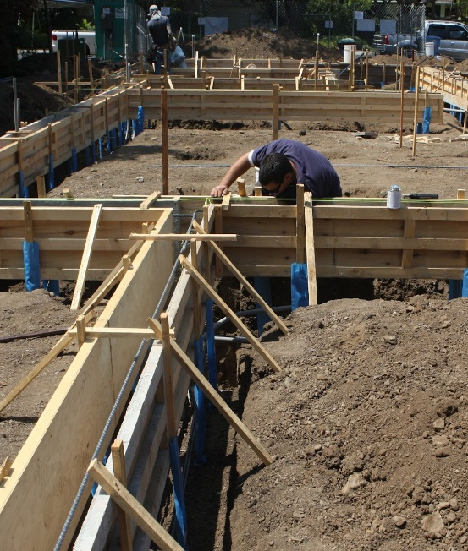
Our strategy is built on the “five betters”
Better
routine
Better campaigns
Better data & surveillance
Better
tools
Better partnerships & policy

Slide 3
Our strategy is built on the “five betters”
Better
routine
Better campaigns
Better data & surveillance
Better
tools
Better partnerships & policy

Slide 4
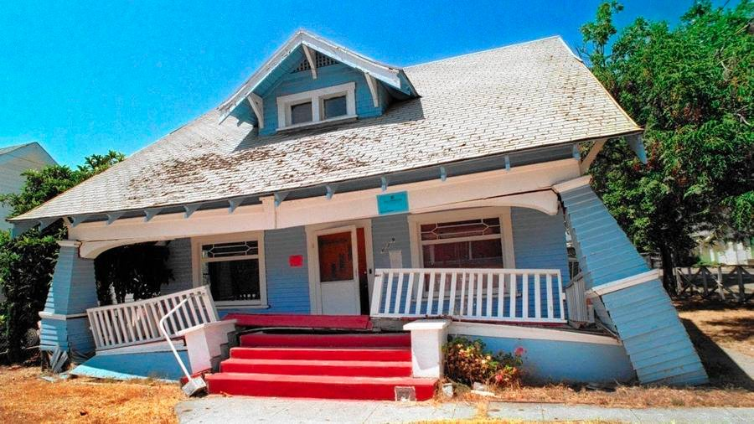
Our strategy is built on the “five betters”
Better
routine
Better campaigns
Better data & surveillance
Better
tools
Better partnerships & policy

Slide 5
The need for investment now in new approaches
Better
routine
  If we have learned anything from polio eradication, it is that we must invest in a diverse portfolio of tools early
  Some might fail, some might succeed, and some might prove essential
Better campaigns
Better data & surveillance
Better
tools
Better partnerships & policy

Slide 6
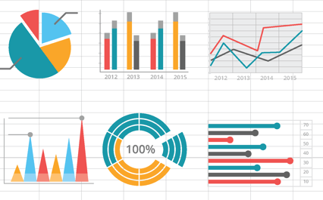
Innovations in data
  New WHO data system (WIISE)
Better
routine
  Improve data availability
Better campaigns
Better data & surveillance
Better
tools
Better partnerships & policy

Slide 7
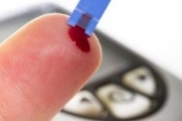
Innovations in data
  New WHO data system (WIISE)
Better
routine
  Improve data availability
Better campaigns
  Risk modeling
  Sero-epidemiology
Better data & surveillance
  Better define measles risk
Better
tools
Better partnerships & policy

Slide 8
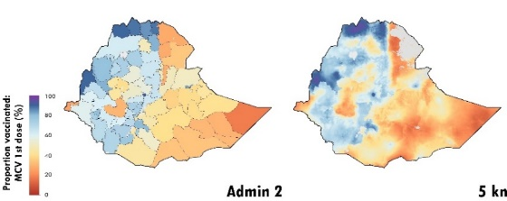
Innovations in data
  New WHO data system (WIISE)
Better
routine
  Improve data availability
Better campaigns
  Risk modeling
  Sero-epidemiology
Better data & surveillance
  Better define measles risk
Better
tools
  Coverage modeling
  Sub-national MCV1/2 coverage estimation
Better partnerships & policy

Slide 9
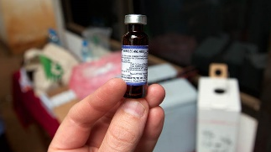
Innovations in program tools
Better
routine
  Diversify MR 10dv supply
  Additional suppliers
  Increase MR 5dv supply
Better campaigns
Better data & surveillance
Better
tools
Better partnerships & policy
Notes:
Nevoline - intensified & automated viral production system
VaxArray potency assay - tracks M/R antigen concentration through production (potential to replace current, e.g. TCID50)
DelSiTech - Development of liquid MR vaccine, using DelSiTech silica-based formulation
Vaccination tracking - MIT/Langer, NIR dyes injected in the skin that record vaccination history, plus reader. PFH to conduct a field study to determine cultural acceptability in Africa and Asia, and a non-clinical toxicology study

Slide 10
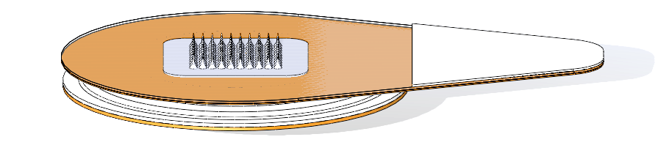
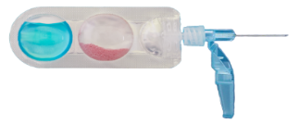
Innovations in program tools
Better
routine
  Diversify MR 10dv supply
  Additional suppliers
  Increase MR 5dv supply
Better campaigns
  MAPs
  Dual chamber devices
Novel MR delivery device development
Better data & surveillance
Better
tools
Better partnerships & policy
Notes:
Nevoline - intensified & automated viral production system
VaxArray potency assay - tracks M/R antigen concentration through production (potential to replace current, e.g. TCID50)
DelSiTech - Development of liquid MR vaccine, using DelSiTech silica-based formulation
Vaccination tracking - MIT/Langer, NIR dyes injected in the skin that record vaccination history, plus reader. PFH to conduct a field study to determine cultural acceptability in Africa and Asia, and a non-clinical toxicology study

Slide 11
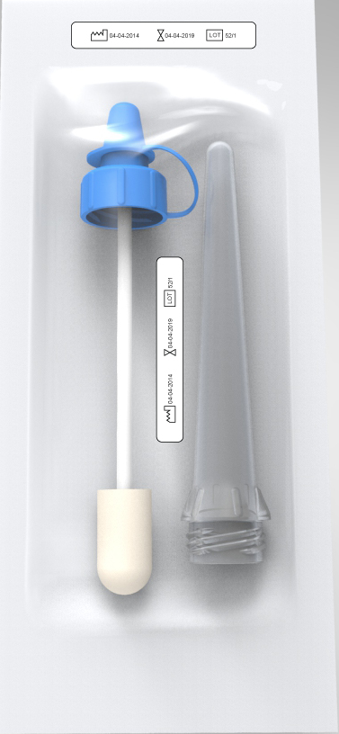
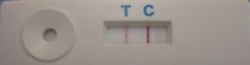
Innovations in program tools
Better
routine
  Diversify MR 10dv supply
  Additional suppliers
  Increase MR 5dv supply
Better campaigns
  MAPs
  Dual chamber devices
Novel MR delivery device development
Better data & surveillance
  PoC diagnostic test development
Better
tools
Better partnerships & policy
Notes:
Nevoline - intensified & automated viral production system
VaxArray potency assay - tracks M/R antigen concentration through production (potential to replace current, e.g. TCID50)
DelSiTech - Development of liquid MR vaccine, using DelSiTech silica-based formulation
Vaccination tracking - MIT/Langer, NIR dyes injected in the skin that record vaccination history, plus reader. PFH to conduct a field study to determine cultural acceptability in Africa and Asia, and a non-clinical toxicology study

Slide 12
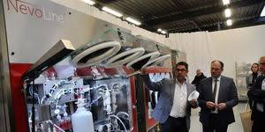
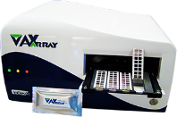
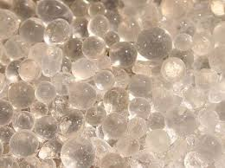



Innovations in program tools
Better
routine
  Diversify MR 10dv supply
  Additional suppliers
  Increase MR 5dv supply
Better campaigns
  MAPs
  Dual chamber devices
Novel MR delivery device development
Better data & surveillance
  PoC diagnostic test development
Better
tools
  Lower cost MR vaccine manufacturing
Better partnerships & policy
  Better tools learning agenda
Notes:
Nevoline - intensified & automated viral production system
VaxArray potency assay - tracks M/R antigen concentration through production (potential to replace current, e.g. TCID50)
DelSiTech - Development of liquid MR vaccine, using DelSiTech silica-based formulation
Vaccination tracking - MIT/Langer, NIR dyes injected in the skin that record vaccination history, plus reader. PFH to conduct a field study to determine cultural acceptability in Africa and Asia, and a non-clinical toxicology study

Slide 13

THANK YOU

