Slide 1



Myanmar March 2012
Mass Measles Campaign (2012)
Immunize all children
Eliminate measles

Slide 2
Notes about this presentation
Is a combination of slides
  Communications planning
  Monitoring results
    National
  Monitoring observations (in-process independent monitoring-C. McNab)
With thanks to Gov. of Myanmar, Dr. Vinod Bura, WHO Myanmar, and MMC partners.

Slide 3
Outline
What did Myanmar plan?
What did Myanmar do?
  Observations from monitoring
Results

Slide 4
Overall Reach
Grass Roots Level Movement
to Reach Out
6.4 Million Children 9 to 59 mos
for Mass Measles Campaign
22 -31 March 2012

Slide 5
What did they plan?

Slide 6
Key Communication Objectives
Inform about the dates of Mass Measles Campaign 2012
Apprise about where and how to avail immunization service
Motivate parents and caregivers to get their children (9 months to 5 years old) immunized

Slide 7
Key Communication Strategies
Advocacy with national/state/region decision/policy makers
Grass root movement – improved engagement of township leadership and village authorities
Focus on continuous and targeted interpersonal communication (IPC) for raising awareness and demand creation

Slide 8
Advocacy
Advocacy for high level commitment
  During preparatory phase, high-level commitment obtained from Ministries, Central/State/Regional level authorities and other partner agencies to support MMC.
A day-long workshop on enhancing awareness on Mass Measles Campaign for State and private print and broadcast media
Documentation of campaign achievements and activities
Media Field Visit for first hand reporting
Media Advisory and Press Release

Slide 9
The launching ceremonies
Launching ceremony at Nay Pyi Taw is planned for inauguration by Health Minster with the presence of international and national media
Launching ceremonies at the Central, State/Regional and Township levels with Chief Ministers; and other high authorities, children, celebrities and media
A briefing kit will be used as an advocacy tool at the launches

Slide 10
Social Mobilization
Organize social mobilization activities – to generate more visible sub-national commitment
Mobilize local authorities and related departments
Mobilize INGO, local NGO, FBO, CSO, CBO and VHW to have access to hard-to-reach areas/border areas and to coordinate outreach efforts
Mobilize faith leaders to discuss and agree on their role to address measles immunization in their respective communities

Slide 11
Interpersonal Communication
BHS and volunteers to take lead on:
Informing families/caregivers about the dates of the measles campaign
Mobilization activities in community

Slide 12
Grass Roots Level Movement
IPC training for BHS on communicating with families (combined with orientation for BHS)
TMOs and BHS to lead and NGOs/CBOs to support distribution of posters, banners and supervise IPC activities for raising awareness and demand creation
Announcement at schools – through school children to inform their families
Railway/bus station announcement
Send invitation cards to households with specific children’s names, date, time and vaccination place
Miking announcement one day before launch in wards and villages, churches, mosques and monasteries

Slide 13
Mass Media Channels
3-minute TV spot on MMC
Celebrities endorsement with those who have 9 months to 5 years old children
TV discussions/interviews
Radio programmes and messages

Slide 14
Communication package
Logo
Poster
Post banner
Billboard
Development of a campaign brand with exclusive theme and colour scheme
Advocacy kit
Training manual
Invitation card
Caps for volunteers
TV/radio spots and PSAs

Slide 15
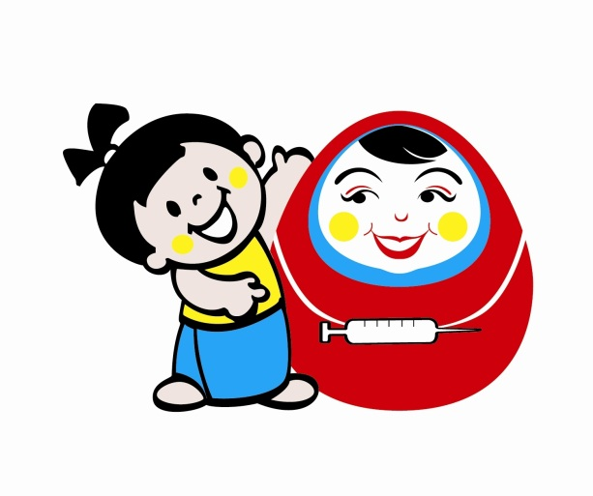
Campaign logo

Slide 16

Poster
Purpose:
Inform families about the campaign and the dates
Ask families to take all eligible children to the vaccination posts on campaign days
Sites for posters should include:
  Hospital/rural health centre/sub-centre
  Markets
  Tea shops /Cinema halls
  Pharmacies
  Bus/train stations/ ferry
  Transit points
  Construction sites

Slide 17

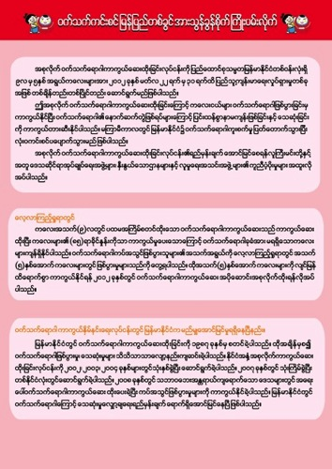
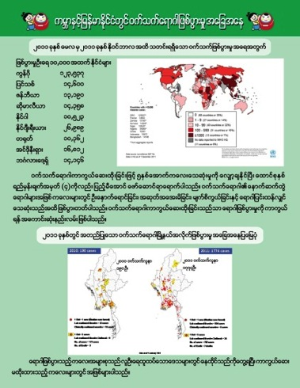
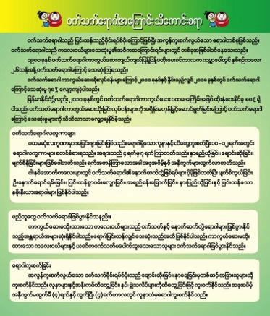
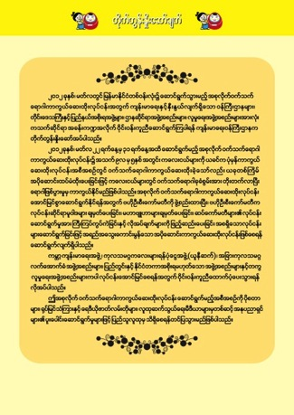
Advocacy folder
A full information kit including Fact Sheet and Q&A.
In English and Burmese language
Purpose: Advocacy tool to be distributed at launching ceremonies/ advocacy meetings / media workshop

Slide 18

Post banner
Purpose: Inform families where the vaccination post is
Ask families to bring children from aged 9 months to 5 years to the vaccination post
Ensure all vaccination posts have posted “Post Banners”.

Slide 19

Billboard
Quantity: 20 (NPT, State/Region major cities); Size: 12’ x 8’
Purpose: Mass awareness

Slide 20
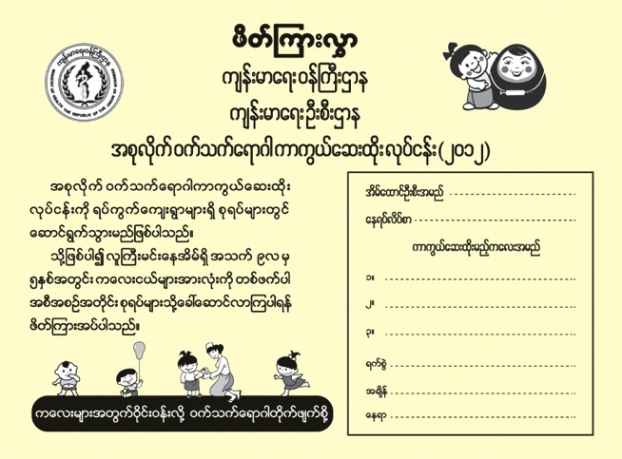
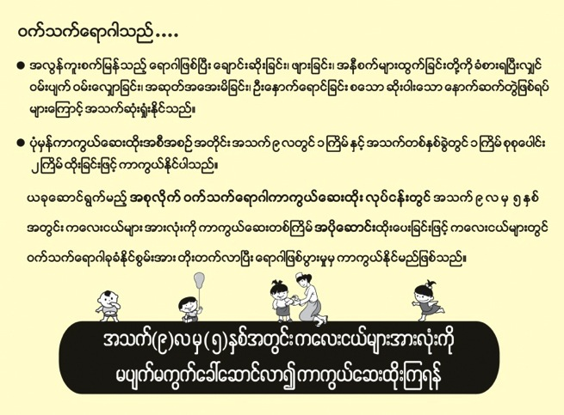
Invitation card
Front
Back
Quantity: 6.4 million
Purpose: Invite families to bring their children (from 9 mths to 5 years) to a vaccination post (place) at ….. (time) and on ….. (date)
Inform families about the measles, how to prevent and benefits of immunization
Ensure invitations are sent to every single household in country by H-H- visits 3-4 days prior to vaccination day and mid wife, village head informs the family

Slide 21
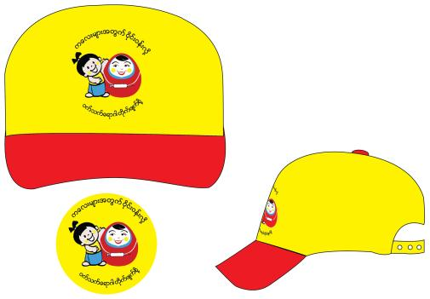
Other materials
TMO Guideline
Flip chart for training of Health staff and volunteers
Field Guide for BHS
Stickers
Caps for all Health workers
and volunteers

Slide 22
Monitoring & Review
Monitoring and review of impact of communication interventions will be part of overall monitoring process
Joint communication and programme review recommended at township/state/regional and national levels

Slide 23
INGO/ NGO meetings

Slide 24
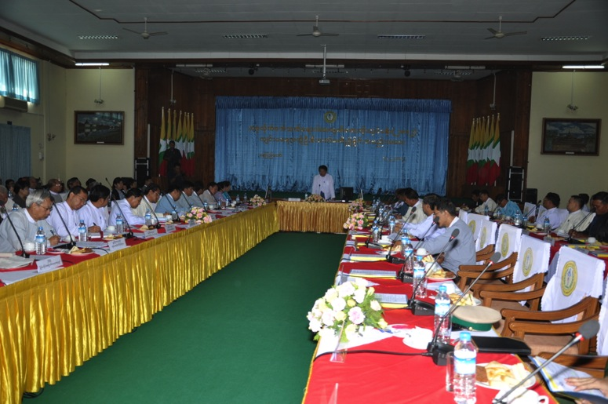
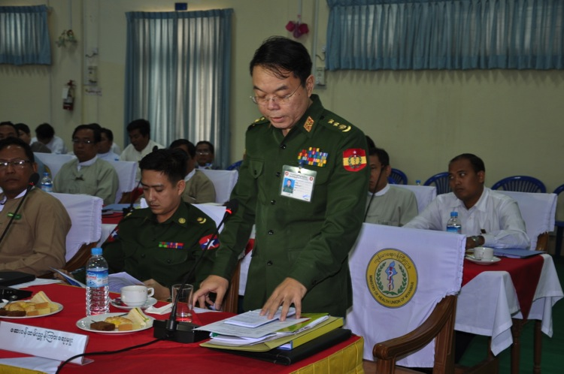
Central Executive Committee Meeting for Inter Department coordination Chaired by Health Minister
Health Minister Chaired the inter departmental coordination meeting , inviting all State Chief ministers, all department heads from all ministries of government of Myanmar

Slide 25
What did they do?

Slide 26

Joint monitoring of MMC at a Glance
9 international monitors from WHO SEARO/ India, Bangladesh, Nepal, GAVI, UN foundation & Measles initiative visited Myanmar to monitor MMC 2012
51 National staff from WHO/ UNICEF also participated

Slide 27
Joint monitoring of MMC at a Glance
All 17 states and regions of Myanmar monitored
99 townships monitored
554 posted observed
5432 house checked by monitors
6002 children checked by monitors during H to H visits

Slide 28
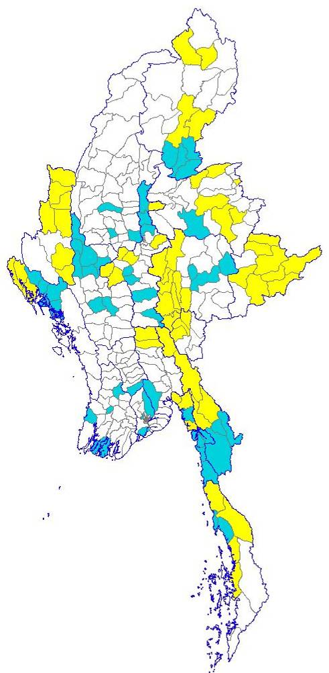
States, regions and townships
Monitored for MMC 2012
UNICEF
WHO

Slide 29
Trainings
Around 15,000 health workers and supervisors were trained before campaign on key technical issues, planning, injection safety , AEFI, Cold chain, Social mobilization
400 Medical officers TMO / SUDC / EPI managers from all provinces and townships were given comprehensive trainings on campaign planning and management by specifically designed tools.

Slide 30
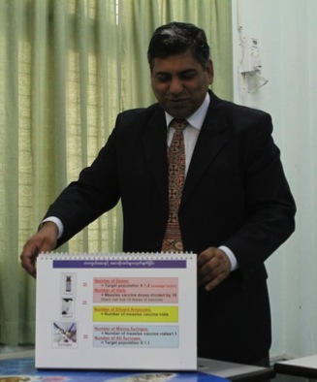
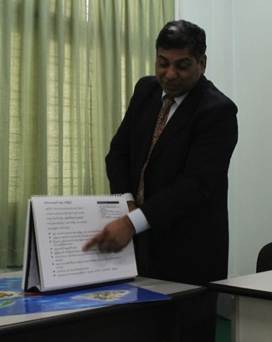
Training
Good use of cascaded training from national to regional and township levels
Excellent two-sided flipchart used nationwide resulting in standardized training at all levels
Side 1 clear info for trainees
Flipside 2
Clear instructions / info for trainers

Slide 31
Micro-planning
All teams had master list at all post
Most of master list was updated.
In few places master list was missing visiting family children or HRA children
All areas need to be mapped not only accessible areas.
Construction areas, plantation areas, mining areas etc were not clearly identified, highlighted in micro- plans

Slide 32
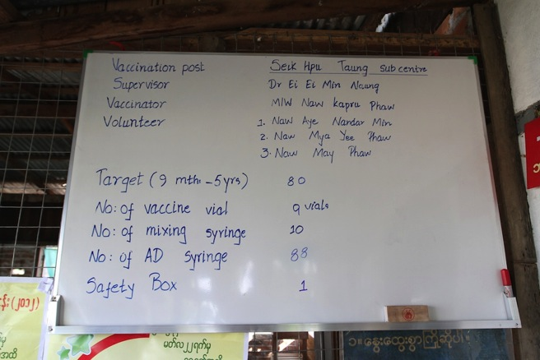
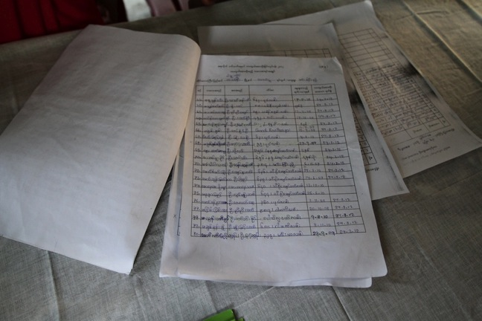
Planning Continued
Taungoo rural post lists daily personnel, TP, logistics
Daily master lists of families and children corresponding to invitations makes tracking, follow-up easy
Challenges:
Uneven use of these tools
Eg. One post had 3-day master list

Slide 33
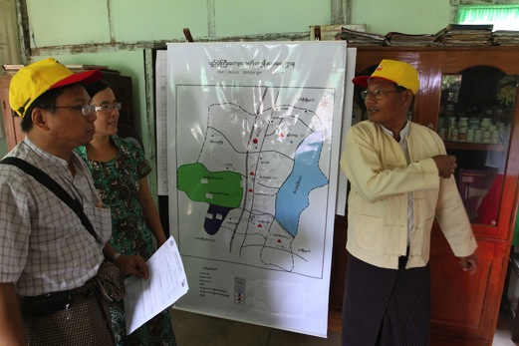
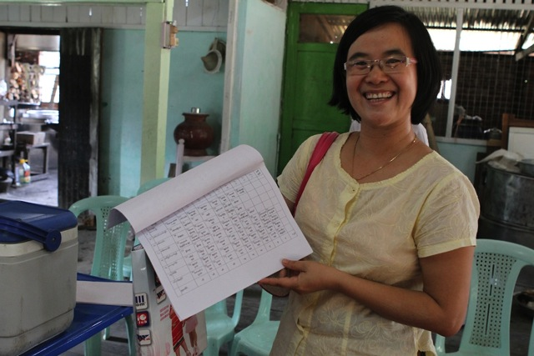
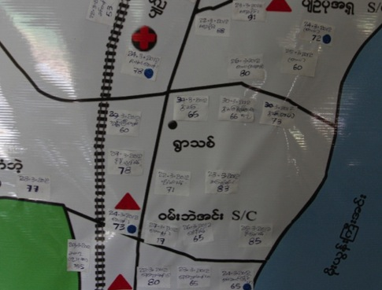
Microplanning
Microplan for Bago
HWs mark map in health post with booths, dates and TPs for MMC

Slide 34
Post organization
High turn out of community for vaccination
Well organized , orderly flow of children and caretakers
In some places festive atmosphere observed
Local authorities, volunteers role and participation highly appreciated
Transit post need to be increased and more proactive in future SIA

Slide 35
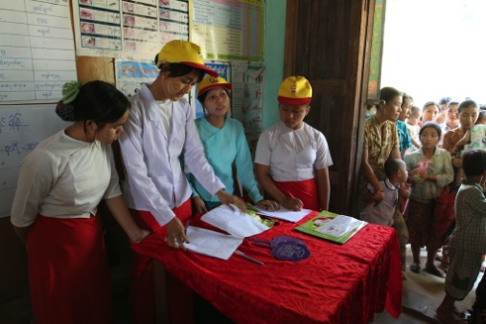
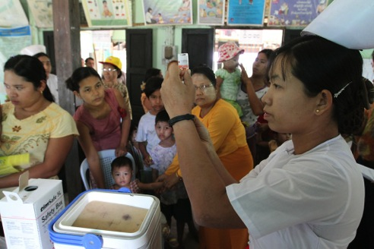
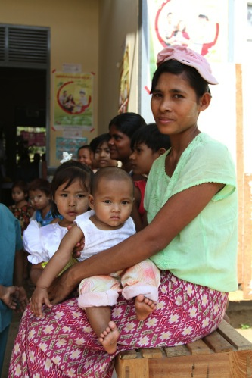
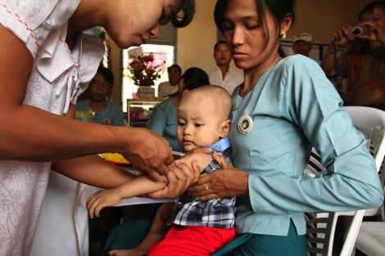
Booth Operations & Injection Practices
Good flow in every post observed from
1. screening/ registration…
2. Injection…
3. To resting for 30 minutes

Slide 36
Cold chain and Injection safety
Adequate no of logistics at all places
Well maintained cold chain
No pre filling of syringes
Vaccine administration in correct 0.5 ml at right site
Some health workers were observed giving Intra muscular injection
No re- capping observed
Safely box available and correct used universally
HW had good knowledge of AEFI

Slide 37
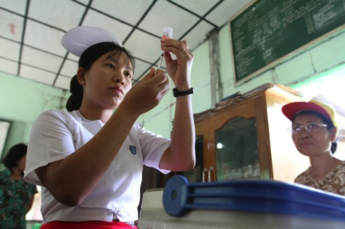
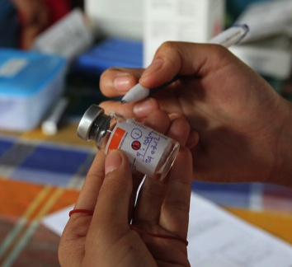
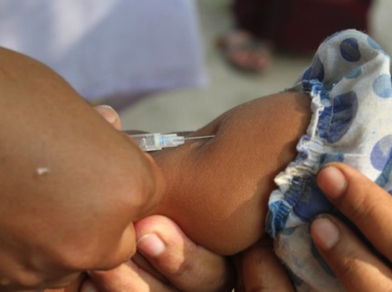
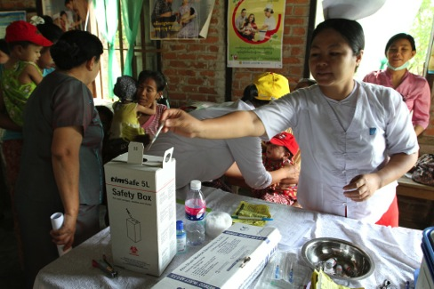
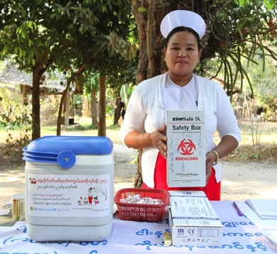
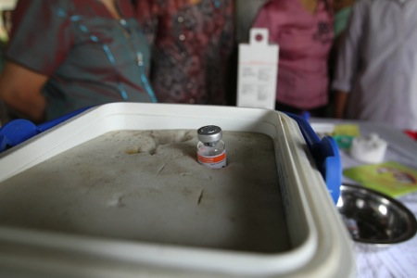
Booth operations/ injection practices
Monitoring: midwives scored 100% on injection practices.
V. good vial mngmt
Generally good 45° SC technique
Correct use of safety boxes
Storage; filling 1 per time

Slide 38
Vaccine and logistics
No shortage of vaccines /logistics observed
Wet ice used at many locations
AD syringes, mixing syringes Safety boxes and reporting formats in place
Vaccine buffer stocks at Township or RHC was not adequate

Slide 39
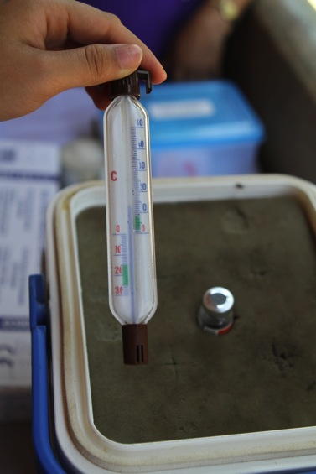
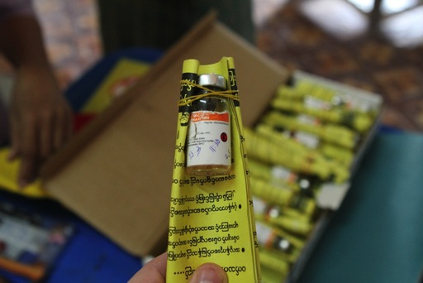
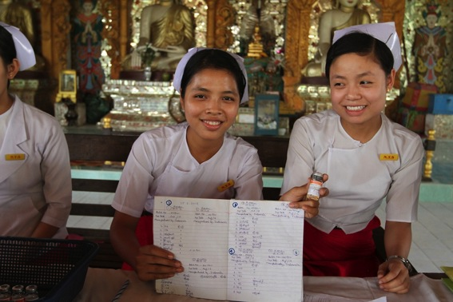
Booth Operations/ Injection Practices
Some challenges with temperature despite good use of ice packs. VVMs showing no cold chain problems.
Impressive meticulous association of vaccine vial with child. Bago rolled invitations around vial. Taungoo kept records in a notebook.

Slide 40
AEFI Management
All health workers were trained on AEFI Management
Teams carried medication for anaphylaxis ( anti shock kits)
Health workers were seen asking parents to wait to 30 min after vaccinating to handle any AEFI
Close monitoring of AEFI cases and reporting. No major AEFI reported during campaign

Slide 41
Supervision
Pre campaign supervision needs to strengthened for corrective actions
TMO should be encourage to conduct RCA during and after activity
Supervision for migrant families, peri- urban settlements, and other high risk areas need improvement

Slide 42
Social Mobilization
Use of invitation cards found to be very effective and well appreciated by families
Posters, Banner seen at most of place and effectively used
Volunteers from Red cross, MMCWA, teachers, other department volunteers were actively engaged at vaccination post
Nursing students participation is a positive step
Media played a very important role,
  Media training was done well in advance ( print, electronic and Radio)
  New on measles campaign two weeks before SIA , daily coverage of achievements, appeal for left out parents
  Only positive new

Slide 43
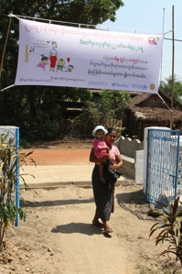
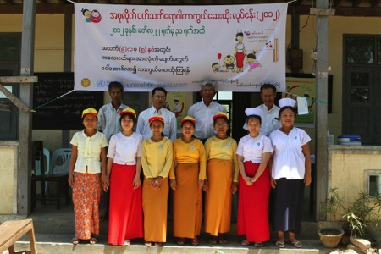
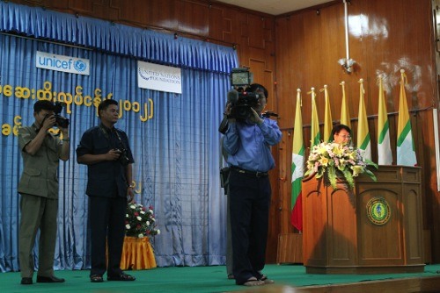
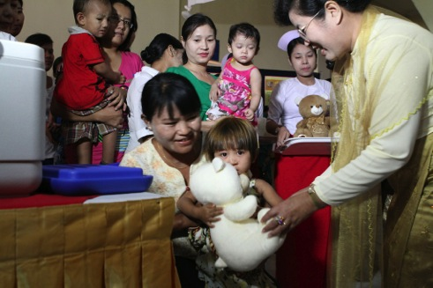
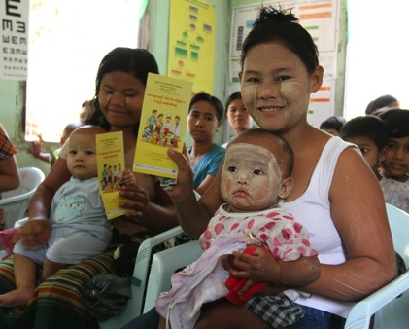
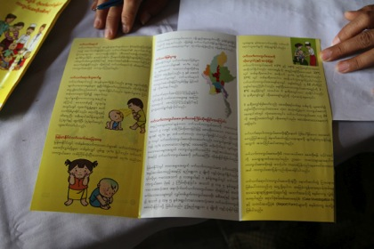
Social Mobilization
V. good post visibility
Launch event = national publicity.
TV and Radio also had impact (esp. TV in urban areas)
V. Good IEC materials
Challenge: Not available at all posts

Slide 44
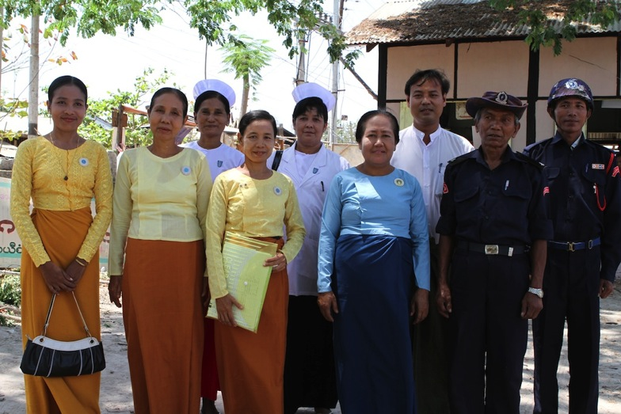
Advocacy, Partnership & Social Mobilization
Excellent partnership between midwives, the “yellow” and “blue” NGOs, INGOS and Village Leaders (in white in this photo)
Excellent collaboration with National Pediatric Association

Slide 45
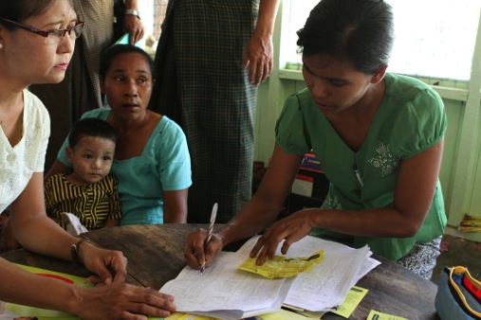
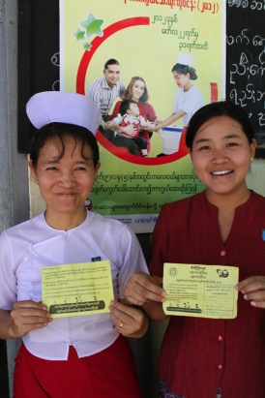
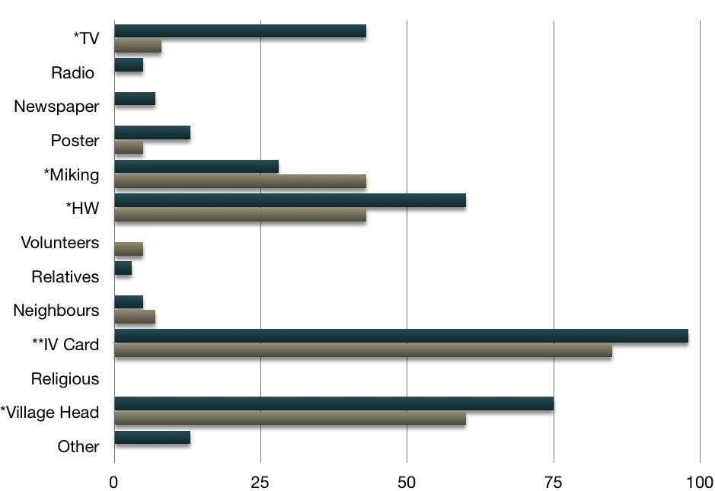
Monitoring in Taungoo
RCA: Source of Knowledge
Blue = urban
Brown = rural
Widely observed: volunteer corresponds invitation card to master list
In both rural & urban settings, RCA showed IPC (Village Head and Health Workers) with invitation cards most important social mob.

Slide 46
Coverage among monitored children
Around 5402 house visited
Around 6000 children checked randomly
97% of these children were found vaccinated during MMC
Many children received measles vaccine first time.
Miking , invitation card and Health worker were the main source of information

Slide 47
National: Source of information

Slide 48
Media

Slide 49
Conclusion
Government of Myanmar demonstrates very high committed to the MDG4, GIVS and Measles elimination
Myanmar health workers are highly committed and dedicated towards EPI program
Community trust in EPI program is very high
Myanmar measles campaign in March 2012 has helped to reduce immunity gap among children under 5 and prevent measles related morbidity/ mortality
Immunity gaps still persist in high age group above 5 and some out break may continue in near future, MOH and partners should carefully review Measles program to plan additional interventions to close immunity gap in high age groups

Slide 50
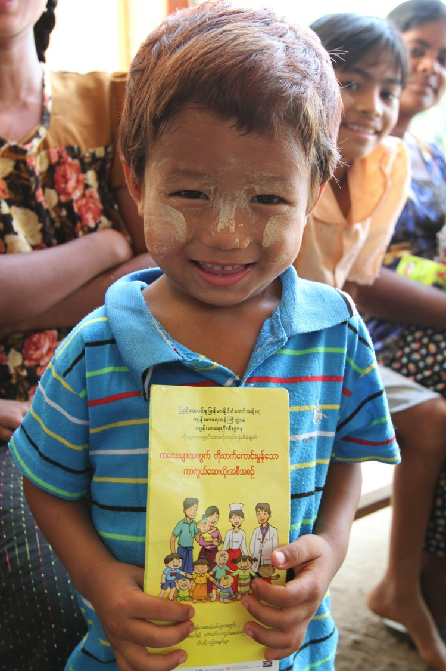
Thank you.

