Slide 1
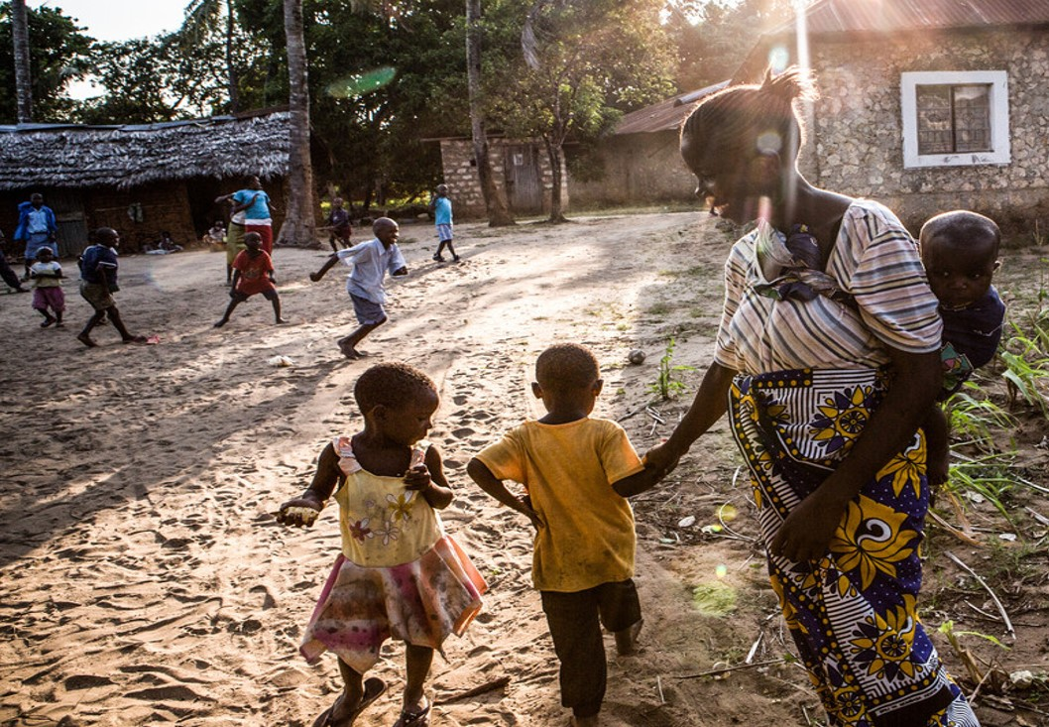
Looking ahead: Gavi 5.0
Dr. Khin Devi Aung
Senior Programme Manager, Gavi
M&RI Partners’ Meeting
Washington DC, 10-11 Sep 2019
Reach every child

Slide 2
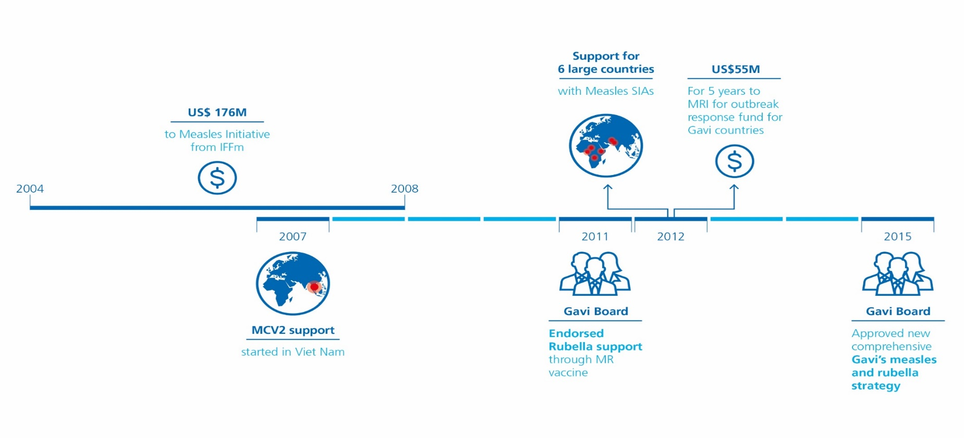
Gavi’s Measles and Rubella strategy approved by the Gavi Board in 2015
To date, Gavi has disbursed $1.2 Billion for measles and rubella

Slide 3


Gavi 5.0 (2021-2025) will be critical for Alliance’s new 2030 aspiration
Vision
Leaving no-one behind with immunisation
To save lives and protect people’s health by increasing coverage
and equitable use of vaccines
Mission
Set of principles
1
2
3
4
Ensure healthy markets for vaccines and related products
Goals
Strengthen health systems to increase equity in immunisation
Improve sustainability
of immunisation programs
Introduce and
scale up vaccines
Enablers

Slide 4
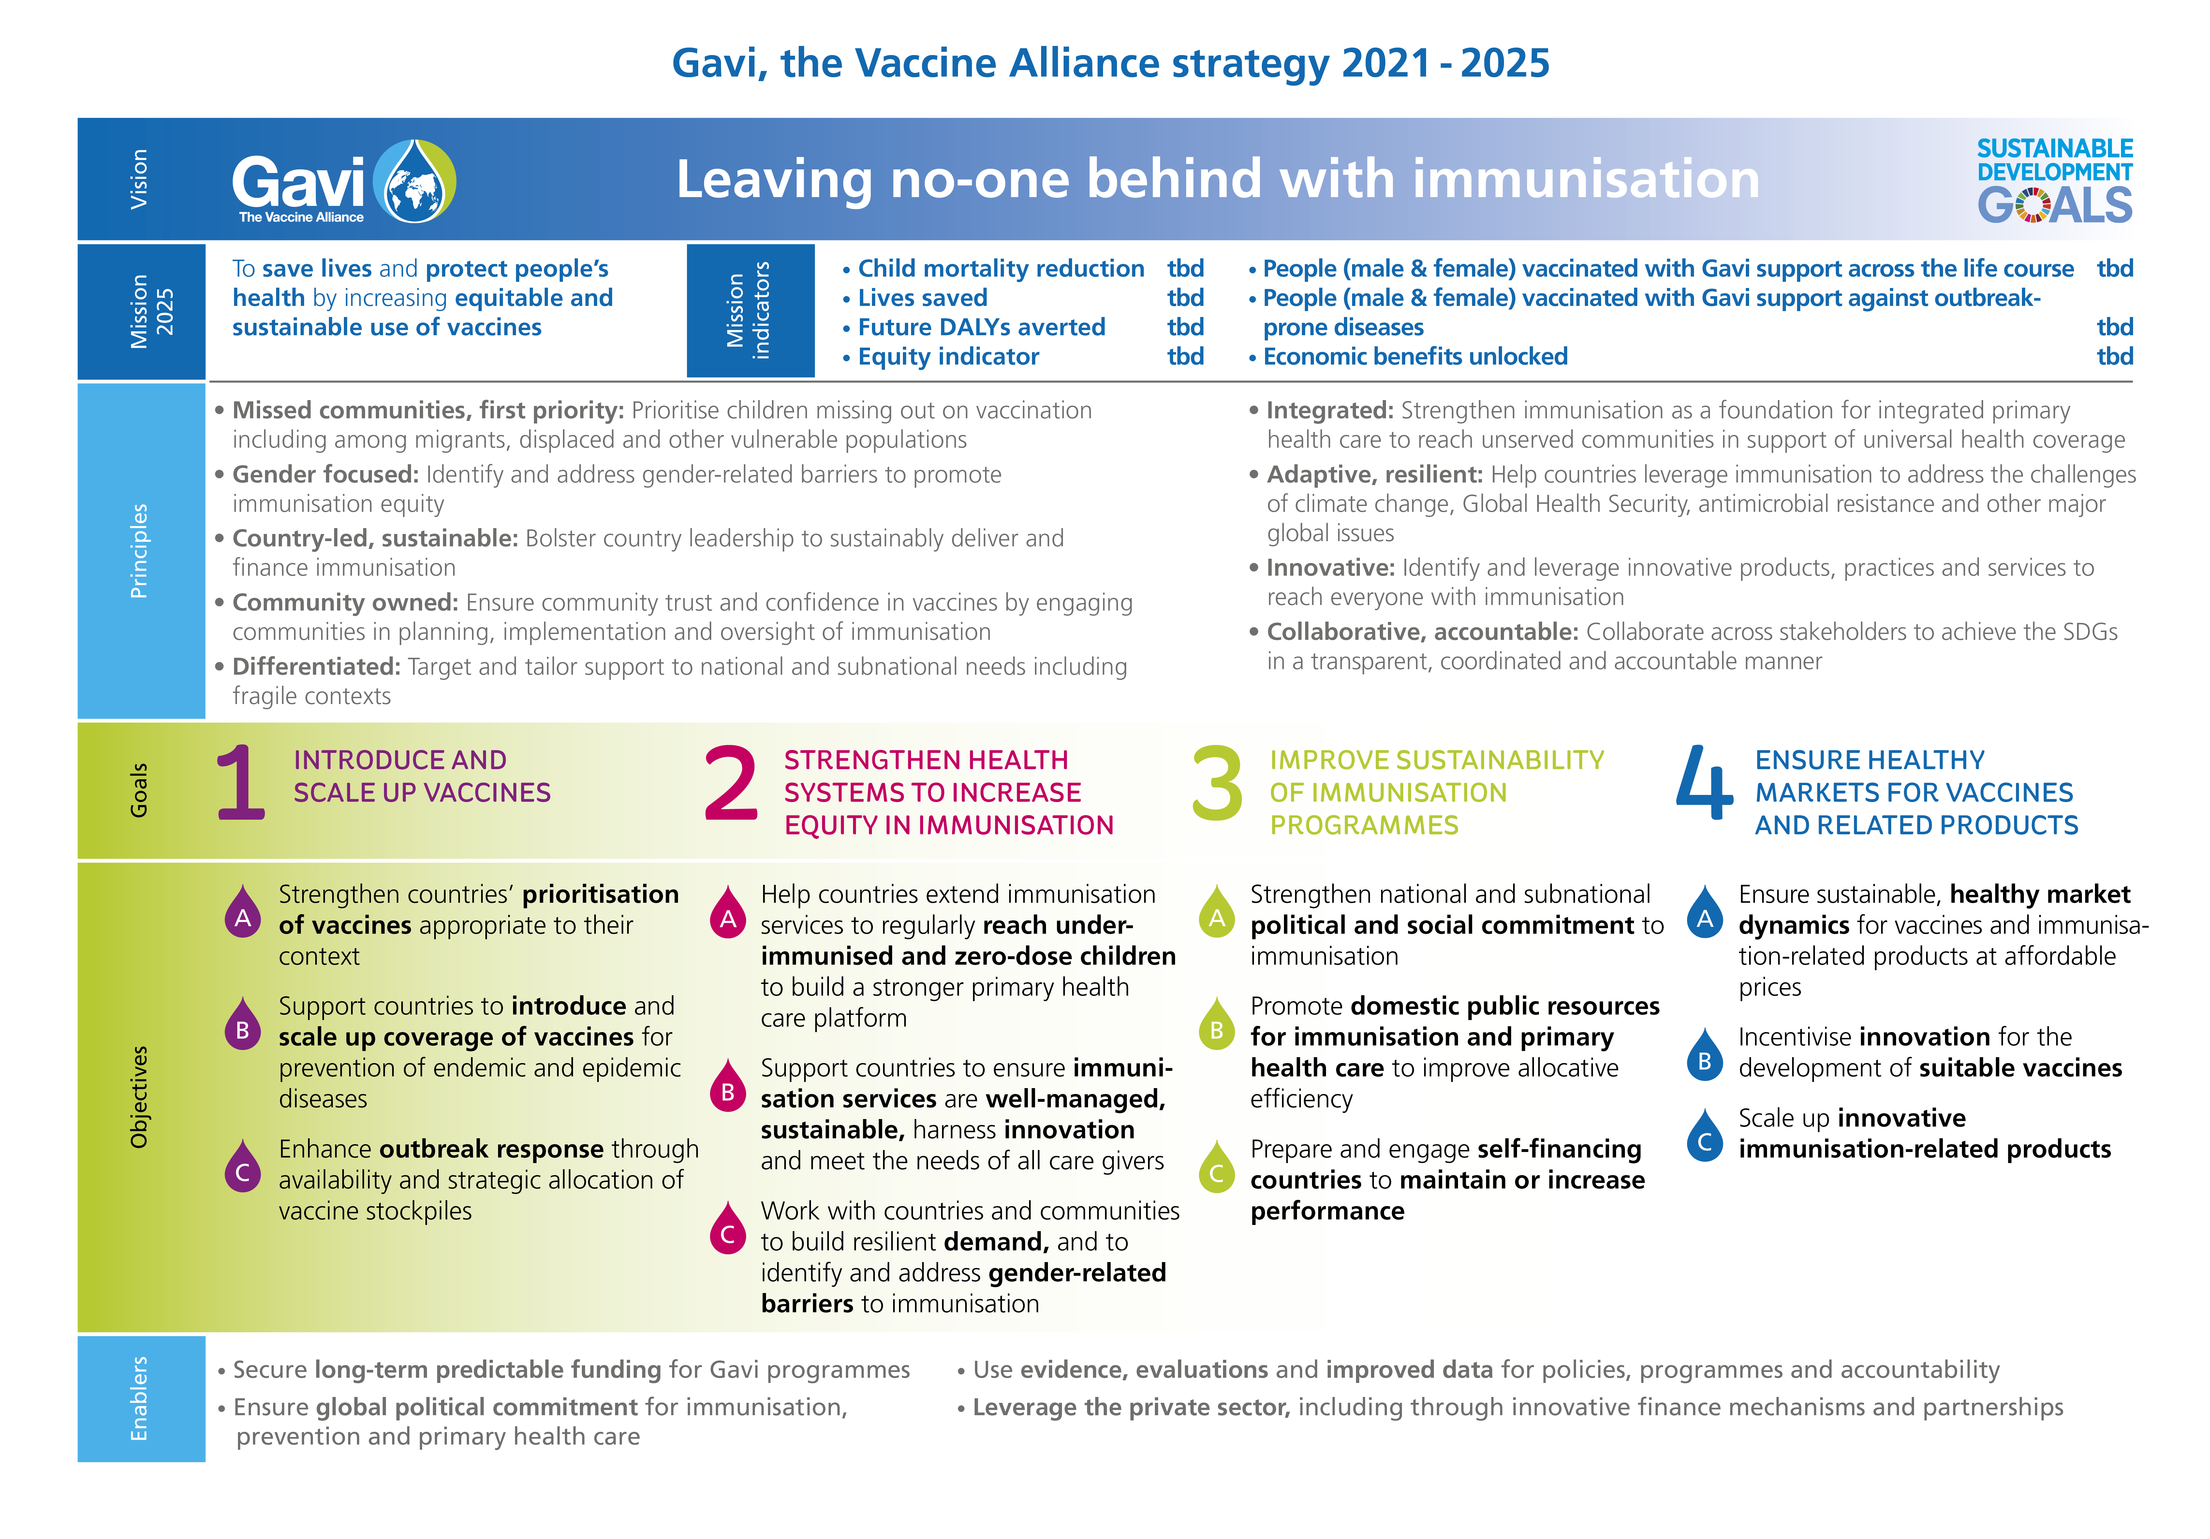
Gavi 5.0: focus on equity and reaching zero dose children, with differentiated, tailored and targeted approaches

Slide 5









9 guiding principles for the new strategy
Missed communities, first priority
Gender focused
Country led, sustainable
Community owned
Differentiated
SET OF PRINCIPLES
Integrated
Adaptive, resilient
Innovative
Collaborativeaccountable

Slide 6
Goal 1: Introduce and scale up - support countries in prioritising the most appropriate vaccines
1
Beyond 2020: new vaccines on the horizon
2018
2021/22
2023
INTRODUCE AND SCALE UP VACCINES
Rabies
Multi-valent Mening.
Endemic
Cholera
RSV
DTP boosters
Hep B birth dose
Malaria
(RTS,S)
e.g.
2nd gen TB
e.g. HIV
Vaccines conditionally approved in VIS 2018
  Important, new diseases in pipeline

Slide 7
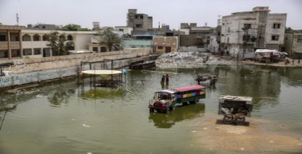

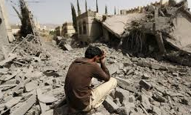
Goal 2: Strengthening health systems- Increasing equity in immunisation delivery will be the priority with intensified focused on hard to reach
2
Hard to reach / zero-dose children are often in…
Urban slums
By 2050 an additional 1.25bn people in Asia
and an additional 0.8bn people in Africa will be in urban areas
STRENGTHEN HEALTH SYSTEMS TO INCREASE EQUITY IN IMMUNISATION
Remote communities and nomadic populations
Conflict settings
doubled number of conflicts since 2010 worldwide
(from 60 in 2010 to >100 in 2015)

Slide 8
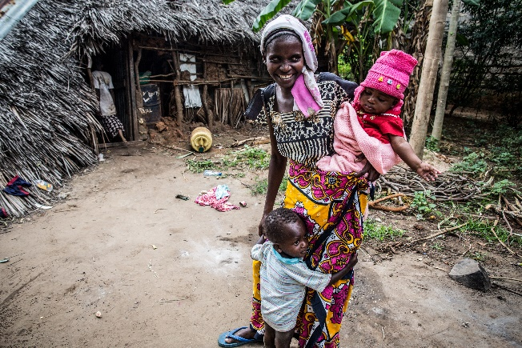
Reaching marginalised propulations will require strengthened programmatic approaches
2
Gender
Service
delivery
STRENGTHEN HEALTH SYSTEMS TO INCREASE EQUITY IN IMMUNISATION
Demand
Supply chain, data, leadership and workforce, political will

Slide 9




Gavi 5.0 portfolio will become increasingly differentiated
2
Cambodia:
“Strong performers”
Guinea:
“Weak systems”
Ethiopia:
“Large Countries”
South Sudan: “Conflicts
/ Highly challenging operating environment”
STRENGTHEN HEALTH SYSTEMS TO INCREASE EQUITY IN IMMUNISATION
DTP3 COVERAGE
DTP3 COVERAGE
DTP3 COVERAGE
DTP3 COVERAGE
93%
45%
73%
26%
GEOGRAPHIC EQUITY
GEOGRAPHIC EQUITY
GEOGRAPHIC EQUITY
GEOGRAPHIC EQUITY
78%
76%
78%
30%
BREADTH OF PROTECTION
BREADTH OF PROTECTION
BREADTH OF PROTECTION
BREADTH OF PROTECTION
67%
17%
37%
7%
Effective Vaccine Mgmt
Effective Vaccine Mgmt
Effective Vaccine Mgmt
Effective Vaccine Mgmt
68%
40%
65%
39%
In line with its high ambition of reducing the number of under-immunised children, the Alliance will differentiate its support model across varying country contexts

Slide 10
3
Goal 3: Sustainability- GNI & programmatic readiness will drive transition out of Gavi support
100% vaccine cost
Accelerated
transition
Country co-financing level
IMPROVE SUSTAINABILITY OF
IMMUNISATION PROGRAMMES
Preparatory
transition
Initial self financing
  End of Gavi financing
  5 years
  Variable
  duration
  Variable duration
GNI criteria but also programmatic readiness

Slide 11
More deliberate engagement in former Gavi eligible MICs could be extended to select never eligible MICs
3
Accelerate key missing vaccine introductions
Strengthen immunisation programme and prevent backsliding
Goals
Advocacy & political will building
Market shaping
Technical assistance
IMPROVE SUSTAINABILITY OF
IMMUNISATION PROGRAMMES
The Alliance’s three levers of support
Strengthen countries’ political commitment to immunisation and new vaccine introductions
  Pooled procurement - tender mechanism pooling countries’ demand
Strengthen decision-making, regulatory processes and immunisation know-how
Support to former and never Gavi eligible MICs to be catalytic only, helping countries maximise the impact of domestic investments

Slide 12

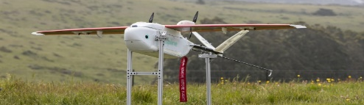

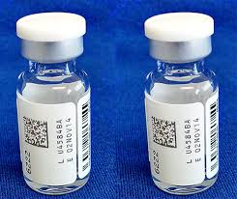


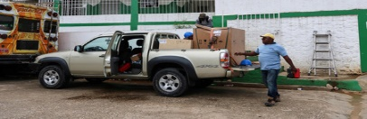
Goal 4. Healthy markets - continue to invest in innovation across practices, services and products
4
Services
Practices
Products
Private sector partnerships
ENSURE HEALTHY MARKETS FOR
VACCINES AND RELATED PRODUCTS
Barcode labelling of vaccines
The Alliance will develop a more purposeful approach to promote transformational innovations to help deliver on Gavi’s equity ambition

Slide 13
Operationalisation of Gavi 5.0: key areas of work post Board approval of strategy one-pager
Policies
Portfolio Management Processes
Partnerships
Programmatic Approaches
Innovation
Measurement & Accountability
1
2
3
4
5
6

Slide 14
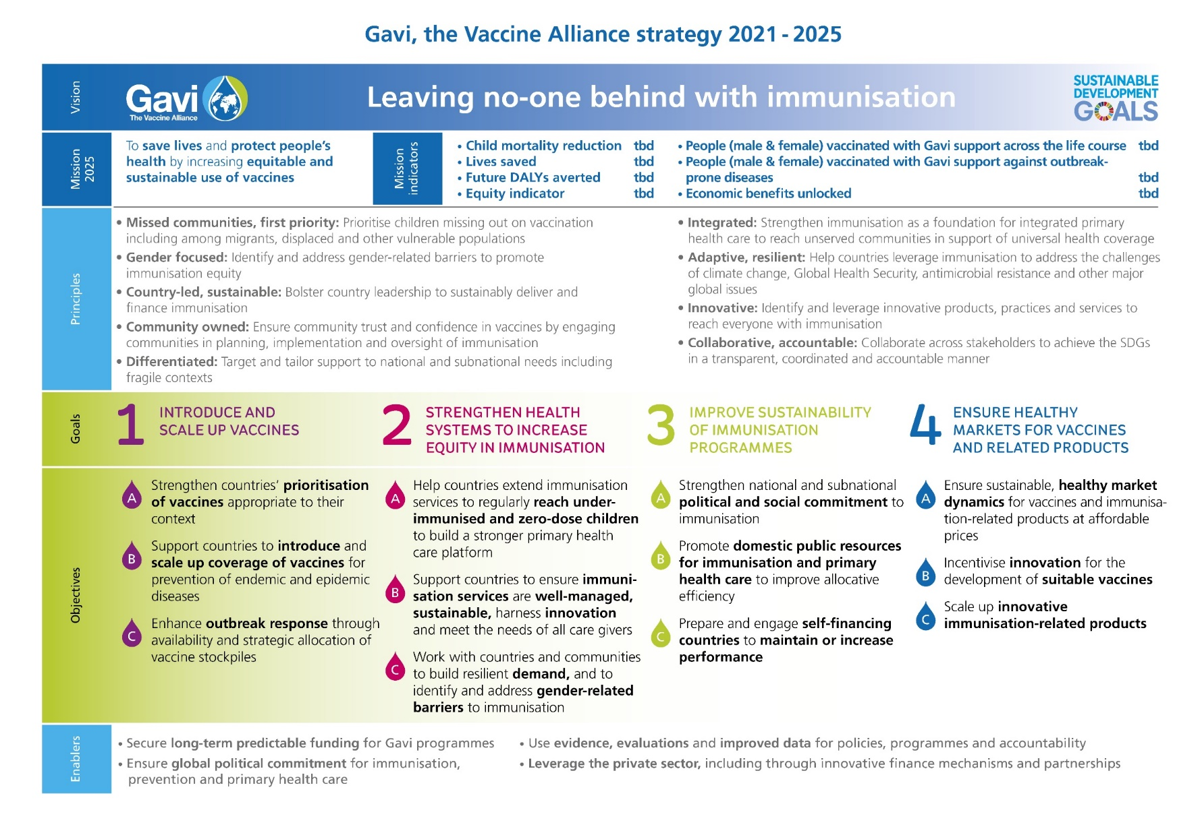

Slide 15
Thank you

