Slide 1

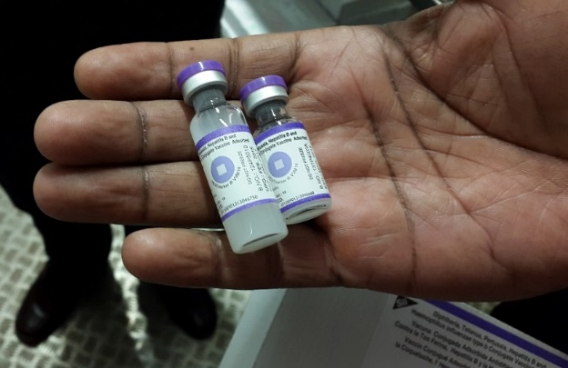
Measles Rubella Meeting
22nd June, 2016
Dr. Craig Burgess, JSI

Slide 2

Overview
Multi Dose Containers (MDCs): framing the issue & trade offs considered
Phase 1: April – Oct 2015
Phase 2: Dose Per Container Partnership (DPCP) Nov 2015 – December 2017
Broader context

Slide 3
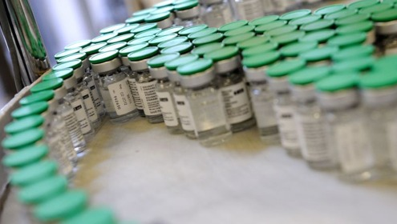
Framing the issue
DPC changes impact system
performance
MDC can decrease price &
cold chain storage
But: new vaccines > expensive:
may increase reluctance to open
vial for every child
More evidence needed for global & country decisions on DPC trade-offs between costs & system impacts (coverage)

Slide 4
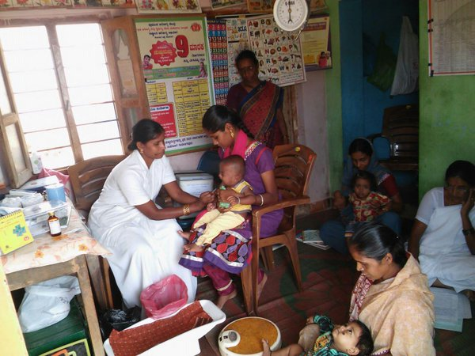
Phase 1: April – Oct 2015
Summarizing evidence gaps: Evaluation of existing data and highlighting gaps in data and processes for decision making
Methods: Literature review, informal surveys, key informant interviews, and stakeholder meeting
Partnership: Creation of informal network of interested partners
Notes:
Funder, implementer, output

Slide 5
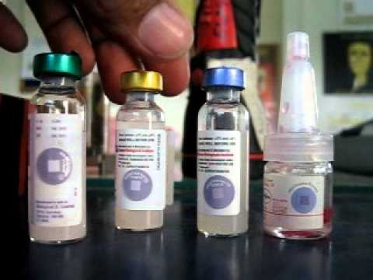
MDC trade-offs considered for assessment
Evidence to better understand & inform decision making:
Price per dose purchased
Cost & impact on health system (coverage)
Supply / cold chain / volume per dose
Decision on when to open / risk of contamination
Wastage rate
Shifting burden to HCW
Communication

Slide 6
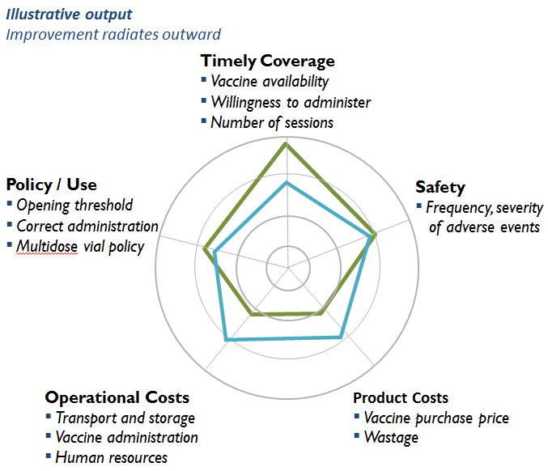
Illustrating trade offs
Total system effectiveness analysis provides a framework for evaluating trade-offs of a vaccine or intervention.

Slide 7
Phase 2: DPCP Nov 2015 – Dec 2017
Gather data and document current practices / policies / systems for deciding how many doses per container
Changes in system:
Coverage (equity, timeliness, session size)
Wastage rates
Cost benefit
Safety
Cold Chain, Supply Chain and distribution capacity
Healthcare worker behaviour & needs
Document effect of these changes
Changes in Doses per Container:
Tanzania & Senegal
MR & Birth dose HepB
# dose per vial
Evidence used to:
Inform global processes & supply for doses per container (multiple antigens)
Country level guidance & tools: produce a simple and easy to use tool that outlines the tradeoffs that are considered when making product selection decisions, demonstrates best practices and guides decision makers for product forecasting, planning, selection and ordering

Slide 8







Phase 2: DPCP Partnership

Slide 9
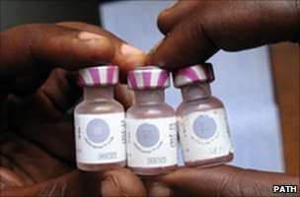
Work Stream 1
Document & assess national policies and processes for decision-making, including product selection, quantification, ordering, and financing
2 country case studies to understand historical decisions
Key stakeholder interviews
Looking at existing tools to inform decision making
Documentation of when and how DPC is part of regular processes

Slide 10
Work Stream 2
Prospective implementation research
 | SENEGAL | TANZANIA
Antigen | Hep B @ birth (co-coverage BCG) | Measles-Rubella @ 9 & 18 months
Vial dose change | 10 (liquid - Crucell) to 1 (liquid - LG Life Sciences) | 10 (lyophilized - SII) to 5 (lyophilized - SII)
Districts / Sample Size | 2 regions: 8 districts (4 control; 4 intervention) 125 HFs (62 in control arm; 63 in intervention arm) | 3 regions: 7 districts 246 HFs (123 in control & 123 HFs in intervention arm)
Vaccinated target population | 40,627 | 130,000
Lead | PATH and MOH | JSI and MOH

Slide 11
Work Stream 2
Prospective implementation research
Systems aspects | Vaccine purchase costs, cost per dose and total systems costs, equitable & timely coverage, open vial vaccine wastage, immunization session & frequency, logistics storage & distribution capacity & costs, missed opportunities, drop out rate, safety & HCW behavior.
Methodology & tools | 12 month retrospective data collection. Field based implementation research with one intervention and one control arm. Pre- and post- cross sectional design to measure difference in qualitative and quantitative indicators between arms. Key informant interviews, observing HCW behavior, registers, data collection tools, cold chain assessment, registers & quantitative data collection tools.

Slide 12
Work Stream 2
August 2016: baseline data collection
September 2016 – August 2017: implementation / introduction & monitoring new presentation
September 2017: end line data collection

Slide 13
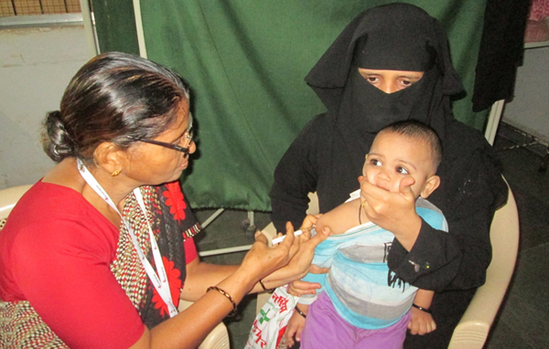
Work Stream 3
Coordination: partners, links to others (eg. CDC, industry)
Modeling: with HERMES & others
Communication: website, results, TechNet, GIN, via partners & TAG
Cost benefit
Technical Advisory Group (TAG): broad range of 8 individuals, objective strategic guidance (incl. WHO / UNICEF SD / GAVI / industry & countries)

Slide 14
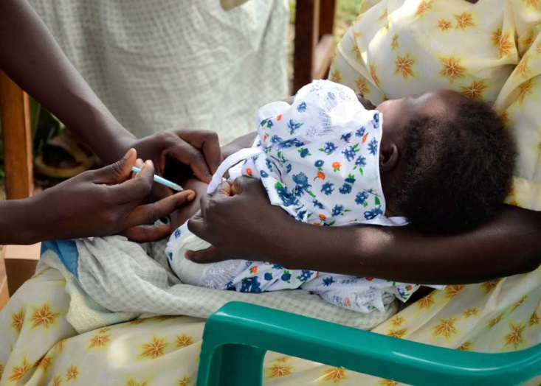
End Results
Global stakeholders: evidence filling critical knowledge gaps in analysis and policy making processes, guiding stakeholders to make informed, sustainable decisions on DPC when considering vaccine products and program designs
Country stakeholders: Produce easy-to-use and -understand guides & tools to assess DPC tradeoffs, including cost and systems impact to inform vaccine product selection.

Slide 15
Broader context
Ethiopia study
Wastage studies: Cambodia 2013 & Nigeria 2012 (issues on MCV MDVP), Ghana and possibly Fiji
HERMES Benin / Mozambique MR / BCG / penta vial size: wastage & supply chain
Industry impact

Slide 16
References / contacts
TechNet Dose per Container Partnership Group
www.technet-21.org/en/network/groups/item/196-dose
Sarah Melendez (sarah_melendez@jsi.com)
Craig Burgess (craig_burgess@jsi.com)
JSI website www.jsi.com/immunization

