Slide 1
Increasing awareness of MCV wastage an update on WHO vaccine wastage Model
Geneva, June 2016
S. Kone, WHO/IVB/EPI

Slide 2
Purpose of this Presentation
Review factors influencing vaccine wastage
Highlight why this is relevant to measles elimination
Tell you about two tools on estimating vaccine wastage (Model and Mobile Application)

Slide 3
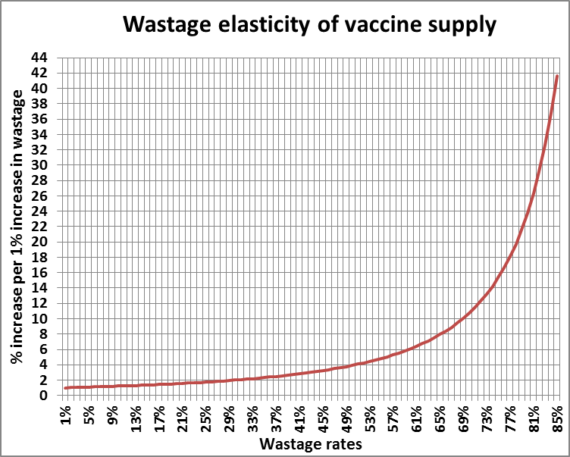
Why vaccine wastage matters?
Vaccine supply
  Impacts exponentially supply
  Inflates capacity of infrastructures
  Challenges sustainability
  Loss of investment
  Alliterates donors trust
Coverage & equity targets
  High potential impact on service delivery (stock-outs, miss-opportunities)
  Loss of public confidence in vaccines & health services
  AEFI & false sense of protection

Slide 4
Why vaccine wastage matters to
Measles Elimination?
Nearly all countries use 10dv
Can’t use MDVP
Only 1 or 2 dose schedule (means lower number of doses administered per session compared to many other vaccines)
Need very high coverage to eliminate measles; can’t afford stock-outs or missed opportunities
Measles second dose assessments and outbreak investigation have revealed that HCW may be reluctant to open 10dv because of fear of running out of vaccine or fear of wastage.

Slide 5
How do we estimate vaccine wastage?
Supply chain structure
  Number of levels
  EVM limits
Type of wastage
  Unopened/closed vial
  Opened (multi-dose) vial
Service delivery pattern
  Session size (#doses administered)
  Frequency (how often)
WHO vaccine wastage Model (under IPAC)
Closed vial wastage, based on supply chain levels and EVM maxi limits
Opened (multi-dose) vial, based on vial presentation, status of MDVP and session size and frequency
Handling & administration conditions of opened vial during and after session

Slide 6
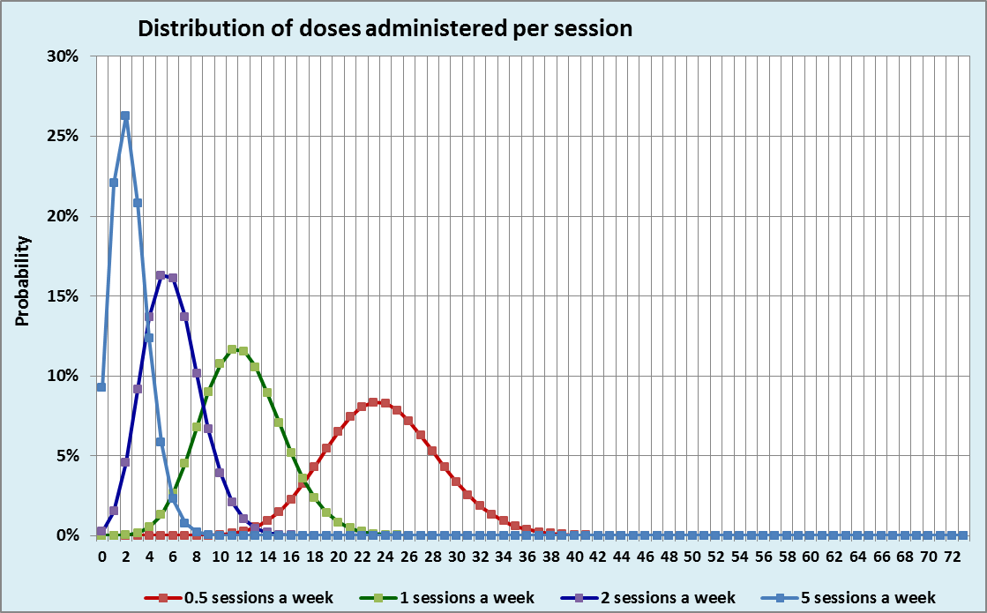
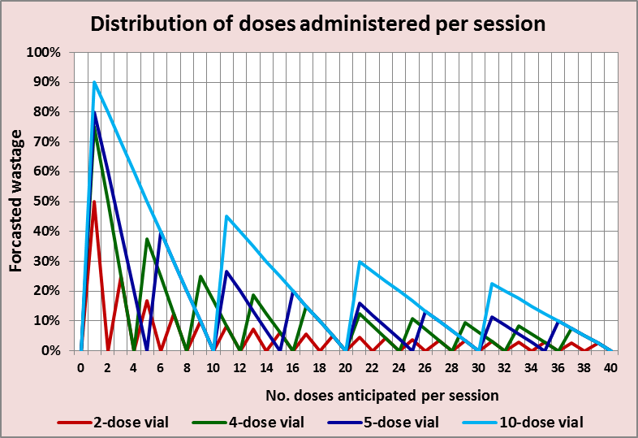
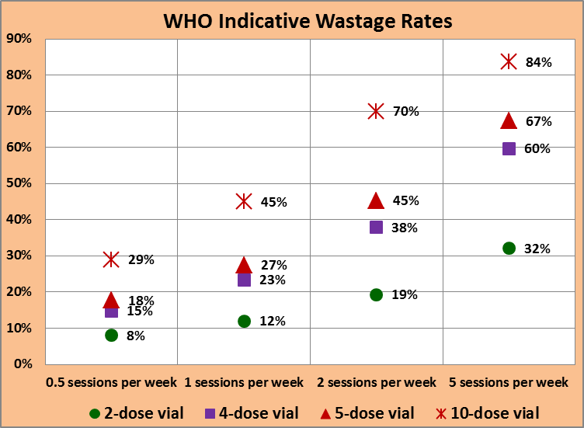
WHO vaccine wastage model
Binomial distribution of no. of doses administered per session based on:
  Size of target population
  Frequency of session
  No. of doses per target
Doses of vials opened to be discarded at end of session depends on:
  Vial size
  Status of MDVP
WHO indicative wastage defined as:
  Product of binomial distribution by wastage
  Factor of no. levels in supply

Slide 7
The use of the model
Policy setting
Assessing impacts of policy settings (selecting vaccines) and organizing services (frequency of sessions),
Matching expectations with policies
Adequacy of supply
Accurately forecasting vaccine needs
Defining safety stocks to avoid stock outs
Supplying adequate quantities in supply chain
Service delivery
Assessing organization and implementation of services according to the policy
Monitoring services and consistency of data
Ensuring quality of data

Slide 8
Mobile Application background
A Mobile Application is currently under development
The Application is designed to be used by district managers to facilitate supportive supervision related to vaccine supply, wastage, and practices.
HF-specific information is input and provides an estimate of expected wastage in that HF. This may help the supervisor and HCW understand – for example:
  How much wastage is expected in given HF
  If enough safety stock has been given to vaccinate according to policy
  If wastage is lower than expected, the supervisor may inquire about vaccination practices and reassure HCW to vaccinate according to policy (or increase safety stock if needed).
  If wastage too high, investigate factors (volume is lower than expected), may need to adjust session frequency (according to national guidance).

Slide 9
Demo wastage mobile application

Slide 10
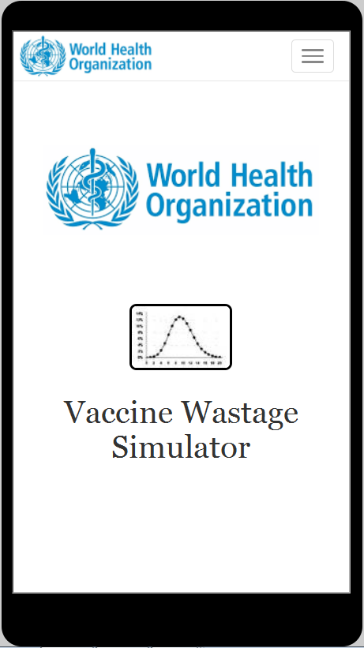
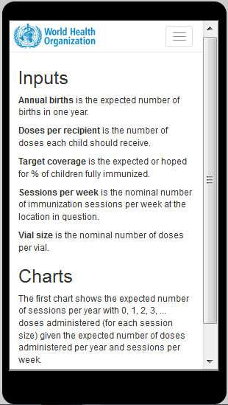
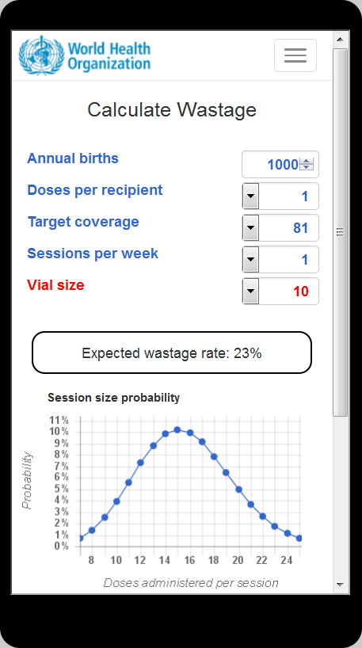
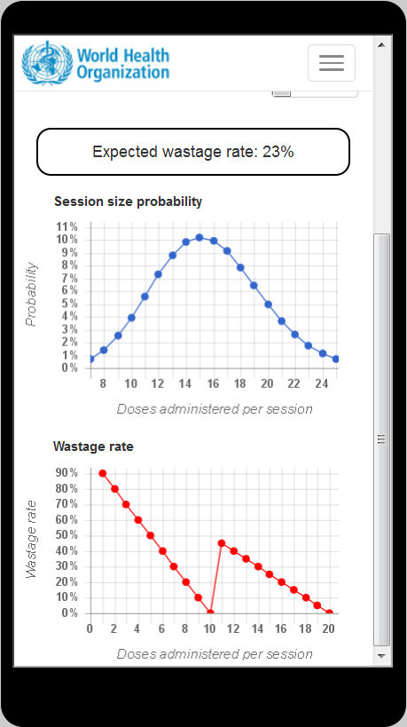

Slide 11
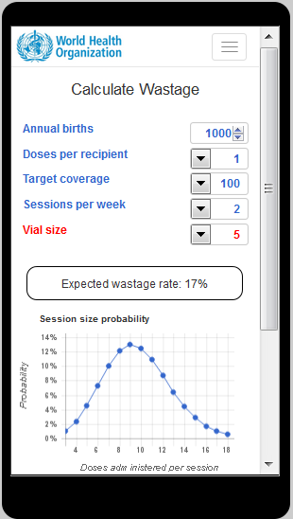
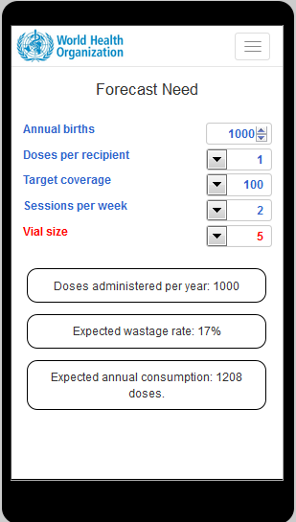
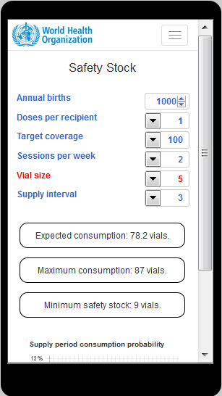
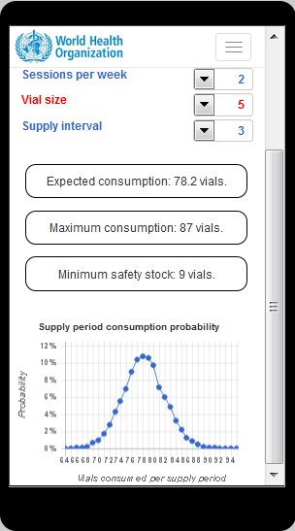

Slide 12
Next Steps for Mobile Application
Complete the design and programming of the Application
Carefully pilot to ensure the application will promote national policies and support providing safety stock needed to implement policy.
  Pilot country must have clear policies related to vaccine supply/safety stocks, wastage, vaccination policy (how many children present before opening a vial)
  Clear guidance must be developed on how to use the Application, what additional information may be needed (ie, closed vial wastage?), what advice should be given under different scenarios
  Determine if application adds-value in terms of increasing knowledge of supervisor and HCW, facilitating sufficient supply of safety stocks, promoting vaccination practices in-line with national policy.

Slide 13
Thank you!

