Slide 1
Lessons Learned and Key Factors Affecting SIA Quality
Accelerating Progress towards Measles and Rubella Elimination
22-24 June, 2016
Geneva, Switzerland
Katrina Kretsinger, MD, MA
CDC GID

Slide 2
Outline
Recent SIA performance
Analysis of SIA technical reports
SIA Field Guide and new tools
Questions for discussion

Slide 3
Measles-Containing Vaccine Doses Delivered through SIAs
2.6 billion vaccinated in measles SIAs during 2000–2014
1st and 2nd routine dose: WHO/UNICEF coverage estimates, the World Population Prospects New York, 2015. SIA dose: WHO SIA database, March 2016 (provisional data)
Slide courtesy of Robert Perry

Slide 4

Measles Campaigns in 39 Countries in 2015
180 million children reached
40/66 (61%) attained 95% coverage
18/66 (27%) included coverage survey
4 surveys document >95% coverage
Measles (21)
42 of 66 SIAs integrated 1 or more other interventions
OPV – 15
Vitamin A – 15
De-worming – 8
Other interventions – 1
Measles and Rubella (15)
Measles, Mumps and Rubella (3)
No SIA in 2015
Not Applicable
The boundaries and names shown and the designations used on this map do not imply the expression of any opinion whatsoever on the part of the World Health Organization concerning the legal status of any country, territory, city or area or of its authorities, or concerning the delimitation of its frontiers or boundaries. Dotted lines on maps represent approximate border lines for which there may not yet be full agreement. ©WHO 2014. All rights reserved.
Updated on 15 April 2016

Slide 5
Administrative vs survey coverage, M/MR SIAs, AFR, 2011-13
Courtesy Balcha Masresha
Notes:
This figure shows a comparison of measles SIA administrative coverage vs. survey coverage for 20 countries in the African Region in 2011-2012. The dotted line shows the target of 95% coverage and you can see that whereas three quarters of the countries report achieving the target (blue bars), by survey only ONE quarter did (red bars). This has led to a false sense of security and unexpectedly large measles outbreaks following SIAs

Slide 6
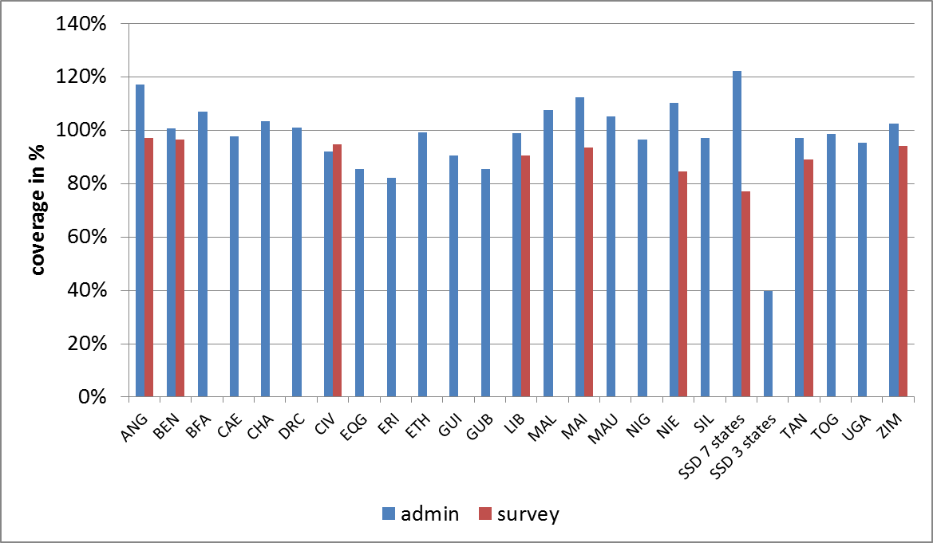
Administrative vs survey coverage, M/ MR SIAs, AFR, 2014 – May 2016
5/9 SIAs w coverage surveys > 95% cvg
Courtesy Balcha Masresha

Slide 7
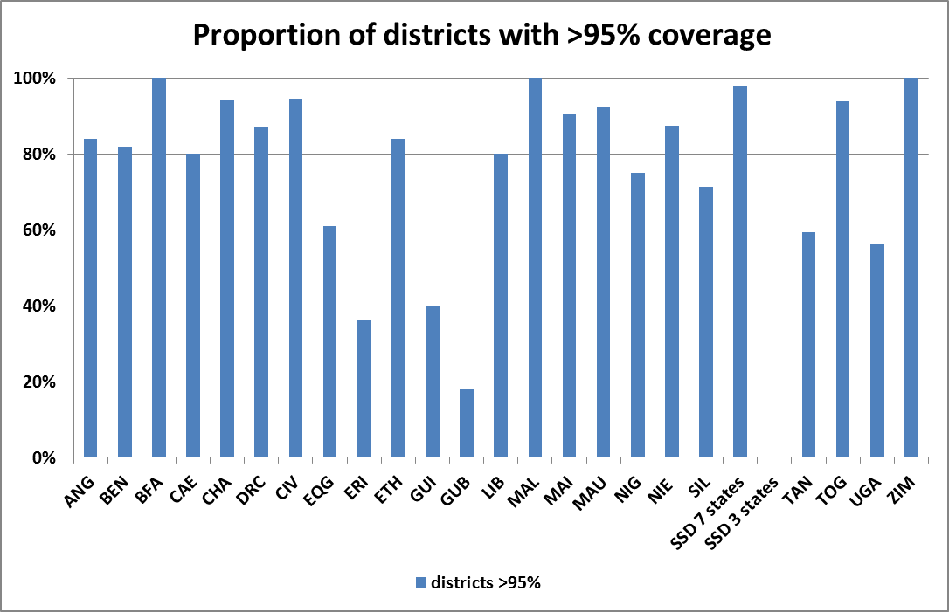
District coverage in M/ MR SIAs, AFR, 2014 – May 2016

Slide 8
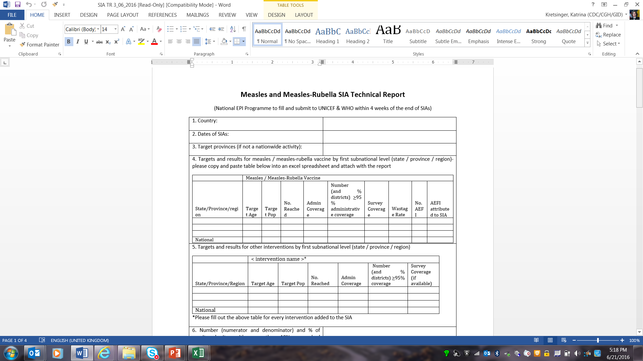
M / MR SIA Technical Reports

Slide 9
Update –
2014 GMRMM SIA Technical Report Discussion Points
Develop repository of technical reports and survey reports
  Enter into an electronic database? Partially completed
  Primary data from surveys? Primary data – yes; qualitative/text data, less so
Is a regular review of SIA technical reports useful? To be determined
How can we ensure that reports are submitted for all SIAs, and in a timely manner? For further discussion
Should a summary of the review findings be written up and disseminated/published? In progress
Discussion of possible analyses of technical reports Forthcoming …

Slide 10
M / MR SIA Technical Reports – New Indicators
8. Timing of availability of donor funding (e.g. GAVI/MRI) at national level in relation to the start date of the SIA 9. Timing of availability of operational funds at district level in relation to the start date of the SIA 10. When was the national SIA logistics plan completed in relation to the start date of the SIA? 11. Timing of completion of district level micro-planning workshops in relation to the start date of the SIA 12. Was SIA readiness assessed at the national level using the standard tool to assess status of preparedness at 12, 9, 6, 3 and 2 months prior to the start date of the SIA? If not, at what time points was SIA readiness assessed at the national level? 13. What percentage of districts conducted readiness assessment at least twice within the last 8 weeks prior to the SIA? 14. What percentage of districts had planned quantities of vaccine and devices at least 2 weeks before the start of SIA? 20. What is the number and percentage of unvaccinated children detected during intra-campaign RCM? 32. What is the number and percentage of unvaccinated children detected during post-campaign independent RCM? 34. What is the number and percentage of monitored areas showing <95% of total children vaccinated that had remedial action (e.g. mop up vaccination activities) taken within one week of end of the SIA?

Slide 11
Preliminary Analyses of Technical Reports –
Methods
All technical reports 2011-2015 available at WHO HQ
  Separate subnational reports included
  Narrative SIA reports included if technical report not available
Total number of SIAs conducted based on best available information (WHO SIA database)
Questions assessed: Greatest strengths, greatest weaknesses, lessons learned
  Best practices, innovative practices, recommendations
Each question subdivided into multiple responses with unique identifiers
Responses coded:
  Level (partners [int’l or in-country] vs. country [ministries])
  Process (planning, communication, implementation, and assessment)
  Elements
  Type (challenge, recommendation, strength)
Random audit of 5% of responses tested for consistency of coding

Slide 12
Proportion (%) of SIAs with available Technical Report, by year, 2001-2015

Slide 13
Proportion of SIAs (%) with available Technical Report, by Region, 2011-2015
AFR: 88/147
EMR:
50/86
SEAR:
9/17
Total:
170/315
EUR:
4/8
WPR: 15/30
AMR:
4/27

Slide 14
Preliminary Analyses of Technical Reports – Results
137 technical reports included
1,684 unique responses
Partners’ involvement
215 / 1,684 (13%) of issues related to partners
  125 (58%) classified as strengths
    e.g., good collaboration, external monitoring, consultants
  50 (23%) classified as challenges
    e.g., funds or communications material not arriving on time

Slide 15
Where in the SIA process were issues (positive or negative) identified?
Assessment – 12%
(e.g., M&E, supervision, daily reporting, mop up, AEFI)
Planning - 49%
(e.g., Collaboration, finance, high-level support, integration, timeline, training, population estimates, microplanning, personnel)
Implementation – 15%
(e.g., Distribution of supplies, vaccine refusal, curveballs, supervision, vaccine)
Communication – 24%
(e.g., Social mobilization, rumors, distribution of communication supplies)

Slide 16
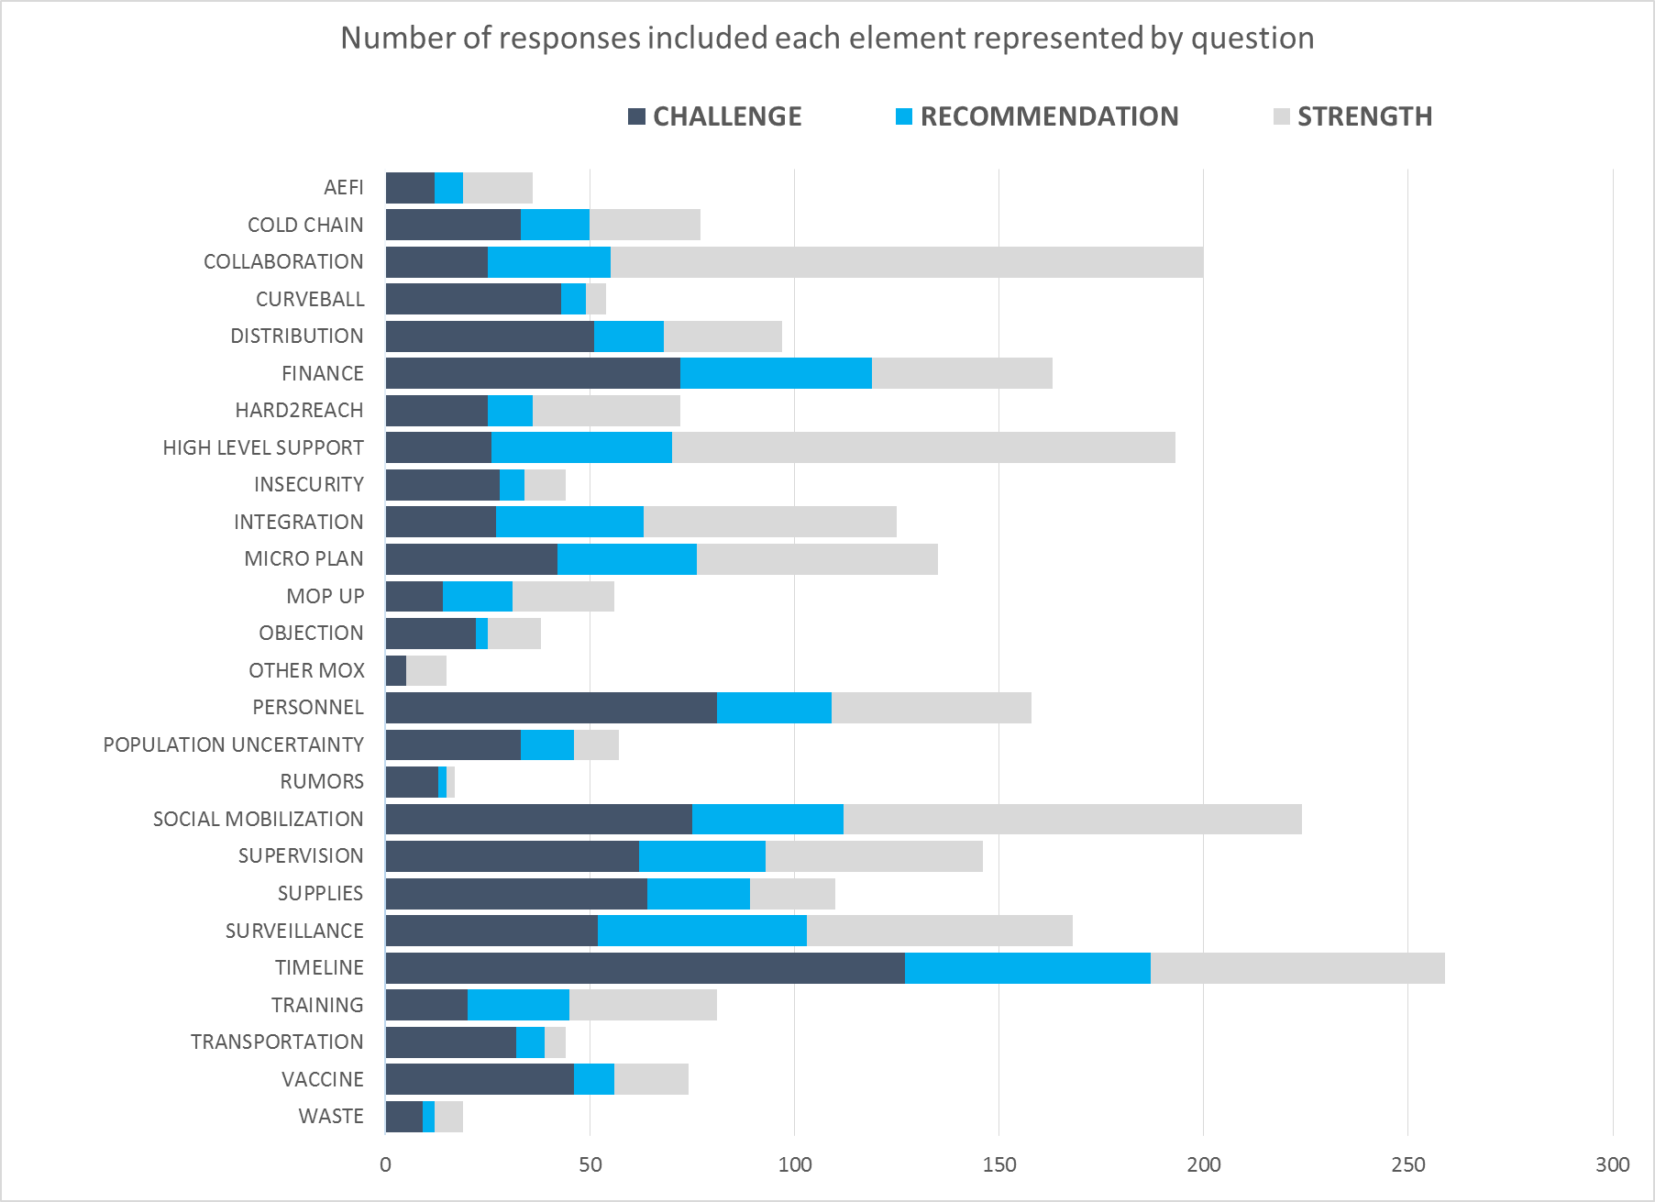
Synthesis of Key Process Issues
Response Elements by Type (Challenge, Recommendation, Strength)
 | Strengths | Weaknesses / Recommendations
Planning | 44% – collaboration with partners, other ministries, private hospitals; importance of high-level support; benefit of good microplanning | 56% – inadequate planning, tight and unrealistic timelines, late arrival of approval or funding; hazard of poor microplanning
Communication | 47% – impact of good communications in general and in particular to counteract rumors | 53% – underfunded; delays in timeline; negative impact of rumors
Implementation | 31% - well-organized | 69% - lack of personnel; low motivation; underfinanced; lack of effective supervision
Assessment | 48% - benefit of daily reporting and daily debriefing meeting; effective AEFI reporting | 52% - lack of effective mop-up; in-process monitoring not implemented; poor data management with tally sheets (inadequate training)

Slide 17
Response Elements by Type (Challenge, Recommendation, Strength)

Slide 18
Conc
Response Elements by Type (Challenge, Recommendation, Strength)

Slide 19
Preliminary Analyses of Technical Reports –
Limitations and Conclusions
Limitations
Work in progress (suggestions welcome)
Technical reports not representative of all SIAs
Not correlated with SIA quality
Country-level impressions
Conclusions
Planning process very important
Important elements for successful SIA
  Appropriate timeline
  Timely arrival of funds
  High-level support
  Collaboration with partners (international or country level)
  Social mobilization
  Microplanning

Slide 20
SIA Field Guide
Funded by BMGF
Expected publication July 2016
Comprehensive guide for planning, implementing, and monitoring SIAs
Chronological order, using concept of project management
E-Learning modules

Slide 21
SIA Field Guide - Highlights
Addressing inequity
Identification of hard-to-reach and high-risk groups
Tailoring vaccination strategies to needs of each community
Early planning and budgeting
SIAs within overall immunization programme
  Means to strengthen routine immunization

Slide 22
SIA Field Guide - Tools
Comprehensive budgeting, macro and micro-planning
  Pre-SIA readiness assessment tool
    National and subnational level
    Timely implementation of corrective actions
    Feedback to decide if postponement appropriate
  Intra-SIA monitoring (RCM)
    Mop-up activities
  Post-SIA independent monitoring
E-learning modules

Slide 23
Parting shots
How to escape the cycle of poor quality SIAs, followed by large outbreaks?
Relative role in SIA success?
  High-level support and advocacy
  Adequate and timely funding
  Technical improvements and accountability
Should countries conduct SIAs if they are not ready?
How should these additional activities be financed?
How to obtain high-quality surveillance (and coverage) data in order to tailor SIA strategies?
What lessons should we take from polio SIAs? (accountability? end-process monitoring?)
Ultimate goal: M / MR delivery through RI to make SIAs less frequent and unnecessary

Slide 24
Thank you
Jennifer Knapp
Meredith Dixon
Tracey Goodman
Alya Dabbagh
Robert Perry
Claudia Catherine-Steulet
Peter Strebel
Balcha Masresha

