Slide 1


Micro-planning to ensure Supplementary Immunization Activity (SIA) reaches the unvaccinated-
India Experience
Dr Pradeep Haldar, DC(I), Government of India

Slide 2


Outline of the presentation
Development of & salient features of Polio micro-plans
Lessons learnt from Polio Supplementary Immunization Activity (SIA)
Micro-plans for injectable Measles Supplementary Immunization Activity (SIA)

Slide 3
Why micro-planning in SIAs ?
To reach the last child with vaccination services
Micro planning ensures
  Area map: To reach all geographical areas and all communities
  IEC plan : Community awareness, demand and utilization
  Human Resource Plan: Availability of appropriate and trained human resources
  Monitoring plan: Quality and completeness through supervision and monitoring
  Logistic plan: for timely delivery of vaccines & other logistics
  Cold Chain plans: Proper storage
  AEFI management plan: AEFI reporting and management
  Waste management: Safe disposal of immunization waste

Slide 4
Development of polio micro-plans
Polio micro-plans evolved as the country continued to detect cases despite coverage
Need to improvise strategy to increase coverage to reach last unvaccinated child
Constant endeavor to reach the unvaccinated led to development of detailed micro-plans
Advantages with polio SIA:
  Oral vaccine
  Can be administered anywhere

Slide 5
Micro-planning for Polio SIAs- Salient features
Every Polio national rounds in India
  Reaches ~170 million children
  2.3 million vaccinators engaged
  150,000 supervisors deployed for quantity assurance
Detailed plans developed up to block-level
  Plan for fixed sessions
  Plan for hard to reach areas – mobile teams etc
  Special plan for migratory /mobile population
  Special plan for congregation sites
  Cross cutting plans viz; communication plan, logistic plan, monitoring and supervision plan

Slide 6
Microplanning to reach high-risk groups & areas in Polio

Slide 7
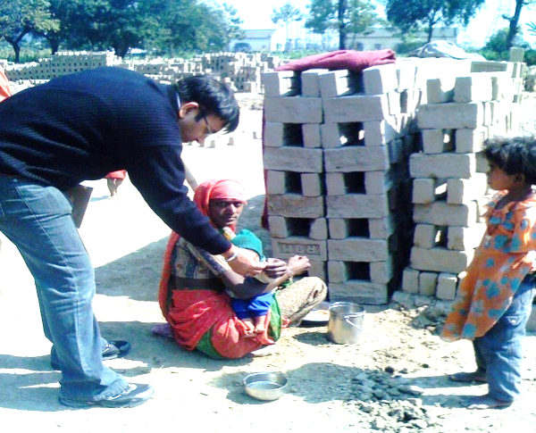
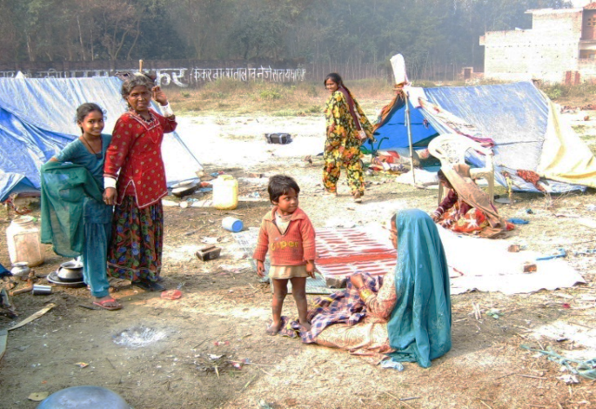
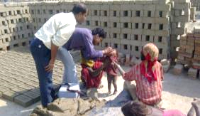
Systematic identification, mapping & coverage of migrant/ mobile communities in Polio SIA
Brick kilns/Construction sites/Rag pickers colony
Slums at rail station/bus stops/under over bridges
Along side railway track in urban areas
Migratory /gypsy population /mobile /floating
unregistered population
Factories/ prisons/brothels/red light areas
Urban outskirts/periurban /overlapping areas
Scattered/forest/hard to reach/hill population

Slide 8
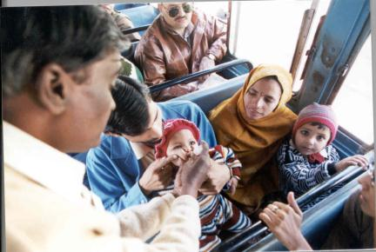
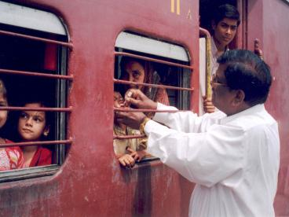
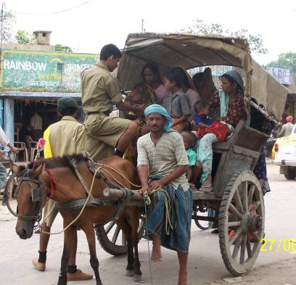
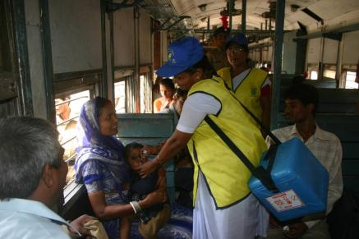
Polio - vaccinating children on the move: Transit Teams

Slide 9
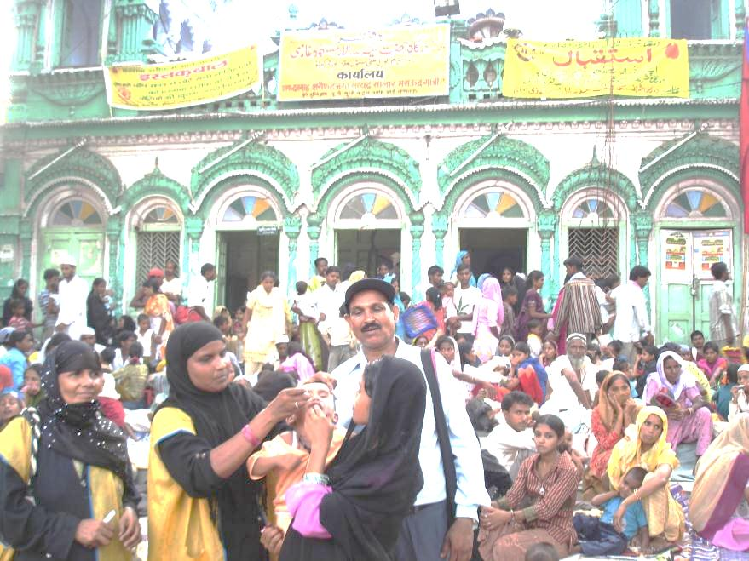
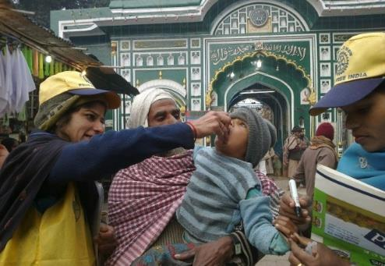
Polio vaccination at religious congregations/ festivals

Slide 10
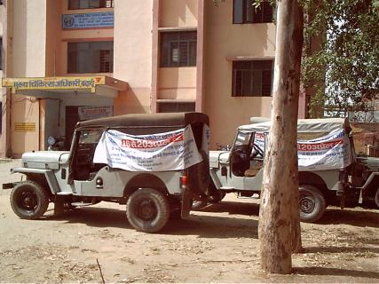
Microplan format for mobile teams
Vaccinators on 2 or 4 wheelers
Vaccinate children at scattered migrant sites and hard to reach areas
Make more than one visit to each site on different days to ensure completeness

Slide 11
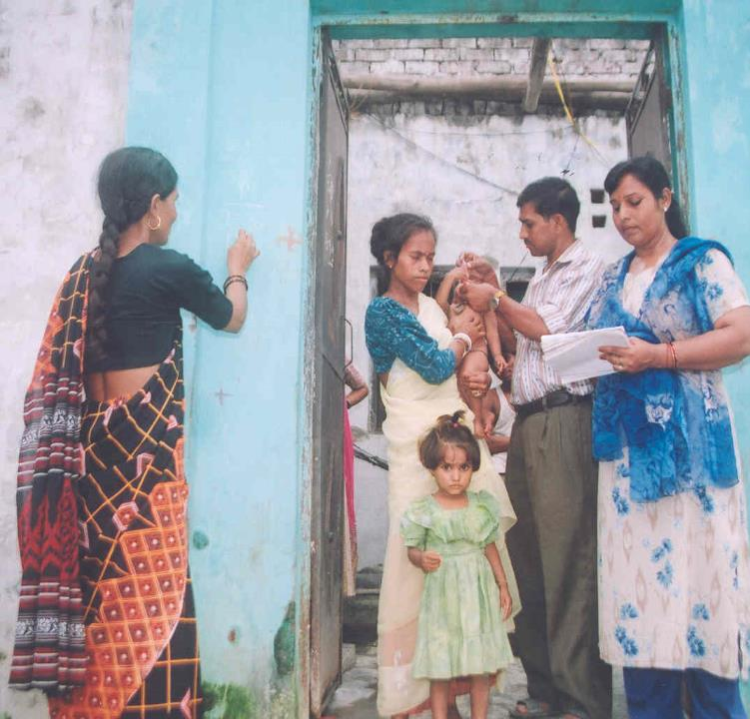
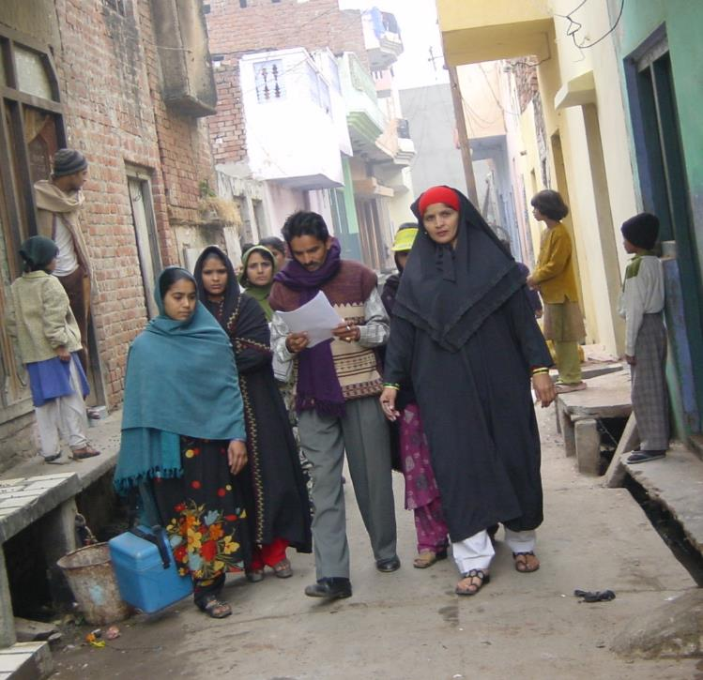
Polio - House-to-House vaccination teams
Visit all houses search & immunize all children 0-59 months
Re-Visit ‘X’ marked houses and immunize children missed during 1st visit

Slide 12
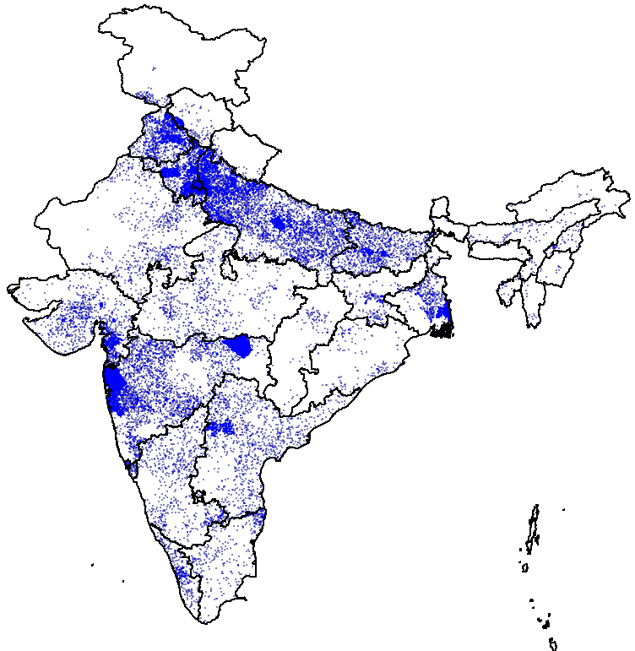
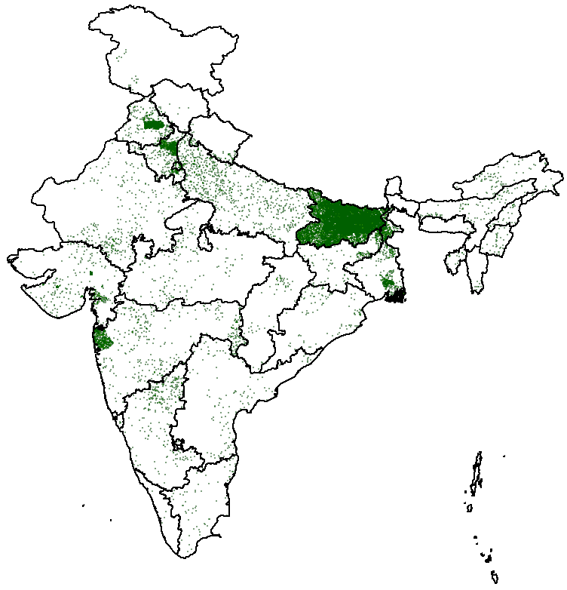
Augmenting Polio SIA coverage by HRA planning
(Inclusion of 400,000 high risk settlements to Polio SIA micro plans)
Migratory sites
Settled population HR sites
= 10 Migrant sites
= 10 High-risk sites
~ 256,000 at Migrant sites
~ 166,000 HR areas in settled population
~ 4,500,000 children <5 yrs
vaccinated during each NID
~ 8,500,000 children <5 yrs
vaccinated during each NID

Slide 13
Percent full immunization ( 12-23 months)
Selected 9-high burden states^, 2012-2016*
~ 96% of HRAs are now part of RI micro plans
Routine Immunization Monitoring data
So far out of total 184,176 HRAs identified ,176,296 HRAs have been tagged to RI Micro plans
^ High burden states (9) : Bihar, Chhattisgarh, Gujarat, Haryana, Jharkhand, Madhya Pradesh, Rajasthan, Uttar Pradesh, West Bengal
*Source : RI monitoring data, Jan-Apr 2016

Slide 14
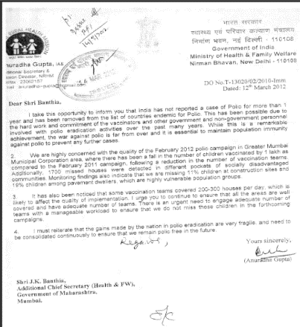
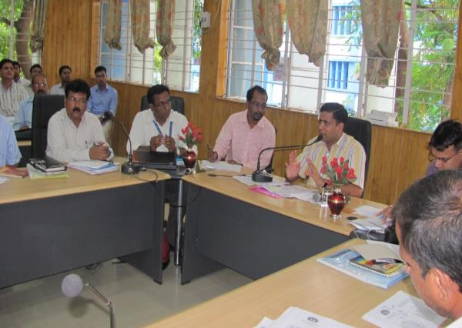
Overarching mechanism review
Regular program review at Union, State & District level
  Monitoring feedback from State/partners used for corrective action
District Task Force, chaired by district magistrate, in each district to review campaign preparedness & implementation
Daily review meetings, at district and sub-district level, during campaigns to identify & plug gaps
Letter from Addl Secy, Govt of India to the State Secretary
District Magistrate presiding over a
District Task Force Meeting

Slide 15
Lessons from polio SIA micro-plans
Polio SIA micro plans have evolved, refined and matured over decades to include
  Every village/hamlet/ward and mapped
  Migratory / temporary settlement mapped updated regularly
  Day-wise route chart with landmarks on the ground
  Team-wise and day-wise vaccination sites including names of team members and local influencers
  Same community woman as a third team member
  Rationalized work-load, with pre allocated areas/day
  Detailed supervisory visits along with time and map

Slide 16
Experience of micro-planning for injectable vaccination campaign - Measles campaign

Slide 17
Uniqueness of Measles SIA
Injectable campaign, can only be given at fixed sites
Wide age group covered (9 months to 10 years)
Targeting school going children
Human Resource requirement high
Temporary Cold Chain space requirement high

Slide 18
Background work for measles SIA micro-plans
List of all villages/hamlets/wards/any human settlements in the block
Due-listing of eligible children through house visits with invitation for vaccination
Identifying and enlisting all types of schools
Identifying potential vaccinators outside the health system (medical interns / pharmacy students/general nursing staff/ANM training school/private nursing homes staff)
Use of polio micro plans for identifying high risk areas
Alternate cold chain plan

Slide 19
Micro-planning in measles SIA
Macro-plan should follow the micro plan
  At State and district level to generate high level commitment and ensure cross-cutting issues are adequately addressed
Unit of micro-planning
  Primary Health Center (or last ILR point) in rural areas
  Distribution area under each cold chain point in a municipality
Routine Immunization (RI) sessions not disrupted during measles SIA - RI conducted as per the schedule
All sessions at fixed site (no house to house visits)
One day-one village-One fixed site approach
  To ensure injection safety
  Easy supervision and monitoring of village.
  Easy identification of missed pocket within village

Slide 20
Campaign strategies
Four types of session sites
  Fixed sites in Educational Institutes in the first week
  Fixed Outreach sites in communities – current RI sites/newly identified for subsequent week.
  Mobile/special teams (but from fixed location) for Hard to reach population
  Health Facilities – All PHCs and above facilities
Vaccination team: consist of 3-4 members with 1-2 trained vaccinator
  e.g. ANM as vaccinator with ASHA/Link worker/AWW and a volunteer as mobiliser
Injection Load per vaccinator - 150 injections in community session and 200 injection at school session.

Slide 21
Key components of measles SIA micro-plans
1. Human Resource
and logistics plan
with mapping
10. Monitoring and Evaluation Plan
2. Training Plan
9. Contingency plans for HR, logistics & Cold chain
3. Cold chain Plan
Target Beneficiaries
8. Supervision Plan
4. Logistics movement plan
7. AEFI management Plan
5. Waste management plan
6. Social mob. & IPC plan

Slide 22
Map is integral component in a micro-plan
School
Hard to Reach Pop
Notes:
Take time to explain this map. This map is for a hypothetical PHC area which has 6 ANMs + 1 clinical nurse (at PHC). This map does not capture the school plan.
On every day of activity they can deploy up to 6 ANMs (with other team members) in different parts of the PHC area. Plus the PHC runs a fixed site team at the PHC for all days of activity. They start outreach activity on 13 Sept.
On 13 Sept, they send out all 6 ANMs (with local ASHA/AWW/Vol etc.) to Garhi village as this is a big village having nearly 900 target population. On 14 Sept. they send 1 ANM to Nagama, 3 ANMs to Kushalgarh (main sub-centre village) and 2 ANMs to Kalinjara village. The local ASHA, AWW and volunteers change. On 15 Sept. they send 4 ANMs to Aajna (main village) + 2 ANMs to Aajna hamlet according to target population. Similarly the same map can capture the school activity plan.

Slide 23
Challenges encountered
Microplans prepared by ANMs/health workers not reviewed by supervisors/Medical Officers (MO)
Formats / guidelines not standardized at district/state
MOs not aware /oriented for the need of mapping and micro-planning
MOs were not aware/sensitized about method of estimation of beneficiaries and injection load
Logistic calculation was not based on due-listing of beneficiaries and injection load calculation
Source: MO training evaluation study conducted in 2012

Slide 24
Accountability Framework
At state and district through - STFI/DTFI, inter-sectoral subcommittees for effective operations and coordination
PHC under the supervision of Block Medical Officer
Block Medical Officer under the supervision of DIO
State: SEPIO
Sub-Centre: ANM
Village: ASHA/ AWW/PRI
District: DIO
Block: MOIC
PHC: Medical Officer

Slide 25
Inter-Departmental coordination
Inter-departmental Committees formed at all level for coordination
During campaign, regular evening meetings held for feedback and corrective actions
Advocacy meeting with school teachers, Principals, Panchati Raj, Social Justice etc
Sensitization and involvement of professional bodies- Indian Medical Association, Indian Academy of Pediatrics etc.

Slide 26
Quality assurance mechanisms
State & District Task Forces on Immunization
Monitoring of areas by Supervisors immediately on completion of activity
  Supervisors to check at least 20 target age group children for quality of coverage
  Identification of missed areas not in micro-plan
Sweeping activity to immunize missed children: Immunization Officer & Medical Officer to review and identify any area with low coverage targeted for sweeping activity

Slide 27
Summary
Quality microplans essential for achieving high SIA coverage
Focus on high-risk, hard to reach population and area
Urban area micro planning needs special attention
Micro plans need to be reviewed & validated on field
Micro plans needs to be revised after every SIA round

Slide 28
Summary …. Contd
Role of State and District is crucial in micro-planning
  Build capacity of MOs, health workers and supervisors
  Visit PHCs and health sub centres to validate quality
  Track progress particularly in HR districts and PHC/ blocks
  Important role of inter & intra departmental bodies at State and District level (STFI and DTFI)

Slide 29
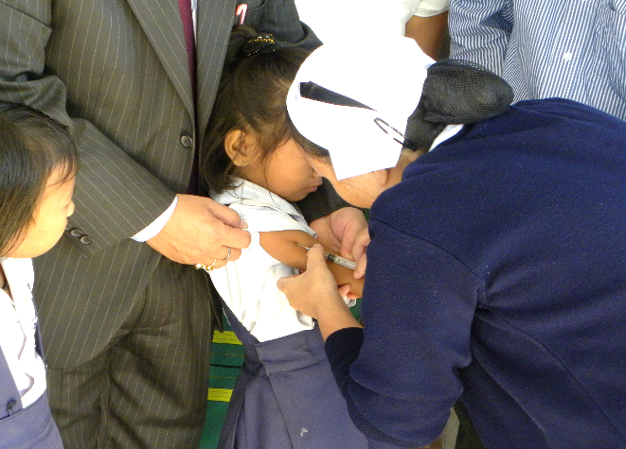
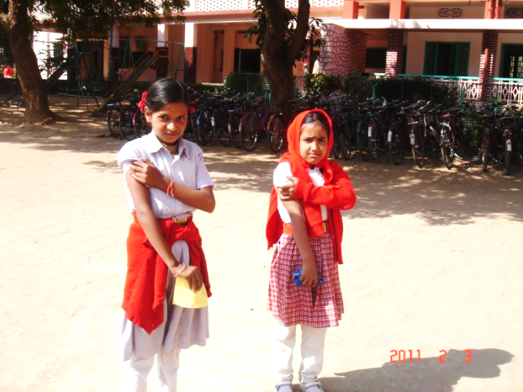
Thank You

Slide 30
Tools for Micro-planning
PHC Level - Base Line Information
MCUP-Form 1 | Sub Centre wise Village/School/Hard to Reach /High Risk population Information
MCUP-Form 2 | Beneficiary Due List
PHC Level – Micro-planning tools (Session plans with teams, vaccine and logistics details)
MCUP-Form 3 | School Micro-plan
MCUP-Form 4 | Out Reach Micro-plan (including Regullar,H2R and High Risk session sites)
PHC Level - Sub-Centre wise PHC compilation
MCUP-Form 5 | PHC/Block HR, Vaccines ,logistics Plan
MCUP-Form 6 | Cold chain contingency and waste management plan
MCUP-Form 7 | PHC/Block Communication Plan
MCUP-Form 8 | Supervisor Plan
District Level Tools
MCUP- Form 14 | Districts HR, Vaccines and logistics plan (Compilation of Form 5)
MCUP- Form 15 | District Cold Chain Plan
MCUP- Form 7-A | District Communication Plan (compilation of form-7)
MCUP- Form 16 | District Supervision Plan

