Slide 1

Achieving and Sustaining Measles and Rubella Elimination
10th Annual Measles Initiative Meeting
Washington, D.C. 13-14 September, 2011
Jon Kim Andrus, MD
Carlos Castillo-Solórzano, MD, MPH

Slide 2

Presentation
Progress on the achievements
  Documenting and verifying measles/rubella elimination
Challenges to maintaining elimination
Sharing experiences

Slide 3
Measles Elimination, the Americas, 1980-2011*.
Catch-up campaigns
Follow-up campaigns
Confirmed cases
Routine vaccination coverage (%)
Interruption of endemic transmission
A total of 3.2 million measles cases and 16,000 deaths would have occurred between 2000-2020 if PAHO strategies were not implemented. This resulted in a savings of US$ 208 million in treatment costs.¹
Source: Country reports to PAHO/WHO.
*Data until EW 35/2011; coverage data not available for 2010.
¹ Ibdem Acharya et. al.

Slide 4
Rubella Elimination in the Americas, 1982-2011*.
>12 months with no endemic rubella cases in the Region.
Speed-up campaigns
Beginning in 2001, over a 15 year period the rubella and CRS initiative will have saved an estimated US $3 B by preventing more than 112,500 CRS cases in Latin America and the Caribbean.
Follow-up campaigns
1G transmission interrupted
1C transmission interrupted
Last rubella case (2B) EW 5/2009
Confirmed Rubella Cases
Routine Vaccination Coverage (%)
Source: Country reports to PAHO/WHO.
*Data until EW 35/2011; coverage data not available for 2010.
Notes:
4
4

Slide 5
Distribution of Confirmed Measles Cases Following
the Interruption of Endemic Transmission,
the Americas, 2003-2011*
Rate: 1.066 X 1,000,000 pop.
N=993
Confirmed Cases
N=226
N=253
N=119
N=108
N=85
N=176
N=207
N=89
* Data as of EW 35/2011.
Source: Country reports to PAHO/WHO.

Slide 6
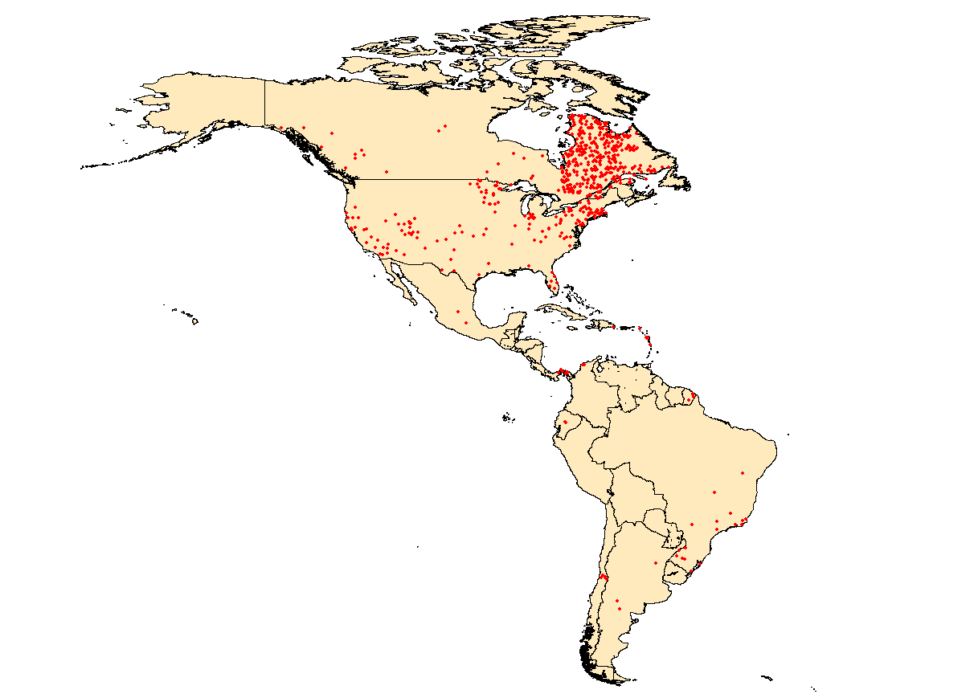
Confirmed measles cases in the Americas, 2011*
Canada = 730
United States = 203
Dom. Rep = 1
Mexico = 3
French Departments = 20
TOTAL = 983 cases
Panama = 4
Colombia= 4
Ecuador = 2
1 dot = 1 case
Note: Cases were imported, import-related or unknown.
Brasil = 18
Chile = 6
Argentina = 3
*Data as of EW 35/2011
Source: MESS and country report to PAHO/WHO

Slide 7
Confirmed Rubella Cases in the Americas, 2010-2011*
French Guiana = 1
Canada
2010 = 7
2011 = 1
United States
2010 = 7
2011 = 4
Chile
2011 = 2
TOTAL
2010 = 17 cases
2011 = 7 cases
1 dot = 1 case
Note: Cases were imported, import-related or unknown.
*Data as of EW 35/2011
Source: MESS and country report to PAHO/WHO

Slide 8
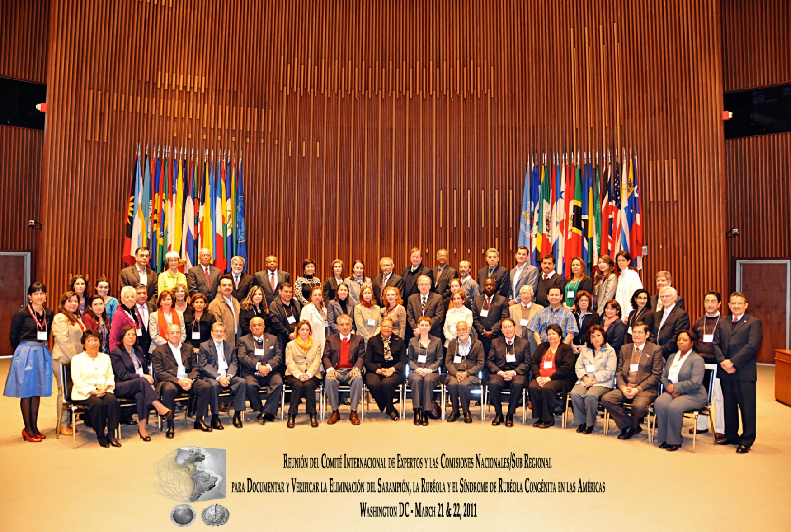

Meeting between the IEC and the National Commissions for MEA/RUB Elimination
WDC 21-22 March 2011
Participants from:
21 Nat. Com.
1 SB (13 countries)
PAHO
CDC
SVI
UNICEF
CIDA
IEC Members held two meetings in December 2010 and March 2011.

Slide 9
Roadmap for Documenting and Verifying Measles and Rubella Elimination, 2011-2012
Eluminate sessions by subregion to track progress on doc/verf process
Submission of draft country reports to IEC following commitment made by NC (March 2011)
Submission of final country report to IEC
Review of the country reports by IEC supported by PAHO
2nd meeting between IEC and National/Sub Regional Commissions
Presentation of regional report to PAHO Directing Council
Aug 9-10.
2011
Oct.
2011
Dec.
2011
Jan-April. 2011
May.
2011
Sep.
2012

Slide 10
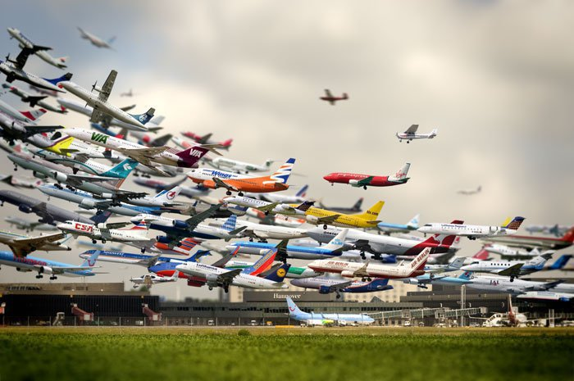
Risk of Virus Importations from Other Regions, including CRS Cases
~150 million tourists have arrived to the Americas in 2010, which is an increase of 6% compared with 2009.

Slide 11
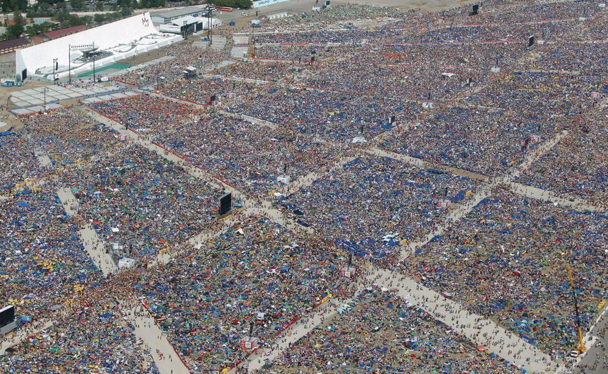

World Youth Day concluded on August 21, in Madrid, Spain. This image illustrates the size of the event and the close proximity in which the participants were.

Slide 12
Number of import/imported related measles and rubella cases per country, The Americas – 2011*
 | MEASLES |  |  | RUBELLA
Country | Import | Import related | Unknown | Import | Import related | Unknown
Argentina | 1 | 2 | 0
Brazil | 7 | 8 | 3
Chile | 3 | 3 | 0 | 1 | 1
Canada** | 13 | 23 | 694 |  |  | 1
Colombia | 1 | 3 | 0
Dominican Rep. | 1 | 0 | 0
Ecuador | 1 | 1 | 0
Guadalupe*** | 7 | 5 | 1
French Guiana | 2 | 2 | 0
Martinique | 2 | 0 | 1
Mexico | 3 | 0 | 0
Panama | 4 | 0 | 0
United States | 103 | 82 | 18 | 2 | 1 | 1
Total | 148 | 128 | 717 | 3 | 2 | 2
** It does not include clinical cases reported.
*** Five cases have been notified in the island of Saint Martin (1 import and 4 import-related).
*Data as of EW 35/2001

Slide 13
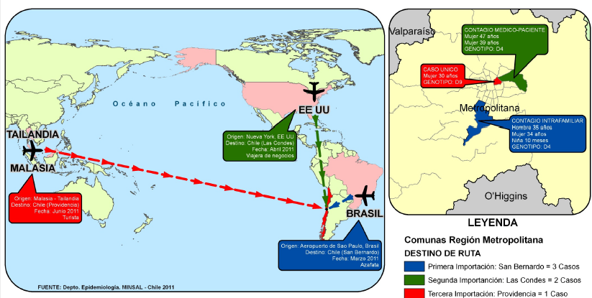
Route of Importation of Measles Cases to Chile, 2011
Infection in medical setting
47 Year-old Female
39 Year-old Female
One Case
30 Year-old
Female
USA
Thailand
Infection in family setting
35 Year-old Male
34 Year-old Female
10 Month-old Girl
-From New York, USA
-To Las Condes, Chile
-Date: April 2011/Business
Malaysia
-From Malaysia/Thailand
-To Providencia
-Date: June 2011 /Tourist
Brazil
Legend
Municipalities in the Metropolitan Region
-From Sao Paulo, Brazil
-To San Bernardo, Chile
-Date: March 2011 /Flight Attendant
First importation: San Bernardo = 3 Cases
Second importation: Las Condes = 2 Cases
Third importation: Providencia = 1 Case
3 importations: 1 from Asia (D9), 1 from Brazil (D4) with 2 secondary cases, and 1 from United States (D4) with 1 secondary case.
Data as of EW 35/2011
Source: Ministry of Health, Chile

Slide 14
Measles Case in Barranquilla, Colombia, 2011
Colombia reported a measles case in a 14-year old adolescent, who traveled to Brazil on June 27, 2011. Given the probable exposure period, the case may have been infected in either Brazil or Colombia where the 2011 FIFA U-20 World Cup is taking place.
National authorities have initiated outbreak control measures, including contact tracing activities with follow-up for 4 weeks from the case’s date of rash onset and the intensification of vaccination activities.
Measles D4
Barranquilla, Colombia
16:55 / July 25, 2011

◉

DRO: August 9, 2011
14 years old
Bogota, Colombia
15:30 / July 25, 2011
DRO: Date of rash onset
Sao Paulo, Brazil
08:35/ July 25, 2011
DOS: Date of onset of symptoms
DOS
DRO
Hospitalization
Source: National Institute of Health - Colombia

Slide 15
Epidemiological Alerts
Mass-gathering events
  Evidence of immunity to measles and rubella for international travelers.
  Travelers should take notice of symptoms.
  What to do if the traveler believes that they have measles or rubella.
Recommendations on awareness of immunization
Entry points of the countries (i.e: airports)
Strategic alliances with key stakeholders to maximize alert dissemination (airlines, travel agencies, etc.)

Slide 16






July 1- 24
June 18 – July 10
July 29 – August 20
September 23 – October 2
August 16 –21
October 2 –15

Slide 17

Mass Gatherings and the Follow-up of International Contacts
Meeting of Walmart stakeholders in Fayetteville, AR
Attendee from India arrives on 30 May 2010. Male, 29-years old, with ROD on 2 June, 2010
Lab results confirm IgM+ for rubella with 2B virus identified.
Over 15,000 people attended the conference.
Index case potentially in contact with 5,000-6,000 participants in corporate conference
FCH/IM sends alert to 10 countries with Walmart stores (on 14 June) and IHR/PAHO sends alert to all countries.
International contact tracing identified contacts in… -CHI (126 individuals, including 3 pregnant women); -COR (25 individuals); and -HON (11 individuals)
No secondary cases identified after follow-up with contacts.

Slide 18
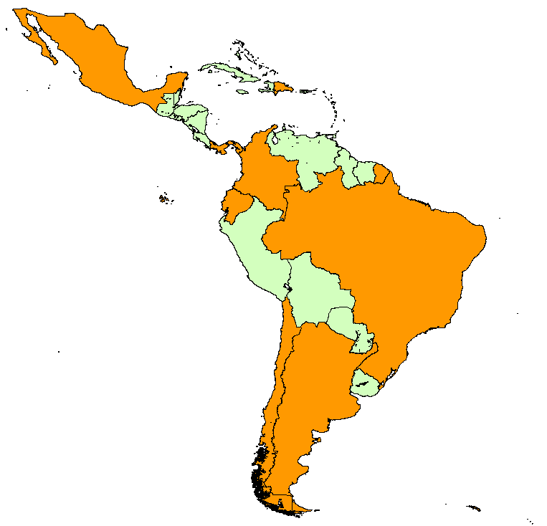
Measles Genotypes in Selected
Latin American Countries, 2011
Dominican Republic: D4
from Italy
Mexico: D4 from France,
London, and Canada or USA
Panama: D4 from Poland
French Territories: D4
from France
Colombia: D4 from Europe (?)
Ecuador: B3 from Kenya
Brazil: D4 from Europe,
France, Germany and USA; G3 from Europe
Chile: D4 from USA and unknown source; D9 from Malaysia
Argentina: D4 from France
or Germany and Italy
Data as of EW 34/2011
Source: Country reports to PAHO/WHO and CDC Global Measles Laboratory.

Slide 19
  Ongoing High-quality Follow-up Campaigns and Rapid Coverage Monitoring, The Americas, 2011-2012
Follow-up campaigns programmed for 2011-2012
Haiti: 2012 (9m-8y)—MR + OPV
Mexico: April 2011
(1-4y) – MR
Brazil: July 2011 (1-6 y) – MMR
Honduras: 2012 (1-4) — MR
Costa Rica: May 2011 (1-9 y) – MMR
Peru: May 2011
(1-5 y)—MMR
Bolivia: October 2011 (1-5y) –MMR
Chile: Began November 2010
(1-5y)—MMR
Notes:
19

Slide 20
Rate of Suspect Measles/Rubella Cases per 100,000 population, Latin America and the Caribbean, 2011*
Rate per 100,000 population
<1
1-1.99
≥2
* Last 52 weeks (2010/31 – 2011/30)
Source: Country reports to PAHO/WHO.

Slide 21
On going support to strengthen measles/rubella surveillance system Indicators, Region of the Americas, 2007-2011*
%Percentage
Source: Country reports to PAHO.
*Data until EW 34/2011.

Slide 22
Strengthening routine immunization services by maintaining measles, rubella and CRS elimination and polio eradication in Haiti
Reorganization of routine immunization services.
Revitalize managerial processes of the EPI.
General training for those responsible for vaccination activities at national and departmental levels.
Systematization of procedures and vaccination techniques.
Strengthening of epidemiological surveillance of VPDs with a contingency plan in place.
Implementation of the follow-up campaign.

Slide 23
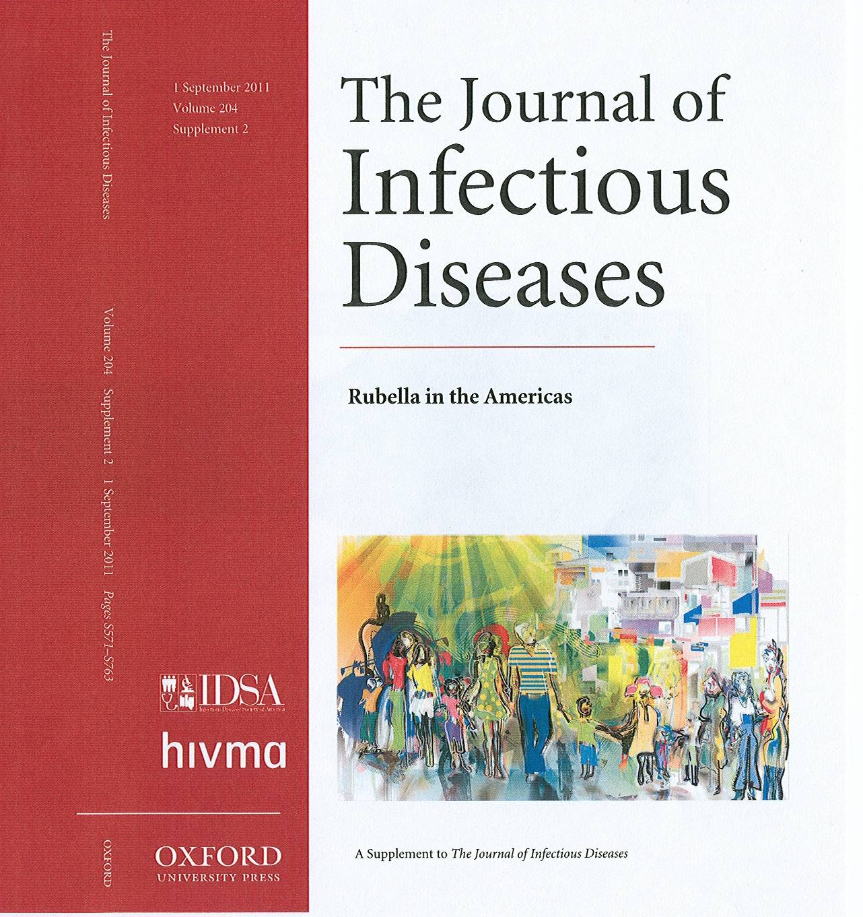
Sharing Experiences in 2011
Launching of the rubella JID supplement during the PAHO Directing Council: September 29.
Study Tour to Brazil and Chile: Visit of Technical Staff of the MOH-China to observe surveillance strategies for CRS: 14-22 November.
Rubella and CRS Elimination in the Americas

Slide 24


Slide 25
We request…
World Health Assembly should consider a global measles eradication goal.
Measles eradication activities should be used to accelerate the control of rubella and the prevention of CRS, while cementing the achievements of polio eradication and introduction of new vaccines.

Slide 26
THANK YOU!
www.paho.org/immunization

