Slide 1
Measles Moves Fast, Our External Communications Should Too

Slide 2
Panelists
Rachel Smidt,
Global Health Communications Manager, UN Foundation
Lindsey Miller-Voss,
Communications Officer, Shot@Life Campaign
Laura Keenan,
Communications Officer, World Health Organization
Dr. Robb Butler,
Senior Social Scientist, Vaccine Demand, UNICEF
Yolonda Freeman,
Lead Communications Specialist, Centers for Disease Control and Prevention

Slide 3
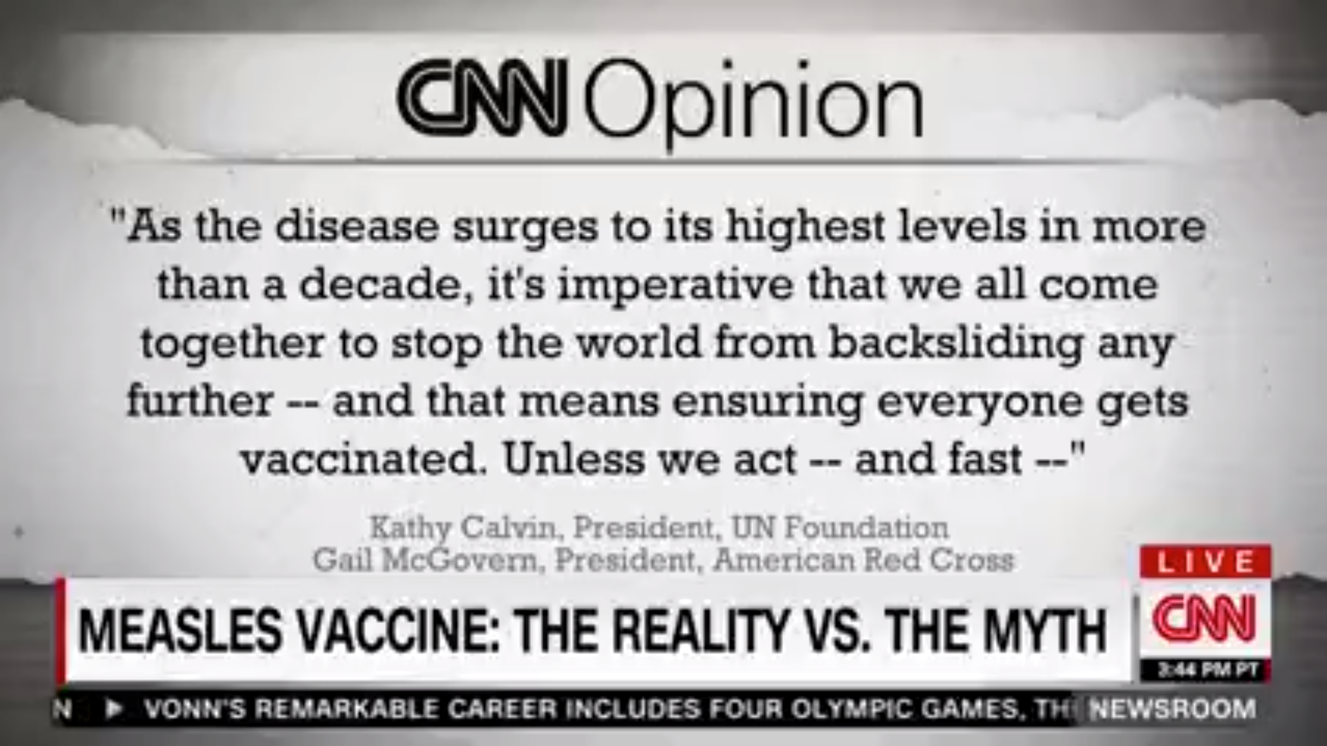

Slide 4
Questions

