Slide 1
Regional update of the
Eastern Mediterranean Region
12th Annual Meeting of The Measles & Rubella Initiative
American Red Cross, Washington, DC -10-11 September , 2013
Dr Nadia Teleb,
Regional Adviser, Vaccine Preventable Diseases and Immunization
WHO/EMRO

Slide 2
Regional Measles and Rubella Goals
Measles elimination from all countries by 2015
  Resolution EM/RC44/R.6 – 1997 (elimination by 2010), revised by Resolution EM/RC58/R.5 – 2011 (elimination by 2015)
No regional target for rubella/CRS elimination

Slide 3
90% Reduction in Reported Measles Cases
Reported measles cases and MCV1 coverage, Eastern Mediterranean Region, 1980-2012

Slide 4
MCV2 introduction into routine EPI in Countries of the EMR 2012
Palestine
Bahrain
Routine MCV2 introduced
No plan for routine MCV2 introduction
Notes:
4

Slide 5
Routine measles vaccination, 2012
Source: MCV1: WHO UNICEF estimates
MCV2: reported JRF

Slide 6
Measles Case-Based Surveillance in EMR, 2012
Palestine
Bahrain
Nation-wide Measles-rubella Case-based surveillance (20)
Moving to Nation-wide measles surveillance (1)
Sentinel site measles surveillance (2)

Slide 7
11,183
23,451
13,348
12,347
6,079
6,459
4,983
3,081

Slide 8
Situation of Rubella

Slide 9
Rubella vaccine use in countries of the EMR, 2013
Palestine
Bahrain
Rubella vaccine in use (16 country)
Rubella vaccine planned 2014 (Yemen)
Rubella vaccine planned 2015-2016 (Djibouti)
Rubella vaccine introduction not decided (5 countries)

Slide 11
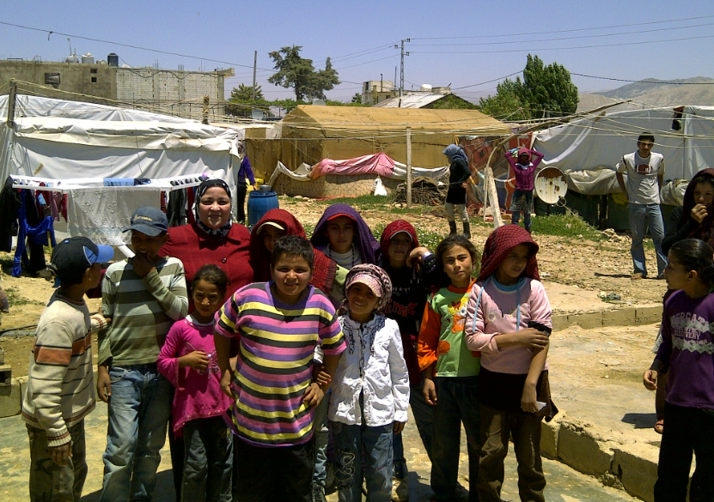
Measles in Syria and the surrounding countries
Syrian camp in Lebanon

Slide 13
Efforts are ongoing to coordinate synchronized MCV SIAs in Syria and surrounding countries

Slide 14
Syria
Activities Completed Activities Planned
March 2013
  MMR SIAs for IDP shelters (6 m - 15 y)
  MMR SIAs for school children 1st- 4th grade
April 2013
  MMR SIAs during the regional vaccination week (1-5 y)
10-21 November 2013
  MMR SIAs
  1-5y not reached in previous SIAs
MMR SIAs
  School students
  6th – 9th grade
Negotiation to implement SIAs for higher age group

Slide 15
Jordan
Activities Completed Activities Planned
April 2013
  M SIAs in Syrian refugee camps
  6 m-30y
  Coverage was not very high.
On going M vaccination of new Syrian refugees
  6 m-30y
July 2013
  M SIAs in Irbid and Mafrak, including the camps
  almost 100% coverage
2-21 November 2013
  Nationwide MR SIAs
  6m-20y

Slide 16
Lebanon
Activities Completed Activities Planned
March 2013:
  National M SIAs
  including Syrian refugees
  9m-18y
MMR vaccination of Syrian new comers
Outbreak is still ongoing
EMRO recommendation for elimination:
  MR SIAs (9m-30y)
  synchronized with Jordan
Under negotiation with MOH

Slide 17
Iraq
Activities Completed Activities Planned
Refugee camps:
  Vaccination with MMR for age 6m-18y for refugee camps and surrounding community
  Vaccination of all new comers (6m-18y)
Nation-wide preferable
  or at least in most affected provinces
EMRO recommended
  MR/MMR SIAs (6m-30y)
Under discussion with MOH

Slide 18
Challenges and barriers to achieving the target
  Security situation, refugees and displaced populations
Susceptible hard to reach populations groups
  Gypsy, resistant population, expatriate work forces
  Measles among older age group
  in almost all countries
Human Resources
  - Inadequate technical and managerial capacity of national EPI programme
  Rapid turn over of staff
Inadequate data quality
  High incidence of measles despite reported high coverage of routine and/or SIAs coverage
Funding: specially for the follow-up campaigns
  FU campaigns needed in 7 countries
  Measles surveillance

Slide 19
Facing the challenges:
1. Routine strengthening and improving data quality
Conduct EPI/measles programme reviews:
  Afghanistan, Bahrain, Egypt, Jordan, Oman, Qatar, Kuwait, Pakistan, Saudi Arabia, Sudan, Yemen, UAE
Strengthening implementation of RED approach
  Afghanistan, Iraq, Pakistan, Somalia, South Sudan, Sudan and Yemen
Training workshop on measles surveillance and monitoring and evaluation of EPI with emphasis on data quality to improve routine immunization, January 2013
Annual measles/rubella elimination meeting: reviewing performance and developing annual plans
EPI-PEI collaboration in Pakistan: Using PEI assets to strengthen routine immunization
WHO-CDC collaboration for strengthening routine immunization and data quality in Afghanistan, started August 2013

Slide 20
Facing the challenges:
2. Advocacy and Communication
Regional Director highlighting progress towards measles elimination at the Regional Committee
Regional vaccination week 2013: Theme “Stop Measles Now” celebrated by all countries
NITAG chairpersons attend annual measles/ rubella meeting
Advocacy for allocation of national resources and targeting older age group
  Pakistan, Morocco, Jordan, Lebanon SIAs in 2013

Slide 21
SIAs and Fund requirement for SIAs 2013-2014
Country | SIAs |  |  |  | Surveillance | Funding gap
 | Vaccine | Target age | Target number | Total cost in US$
Afghanistan 2014 | M | 9-59M high risk dist. | 1,500,000 | 1,275,000 | $154,375 | $1,429,375
Somalia 2013 | M | 9-59M CHDs | 1,287,935 (accessible areas) | 2,610,000 | $91,000 | None (if committed money is provided
Somalia 2014 | M | 9-59M | 1,779,095 | 4,600,000 | $148,000 | $4,748,000
Pakistan 2013 | M | 6M to 9Y | 14,000,000 | 14,760,601 | $100,000 | $2,200,000
Pakistan 2014 | M | 6M to 9Y | 48,500,000 | 50,833,067 | $100,000 | $17,122,067
Sudan 2013 | M | 9M-15Y | 15,203,664 | 16,700,000 | $150,000 | $1,660,000
Sudan 2014 | M | 0 | 0 | 0 | $150,000 | $150,000
Yemen 2013 | M | 6M-10Y | 304,527 (Sa'adah) | 120,023 | $260,000 | $105,000
Yemen 2014 | MR | 6M-20Y | 14,379,556 | 11,503,645 | $368,000 | $3,902,434
Total |  |  | 93,224,710 | 103,323,590 | 1,521,375 | 31,316,876

Slide 22
Technical assistance needs in 2013-2014
For all countries planning SIAs: strong consultants are needed to support planning, implementation and evaluation of the SIAs

Slide 23
Thank You

Slide 24
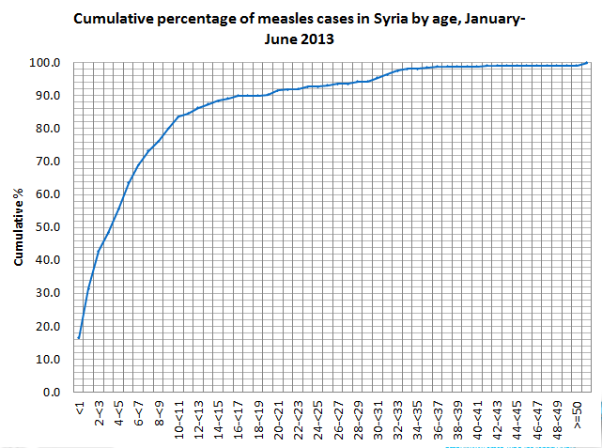
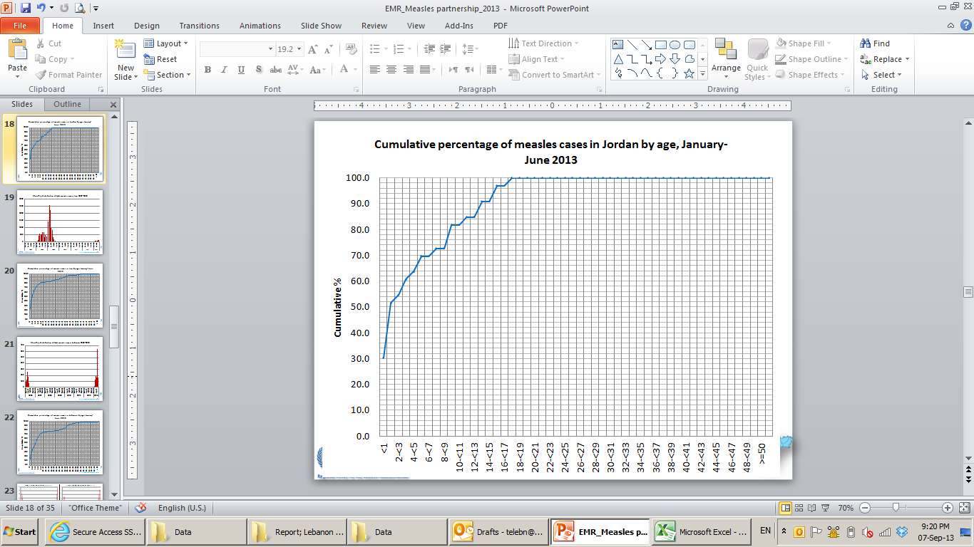
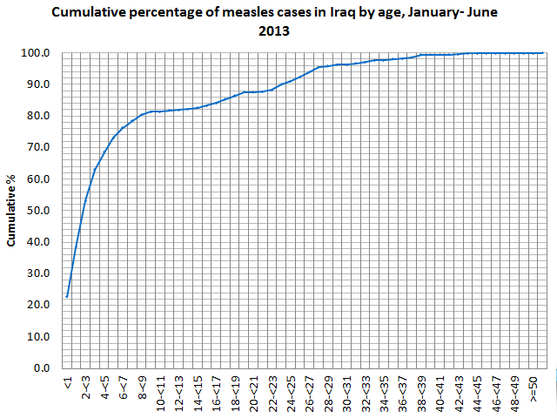
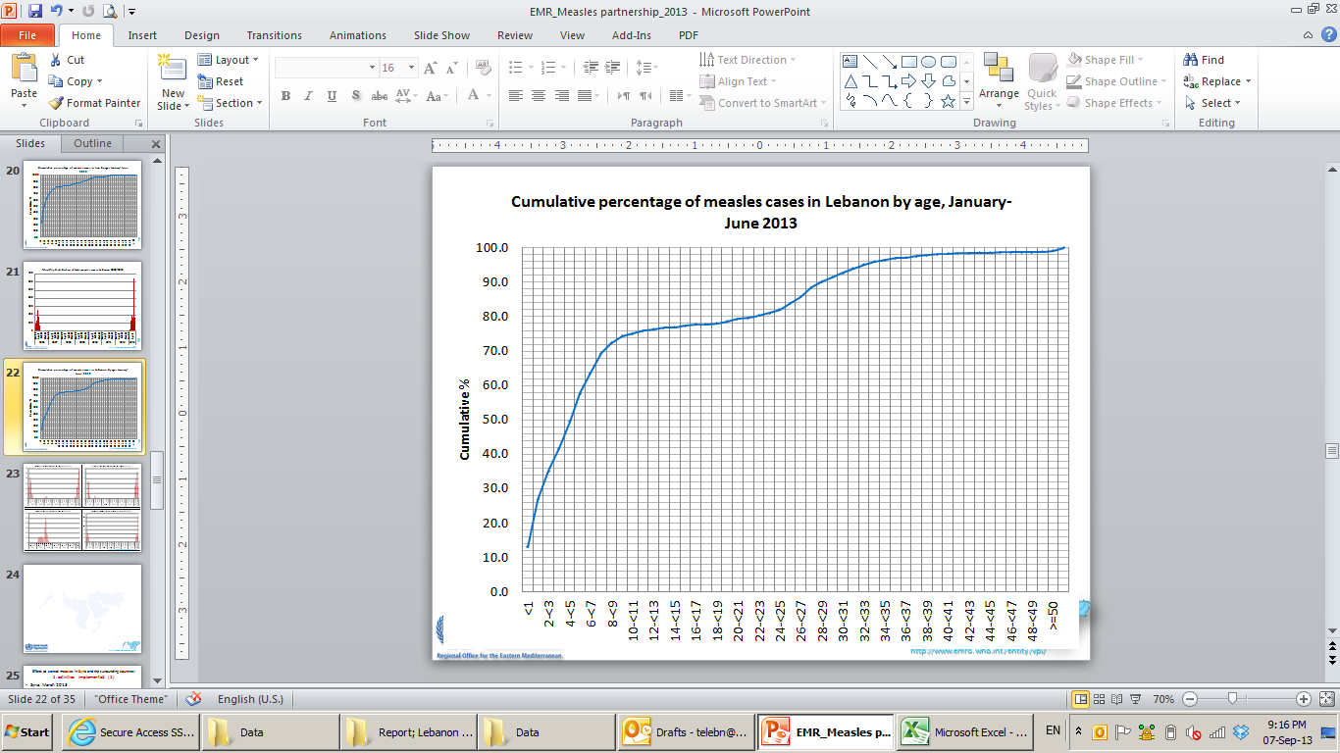
21y
13y
23y
29y

