Slide 1
Road Map to Achieving Goals
11th Annual Meeting
Measles and Rubella Initiative
Washington, DC
Peter Strebel, WHO/EPI

Slide 2
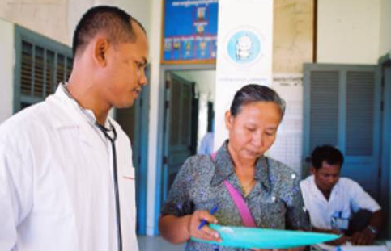
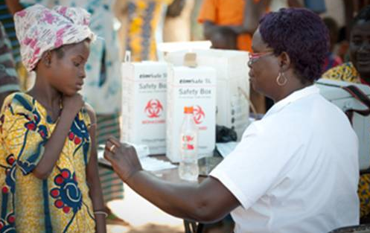
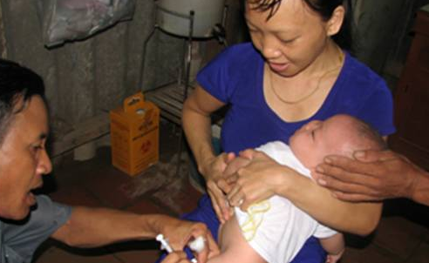
The mission of the Decade of Vaccines is to extend, by 2020 and beyond, the full benefits of immunization to all people, regardless of where they are born, who they are, or where they live."
Decade of Vaccines vision
Notes:
At the world economic forum in 2010, Mr Bill Gates junior challenged the world to make the next 10 years the Decade of Vaccines. The mission of the DOV

Slide 3
The Decade of Vaccines (DoV) is about taking action to achieve ambitious goals
Avert hundreds of millions of cases and millions of future deaths
Gain billions of dollars of economic productivity
Contribute to exceeding MDG 4 target for reduction in child mortality
Achieve a world free of polio
Meet global and regional elimination targets
Meet vaccination coverage targets in every region, country and community
Develop and introduce new and improved vaccines and technologies
Notes:
The DOV is about taking action to achieve ambitious goals. Four such high level goals have been established for the decade …

Slide 4
The Global Vaccine Action Plan (GVAP) identifies measurable targets for each goal
  By 2015: Interrupt wild polio virus transmission
  By 2020:Certification of poliomyelitis eradication
Meet vaccination coverage targets in every region, country and community
  By 2015: 80+ LICs and MICs have introduced 1+ new or underutilized vaccine to their immunization (vs 2011)
  By 2020: 90% national coverage , 80% in every district for all vaccines in immunization programmes
Achieve a world free of polio
  By 2015: Neo-natal tetanus eliminated in all WHO regions, Measles eliminated in at least 4, Rubella in at least 2
  By 2020:Measles and rubella eliminated in 5 WHO regions
Develop and introduce new and improved vaccines and technologies
  By 2020: Licensure, launch of vaccine(s) against one or more major non-VPDs
  By 2020: Licensure, launch of 1+ new platform delivery technology
Meet global and regional elimination targets
Notes:
The DOV is about taking action to achieve ambitious goals. At the World Health Assembly in May 2012, all Member States endorsed the Global Vaccine Action Plan of the DOV. The GVAP identifies measurable targets for each goal. Under the goal of meeting global and regional elimination targets, the milestones are by ..

Slide 5


GLOBAL MEASLES AND RUBELLA
strategic plan
2012–2020
Notes:
On April 23 of this year, one month before the GVAP, the core partners of the Measles Initiative launched the Global Measles and Rubella Strategic Plan, 2012-2020

Slide 6
“With strong partnerships, resources and political will, we can, and must work together to achieve and maintain the elimination of measles, rubella and CRS globally”
Margaret Chan, DG, WHO
Anthony Lake, Executive Director, UNICEF
Timothy E. Wirth, President, UNF
Gail J. McGovern, President & CEO, ARC
Thomas R. Frieden, Director, CDC
Notes:
The new strategic plan took over 15 months to develop. It involved extensive consultation, consensus building and was finally signed off by the Heads of Agency. In the foreward to the plan, they layout the future direction ….

Slide 7
Vision
Achieve and maintain a world without measles, rubella and congenital rubella syndrome
Notes:
7
The new strategic plan provides a more detailed "road map" to where we are going. The vision is to ….

Slide 8
Goals
By end 2015:
Reduce global measles mortality by at least 95% compared with 2000 estimates
Achieve regional measles and rubella/CRS elimination goals
  Measles: The American, European, W. Pacific, and E. Mediterranean
  Rubella: The American and European
By end 2020:
Achieve measles and rubella elimination in at least five WHO regions
Notes:
8
Our goals are by end 2015 to … And by end 2020 to … These goals are the same as the goals established by Member States in each of the WHO Regions and are directly aligned with the high level goals in the GVAP

Slide 9
Five Strategies
High population immunity through vaccination with two doses of M and R containing vaccines
Effective surveillance, monitoring and evaluation
Outbreak preparedness and response & case management
Communication to build public confidence and demand for immunization
Research and development
Notes:
9
How will we reach these ambitious goals? The Strategic Plan has 5 key strategies for reaching the goals. They are …

Slide 10
Four Guiding Principles
Country ownership and sustainability
Routine immunization and health systems strengthening
Equity
Linkages
  polio eradication
  new vaccines
  other proven child survival interventions
  surveillance activities
Notes:
In addition, the Strat Plan emphasizes 4 guiding principles for how programme activities should be carried out. They are to develop country ownership, to strengthen systems, to promote equity, and to reinforce linkages with other programmes

Slide 11
Priorities
Reach the 2015 measles mortality reduction goal and regional elimination targets
Strengthen immunization systems
68 priority countries
  Low and lower-middle income countries
  High measles burden (low MCV1 coverage)
  High rubella/CRS burden (not using RCV)
Notes:
Our immediate priorities are to reach the 2015 measles mortality reduction goal and regional elimination targets. And to do this in a manner that strengthens immunization systems and improves routine coverage. The focus of our work will be 68 priority countries that are low or lower-middle income countries, with high burden of measles and rubella/CRS

Slide 12
Focusing in on the details… population immunity monitoring and surveillance outbreak response
Notes:
For the remainder of the presentation, I would like to zoom in on 3 of the key strategies … building high population immunity, monitoring/surveillance, and outbreak preparedness and response. There will be separate presentations on the communications strategy and the research agenda

Slide 13
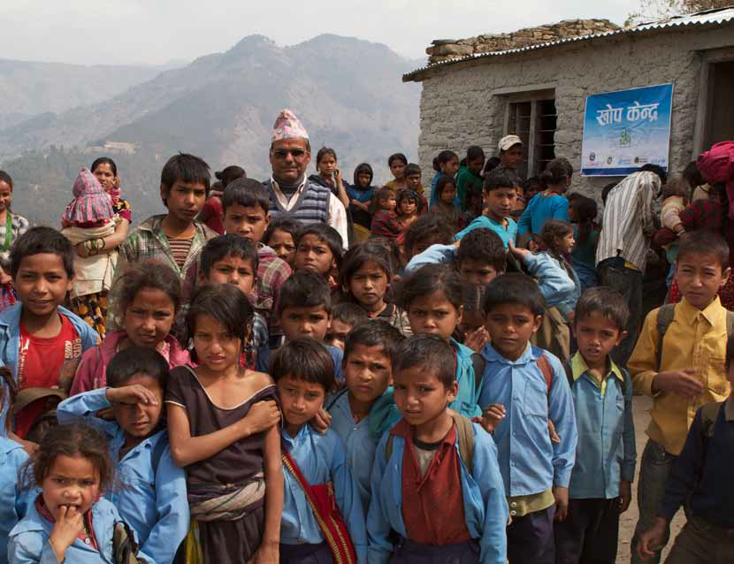
1. Building blocks of high population immunity ….
Increase 1st dose to >95%
Expand coverage with 2nd dose
High quality SIAs
Notes:
There are 3 basic building blocks to achieve high population immunity. They are

Slide 14
20.1 million infants not immunized (MCV1), 2011
Source: WHO/UNICEF coverage estimates 2011 revision. July 2012
Immunization Vaccines and Biologicals, (IVB),
World Health Organization.
194 WHO Member States. Date of slide: 13 September 2013.
Notes:
Two thirds of the 20 million infants who missed their first dose of measles vaccine live in 10 countries shown on the is pie chart…

Slide 15
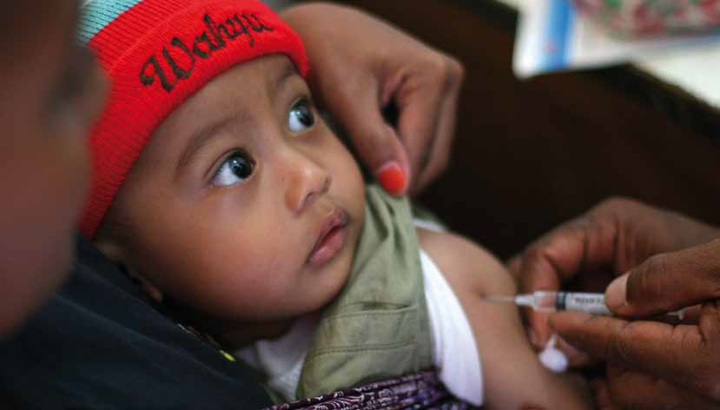
Root causes of low coverage ….
Lack of vaccine availability
Physical access
Missed opportunities
Health worker KAPs
Caregiver factors
Community/societal factors
Notes:
The strategic plan makes a firm commitment to work with other immunization partners to identify the root causes of low coverage. These include …
In addition work is ongoing to determine how to monitor the impact of measles SIAs on the immunization system in general and Rebecca Fields will be presenting her work on this latter during the meeting.

Slide 16
Countries Giving 2 Doses of Measles Vaccine in their Routine National Immunization System, 2011
No (53 countries or 27%)
Yes (141 countries or 73%)
Source: WHO/IVB database, 194 WHO Member States. Data as of July 2012
Date of slide: 20 July 2012
Notes:
The second building block of high pop immunity is to expand the use of a 2nd dose of measles vaccine delivered through the routine programme. This map shows the 53 countries in grey that had not established a routine visit in their schedule to deliver a 2nd dose of measles vaccine.

Slide 17
Expanding MCV2 in routine
No of Countries with MCV2 in Routine
2020 to 2011
Countries introducing MCV2:
2011:
  Bolivia, Botswana, Djibouti, India, Suriname
2012:
  Bangladesh, Burundi, Cambodia, Eritrea, Gambia, Ghana, Sao Tome, Zambia
2013
  Burkina Faso
  Kenya
Notes:
There has been a gradual but steady increase in the number of countries with a routine 2 dose schedule. The chart on the left this increase which if it is maintained will result in nearly all Member states using routine MCV2 by 2020. Countries that have introduced MCV2 in 2011 were …
For many of these countries this has been made possible by funding provided by GAVI

Slide 18
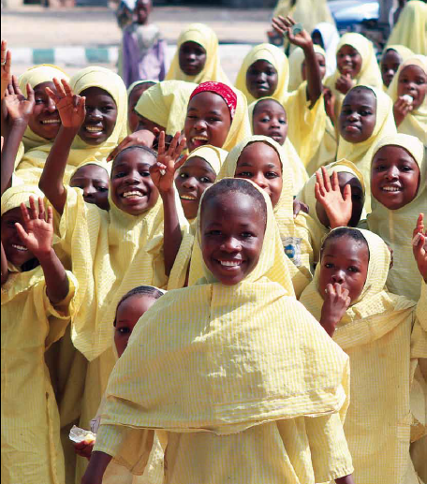
Rubella Vaccine Position Paper
(WHO, July 2011)
  “In light of the remaining global burden of CRS and proven efficacy and safety of RCVs,
  WHO recommends that
  countries take the
  opportunity offered by measles
  control and elimination
  activities to introduce
  RCVs."
  The preferred approach is
  through a wide age-range
  campaign for all children 9 months to 15 years of age followed by introduction of RCV in the routine programme
Notes:
SIAs play a major role in rapidly increasing population immunity through specifically targeting children who missed routine immunization and covering multiple birth cohorts at one time. The new WHO PP on rubella vaccine provides the policy basis for a combined approach to the prevention of both rubella and measles through SIAs. It reads …

Slide 19
Projected Dates of Rubella introductions
GAVI and non-GAVI countries, by end 2018
2013 | 2014 | 2015 | 2016 | 2017 | 2018
11 | 12 | 17 | 14 | 6 | 5
2013
Cambodia
Cape Verde
Ghana
Indonesia*
Kiribati
Korea, DPR
Rwanda
Senegal
Samoa
Solomon Islands
Vanuatu
Vietnam
2014
Benin
Botswana
Djibouti
Gambia
Lesotho
Mali
Pakistan
South Africa
Sudan: North
Tanzania
2015
Afghanistan
Bangladesh*
Burundi
Cameroon
Eritrea
Kenya
Myanmar
Papua New Guinea
Philippines
Sao Tome e Principe
Somalia
Sudan: South
Uganda
Yemen
Zimbabwe
2016
Burkina Faso
Central African Republic
Comoros
Congo, DR*
Congo, Rep
Ethiopia
Madagascar
Malawi
Mozambique
Niger
Swaziland
Timor Leste
Togo
Zambia
2017
Angola
Cote d'Ivoire
Gabon
Liberia
Mauritania
Nigeria*
2018
Chad
Equatorial Guinea
Guinea
Guinea-Bissau
Sierra Leone
Based on WHO Regional Office, UNICEF SD and PD, and GAVI Strategic
Demand Forecast, September 2012 (subject to change)
India and Indonesia plans are uncertain
* rolling SIAs
Notes:
There are some 64 countries not using RCV in their routine programme. When the GAVI Board announced in November 2011 that it would open a window to support these countries introduce rubella vaccine, there was a flurry of activity to determining the likely date of introduction for different countries. This chart show the projected dates based on information from

Slide 20
Projected Rubella Vaccine Introductions,
No. to be vaccinated by year and country, 2012-2018
Notes:
When these country introductions are plotted according to the number of children to be vaccinated by year the picture looks like this.
Cumulative total SIA (0-15 years) = 974 million
Cumulative total routine (birth cohort starting birth cohort following SIA India total started in 2016) = 221 million

Slide 21
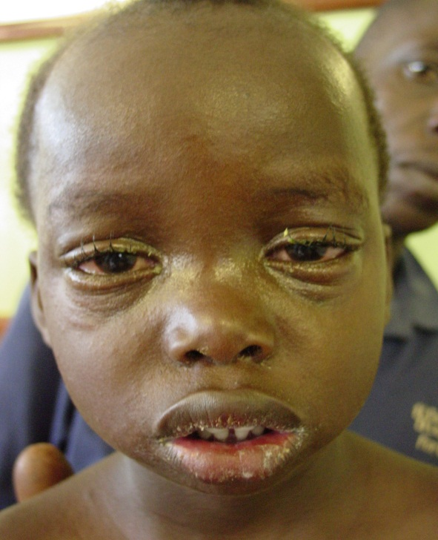
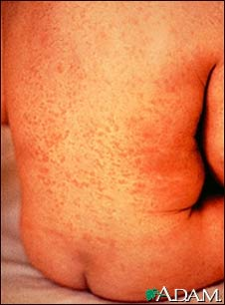
2. Monitoring and
Surveillance …
Measles is easily recognized
Network of global laboratories

Slide 22
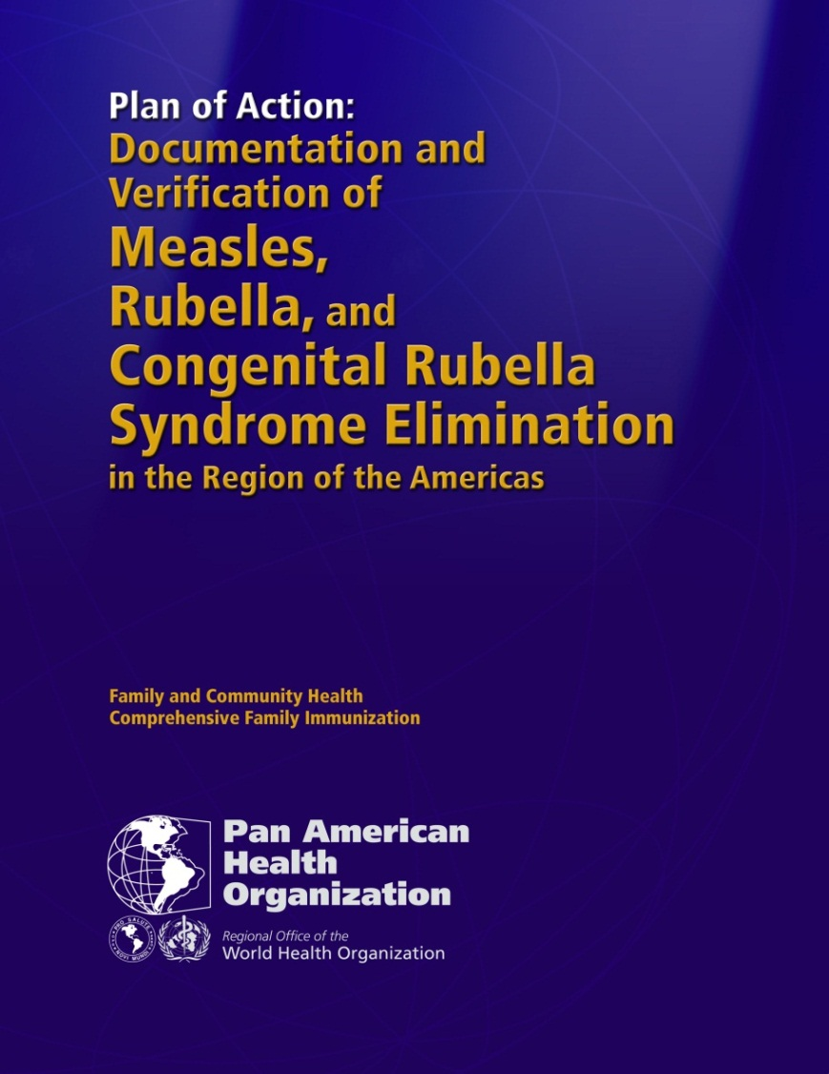
Verification of elimination as a driver of programme performance…
PAHO Plan of Action
Basic Principles
Criteria
Components
Terms of reference
  Intl Expert Committee
  National Commissions
Time line
Notes:
4 WHO regions have established regional commissions for monitoring progress towards elimination and verifying its achievement. PAHO and the countries in the Americas have pioneered this approach. Their plan of action for the …
This verification process demands scrutiny of the evidence at national level is acting as a driver of programme performance.

Slide 24
"Measles is the canary in the coal mine" ….. Seth Berkley
"Measles outbreaks are a stress test for the health system"
….. Dave Durrheim
3. Outbreak Response
Notes:
Why are outbreaks important? Firstly measles is one of the most infectious human diseases. The second is that measles outbreaks are an early warning signal of low immunization coverage. Seth Berkley, CEO GAVI has called measles the canary in the coal mine because it is an early warning signal of low immunization coverage; Dave Durrheim, Chair of the WPRO RVC recently said ….

Slide 25

Reported Measles Incidence Rate, January to December 2011, and
Number of Reported Measles Cases in 15 Large Outbreaks, January 2011 to May 2012
France: 15,576 Cases
Ukraine: 11,441 Cases
Romania: 5,616 Cases
Pakistan: 4,386 Cases
Italy: 5,314 Cases
Somalia: 17,508 Cases
Niger: 12,004 Cases
Nigeria: 19,021 Cases
Philippines: 6,910 Cases
Chad: 13,324 Cases
Dem Rep Congo: 151,022 Cases
0
900
1'800
3'600
Km
Ethiopia: 6,119 Cases
<1
(75 countries or 39%)
Zambia: 13,234 Cases
≥1 - <10
(39 countries or 20%)
Sudan: 5,616 Cases
≥10 - <50
(38 countries or 19%)
≥50
Kenya: 3,872 Cases
(25 countries or 13%)
No data reported to WHO HQ
Data sources: surveillance DEF file and country reports received at WHO IVB
(17 countries or 9%)
Data in HQ as of 30 May 2012
Not applicable
Notes:
This map shows the 15 largest measles outbreaks over the past 18 months. Outbreaks have affected primarily Europe (with outbreaks in Ukraine, France, Romania and Italy), Africa (with large outbreaks in …) and to a lesser Asia. During this period, 10 of these 15 outbreaks were associated with documented importations into the Americas.

Slide 26
GAVI Support for Outbreak Response
Purpose
  To prevent measles deaths and limit spread
  To enable rapid response
Mechanism
  To be managed by MR Initiative
  Standard operating principles being developed
Criteria:
    Laboratory confirmed
    Outbreak of national or international public health importance
    Field investigation/risk assessment
    Government commitment
Notes:
For these reasons, outbreak preparedness and response has been made a key strategy in the fight against measles and rubella. In June of this year, the GAVI Board decided to provide support to the MR Initiative to enable effective outbreak response. The purpose … the mechanism, and the criteria for deployment of the funds.

Slide 27
Summary
We have the road maps
We have proven strategies
We have immediate priorities
Will face challenges
Opportunities:
  Renewed commitment within the MR Initiative
  Roll-out of rubella vaccine
  New resources and partners
Notes:
Annual reports at WHA on GVAP (on progress towards the goals)

Slide 28
Remarks by William H. Gates Sr.
Lions Club, July 7, 2011
One of the challenges of the fight against measles, and of immunization in general, is that you’ve got to keep at it. You’ve got to be relentless, tireless. Because children who need to be protected … are born every day. You don’t vaccinate once. You do it year, after year, after year.
Notes:
What remains to be done? This quote captures the work that id needed to achieve our goals

