Slide 1
Measles and Rubella
Global Update
M&RI Partners Meeting
September 11, 2019
Washington, DC
Katrina Kretsinger, MD, MA
WHO HQ, IVB/EPI

Slide 2
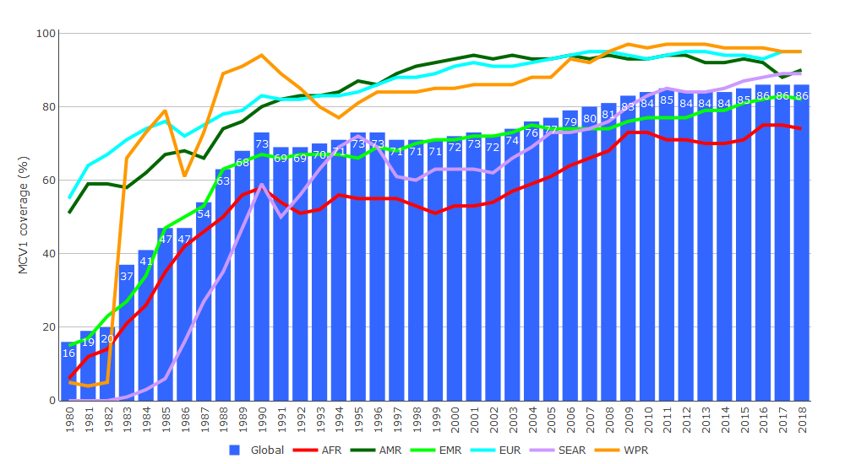
Global Measles Vaccine Coverage Flat
Measles containing vaccine 1st dose (MCV1) coverage by WHO region, 1980-2018
86%
Source: WHO/UNICEF coverage estimates 2018 revision, July 2019.
Immunization Vaccines and Biologicals, (IVB), World Health Organization (WHO).
194 WHO Member States. Date of slide: 08 July 2019.

Slide 3
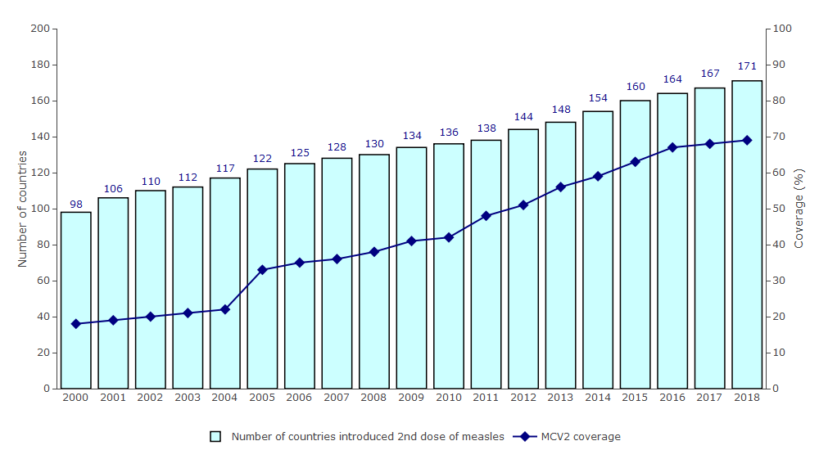
Steady Increases in Measles Second Dose Number of countries having introduced 2nd dose of measles containing vaccines (MCV2) and global MCV2 coverage, 2000-2018
2018 introductions: Bolivia, Dominican Republic, Honduras, Solomon Islands
69%
Source: WHO/UNICEF coverage estimates 2018 revision, July 2019, and WHO database, as at 01 July 2019.
Immunization Vaccines and Biologicals, (IVB), World Health Organization (WHO).
194 WHO Member States. Date of slide: 08 July 2019.

Slide 4
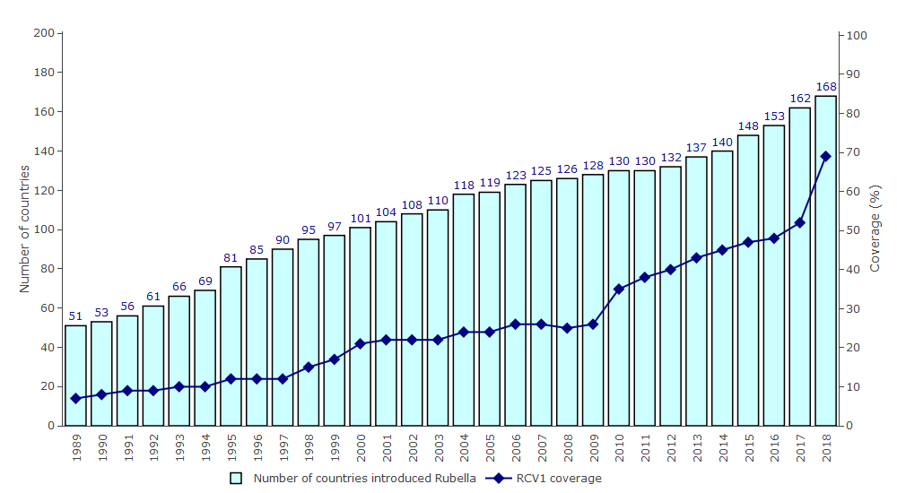
Dramatic Increases in Rubella Vaccine Coverage
Number of countries having introduced rubella containing vaccines and global infant coverage of 1st dose of rubella containing vaccines (RCV1)*, 1989-2018
2018 introductions: Angola, Côte d'Ivoire, Eritrea, Mozambique, Mauritania, Togo
69%
Source: WHO/UNICEF coverage estimates 2018 revision, July 2019, and WHO database as at 01 July 2019.
Immunization Vaccines and Biologicals, (IVB), World Health Organization (WHO).
194 WHO Member States. Date of slide: 08 July 2019.
*coverage estimates for the 1st dose of rubella containing vaccines are based on WHO and UNICEF estimates of coverage of measles containing vaccines.

Slide 5
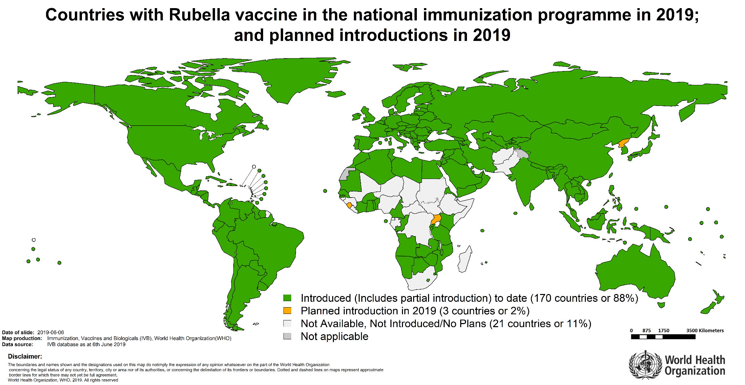
Countries with rubella vaccine in the national immunization programme; and planned introductions in 2019
Notes:
Introduced to date:
Albania Algeria Andorra Angola Antigua and Barbuda Argentina Armenia Australia Austria Azerbaijan Bahamas Bahrain Bangladesh Barbados Belarus Belgium Belize Benin Bhutan Bolivia Bosnia and Herzegovina Botswana Brazil Brunei Darussalam Bulgaria Burkina Faso Burundi Cabo Verde Cambodia Cameroon Canada Chile China Colombia Congo Cook Islands Costa Rica Côte d'Ivoire Croatia Cuba Cyprus Czech Republic Denmark Dominica Dominican Republic Ecuador Egypt El Salvador Eritrea Estonia Eswatini Fiji Finland France Gambia Georgia Germany Ghana Greece Grenada Guatemala Guyana Haiti Honduras Hungary Iceland India Iran (Islamic Republic of) Iraq Ireland Israel Italy Jamaica Japan Jordan Kazakhstan Kenya Kiribati Kuwait Kyrgyzstan Lao People's Democratic Republic Latvia Lebanon Lesotho Libya Lithuania Luxembourg Malawi Malaysia Maldives Malta Marshall Islands Mauritania Mauritius Mexico Micronesia (Federated States of ) Monaco Mongolia Montenegro Morocco Mozambique Myanmar Namibia Nauru Nepal Netherlands New Zealand Nicaragua Niue North Macedonia Norway Oman Palau Panama Papua New Guinea Paraguay Peru Philippines Poland Portugal Qatar Republic of Korea Republic of Moldova Romania Russian Federation Rwanda Saint Kitts and Nevis Saint Lucia Saint Vincent and the Grenadines Samoa San Marino Sao Tome and Principe Saudi Arabia Senegal Serbia Seychelles Singapore Slovakia Slovenia Solomon Islands Spain Sri Lanka Suriname Sweden Switzerland Syrian Arab Republic Tajikistan Thailand Timor-Leste Togo Tonga Trinidad and Tobago Tunisia Turkey Turkmenistan Tuvalu Ukraine United Arab Emirates United Kingdom United Republic of Tanzania United States of America Uruguay Uzbekistan Vanuatu Venezuela Viet Nam Yemen Zambia Zimbabwe
Partial introductions:
Indonesia
Planned introductions in 2019:
Democratic People's Republic of Korea Sierra Leone Uganda
Not Available, Not Introduced/No Plans:
Afghanistan Central African Republic Chad Comoros Democratic Republic of the Congo Djibouti Equatorial Guinea Ethiopia Gabon Guinea Guinea-Bissau Liberia Madagascar Mali Niger Nigeria Pakistan Somalia South Africa South Sudan Sudan

Slide 6
80% Reduction in Estimated Global Measles Deaths
Measles deaths down 80%
No. of measles deaths
Year
21.1 million deaths prevented from 2000-2017 by measles vaccination
Notes:
Deaths have decreased by an 80% which has resulted in measles moving down from being the 5th to the 15th leading cause of <5 child mortality (might needt o update). Despite this impressive reduction, it is still short of the 2015 target of a 95% reduction. Importantly, for both cases and deaths, progress has levelled off for the past 8 years and all three 2015 control targets were not met.
Measles vaccination has averted about 21 million deaths since 2000 with 5.5(?update) billion doses of MCV administered during this time.

Slide 7
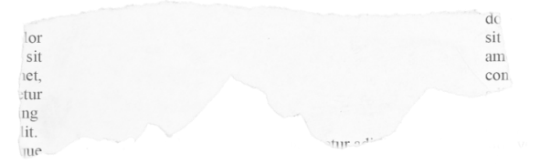

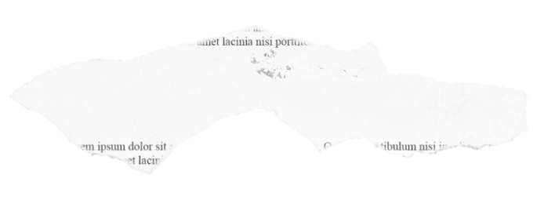
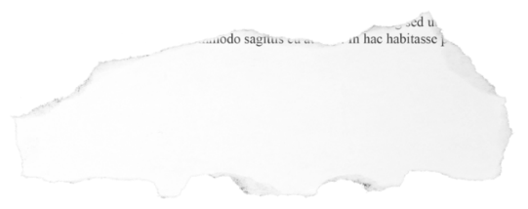
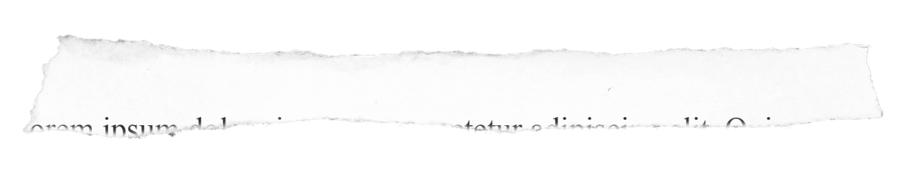
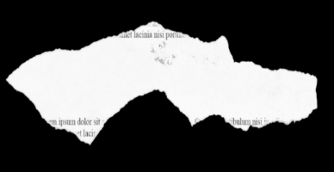


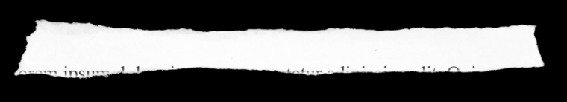
States seek to force parents
to vaccinate children
Lawmakers to propose bill to
allow teens to get vaccinated
without parental consent
Philippines measles outbreak fed by
distrust of vaccines
Hundreds of children die in
Madagascar measles outbreak
Amazon removes books peddling
vaccine misinformation
Concerns over global
resurgence of measles
Anti-vaxx 'mobs'
New York measles outbreak
prompts state of emergency
Unvaccinated children banned
from public spaces
Anti-vaxxers' must not be given credence
Italy bans unvaccinated children from schools

Slide 8
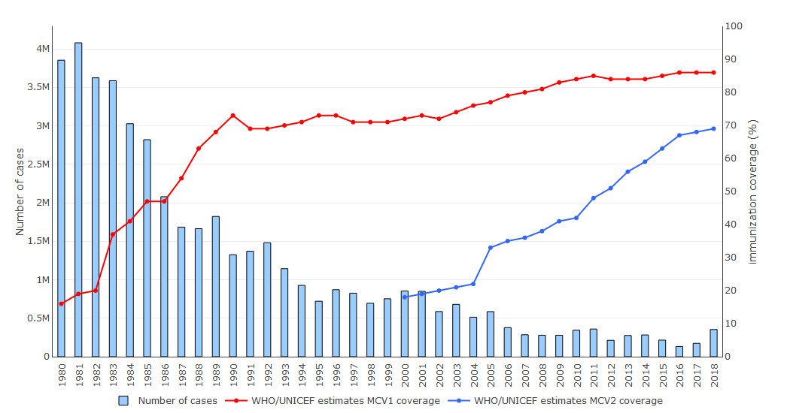
Increases in Reported Measles Cases
Measles global annual reported cases and MCV1 and MCV2* coverage, 1980-2018
86%
2017 reported measles cases = 173,330
2018 reported measles cases to date = 353,236
2019 reported measles cases (through August 7,2019, monthly data) = 364,808
Same time in 2018, 129,239 cases
Source: WHO/UNICEF coverage estimates 2018 revision, July 2019 and Cases of vaccine preventable diseases and Offical Estimates reported by Member States through the WHO/UNICEF joint reporting Form as at 01 July 2019.
Immunization Vaccines and Biologicals, (IVB), World Health Organization.
194 WHO Member States from the WPR. Date of slide: 08 July 2019

Slide 9
Measles case distribution by month and WHO Region (2015-2019)
1e+05
95000
90000
85000
80000
75000
70000
65000
60000
Measles cases (Lab+Epi+Clinical)
55000
50000
45000
40000
35000
30000
25000
20000
15000
10000
5000
0
2015-01
2015-03
2016-03
2017-03
2018-03
2019-03
2015-02
2015-04
2015-05
2015-06
2015-07
2015-08
2015-09
2015-10
2015-11
2015-12
2016-01
2016-02
2016-04
2016-05
2016-06
2016-07
2016-08
2016-09
2016-10
2016-11
2016-12
2017-01
2017-02
2017-04
2017-05
2017-06
2017-07
2017-08
2017-09
2017-10
2017-11
2017-12
2018-01
2018-02
2018-04
2018-05
2018-06
2018-07
2018-08
2018-09
2018-10
2018-11
2018-12
2019-01
2019-02
2019-04
2019-05
2019-06
2019-07
2019-08
Month of onset
AFR
AMR
EMR
EUR
SEAR
WPR
Notes: Based on data received 2019-08 - Data Source: IVB Database - This is surveillance data, hence for the last month(s), the data may be incomplete.

Slide 10
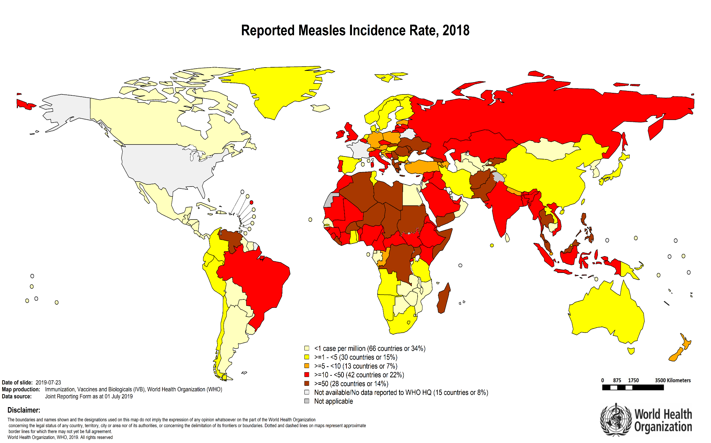
2018: 49 reported cases / million
2017: 24 reported cases / million

Slide 11
Progress and Setbacks in Measles Rubella Elimination
Regional Scorecard on Verification of Elimination, August 2019
WHO Region (No. Member States) | Regional Verification Commissions Established | Elimination Achieved |  | Re-established
 |  | No. of MS (areas) | % of MS
Americas (n=35) | Yes | Measles: 33 Rubella: 35 | 94% 100% | Venezuela Brazil
Europe (n=53) | Yes | Measles: 35 Rubella: 39 | 66% 74% | Albania, Czech Republic, Greece, United Kingdom
Western Pacific (n=27) | Yes | Measles: 7 (2) Rubella: 4 (1) | 26% 15% | Mongolia
Eastern Mediterranean (21) | Yes | Measles: 2 Rubella: 3 | 10% 14%
South-East Asia (n=11) | Yes | Measles: 5 | 45%
Africa (n=47) | Yes | - | -
TOTAL (n=194) |  | Measles: 82 (42%) Rubella: 81 (42%)
EUR: 1 (2%) additional countries interrupted measles transmission fr >12 m but <36 m.
3 (6%) additional countries interrupted rubella transmission for >12 m but <36 m.
WPR: 2 reporting entities verified for measles elimination; 1 reporting entity verified for rubella elimination
SEAR: 6 member states verified as having achieved control of rubella

Slide 12
Summary
Substantial progress in measles control since 2000
  Global number of cases and estimated deaths significantly reduced
  82 countries verified as measles eliminated; 21 million deaths averted
  81 countries verified as rubella eliminated
  More countries with rubella and measles second dose introduced
Concerns
  Resurgence of measles in all Regions
  Increasing vulnerability of countries with strong programs and high coverage
Recent trends highlight
  Measles v infectious and will find pockets of susceptibility
  Fragility of gains made in measles control
  Regional measles elimination can be achieved but difficult to sustain
  Need for global and national commitment to achieve and sustain goals

Slide 13
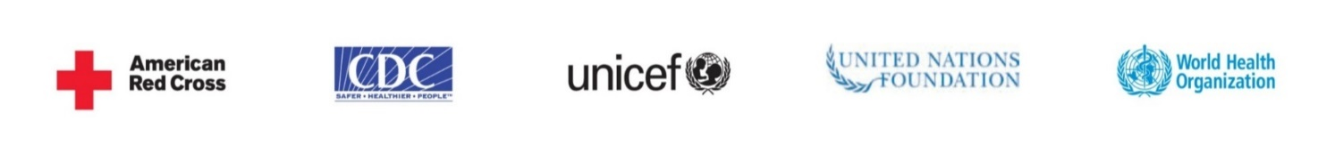
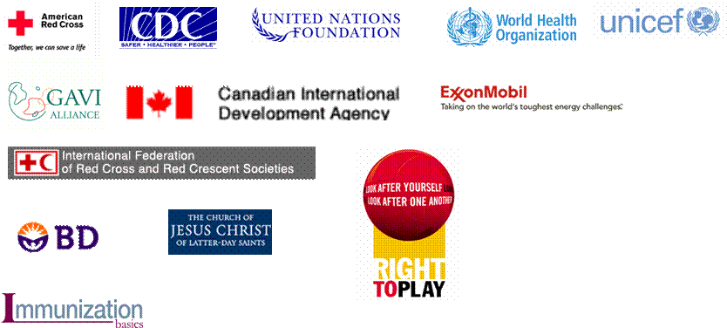



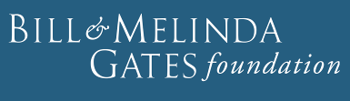











Anne Ray Charitable Trust
Thank you from the Measles and Rubella Initiative Partners

