Slide 1
Piloting of Mobile Technologies for Rapid Convenience Monitoring in Nepal’s Measles-Rubella Campaign, 2016
Dr Rajendra Pant
Director
Child Health Division
Nepal

Slide 2
What is Rapid Convenient Monitoring?
Intra-SIA RCM –
  Carried out by supervisors
  Focuses on identifying soc. mob gaps as well as unvaccinated children for corrective action while SIA is ongoing
Post SIA-
  Independent
  Focus on identifying unvaccinated children and vaccinating them
New RCM developed with CDC and piloted by WHO.
Simplifies previous methodology. Only 15 households visited and clear cut-off points to trigger corrective action.
In-House, out-of-House and school monitoring tools- focus is on In-House
Paper forms used, no real time feedback to program managers for quick corrective actions

Slide 3
Region:__________________ |  | District:________________ | Vaccination Team Supervisor (name): _____________________
Date of visit:__ /__ /__ |  | Day of SIA _______ | Post Name __________________________
Age of eligible children: |  | Monitor Name(s): _____________________ | Additional location information (optional):
HH Number | No. Eligible Children in HH | No. Eligible Children VACCINATED IN SIA (CARD/ FINGERMARK/ RECALL) | If ANY unvaccinated, reason (see list below) | If reason is REFUSAL, reason (see list below) | HH is COMPLETELY VACCINATED 1 = YES, 0 = NO
 | (A) | (B) | (C) | (D) | (E)
1
2
3
4
5
6
7
8
9
10
11
12
13
14
15
 | TOTAL NO. ELIGIBLE CHILDREN | TOTAL NO. VACCINATED CHILDREN |  |  | TOTAL NO. COMPLETELY VACCINATED HHs
In-House Monitoring Form
7 options for reasons unvaccinated
3 options if reason is refusal

Slide 4
Criteria for Trigger for corrective actions
Indicators | Trigger for corrective action
Number of houses (out of 15) with all SIA-eligible children vaccinated during SIA | <14 houses completely vaccinated
Percentage of SIA-eligible children identified in IN-HOUSE monitoring that were unvaccinated during this SIA | <90% vaccinated children; <95% used in Nepal
Percentage of SIA-eligible children identified in OUT-OF-HOUSE monitoring that were vaccinated during this SIA | <90% vaccinated children; <95% used in Nepal

Slide 5
Use of Mobile Technology for Rapid Convenience Monitoring (RCM) during Phase II of the Measles-Rubella Campaign in Nepal
February - March 2016

Slide 6
Objective & Scope
Piloting of mobile phones to tests its feasibility & utility for RCM monitoring in 10 districts of Nepal during MRC campaign
To illustrate the results for key performance indicators on a dashboard to all levels of the health system (central, regional, district) for more adequate real time supervision and remedial action-planning

Slide 7
Why use mobile phones?
Collection of GPS coordinates for team monitoring
Real-time availability of field data
Quicker analysis for more timely action.

Slide 8
Pilot Study in Nepal
  When ?:
    February-March 2016 (Phase II of campaign)
    Campaign completed in each sub-district over 10 days,
  What ?
    RCM done on 3rd and 7th days of the 10 day long campaign
    200 communities to be visited, 400 RCM reports expected to be submitted
  Where ?: Mobile phones based apps in 10 districts, 100 data collectors; Paper based in 29 districts
  Who ?: 10 District Supervisors from each district responsible for carrying out the RCMs using mobile phone based applicaiton.
  How ?: A one-day training was conducted by the central team to the 10 districts a week before the MRC. 10 phones with RCM tools installed were distributed to each of the districts.

Slide 9
Dashboard were available for supervisors
Types of dashboard – Action & Monitoring
  Action Dashboard: For supervising teams on how to take action, what action to take, and which villages need action
  RCM Team Activity Monitoring Dashboard: For making sure all RCMs are being conducted and data being submitted in all villages
Notes:
Each district was given a specific view and a URL through which they could view the visualizations on dashboards in order to keep track of the monitoring progress and RCM results.

Slide 10
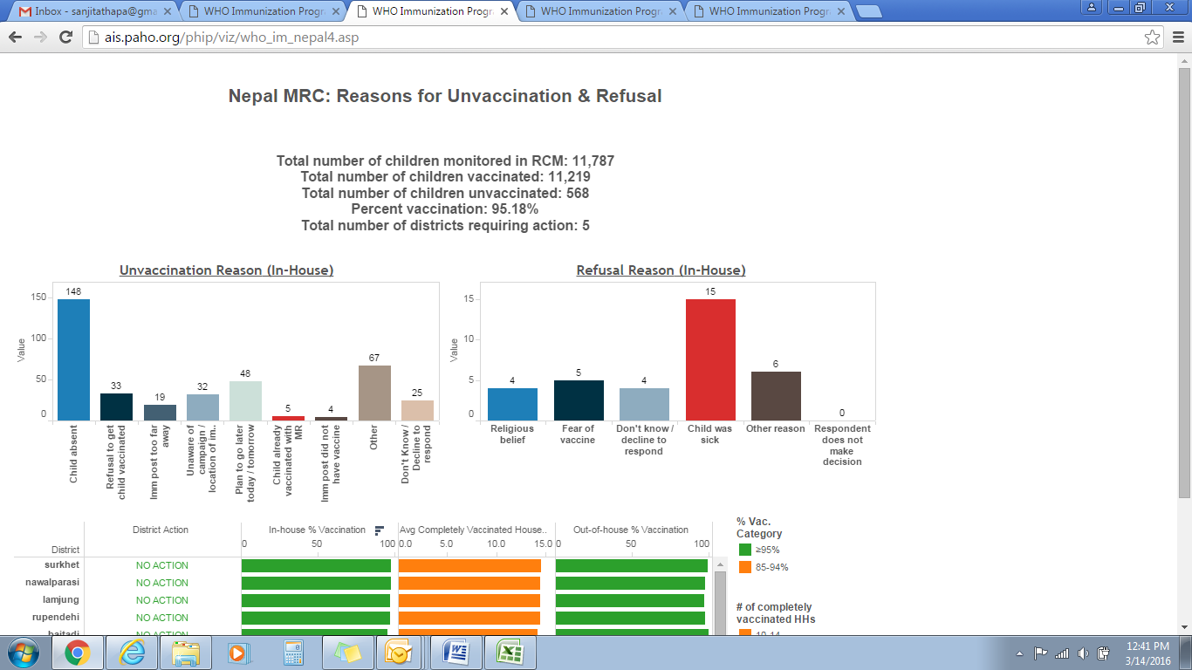
Action Dashboard: Used by District EPI Supervisor to track the overall status and the reasons for unvaccination or refusal, so that the programme can use tailored approaches in addressing low coverage in particular district
Notes:
Overall performance of the district quantitatively, Reasons cited for non-vaccination, Reasons for refusal, Table-listing of each RCM completed by district, VDC, date of visit, ward number, and whether to take action in that particular VDC based on the trigger criteria

Slide 11
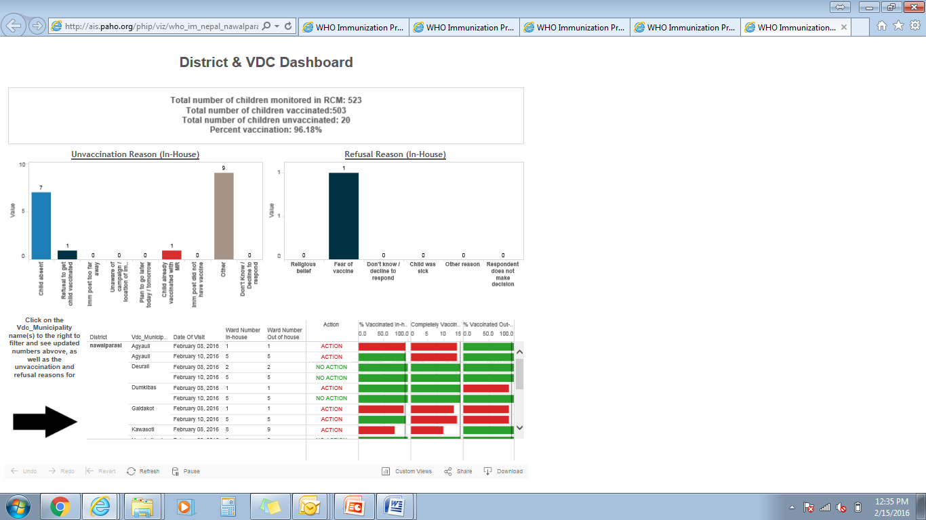
Action Dashboard

Slide 12
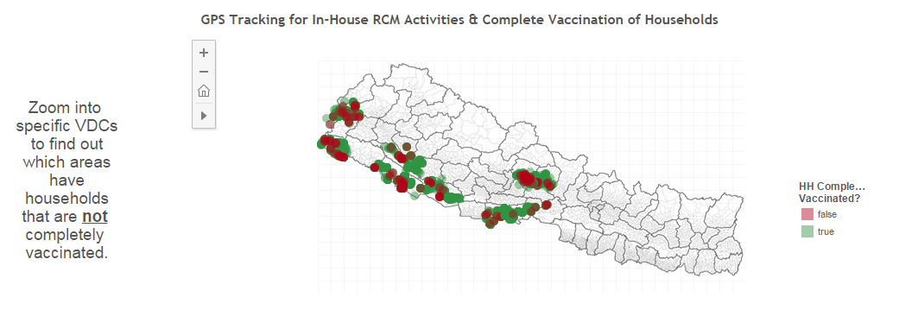
Monitoring Dashboard: Used by District Supervisors to monitor their RCM staff, making sure that RCMs are being conducted and data is being submitted from all reporting areas.

Slide 13
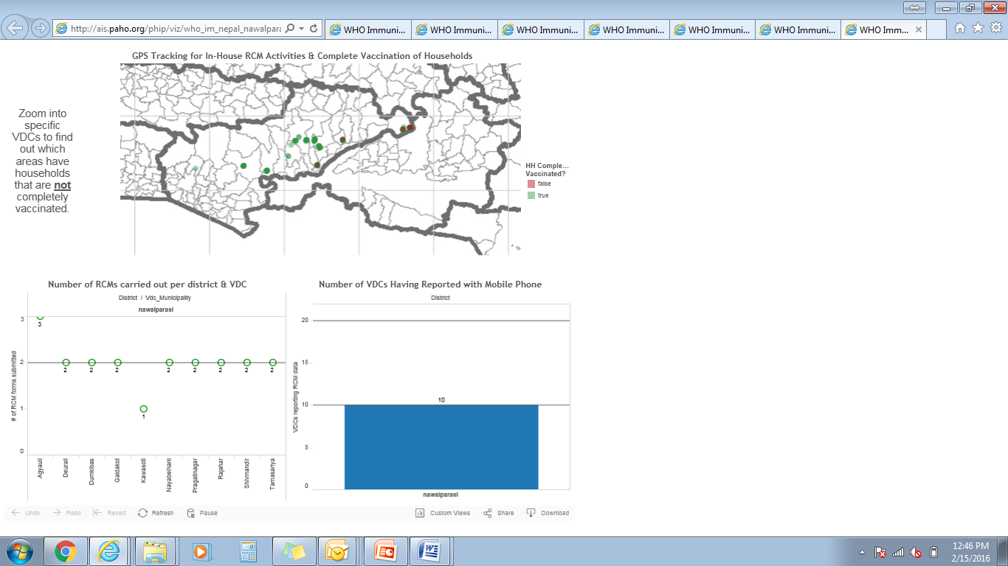
TEAM ACTIVITY MONITORING Dashboard
Notes:
A map of his/her own district with visible VDC sub-divisions including point locations of monitored households. Each household point was color-coded to distinguish between households that were and were not completely vaccinated, which was useful in showing clusters of non-vaccinated households (in red) within the district.
The number of RCMs done per VDC with the target of two RCM visits per VDC
The number of VDCs that submitted RCM reports by district, with the target of 10 by the first sub-phase, and 20 by the second sub-phase

Slide 14
What was the response to the new technology ?

Slide 15
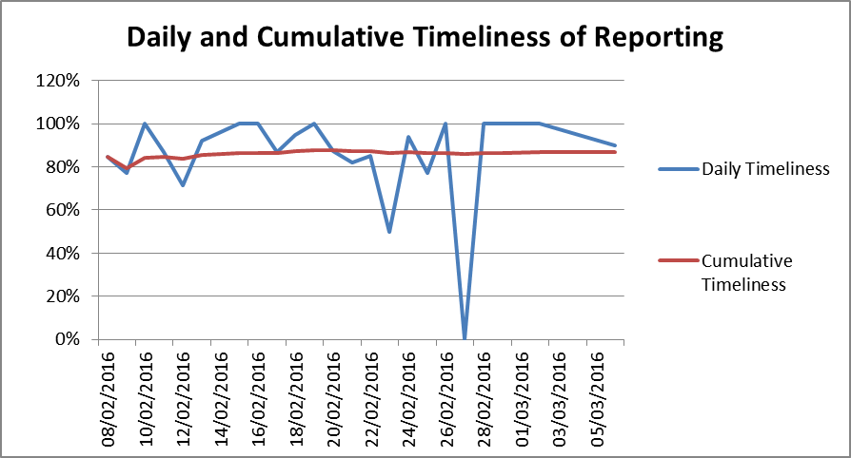
Completeness & Timeliness of Reporting
  98% (196/200) of all sub-districts reported, 94% (377/400) of expected reports received
    No paper reports received at central level as of last day of campaign
87% (328/377) reports submitted on same day as data collection

Slide 16
Difficulty on use of Monitoring Forms
 | In-house (n=90) | Out-of-house (n=89)
Easy | 32 (35.6%) | 52 (58.4%)
Somewhat easy | 10 (11.1%) | 12 (135%)
Neither difficult nor easy | 28 (31.1%) | 20 (22.5%)
Somewhat difficult | 15 (16.7%) | 3 (3.4%)
Difficult | 5 (5.5%) | 2 (2.2%)
Notes:
On the whole, adoption of new technology was well-accepted among the district health personnel, with 83% of the data collectors not finding the technology difficult to use, 94% expressing that mobile phones increased data accuracy, and 89% recommending its use in the future campaigns. Many EPI supervisors appreciated the convenience of having real-time analysis on the dashboard, allowing them to identify missed children triggering remedial action well within the timeframe of the campaign period. Nepal is trying to move from "paper-based" towards "paperless" and this was certainly a step ahead in that direction, especially in regards to the use of mobile technologies in routine immunization, for which the lessons from this pilot will be helpful.

Slide 17
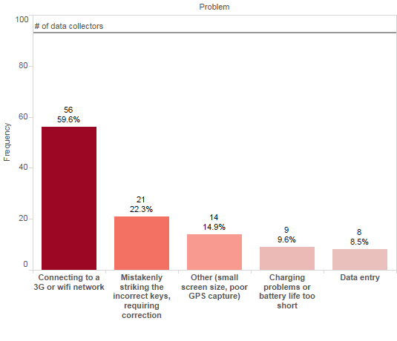
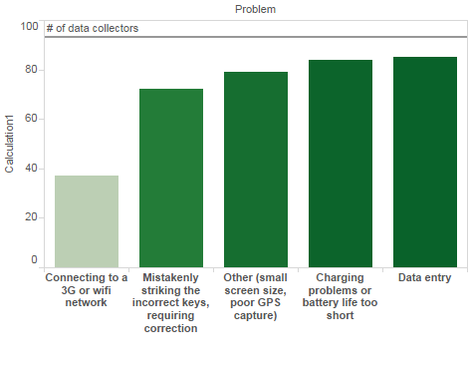
Feedback from Data Collectors: Highlights
64% found it easy or somewhat easy, 16% found it difficult
96% thought it increased accuracy
Main challenge was connecting to 3G network
About half or less expressed it was easier or reduced workload
90% recommended future use

Slide 18
Feedback from Central Level Staff
Most WHO staff and district EPI supervisors used dashboard often (every few days) to check progress of campaign
Acceptability (scale of 1-5, 5 highest)
  Data collectors: 3.6
  EPI district supervisors: 3.8
  WHO-Nepal: 4.2
  Nepal MOH: 3.0

Slide 19
How did it help in the campaign?

Slide 20
Helped to find the missed child
Identification of communities with lower than target vaccination rates, and consequent actions taken
  Overall 95.4% vaccination,
  7,323 in-house children, 5,655 households, and 3,770 out-of-house children were monitored, for a total of 11,093 children surveyed
Identified situations when action was required
While the overall percentage was fairly high, the proportion of RCM results that were marked as requiring action due to poor performance was 159 of 377, or 42%.

Slide 21
Vaccination Rates per District
 | Total eligible | Total vaccinated | % Vaccination | RCM: Action Triggered | RCM: No Action Triggered
Baitadi | 1,098 | 1,060 | 96.5% | 12 (33%) | 24 (67%)
Banke | 1,171 | 1,064 | 90.9% | 25 (64%) | 14 (36%)
Bardiya | 882 | 832 | 94.3% | 11 (37%) | 19 (63%)
Dang | 1,111 | 1,039 | 93.5% | 15 (38%) | 25 (63%)
Kanchanpur | 1,109 | 1,063 | 95.9% | 21 (57%) | 16 (43%)
Kaski | 1,079 | 1,005 | 93.1% | 21 (54%) | 18 (46%)
Lamjung | 1,161 | 1,126 | 97.0% | 17 (40%) | 25 (60%)
Nawalparasi | 1,174 | 1,143 | 97.4% | 13 (33%) | 27 (68%)
Rupendehi | 1,140 | 1,108 | 97.2% | 13 (38%) | 21 (62%)
Surkhet | 1,168 | 1,143 | 97.9% | 11 (28%) | 29 (73%)
Grand Total | 11,093 | 10,583 | 95.4% | 159 (42%) | 218 (58%)
Notes:
Of the 510 non-vaccinated children, 378 children were from the in-house monitoring surveys. These 378 children came from 311 different households, and for each of these households the reason for non-vaccination was asked, with respondents being able to choose multiple reasons if applicable.

Slide 22
Reasons for Non-Vaccination (n=311)
 | Reasons | # | %
1 | Child was absent/away from home | 126 | 41%
2 | Unaware of the campaign/ location of Imm post | 37 | 12%
3 | Imm post too far away | 4 | 1%
4 | Imm post did not have vaccine | 0 | 0%
5 | Plan to go later today/tomorrow | 41 | 13%
6 | Child is already vaccinated with MR | 2 | 1%
7 | Refusal to get child vaccinated | 68 | 22%
8 | Other | 18 | 6%
9 | Don’t know/decline to respond | 26 | 8%
Notes:
Most common reason for unvaccinated children: child being absent or away from home, with 41% of the incompletely vaccinated households citing this as a reason. Both anecdotal evidence and submitted data show that many of these children were in school. Other reasons for non-vaccination included being unaware of the campaign or the location of the post (12%), planning to go later (13%), as well as refusal (22%) to get child vaccinated, the vast majority of which was due to child being sick.

Slide 23
Reasons for Refusal (n=68)
Child was sick | Religious beliefs | Fear of vaccine | Respondent does not make that decision | Other | Don’t know/decline to respond
53 | 1 | 5 | 2 | 4 | 5
78% | 1% | 7% | 3% | 6% | 7%
Notes:
The most commonly cited sickness or condition that led to this refusal was high fever.

Slide 24
Successes
Increased transparency & accountability and more effective supervision as data is available at central level immediately
Training and process was clear enough to have complete, timely data
Overall, high acceptability and enthusiasm among country staff despite expressed difficulties
Whats app support group

Slide 25
Challenges
Limited documentation of actions taken
Limited district- or region-wide actions
Challenges using the phone
  GPS often impossible to capture or inaccurate
  Connection to 3G network difficult in rural areas
  Small screen size, mistakenly striking wrong keys
Challenges with analysis
  Duplicate data points/data cleaning
  Community names

Slide 26
Future Use and Sustainability
Demand from countries
Human Resource
  Support from which level?
  In-house capacity or contractor?
Funding
  Communication & advocacy (documentation, etc.)

Slide 27
Looking forward
Implementation of new global guidance on use of RCM
More robust evaluation mobile technology impact
Sustainable framework for support and funding
  Advocacy for wider use of this technology in countries
Documentation

Slide 28
Challenges
Minor challenges identified during the piloting with mobile phones
  inaccurate or unavailable GPS coordinates,
  difficulties with connecting to 3G network,
  problems with form uploads
  small screen size on the phones

Slide 29
Conclusion
RCM using mobile technology is user friendly and can be used with minimal training
  Currently more than 98% health workers are already using personal mobile phones so not a new technology
Real time reporting effective to take actions
Use could be expanded to monitoring of session in Routine Immunization
However need to consider
  Regular Maintenance of the technology
  Easy availability of internet connection and server to managers

Slide 30
धन्यवाद
THANK YOU !

