Slide 1
Post-SIA Coverage Survey:
New WHO Vaccination Coverage Cluster Survey Reference Manual
Accelerating Progress Towards Measles and Rubella Control/ Elimination Goals
June 2016

Slide 2


Vaccination Coverage Cluster Survey
Working draft available on the Web: http://www.who.int/immunization/monitoring_surveillance/en/
Pilot test(s) ongoing
Implementation experiences will inform finalization
Working Group
  Tony Burton
  Pierre Claquin
  Felicity Cutts
  Dale Rhoda
Immunization coverage cluster survey – updated Reference Manual
2015

Slide 3
Why a New WHO Manual
To provide a methodology more aligned with well-accepted household cluster survey methods, aimed at improving survey accuracy and overall quality.
  Routine Immunization (RI)
    Including HPV
  Post supplementary immunization activities (SIAs)
Old points with renewed emphasis:
  Taking steps to ensure minimize bias and improve data quality
  Highlighting limitations
    To try to avoid unmet expectations or misuse of results
  Using results for action

Slide 4
Main 2015 Enhancements: 1. Defining the Survey Scope
Define the target population
  What are the eligibility criteria for the population you plan to survey?
    e.g., children 12-23 months of age
  Is there more than one target population?
    e.g., children 12-23 months of age and women who gave birth in the last 12 months for tetanus ascertainment
    e.g., children up to 15 years for measles SIA coverage and children 12-23 months for RI assessment

Slide 5
Main 2015 Enhancements: 1. Defining the Survey Scope
Set Goal(s)
Estimate (for certain level of desired precision)
  Specify target coverage and max width of (asymmetric) 95% CI
  Specify average respondents per cluster (eligible persons accepting to participate)
  Specify intra-cluster coefficient (ICC), which relates to design effect
Classify (more on this later)
  Specify two coverage thresholds
  Specify probability of Type I & II errors
Test for Difference or Change
  Specify baseline & hypothesized change
  Specify probability of Type I & II errors

Slide 6
Defining the Survey Scope
After selecting goals it is possible to:
  Propose a survey design
  Calculate sample size
  Set a survey schedule
  Estimate a budget
  Develop an analysis plan

Slide 7
Drivers of Sample Size
Number of strata
  The eligible respondents are divided into mutually exclusive and exhaustive groups, and a separate survey is conducted and reported for each group (eg. Provinces). Stata results can be combined to a nationally representative result
Desired precision
  Desired level of precision for a particular indicator
  Small increases in precision result in large increases in sample size
Coverage (expected)
  50% results in the largest sample size
Estimation vs. Classification
  Ask what stakeholders really want to know
  Wanting “precise estimation” may really mean wanting to use results to classify
  Less precise results may be adequate to classify coverage that is 5% or 10% above or below a threshold
Notes:
A group for which survey results will be reported and important parameters are estimated with a desired level of precision (the sample size has been purposefully selected to be large enough to do this). We say that a survey is stratified if the eligible respondents are divided into mutually exclusive and exhaustive groups, and a separate survey is conducted and reported for each group. Coverage surveys are often stratified geographically (reporting results for different provinces) and demographically (reporting results for urban respondents and rural respondents within each province). When the survey is conducted in every stratum, it is possible to aggregate the data (results) across strata, with care, to estimate overall results. For example, we can combine data across all provinces, weighting appropriately, to estimate representative national level coverage figures. In some situations, the eligible respondents are divided into groups, and surveys are only conducted in a subset of those groups (for example, only in provinces thought to have especially low coverage). It may not be possible to combine data across the subset of strata that were selected purposefully (that is, not selected randomly) to estimate national level results
Statistical power is usually characterized by three parameters:
1. The minimum detectable difference between two groups, or between a fixed threshold and the survey sample
2. The probability of making a Type I error, usually named α (alpha). This refers to the probability that the hypothesis test will declare the difference to be statistically significant when in truth there is no underlying difference.
3. The power of the test, which is the probability that the hypothesis test will find a statistically significant difference given that the difference exists in the population quantities. Power is often expressed as 1 – β (beta). See Annex B3 for more detail.

Slide 8
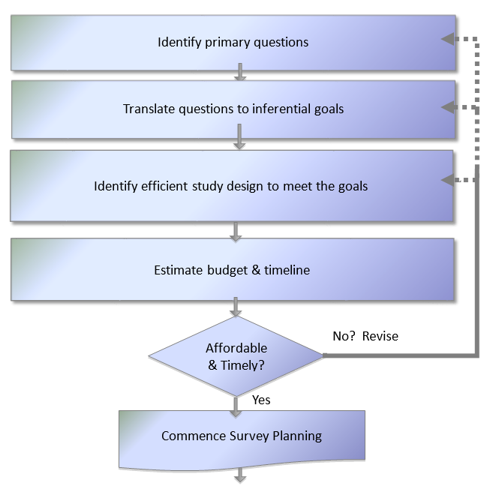
Sizing Survey to Meet Goals & Budget

Slide 9
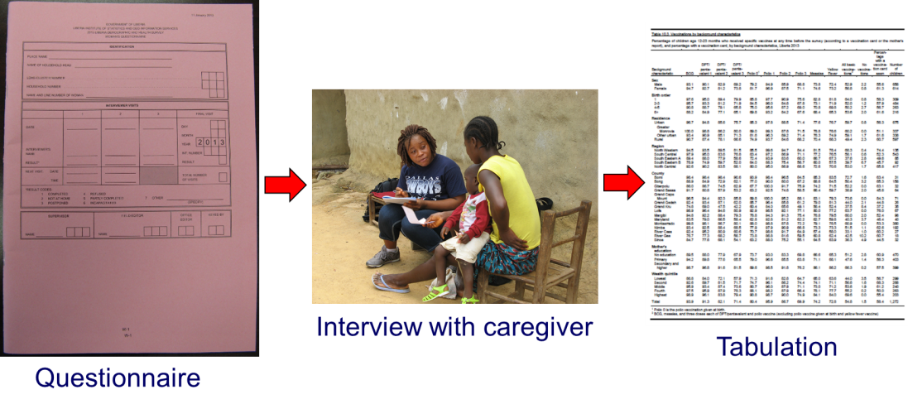
Designing Data Collection Tools
Where should you start?
Select and/or define the indicators needed
  Which vaccinations?
  Which age cohorts?
  Which background characteristics (urban/rural, sex, wealth quintile, education level of mother/caregiver)?
Maintain focus/avoid temptation to add on
  Identify how each field/question will be used in analysis and reported
  “Must have” vs. “nice to have”
    Data quality decreases with increasing number of questions
    There is such a thing as a ‘bad question’.
    How will these data be used?

Slide 10
Main 2015 Enhancements: 2. Sampling
Use probability sampling to allow strong claim of representativeness and meaningful confidence intervals
Pre-select households to be interviewed – limit opportunities for field data collectors to influence selection
Document the outcome of visits to each household so that missing data can be accounted for properly
Conduct weighted statistical analyses

Slide 11
1. Probability Sampling for Representativeness
& Meaningful Confidence Intervals
Using census enumeration areas (EAs) for primary sampling units
Obtaining (or making) maps
  Pre-selecting a segment of the EA & interviewing every eligible respondent
  Enumerating HH & selecting random sample
Revisiting those not at home at least twice
Not replacing households
Probability Sample
  - Every eligible respondent has a non-zero chance of selection into survey sample
  - Those probabilities are calculable for selected individuals

Slide 12
2. Pre-Selecting Households to Interview
In some places, microplanning may be possible without visiting the clusters, using maps & Google Earth
Elsewhere, an early visit will be necessary to make a good map and randomly select a segment to sample
Same day visit can work, but household selection should be centrally or randomly accomplished – not left to data collectors

Slide 13
3. Document Outcome at Each Household
Earlier methods used a quota sample (often n=7) for completed questionnaires in each cluster
Households with no one at home usually not recorded in any way, just substituted
These biases have not been well accounted for
The new methods will document the interview outcome at every household, which will allow statistical adjustments for missing data

Slide 14
4. Weighted Statistical Analysis
Probability sample makes confidence intervals and bounds meaningful
Plot coverage estimates along with 95% confidence intervals (CI) and 95% lower and upper confidence bounds (UCB-LCB)
Estimation and classification are straightforward

Slide 15
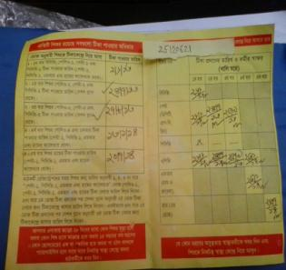
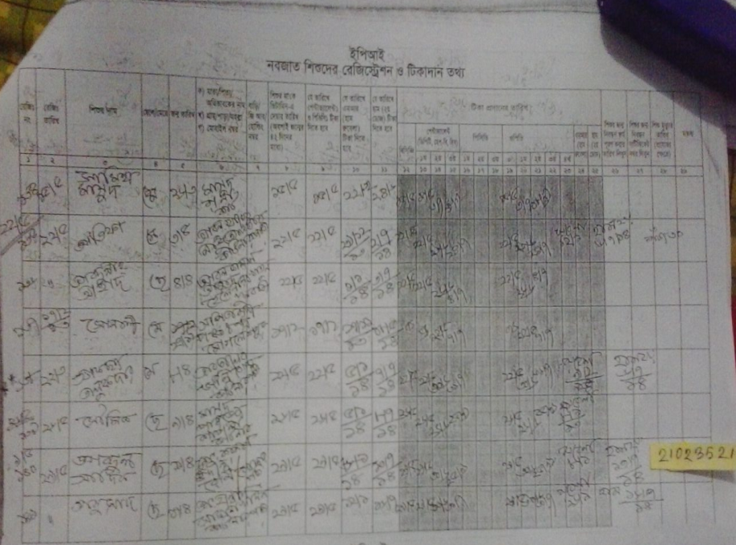
Main 2015 Enhancements: 3. Vaccination Ascertainment.
More documented data on vaccination status – visit health facilities to search registers in addition to cards
Traditional: transcribe card & if card is not available, record recall
New: Transcribe card & if card is not available, record recall AND go to the health facility to find child’s record in EPI register.
Photograph cards & registers for date verification
Record any “other vaccination”

Slide 16
Main 2015 Enhancements: 4. Guidance on digital data collection
Advantages
  Automatic data quality safeguards
    Age checks
    Built-in skip patterns
  Regular/daily transmission of data to central office
  GPS capabilities within device
  Camera in device –facilitates linkage of photos with forms
Disadvantages
  Need of procuring equipment
  Theft/breakage
  Malfunctions (eg. in hot weathers)
  Electricity/batteries
  Problems with data transmission with bad connectivity
  Programming may require outside technical assistance and special training

Slide 17
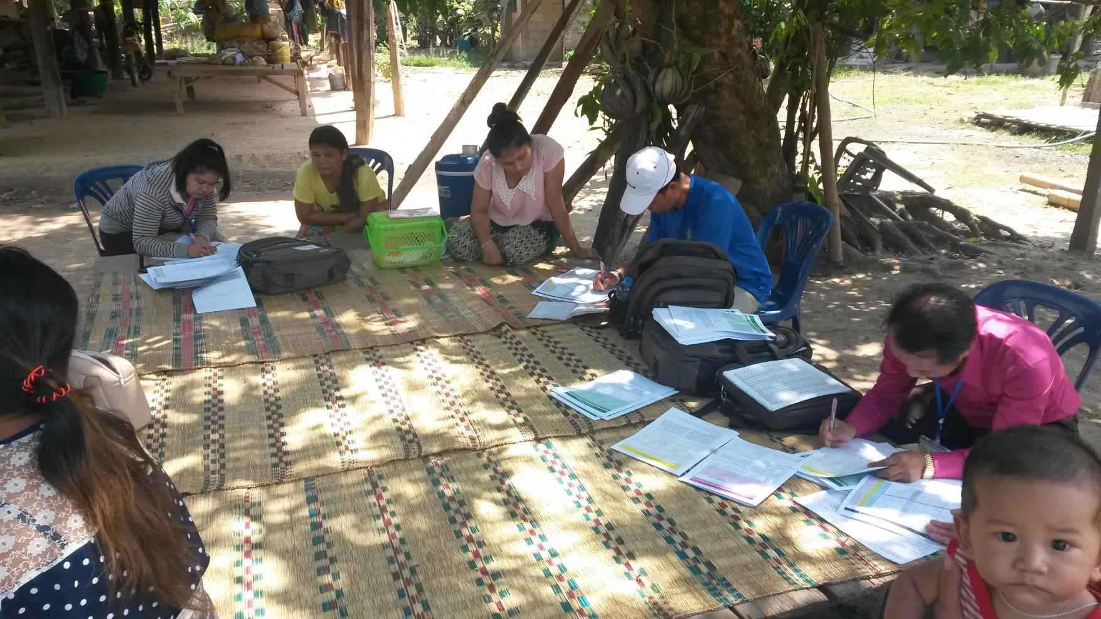

Slide 18
Main 2015 Enhancements: 5. Steps to Minimize Bias and Bolster Data Quality
Field data collectors do not select which homes are visited
Improved training on how to administer survey, interpret a variety of cards that can co-exist in the field & fill-out forms
Revisiting if no one is at home and attempting to visit at non-traditional hours
Double-checking of data before leaving home & cluster
Well-trained supervisors available to address questions
Independent monitors to re-interview some respondents and flag any issues
Emphasis on proper data recording (paper or ICT) and management

Slide 19
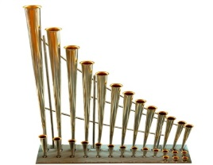
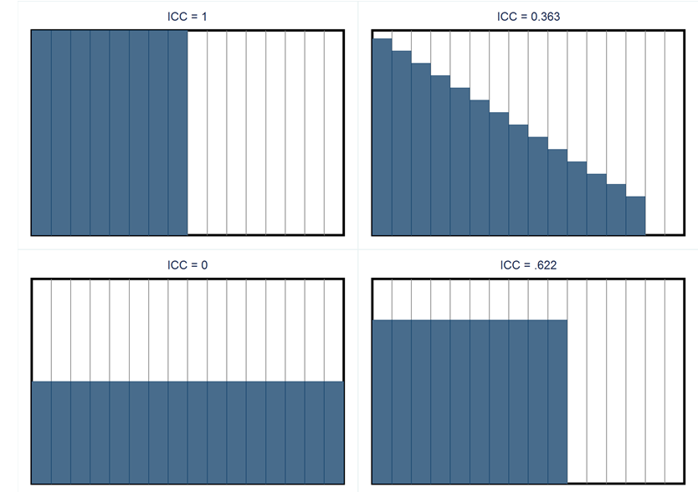
Main 2015 Enhancements: 6. Innovative graphs for presenting some results
Organ Pipe Plots
Intuitive visual representation of coverage heterogeneity
Clusters with highest coverage at left; lowest at right
Easily detect clusters with “alarmingly” low sample coverage
If the width of bar = cluster weight, then shaded area = coverage estimate
Relates to intracluster correlation coefficient (ICC), which drives design effect
“Covered strata are all alike; every poorly covered stratum is poorly covered in its own way.” – Neo Tolstoy

Slide 20
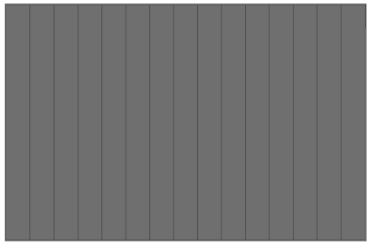
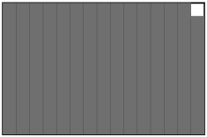
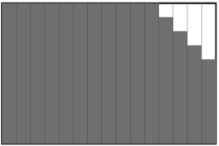
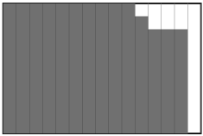
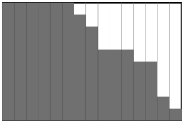
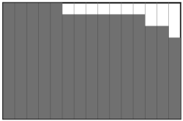
Examples of Measles Campaign Organ Pipe Plots
These three clusters have alarmingly low coverage in the survey sample.
Definition of “alarmingly low” could vary from one context to another.
Notes:
This is an immediately actionable result – and robust against all sorts of biases
Right away: Compare caregiver’s reasons for non-vaccination in the low cluster(s) with those from other clusters in the stratum
Right away: Map the locations of the clusters with low coverage and go there to investigate

Slide 21

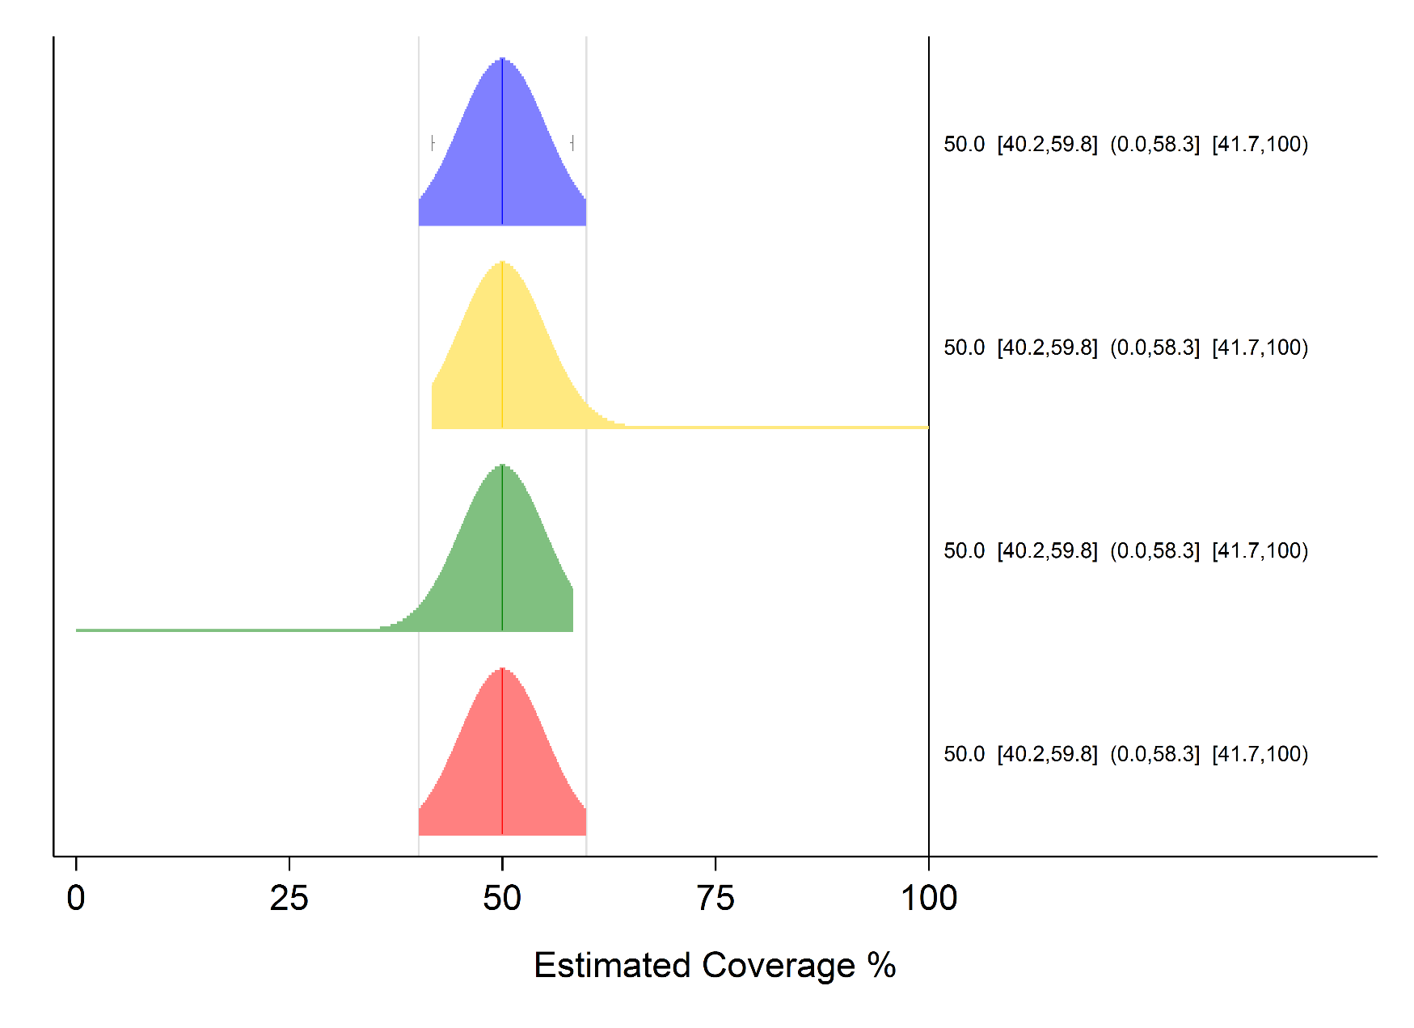
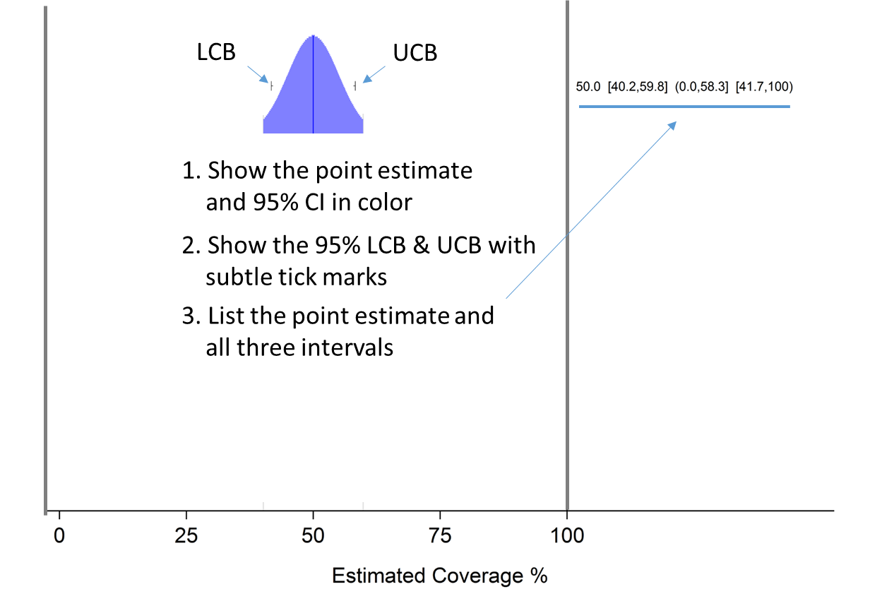
Inchworm Plots
Point estimate and Confidence Intervals

Slide 22
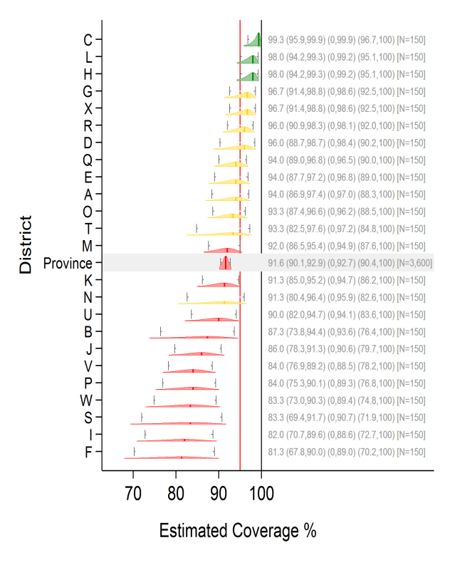
Example of inchworms
Show the distributions, and the Upper Confidence Bound and Lower Confidence Bound
Describe your classification rule clearly and portray the classification outcomes along with the graphic distributions

Slide 23
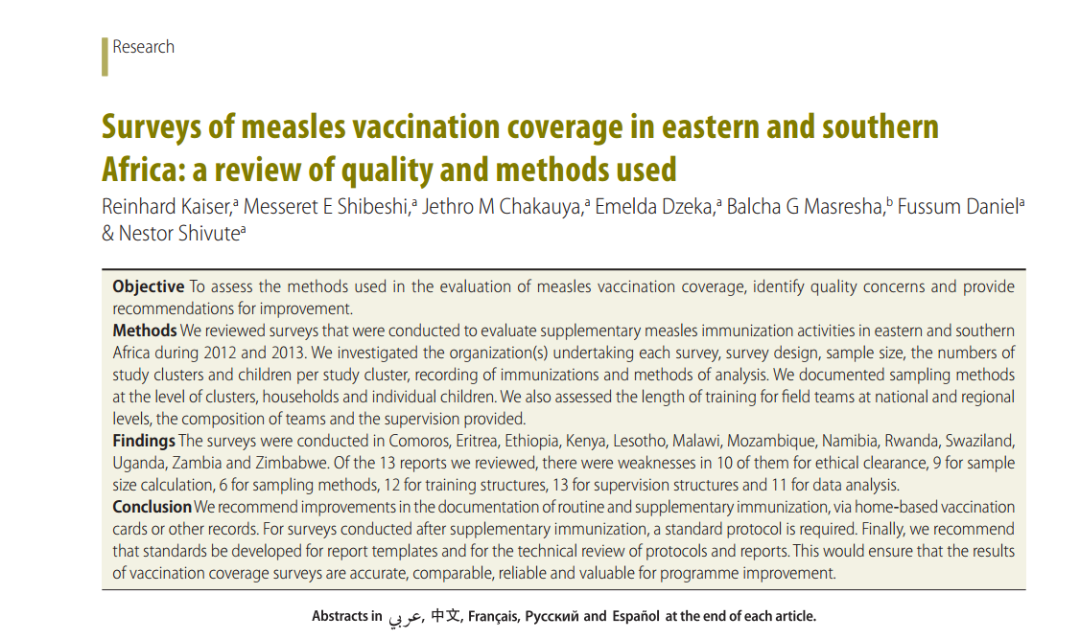
Main 2015 Enhancements: 7. Reports to be Comprehensive and persuasive about quality
Clear and complete reporting of coverage surveys
More substantive sections on strengths and limitations
Authors should be prepared to persuade the reader that the survey organizers worked hard to minimize bias in order to produce results that are representative, understandable, and actionable

Slide 24
Challenges: Technical Assistance and Investments
Probability Sampling
Larger sample sizes often appropriate, revisits
  May require 2+ trips per cluster
  Revisit non-respondents in evening/morning or during weekends, may require overnight stay in clusters
Costly technology for data capture
Technical assistance
  General implementation
  Statistical (throughout)
  Possibly with digital maps
  Possibly for data management & record linking

Slide 25
Challenges: Microplanning
Good maps
  Without them, household selection is likely to exclude outlying households
  Some countries will not have digital coordinates of census EAs and some will not have recent high-quality satellite photos; sometimes tree or cloud cover will render such maps useless or deceptive
Cluster visits
  The best plans probably result from visits
  The feasibility and workload of microplanning without a visit will vary substantially

Slide 26
Challenges: Expectations, Interpretation of Results, Understanding of Limitations
Countries with poor administrative [coverage] data quality likely to have low card retention, poor records in health facilities
Some EPI manager may expect district-level representativeness… this is costly, time-consuming and may affect overall quality
Going beyond coverage point estimates…
All the investment in a survey…what for?

Slide 27
Conclusion
The WHO Vaccination Coverage Cluster Survey recommendations have been substantially revised
Results from the new surveys should meet the increasingly high standards of immunization programs, ministries of health, and partners
Surveys conducted with the new guidelines will be more rigorous, thus more complicated, and, in most cases, more costly than under earlier guidelines
  At least at the beginning, more need for qualified Technical Assistance
  These sobering aspects should drive productive conversations about what info is truly needed next and how good is good enough

Slide 28
EXTRA SLIDES

Slide 29
New WHO Reference Manual
New Manual is NOT prescriptive, it rather walks the user through survey design, implementation, analysis and producing a report
Increase emphasis on choosing survey goals (estimation/ hypothesis testing/classification) and sizing the sample to answer key questions
Assessing Need for a Survey
Creating Steering Group
Defining Survey Scope and Budget
Setting Survey Schedule

Slide 30
“Old” EPI Cluster Survey
Typically 30 clusters of 7 kids each
Assumes DEFF = 2 or ICC ≈ 1/6
Randomly select first dwelling using spin the bottle/pen technique
Data collectors select households to visit – risk of selection bias
Survey nearby dwellings (1 child per dwelling) until 7 reached
Analysis gives equal weight to every respondent
Includes instructions to calculate a confidence interval…but not a true probability sample

Slide 31
 | “Old” EPI Cluster Survey | “New” Vaccination Coverage Cluster Survey
Sampling | Non-probabilistic sampling, analysis gives equal weight to every respondent (non-interpretable CIs) | Probabilistic sampling, weighted analysis and meaningful confidence intervals (CIs)
 | Data collectors select households to visit and randomly select first dwelling using spin the pen/bottle technique | Households (HHs) to be interviewed are pre-selected (requires good maps and usually field visits prior to interviewers field work)
 | Usually 30 clusters of 7 children each (quota sampling) | Sample size defined according to survey objectives (estimation, hypothesis testing or classification). Pre-defined number of HHs to find an approximate number of children in each cluster
 | Assumed design effect (DEEF) of 2 (intra-cluster correlation of 1/6) | Recommends DEEF depending on number of eligible people per cluster

Slide 32
 | “Old” EPI Cluster Survey | “New” Vaccination Coverage Cluster Survey
Sampling (cont.) | No attempts at revisits recommended | Recommends at least two revisits to obtain interviews in pre-selected HH; document outcomes of each visit
Vaccination Status | Relies on home-based records (cards) and/or maternal recall | Relies on home-based records (cards) and/or maternal recall, but encourages visits to health care facilities to document vaccination using registries
 |  | Recommends photographing cards
Data entry | Only paper forms included | Includes section of mobile data collection (using mobile devices)
Survey report | Not clear guidance on report writing | Encourages using the results for action Encourages detailed report writing to clearly understand limitations
Overall quality |  | Renewed emphasis on taking steps to ensure minimize bias and improve data quality

Slide 33
Characteristics, advantages, and limitations of the methodologies used for monitoring vaccination coverage
Methodology | Characteristics | Advantages | Limitations
Coverage based on administrative registries | The numerator is the reported number of persons vaccinated and the denominator is the relevant official population figure. It may or may not be nominal. | It provides periodic information for monitoring coverage progress It provides coverage information systematically for each type of vaccine based on time, place, and person. | Depending on the quality of the data, both the numerators and the denominators can over- or underestimate coverage. The numerators can be affected by inaccurate recording of the place of residence or by the inclusion of migrant population that had not been considered in the program’s total target population. If revaccinated people are registered and the registry is not nominal, the coverage will be overestimated. The official demographic data may contain errors or biases.
Rapid coverage monitoring door to door | It provides a rapid assessment of the proportion of people vaccinated in a small, conveniently selected area. It is used as supervisory tool. | It is a simple, low-cost tool that provides information immediately. It is done by the local health team under the supervision of other levels, which means that it promotes evaluation of program performance and service improvement. | The data obtained are not representative of the area evaluated, they cannot be aggregated, and they do not allow statistical inferences about the coverage. If the homes visited had a greater probability of being well vaccinated or if many homes were excluded because they did not have the information or did not participate in the rapid monitoring, the results can give the false impression that the entire population in the area of influence is well vaccinated.
Lot quality assurance sampling | It randomly selects lots that are relatively uniform internally. It establishes a minimum and a maximum value as criteria for acceptance. | The data collection tools are relatively simple. It shows the relative uniformity of coverage between one lot and another. It is not necessary to have information on all the lots in order to make decisions; specific measures are taken for each lot as soon as the results are available. | It does not estimate the coverage for each lot; it only tells whether or not the lot met the criteria for acceptance. By establishing a minimum value for deciding whether or not to accept the lot, there is a risk of concluding that the lots above that cutoff point do not require intervention. Thus, it is important to analyze the status of the lots that met the acceptance criteria. For high margins of acceptance (for example, 95% coverage) and narrow ranges of acceptability, the sample size needs to be large. LQAS has the same cost and logistic limitations as cluster surveys.
Cluster sampling coverage surveys | The sampling design is probabilistic, with random selection of the population. It allows for statistical inferences. | It provides a direct measure of coverage of the population universe. It allows for the compilation of information on a larger number of variables by using more extensive forms than those used with the rapid methods. | The method requires detailed planning and organization and specialized professionals, resources, and logistics. It requires a greater investment of time and resources to key in, process, tabulate, and analyze the data. Unlike LQAS, it does not allow conclusions to be drawn for every cluster in the sample. The estimates are interpreted by adding up the data for all the sampling units. The results can be affected by biases.

Slide 34
Estimating Coverage
Estimating coverage (setting inferential goals)
  Confidence intervals (CIs) – want to balance precision and field logistics
  Generally, what factors drive the sample size calculation:
    Non-modifiable:
    Estimated current coverage
    Design effect (DEFF)
    Modifiable:
    Maximum width of CI
    (e.g., Steering Committee wants estimates no wider than +/- 5%)

Slide 35
Comparing Coverage
(This is not usually the primary goal of a coverage survey)
Looking for strong evidence of
  a trend over time
  a difference between geographic regions
Small surveys are only powered to detect large differences
Large surveys are required to detect small differences
(but accuracy may suffer in a large survey)

Slide 36
Comparing Coverage
    Generally, factors that drive the sample size calculation include:
Non-modifiable:
  Estimated current coverage
  Estimated coverage for comparison group
  Design effect (DEFF)
Modifiable:
  Magnitude of difference to detect (programmatically relevant), e.g., difference of >10% points since last survey
  Alpha (acceptable level of probability of finding a difference when there is no difference)
  Power (acceptable level of probability of finding a difference given there is a difference)

Slide 37
Classifying Coverage
Use estimation results to apply a label to coverage
The label often involves a threshold
  “Very likely to be > 80%”
  “Very likely to be < 80%”
  “Too close to 80% to draw a strong conclusion”
Larger surveys
  Have smaller chance of classification error
  Are able to classify with power nearer to the threshold
  But may be more difficult to maintain quality & accuracy

Slide 38
Classifying Coverage
  Can aggregate imprecise district- or province-level results into precise national level results
  Generally what factors drive this calculation:
  Non-modifiable:
    Estimated current coverage
  Modifiable:
    Above or below a threshold
    Difference in coverage we want to be quite sure to classify correctly

Slide 39
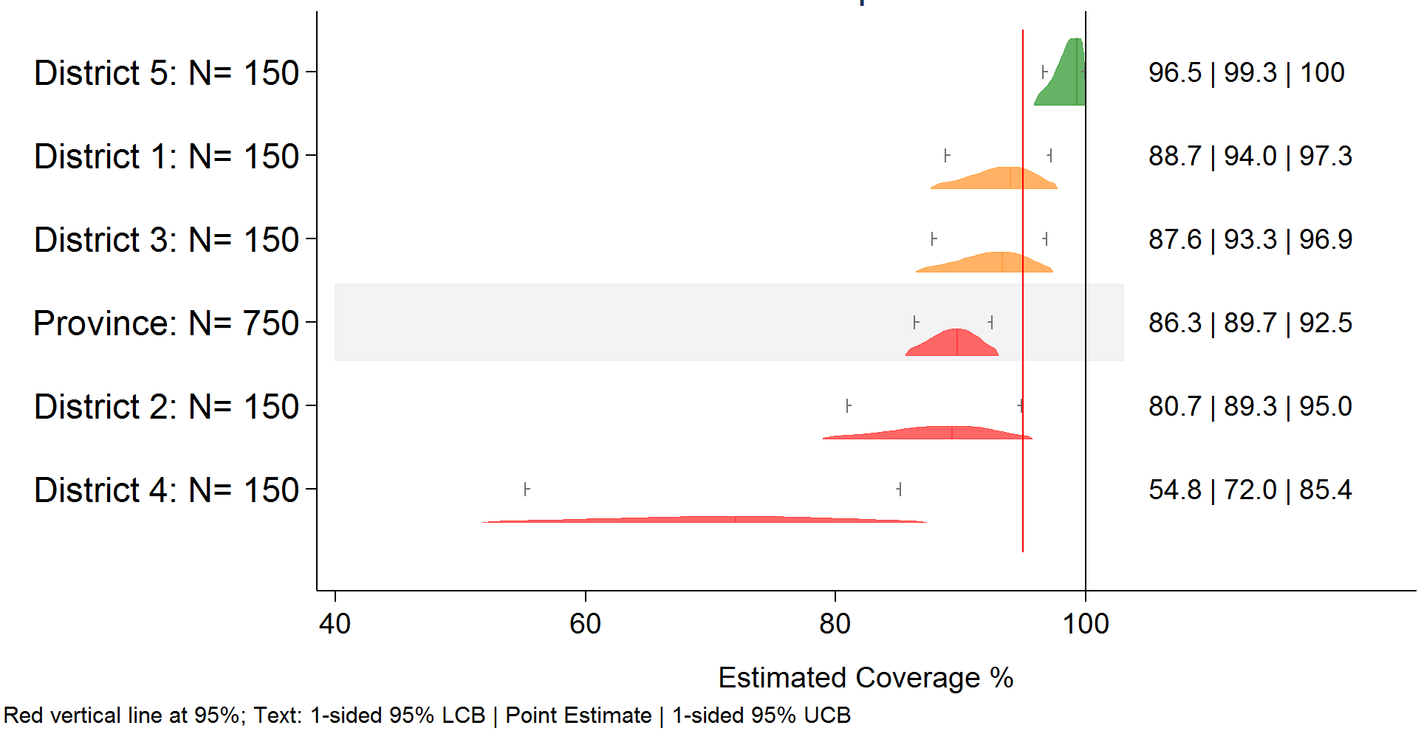
Classification Example

Slide 40
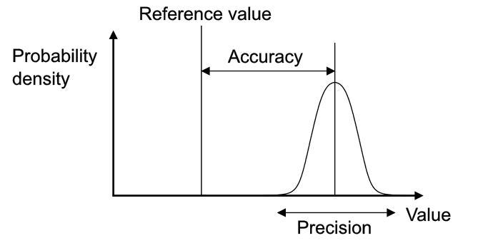
Precision vs. Accuracy
True
Estimated
Probability
density
Accuracy
Coverage (%)
Precision
This is a modified version of an image from Wikipedia: "Accuracy and precision" by Pekaje at English Wikipedia –
Transferred from en.wikipedia to Commons. Licensed under GFDL via Wikimedia Commons –
http://commons.wikimedia.org/wiki/File:Accuracy_and_precision.svg#/media/File:Accuracy_and_precision.svg

Slide 41
Including Multiple Age Cohorts
Most of the steps are the same to do field work on different age cohorts
New guidelines give guidance to select sample size according to goals and select target number of households depending on the size of the age cohort
Includes guidance for simultaneous work on more than one cohort

Slide 42
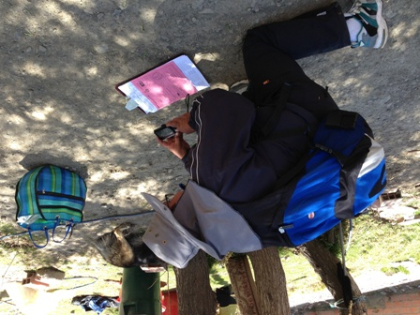
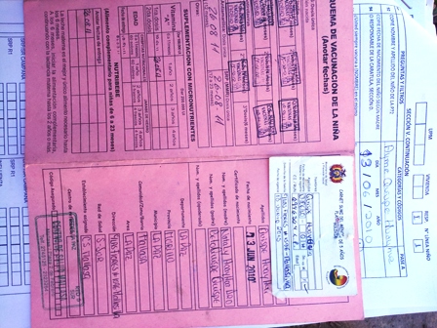
Photos Present Challenges & Benefits

Slide 43
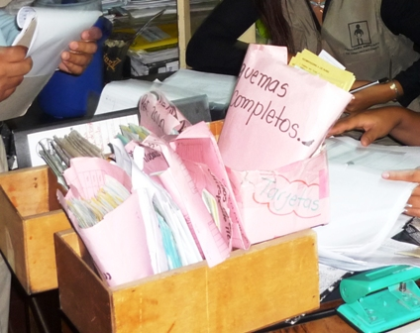
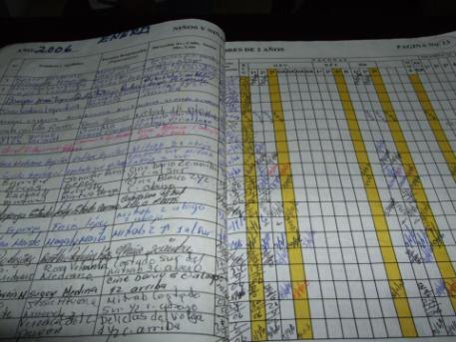
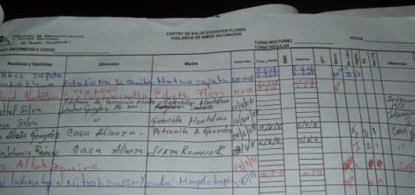
Visit Health Facilities
If no vaccination card at home, seek a copy of the child’s vaccination records at the relevant health facility
It requires resources to identify, liaise, copy records, enter & manage data
This can yield substantial increases in proportion of survey data based on documented evidence

