Slide 1
Challenges and opportunities associated with the new SIA coverage survey guidelines, and practical issues related to implementing these guidelines
Accelerating Progress Towards Measles and Rubella Control/Elimination Goals
Geneva, Switzerland
22 June 2016
Tony BURTON, on behalf of:
Lao People’s Democratic Republic’s National Institute of Public Health
WHO/Lao,
Biostats Global Consulting

Slide 2


Slide 3
2014: Inception and elaboration of the protocol. Request for financial support
GAVI Alliance offers to fund RI survey.
Lao PDR plans MR campaign (Nov - Dec 2014) for children 9 months - 9 years of age.
June: Initial concept note draft, finalized August 2014. MR 9 months - 9 years of age, 12-23 months for routine immunization. National Institute of Public Health identified as potential executing agency with support from National Statistical Bureau.
August: Proposal finalized.
September: Proposal submitted to GAVI Alliance.

Slide 4
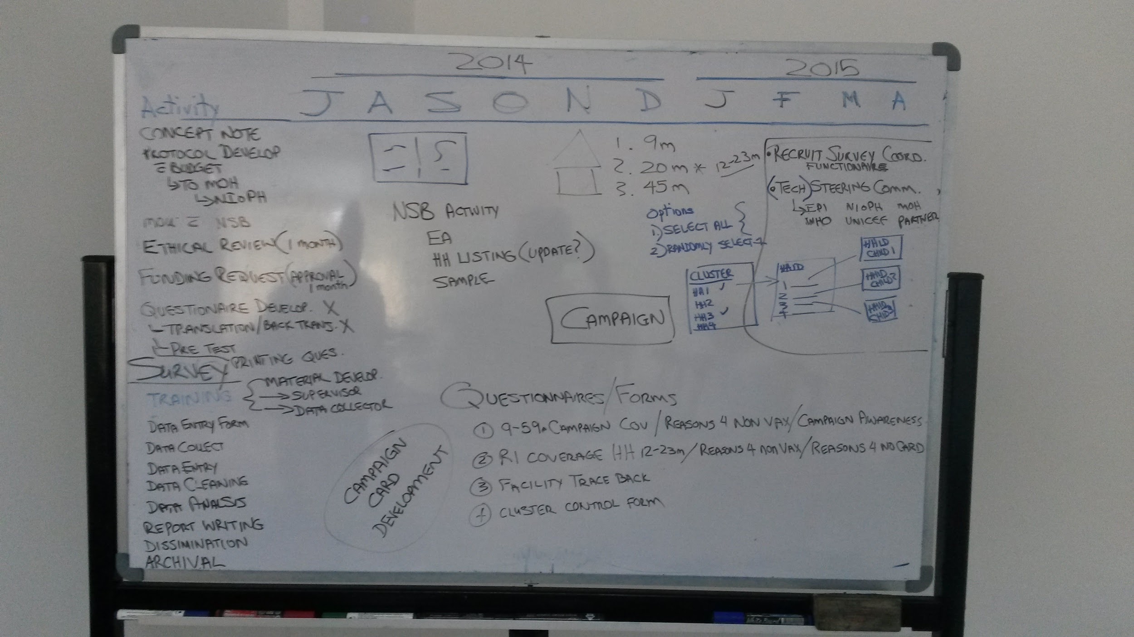

Slide 5
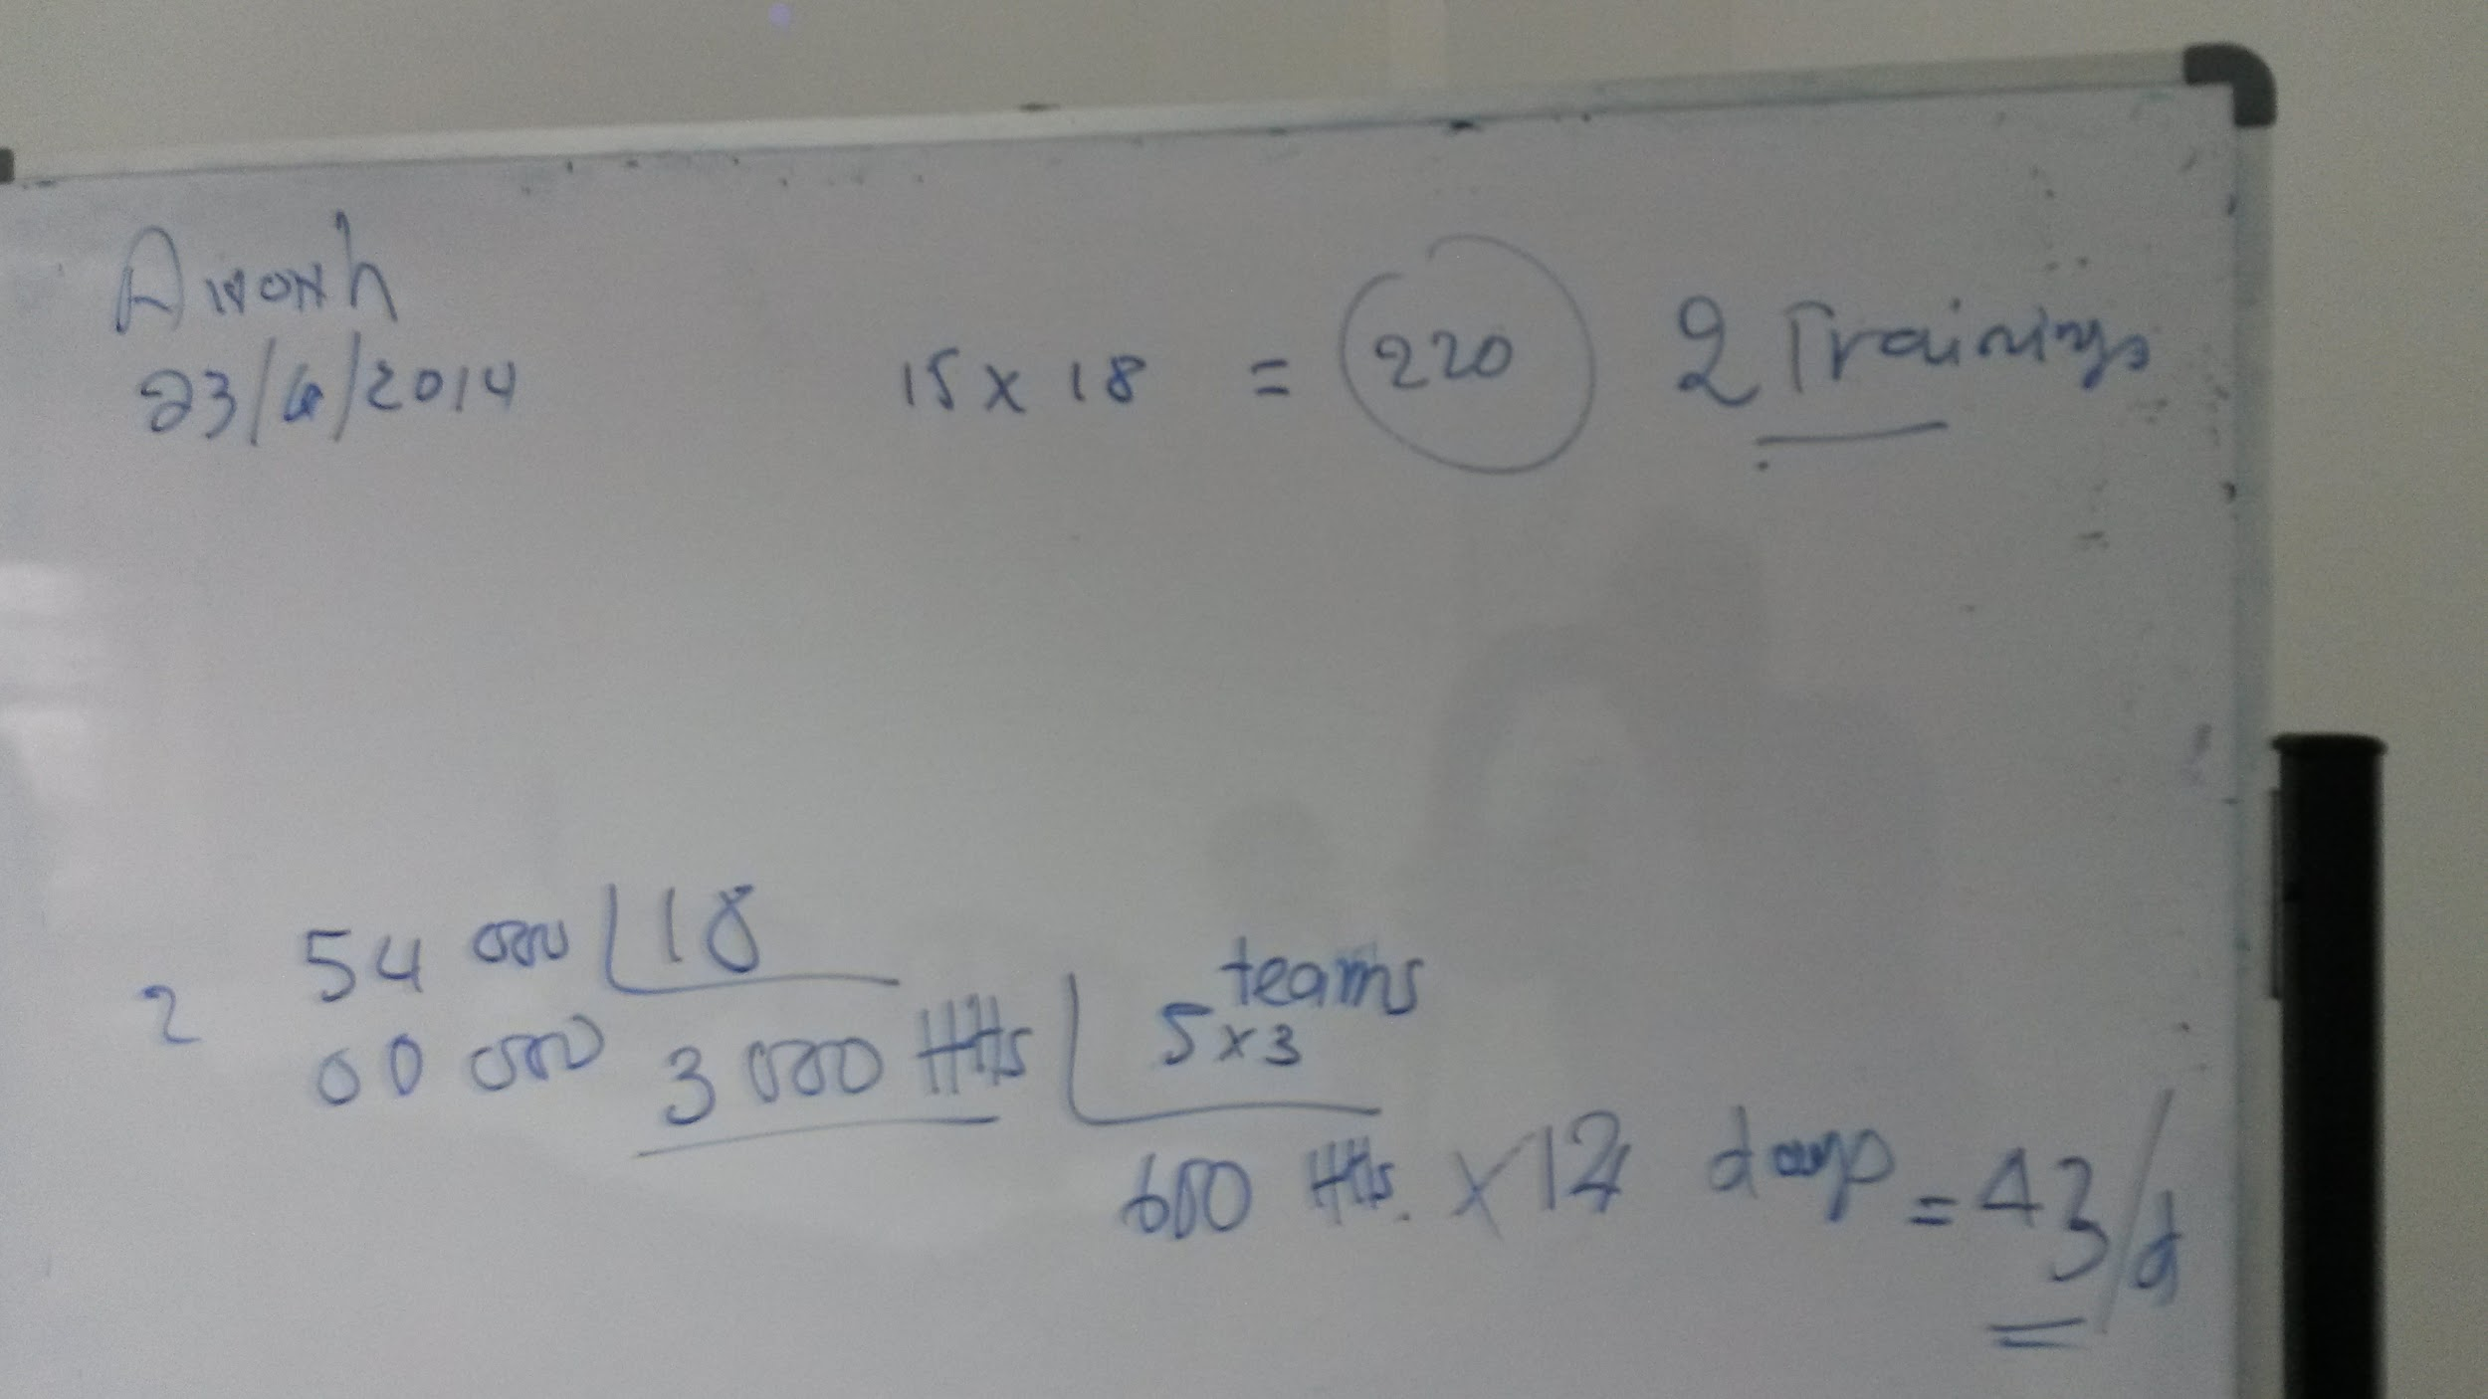

Slide 6
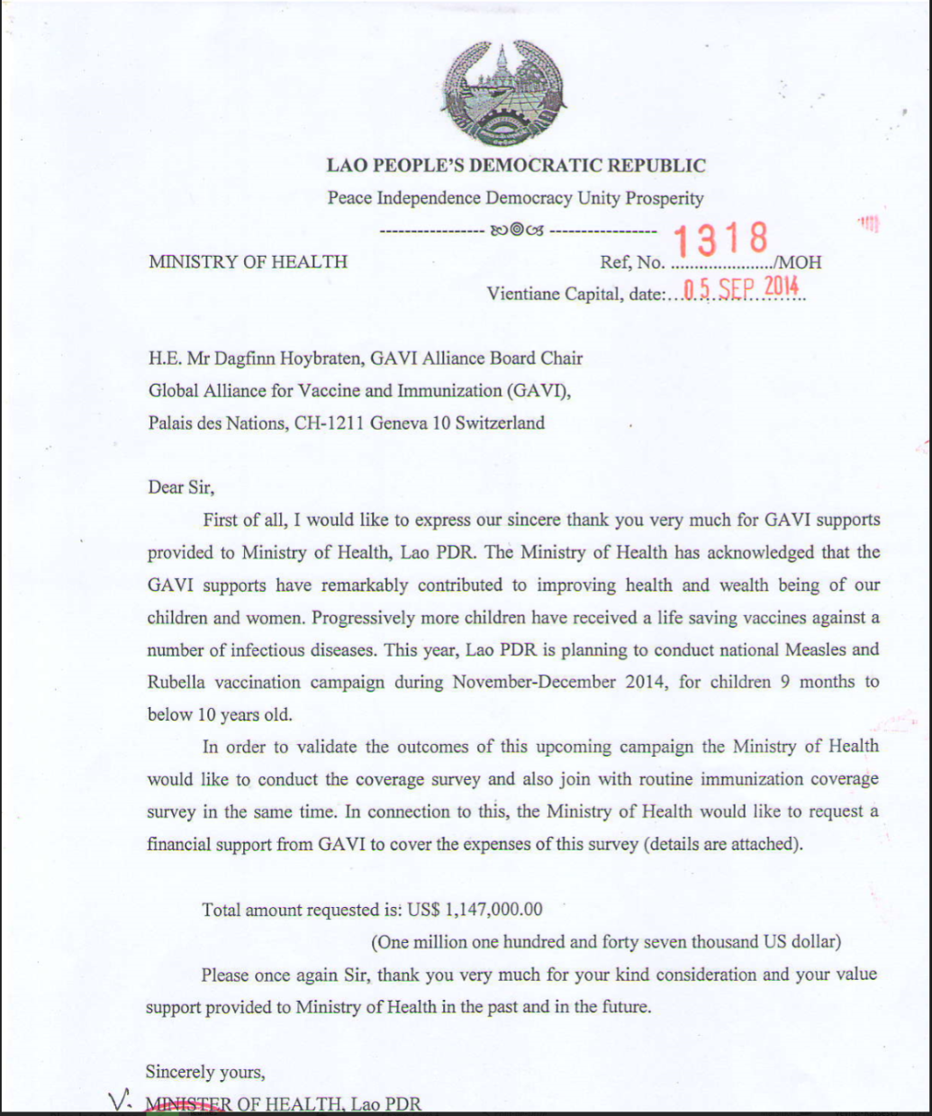
Sept 2014:
Request for funding.

Slide 7
Measles-Rubella Supplemental Immunization Activity
November - December 2014

Slide 8
October 2014 - March 2015: Protocol and questionnaire development
Based on 2011-2012 Lao PDR Social Indicator Survey*
Household members and characteristics
  Education of household members, water and sanitation facilities, supplies and facilities.
  Housing characteristics
MR campaign: 9 months up to 10 years of age (14 months)
Routine immunization: 9-23 months of age
Japanese encephalitis 1 - 14 years of age in 10 districts
Height & weight measurement: children 0 - 4 years of age

Slide 9
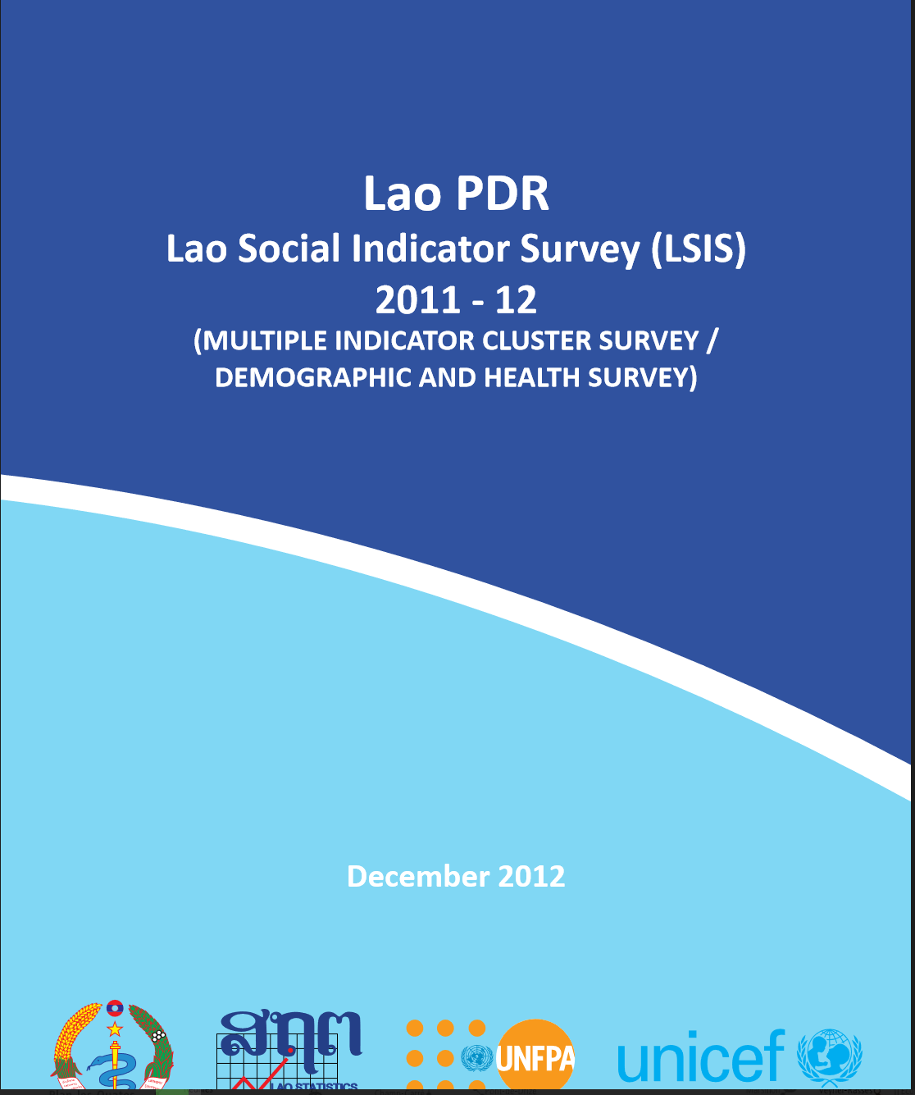
Previous experience was important

Slide 10
October 2014 - March 2015: Planning, preparation
  Ethical & administrative clearance.
  Administrative coordination between national and local administrative/health offices
  Selection of clusters by National Statistical Bureau
  Recruitment of enumerators and supervisors.
  Development of training material and field guides.
  Logistics planning - drivers, etc.
  Printing of questionnaires

Slide 11
April 2015 - July 2015: Training, testing and field work. Data entry, cleaning, tabulation
  Training of trainers (5-9 May 2015)
  Enumerator & supervisor training (19-24 May 2015)
  Field testing (23 May)
  Field exercise in Vientiane (27-31 May 2016)
  Field work in provinces (10 June - 31 August 2016)
  Data entry & cleaning (September 2015 - March 2016)
  Data tabulation & report writing (April - July 2016)

Slide 12
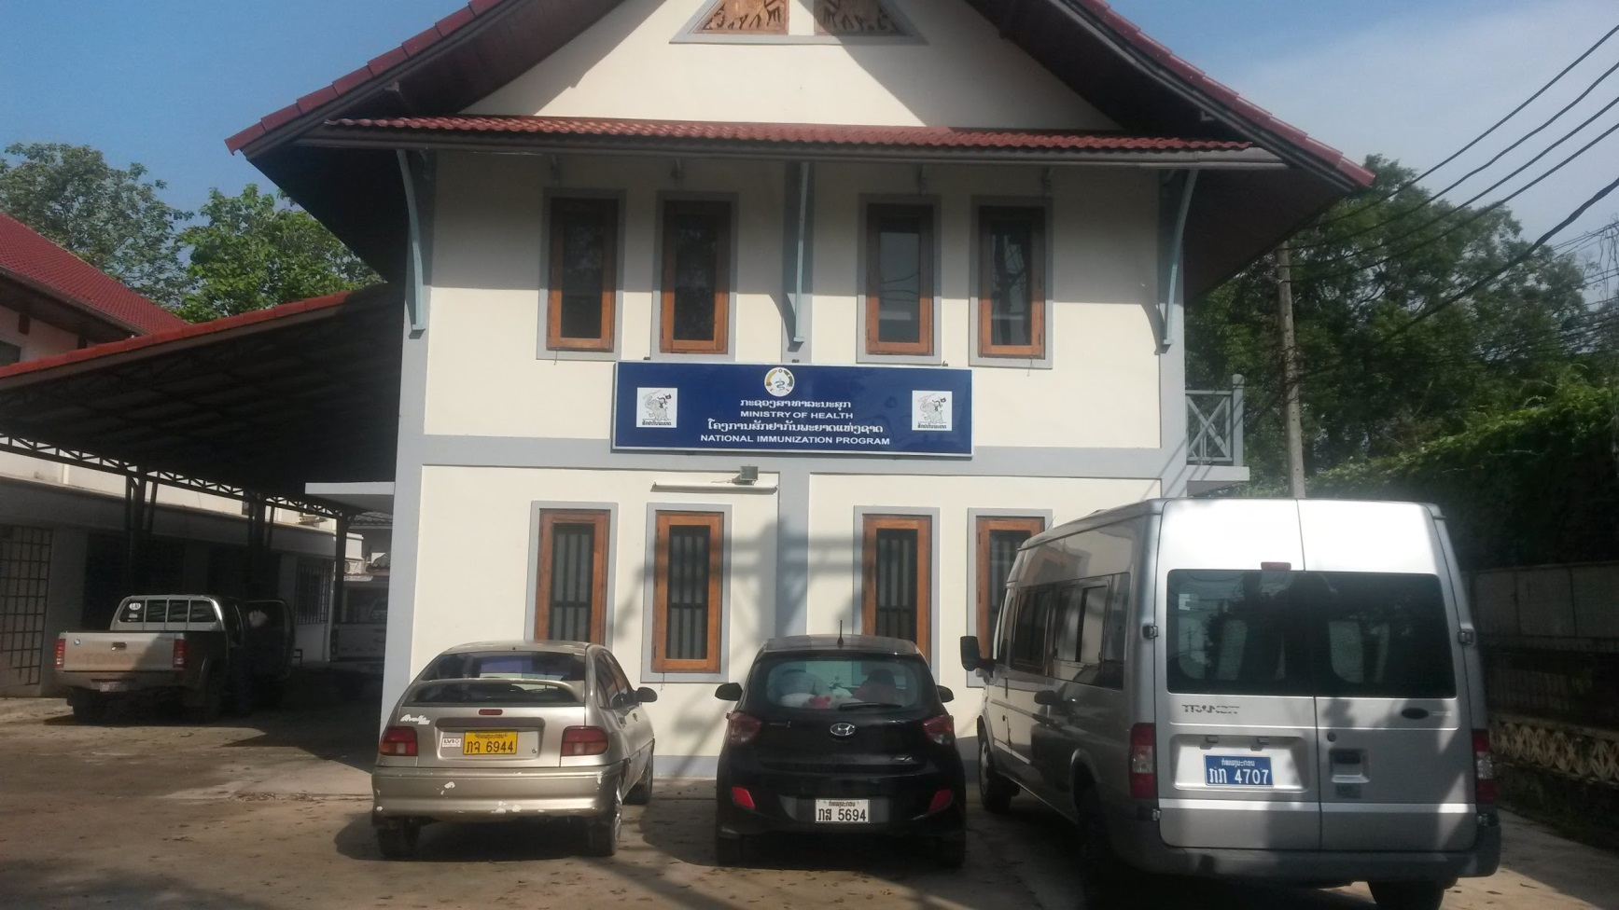
National Immunization Programme

Slide 13
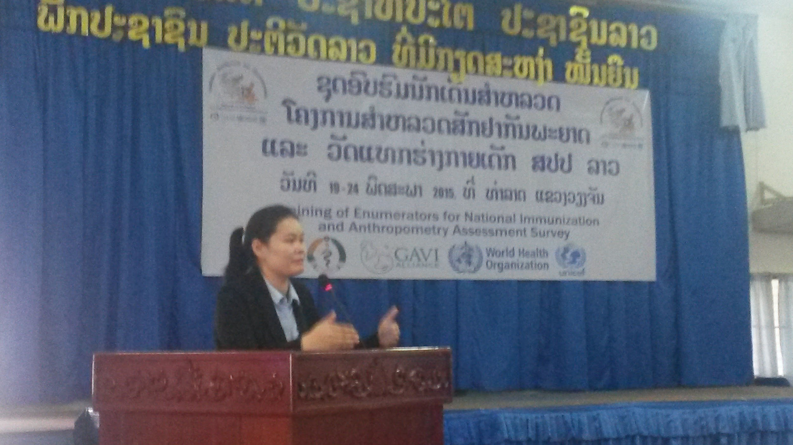
Dr Manithon Vonglokham, Principal Investigator, NIOP

Slide 14
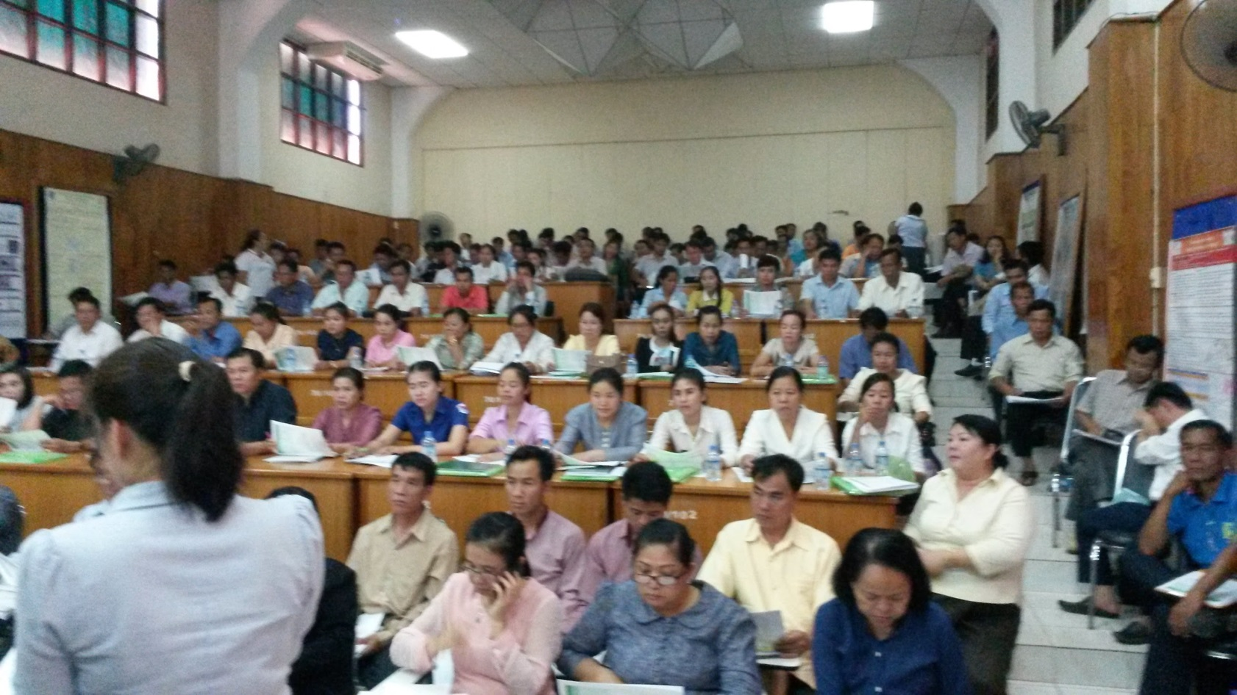
Training - everybody at once; no cascade training

Slide 15
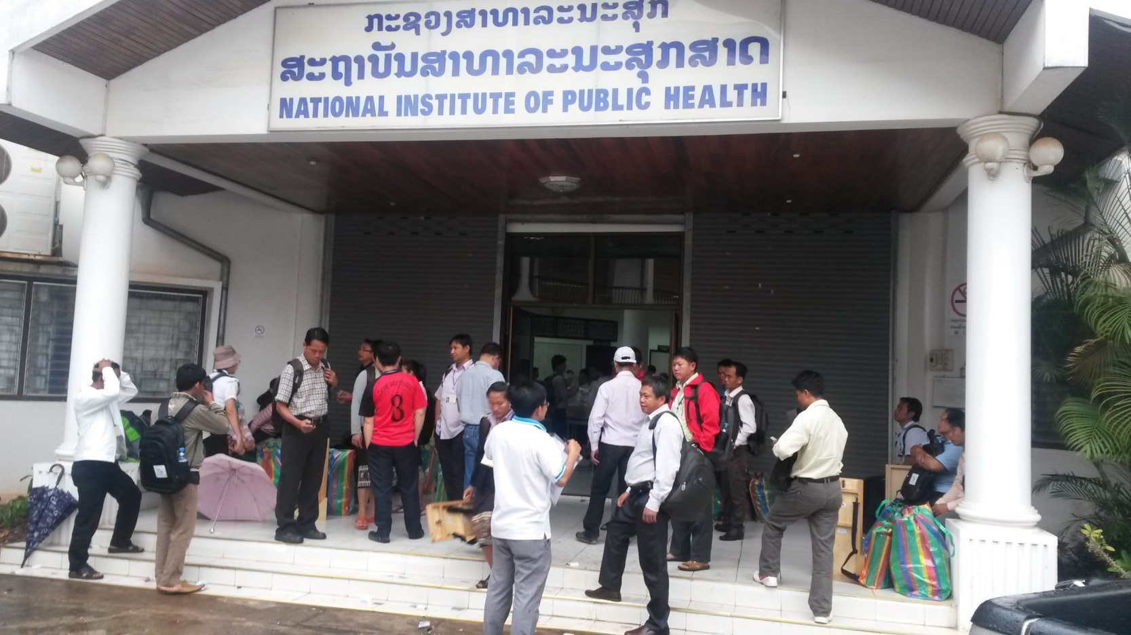
Getting ready for field work

Slide 16
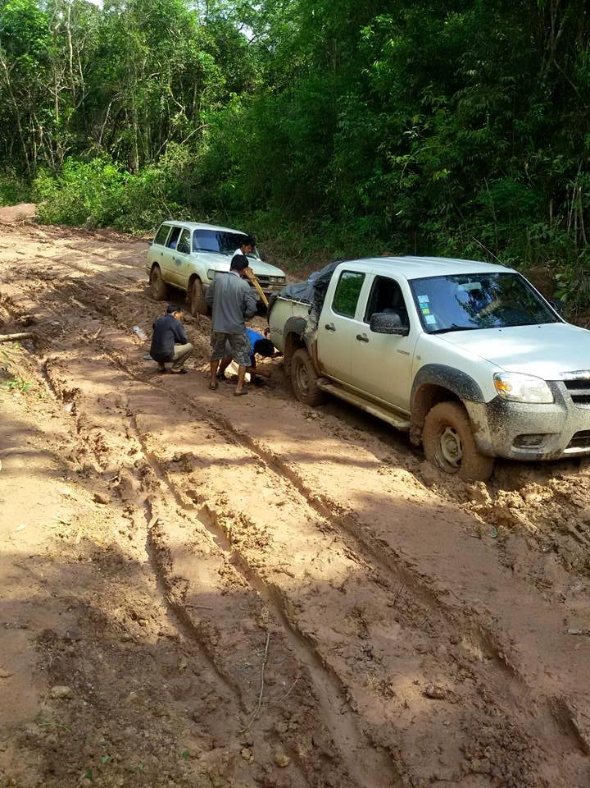


Sometimes the truck just won’t get you there.

Slide 17
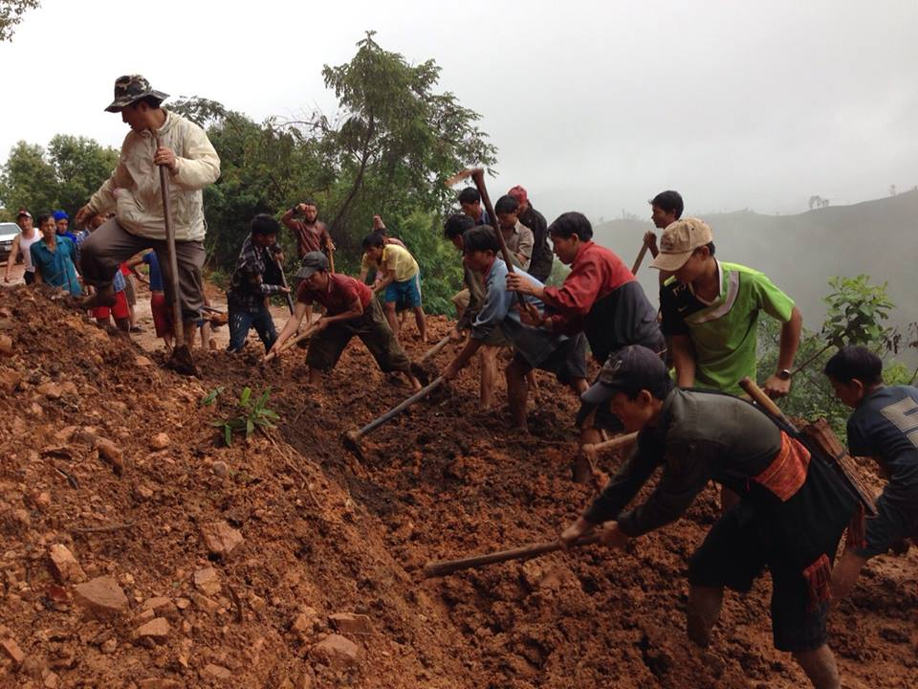
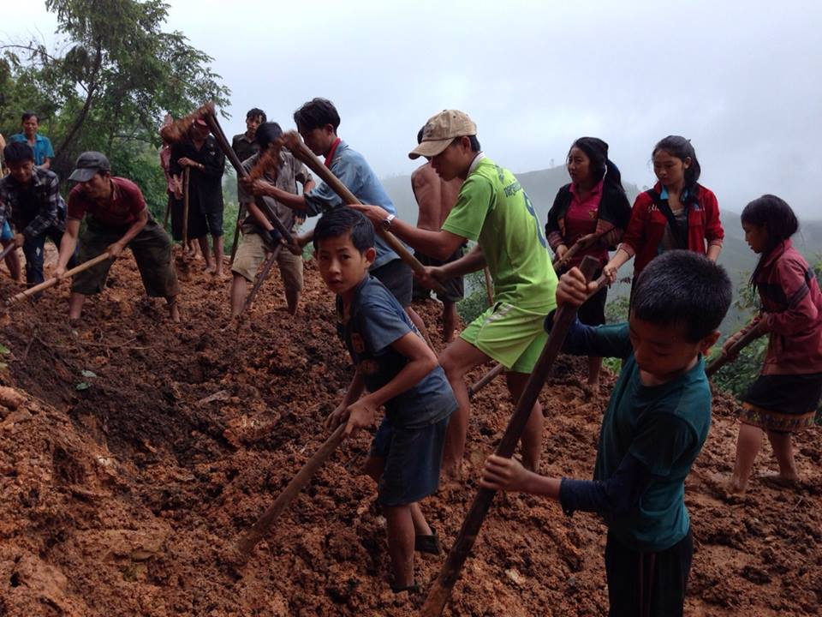
Phieng village helps.

Slide 18
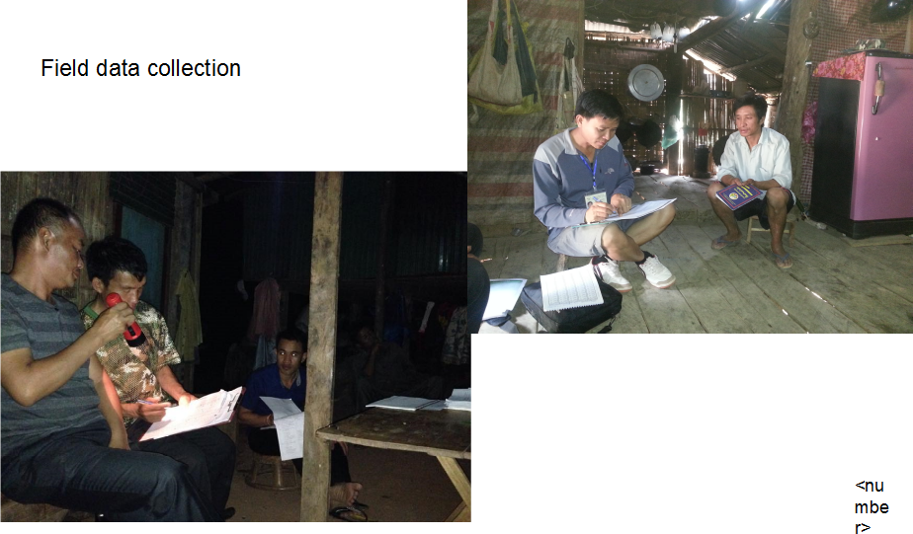
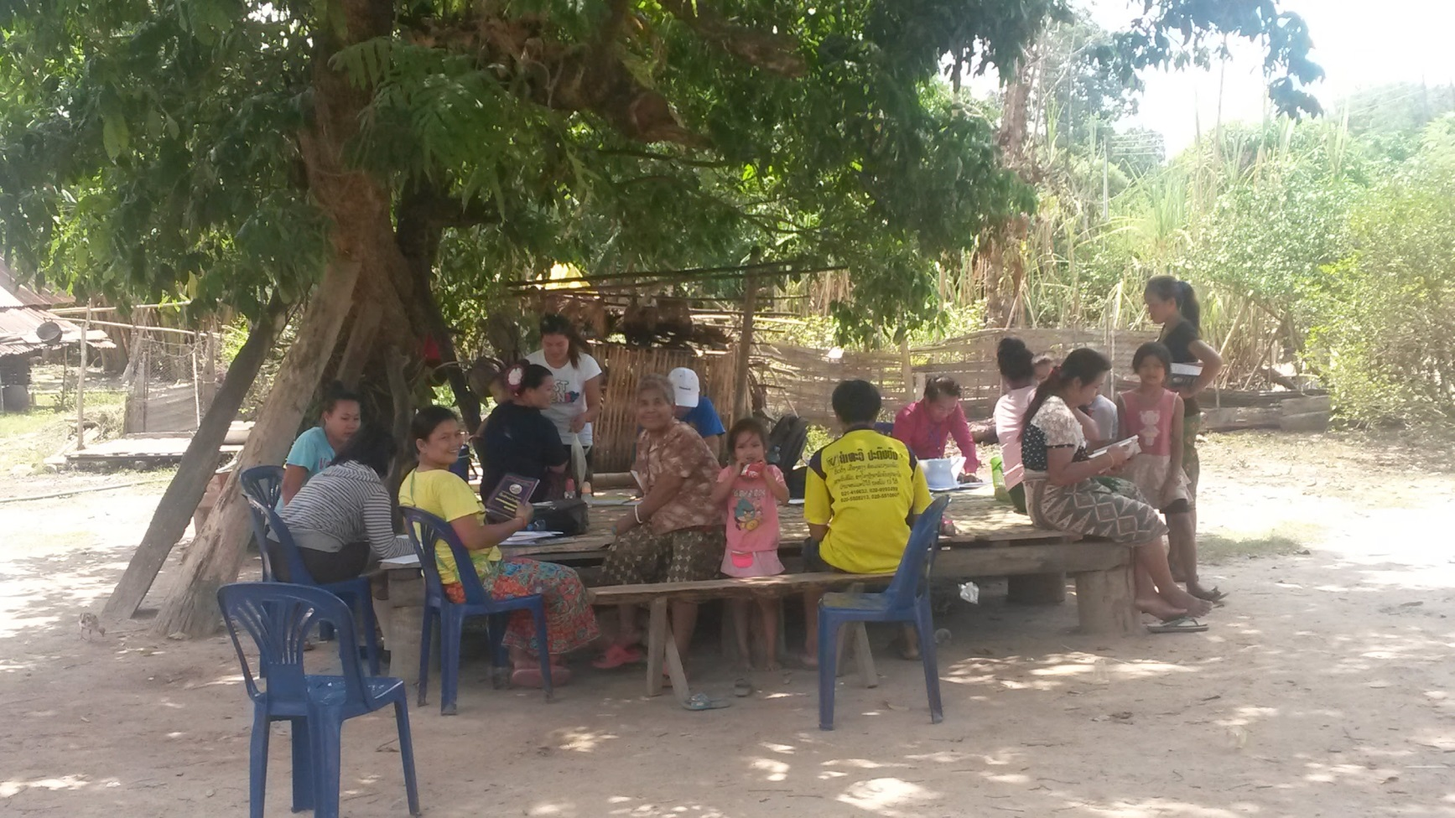
Surveys in small villages. So much for house to house.

Slide 19
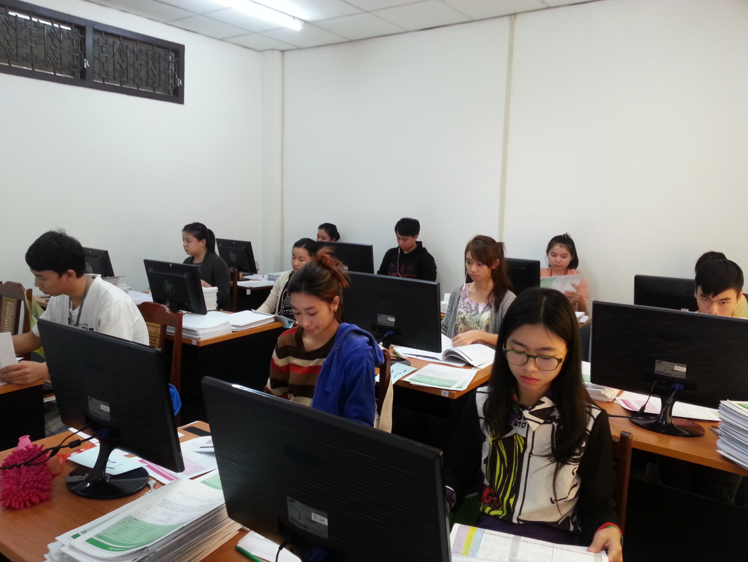
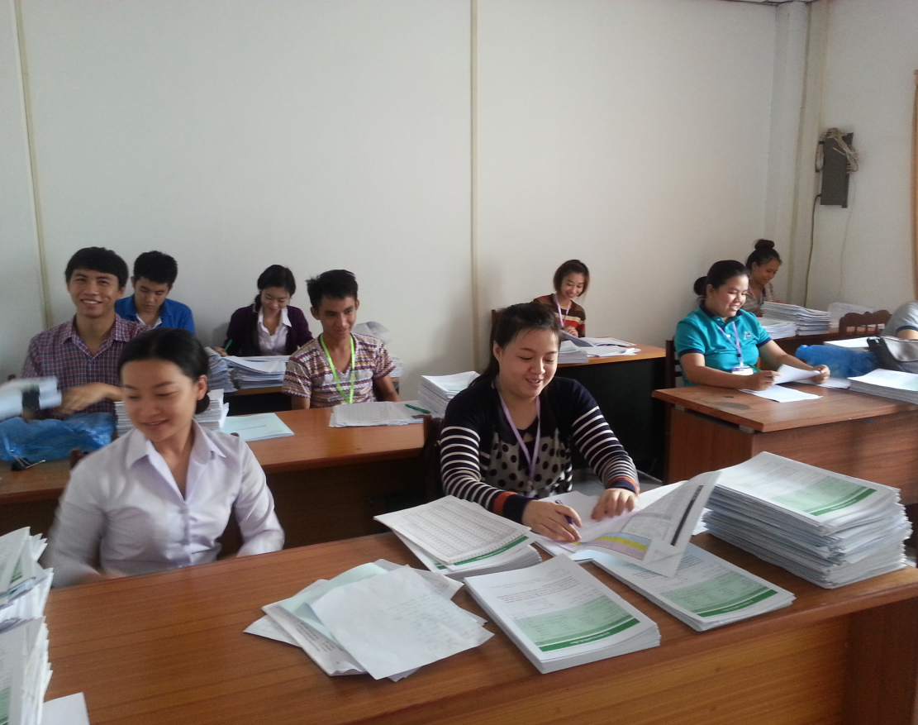
Data editing and cleaning

Slide 20
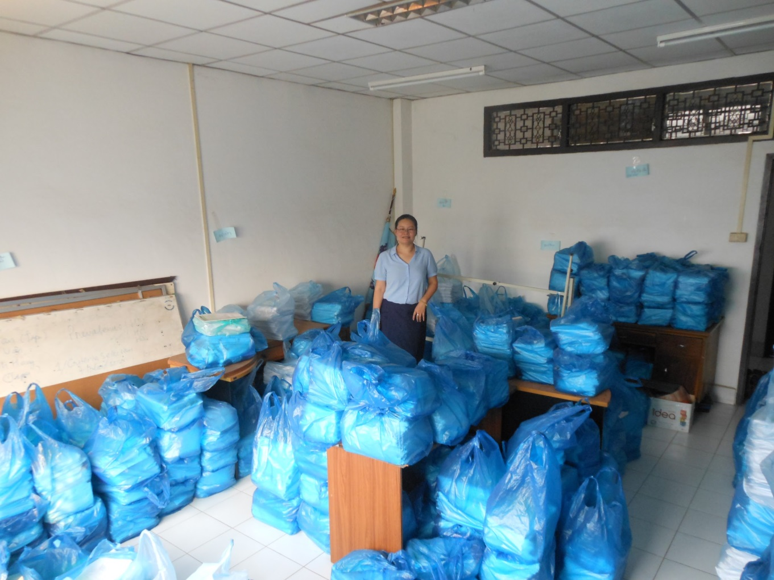
Entered, cleaned and ready for analysis

Slide 21
Notable points
NIOPH had previous experience with household cluster survey (LSIS)
  Similar questionnaire, experience with logistics, previous work with Lao Statistical Bureau.
  Expertise is limited and competes with other activities.
Lao Bureau of Statistics conducted a national census in spring 2015
  update maps, listings and demographic estimates.
  unavailable to develop data entry and tabulation computer systems.
Delay in funding resulted in field work being conducted in rainy season
  Difficult transportation in some areas.
  Families in fields during day time hours.
Complex survey
  Multiple age cohorts/indicators
  Powered for children 9-23 months of age. Likely oversampled for campaign
  Results powered for province level estimates

Slide 22
Summary I.
The 2015 revisions describes a survey method, not a survey design. It includes questions and discussions leading to a survey-specific design but does not prescribe one.
Probability-based sampling and health facility visits feasible.
Prior experience with DHS, MICS and other household survey makes questionnaire development, sampling and analysis facilitates implementation.
Training was done centrally - rather than cascade training - improving consistency and quality of training.
Digitization of interview results was done centrally due to difficult prior experience.

Slide 23
Summary II.
Increased complexity in cluster and household selection, tracking of individual household participation and weighted analysis usually necessitates collaboration with national statistical offices or other statistically sophisticated agencies or institutions. Coordination and scheduling can be complicated.
Increased number of indicators, lower levels of representativeness and desire for finer levels of precision results in a more costly (financial, human, managerial and logistic) resources. Quality and timeliness becomes difficult to maintain.
Clarity regarding use of survey results become essential as cost rise.

