Slide 1
Measles and Rubella Surveillance Roadmap
Accelerating Progress towards
Measles and Rubella Control/Elimination Goals
Geneva, 23 June 2016
Marta Gacic Dobo, WHO IVB/EPI

Slide 2
Background
Roadmap for the development of elimination -standard measles, rubella and congenital rubella syndrome surveillance and monitoring
  This document was developed by the SAGE WG on measles and rubella with significant support from the WHO secretariat, Regional Office staff and the following individuals: David H Sniadack, Susan Reef, Emma Lebo, Boubker Naouri, Fiona Guerra, Gillian Lim. It was developed with input and support from the Chairs of the Measles and Rubella Regional Verification Commission at a meeting in June 2015.

Slide 3
Why we need a roadmap
All Member States and every WHO region has a measles elimination goal by 2020 or earlier.
Key factor to achieve and sustain elimination is high quality case based surveillance.
Current surveillance standards and systems are not sufficient quality to facilitate and verify elimination in some countries.
The development and implementation of a roadmap can serve as an implementation tool for strengthening surveillance.

Slide 4
Roadmap objectives
To describe the functions, attributes and infrastructure needs to conduct surveillance in different phases of measles and rubella transmission
To describe current surveillance recommendations by Region and identify the gaps to achieve elimination-standard surveillance
To propose a prioritization scheme and criteria, by surveillance function and attribute, on when and how countries may transition to elimination-standard surveillance
To provide guidance on surveillance needs during large outbreaks that may occur even when countries are near or post elimination

Slide 5
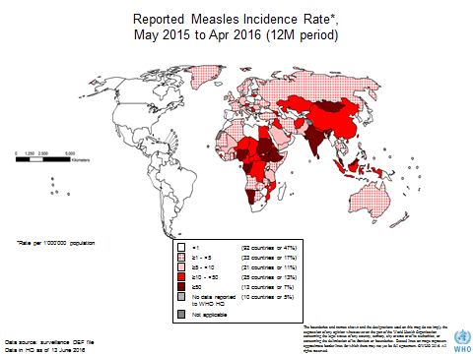
Different stage of elimination status described by goals or degrees of measles virus transmission
Control/Highly endemic (more than 5 cases per million)
Accelerated Control-Mortality Reduction /Endemic (less than 5 cases per million)
Near Elimination-Elimination/Sporadic cases and small outbreaks (less than 1 case per million)
Attributes of measles (and rubella) surveillance should change
as countries progress towards elimination

Slide 6
Measles Surveillance, by Goal and Epidemiologic Phase
Control
Accelerated Control
Elimination
Type: Aggregate
Data: # of clinical
cases
Analysis: incidence
by time, place
Purpose: monitor
incidence; ID high
risk areas
Type: case based for
outbreak only: specimens
from 5-10 cases
Data: ID, residence, age,
vax status, donset
Analysis: age specific
incidence; cases by age
group, vax status; RFs
Purpose: describe
changing epidemiology;
ID high risk populations
Type: case-based, for all;
specimens from all unless
epi-linked
Data: 12 core variables
Analysis: same as AC
plus source;
monitor surveillance
performance indicators
Purpose: classify cases;
customize interventions;
ID virus; verify elimination
8000
100%
7000
90%
80%
6000
70%
5000
60%
Cases
4000
50%
Coverage
3000
40%
30%
2000
20%
1000
10%
0
0%
Highly Endemic
Endemic with occasional outbreaks
Sporadic cases and rare small
outbreaks
Measles Cases
Measles Coverage

Slide 7

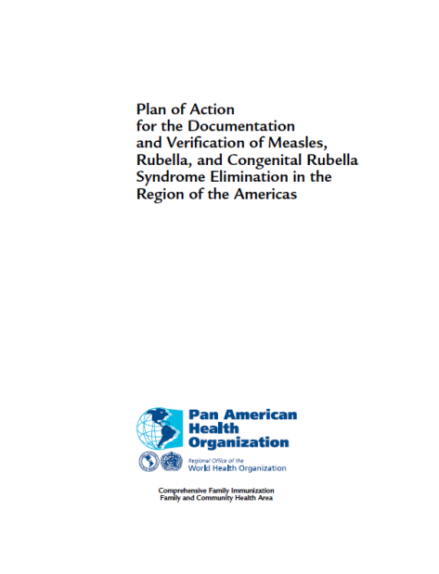
Existing guidance and the roadmap
Framework for verifying elimination of measles and rubella
Regional surveillance and verification guidelines
The role of roadmap is to help countries accelerate surveillance from control to verification standards

Slide 8
Summary of recommended measles and rubella surveillance indicators globally and in WHO regions
Surveillance Performance Indicators | Frame Work | AMR | WPR | EUR | EMR | AFR | SEAR
1.≥ 80% of reporting units report to national level on time | Yes | Yes | Yes | Yes | Yes | Yes with modification | Yes
2.100% of countries report to RO on time | Yes | No | No | No | No | No | Yes
3.Discarded MR ≥ 2/100,000 | Yes | Yes with modification | Yes | Yes | Yes | Yes | Yes
4.≥ 80% of subnational admin units (e.g., province) with discarded MR ≥ 2/100,000 | Yes | No | Yes | Yes | Yes | Yes with modification | Yes
5.≥ 80% of suspected cases with adequate investigation | Yes | Yes | Yes | Yes | Yes | Yes | Yes
- adequate investigation definition (CV Core Variable) | 12 CV | 11 CV | 10 CV | 9 CV | Yes | Not specified | Not specified
- investigated within 48 hours of notification | Yes | Yes | No | Yes | Yes | Yes with modification | Yes
6.≥ 80% of suspected cases with adequate specimen | Yes | Yes | Yes | Yes | Yes | Yes with modification | Yes
7.≥ 80% of outbreaks/transmission chains with adequate specimens for virus detection | Yes | Yes | Yes with modification | Yes | Yes | No | Yes
8.≥ 80% of specimens arrive to lab within 5 days of collection | Yes | Yes | Yes | No | Yes | Yes with modification | Yes
9.≥ 80% of specimens with serologic results within 4 days of arrival to lab | Yes | Yes | Yes | No | Yes | Yes with modification | Yes
Source: Roadmap for the development of elimination/verification-standard measles, rubella and congenital rubella syndrome surveillance and monitoring
SAGE working group on measles and rubella, 2015

Slide 9
Regional differences in surveillance standards
All regions collect the critical person, place and time data
Regional recommendations contains most of the functional attributes associated with elimination standard surveillance
Framework for verifying elimination of measles and rubella + 6 regional surveillance or elimination guidelines
8 out 12 core data elements are common between regions for recommended cases investigation
Case and outbreak definitions of measles varies between regions
Recommended surveillance performance indicators slightly vary between regions
Reporting requirements (feedback and feed forward) varies between weekly, monthly an quarterly

Slide 10
Rubella / Congenital rubella syndrome (CRS)
3 regions established rubella elimination goal (AMR,EUR,WPR)
1 region (SEAR) established rubella/CRS control goal
WHO recommends rubella surveillance to be integrated to measles surveillance.
  In practice this is not happening in most regions

Slide 11
  Prioritizing surveillance improvement
  Functional Attributes for Phased Adoption
Detecting cases/outbreaks
  case definition: fever and rash vs. fever, rash and 1/3 Cs
  a single case is considered an outbreak
Investigating and confirming cases/outbreaks
  contact tracing is conducted to determine who infected the case (7-21 days before rash onset) in addition to who the case may have infected (4 days before to 4 days after rash onset)
  More restrictive requirements for epidemiologic linkage?
3. Data collection for cases/outbreaks
  core variable data may include more data points (e.g., 12 core variables)
  additional data on potential risk factors for exposure and spread
4. Interpretation and use of data
  Determining the effective reproductive number (R_{e}) for measles
  Verification of elimination

Slide 12
Potential Thresholds for Phased Adoption of Resource-Intensive Functional Attributes
China: provinces targeted elimination when measles incidence
≤ 20/million
AFRO criteria for selecting countries for “elimination mode” surveillance:
  annual incidence that has remained at less than 10/ million
  standard measles surveillance performance maintained for > 3 years
  WHO/UNICEF estimates of MCV1 ≥ 80% for > 3 years
  MR and/ or MCV2 introduced in the EPI program
  Wide age range M or MR SIAs conducted nationwide after 2010
  No “significant” measles outbreak reported in at least 3 years

Slide 13
Funding for surveillance personnel
Polio funded
CDC, BMGF and Gavi funded
Category of staff | Number (globally) | Funds allocated (globally) USD
Data managers | 18 | ~4.0 million
Field surveillance staff (all categories) | 133 | ~31.8 million
Laboratory surveillance staff (all categories) | 18 | ~1.9 million
Total | 169 | 37.7 million
Category of staff | Number (globally) | Funds allocated (globally) USD
Data managers | 6 | 0.55 million
Field surveillance staff (all categories) | 38 | 8 million
Laboratory surveillance staff (all categories) | 5 | 1.1 million
Total | 49 | 9.7 million
~80% is polio funded

Slide 14
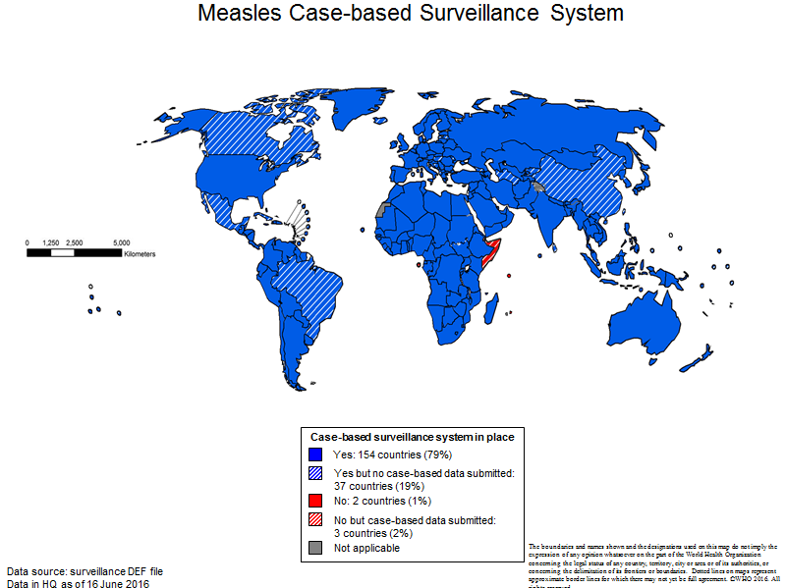
Case based surveillance status most Member States implementing but....
189 (97%) countries have case based surveillance
37* (19%) not report case based surveillance data to WHO HQ
5 (3%) counties have not yet implemented national case based surveillance

Slide 15
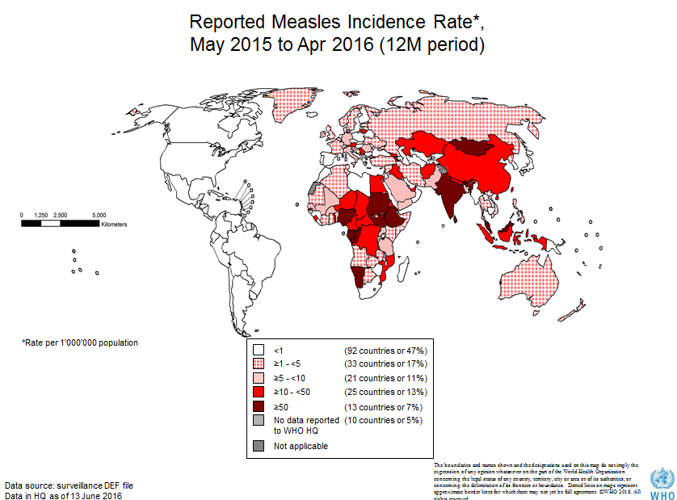
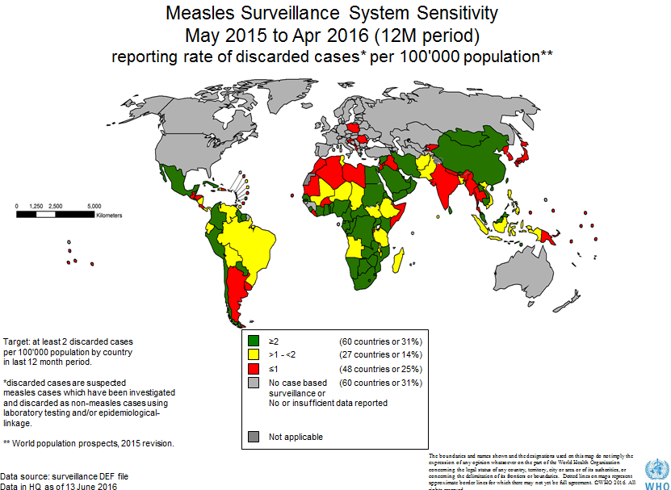
Limitations of global monitoring system
Most Member States (95% in 2015) report data monthly
Only 60 (31%) meets surveillance sensitivity indicator (2/100 000 discarded cases)
Due to monthly reporting at least 2 month lag of data availability at global level

Slide 16
The road forward
Country ownership
Strengthen case based surveillance
  Data collection, consolidation, analysis and feedback
  Integrate Measles and rubella surveillance
Establish and strengthen CRS surveillance
Strengthen laboratory capacity
Strengthen outbreak response capacity
Ensure high quality coverage data
Consider hard to reach groups that become increasingly important as potential reservoirs as elimination is approached.
What is needed to achieve the above?

Slide 17
Acknowledgement
Natasha Crowcroft and Sage WG on measles and rubella
David Sniadack
Susan Reef
Fiona Guerra
Gilliam Lim
Minal Patel
Peter Strebel

Slide 18


Thank You

