Slide 1
How the Philippines Overcome the
Surveillance Challenges Elicited by the 2014 Measles Outbreak
MARIA Wilda T. Silva, MD
Department of Health
Philippines

Slide 2
Epidemiology of Measles in the Philippines

Slide 3
Measles cases by month of rash onset
2010 - 2015
Notes:
Measles epidemic peak was in January 2014, however due to delays in lab testing and result, this was not immediately realized until the specimen testing resumed to normal and databases have been updated.
The challenge on how to timely determine epidemic peak during a major outbreak remains.

Slide 4
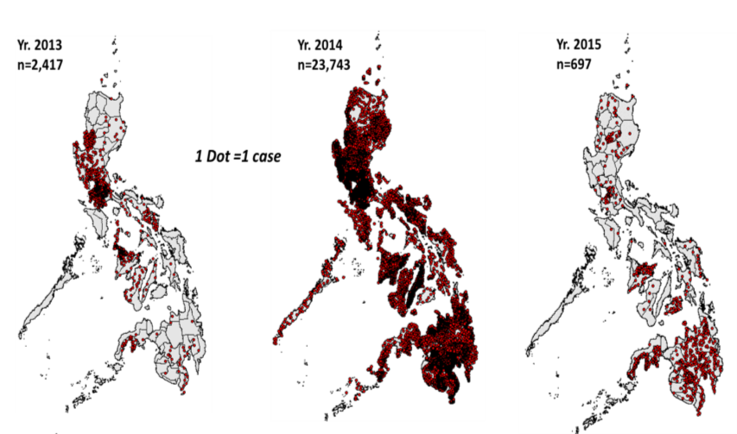
Confirmed Measles Cases
2013 - 2015
Notes:
These maps show the measles situation in the Philippines in 2013, 2014 and 2015. The outbreak actually started in Q1 of 2013 in Region 1 (Pangasinan), Region IVA and NCR, and gradually spreading in Region V, Region 6 (Panay Island), Region 9 and 10 in Mindanao.
In 2014, transmission persisted but with gradual spread until Q4 2013 when the country was hit by 3 major disasters that resulted to massive population displacement and movement that facilitate more rapid spread of measles such that in December 2013, almost all regions had massive outbreaks.
A catch up vaccination in Regions 3, 4A and NCR was conducted targeting under-two children with the purpose of averting further deaths and spread of the virus. Also, a national MR-OPV SIA targeting under-five children was also conducted in September 2014,
Despite of the nationwide SIA, measles persisted in some areas in Luzon, Visayas and Mindanao, mostly affecting older children and adults.

Slide 5
Surveillance challenges
2014 measles outbreak

Slide 6
Key Surveillance Challenges
Manpower capacity
Adequacy of supply and logistics
Quality of Data management
Reporting and feedback mechanism
Notes:
1. Manpower capacity and logistics
Only one person is in-charge of measles surveillance coordination at the central level and no dedicated VPDSO at the regional level
Local health workers and hospital staff are already over-stretched and have limited time for surveillance resulting to delayed investigation, reporting, specimen collection and transport
Main sentinel site (San Lazaro Hospital) is understaffed and unable to cope with patient care demand, resulting to significant surveillance backlog
In many areas, Many new DSOs were not yet trained on measles outbreak / field investigation and epi-linking, thus dependent on lab confirmation for initiating response activities
Limited fund for specimen shipment, field investigation, production of forms and procurement of specimen kits
2. Adequacy of supply and logistics
Limited fund for production of forms and procurement of specimen kits
Lack of funds for specimen transport resulting in delays in shipment or spoilage of specimens
DOH contracted courier, XIMEX, does not operate in all provinces and lacks awareness on specimen transport protocols which contributes in the delay of specimen transport
Most of the local airline companies reject airfreight of biological specimens
Stock out of specimen collection kits in many areas
3. Quality of Data management
Delays in case investigation resulting to some cases being discharged without investigation and/or specimens
Backlog in data encoding and submission to next levels resulted to inability to timely analyse data for detect clusters. Many outbreaks were detected only when they became full blown.
Incomplete data in the CIF and significant discrepancy between laboratory and surveillance data.
Many information are missing in the surveillance data making it difficult to epi-linked cases, or predict outbreak patterns
4. Reporting and feedback mechanism
Back log in providing lab results to sub-national levels to help in planning and dealing with the outbreaks
Unmet expectations of the local health workers for lab result resulted to confusion and delayed outbreak response, further aggravating the situation.
Shifting the surveillance activities to outbreak mode: collection of specimens from all cases vs. collection of representative samples
Outbreak happened when most regions have already cascaded the information that specimens must be collected in at least 80% of measles cases in compliance with AO2012-003. When NML is already flooded with blood specimens, there was a concern about asking the LGUs not to collect specimen from all cases anymore because it may backfire to surveillance once the outbreak is over.

Slide 7
Key Interventions to maintain surveillance functionality
Surge capacity was activated after the Secretary of Health officially acknowledge the outbreak,
Many regions conducted refresher orientation on measles surveillance and outbreak response for DSO, DSC and LGUs
DOH EB and WHO did emergency procurement of additional supply of specimen collection kits for measles investigation
To overcome collection and transport issues, promoted collection of DBS instead of whole blood in areas with difficulty
The DOH EB and NML regulated the allocation of specimen collection kits (limit to 5 per region per week)
DOH EB promoted epi-linking of cases in areas with documented lab-confirmed cases
Notes:
Surge capacity was activated after the Secretary of Health officially acknowledge the outbreak, especially in Regions 3, 4A and NCR
At the national level, 2 PIDSR SO were repurposed to support measles surveillance coordination and data management
RHOs also repurpose regional staff (HEMS, ESR, EPI, MCH, etc.) to support RESU for measles surveillance and response
NCR DSOs assigned RHO staff to conduct daily monitoring and investigation of cases in San Lazaro Hospital
Many regions conducted refresher orientation on measles surveillance and outbreak response for DSO, DSC and LGUs
DOH EB and WHO did emergency procurement of additional supply of specimen collection kits for measles investigation
To overcome collection and transport issues, promoted collection of DBS instead of whole blood in areas with difficulty
The DOH EB and NML regulated the allocation of specimen collection kits (limit to 5 per region per week)
DOH EB promoted epi-linking of cases in areas with documented lab-confirmed cases

Slide 8
Key Interventions to maintain surveillance functionality
DOH EB issued a released AO for strengthening laboratory confirmation for measles surveillance
The DOH EB and NML developed a more strategic approach to case/outbreak confirmation that will prevent confusion in specimen collection particularly when the outbreak is over.
WHO provided data management support to SLH and DOH EB for data encoding, consolidation, analysis, epi-linking, mapping, report generation, etc.
DOH EB also came up with an AO providing guidance for LGUs in responding to measles outbreak, including epi-linking of case in areas with laboratory confirmed measles
Notes:
DOH EB issued a released AO for strengthening laboratory confirmation for measles surveillance. Contains guidelines on specimen collection in an outbreak setting
The DOH EB and NML developed a more strategic approach to case/outbreak confirmation that will prevent confusion in specimen collection particularly when the outbreak is over.
WHO provided data management support to SLH and DOH EB for data encoding, consolidation, analysis, epi-linking, mapping, report generation, etc.
DOH EB also came up with an AO providing guidance for LGUs in responding to measles outbreak, including epi-linking of case in areas with laboratory confirmed measles – while this was drafted in March, the AO was only issued in October 2014.

Slide 9
Epi linking compatible cases with lab-confirmed cases
Even in January, when specimen referrals sharply rose and blood collection kits are running out, the system resorted to DBS collection more than epi-linking of cases.
When the lab ran out of test kit in February and unable to test more than 10,000 samples taken from suspect measles, epi-linking has become more critical. It needs to be done first to support the lab in the representative sampling method
A data manager is provided by WHO to support the central office in the data cleaning, analysis and epi-linking of cases
Notes:
While there is knowledge on epi-linking, this is not routinely practiced in regular times because the surveillance guidelines promotes collecting samples from every case, as possible.
Even in January, when specimen referrals sharply rose and blood collection kits are running out, the system resorted to DBS collection more than epi-linking of cases.
When the lab ran out of test kit in February and unable to test more than 10,000 samples taken from suspect measles, epi-linking has become more critical. It needs to be done first to support the lab in the representative sampling method (which will be explained later.
A data manager is provided by WHO to support the central office in the data cleaning, analysis and epi-linking of cases

Slide 10
laboratory challenges
2014 measles outbreak

Slide 11
NUMBER OF SPECIMEN REFERRALS
Specimens referral increased in 6 folds, from 6,091 in 2013 to 41,248 in 2014
Only 50% of the specimens referred in 2014 were tested by the NML
Specimen referral peaked in January 2014
Positivity rate for measles was 68% and 6% for Rubella

Slide 12
Chronology of events
24 Jan 2014: backlog in sample testing widened. DOH issued AO#2014-0003
Dec 2013: Outbreak caught the media attention blood specimen referrals rose sharply
Jan 2014: surveillance system & lab overwhelmed. WHO data managers supported lab & surveillance
Jan 2015: reverted to regular surveillance & specimen collection & testing
Nov 2013: virus spread in all regions leading to sharp increase in reporting
March 2014: NML used sampling method to prioritize specimens for testing
Q1-Q3 2013: measles outbreak started in 5 regions
Sep 2014: MR-OPV SIA for under-five children
1
2
3
4
5
6
7
8
9
10
11
12
13
Q4 2013: three major disasters resulted to rapid measles transmission
23 Jan–3 Feb: Measles catch up in NCR, III and IVA
10 Feb 2014: Test kit stock out; NML stopped testing
July 2014: NPL resumed testing 100% of samples
27 Oct 2014: DOH AO#2014-0039
Notes:
1. 2013: measles outbreak already noted first in NCR, then in Regions 3 and 4A, which further spread to Regions 5 & 6I
2. Three major disasters (Zamboanga City siege, earthquake & typhoon Haiyan) resulted to massive internal displacement of population, which is believed to facilitate rapid spread of measles to other parts of the country
3. Nov 2013: while the country is dealing with the aftermath of typhoon Haiyan in 3 affected regions, virus has spread in almost all regions of the country causing a sharp increase in measles reporting
4. Dec 2013 – blood specimen referrals to National Measles Laboratory rose sharply
5. With the media hype, public awareness on measles increased resulting to a proportionate increase in the suspect case reporting and blood specimen referrals. WHO hired 2 data managers assigned to support NPL and San Lazaro Hospital, which has the highest admission of suspect measles cases.
6. From 23 Jan-3 Feb, the DOH supported the three regions with the highest measles transmission. These are Regions III, IVA and NCR. DOH also promoted the use of dried blood spot for specimen collection due to insufficient supply of collection kits.
7. On 24 Jan 2014, DOH issued administrative order #2014-0003, updated guidelines on strengthening laboratory confirmation of measles cases. This provided further guidance on how disease surveillance officer will adjust the number of specimens to be collected from suspect cases in an outbreak area.
8. 0n 10 Feb, the NPL stopped testing measles specimen due to stock out of measles IgM test kit. Likewise, allocation of serum and DBS collection kit were controlled. Only sets are given per region.
9. WHO replenished the NPL with test kits and lab testing resumed. However, only new specimens will be tested. There was an agreement between NPL and DOH EB that NPL will no longer test old specimens. The purpose is to better guide the LGU in determining where response immunization is necessary.
10. In Sept 2014, a country-wide MR-OPV SIA was conducted with a 91% coverage.
11. On 27 Oct 2014, DOH issued AO#2014-0039, Strengthening LGU capacity for identifying measles outbreak and planning for appropriate response.
12. After the 2014 MR SIA, the number of cases sharply decrease and la resumed testing all incoming samples.

Slide 13
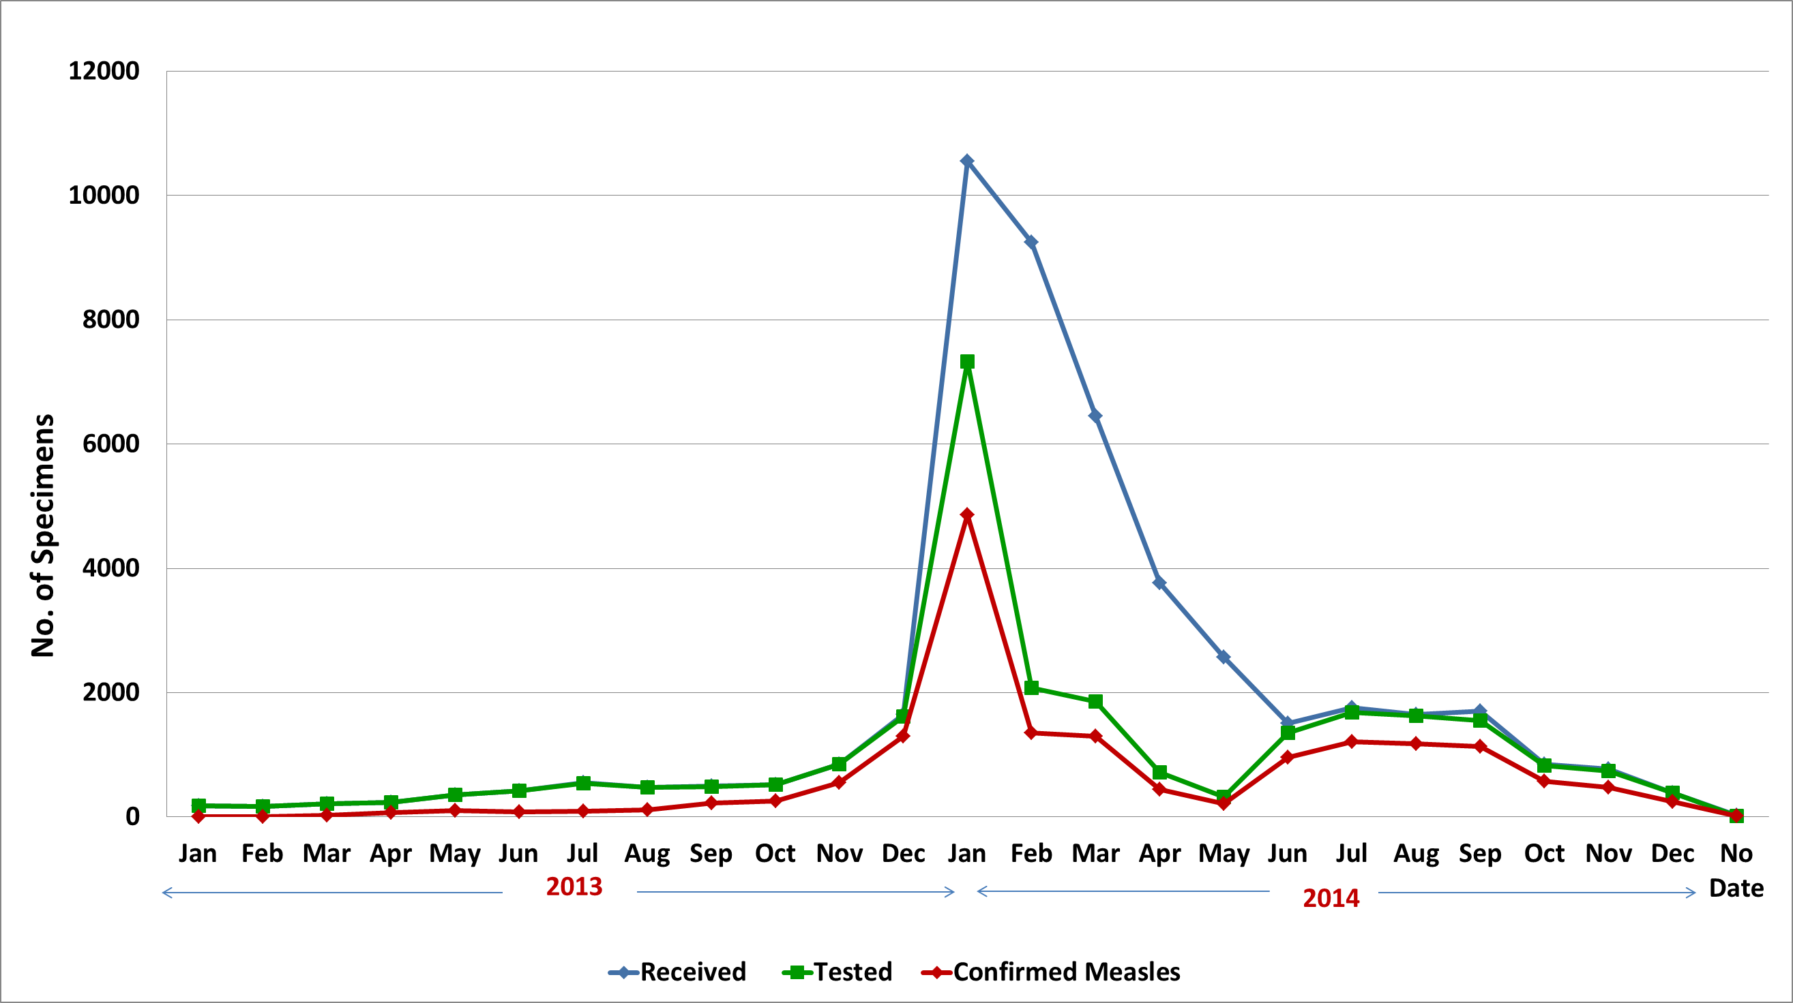
Status of specimens collected from suspect measles cases, 2013 vs. 2014
Jan 2014: surveillance & lab overwhelmed. WHO data managers supported lab & surveillance. DOH issued AO#2014-0003
10 Feb 2014: Test kit stock out; NML stopped testing
March 2014: NML used sampling method to prioritize specimens for testing until June
Dec 2013: Outbreak caught media attention. specimen referrals rose sharply
Q4 2013: three major disasters resulted to rapid measles transmission
July 2014: NPL resumed testing 100% of samples
Q1/Q3 2013: measles outbreak started in 5 regions
Jan 2015: reverted to regular surveillance & specimen collection & testing
27 Oct 2014: DOH AO#2014-0039
Notes:
Following outbreak years 2010 and 2011, 2012 was a relatively more “relaxed” or “benign” year for the National Measles Lab, with referrals distributed across the 12 months.
2013, however, was a different story, with referrals beginning to rise by May and steeply rising up to December and peaking during the 1st quarter of 2014.
There was no directive from our ministry to strategize specimen collection. Specimens were still taken from ALL suspected cases, following the Administrative Order from 2012.
Note that almost 18,000 serum samples were received in January to February alone.
A good thing to note is that collection of swab samples for viral isolation significantly improved
Encouragingly, average daily samples referrals, after it peaked in January and February, started to decline.

Slide 14
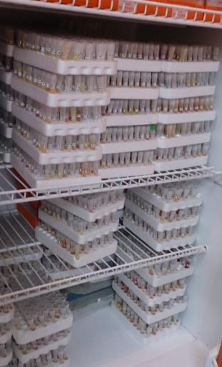
Laboratory testing challenges
1. Sustainability of operations and preparedness
2. Serology test kit stock out
3. Laboratory contamination
4. Specimen storage and retrieval issue
5. Compromised specimen and data quality
6. Maintaining Timeliness and Other Quality Indicators
Notes:
1. Sustainability of Operations and Preparedness
A key challenge for the NML is the sustainability of its operations (increased number of testing staff, integration of real time PCR testing in the testing algorithm of viral isolation, inclusion of regular genotyping of Measles virus isolates, etc.).
Towards the end of January, the NML reached the lab’s maximum testing capacity, which is 10 plates a day, with 5 plates per staff but the demand from hospitals and local government unit for test result is increasing day-by-day.
Many LGUs were waiting for lab-confirmation of the outbreak before they would implement outbreak response immunization.
2. Serology test kit stock out
Stock out experienced by end of February 2014. WHO procured additional test kits were not sufficient to test all the specimens
3. Laboratory contamination
NML had to simultaneously deal with an incidence of mycoplasma contamination of Vero-hSLAM cell lines
4. Specimen storage and retrieval issue
untested specimens occupied significant storage space
Due to large quantity of stored specimens, even the retrieval of specimens for priority testing proved to be time-consuming
All untested samples continued to be stored at NML
5. Compromised specimen and data quality
Incompletely CIF, discrepancy of lab and surveillance data, illegible hand writings or poor labeling
duplicate samples or samples without CIF (vice-versa), grossly hemolyzed/degraded blood samples, improperly collected DBS
6. Maintaining Timeliness and Other Quality Indicators
Due to the overwhelming number of specimen referrals, the NML’s turn around time for providing final laboratory results extended to more than 2 months during the height of the measles outbreaks.
Turnaround time aligned with the WHO standards resumed in July.
NML is also working on the recommendations provided by the WHO Accreditation Team for to ensure quality laboratory operations.

Slide 15
Key Laboratory interventions
Temporarily discontinued re-testing of measles equivocal results and regulated weekly supply of specimen kits
Frequency of measles IgM Testing shifted from thrice a week to daily, with 2 shifts per day
Activated the Incident Command System to support the national measles Lab operations
RITM Surveillance Unit created to deal with data management and providing feedback and test results
NML adopted a priority sample testing method by mid-February 2014
Other tests were performed to compensate for LGU demand for results during time of test kit stock out
Notes:
Temporarily discontinued re-testing of measles equivocal results
The NML and EB agreed to regulate weekly supply of specimen kits
Frequency of measles IgM Testing shifted from thrice a week to daily, with 2 shifts per day
Early 2014, the Virology Department of RITM activated its Incident Command System (surge capacity) to support the National measles Lab operations
Additional Laboratory Technical Staff for the NML were hired and trained
6 RITM staff were repurposed to support samples and information management
WHO assigned one data manager to support the NML in data encoding, analysis and identification of samples to be prioritized for testing.
RITM Surveillance Unit was created to deal with data management and providing feedback and test results. This way, NML laboratory staff were able to focus on running the tests
NML adopted a priority sample testing method by mid-February 2014 to strategically support the LGUS in dealing with the outbreak.
When the lab ran out of IgM test kit towards the end of February, other tests were performed to compensate for LGU demand for results:
With more swab samples available, Measles VI and IF confirmation became more regularly performed.
In parallel, NML began to use realtime PCR, which honed lab staff skills in the use of this testing method
Conventional PCR followed by sequencing and analysis
Mycoplasm contamination was treated with Mycokill. All the other cell lines are already negative

Slide 16
Method for priority sample testing
Identified priority samples to be tested are among specimens referred from January to June 2014
Samples from suspect cases from an area with at least one laboratory confirmed case are no longer tested.
Epi-linking had to be conducted first before data can be analyzed for determining samples to be prioritized for testing
The following criteria was use to identify priority samples:
  Calamity areas (Region 8 that was severely affected by Typhoon Haiyan
  Areas without documented laboratory-confirmed measles case yet
  Areas that are considered “urgent/priority” by the Regional Epidemiology and Surveillance Units because of presence of risk factors
Notes:
Identified priority samples to be tested are among specimens referred from January to June 2014
Samples from suspect cases from an area with at least one laboratory confirmed case are no longer tested. Instead, cases were epidemiologically-linked to the confirmed case.
With the priority testing method, the following criteria was use to identify samples to be tested:
Calamity areas (Region 8 that was severely affected by Typhoon Haiyan – situation in the area at the time was bleak, e.g. down health system and service delivery, over-crowded evacuation centers, etc., and any delay in the outbreak response will prove detrimental
Areas without documented laboratory-confirmed measles case yet
Areas that are considered “urgent/priority” by the Regional Epidemiology and Surveillance Units because of presence of risk factors

Slide 17
General Impact of Measles Outbreak on Surveillance
Awareness and sensitivity of measles surveillance generally improved
Updated guidelines on surveillance and laboratory confirmation
Awareness on the importance of cluster monitoring and epi-linking of cases
Development of an outbreak response guidelines for local health workers based on different scenarios during a high and low transmission period
Lab gained expertise on use of real-time PCR, conventional PCR, genotyping analysis, which have become regular NML activities
Lab continued to implement WHO recommendations to strengthen lab capacity and prevent contamination.

Slide 18
Key Lessons Learnt
Surveillance
In order to facilitate ease of encoding and data analysis, and for preventing delays in outbreak detection and response, consider shifting from case-based investigation to linelisting of cases.
Consider shifting to emergency weekly reporting with linelisting to facilitate monitoring and implementation of outbreak response
Need to further strengthen use of data for action, including timely data analysis of surveillance and lab data, and epidemiologic linkage

Slide 19
Key Lessons Learnt
Laboratory:
Development of a laboratory contingency plan for activating surge capacity and for adjusting approach to lab confirmation especially in resource-limited areas
In case of another major outbreak in the future, consider establishing satellite VPD laboratory in the affected area
Need to develop a guidelines on how to deal with stored untested samples – e.g. explore possibility of using the samples for sero-prevalence study
Discuss further need to improve surge capacity (staff and additional equipment) and performance of both surveillance and laboratory

Slide 20
Thank you!

