Slide 1
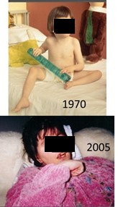
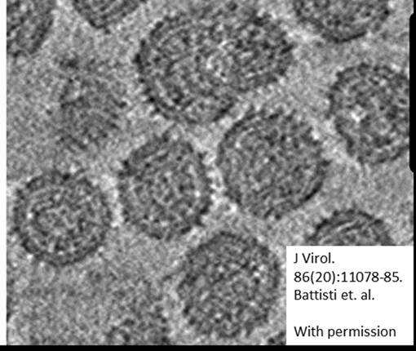

CRS Burden Estimates
Susan Reef, MD, and Joseph P. Icenogle, PhD, colleagues,
and other collaborators
Accelerating Progress towards Measles and Rubella Elimination,
21-23 June 2016, Hotel Royal, Geneva
Division of Viral Diseases, Global Immunization Division

Slide 2
Background
The purpose of any rubella vaccination program is prevention/elimination of congenital rubella infections
Identification of children with CRS can be challenging
Up to 50% of mothers who give birth to infants with CRS are asymptomatic or without rash and would not be identified as rubella cases
Identification of children with CRS
  used for advocacy
  monitoring vaccination program – need to measure the impact
  documenting the elimination of CRS

Slide 3
CRS Case Definitions
Suspected CRS (to be investigated):
Any infant less than one year of age in whom a health worker suspects CRS.
A health worker should suspect CRS when
  an infant presents with heart disease and/or suspicion of hearing impairment and/or one or more of the following eye signs: white pupil (cataract), or larger eye ball (congenital glaucoma) or pigmentary retinopathy.
  an infant’s mother has a history of suspected or confirmed rubella during pregnancy, even when the infant shows no signs of CRS.

Slide 4
WHO CRS case definitions
Clinical criteria for CRS:
Presence of ≥2 clinical features from group A or
≥1 feature from group A and ≥1 feature from group B:
(A) cataract(s), congenital glaucoma, congenital heart disease, hearing impairment, pigmentary retinopathy
(B) purpura, splenomegaly, microcephaly, mental retardation, meningoencephalitis, radiolucent bone disease, jaundice with onset within 24 hours after birth

Slide 5
WHO CRS case Classification
Clinically-compatible: A suspected case which meets the clinical case definition and without any other obvious clinical cause that has not been adequately tested by laboratory
Confirmed: A suspected case with one clinical defect from group A that is laboratory confirmed
Congenital rubella infection (infection only): A case that demonstrates laboratory evidence without any clinical defect from group (A)
Discarded: A suspected case that does not meet the definition of clinically-compatible and with a negative laboratory results from adequate testing *
*Adequate testing is defined as follows: at least 200μl serum is obtained (from a minimum of ~0.5ml of blood); serum sample is stored in the refrigerator or on ice prior to reaching the laboratory and shows no sign of being subjected to heat; serum is tested for rubella-IgM, and if the infant is 6–12 months of age and IgM-negative, tested at least twice for rubella-IgG as required by the testing protocol.

Slide 6
Surveillance classification of suspected CRS case-patients up to 6 months of age
Blood sample
not obtained
Blood sample obtained (1ml)
IgM –
IgM +
Absence of ≥1 defect from (A)
Does not meet clinical criteria for CRS
Presence of ≥1 defect from (A)
Within 1st month of life, and high suspicion of CRS
Follow up test 1-2 mos. later
Infection only (CRI)
Discarded
Clinically compatible
Discarded
Confirmed
IgM -
IgM+
Confirmed
Discarded
Meets clinical criteria for CRS
Suspected CRS case
<6 months of age
6 to <12 months of age

Slide 7
Surveillance classification of suspected CRS case-patients 6 to <12 months of age
Blood sample
not obtained
Blood sample obtained (1ml)
IgG + and
IgM –
IgG+ and
IgM +
Absence of ≥1 defect from (A)
Does not meet clinical criteria for CRS
Presence of ≥1 defect from (A)
2nd blood sample obtained
Infection only (CRI)
2nd blood sample not obtained
Clinically compatible
Discarded
Confirmed
IgG –
Discarded
Meets clinical criteria for CRS
Suspected CRS case
6 to <12 months of age
IgG +
IgG – and
IgM + / IgM –
<6 months of age
Discarded

Slide 8
Proposed Congenital Rubella Syndrome Surveillance Performance Indicators
Criteria | Indicator | Minimum threshold
Reporting rate | National annual rate of suspected CRS cases | ≥1 per 10 000 live births
Adequate investigation | % suspected CRS cases with the following data points completed: name and/or identifier, place of residence, sex, date of birth, date of reporting, date of investigation, date of specimen collection, history of rash illness of mother, travel history of mother, vaccination history of mother; age of mother; clinical examinations for hearing impairment, cataract, and congenital cardiac/ heart defects and clinical outcome of the CRS case (alive or dead) | ≥80%
Laboratory confirmation (adequate specimen rate) | % suspected cases with adequate blood specimen tested for laboratory confirmation (IgM/ IgG, PCR) in an accredited laboratory. | ≥80%
Viral detection (adequate specimens for virus detection) | % confirmed cases with adequate specimens tested for virus detection/isolation | ≥80%
Monitoring of virus excretion | % confirmed cases with at least 2 negative tests for virus detection/isolation after 3 months of age with at least a one month interval between specimen collection | ≥80%
Timeliness of detection | % of confirmed CRS cases detected within 3 months of birth. | ≥80%
Timeliness of specimen transport | Proportion of specimens (serologic or virologic) received at the laboratory within 5 days of collection | ≥80%
Timeliness of reporting laboratory results | Proportion of serologic results reported by the laboratory within 4 days of receiving the specimen | ≥80%

Slide 9
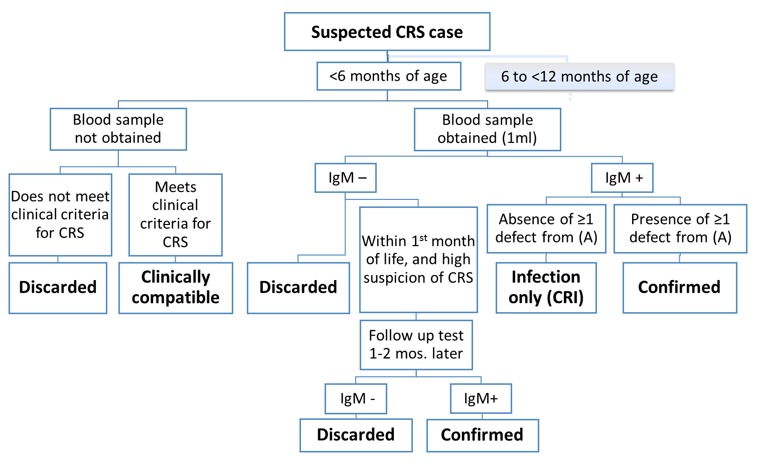
Surveillance classification of suspected CRS case-patients 6 to <12 months of age Special Circumstances
Unlike persons with
rubella, infants
with CRS may shed
virus for a prolonged
period (3-4 months
is typical) and can
often be confirmed
by detection of virus
or virus genome
(RT-PCR).

Slide 10
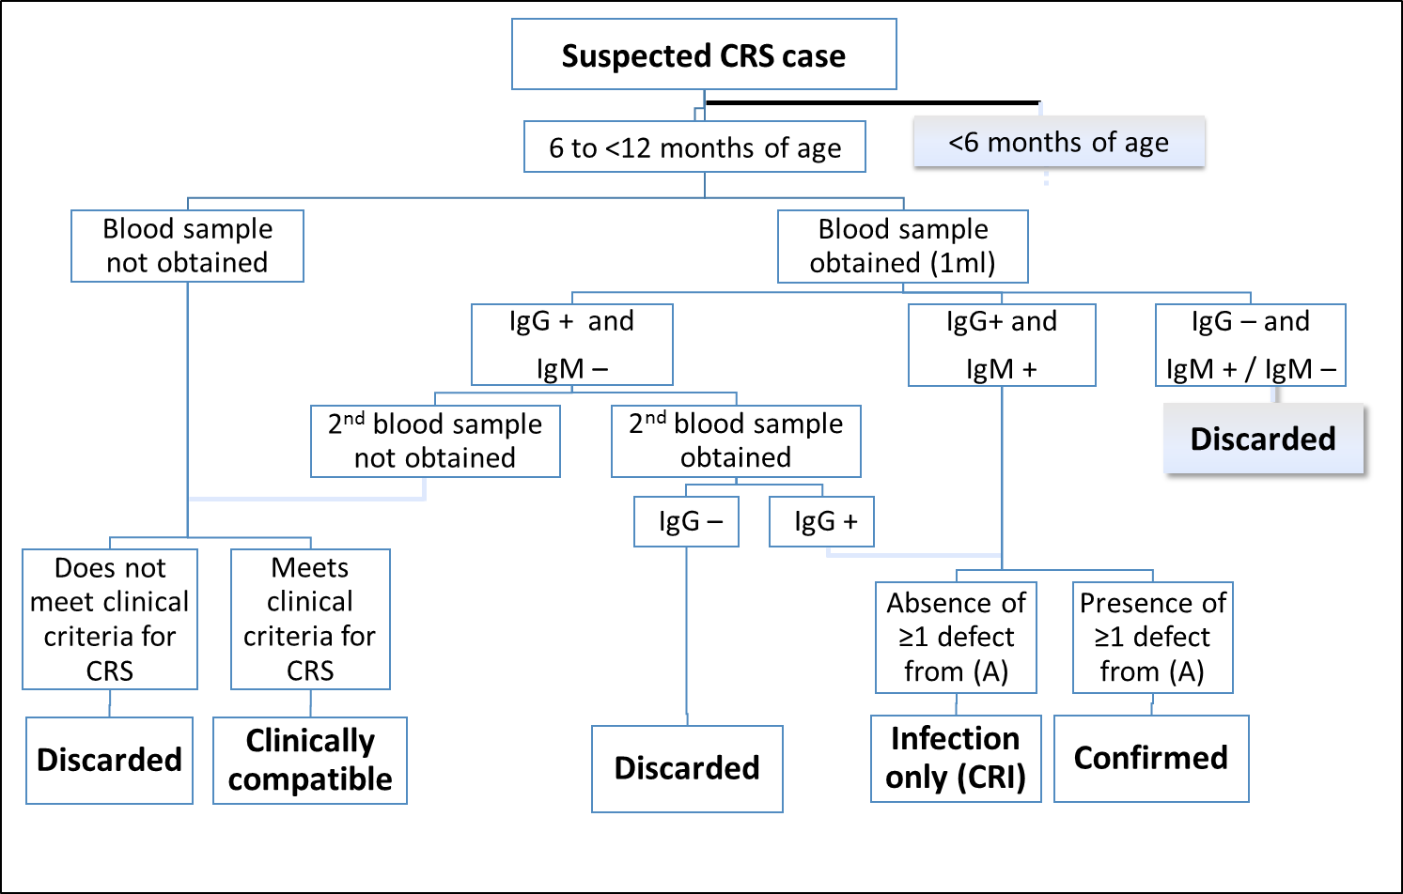
Surveillance classification of suspected CRS case-patients 6 to <12 months of age Special Circumstances
Risk of suspect CRS
case having had
postnatal rubella may
need to be assessed
(i.e. not CRS but had
postnatal rubella).

Slide 11
DALYS and Mortality associated with CRS
CRS is associated with significant morbidity and mortality
Cost per Congenital Rubella Syndrome (CRS) case
  $11,300 for LOW to $934,000 for HIGH
  reflects lifetime of chronic care for individuals with disabilities
CRS DALYS:
  Higher than DALYs associated with measles and rubella
  The estimated DALYs associated with the income level of country
    High, Upper Middle, Lower Middle, Low – 18.7, 22.3, 27.5, 28
Mortality
  Estimated mortality has ranged from 20-33%
    Recent publications confirm significant mortality
      (e.g. recent work from Romania*)
  Infants born with cardiac defects have the highest risk of mortality
*Lazar et al., Eurosurveillance In Press

Slide 12
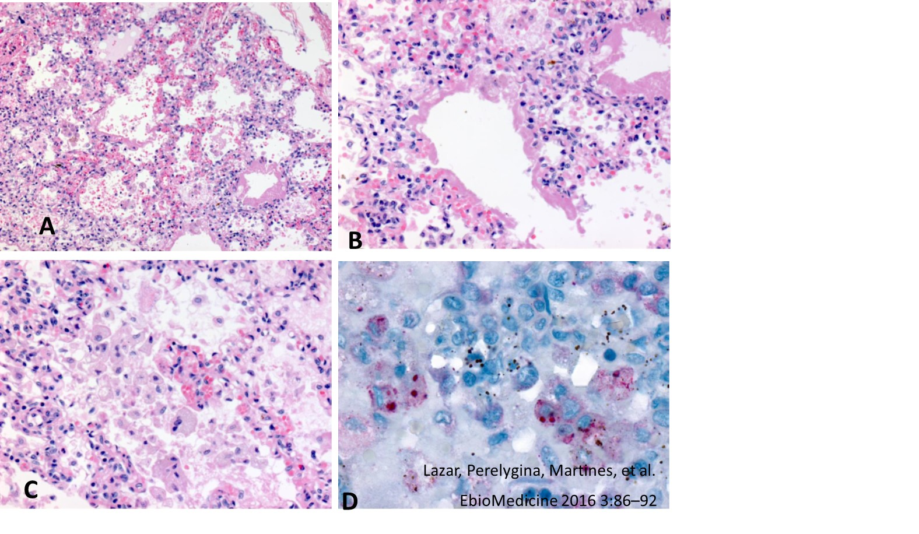
Development
Detailed characterization of fatal cases
Case 1. Multiple defects
Including
pulmonary hypertension.
anti-RV polyclonal antibody
Pulmonary histopathologic and
immunohistochemical features
in a fatal CRS case.
Low-power image of lung
shows congestion, edema, mild
interstitial inflammation and
hyaline membrane formation.
(B) Diffuse alveolar damage and
interstitial pneumonitis.
(C) High-power image shows
intra-alveolar macrophages.
(D) Rubella virus antigens
in intra-alveolar macrophages.
Note immunostaining of
globular inclusions.

Slide 13
Challenges/Developments
Clinical manifestations may not be manifested within the first year of life (after which laboratory confirmation is not currently possible)
Health care system may not have the technology (e.g., hearing testing) to detect the defect
Chronic disability and death may be underestimated in infants/children with CRS depending on the follow-up of the infants with CRS
Laboratory confirmation – for infants => 6 months, may be challenging to get second specimen for IgG testing.
  Evaluating if only one IgG is sufficient in special circumstances
Adding viral isolation and RT-PCR to the algorithm
Development of global CRS surveillance performance indicators

Slide 14
CRS Burden Estimates
Susan Reef, MD, and Joseph P. Icenogle, PhD, colleagues,
and other collaborators
Accelerating Progress towards Measles and Rubella Elimination,
21-23 June 2016, Hotel Royal, Geneva
Division of Viral Diseases, Global Immunization Division

